Slide 1
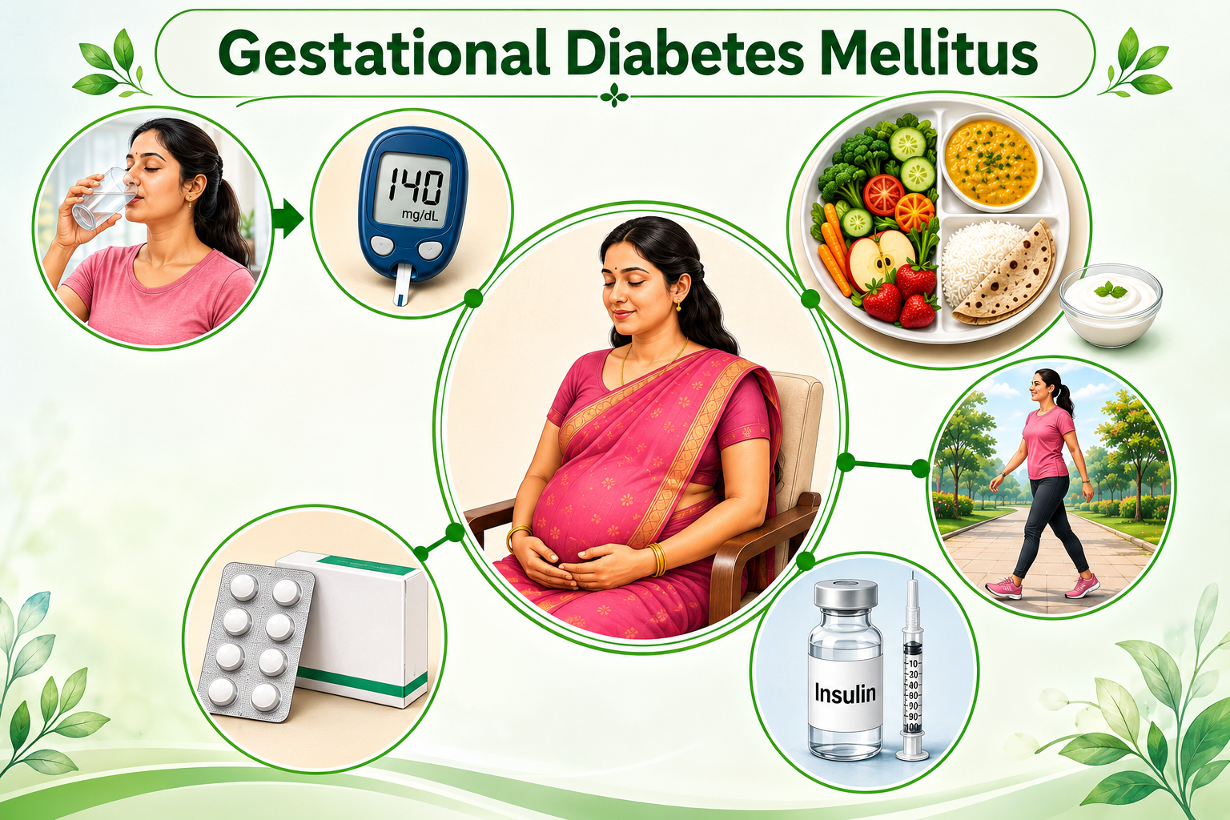
Topic 3

Slide 2
Introduction
Impaired Glucose Tolerance (IGT) with onset or first recognition during pregnancy.
Out of 100 pregnant women in different parts of the country, 10-14 women have GDM
Prevalence of GDM in Indian women is high
GoI recommends screening of all women during ANC, this is part of essential antenatal care package

Slide 3
Effects of GDM on Pregnant Woman and Newborn
Effect on Mother | Effect on Newborn
Spontaneous abortion | Intra-uterine death
Polyhydramnios leading to preterm or premature rupture of membranes | Fetal macrosomia
Pre-eclampsia, fits | Shoulder dystocia
Prolonged labor leading to assisted delivery | Birth Injuries, stillbirth
Obstructed labor leading to caesarean section | Infant respiratory distress syndrome
Uterine atony leading to PPH | Neonatal hypoglycemia and hypocalcemia
Infection | - Congenital malformation
6

Slide 4
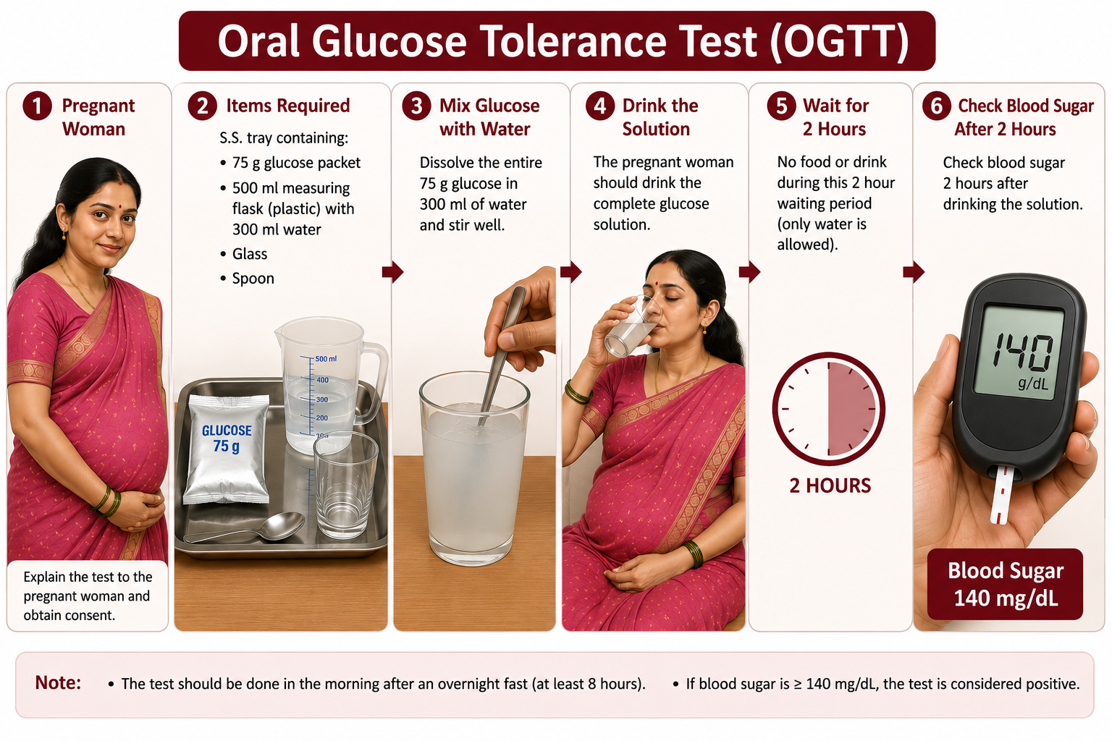

Slide 5
Consideration for GDM Screening
Single step testing using 75 gm oral glucose & measuring blood sugar 2 hours after ingestion.
75 gm glucose is to be given orally after dissolving in approximately 300 ml water whether the pregnant women comes in fasting or non-fasting state, irrespective of the last meal.
The intake of the solution has to be completed within 5-10 minutes.
If vomiting occurs within 30 minutes of oral glucose intake, the test has to be repeated the next day, or else refer to a facility. If vomiting occurs after 30 minutes, the test continues.

Slide 6
Universal Testing of all pregnant women for GDM
Pregnant Women in Community
Testing for GDM at 1st Antenatal contact (75 gm oral glucose in 300 ml water, 2 hrs later blood sugar (BS) level)
Positive, 2 hrs BS 140 mg/dL or more
Negative, 2 hrs BS less than 140 mg/dL
Repeat Test at 24-28 weeks
Positive, 2 hrs BS 140 mg/dL or more
Negative, 2 hrs BS less than 140 mg/dL
Manage as GDM as per GOI guidelines
Manage as HRP ANC
Manage as normal ANC

Slide 7
Management of GDM Flow Chart
Pregnant Women with GDM (BS ≥ 140 mg/dl)
Start Medical Nutrition therapy and physical exercise
After 2 weeks if identified before 28 weeks , after 28 weeks follow up after 1 week
2 hr PPBS
Controlled blood sugar
Uncontrolled blood sugar
Less than 120 mg/dL Continue Medical Nutrition therapy, physical exercise)
120 mg/dL or more, MO/ Specialist start metformin or insulin therapy + continue Medical Nutrition therapy and physical exercise
Monitor 2 hr PPBS
as per high risk pregnancy protocol (8 tests during pregnancy) or as recommended by physician (at least once monthly)
Monitor FBS & 2 hr PPBS every 3rd day or more frequently for insulin and once in two weeks for metformin dose adjustment to maintain normal blood sugar levels.
Monitor FBS and 2 hr PPBS as per high risk pregnancy protocol or as recommended by physician (at least once monthly)
6

Slide 8
Choice of drugs for GDM management
At CHC/DH/MC, a Specialist/Gynaecologist/ Physician/MO can start metformin or insulin.
Aim should be to maintain FBS less than 95 mg/dl and PPBS less than 120 mg/dl
Insulin is the first drug of choice any time during pregnancy and Metformin (stat 500mg twice daily, maximum upto 2 gm) can be considered after 20 weeks of gestation for medical management of GDM.
1. Hypoglycaemia and weight gain with metformin are less in comparison to Insulin.
2. If Insulin is required in high doses, metformin may be added to the treatment.

Slide 9
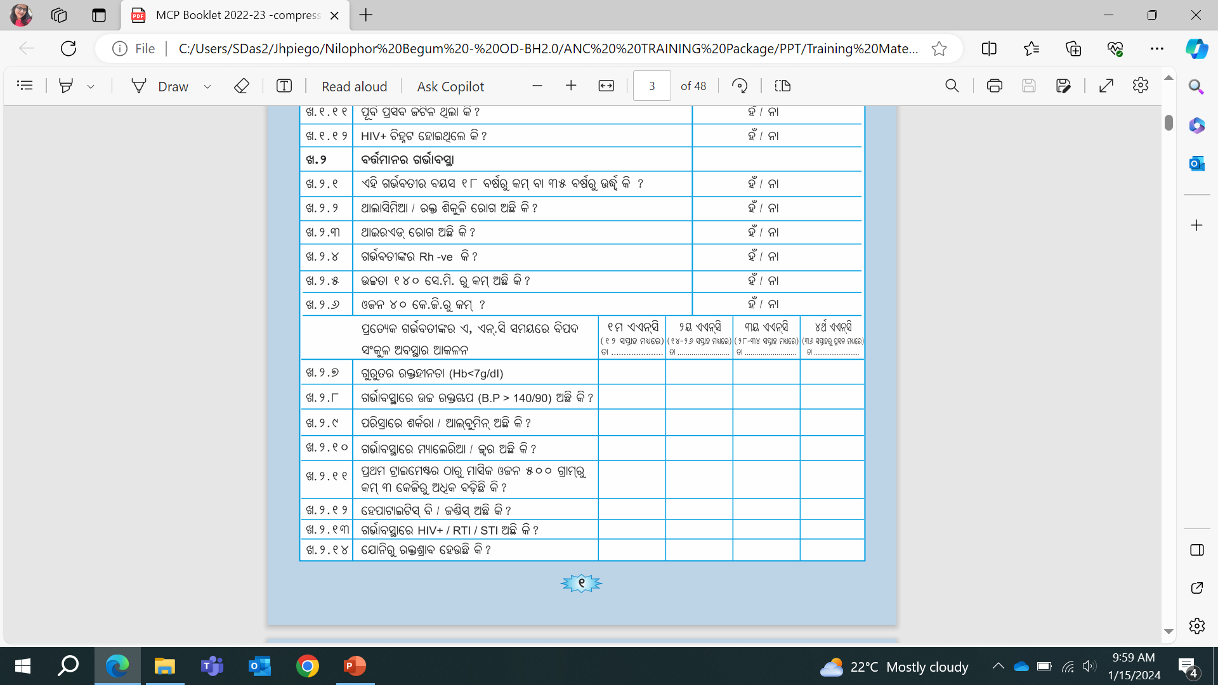
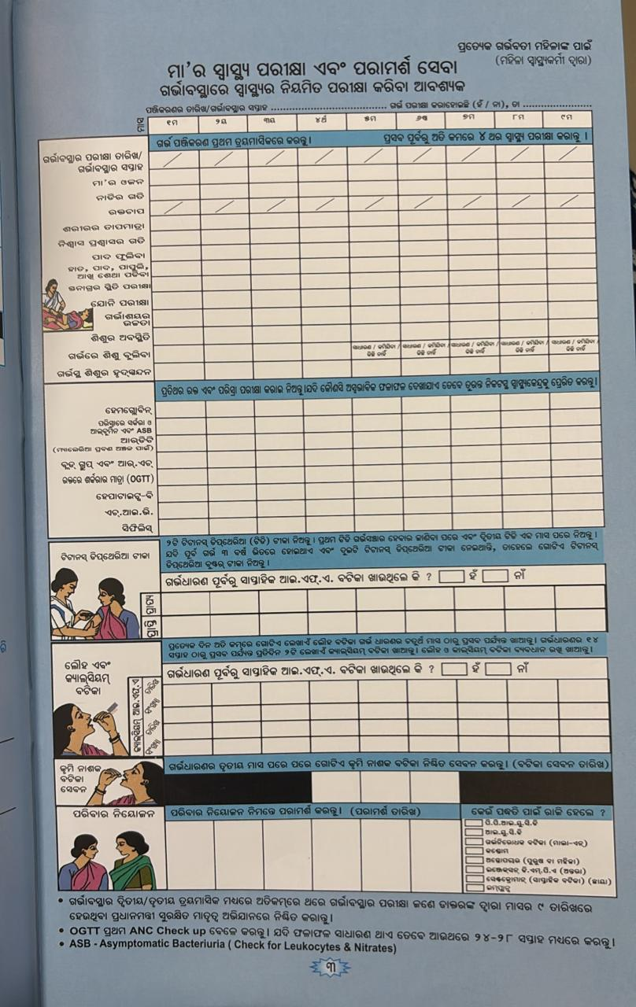
Recording
MCP Card

Slide 10
Management of GDM-Medical Nutrition Therapy (MNT)
Single visit approach should be used for GDM diagnosis and MNT counseling- all pregnant women with GDM should receive MNT counseling on the day of diagnosis.
The meal pattern should provide adequate calories and nutrients to the woman and the baby in the womb to meet the needs of the pregnancy
The meal plan should be individualized and such that prevents excess weight gain and post-prandial hyperglycemia
Energy Requirement of pregnant woman
Energy requirement of an adult woman
Energy required for foetal growth
Energy requirement for increase in body weight of pregnant woman
=
+
+

Slide 11
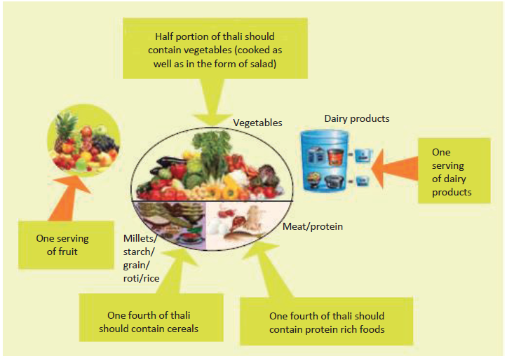
Medical Nutrition Therapy
Meal plan should be divided in to 3 major meals-breakfast, lunch and dinner and 2-3 snacks in between them
Composition of lunch and dinner thali

Slide 12
Management of GDM – Physical Exercise (contd.)
Do’s | Don’ts
Do moderate and regular physical activity | Do not get too tired while exercising
Wear light and loose comfortable clothes during exercise | Do not do any activity while lying on back/abdomen after beginning of 2nd trimester
Drink sips of water before, during and after exercise | Do not exercise in hot weather
Stop when you feel tired or have difficulty in talking | Do not perform exercise that may bump or hurt belly. Do not do exercises which need balancing
Eat healthy diet | Do not fast or skip a meal
Choose activities which do not require standing or balancing | Do not over exert

Slide 13
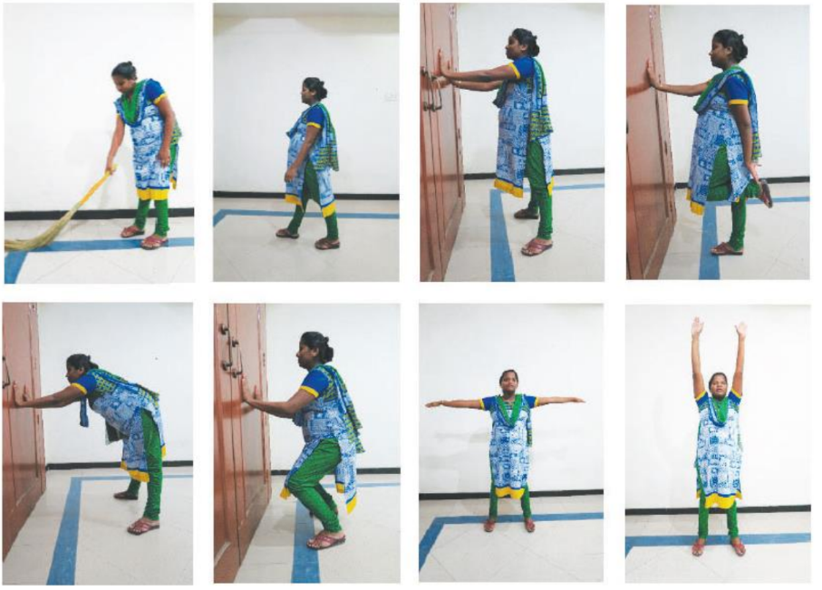
Physical Exercise

