Slide 1
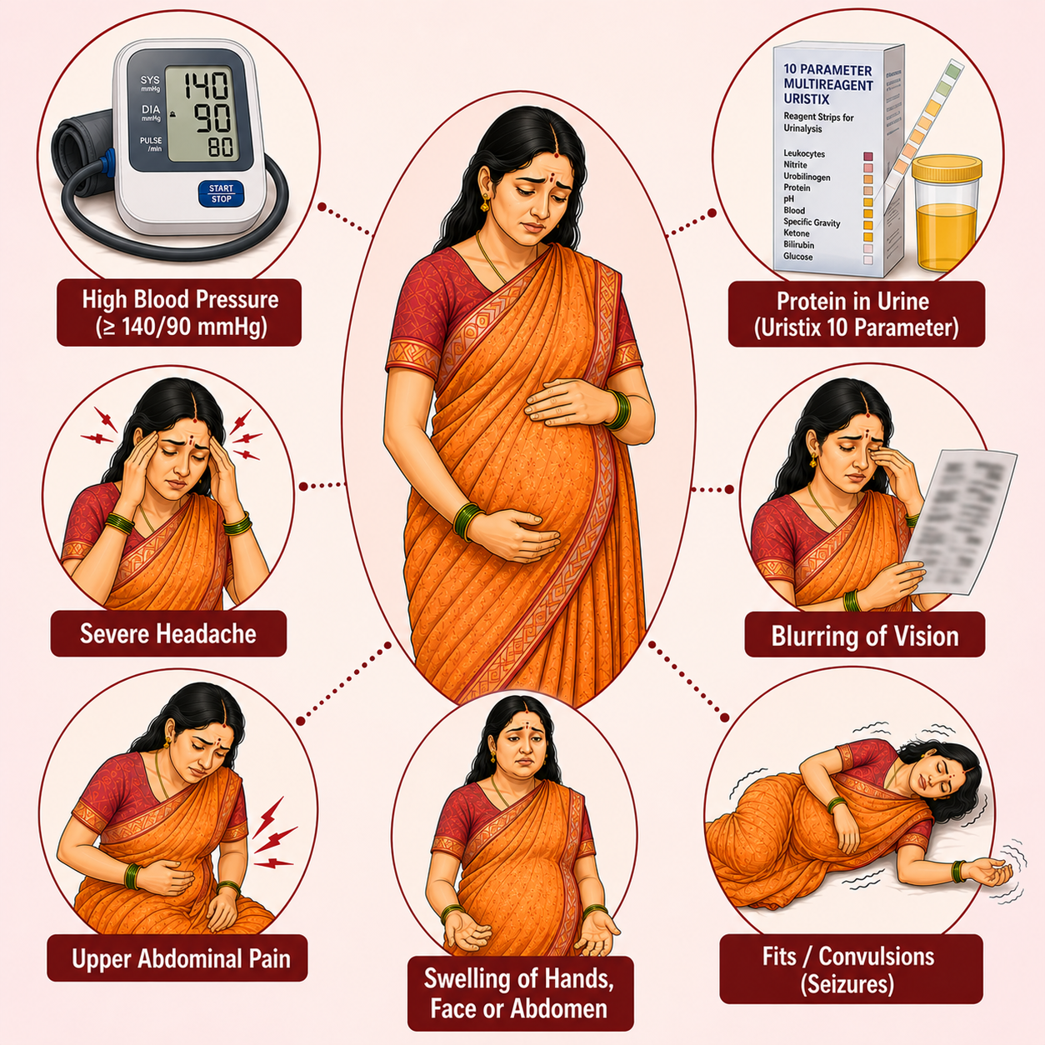
Hypertensive Disorders of Pregnancy
Topic 1

Slide 2
Importance of diagnosing hypertensive disorders of pregnancy
Hypertensive disorders are the second leading cause of maternal mortality in India
Hypertensive disorders increase the risk of complications in pregnant women, her foetus and new born
Accurate measurement and recording of pregnant mother’s BP and urine examination helps in timely diagnosis of at risk mothers
Early diagnosis and timely management and/or referral helps in reducing the risk of complications in such cases
During pregnancy Calcium supplements can help in prevention of hypertensive disorder during pregnancy

Slide 3
Effects of high BP on mother and child during pregnancy
Hypertensive disorders increase the chances of death in both mother, foetus and newborn. Early diagnosis and referral helps in reducing this risk.
Effects on mother:
Antepartum Haemorrhage
Postpartum Haemorrhage
Preterm labour
Maternal Death
Effects on foetus and Newborn
Intrauterine Growth Restriction
Intrauterine Death
Prematurity
Low birth weight

Slide 4
Diagnostic Criteria
Before 20 weeks of
After 20 weeks of Pregnancy
Before 20 weeks of pregnancy
Pregnancy Induced Hypertension
Pre-Eclampsia
Increased BP and protein in urine
BP more than or equal to 140/90 and less than 160/110
And Proteinuria
Trace/1+/2+
Eclampsia
Increased BP, protein in urine and convulsions
BP more than and equal to 140/90
Severe Pre-Eclampsia
Increased BP and protein in urine
BP more than and equal to 160/110
Heavy Proteinuria
3+/4+
And /or Presence of danger signs
Pre Eclampsia + Danger signs
Proteinuria
Trace or more
Presence of convulsions
Convulsions in pregnancy, labor and postpartum period should be considered ‘Eclampsia’ unless proved otherwise.
Chronic Hypertension
Not induced by pregnancy
Gestational Hypertension
Increased BP and protein in urine
BP more than or equal to 140/90

Slide 5
Screening for HDP
Check women’s blood pressure in ANC visit
Counsel for regular ANC check up and educate about danger sign
BP ≥ 140/90 mmHg
Check Urine for albumin
NO
Yes
- Ve
+ Ve
Pregnancy Induced Hypertension
Pre-Eclampsia
Counsel regarding High risk pregnancy & Refer to nearest FRU
Follow up for treatment compliance and HRP management

Slide 6
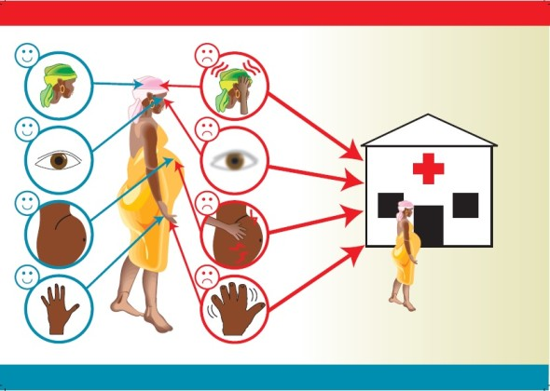
Danger Signs during Severe Pre –Eclampsia and Eclampsia
Headache (increasing in frequency & severity)
Blurring of vision
Oliguria (less than 500 ml in 24 hours)
Pain in upper part of abdomen
Abnormal oedema over face, hands, abdomen and vulva

Slide 7


Need for MgSO4
Management with Inj. MgSO4 should be given in following conditions:
Eclampsia :
Convulsions
Severe PE:
BP>= 160/110 with proteinuria 3+ or 4+
PE with presence of danger signs like headache, blurring of vision, epigastric pain or oliguria and abnormal edema over face, hands, abdomen and vulva
Administration of MgSO4
First dose (at SC/PHC level (If No MO)/referral dose: Total 10 grams
5 g (10ml) magnesium sulphate deep IM in each buttock
Patient should reach FRU in 2 hours for further management.
As per GoI guidelines, the pre-referral dose can be given by staff nurse/ANM/CHO, before referring the woman to a higher center, record the same in MCP card.

Slide 8
Need for MgSo4
Administration of Mgso4 at Facility
Loading dose: Total 14 grams
4 g (8mL) magnesium sulphate diluted with 12 ml NS or distilled water in 20 ml syringe i.e. 20%, and given slow IV in 5-10 minutes
5 g (10mL) magnesium sulphate with 1 ml 2% lignocaine deep IM in each buttock
Maintenance dose
5 g (10mL) magnesium sulphate with 1 ml 2% lignocaine deep IM in alternate buttock every 4 hours
To be given till 24 hours after last convulsion or delivery - whichever occurs later
Dose of Recurrent convulsions
If 30 minutes after loading dose – repeat MgSO4 2 gm 20% (4ml drug in 6ml NS) slow IV in 5 minutes (Can be given only once).

Slide 9
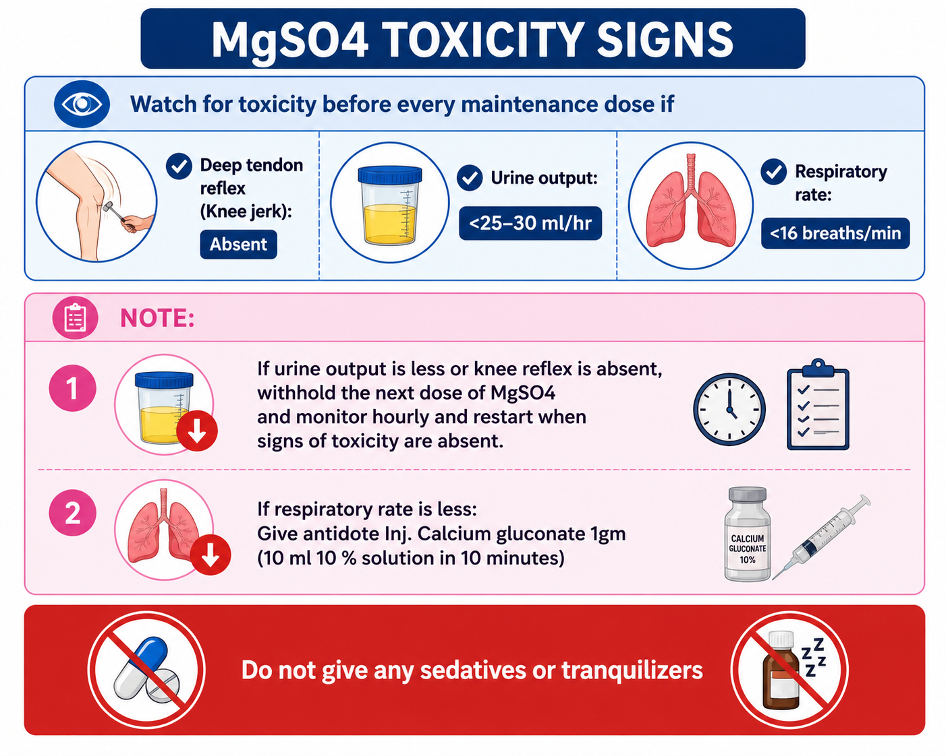
< 12/min

Slide 10
