Slide 1
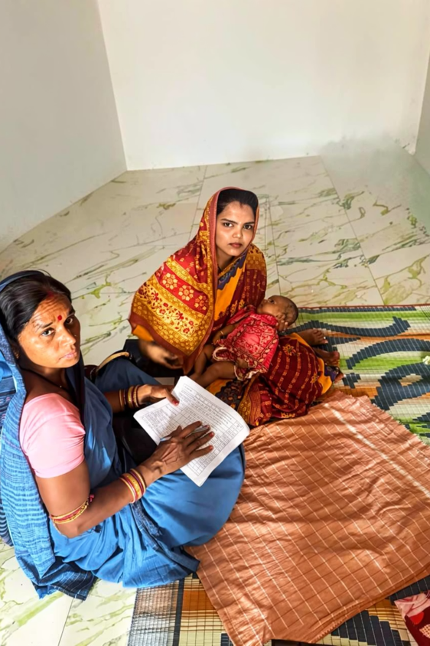
SAMMPurNA Tracking Tool, Odisha
Guidance Note
A comprehensive digital solution for tracking maternal and child health beneficiaries in high priority blocks, Odisha — empowering frontline health workers with real-time decision support.

Slide 2
Features: SAMMPurNA Tracking Tool
Beneficiary Tracking
Joint Visit Capture
End-to-end tracking for ANC, HBNC, HBYC, and PNC with complete visit history for each individual beneficiary.
Records joint visits by MO/CHO/ANM and ASHA together, ensuring coordinated care and accountability.
Risk Classification
Decision Support System
Automatically classifies beneficiaries as High Risk, Moderate Risk, or No Risk based on recorded signs and symptoms.
Provides actionable guidance — including doses, counselling subjects, referral advice, and home care — based on risk level.
Referral Management
Auto Geo-tagging
Streamlines the referral process, ensuring timely escalation of high-risk cases to appropriate facilities.
Automatically captures date, time, and geo-location at the point of service, ensuring data accuracy and accountability.

Slide 3
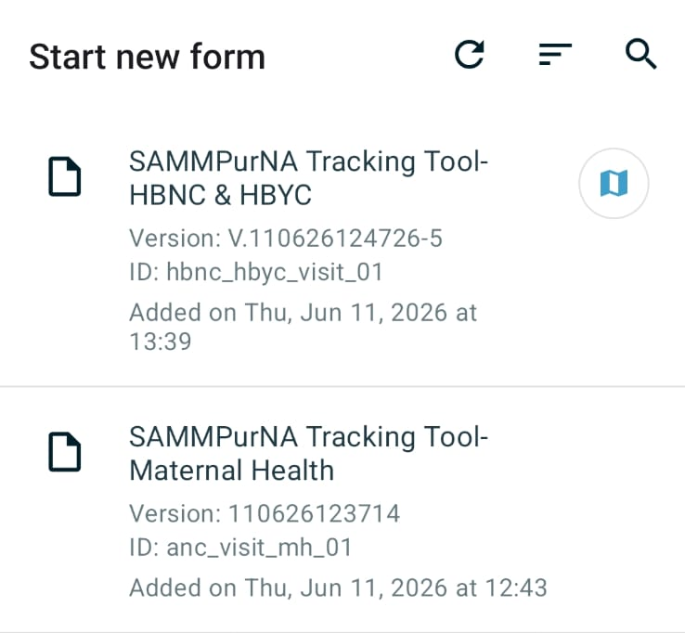
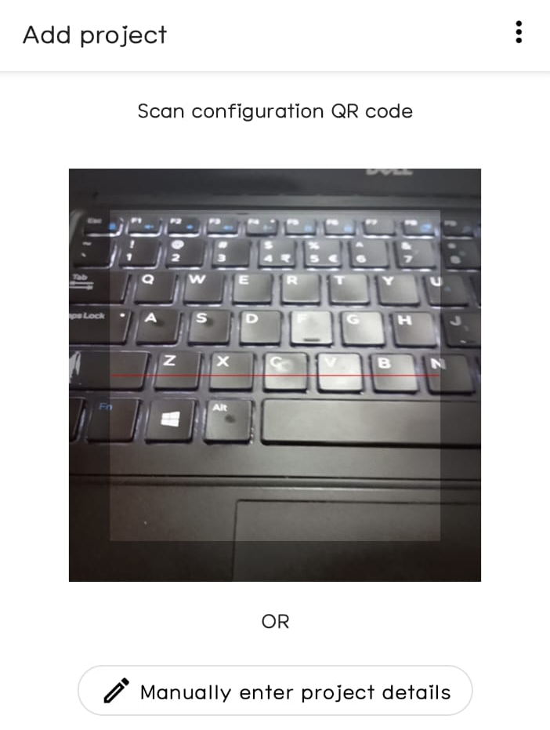
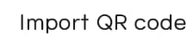

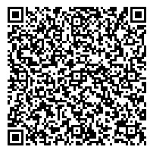
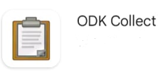
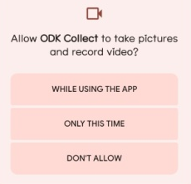
SAMMPurNA Tracking Tool - Installation Process
Step-1
Step-2
Download “ODK Collect” from Google play store
Scan QR code by 2 methods
Search ODK Collect
Method 1- By importing from Photo Gallery
Method 2- Direct Scan using Camera
IOS USERS - USE THE FOLLOWING LINK
https://odk.nipi-cure.org/f/gMdZdbIWtKwD3KJxzxVlgOhq7BqaBgS?st=dJkfIrmGCJzNpV7rIPQZ2sD0mFOUqPTM!n2JaKyUBJawOrt4Zg7W62raxEWk0yWd
FOR HBNC-HBYC
Allow Access
https://odk.nipi-cure.org/f/9uZLir7O4YpRpXZ7adAyzPkhHkDdSZM?st=jWo9xGZXgvsYpROh8RhD1efsdGkVthSV8nQl5$0MEyqZTNctUhztfOF6sB91yE0h
FOR ANC

Slide 4
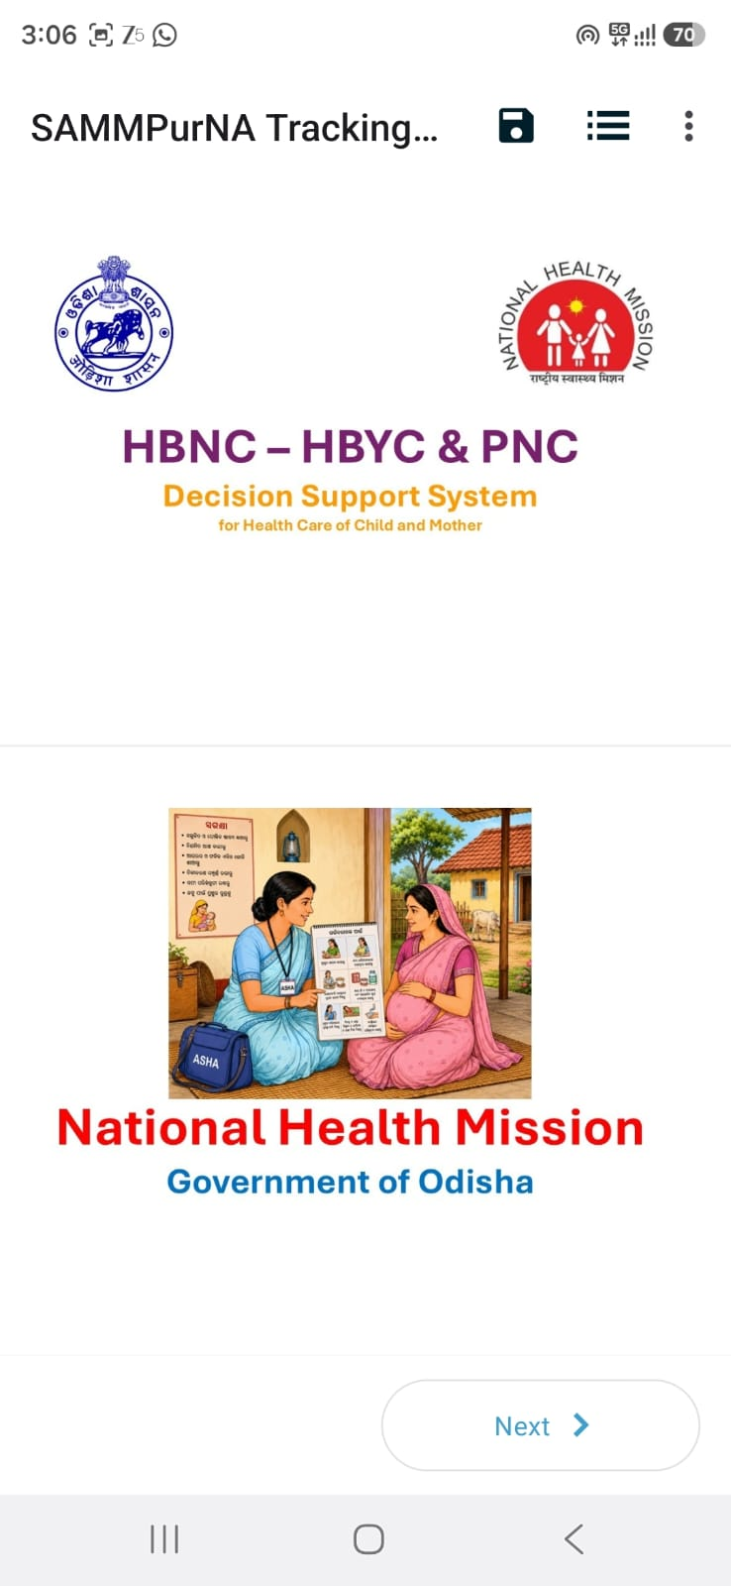
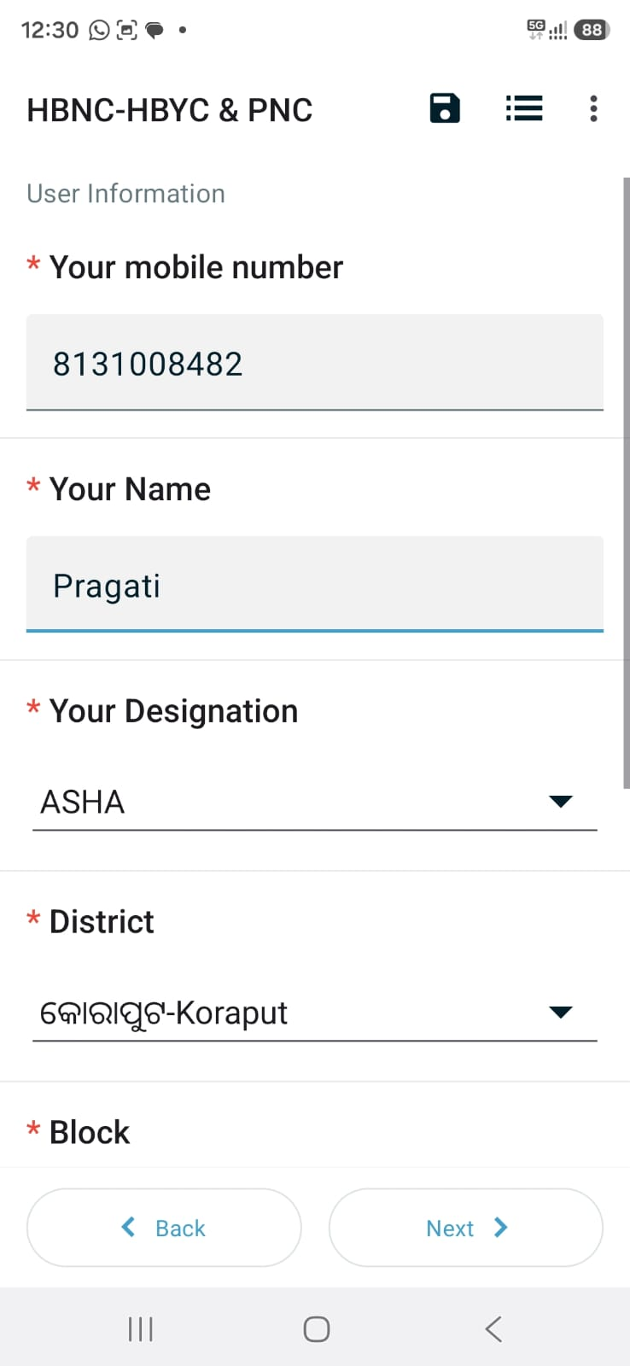
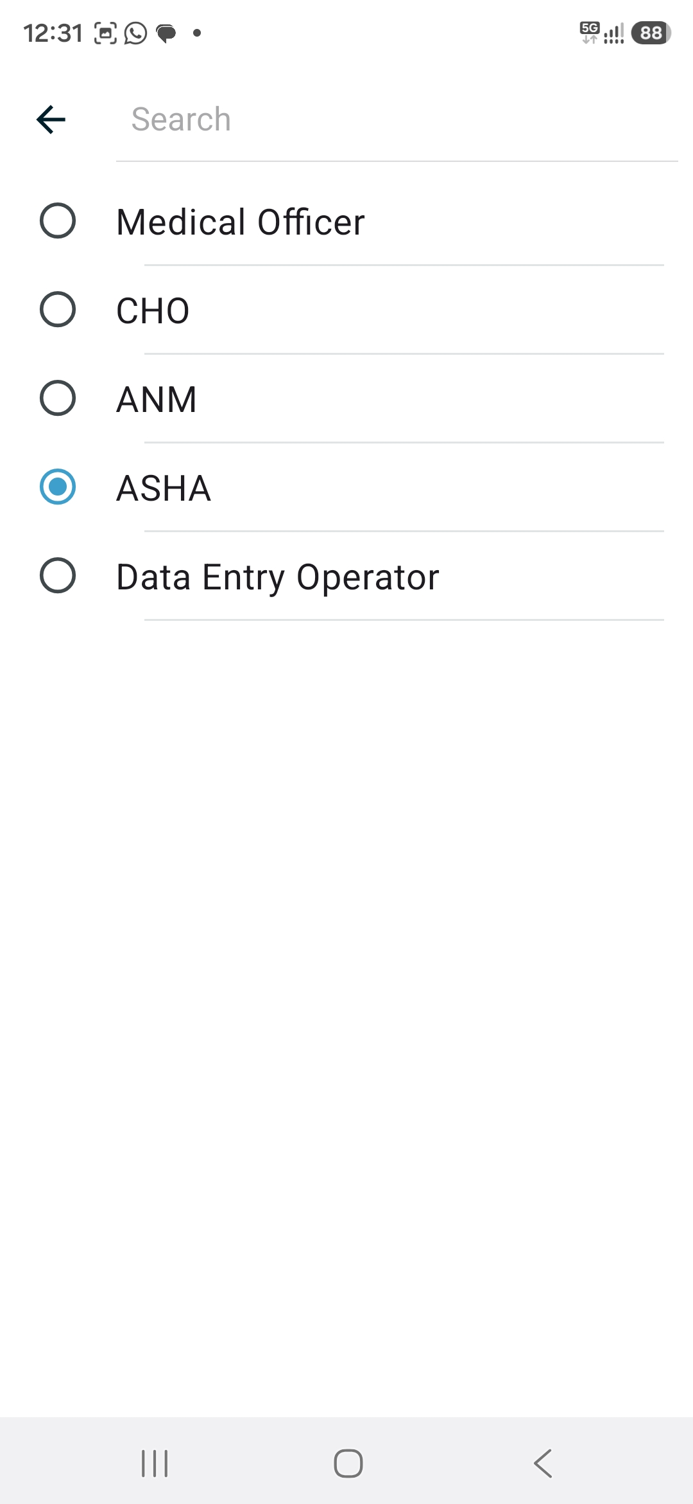
SAMMpuRNA Tracking Tool – Points to remember
Please choose the appropriate designation since this will affect the list of screening assessment questions. Each designation has a different set of screening method and questions.

Slide 5
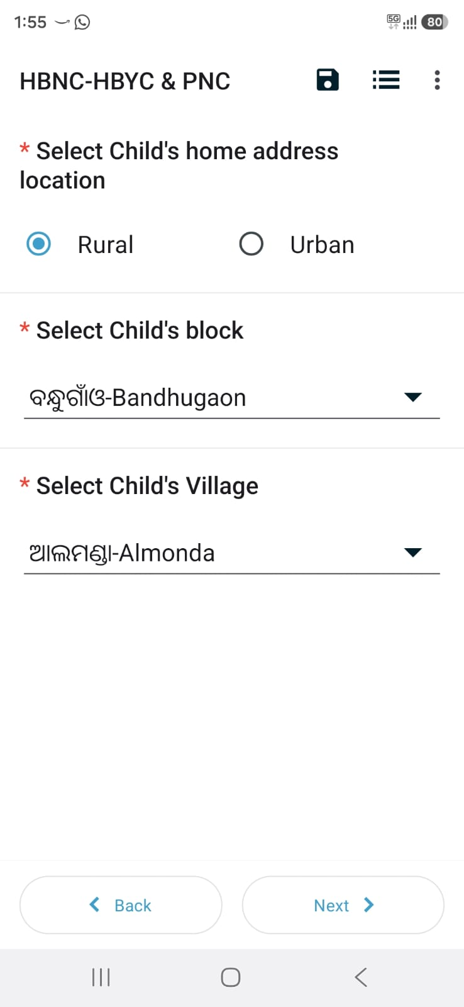
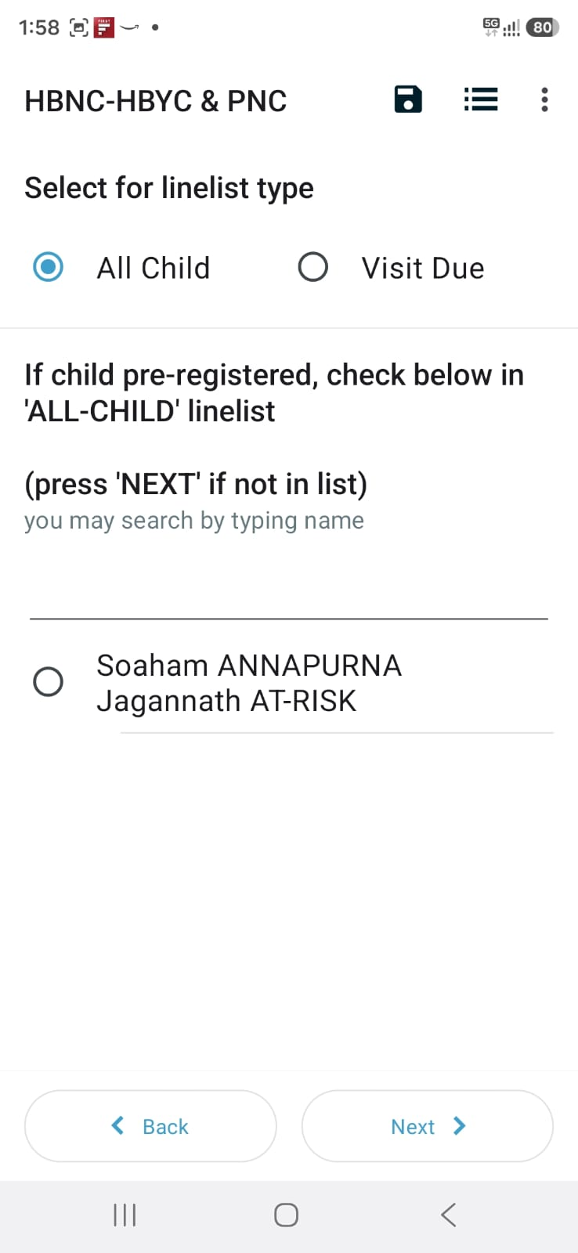
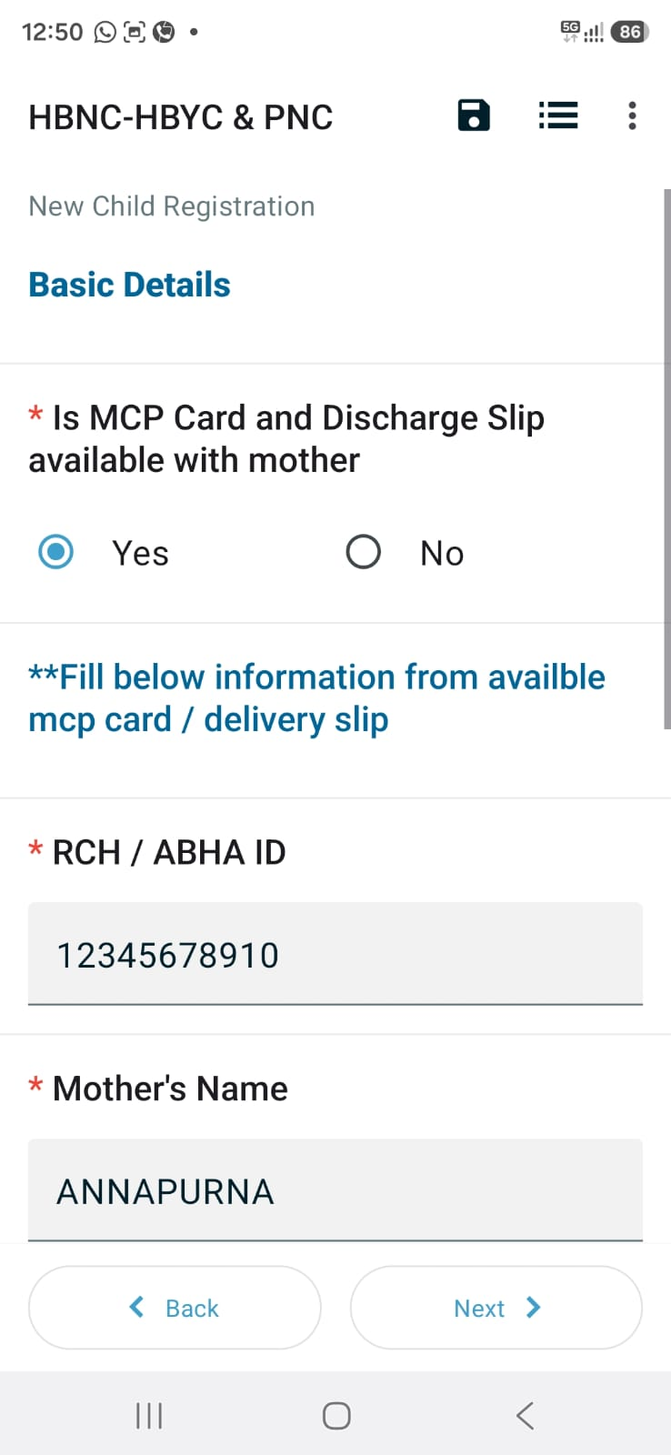
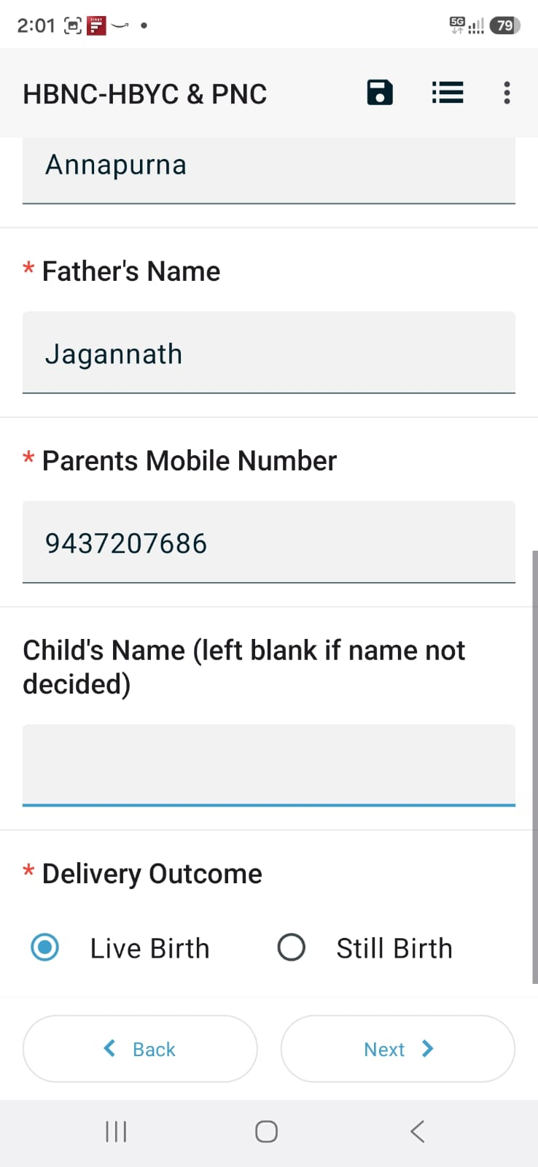
Form navigation and Data entry

Slide 6
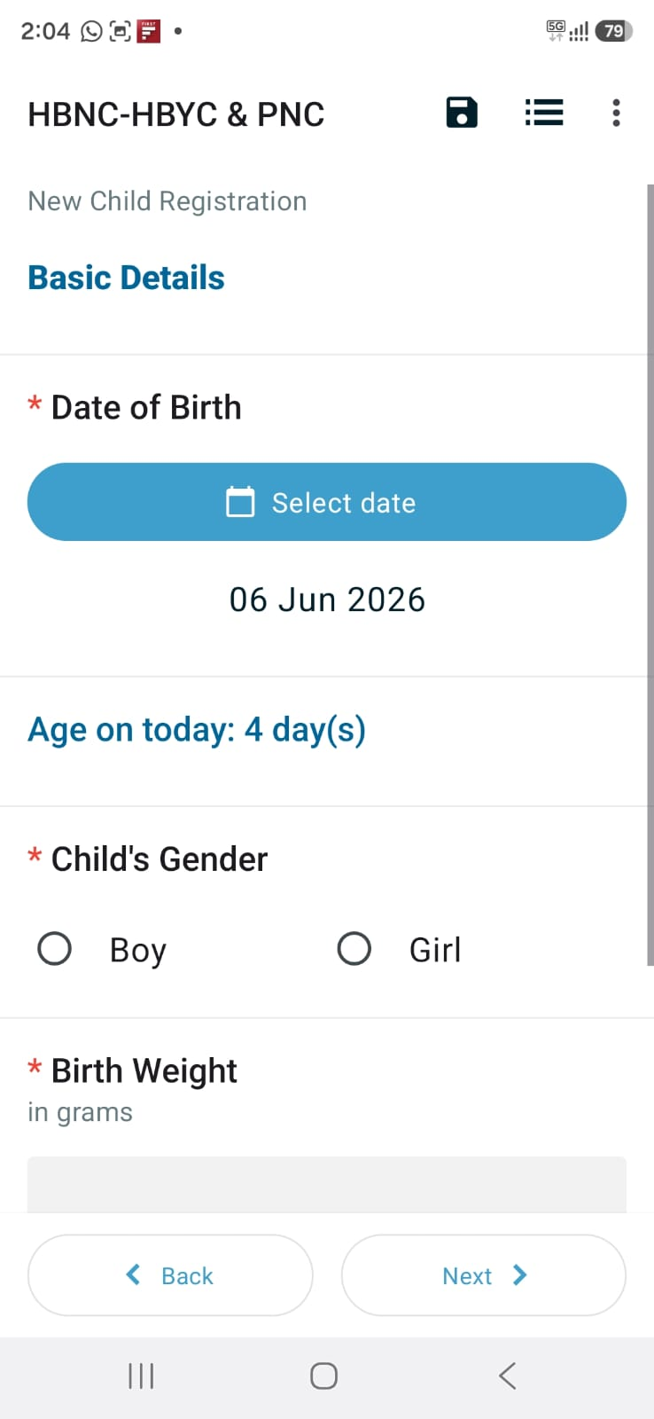
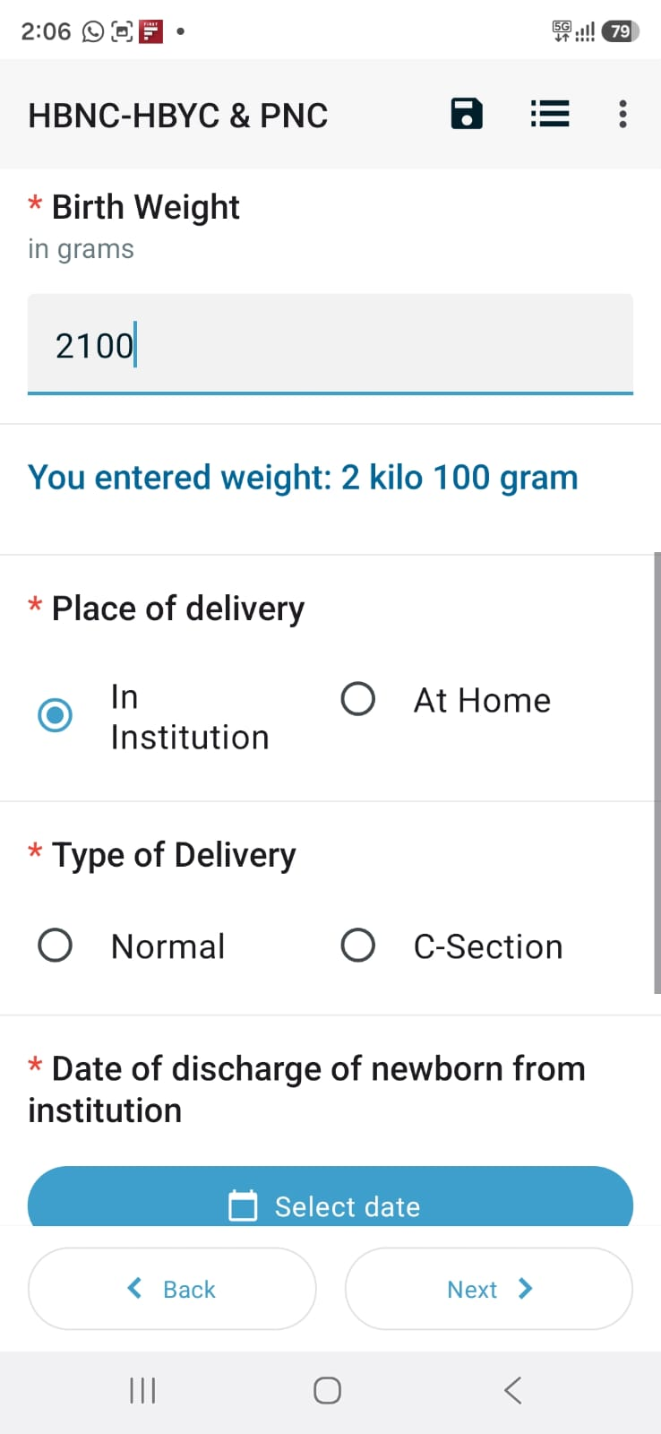
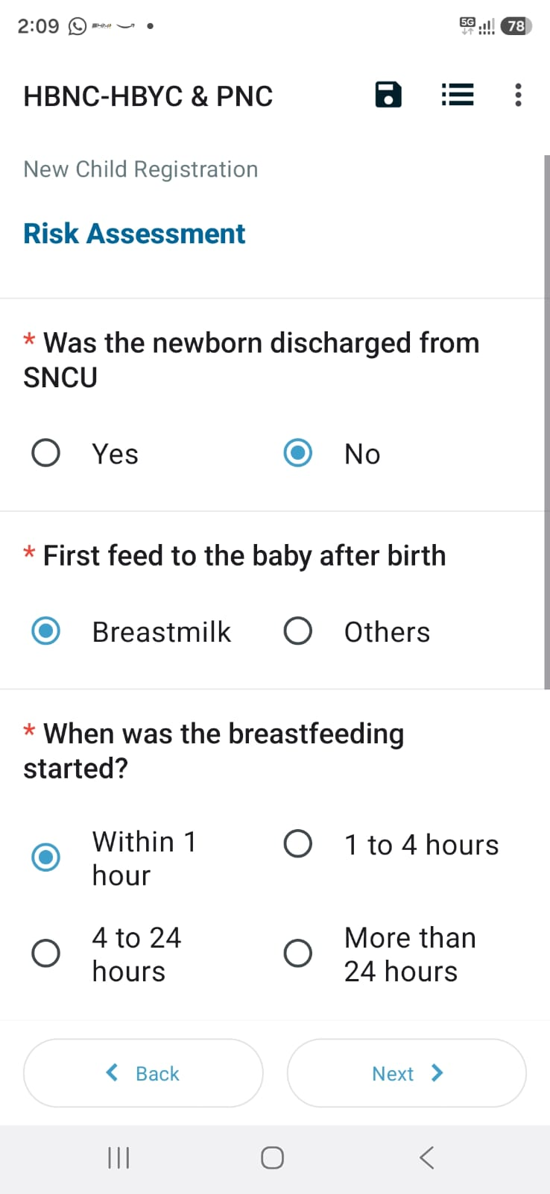
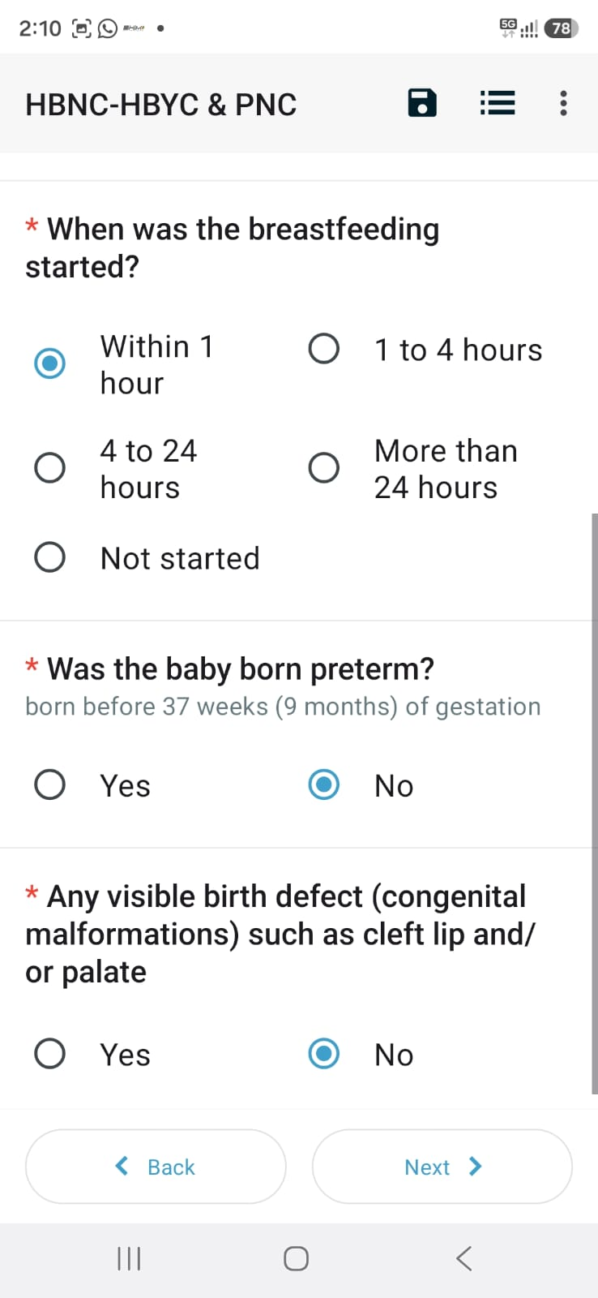
Form navigation and Data entry

Slide 7
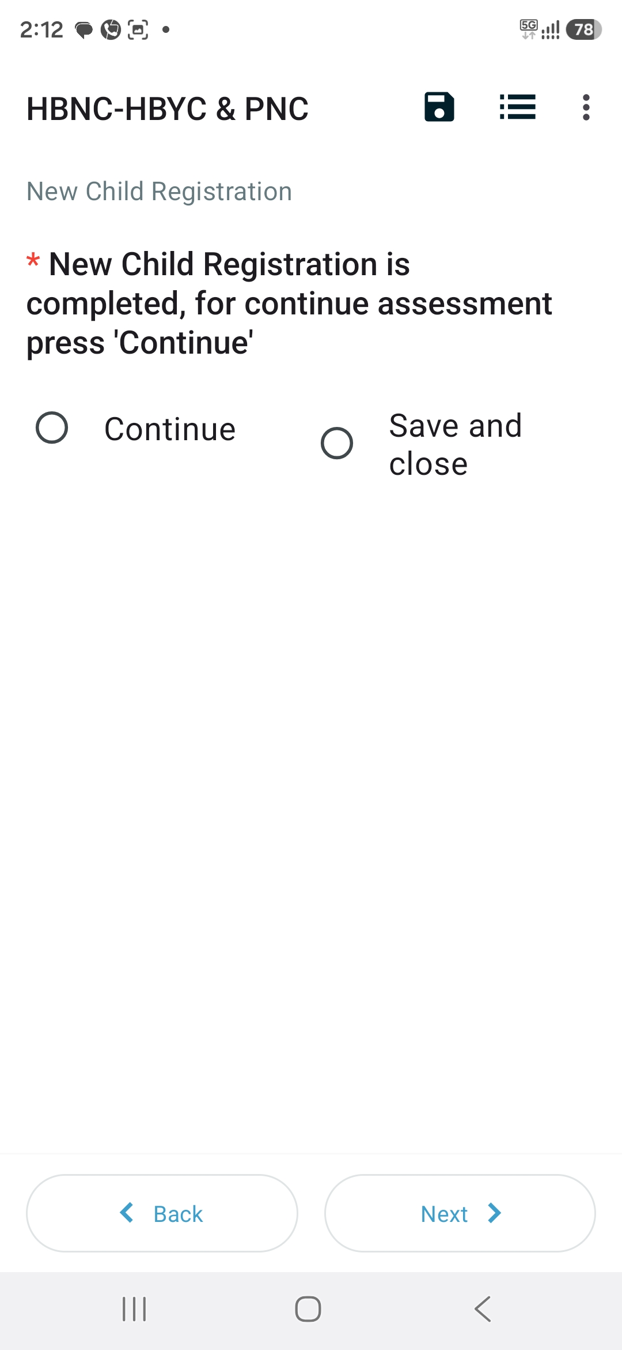
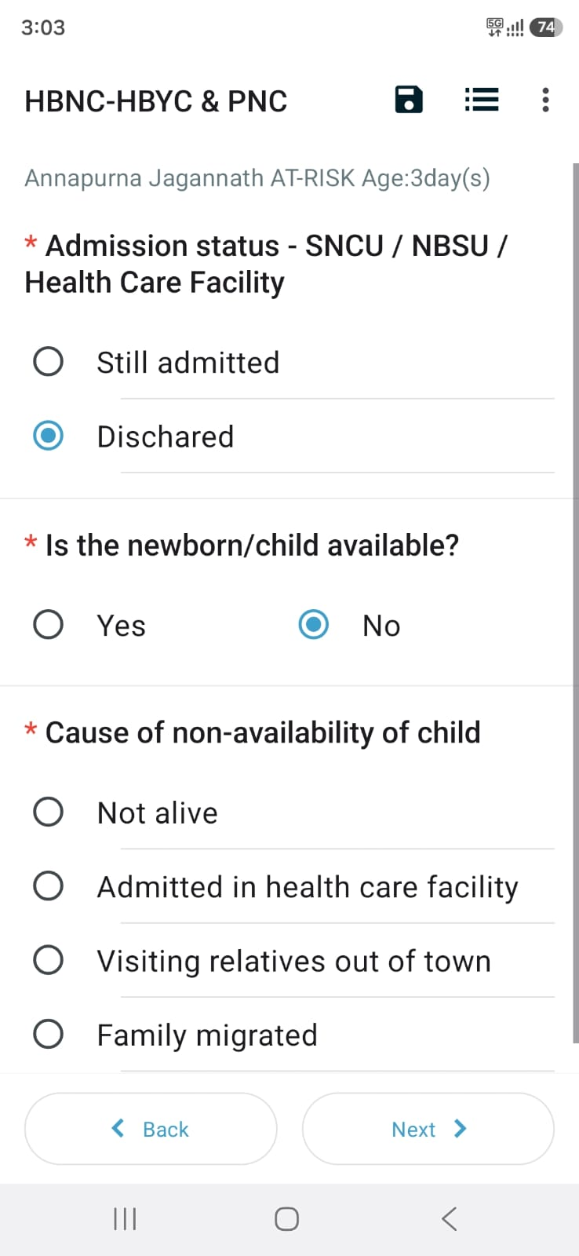
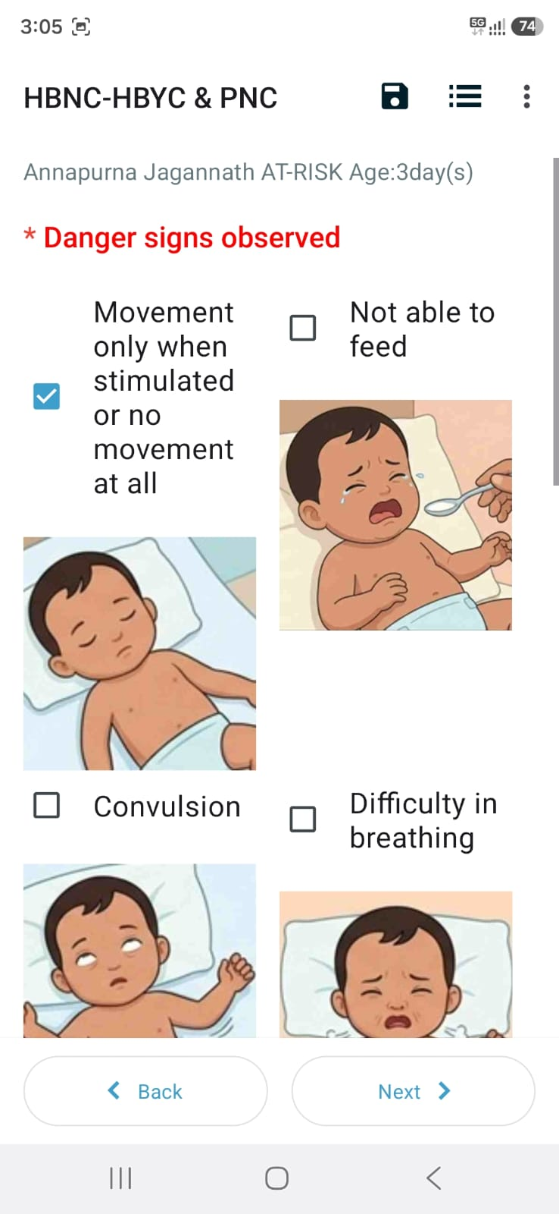
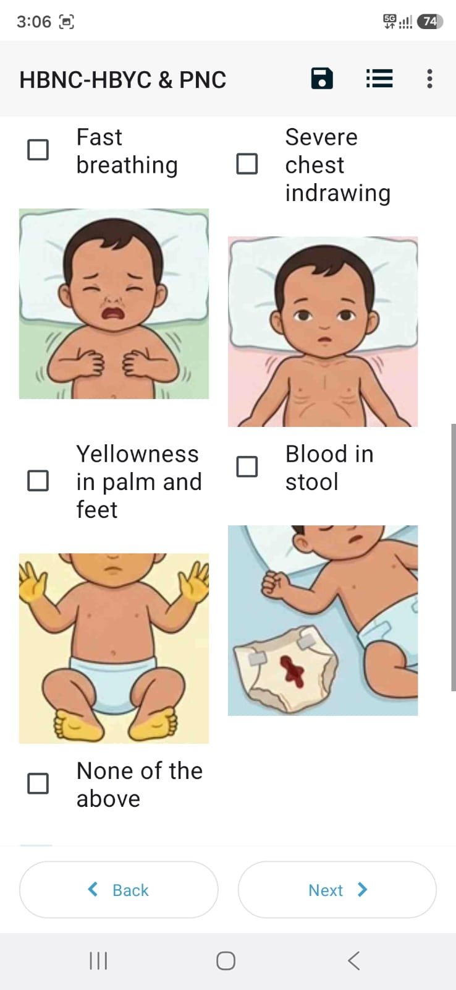
Form navigation and Data entry

Slide 8
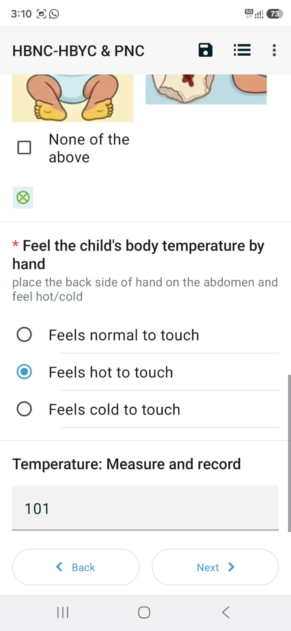
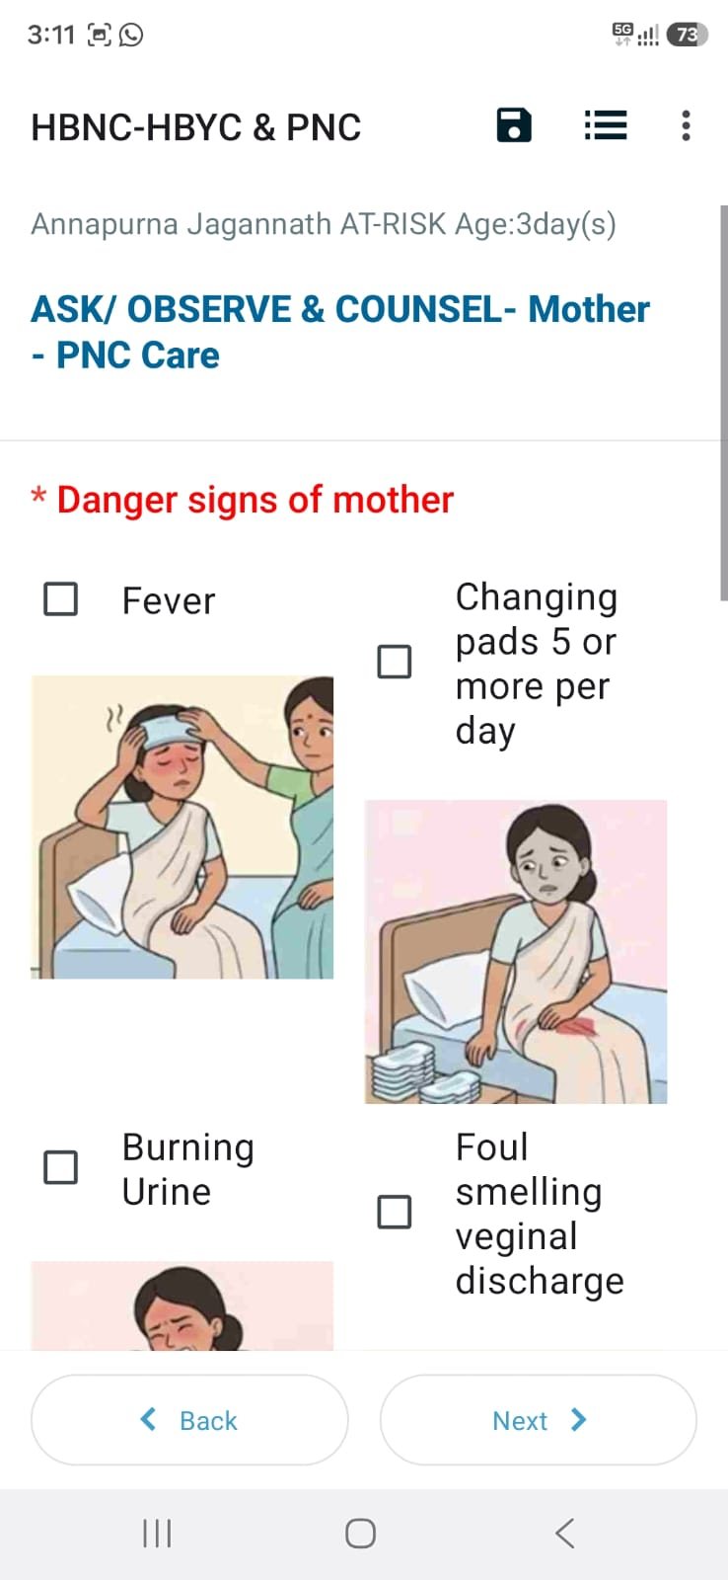
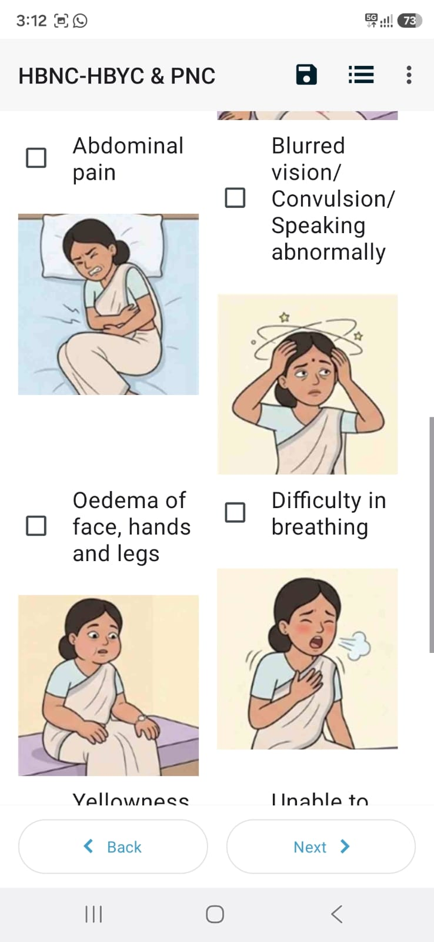
Form navigation and Data entry

Slide 9
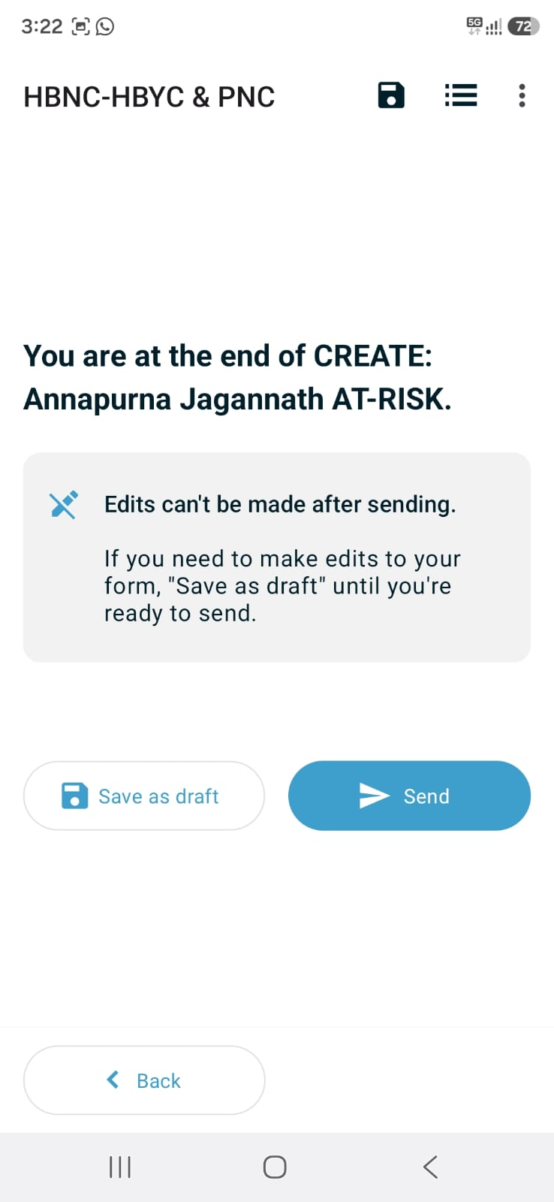
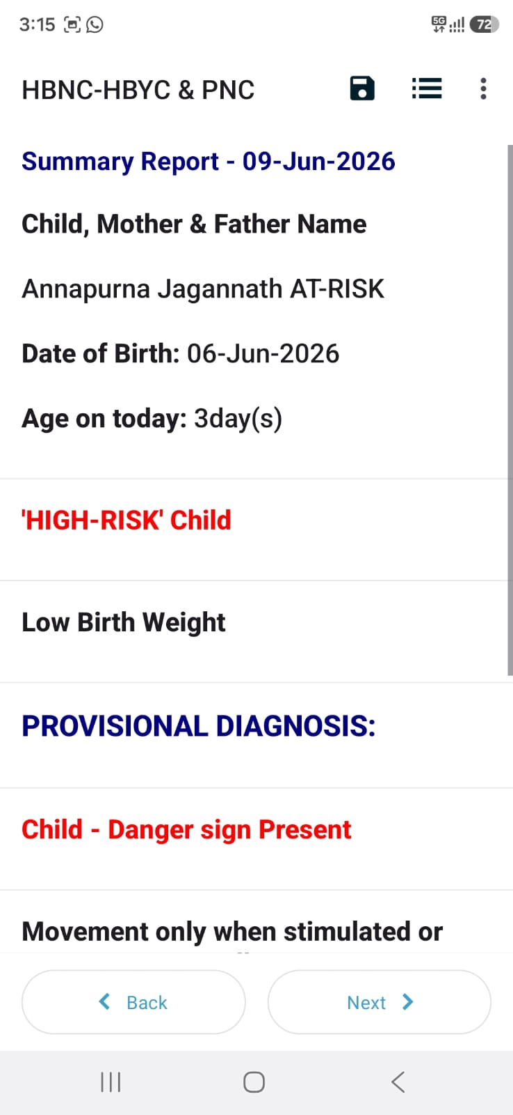
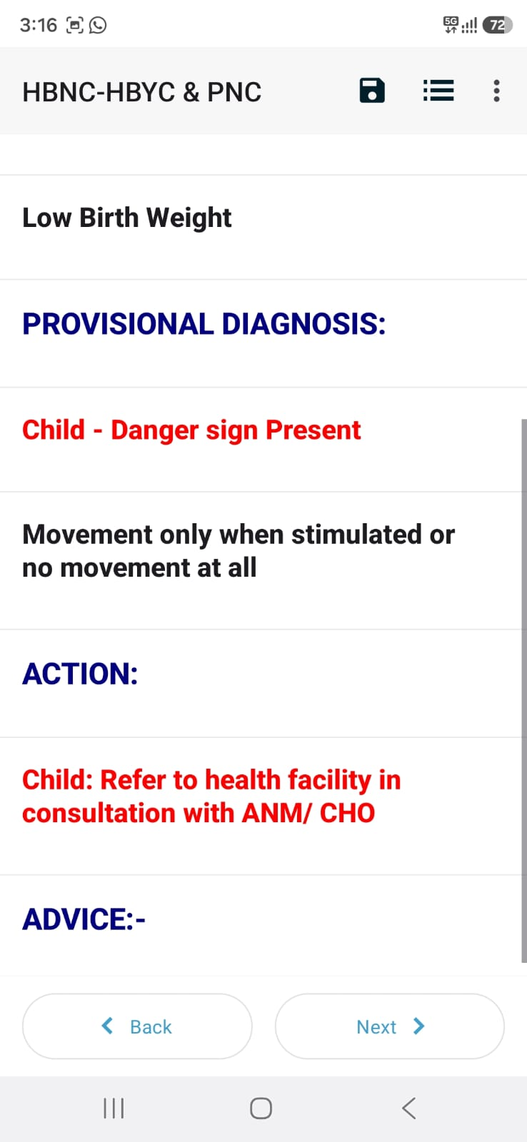
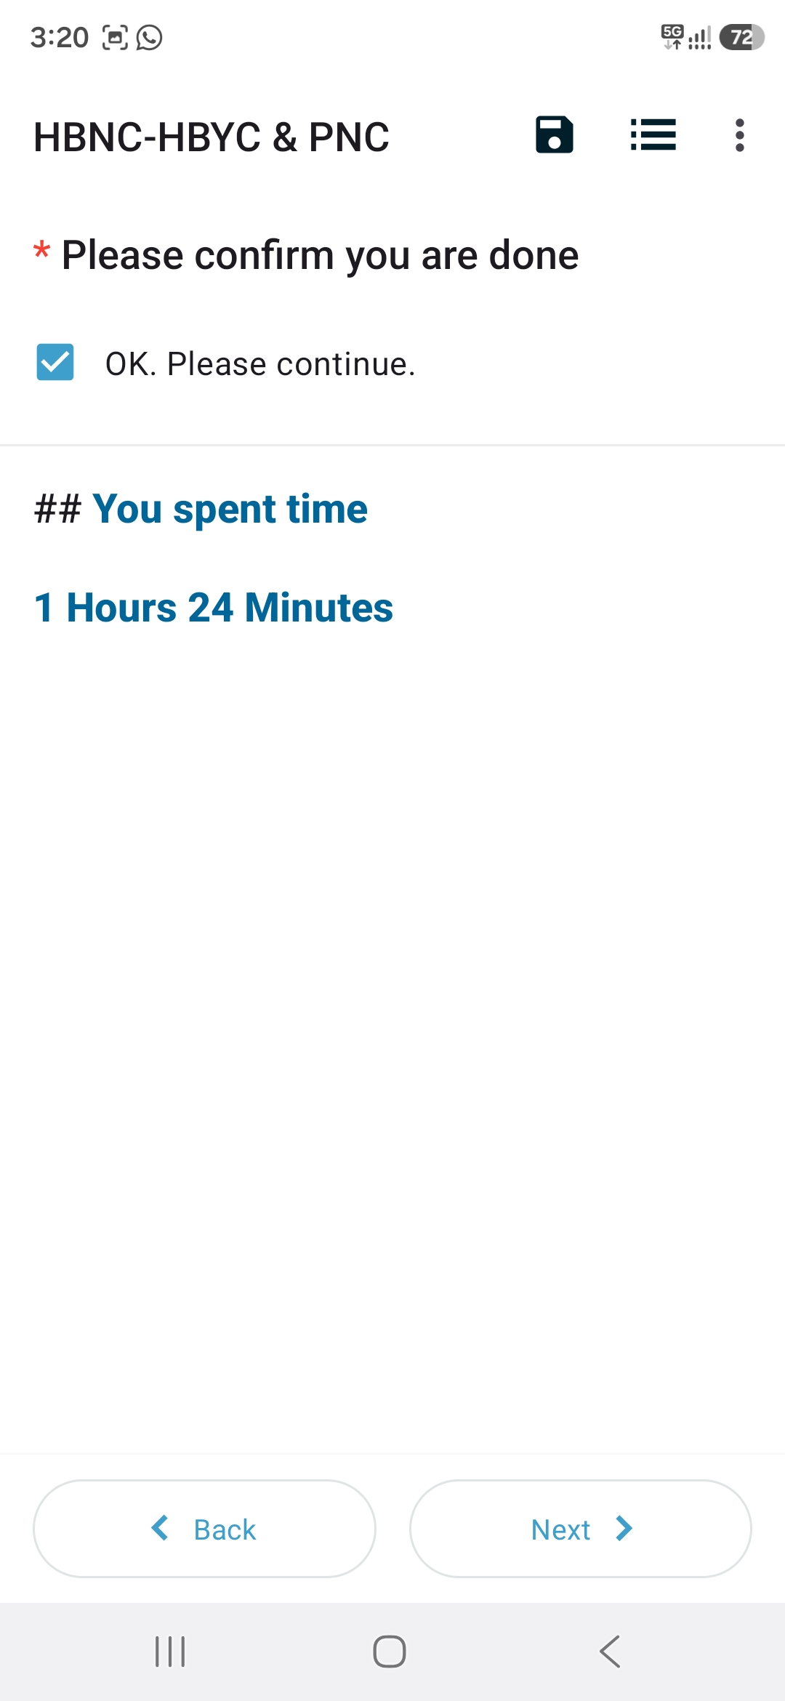
Risk classification and Decision Support
Saving and sending forms

Slide 10
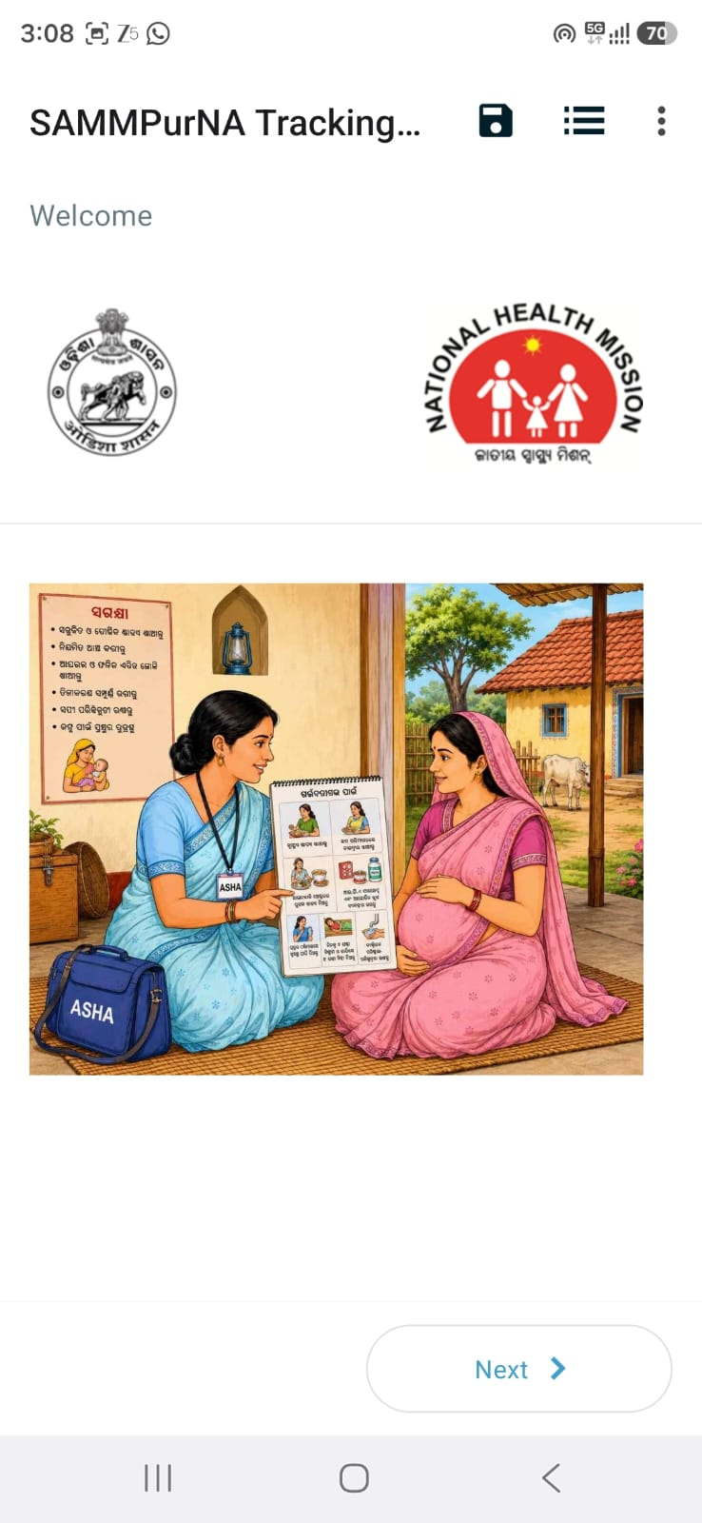
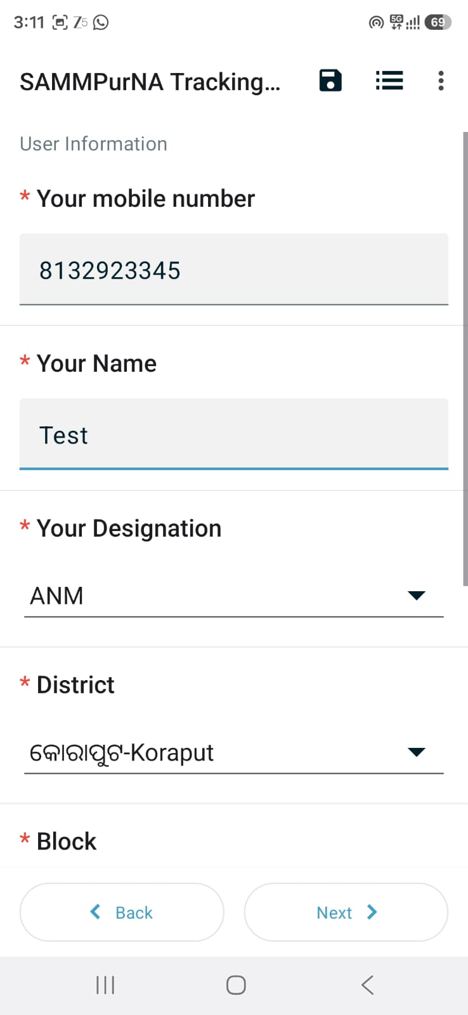
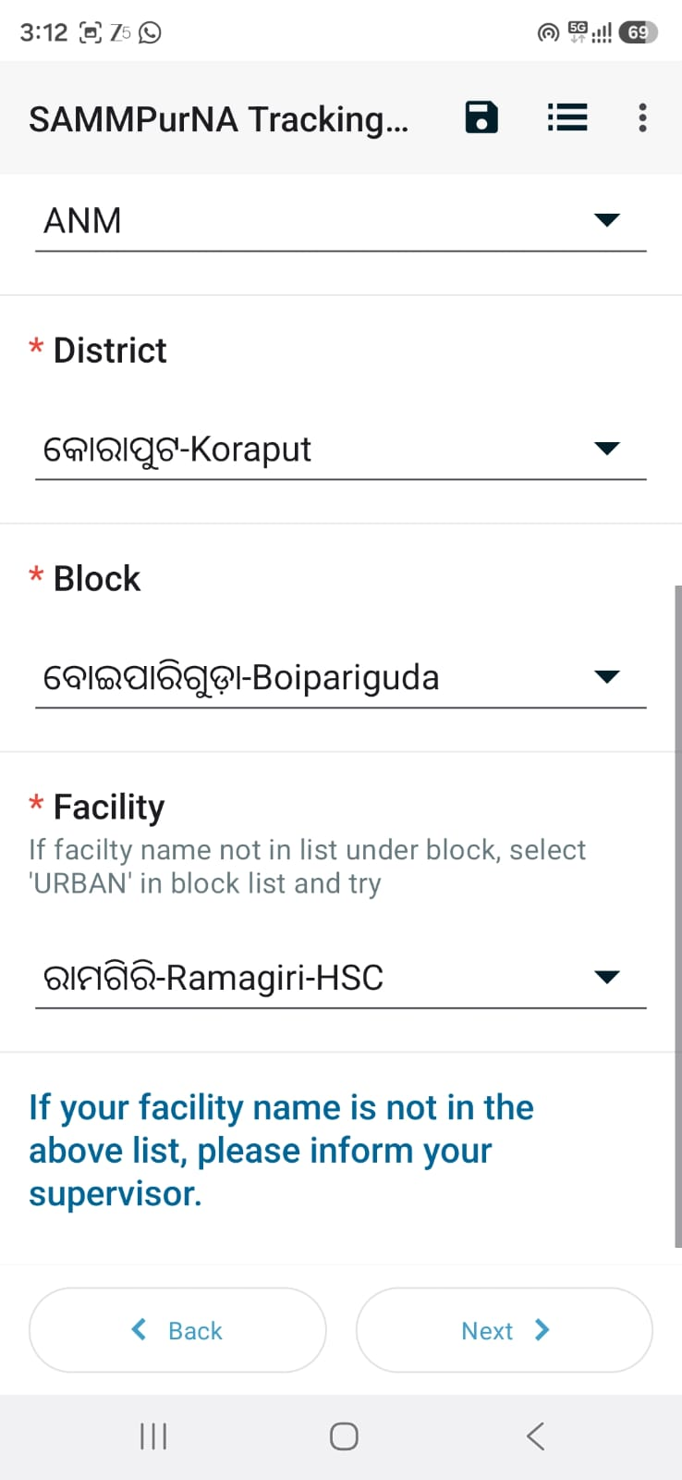
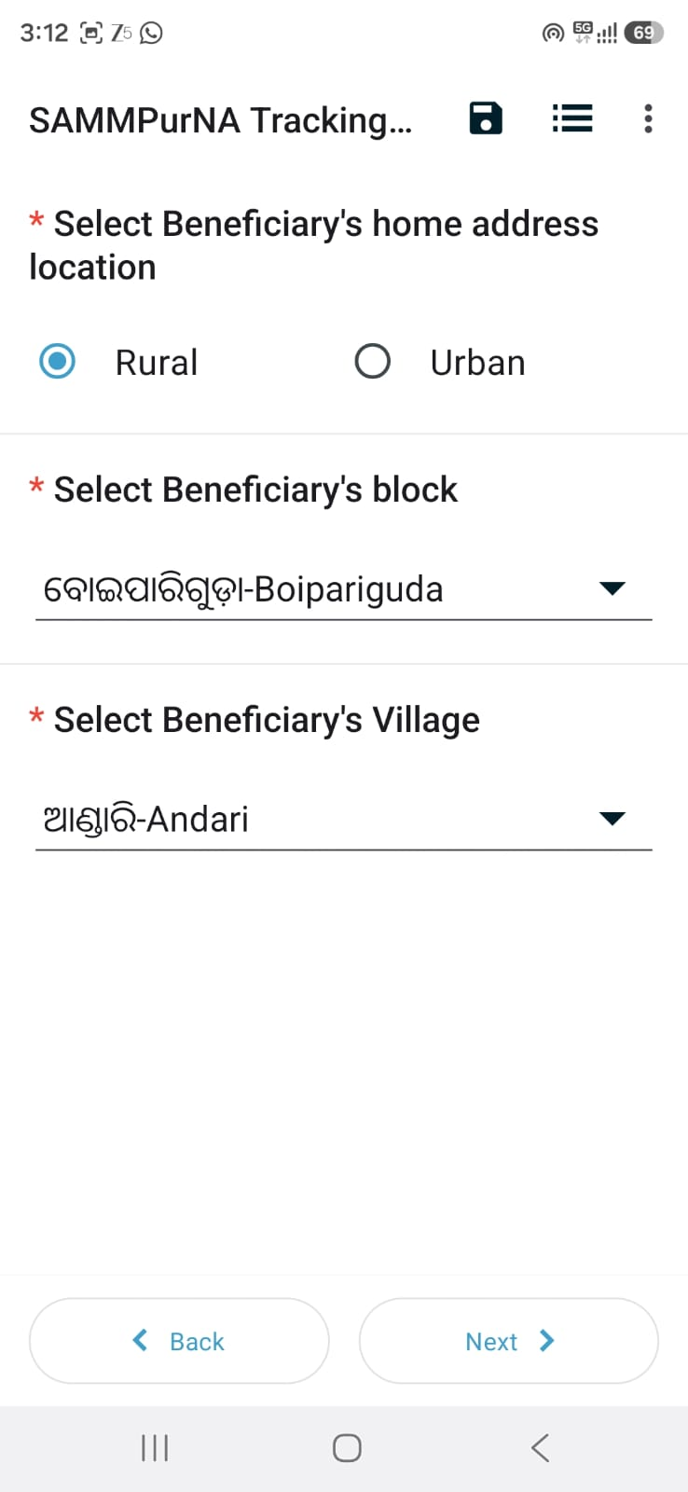
MATERNAL HEALTH

Slide 11
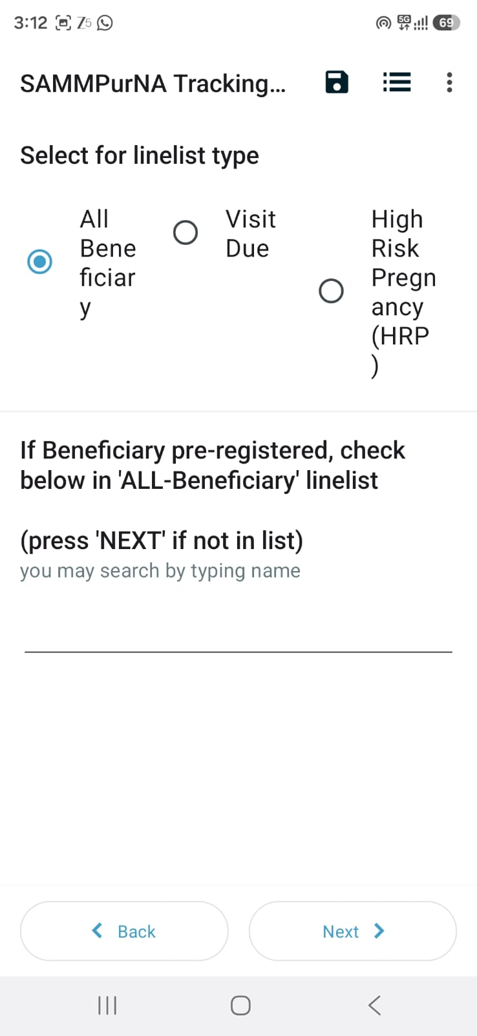
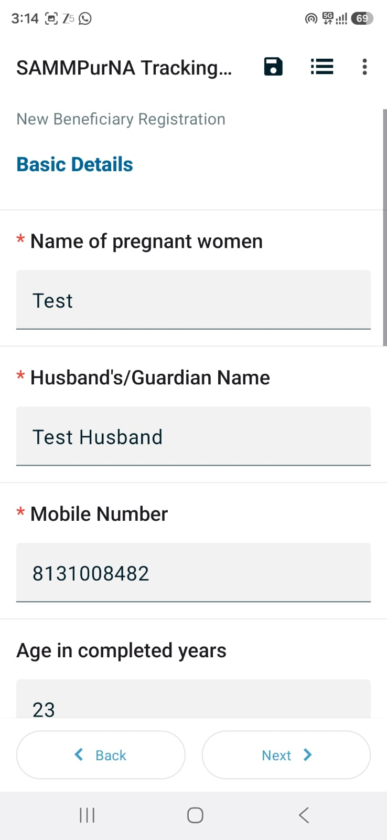
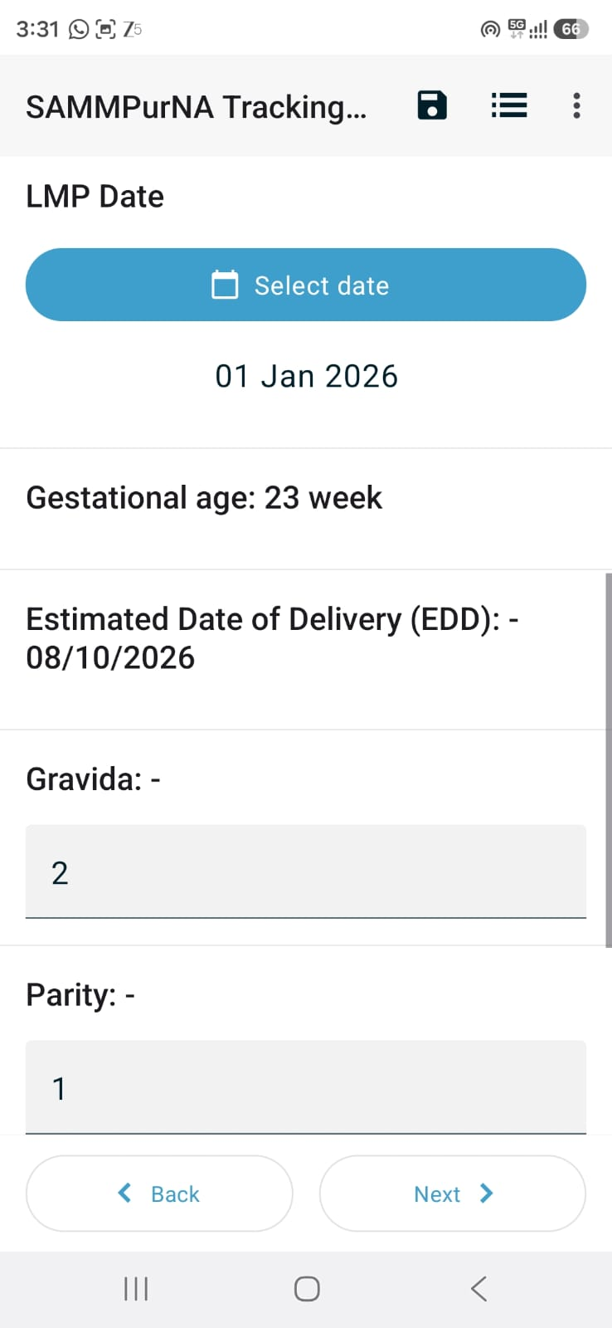

Slide 12
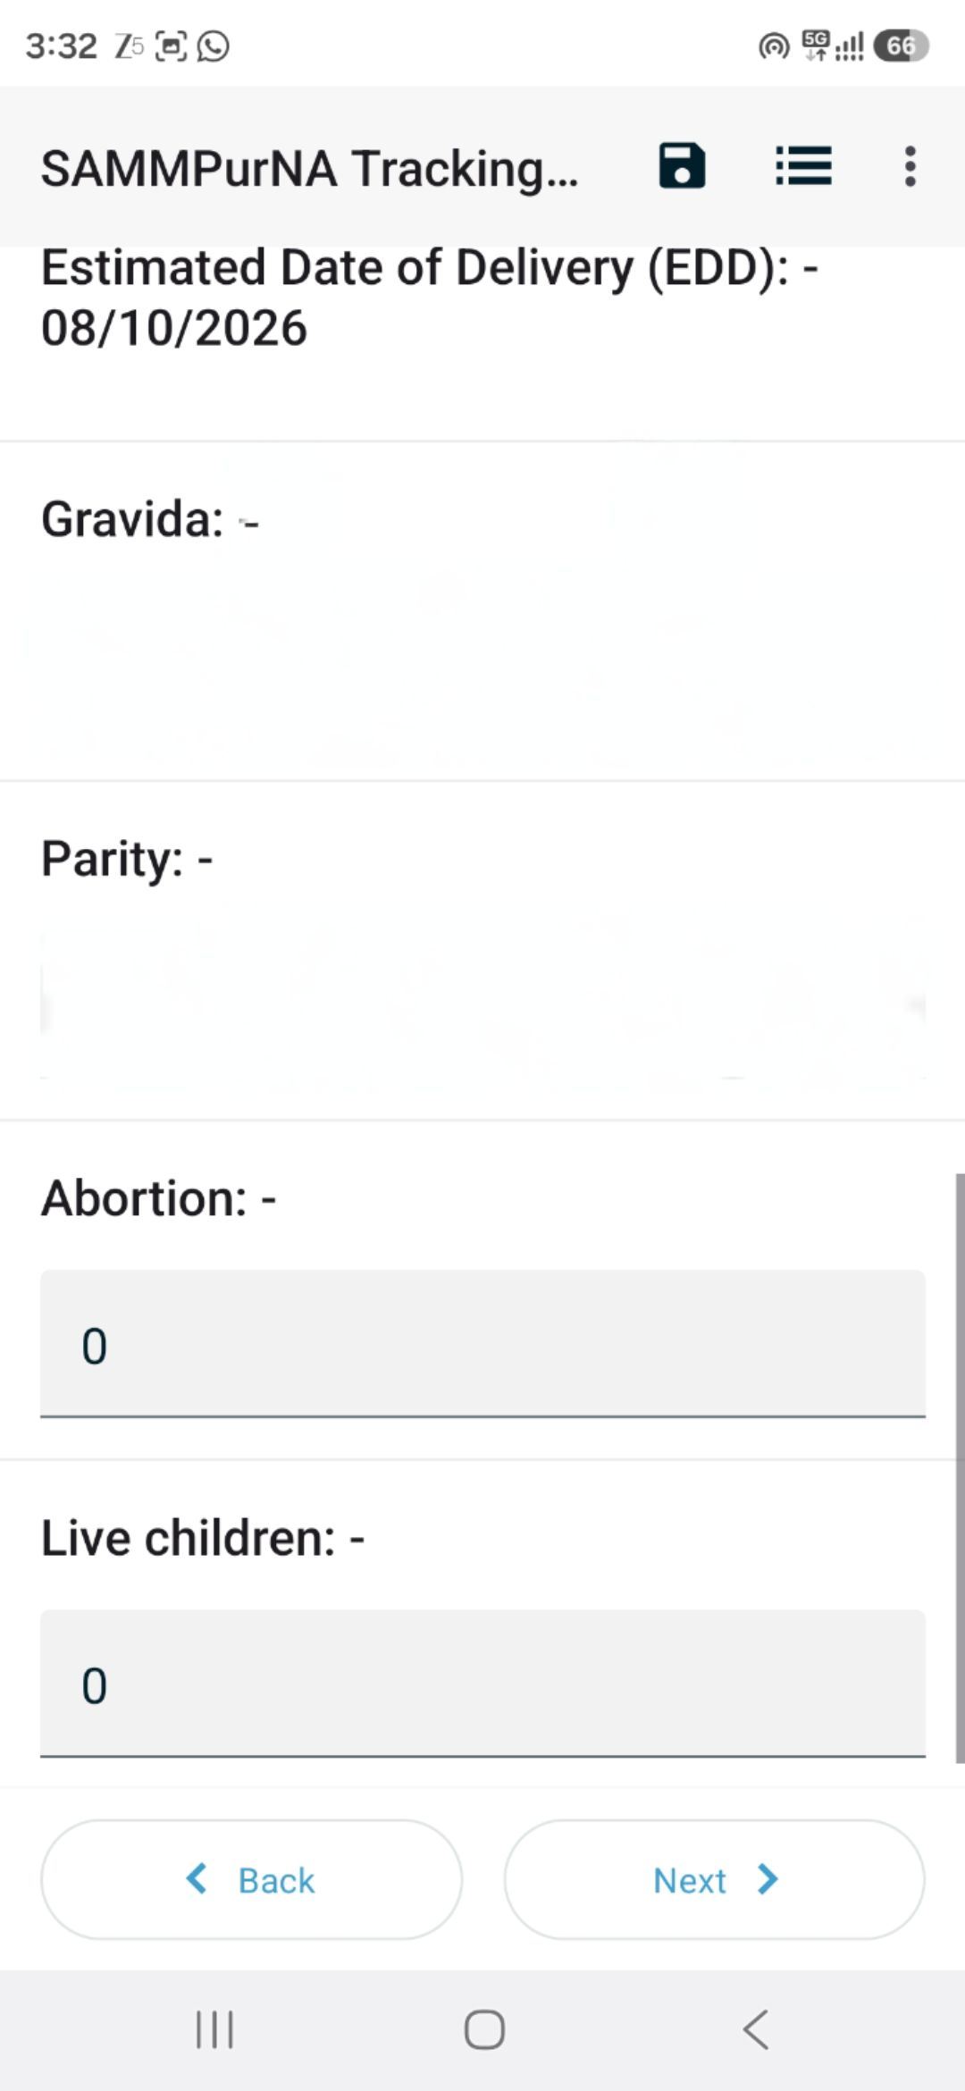
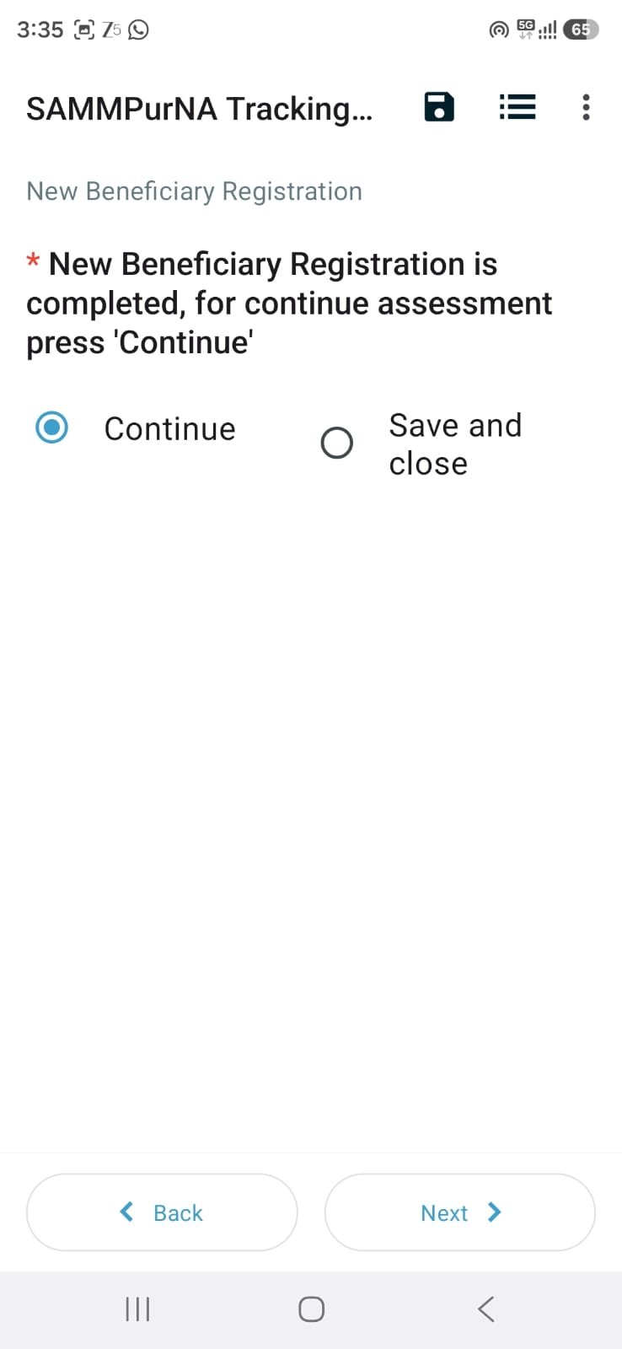
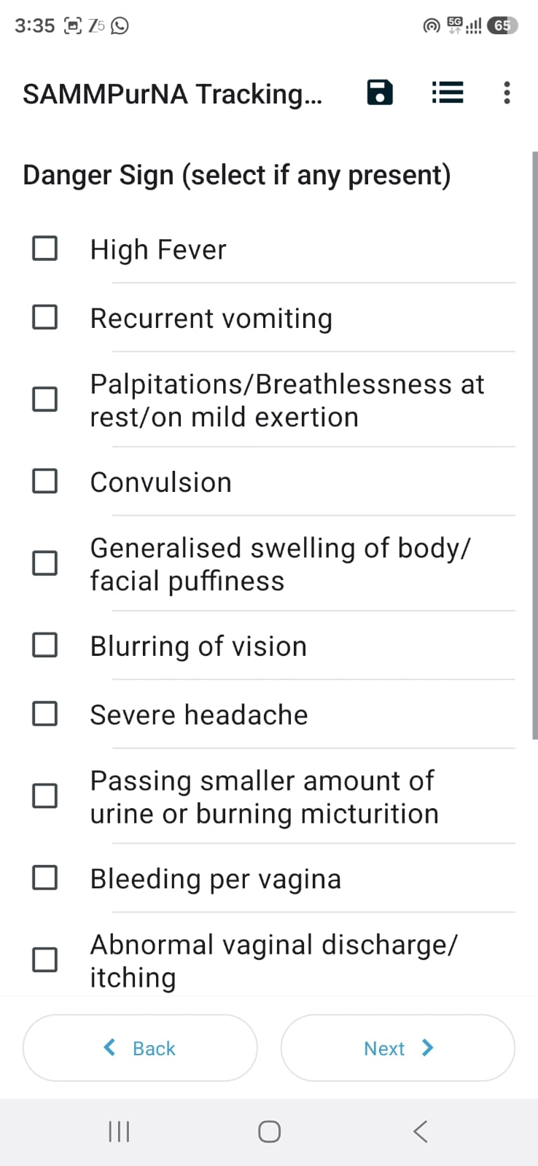

Slide 13
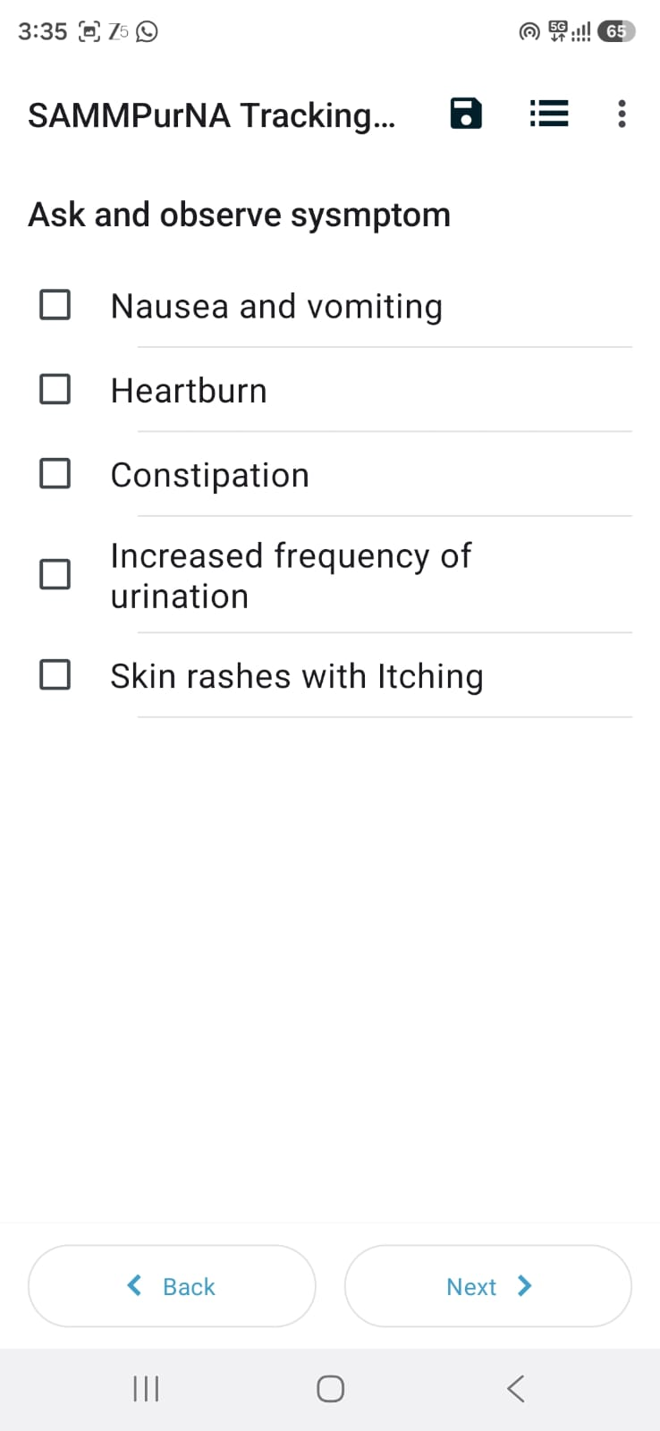
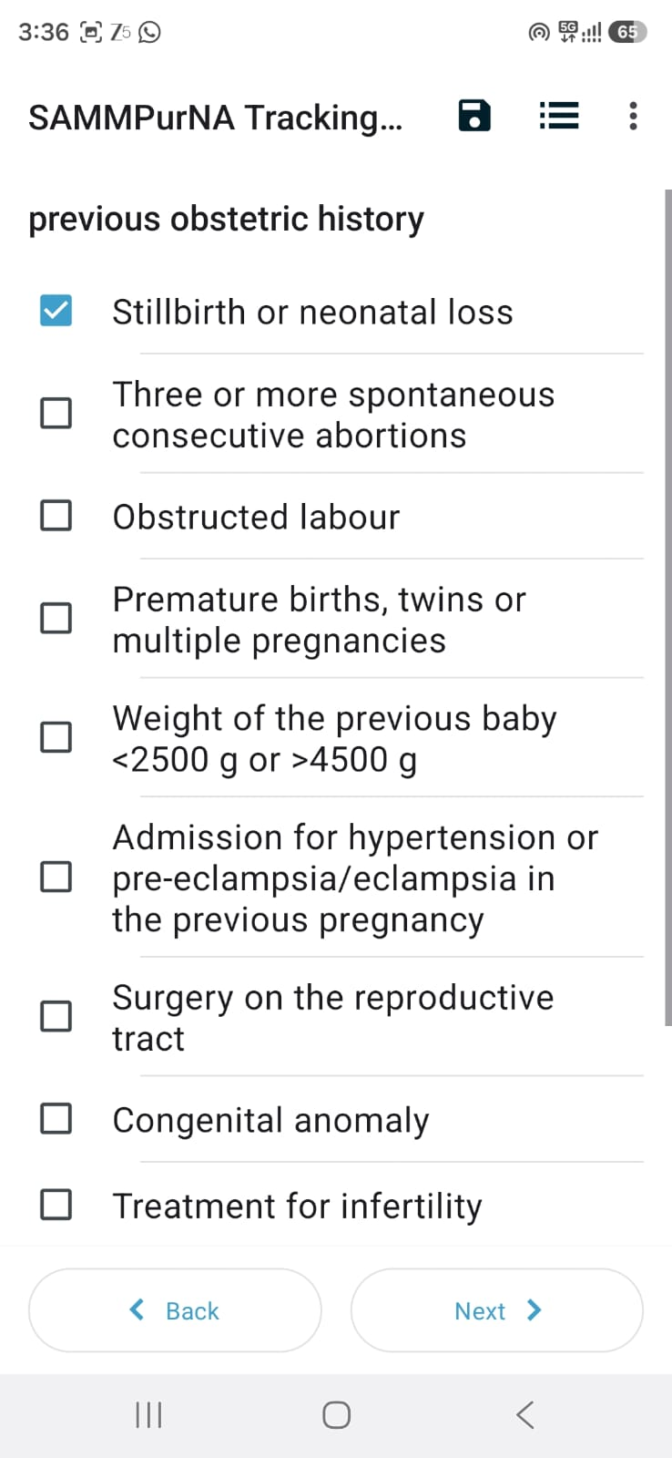
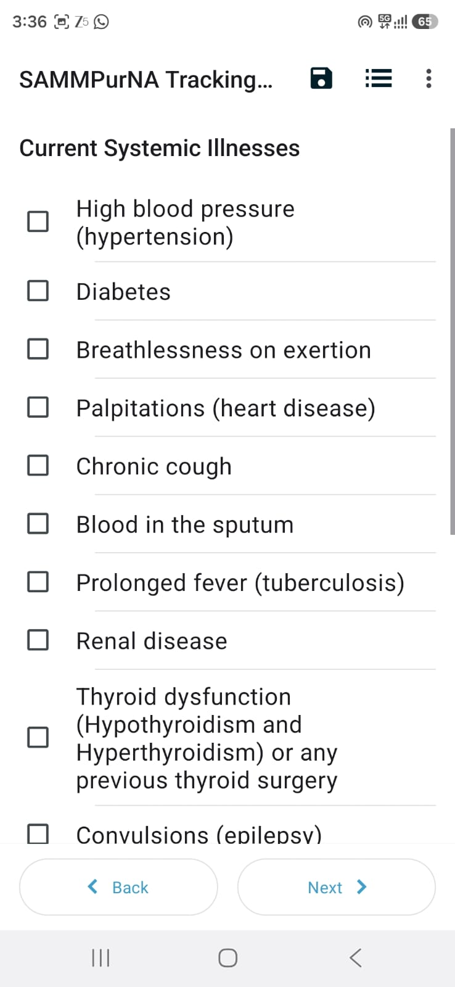

Slide 14
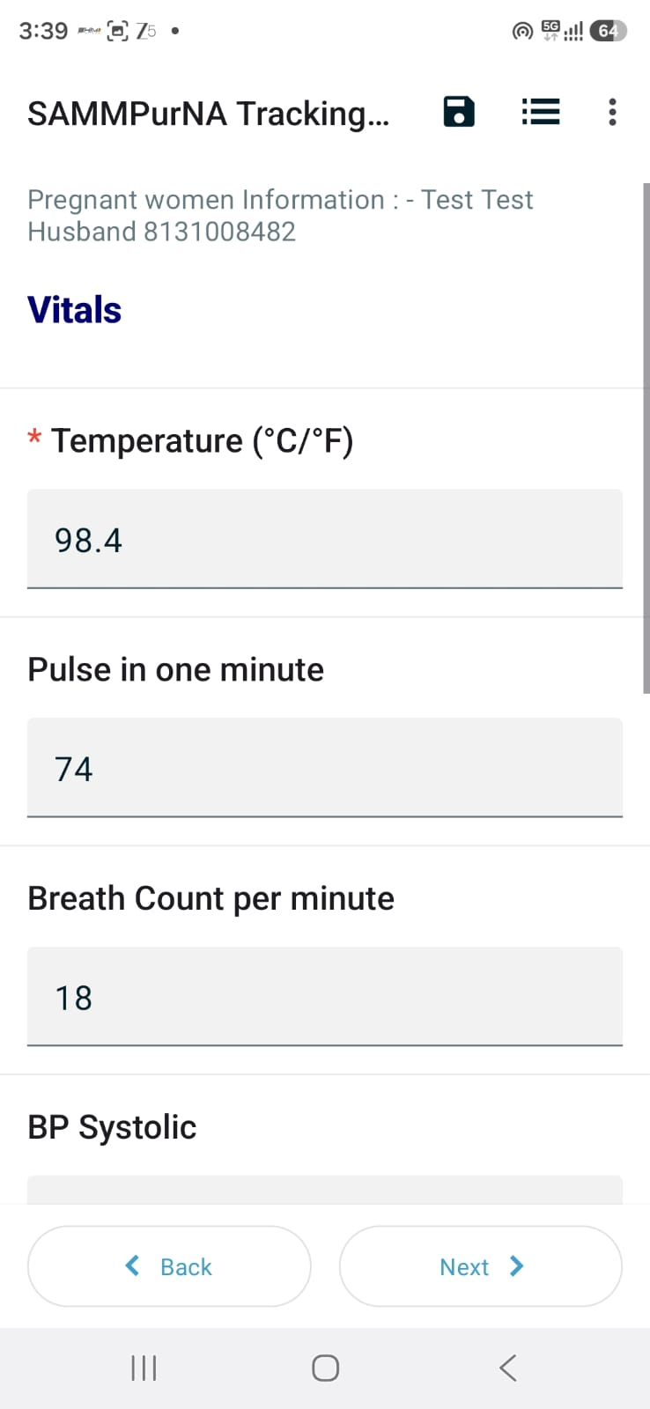
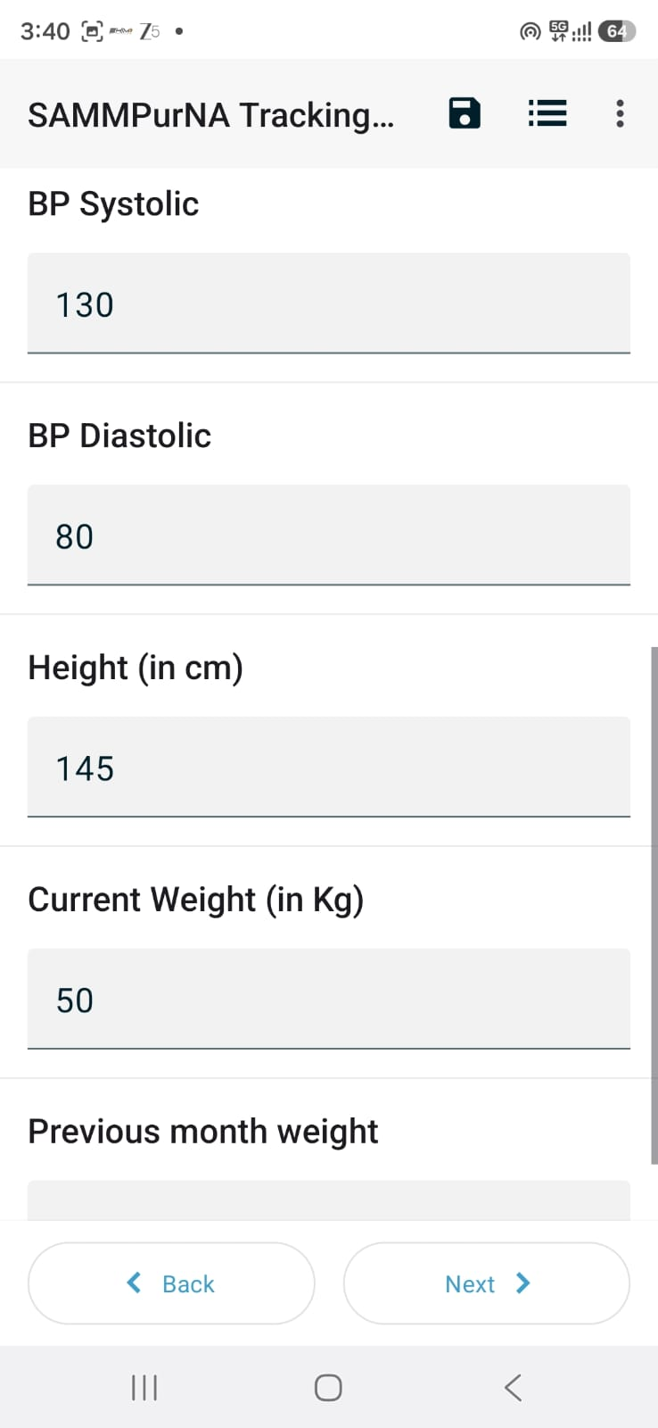
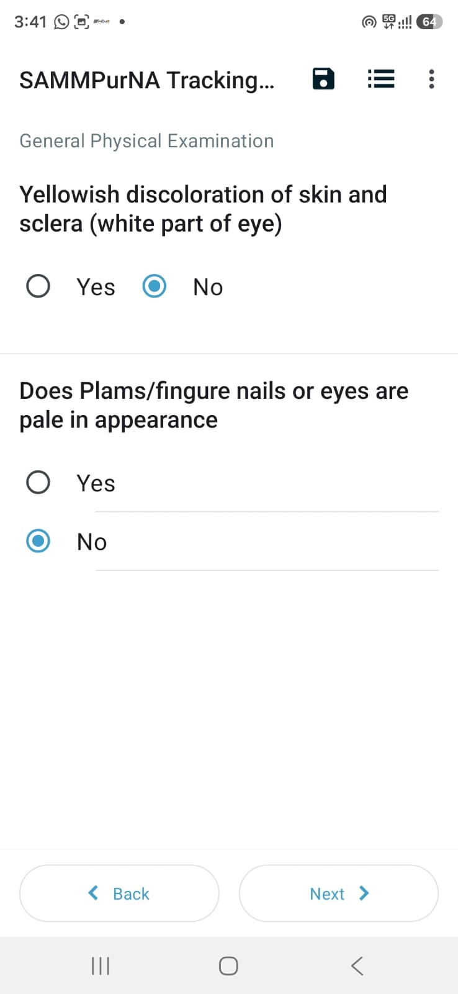

Slide 15
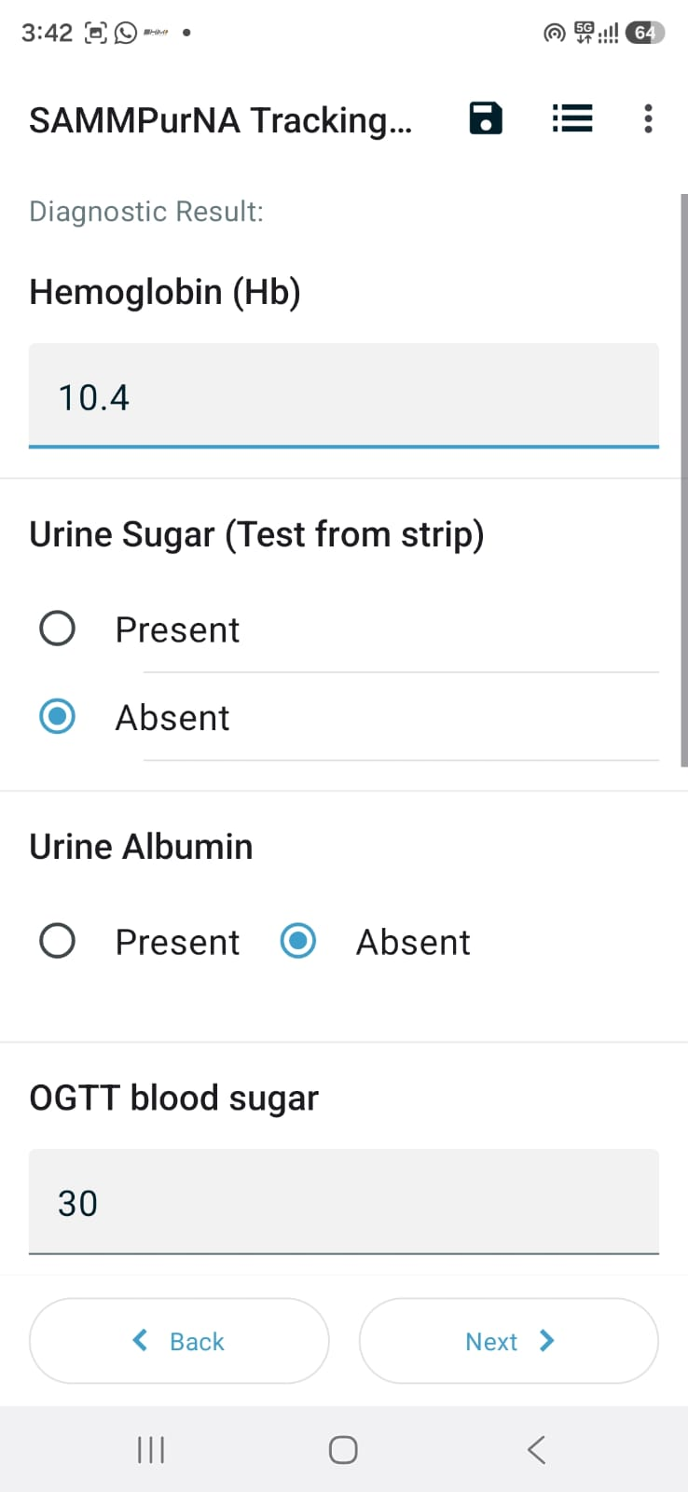
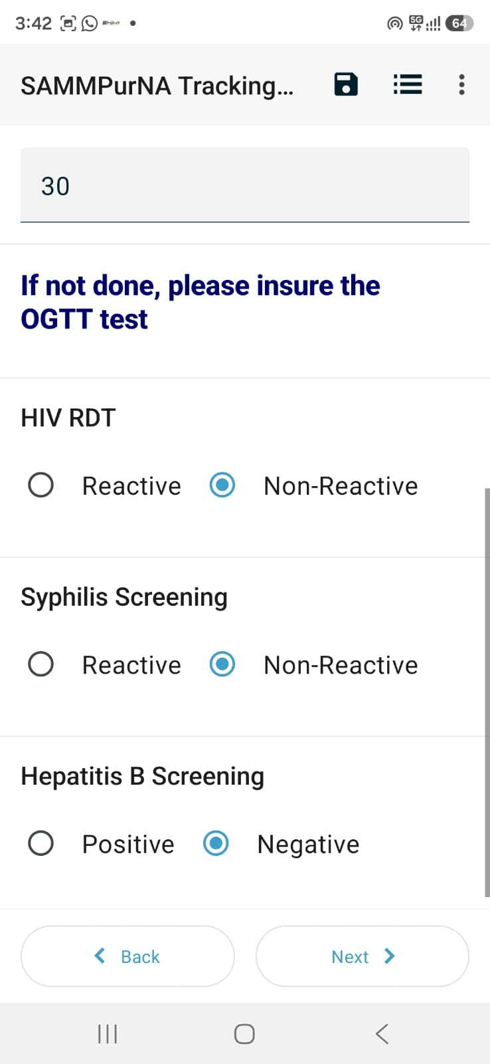
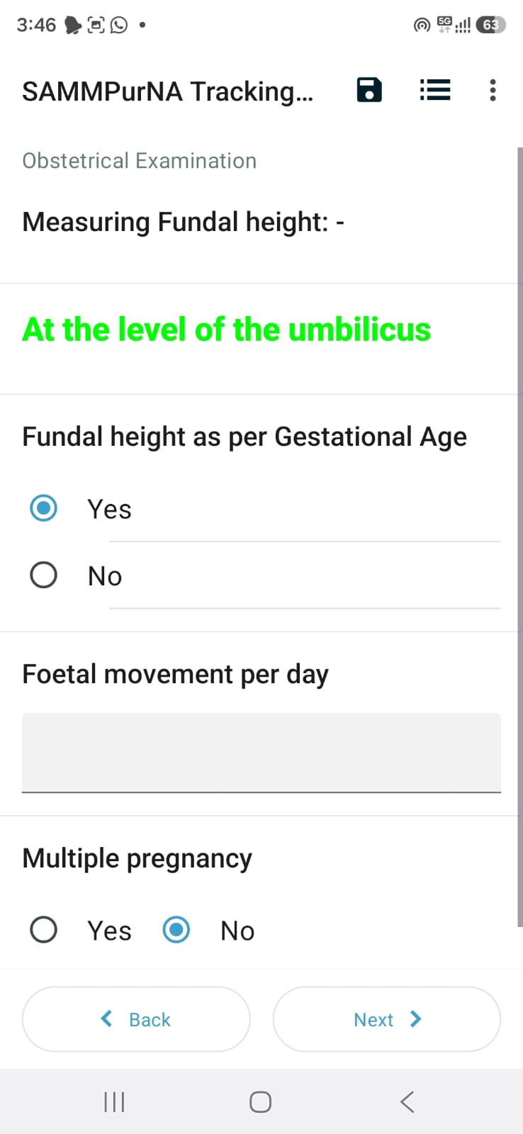

Slide 16
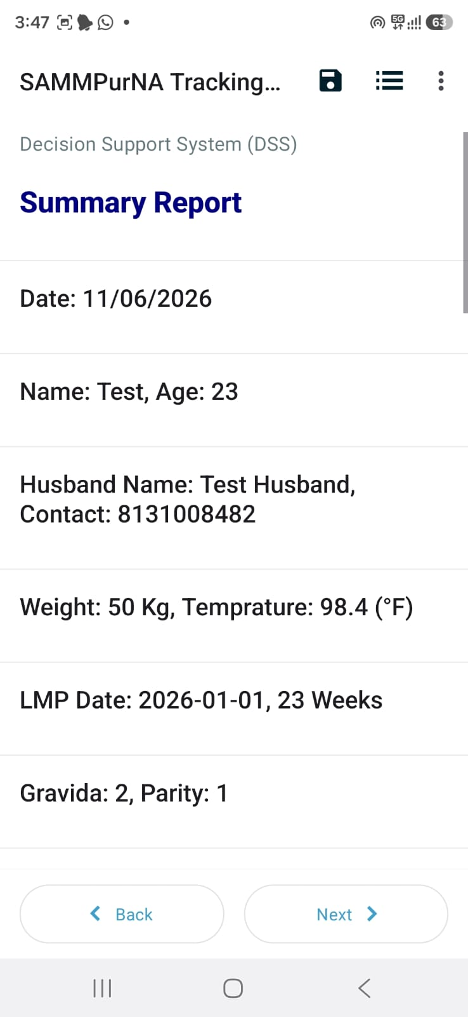
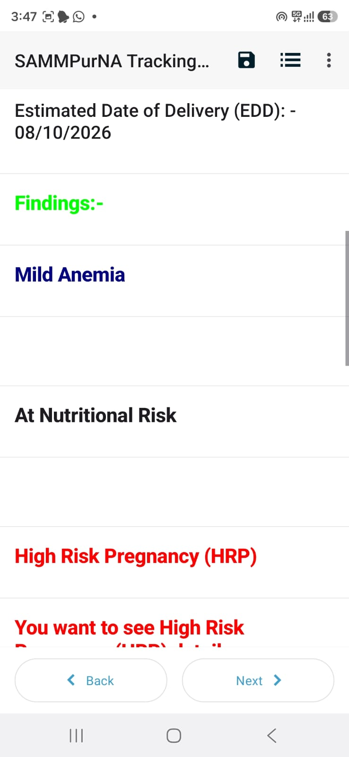

Risk classification and Decision Support

Slide 17



Risk classification and Decision Support
Saving and sending forms

Slide 18
Dashboard Report
The SAMPurNA Dashboard provides near real-time visibility into programme performance at the district and block levels. Supervisors and programme managers can use the dashboard to monitor the following:
Coverage Monitoring
Track the number of ANC, HBNC, HBYC, and PNC visits conducted against targets — sub-centre and village wise.
High-Risk Beneficiary Status
Identify beneficiaries classified as high risk and monitor whether referrals and follow-ups have been completed.
Data Submission Status
View the status of forms submitted by individual health workers — including pending drafts and unsent entries — to ensure data completeness.
Worker Performance Tracking
Assess the regularity and quality of visits by ASHAs, ANMs, and other frontline workers to enable targeted supportive supervision.

Slide 19
TASK FOR BLOCK TEAM
Each team member will enter 5 real HBNC-HBYC and ANC cases within next 15 days.
Share your feedback with regard to data entry and outcome in your HPB (High Priority Block Participants) Whats-app group

Slide 20
SAMPurNA Tracking Tool - Installation Process
Step-1
Step-2
Download “ODK Collect” from Google play store
Scan QR code by 2 methods
Search ODK Collect
Method 1- By importing from Photo Gallery
Method 2- Direct Scan using Camera
IOS USERS - USE THE FOLLOWING LINK
https://odk.nipi-cure.org/f/gMdZdbIWtKwD3KJxzxVlgOhq7BqaBgS?st=dJkfIrmGCJzNpV7rIPQZ2sD0mFOUqPTM!n2JaKyUBJawOrt4Zg7W62raxEWk0yWd
FOR HBNC-HBYC
Allow Access
https://odk.nipi-cure.org/f/9uZLir7O4YpRpXZ7adAyzPkhHkDdSZM?st=jWo9xGZXgvsYpROh8RhD1efsdGkVthSV8nQl5$0MEyqZTNctUhztfOF6sB91yE0h
FOR ANC

Slide 21
Thanks

