Slide 1
Birth preparedness and complication readiness
Topic: 5

Slide 2
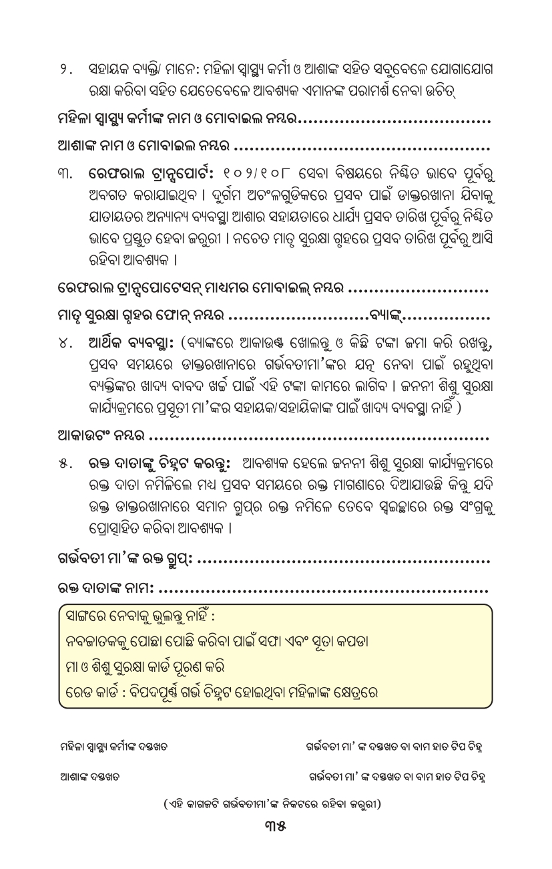
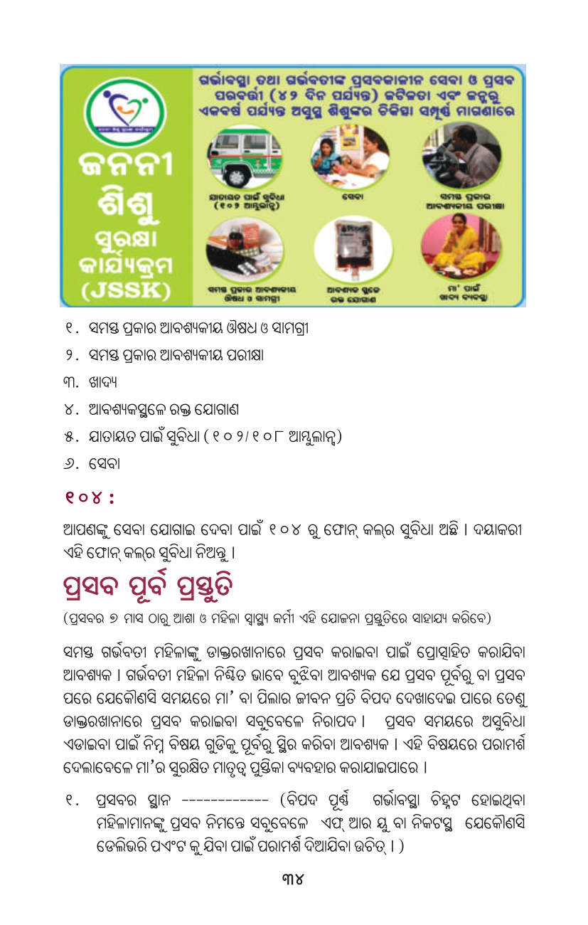
Birth preparedness & complication readiness (BPCR)
Nirapad Matrutva booklet
298
Notes:
298

Slide 3
BPCR – Birth Preparedness
Keep these things Ready in a bag after 8th Month
MCP Card
ID card
Bank Passbook
All test reports
Clean cloth for newborn
Warm scarf or cap for covering ears
Clean and dry socks for feet
Clean and dry clothes for mother
Sanitary pads for mother
Contact persons on Onset of Labour
Name & Mobile no. Of ASHA
Name & Mobile no. Of Nurse
Name & Mobile no. Of Anganwadi worker
Name of nearest PHC
Contact number of PHC
Name of District/Sub-district hospital
Contact number of DH/SDH
Name and number of driver
Inform about government schemes and programs – JSY, JSSK, Emergency Transport Number 108 and Extended PMSMA and to contact at Suman Help desk in case of any problem (104/ 18001801104)
299
Notes:
299

Slide 4
BPCR – Complication Readiness
Under BPCR, it is important to inform the pregnant woman and family members about early recognition of danger signs during pregnancy
Danger Signs
Any bleeding PV during pregnancy
Severe headache with blurred vision
Convulsions or loss of consciousness
Decreased, increased or absent fetal movements
High fever with or without abdominal pain or chills
Excessive vomiting, unable to take anything orally
Breathlessness at rest or dizziness
In case of any Danger sign, take the woman to hospital
300

