Slide 1

PMSMA & EPMSMA
Topic: 6

Slide 2
Pradhan Mantri Surakshit Matritva Abhiyan (PMSMA)/Extended PMSMA
PMSMA is Launched in 2016 by the Ministry of Health & Family Welfare (MoHFW), Government of India. And E-PMSMA 1st April 2022
PMSMA provides fixed-day assured, comprehensive and quality antenatal care universally to all pregnant women (in 2nd and 3rd trimester) on the 9th of every month and E PMSMA On any other Fixed days of the months Other than 9th.
On this day special ANC services are provided by OBGY specialists/ Radiologist/ Physicians at government health facilities.
Using the principles of a single window system
One of the critical components of the Abhiyan is identification and follow-up of high-risk pregnancies and red stickers are added on to the Mother and Child Protection cards of women with high-risk pregnancies.

Slide 3
WHEN
9th of every month and Any Other Fixed Day (E-PMSMA)
BY WHOM
BEmONC trained or specialist
FOR WHOM
2nd & 3rd Trimester PW

Slide 4






Features
Mobilization
Screening
HRP Identification
PMSMA Portal
Tracking of HRP
Management of HRP

Slide 5
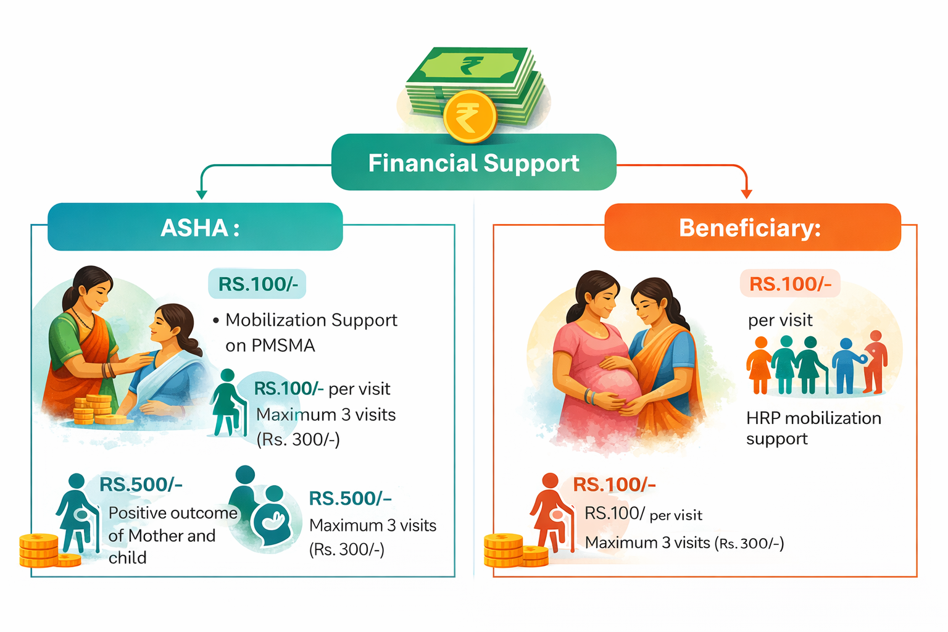
Financial Support
ASHA :
Mobilization Support to ASHA on PMSMA Rs. 100/-
HRP Mobilization support to ASHA RS.100/- for maximum 3 visit (Rs. 300/-)
Positive Outcome of Mother and child on 42 days Rs. 500/- Per High Risk pregnancy
Beneficiary:
HRP transport support to PW RS.100/- for maximum 3 visit (Rs. 300/-)

Slide 6
Non-Negotiable Component
Availbility of Specialist (Obs & Gyn)/ BEmONC
History Taking (All the History as per MCP card)
Investigations ( Hemoglobin, Urine albumin & Sugar, OGTT, Rapid malaria Test, CBC, Blood grouping, TSH & SCD)
USG Coverage (Mandatory 1 USG for all PW)
Diet (Hot cooked Meal)
Flow of Beneficiary

Slide 7
Flow of Beneficiary
1
2
3
4
5
6
7
Registration of PW
Anthropometric Measurement and Vital sign by Nursing officer/ MPHW (F) –Mention in MCP card
PW visit doctor along with results
Doctor examine the PW and label High risk/ non High Risk
Referred for USG and report back to doctor modify HRP based on additional findings
Drugs/Appropriate treatment or referred along with counselling
Lab technician collect blood and urine (Predefined Tests)
Notes:
307

Slide 8
Roles and responsibility of Health care providers
Obstetricians/ BEmONC trained MO:
Conduct thorough ANC check-ups.
Identify and manage high-risk pregnancies.
Ensure accurate documentation and reporting.
Nursing Officer and MPHW (F):
Assist in ANC procedures.
Facilitate patient flow and comfort.
Provide health education to pregnant women.
ASHA Workers:
Mobilize pregnant women to attend PMSMA clinics.
Maintain line lists of pregnant women.
Follow up with high-risk cases.

Slide 9
List of PMSMA HRP Condition (25)
S.L. No | HRP Condition | S.L. No | HRP Condition
1 | HIV | 14 | Abnormal FHR
2 | Syphilis | 15 | Teenage Pregnancy
3 | Severe Anemia | 16 | High Fever
4 | PIH | 17 | RTI/STI
5 | GDM | 18 | H/o Still Birth
6 | Hypothyroidism | 19 | Congenital Malformation
7 | Tuberculosis | 20 | Negative Blood Group
8 | Malaria | 21 | Early primi
9 | Previous LSCS | 22 | Elderly Primi
10 | CPD | 23 | Grand multipara
11 | BOH | 24 | Short Stature
12 | Twins/Multiple Pregnancy | 25 | Others Specify
13 | Hepatitis B

Slide 10
Integration of MCP card and PMSMA HRP condition
S.L. No | PMSMA HRP Condition | MCP card HRP Alignment
1 | HIV | HIV
2 | Syphilis
3 | Severe Anemia | Heamoglobin lessthan 7gm%
4 | PIH | BP >140/90mmhg, Urine albumin
5 | GDM | Urine sugar, OGTT
6 | Hypothyroidism | Thyroid prblem
7 | Tuberculosis | H/O TB
8 | Malaria | Malaria
9 | Previous LSCS | Previous LSCS
10 | CPD
11 | BOH | Prev. LBW, Preterm, IUGR, newborn deaths, Previous H/O APH , H/O PPH, morethan 3 abortion, H/O PIH or eclampsia, primary / Secondary infertility, IVF
12 | Twins/Multiple Pregnancy
13 | Hepatitis B | Hepatitis B

Slide 11
Integration of MCP card and PMSMA HRP condition
S.L. No | PMSMA HRP Condition | MCP card HRP Alignment
14 | Abnormal FHR
15 | Teenage Pregnancy | If pregnancy less than 18 years
16 | High Fever | Fever
17 | RTI/STI | RTI/STI
18 | H/o Still Birth | Previous Still birth
19 | Congenital Malformation
20 | Negative Blood Group | Rh -ve
21 | Early primi | If pregnancy less than 18 years
22 | Elderly Primi | If 1st pregnancy morethan 35 years
23 | Grand multipara | More than 4 pregnancy
24 | Short Stature | Height lessthan 140cms
25 | Others Specify | Geographically Hard to reach area, Prev. sx involving Uterus, H/O Diabetes, Heart disease, Kidney disease, H/O Leprosy. Any Pregnancy morethan 35 years, Thalassemia, SCD, weight lessthan 40kgs,ASB, inappropriate wt gain , MUAC Lesstha 23cm

