Slide 1
AMLAN
Topic: 7

Slide 2

AMLAN: towards vision of Anaemia Mukta Odisha
Goal: Accelerated Reduction in the prevalence of anaemia in the State across all age groups.
Objectives:
To reduce anaemia by 10% among each target beneficiary every year taking NFHS-5 as the base.
To provide a package of interventions to reduce anaemia by addressing nutritional and non-nutritional causes.
To increase the awareness on affordable micro-nutrient rich food.

Slide 3
Target Beneficiaries
Children 6 – 59 months
Lactating Mothers
Pregnant Women
Women of Reproductive Age Group 20-24 years
Adolescents 10-19 years
Children 5 – 9 years (In School

Slide 4
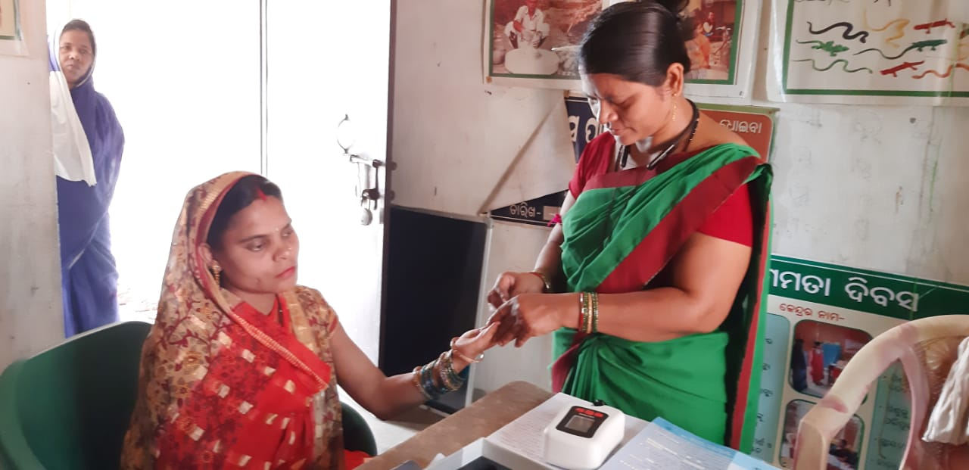
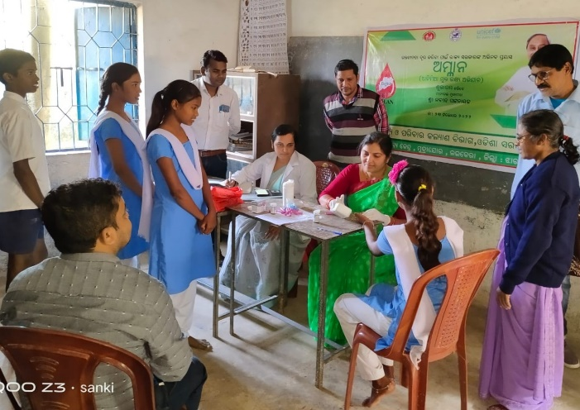
Test, Treat ,Talk & Track
In order to implement the programme effectively and to ensure maximum coverage of the target beneficiaries, 3 major platforms have been identified for ensuring the service deliveries categorized under Test, Treat and Talk. They are:
- Schools
- VHSND
- T3 camps
The testing of the beneficiaries categorised under different groups will be done by CHO / MPHW(F) / MPHW(M) and so also the treatment.
The talk and track activities will be carried out by Teacher, MPHW(F), MPHW(M), CHO, AWW and ASHA

Slide 5
T3 at VHSND
Service provider – MPHW(F)/MPHW(M)/AWW/ASHA
Target Group
- Children aged 6-59 months
- Out of school Adolescents girls 10-19 years
- Pregnant women
- Lactating mother
- Women in Reproductive Age (20-24 years)
Day designated for T3(Test, Treat & Talk) – VHSND
Test & Treat - MPHW(F)/MPHW(M)
Counselling , IFA Tablet and facilitate filling the follow-up card – MPHW(F) and AWW
Record keeping – MPHW(F) and AWW
Facilitate, monitoring and home visit - ASHA

Slide 6
T3 in Schools
Service provider – MPHW(F)/MPHW(M)/CHO/Teacher/ASHA
Target Group – Students of class 1 to 12
Day designated for T3(Test, Treat & Talk) – Monday
Test & Treat by - MPHW(F)/MPHW(M)/CHO
Counselling , IFA Tablet and facilitate filling the follow-up card – Teacher
Record keeping – Teacher and MPHW(F)
Facilitate, monitoring and home visit - ASHA

Slide 7
Key Activities Under AMLAN
The beneficiary category of Children 6 to 59 months. Out of school Adolescent girls 10-19 years, Women in Reproductive Age (WRA) 20-24 year, Pregnant Women and Lactating Mother will be tested for haemoglobin estimation at their respective VHSND/UHSND.
All students studying in class 1st to 12th in Govt and Govt. aided schools will be tested for haemoglobin estimation at their respective schools.
Those beneficiaries who are left out or in out reach areas will be tested in T3 camps, which will be organized yearly twice at every CHC.
After testing for the Hb. level, it should be recorded in the prescribed register by MPHW(F)/CHO/MPHW(M)/ School nodal teacher/AWW for AMLAN
Based on the test results, necessary therapeutic dose is to be prescribed/ referral is to be done to higher centre.
Counselling & follow-up (tracking) to be carried out.

Slide 8
Frequency of Screening
Every year there will be four time screening. First time-Universal screening of all beneficiaries
- Next three times- only identified anaemic cases and those with signs & symptoms
Catagory | 1st Screening | Rescreening | Action | Action
6-59 Month | Screening of all beneficiaries in first Quarter | Rescreening of only identified anaemic cases after two month consumption of therapeutic doses | After 2 months if Hb<11 gm/dl but improvement in Hb. Level >1gm then continue therapeutic dose for next two months | If no improvement or decrease of Hb then refer for investigation.
5-9yrs Sishubatika to class-5 | Screening of all beneficiaries by 2nd Quarter | Rescreening of only identified anaemic cases after two month consumption of therapeutic doses | After 2 months if Hb<11.5 gm/dl but improvement in Hb. Level >1gm then continue therapeutic dose for next two months | If no improvement or decrease of Hb then refer for investigation.
10-19yrs(In schoolclass 6-12 and out of school adolescent girls | Screening of all beneficiaries by 2nd Quarter | Rescreening of only identified anaemic cases after three month consumption of therapeutic doses | After 3 months if Hb<12 gm/dl but improvement in Hb. Level >1gm then continue therapeutic dose for next three months | If no improvement or decrease of Hb then refer for investigation.

Slide 9
Frequency of Screening
Catagory | 1st Screening | Rescreening | Action | Action
WRA (20-24months) | Screening of all beneficiaries in first Quarter | Rescreening of only identified anaemic cases after three month consumption of therapeutic doses | After 3 months if Hb <12 gm/dl but improvement in Hb. Level >1gm then continue therapeutic dose for next three months | If no improvement or decrease of Hb then refer for investigation.
Pregnant Women | Screening of all beneficiaries in every visit | Rescreening after one month consumption of therapeutic doses | In next month if Hb<11.0 gm/dl but improvement in Hb. Level >1gm then continue therapeutic dose | If no improvement or decrease of Hb then refer CHC/SDH/DHH for further investigations and will be managed with IV Iron Sucrose/ FCM
Lactating Mother | Screening of all beneficiaries in every visit | Rescreening after one month consumption of therapeutic doses | In next month months if Hb<12.0 gm/dl but improvement in Hb. Level >1gm continue therapeutic dose | If no improvement or decrease of Hb then refer CHC/SDH/DHH for further investigations and will be managed with IV Iron Sucrose/ FCM

Slide 10
Hemoglobin levels to diagnose Anaemia
Population | No anemia (g/dl) | Anemia
 | No anemia (g/dl) | Mild (g/dl) | Moderate (g/dl) | Severe (g/dl)
Children 6-59 months | 11.0 | 10 - 10.9 | 7 - 9.9 | < 7.0
Children 5-11 years | 11.5 | 11.0 - 11.4 | 8.0 - 10.9 | < 8.0
Children 12 -14 years | 12.0 | 11.0 - 11.9 | 8.0 - 10.9 | <8.0
Non pregnant women (≥ 15 years) | 12.0 | 11.0 - 11.9 | 8.0 - 10.9 | < 8.0
Pregnant women | 11.0 | 10.0 – 10.9 | 7.0 – 9.9 | < 7.0
Men (≥ 15 years) | 13.0 | 11.0 - 12.9 | 8.0 - 10.9 | <8.0
Source: WHO, 2011

Slide 11
Modalities for Oral IFA consumptions for all age groups

Slide 12
SN | Beneficiaries | Prophylactic | Therapeutic | Time for Consumption | Monitored by
1 | 6 – 59 month | Biweekly (Tuesday & Friday) 1ml of IFA syrup containing 20mg of elemental iron & 100mcg of folic acid | - Children 6–12 months- 1 ml IFA syrup, once a day - Children 1–3 years - 1.5 ml IFA syrup, once a day - Children 3–5 years - 2 ml IFA syrup, once a day | One hour after Complementary food/meal | ASHA through home visit
2 | Sishubatika to Class-V | Weekly once(Monday) 1 Iron and Folic Acid Pink colour tablet | One Iron and Folic Acid Pink colour tablet daily for two months | One IFA pink colour tablet one hour after Mid-day meal at school | Teacher

Slide 13
SN | Beneficiaries | Prophylactic | Therapeutic | Time for Consumption | Monitored by
3 | Class-VI to Class- XII | Weekly once(Monday) 1 Iron and Folic Acid Blue colour tablet | Two Iron and Folic Acid Blue colour tablet daily for three months | Two Iron and Folic Acid Blue colour tablet one hour after Mid-day meal for Class- VI to X Two Iron and Folic Acid Blue colour tablet after prayer class for Students of Class-XI & XII | Teacher
4 | Out of School adolescent Girls 10-19years | Weekly once(Monday) 1 Iron and Folic Acid Blue colour tablet | Two Iron and Folic Acid Blue colour tablet daily for three months | One Iron and Folic Acid Blue colour tablet one hour after Breakfast and one Iron and Folic Acid Blue colour tablet one hour after evening snacks | AWW

Slide 14
SN | Beneficiaries | Prophylactic | Therapeutic | Time for Consumption | Monitored by
5 | WRA(20-24years) | Weekly once(Saturday) 1 Iron and Folic Acid Red colour tablet | Two Iron and Folic Acid Red colour tablet daily for three months | One Iron and Folic Acid Red colour tablet one hour after Breakfast and one Iron and Folic Acid Red colour tablet one hour after evening snacks | ASHA through home visit
6 | Pregnant Women | One Iron and Folic Acid tablet Red colour daily for 180 days | Two Iron and Folic Acid tablet Red colour daily for 180days | For non anaemic PW, One Iron and Folic Acid Red colour tablet one hour after Breakfast for prophylactic cases For mild and moderate anaemic PW, one Iron and Folic Acid Red colour tablet one hour after Breakfast and One Iron and Folic Acid Red colour tablet one hour after evening snacks for therapeutic cases | ASHA & Poshan Sakhi through home visit
 |  | 2 Calcium tablet daily for 180 days |  | One calcium Tablet after lunch and one calcium Tablet after Dinner | ASHA & Poshan Sakhi through home visit
 |  | From the beginning of 2nd trimester Multivitamin tablet once daily for 90days | From the beginning of 2nd trimester Multivitamin tablet once daily for 180days | One multivitamin Tablet after breakfast with tablet IFA | ASHA & Poshan Sakhi through home visit

Slide 15
S N | Beneficiaries | Prophylactic | Therapeutic | Time for Consumption | Monitored by
7 | Lactating Mother | One Iron and Folic Acid tablet Red colour daily for 180 days | Two Iron and Folic Acid tablet Red colour daily for 180days | One Iron and Folic Acid Red colour tablet one hour after Breakfast for prophylactic cases One Iron and Folic Acid Red colour tablet one hour after Breakfast and One Iron and Folic Acid Red colour tablet one hour after evening snacks for therapeutic cases | ASHA & Poshan Sakhi through home visit
 |  | 2 Calcium tablet daily for 180days |  | One calcium Tablet after lunch and one calcium Tablet after Dinner | ASHA & Poshan Sakhi through home visit

Slide 16
Way Forward
Ensure 100% Hb testing of all beneficiaries in the first quarter and timely re-testing of anaemic cases after 3 months of therapeutic IFA.
Strengthen AMLAN micro-planning and stakeholder coordination for universal screening, treatment, and follow-up.
Conduct regular reviews and supportive supervision to address implementation gaps and improve programme performance.
Build capacity of frontline workers on anaemia detection, therapeutic IFA administration, follow-up, and reporting.
Ensure timely reporting, regular updating of high-priority beneficiary lists, and proper maintenance of AMLAN registers.
Improve therapeutic IFA compliance through effective counselling, MCP card tracking, and use of IEC materials like AMLAN flipbook.

