Slide 1
Home Based Newborn & Young Child Care
Topic: 8

Slide 2
HBNC
Home Based Newborn Care:
Care for every newborn through series of home visits by ASHA/AWW/ANM in the 1st 6 weeks of life.
Also assess the mother during the visit
COMPONENTS HBNC: -
Exclusive Breast Feeding
Care of Ubmilicus
Maintenance of temperature
Promoting hygienic practices
Early detection of danger signs
Greater care & support of high risk baby

Slide 3
HBYC
Home Based Young child Care:
Care for every young child through series of home visits by ASHA/AWW during 3 months to 15 months
COMPONENTS HBYC: -
Exclusive Breast Feeding
Complementary Feeding
Early detection of danger signs
Early Childhood Development & identification of development delay
IFA Supplementation
ORS & Zinc Supplementation during Diarrhoea
Promoting hygienic practices
Counselling on family planning

Slide 4
Skill Needed for HBNC
1. Provide newborn care through series of home visits
Weighing newborn, ensure warmth, demonstrate KMC, support EBF
Diagnosing & counselling problems with breast feeding, promoting handwashing, providing skin, cord & eye care
Health promotion & counselling on key messages on newborn care (bathing, bottle feeding, danger signs) & ensuring prompt identification of sepsis or other illnesses
2. Assessing if the baby is high risk (Preterm, LBW) using protocols, managing such babies through:
Increasing number of health visit, monitoring weight gain
Teaching & counselling to keep baby warm & enabling frequent & EBF
Teaching mother to express milk & feed baby using cup or spoon / paladai if needed
3. Detect s/s of sepsis & provide 1st level care, recognize post partum complications
4. Counsel the couple to choose appropriate family planning method

Slide 5
Skill Needed for HBYC
1. Provide young child care through series of home visits
Ensure growth plotting and appropriate complementary feeding
Promoting handwashing, hygiene & sanitation practices
Ensuring IFA supplementation in children >6 months
Assess development milestones
2. Assessing if the baby has any danger signs or developmental delays
3. Detect s/s of Pneumonia & refer
4. Counsel the couple to choose appropriate family planning method

Slide 6

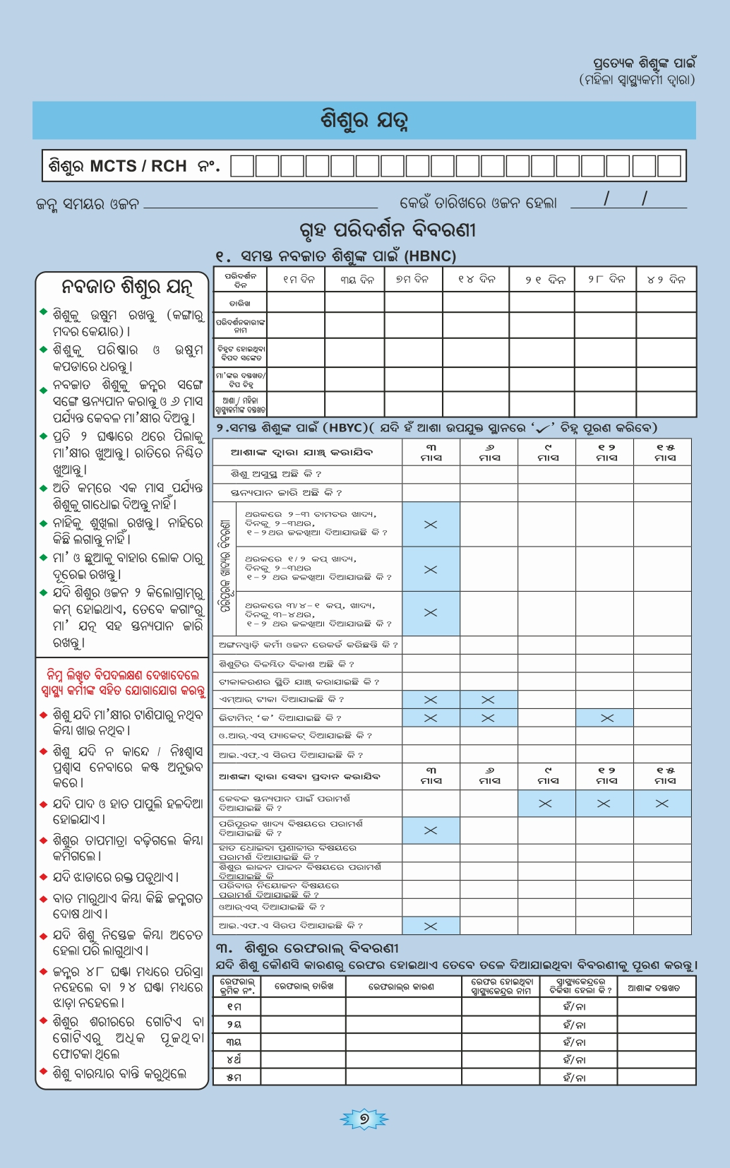

Recording

