Slide 1

DAY 2 Programs

Slide 2
Services & Records at VHSND/UHSND Session & HRP PNC
Topic: 1

Slide 3
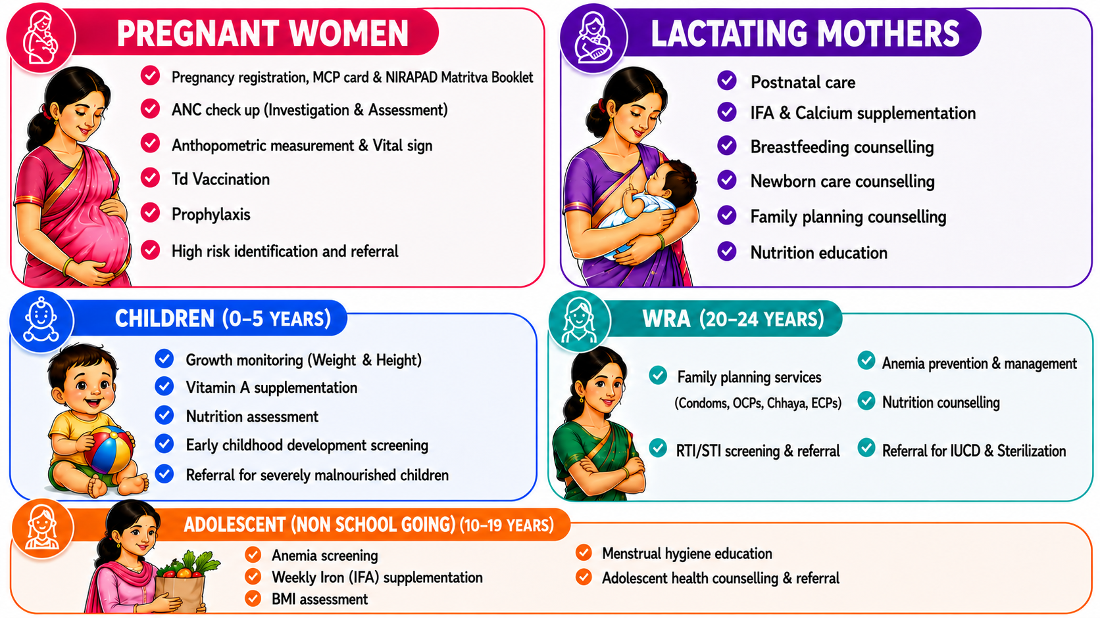

Slide 4
Principles of organizing an VHSND session
PATIENT CARE WORKFLOW
1
Ensure general cleanliness
Arrangement of logistics as per relevant area
Display of IEC at appropriate location
Separate washroom, handwashing area and disposal of BMW
Ensure privacy
WAITING
AREA
Patient Registration
2
MEASUREMENT
HEIGHT & WEIGHT
Vital Signs Collection
3
TAKING HISTORY
& VITALS
Medical Assessment
4
EXAMINATION
AREA
5
Clinical Diagnosis
TESTING &
DRUG DISPENSING
Treatment & Medication

Slide 5
Requirements at VHSND/ UHSND site
Equipment | Drugs & Injections | Consumables | Records
Weighing scale Adult | IFA Red tablets | Cotton swab | Blank MCP cards
Child weighing scale | IFA Blue tablets | Vaccines in vaccine carrier with ice packs | Nirapad Matritve Booklet
Infant weighing scale | IFA syrup | Nishchay Kit/Pregnancy Testing Kit | Red card
Infantometer | Folic Acid tablets | Condoms | IMNCI forms and chart booklets
Stadiometer | Calcium-Vitamin D3 tablets | IUCD sample (375 and 380A) | PMSMA register
Thermometer-Digital | Cotrimoxazole tablets |  | Counselling tools / Job aids / Posters (swasthya Barta)
BP apparatus | Vitamin A syrup | 75gm glucose for GDM screening | Eat Right Toolkit
Stethoscope | Albendazole tablets/syrups | Urine testing kit/Uristix strips (multireagent) | HRP register ( Mother)
Examination table | Paracetamol tablet | Syringes (AD and disposable): (RI day) | High risk children register
Stepping stool for examination table | Gentian violet | Red and black bag | VHSND/UHSND meeting register
Measuring tape | Injectable MPA | AEFI Kit/Anaphylaxis Kit | Referral slips
Fetoscope | Emergency contraceptive pills | HIV and Hepatitis B point of care kits | AMLAN register
BMI Chart | Combined Oral contraceptives | Syphilis point of care kits
Digital Hemoglobinometer and strips | Centchroman (Chhaya) | Malaria RDK kit
Glucometer | Td Vaccine (RI Day) | Lancets
Hub cutter | Multi vitamin Tablets | Measuring Jug 500 ml
Portable screen for privacy
MUAC tape ( child & adult)
Notes:
265

Slide 6
Key messages
While organizing the VHND session privacy and confidentiality must be maintained for every client.
Complete care includes history taking, examination, investigations and prophylaxis/treatment and recording.
While providing care, respectful care must be considered at every step.
Notes:
266

Slide 7
MCP card

