Slide 1


SUPPLY CHAIN MANGEMENT
Topic: 9

Slide 2
FLOW OF INDENT
District:-
PHC, SC will indent to Block CHC.
Wards, PPC, DDC to indent Sub-store.
OH/AH, CHC/Block CHC, SDH will indent to District DWH.
Sub Store to indent District DWH.
District DWH will indent to State DWH.
Medical College/Major Health Institutions :-
Wards, PPC, DDC to indent Sub-store.
Sub Store to indent DWH.

Slide 3
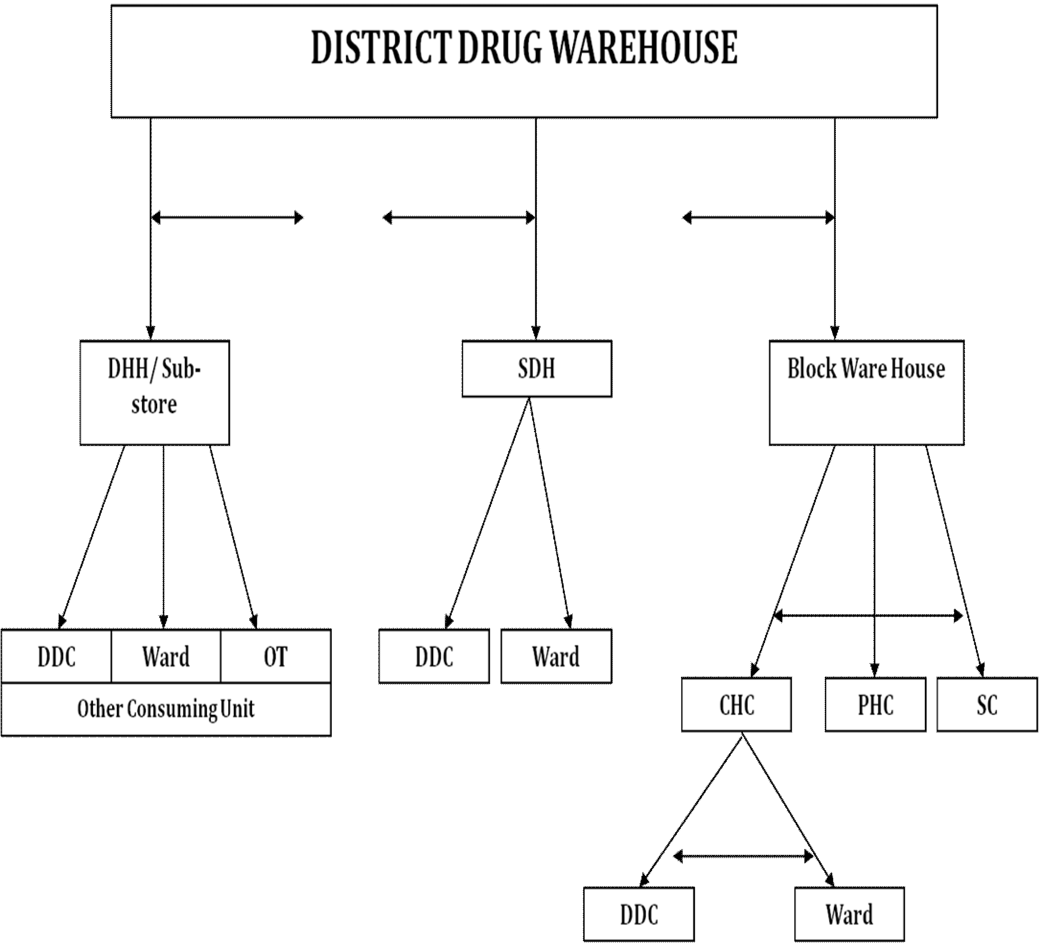
ISSUE OF DRUGS
15 Days/
1 Month Stock
2 to 3 Months Stock
2 to 3 Months Stock
7 Days Stock
7 Days Stock
1 Month Stock
7 Days Stock

Slide 4
INVENTORY MANAGEMENT

Slide 5
INVENTORY MANAGEMENT
When to indent ?
What to indent ?
How much to indent ?
What should be stocked ?
Prevention of loss because of time expired drugs.
Physical stock taking
Damaged or time expired drugs should be recorded and disposed off

Slide 6
BASIC PRINCIPLE
Right Product
Right Quantity
Right Quality
Right Cost
Right Place
Right Time

Slide 7
Monthly Indent Calendar
All CHCs, HWCs and PHCs must review stock from 1st–3rd of every month,
Prepare indents between 1st–5th and
Submit indents on or before the 7th of every month.
Indents should be based on Average Monthly Consumption, stock in hand, lead time and safety stock.

Slide 8
INVENTORY MANAGEMENT
Lead Time (LT):
This is the time between placing of indent and receipt at the Store.

Slide 9
INVENTORY MANAGEMENT
Average Monthly Consumption
Average monthly consumption can be calculated using the sum of quantities used or distributed over a period of time.
Opening Balance + Stock Received – Closing Stock
AMC = No. Of Months Stock Available

Slide 10
MONTHLY AVERAGE CONSUMPTION Ex- Tab. Pantoprazole 40 mg
Consumption:-
April | May | June | July | Aug | Sept | Oct | Nov | Dec | Jan | Feb | Mar | Total Consumption
1000 | 1500 | 1200 | 1300 | 1600 | 2000 | 1500 | 1300 | 1000 | 1200 | 1400 | 1500 | 16500
Stock available :-
April | May | June | July | Aug | Sept | Oct | Nov | Dec | Jan | Feb | Mar | Total Consumption
Yes | Yes | Stock Out | Yes | Yes | Yes | Yes | Yes | Stock Out | Yes | Yes | Yes | Yes

Slide 11
Avg Monthly Consumption
=
16500/ 10 = 1650 Tabs.

Slide 12
FORECASTING
What is your projected requirement for a certain drug?
Previous month/year consumption plus a small percentage to factor annual growth in population.
WAIT

Slide 13
FORECASTING
Did you check if the drug was available throughout the month/year in adequate quantities?
How many months/days of stock out was noticed?
To what extent was another item of the same pharmacological category substituted

Slide 14
FORECASTING
What is the re-order level of an item at Block DWH?
R.O. level = Lead Time + Safety Stock (In Months or days)
How much to re-order?
R.O. Qty = Avg Monthly Consumption x (LT + SS)

Slide 15
SMART MOVES
Prompt utilization of near expiry drugs.
First Expiry First Out (FEFO) principles should be followed to minimize expiry and wastage. Near-expiry products should be identified and redistributed/utilize where possible.
Utilization of an item with similar group when an item is out of stock.
Ex – Utilization of Tab. Rabeprazole in absence of Tab. Pantoprazole.

Slide 16
Block Drug & Therapeutics Committee (BDTC)
Review drug consumption and stock position.
Review stock-outs and near-expiry drugs.
Monitoring of monthly indent compliance.
Prescription audit findings.
Composition:
Block Medical Officer (Chairman & Convener)
Medical Officers of PHCs
Store Pharmacy Officer (CHC)
Block Programme Manager (BPM)

Slide 17
ANNUAL PROCUREMENT PLAN

Slide 18
STEPS INVOLVED IN PREPARATION OF AAP
Collection
Compilation
Rationalisation
Approval by Drug Therapeutic Committee
Upload in DVDMS

Slide 19
Activity | Timeline
Review of previous year's consumption data | July – August
Collection of EDL revision suggestions from BDTC/DDTC | August
Facility-wise Annual Indent Preparation (SC/PHC/CHC/SDH/DHH/MCH) | September
Review & Rationalization by BDTC | September
Review & Approval by DDTC/MIDTC/MCDTC | October
Consolidation of District/Institutional Indents | October
Submission of Annual Indents to OSMCL/SDMU | October
Preparation of Draft APP | October – November
Review by State Drug Management Committee (SDMC) | November
Finalization of APP for next Financial Year | By 15th November
Tendering & Procurement Process | November onwards
Supply Planning & Distribution | As per procurement schedule

Slide 20
How to Rationalise Indents
Simply compare the indents placed with that of average monthly consumption.
Discuss for special requirement, if any.
Patient Load may be taken for analysis.
Eg: Inj. ARV = Patient registered for dog bite cases.

Slide 21
Role & Responsibilities of MO I/C
Ensure uninterrupted drug availability
Verify monthly stock position
Monitor FEFO compliance
Monitor near-expiry drugs
Conduct monthly review meetings

Slide 22
Role & Responsibilities of Pharmacy Officer
Maintain stock registers.
Update receipts and issues in DVDMS
Generate monthly consumption reports
Prepare indents based on AMC
Ensure proper storage conditions

