Slide 1
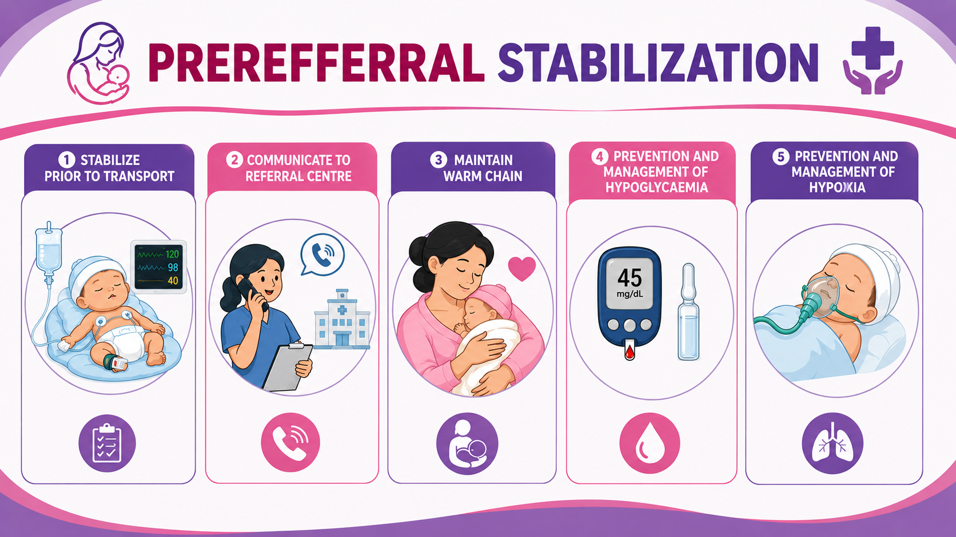
Topic: 5

Slide 2
Stabilize prior to transport
T
Warm the baby (Skin-to-skin contact, Keep baby with mother, wrap the baby)
A
Suction the airway if essential
B
Oxygenate if needed
C
Give/arrange medications as per physician’s order

Slide 3
Communication
Identify facility of referral
1
Inform the nursing officer & MO in-charge (over phone)
2
Document inter-facility referral slip
3
Sign the referral slip & send with mother/caregiver
4

Slide 4
TemperatureMaintenance as per warm chain

Slide 5
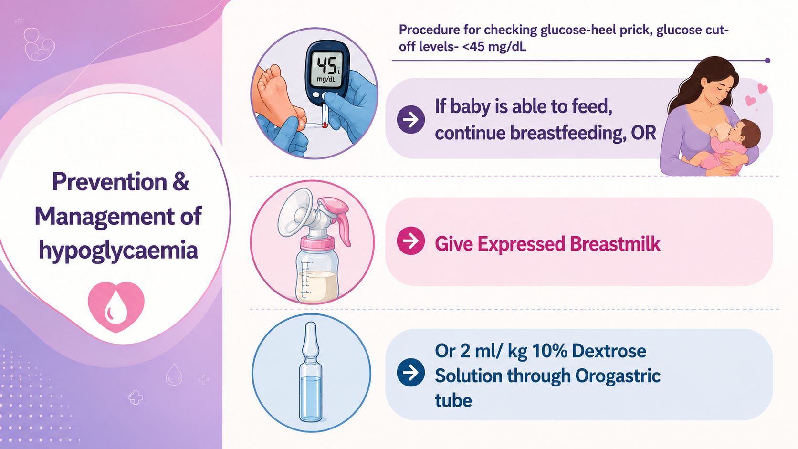

Slide 6
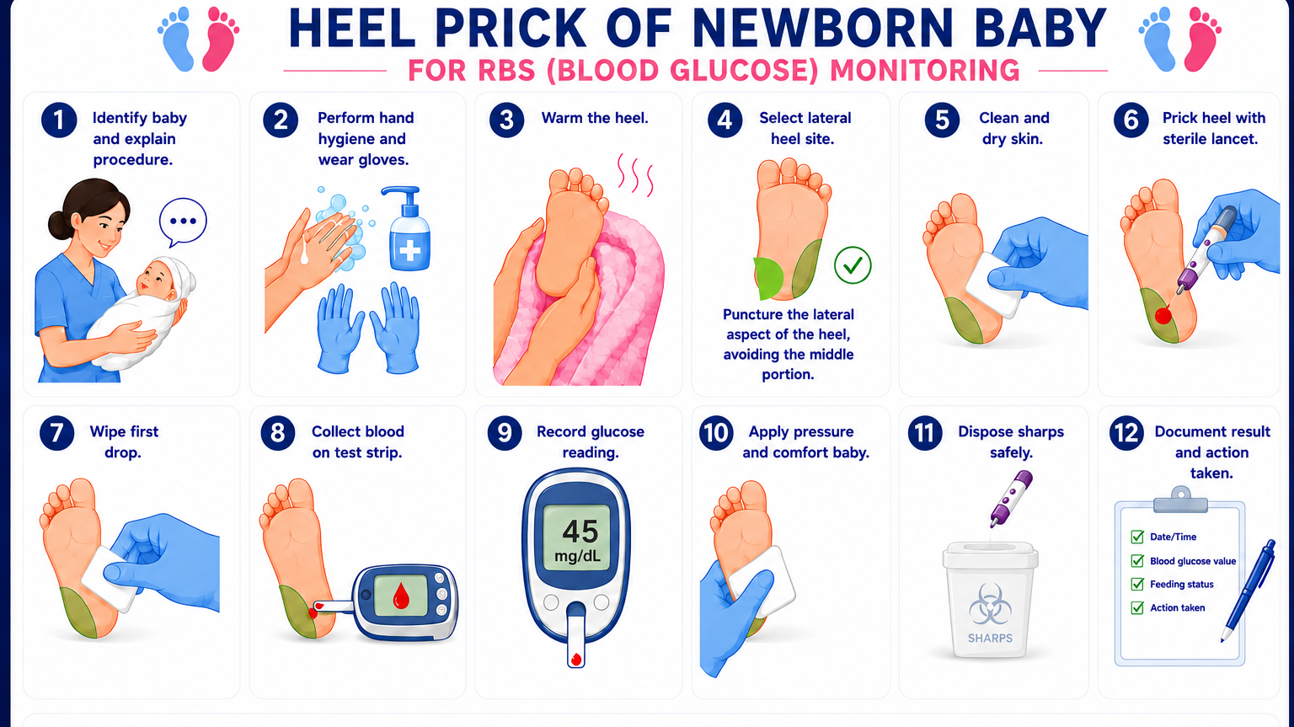

Slide 7

Prevention & Management of Hypoxia
Suction mouth & nose
1
Position ensuring clear airway
2
Use pulse oximeter
3
Give Oxygen by nasal prongs
4
Maintain oxygen saturation at >90%
5

Slide 8
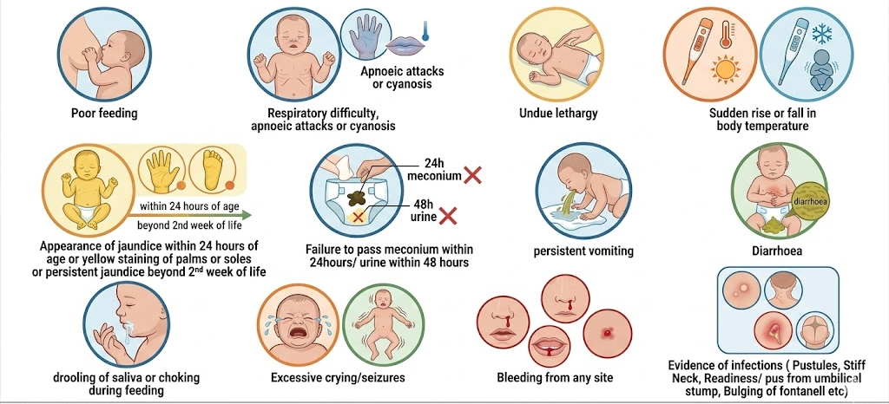
Danger signs of newborn

