Slide 1

TOPIC 6
Identification & Management of
Childhood Pneumonia
Presenter: Dr. Lingaraj Pradhan

Slide 2

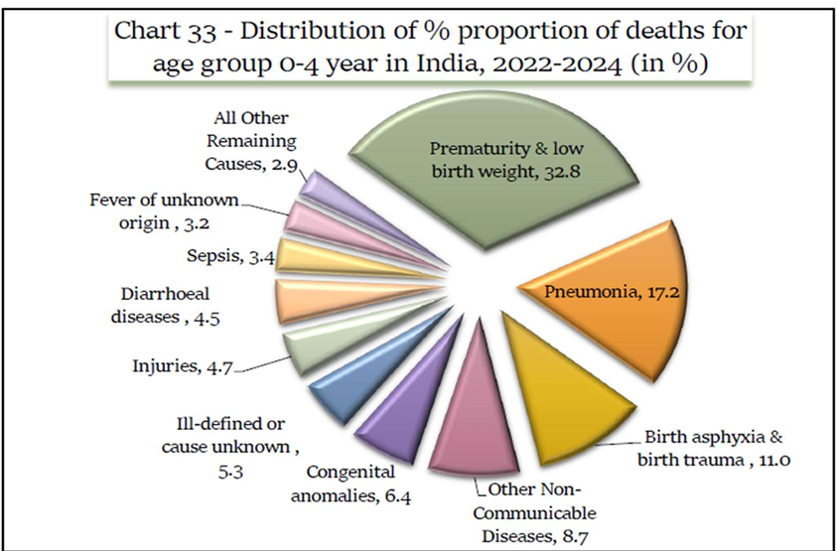
Childhood Pneumonia
Pneumonia is a leading cause of U5 deaths in the State

Slide 3



Childhood Pneumonia: Why It Matters
Identification is divided into two age groups:
Leading Cause of Under-5 Deaths
Pneumonia remains a leading cause of death in children under 5 years of age in the State, making early identification and correct classification a frontline priority for every health worker.
0–2 Months
Classified as Possible Serious Bacterial Infection (PSBI)
2 Months – 5 Years
Classified as No Pneumonia, Pneumonia, or Severe Pneumonia

Slide 4
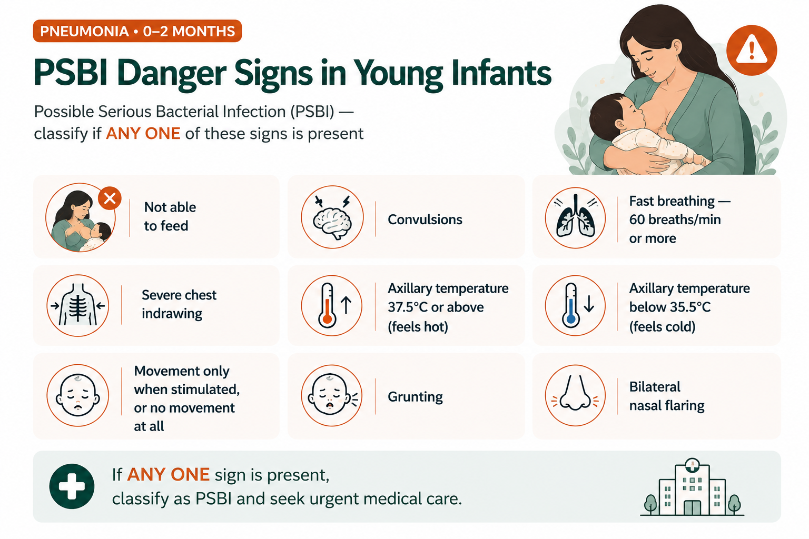

Slide 5

PNEUMONIA · 0–2 MONTHS
Pre-Referral Care & Antibiotic Therapy for PSBI
PRE-REFERRAL STEPS
ANTIBIOTIC DOSING BY WEIGHT
Warm the infant by skin-to-skin contact with mother/caregiver
Treat to prevent low blood sugar
If able to breastfeed, ask mother to breastfeed the child
If not able to breastfeed, give 20–50 ml (10 ml/kg) expressed breast milk by OG tube, or 2 ml/kg of 10% dextrose
Give first pre-referral dose of Inj. Gentamicin + Syp. Amoxicillin, maintain warmth, and refer
Weight | Gentamicin (80mg/2ml vial) | Amoxicillin Syrup (125mg/5ml) | Amoxicillin Tablet (250mg)
< 1.5 kg | Refer to higher facility directly
1.5 – 2.0 kg | 0.2 ml | 2 ml | ¼ tab
2.0 – 3.0 kg | 0.3 ml | 2.5 ml | ½ tab
3.0 – 4.0 kg | 0.4 ml | 3 ml | ½ tab
4.0 – 5.0 kg | 0.5 ml | 4 ml | ½ tab
Gentamicin: 5 mg/kg/dose, once a day. Amoxicillin:
25 mg/kg/dose, twice a day.
If weight is below 1.5 kg, refer to a higher facility directly — do not delay.

Slide 6
PNEUMONIA · 2 MONTHS – 5 YEARS
Classifying Pneumonia in Children
Any child presenting with fever, cough, or cold must be assessed for the following classification:
SEVERE PNEUMONIA
PNEUMONIA
NO PNEUMONIA
General danger signs: can't feed/drink, vomits everything, lethargy, reduced consciousness, convulsions
Central cyanosis or SpO₂ < 90%
Severe respiratory distress (RR > 70/min)
chest indrawing
Head nodding, stridor, grunting, or wheezing
Fast breathing:
2–11 months: RR ≥ 50/min
12–59 months: RR ≥ 40/min
No signs of Pneumonia or Severe Pneumonia are present.
Remember: classify using the highest level of severity for which the child has even one sign present.

Slide 7

PNEUMONIA · NO PNEUMONIA
Home Care for Cough and Cold (No Pneumonia)
ADVICE TO THE MOTHER
DANGER SIGNS -REPORT TO ASHA / ANM IMMEDIATELY
Keep the child properly clothed and warm
Continue feeding during illness; breastfeeding should be continued
Give home-available fluids as much as the child will take — helps relieve cough
For children above 1 year, give a home-made soothing remedy (honey, ginger, herbal concoctions). No remedy for an exclusively breastfed child
Avoid cough syrups
Keep the nose clean using nasal drops
Child becomes sicker
Not able to drink or breastfeed
Fast or difficult breathing
Develops fever
Encourage the mother to keep feeding and offering fluids throughout the illness.
Acting early on these signs can prevent the illness from worsening.

Slide 8

PNEUMONIA · TREATMENT
Treatment of Pneumonia with Oral Amoxicillin
TREATMENT PROTOCOL
AMOXICILLIN DOSING — TWICE DAILY FOR 5 DAYS
Give oral Amoxicillin 25 mg/kg/dose, twice a day, for 5 days
Give first dose at clinic; teach mother to give remaining doses at home
Advise to continue feeding
Advise to return after 2 days, or earlier if child becomes sicker or is unable to drink/breastfeed
Avoid unnecessary medication: cough syrups, medicated nose drops, steam inhalation
Age / Weight | Syrup (125mg/5ml) | Dispersible Tablet (250mg)
2–4 months (4 to <6 kg) | 5 ml | ½ tab
4–12 months (6 to <10 kg) | 10 ml | 1 tab
12 mo – 3 yrs (10 to <14 kg) | 15 ml | 1½ tab
3 – 5 years (14 to <20 kg) | — | 2 tab
Note: Use weight to select the dose whenever the child's weight is known — it is more accurate than age alone, especially for children with malnutrition.
Complete the full 5-day course even if the child improves earlier.

Slide 9
SEVERE PNEUMONIA
Severe Pneumonia: Pre-Referral & Wheeze Management
PRE-REFERRAL TREATMENT
IF THE CHILD HAS WHEEZING
Hospitalize the child
Give oxygen if saturation is below 90% or Respiratory Rate ≥ 70/ Minute
Manage the airway
Give recommended pre-referral antibiotics
Give 3 doses of nebulized Salbutamol for 20 minutes; or 4 puffs of Salbutamol MDI with spacer (gap of 5 min between puffs), repeated every 20 minutes
Reassess the child and reclassify the problem
No antibiotics needed if significant improvement with bronchodilator and no clinical signs of consolidation
If tachypnoea, distress, toxic look, or consolidation persists — continue antibiotics along with bronchodilators
IF REFERRAL REFUSED OR NOT FEASIBLE
Manage illness using Oral Amoxicillin twice a day AND Injection Gentamicin once a day for 7 days, by CHO/ANM.

Slide 10
SEVERE PNEUMONIA · TREATMENT
Management of Severe Pneumonia: Injectable Antibiotics
FIRST-LINE INJECTABLE ANTIBIOTICS
SHIFTING TO ORAL & TOTAL DURATION
Ampicillin 50 mg/kg IM or IV every 6 hours
Gentamicin 7.5 mg/kg IM or IV once a day
Shift to oral drugs as soon as the child can take orally: Inj. Ampicillin → oral Amoxicillin; Inj. Gentamicin IV → IM, to complete the antibiotic course.
SPECIAL SITUATIONS
Clinical Scenario | Total Antibiotic Duration
Clinical response within 48 hours | 7 days
Clinical response after 48 hours | 10 days
Empyema | 4–6 weeks
Staphylococcal infection suspected (skin pustules/boils): give Cloxacillin OR Amoxicillin + Clavulanic acid
Septic shock: give Ceftriaxone with Vancomycin
No improvement within 48 hours: switch to Gentamicin 7.5 mg/kg IV once daily + Ceftriaxone 100 mg/kg IV in two divided doses, OR Cloxacillin 50 mg/kg IV every 8 hours

Slide 11

SEVERE PNEUMONIA · SUPPORTIVE TREATMENT
Oxygen Therapy & Nebulization
OXYGEN THERAPY
NEBULIZATION WITH SALBUTAMOL
Add salbutamol to nebulizer cup with saline to make volume 3 ml — dose 2.5 mg (0.5 ml of the 5mg/ml solution)
Give every 1–4 hours initially, reducing to 6–8 hourly as the child improves
Can be given more frequently if necessary in severe cases
Give oxygen if saturation < 90% (or < 94% if other danger signs like shock are present)
Use nasal prongs at 0.5–1 litre/min — preferred for young infants. If unavailable, use nasal or nasopharyngeal catheter
Use pulse oximetry to guide therapy; keep saturation above 90%
If pulse oximeter unavailable, continue oxygen until clinical signs of hypoxia resolve (e.g. unable to breastfeed, breathing rate ≥ 70/min)
Oral/Syrup Salbutamol: < 1 yr — 1 mg/dose; 1–4 yrs — 2 mg/dose, both every 6–8 hourly.
In severe pneumonia, do NOT delay antibiotic administration — even while giving bronchodilators.

Slide 12
PNEUMONIA · RECOVERY PATHWAY
Supportive Care, Monitoring, Discharge & Follow-up
SUPPORTIVE CARE
MONITORING FREQUENCY
Clear thick nasal/throat secretions by gentle suction
Give paracetamol for fever ≥ 38.5°C
Provide maintenance IV fluids only if unable to feed orally; stop gradually once tolerating
Give rapid-acting bronchodilator if wheeze is present
Encourage feeding as soon as possible — no role for cough syrup (may be harmful)
Ensure vaccination and nutrition advice
Nurse: at least every 3 hours Doctor:
at least twice a day
Improvement signs within 48 hrs: slower breathing, less chest indrawing, less fever, better feeding, improved SpO₂.
DISCHARGE CRITERIA
Respiratory distress resolved; SpO₂ ≥ 90% on room air
Feeding well
Able to take oral medication, OR has completed a course of parenteral antibiotics
Family counseled on when to return
FOLLOW-UP
Arrange follow-up 2 weeks after discharge — check nutrition, vaccination, and address risk factors (malnutrition, indoor air pollution, parental smoking).

