Slide 1
Maternal Perinatal Child Death Surveillance & Response (MPCDSR)
Topic: 12

Slide 2
MDR Process
Maternal Deaths Surveillance & response
Place of occurrence
Transit
Community
Facility
Home to facility
Facility To facility
Notification: By FNO with in 24 hours of deaths
Notification: By ASHA within 24 hours of Deaths: Incentive 200/ case
Form 4: By treating doctor and MO present at time of deaths with in 24 hours
Varification : By MPHW (F) 7days of Deaths
DNO inform to BNO As soon as receiving info
Verbal Autopsy :BY 3-member team formed by BNO with in 21 days . Rs. 150 incentive / member and 200 for transportation
Form 6: Summary form by BNO based on verbal autopsy
Form 4: By FNO to DNO with in 48 hours
Records to DNO: By 5th of every month to share Maternal death linelist and Form 5 & 6
Conduct FBMDSR every month
District Level
DNO: share MDSR linelist to SNO by 7th of every month
District Level
Review: MDSR committee every materbal deaths every month
District Level
Collector review each maternal deaths every month
Notes:
372

Slide 3
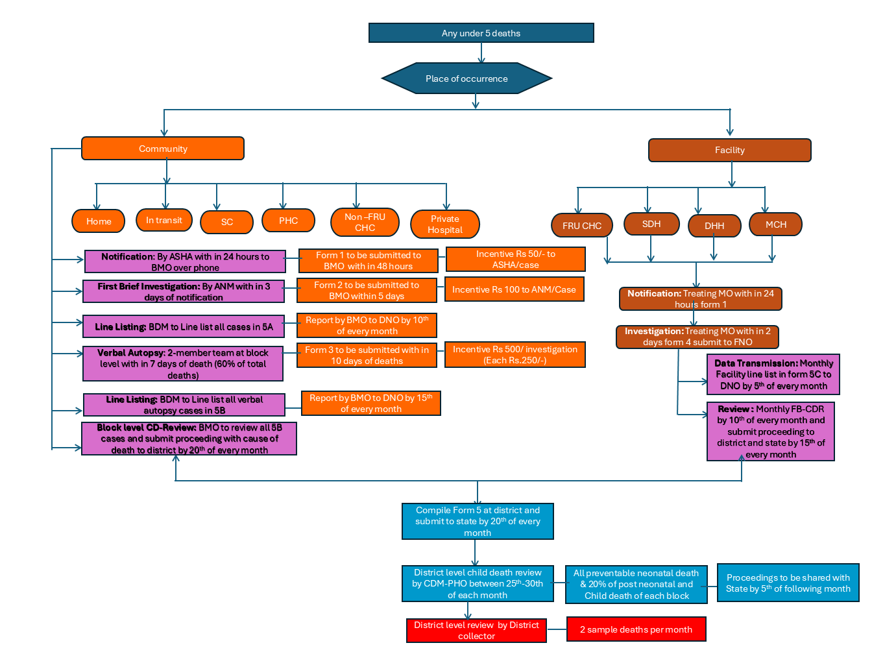
CDR Process

Slide 4



Stillbirth Definition
For international comparison, stillbirths are defined as late fetal deaths with:
Gestation age of 28 weeks or more, or if missing
Birth weight of 1000 grams or more (without the placenta), or if missing
Correct Gestation age is
most appropriate
Body length of 35 cm or more
Fetus to be weighed without placenta

Slide 5
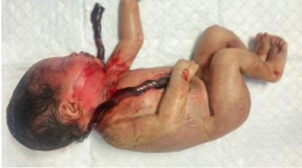
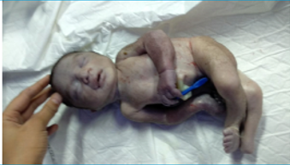
Types of Stillbirths
2
When the status of the fetal heart at the onset of labor is not available, the appearance of skin maceration is used as a proxy for the timing of stillbirths.
Antepartum
Intrapartum
Macerated skin appearance
Fresh or non-macerated skin appearance
Notes:
Audio:
When the status of the fetal heart at the onset of labor is not available, the appearance of skin maceration is used as a proxy for the timing of stillbirths.
In the case of antepartum stillbirths, the macerated appearance of skin appearance is used as a proxy. And in the case of intrapartum stillbirths, fresh or non-macerated skin appearance is used as a proxy.

Slide 6
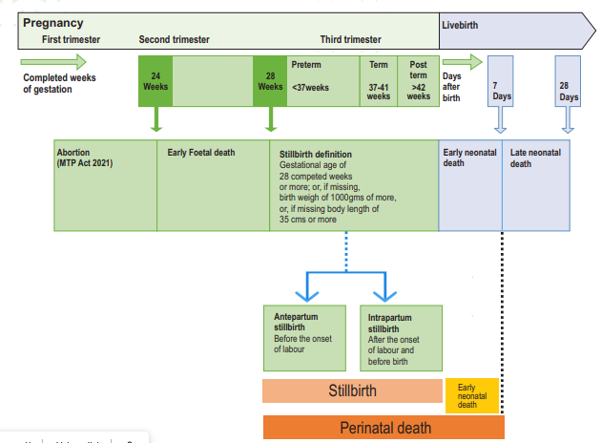

Timing of death and mortality definition

Slide 7
Dummy Data for group work
 |  | Numbers
A | Number of deliveries | 1000
B | Number of live births | 980
C | Number of stillbirths | 20
D | Number of intrapartum stillbirths | 12
E | Number of antepartum stillbirths | 8
F | Early neonatal deaths (0–7 days) | 14
G | Neonatal deaths (0–28 days) | 18
Calculate the following
Stillbirth rate
Percentage of antepartum stillbirths
Early neonatal mortality rate
Perinatal mortality rate
Neonatal mortality rate

Slide 8
Answer key
Stillbirth rate | (C/A)*1000; 20/1000*1000 | 20.0
Percentage of Antepartum stillbirths | (E/C)*100; 8/20*100 | 40%
Early neonatal mortality rate | (F/B)*1000; 14/980*1000 | 14.3
Perinatal mortality rate | ((C+F)/A)*1000 20+14/1000*1000 | 34.0
Neonatal mortality rate | (G/B)*1000; 18/980*1000 | 18.3

Slide 9
Reporting & Review
All maternal & U5 deaths and stillbirths are to be recorded in defined forms & formats
All maternal & U5 deaths and stillbirths are to be entered into the MPCDSR portal
Maternal Death & stillbirths in MDR committee and U5 deaths in CDR committee

Slide 10


