Slide 1
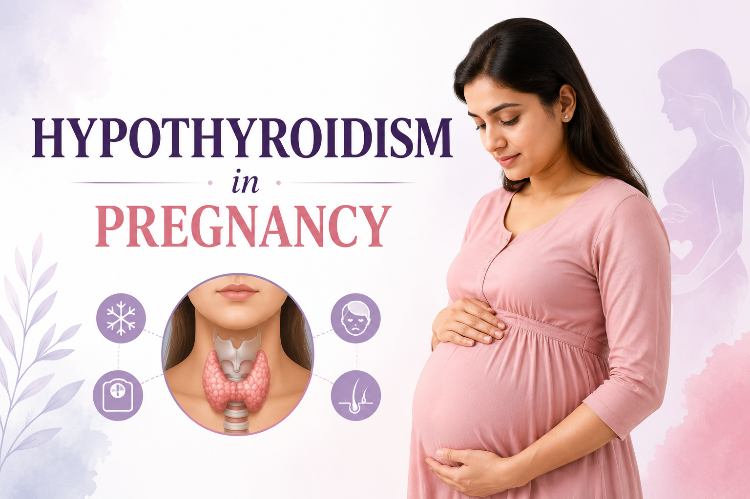
Topic 4

Slide 2
Hypothyroidism and its significance during pregnancy
Hypothyroidism is decrease secretion of thyroid hormone
Primary maternal hypothyroidism: presence of elevated Thyroid Stimulating Hormone (TSH) levels during pregnancy.
Overt hypothyroidism (OH): Serum TSH (S. TSH) levels are elevated and Serum T4/Free T4 (FT4) levels are low. S. TSH≥10mIU/l is taken as OH irrespective of FT4 levels.
Subclinical (SCH): S. TSH level is elevated (≤ 10mIU/l) with normal Serum T4/FT4.
Positive thyroid antibody titers suggest autoimmune thyroid disease.
Significance during pregnancy:
The foetus is dependent on maternal trans-placental thyroid hormone supply in the first trimester. To meet the increased demands, the thyroid hormone production increases by 50%.

Slide 3
Diagnostic equipment for Hypothyroidism
Serum TSH level tested at facility to be collected
if identified as HRP to be enlisted in PMSMA portal and intimated to ANM for HRP linelisting
Level of Facility | Diagnostic equipment
VHSND | 11 Criteria for symptomatic screening
CHC Level ANC | Isolated TSH
PMSMA | Isolated TSH for all PW

Slide 4
Adverse effects of untreated hypothyroidism in mother and fetus/newborn
In mother
Miscarriages
Recurrent pregnancy losses
Anaemia
Pre-eclampsia/Eclampsia
Gestational diabetes mellitus
Abruptio placentae
Postpartum hemorrhage
Increased cesarean section due to fetal distress
Rarely myopathy and
Congestive heart failure in severe cases
In Fetus/newborn
Preterm births
Intrauterine growth retardation
Intrauterine death
Respiratory distress and consequent hospitalization
Increased perinatal mortality
Low birth weight
Possibility of birth defects
low IQ baby
Cognitive, neurological and developmental impairment as thyroid hormone is critical for fetal brain growth

Slide 5
Magnitude of the problem and target population
Global: Overall 2-3%
India: Overall 4.8-12% with average of 10%
In India, screening for hypothyroidism is recommended for high risk pregnant women

Slide 6
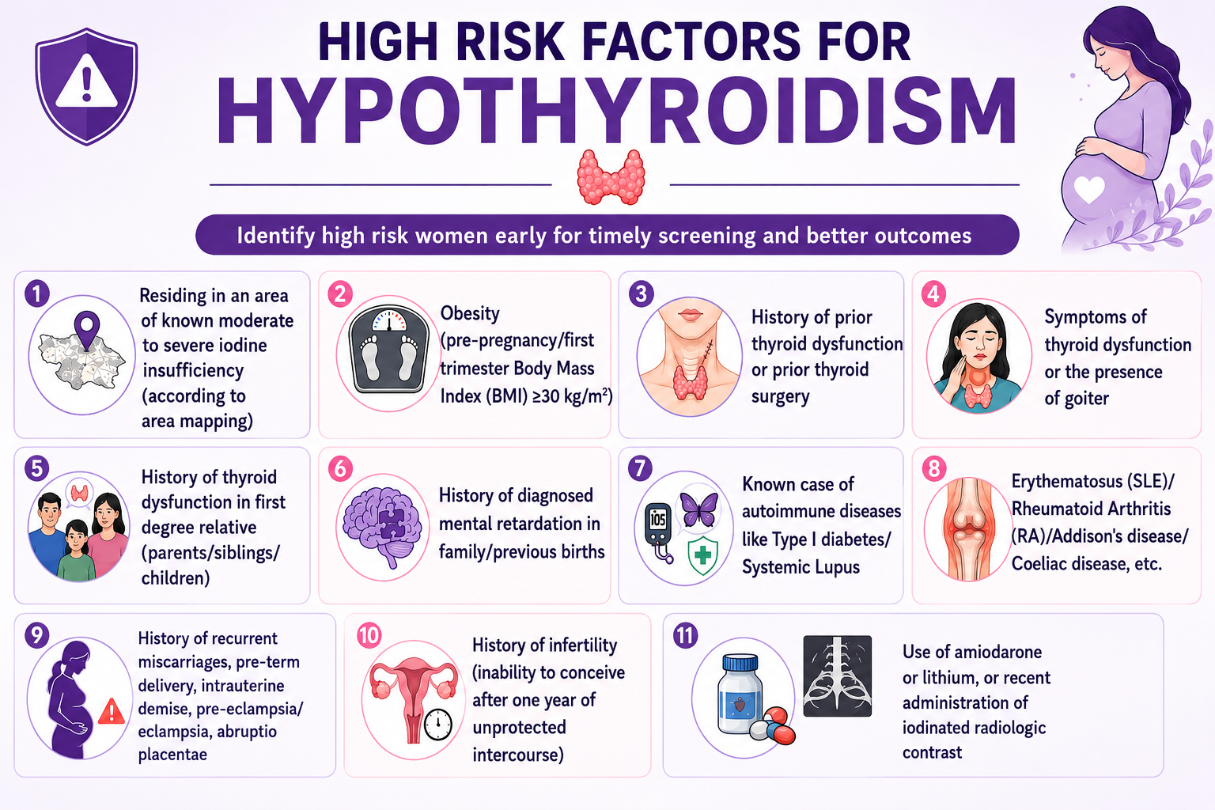

Slide 7
Diagnostic criteria in pregnancy
Normal range (reference levels for TSH) during pregnancy:
Criteria for hypothyroidism during pregnancy
Trimester | Range (TSH)
First trimester | 0.1-2.5 mIU/l
Second trimester | 0.2-3 mIU/l
Third trimester | 0.3-3mIU/l
Type of hypothyroidism | Level of TSH mIU/L | Level of Free T4
Subclinical hypothyroidism | 2.5 -10 | Normal
Overt hypothyroidism | >2.5 - 3 | Low
Overt hypothyroidism | >10 | Any value (irrespective of T4)
Notes:
TSH levels during pregnancy are lower as compared to TSH levels in a non-pregnant state. Pregnancy-specific and trimester specific reference levels for TSH are as follows:
Ist trimester - 0.1-2.5mIU/l; IInd trimester - 0.2-3mIU/l; IIIrd trimester
- 0.3-3mIU/l.
Hence, in pregnancy, SCH is defined as a serum TSH between 2.5 and 10mIU/L with normal FT4 concentration and OH is defined as serum TSH>2.5-3mIU/l with low FT4 levels. TSH>10mIU/l irrespective of FT4 is OH.

Slide 8
