Slide 1

Topic 5

Slide 2
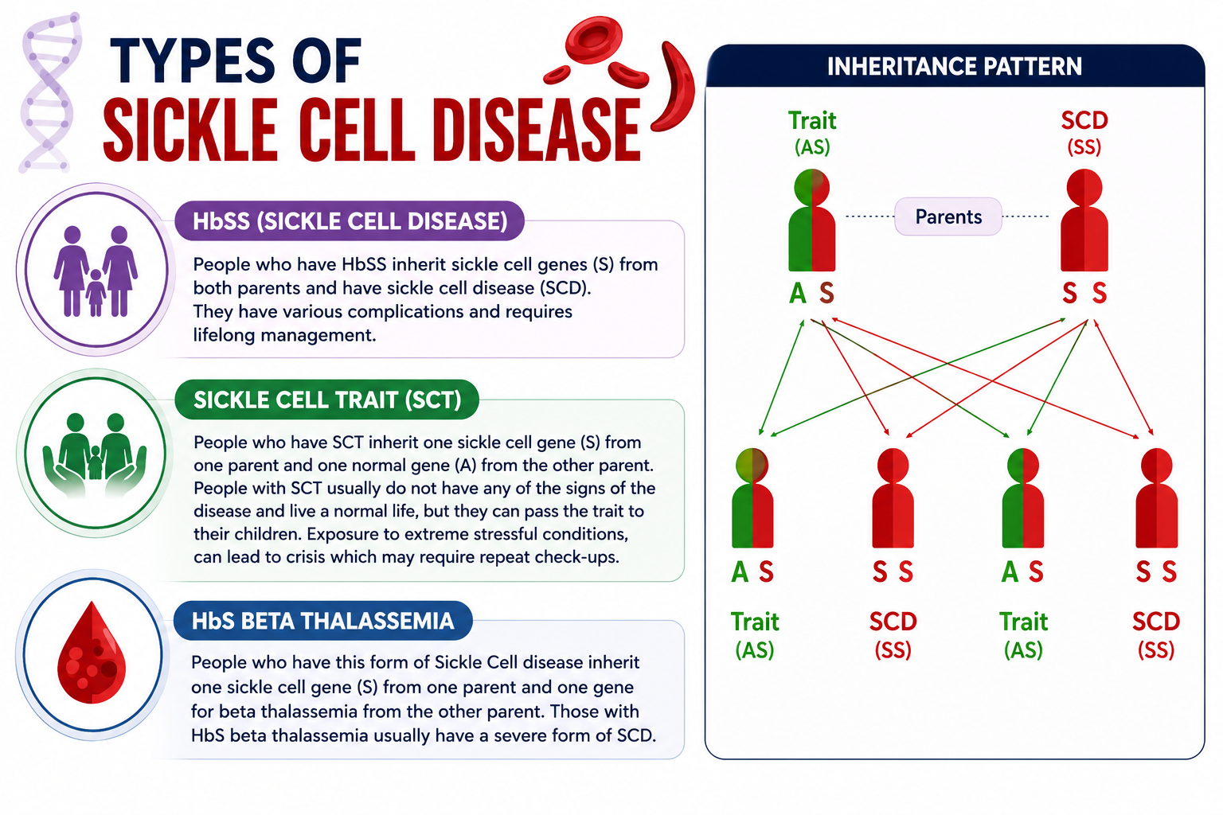

Slide 3
Effect of SCD on Mother and Baby
Mother
Baby
Preterm labor and Spontaneous miscarriage
Severe anemia due to hepatic sequestration crisis
Antepartum and postpartum Hemorrhage
Renal disease
Hepatic dysfunction
Infections
Poor weight gain
PIH & Pre-Eclampsia
Acute chest syndrome
Thromboembolic events
Acute painful crisis
Dysfunctional labor
Maternal Death
Preterm labor and Spontaneous miscarriage
Fetal growth restriction/ IUGR
Abortions
Prematurity
Low birth weight
Fetal loss
Increased perinatal mortality
Stillbirth

Slide 4
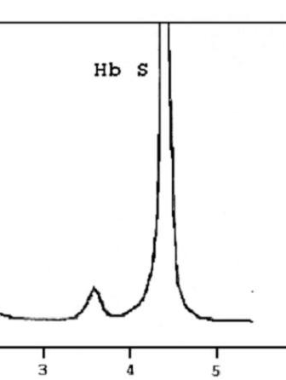
High Performance Liquid Chromatography
Principle: This method separates the hemoglobins into different fractions and identifies them based their retention time and shape of peak.
Criteria used for differentiating HPLC patterns.
A > S | Sickle cell trait, sickle alpha-thalassemia
S, F and no A | Sickle cell anemia, Sickle-beta thalassemia
S > A and F | Sickle-beta thalassemia
A > C | HbC trait
C, F and no A | HbC disease, HbC-beta thalassemia
C > A | HbC-beta thalassemia

Slide 5
Prevention and Management of SCD
Antenatal care
Pre-conception
Screening, counseling, immunizations, and managing complications are key before conception.
Regular monitoring, medication management, and preventing complications are priorities during pregnancy.
1
2
3
First visit
Complete blood work, imaging, and screening tests are done to assess the mother's health.

Slide 6
Prevention and Management of SCD
Pre-Conception period:
Check the finding of sickle cell screening on the SC card .
Provide premarital / pre-conceptional counselling and screening.
Create awareness about the disease, planning for pregnancy and anticipating possible problems.
Women with SCD if planning for pregnancy - should receive immunizations, Folic acid 5mg, (prophylactic penicillin if splenectomized).
Routine assessments for complications of sickle cell disease and referred to higher centre if there are any complications of disease.
Medications to be stopped:
Pre-conceptually Hydroxyurea should be stopped at least 3 months before conception.
Angiotensin-converting enzyme inhibitors and angiotensin receptor blockers should be stopped before conception.
Once pregnant the iron chelation medicines will need to be stopped.

Slide 7
Assessment prior to conception/First visit post conception:
Complete blood count with peripheral blood smear examination.
Blood pressure and urinalysis should be performed.
Renal and liver function tests should be performed annually to identify sickle nephropathy and/or deranged hepatic function.
2D Echo for pulmonary hypertension.
Retinal Screening.
Screening for iron overload before pregnancy by serum ferritin and T2* MRI imaging.
If high iron overload is there, aggressive iron chelation (desferrioxamine) is advisable, before conception.
Screening for red cell antibodies. Presence may indicate an increased risk of hemolytic disease of the newborn.
Screening of partner/spouse for Sickle cell or Beta thalassemia trait.

Slide 8
Management of Sickle cell disease during Antenatal period
Medications:
5 mg Folic acid supplementation
Treat nausea/ vomiting of pregnancy early.
Continue antibiotics (Penicillin Prophylaxis).
Iron supplementation should be given if there is laboratory evidence of iron deficiency.
Low-dose aspirin 75 mg once daily from 12 weeks of gestation to reduce the risk of developing pre-eclampsia and thrombosis. Aspirin may be stopped at 36 weeks to reduce the risk of PPH.
Venous thromboembolism prophylaxis: Compression stocking use daily and prophylactic low-molecular-weight heparin 0.4 mg during antenatal hospital admissions.
NSAIDs should be prescribed only between 12 and 28 weeks of gestation owing to concerns regarding adverse effects on fetal development.
Vaccinations: influenza vaccine (If not received in previous year) Pneumococcal, HIB, Meningococcal and Hep B vaccines.
Regular antenatal check-ups required.
Blood pressure and urinalysis should be performed at each consultation and midstream urine for culture performed monthly. The risk of pre-eclampsia is high.
Avoid precipitating factors of sickle cell crises such as exposure to extreme temperatures, dehydration and overexertion. Persistent vomiting can lead to dehydration and crisis. If this occurs, should receive IV fluids.
STOP: Hydroxyurea, Iron Chelators deferoxamine (DFO), ACE inhibitors/ARBs

Slide 9
Medications and Monitoring
Medications to Stop
Medications to Continue
Monitoring
Folic acid, antibiotics, low-dose aspirin, and anticoagulants are important to manage during pregnancy.
Hydroxyurea, ACE inhibitors, and iron chelators should be stopped before and during pregnancy.
Regular blood tests, ultrasounds, and screening for complications are crucial throughout pregnancy.

Slide 10
Management of Sickle cell disease during Antenatal period
Ultrasound examination:
Offer a viability scan at 7–9 weeks of gestation.
Offer routine first-trimester scan (11– 14 weeks of gestation) and a detailed anomaly scan at 20 weeks of gestation.
May require serial fetal biometry scans (growth scans) every 4 weeks from 24 weeks of gestation.

Slide 11



Management of Sickle cell disease during Antenatal period
Testing of spouse along with genetic counselling for all positive cases should be offered.
If both couples have positive test, then refer for prenatal diagnostic services.
Prenatal Screening and Diagnosis
Chorionic Villus Sampling
Amniocentesis
Genetic Counseling
Couples at risk should receive counseling to understand their options and make informed decisions.
This prenatal test can identify the sickle cell gene in the fetus during pregnancy.
This prenatal test can also be used to screen the fetus for sickle cell disease.

Slide 12

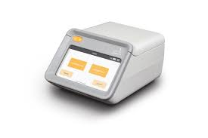
Diagnostic Test of Sickle Cell
VHSND Level
Facility level
PMSMA
Dry Blood Sample be done during 1st ANC at VHSND level.
Report to be collected and shared with PW
Gazella test can also be used for PW for sickle cell disease/trait.
Every PW has to be tested with Gazella Machine in the PMSMA

Slide 13
Modalities of screening, treatment and management
The Screening of pregnant women (PW) for sickle cell & thalassemia shall be done within one month of ANC Registration and preferably within 4 weeks of pregnancy.
The pregnant women (PW) shall be registered in National Sickle Cell Anaemia Elimination Mission (NSCAEM) portal using ABHA ID prior to the screening either at Field / facility level.
The Screening shall be done using available screening kits at VHSND/UHSND level. In case of non-availability of the same, the said screening shall be done at the Facility level as early as possible after registration, using existing Gazelle machines at the facility level.

Slide 14
Modalities of screening, treatment and management
Further, all the facilities conducting PMSMA/ e-PMSMA sessions shall be equipped with Gazelle machines for ensuring screening of pregnant women whose results are not available or have not been tested. In case of non-availability of Gazelle machine, the same shall be procured within a month, utilizing XV-FC (for primary health care facilities)/ NIDAAN funds.
The test results must be reflected in the MCP card by Health Worker (Female). She shall obtain the result from the NSCAEM portal.
In case the result is not uploaded in the portal even after 15 days from the date of the screening, the same shall be intimated to the concerned BPM and the BPM in turn will e-mail the issue to the Prog. Asst (Sickle Cell)/ NCD consultant for necessary action.

Slide 15
Modalities of screening, treatment and management
Birth preparedness and complication readiness plan must be discussed with each SCD positive woman and family. The pregnant woman should be guided to deliver at the nearby functional FRU following the referral protocol.
Treatment shall be taken up as per NSCAEM guidelines. Proper counselling of such cases shall be done by RMNCHA+N counsellors at facility level and CHOs/ ANMs at community level.
Also, a database shall be maintained in GOOGLE SHEET of all PW cases & their screening, treatment / management status till the specific NIC portal for the said purpose is ready.
104 call centre service can be availed by beneficiaries for more information on sickle cell & thalassemia disease.

Slide 16
Management of Sickle cell disease in 2nd & 3rd trimester
Close monitoring of the mother's and baby's health.
Careful ANC and supervision (every 15 days visit -12 to 28 weeks. Weekly after 28 weeks).
Continue Folic acid – 5mg/day.
Iron supplementation for only proven cases of iron deficiency anemia.
The blood pressure and urine should be checked regularly.
Continue Low dose Aspirin (75mg) to prevent pre-eclampsia between 12 to 36 weeks.
Screening for UTI – Asymptomatic bacteriuria by Multi uristrix dip stick and midstream urine culture monthly.
Hospitalizations – in cases of infections or unusual symptoms.

Slide 17
Acute Pain Crisis Management
1
Prompt Treatment
2
Diagnostic Tests
Provide pain relief, hydration, and oxygen within 30 minutes of reaching the hospital.
Complete blood count, cultures, and imaging can help identify the cause of the crisis.
3
Multidisciplinary Care
4
Preventive Measures
A team of specialists should assess and manage the crisis to ensure the best outcome.
Avoiding triggers like dehydration and extreme temperatures can help prevent crises.

Slide 18
Acute Pain Crisis Management
The commonest cause of admission with 27% and 50% of women having a painful crisis during pregnancy.
Rest & advice to avoid excess heat/cold environment, exercise and dehydration.
Adequate fluids/Hydration – oral /IV (60 ml/kg/day)
If pain crisis, give analgesia within 30 minutes of reaching the hospital – NSAIDs if 12–28 weeks of gestation.
Weak opioids such as Tramadol/codeine can be used for moderate pain, and stronger opiates such as morphine can be used for severe pain.
If SpO2 < 95 %, give oxygen.
Refer to higher center.

Slide 19
Mode and timing of delivery
SCD itself is not an indication for LSCS or contraindication for vaginal delivery.
Mode and timing of delivery should depend on obstetric indications. Yet in most women with Hb SS disease, prefer to deliver soon after 37 weeks are reached, and surely before 39 weeks.
Delivery to be planned at a higher institutions like DH/Medical college, which are able to manage both the complications of SCD and high-risk pregnancies.

Slide 20
Roles & Responsibilities of MO/OG
Medical Officer
Screen pregnant women and spouse for sickle cell disease.
Pre and post-test counselling.
Referral of the identified cases to higher centers for diagnosis and treatment initiation.
Refer to attend e-PMSMA clinic for further diagnostics and treatment.
Follow-up of confirmed cases.

