Slide 1

Topic 6

Slide 2
Preterm birth - A leading cause of neonatal deaths in India

Slide 3
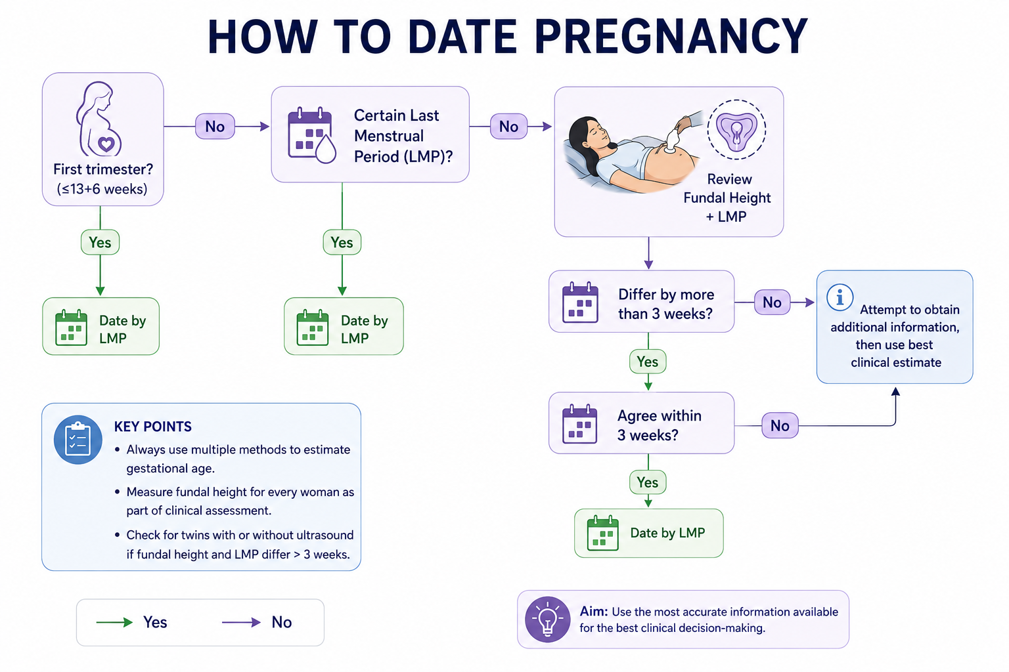

Slide 4
Recognizing true labor
True labor pain | False labor pain
Regular and predictable | Irregular
Felt first in lower back and sweeps towards lower abdomen | Remains confined to lower abdomen
Not relieved by rest | Often relieved by rest
Increase in duration, intensity and frequency with time | Does not increase in duration, intensity or frequency
^^Show” blood stained mucus discharge present | “Show” absent
Accompanied by cervical changes | Not accompanied by cervical changes
76

Slide 5
Interventions done in mother to prevent neonatal complications:
Antenatal Corticosteroids
Antibiotics
Tocolytics
ANCS can be given by MPHW(F) at periphery with referral of case for delivery at higher centre (if delivery is not imminent)
Decision of other interventions is taken by doctor only at higher center.
77

Slide 6
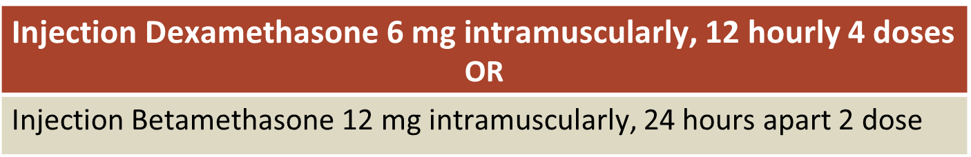
Antenatal corticosteroids
Estimation of correct gestational age is a critical function before administering ANCS
For true preterm labor between 24-34 weeks gestation give antenatal corticosteroids to mother for baby’s lung maturity
What ANCS to give?
If women is in initial stage of labor 1st dose of ANCs should be administered by MPHW(F) or CHO and refer to higher center.
Once 4 doses completed, no need to give another dose for rest of the pregnancy period.
78

Slide 7
When to give and when not to give ANCS
Indications
True preterm labor (between 24-34 weeks of gestation)
Conditions that lead to imminent delivery (between 24-34 weeks of gestation)
Antepartum hemorrhage
Preterm pre-labor rupture of membranes
Severe pre-eclampsia/eclampsia
Contraindications
Frank chorioamnionitis (absolute contraindication)
Signs and symptoms of chorioamnionitis
H/O fever, lower abdominal pain
Foul smelling vaginal discharge
Tender uterus
Maternal and fetal tachycardia
79

Slide 8
Key messages
Correct estimation of gestational age to diagnose preterm delivery is critical for prevention of prematurity related complications
Administer antenatal corticosteroid injection to the pregnant women between 24-34 weeks of gestation who are in true labor or have conditions that lead to imminent delivery
Use Inj. Dexamethasone 6 mg intramuscularly repeated every 12 hours to complete a regimen of four doses
Give one dose of Inj. Dexamethasone even if delivery is imminent or the woman is referred
Repeated course of antenatal steroids is not recommended
Be prepared for management of newborn resuscitation and warmth

