Slide 1

TOPIC 7
Identification & Management of
Childhood Diarhoea
Presenter: Dr. Lingaraj Pradhan

Slide 2

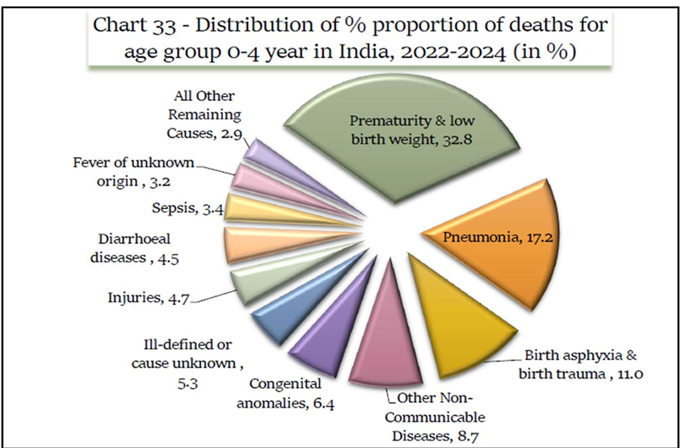
Childhood Diarrhoea
Diarrhoea is a major cause of U5 deaths in the State
Odisha has the 2nd highest prevalence of diarrhoea in t he country

Slide 3
DIARRHOEA · 0–2 MONTHS
Classify Dehydration in Young Infants
For young infants, Severe and Some Dehydration share the same urgent pre-referral treatment.
SEVERE DEHYDRATION
SOME DEHYDRATION
NO DEHYDRATION
Two or more of:
Two or more of:
Not enough signs to classify as Some or Severe Dehydration.
Movement only when stimulated, or none at all
Sunken eyes
Skin pinch goes back very slowly
Restless or irritable
Sunken eyes
Skin pinch goes back slowly
Give first dose of IM Ampicillin AND IM gentamicin
Refer URGENTLY to hospital; mother gives frequent ORS sips on the way
Continue breastfeeding; keep the infant warm en route
Same as Severe Dehydration: urgent referral with first antibiotic doses
Follow Plan B
Follow up in 2 days
Give fluids and breastfeeds to treat diarrhoea at home (Plan A)
Advise mother when to return immediately
Follow-up after 2 days if no improvement

Slide 4
DIARRHOEA · 2 MONTHS – 5 YEARS
Classify Dehydration in Children 2 Months–5 Years
SEVERE DEHYDRATION
SOME DEHYDRATION
NO DEHYDRATION
Two or more of:
Two or more of:
Not enough signs to classify as Some or Severe Dehydration.
Lethargic or unconscious
Sunken eyes
Not able to drink, or drinking poorly
Skin pinch goes back very slowly
Restless or irritable
Sunken eyes
Drinks eagerly, thirsty
Skin pinch goes back slowly
MANAGEMENT: PLAN B
MANAGEMENT: PLAN A
MANAGEMENT: PLAN C
Fluid, zinc, and food for some dehydration. Follow up after 2 days if not improving.
Fluid, zinc, and food to treat diarrhoea at home. Follow up after 5 days if not improving.
Refer urgently to hospital with ORS sips on the way; continue breastfeeding

Slide 5
DIARRHOEA · PLAN A
Plan A: Home Management for No Dehydration
5 steps to prevent dehydration at home: 1. Extra fluids & ORS 2. Zinc for 14 days 3. Continue feeding & hygiene 4. Inform when to return 5. If SAM — refer
ORS + TYPE OF FLUID BY AGE
AMOUNT OF ORS AFTER EACH LOOSE STOOL
< 6 months | > 6 months
Breastfeed frequently (if decreased urination) + ORS + Clean water | Home available fluids + ORS
Age | Amount of ORS
< 2 months | 5 teaspoons full
2 months – 2 years | 50–100 ml (¼–½ glass)
2 – 10 years | 100–200 ml (½–1 glass)
> 10 years | As much as wanted, up to 2 L/day
Home-available fluids: yoghurt, lemon water, rice/dal water, vegetable soup, plain water, tender coconut water.
If the child vomits, wait 10 minutes, then start again slowly — continue giving extra fluids.

Slide 6
DIARRHOEA · PLAN A
Plan A: Zinc, Feeding & When to Return
ZINC SUPPLEMENTATION — 14 DAYS
WHEN TO RETURN IMMEDIATELY
Age | Dose
2–6 months | 10 mg (½ tab)/day, dissolved with breast milk in a spoon
> 6 months | 20 mg (1 tab)/day, dissolved with clean water in a spoon
Child becomes sicker
Not able to drink or breastfeed
Develops fever
Blood in stool
Not able to feed
Demonstrate to the mother how to prepare the zinc tablet and supervise the first dose.
CONTINUE FEEDING & HYGIENE
Continue appropriate complementary feeding
Promote toilet use and handwashing practice
If malnutrition is present: Special care must be taken during fluid administration or refer.

Slide 7
DIARRHOEA · PLAN B & PLAN C
Plan B: Some Dehydration & Plan C: Severe Dehydration
PLAN B — MANAGED AT PHC/CHC BY HW, CHO, OR MO
PLAN C — SEVERE DEHYDRATION
Age | First give 30 ml/kg in | Then give 70 ml/kg in
< 1 year | 1 hour | 5 hours
> 1 year | 30 minutes | 2.5 hours
Give ORS 75 ml/kg body weight within 4 hours
If child vomits, wait 10 minutes, then give in small sips; continue breastfeeding if child wants
Reassess after 4 hours: if no dehydration, shift to Plan A; if severe dehydration, refer for Plan C — continue ORS en route, give pre-referral antibiotics if under 2 months
If SAM: give ORS 5 ml/kg/hr every 30 min for 2 hours, then alternate 5 ml/kg/hr ORS with starter diet hourly for next 10 hours; reassess after 4 hours
Start IV immediately (Ringer Lactate; if Normal Saline unavailable). ORS can be given until IV is set up.
Monitoring: Record baseline pulse, respiration, liver span (to diagnose over-hydration). Repeat dose if radial pulse weak. Reassess every 15–20 min; give fluids more rapidly if not improving.

Slide 8
Dose of ORS in 4 hours
Amount of ORS as per different age to be given within 4 hours
Age | Upto 4 months | 4 months -1 year | 1-2 year | 2-5 year | 5-14 year | >15 year
Weight | <5 kg | 5-8 kg | 8-11 kg | 11-16 kg | 16-30 kg | >30 kg
Quantity of ORS | 200-400 ml (1-2 glasses) | 400-600 ml (2-3 glasses) | 600-800 ml (3-4 glasses) | 800-1200 ml (4-6 glasses) | 1200-2200 ml (6-11 glasses) | 2200-4000 ml (11-20 glasses)
Use age, if you do not know the weight If the child wants more ORS, then it can be given <6 months infants who are not breastfed, give 100ml-200ml clean water during this period along with ORS

Slide 9



DIARRHOEA · PREVENTION
Prevention & Control of Under-5 Diarrhoea
PROTECT
PREVENT
TREAT
Handwashing and hand hygiene
Safe drinking water and sanitation
Waste disposal and management
Vaccines: Rotavirus & Measles
Information, education & communication (IEC) awareness
Exclusive breastfeeding for 6 months
Adequate complementary feeding and supplementary nutrition
Vitamin A supplementation
Improved care-seeking and referral
Case management at health facility & community level (Plan A, B, C)
ORS and Zinc
Goal: reduce Under-5 diarrhoeal deaths through integrated protection, prevention, and prompt treatment at community level.

Slide 10
When to send child home & Advice
If hydration is maintained for 6 hours on ORS after rehydration.
Advice
Teach the mother how to prepare ORS solution & Zinc
Provide at least 2 packets of ORS & Zinc tablets for 14 days
Counsel on continued feeding with appropriate complementary food
Advice about handwashing, personal cleanliness and use of toilet

Slide 11





CLOSING SUMMARY
Key Takeaways for Field Practice
Classify before treating
Always use standard danger-sign checklists for pneumonia and dehydration before starting treatment.
Know correct dosing
Be precise with weight- or age-based dosing for Amoxicillin, Gentamicin, and ORS.
Never delay antibiotics
In severe pneumonia, antibiotics must not be delayed — even while giving bronchodilators.
Refer early
Refer severe pneumonia and severe dehydration early, with pre-referral treatment and continued ORS en route.
Educate caregivers
Counsel families on home care, danger signs, and exactly when to return immediately.
19

