Slide 1
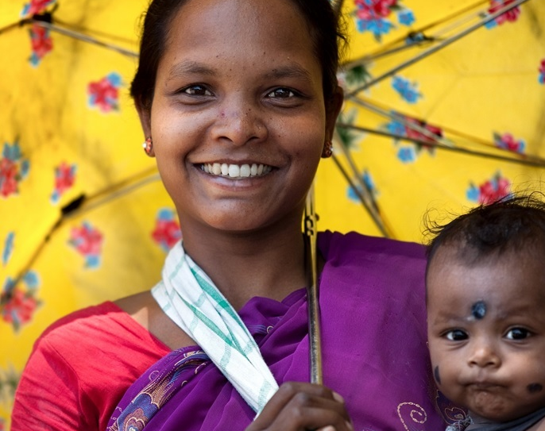
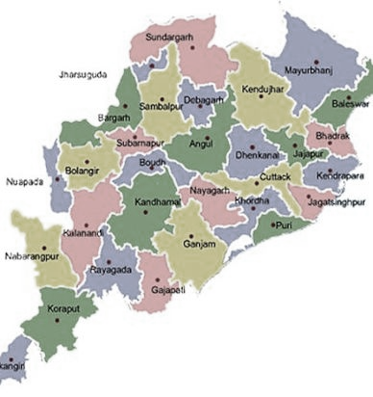
An Over View Immunization Programme
Topic 6

Slide 2
Introduction
Immunization is one of the most cost-effective health investments
Vaccination played a major role in the battle on infectious diseases since 496 B.C
Edward Jenner, pioneered the concept of vaccines and developed world’s first vaccine for smallpox
Last case of smallpox in Somalia in 1977 and eradicated globally in 1980
In 1974, 27th World Health Assembly recommended vaccination against six diseases: Tuberculosis, Diphtheria, Tetanus, Pertussis, Measles and Poliomyelitis under Expanded Programme on Immunization (EPI).
EPI was launched in India in 1978 ( for 6 VPDs :BCG, OPV, Diphtheria, Pertusis, Tetanus , Typhoid-Urban area)

Slide 3
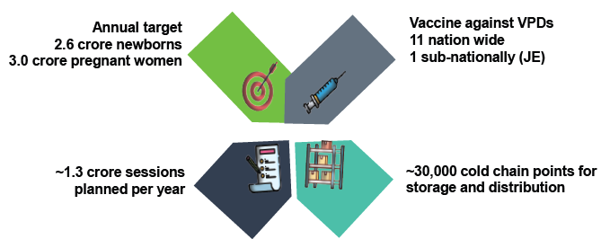
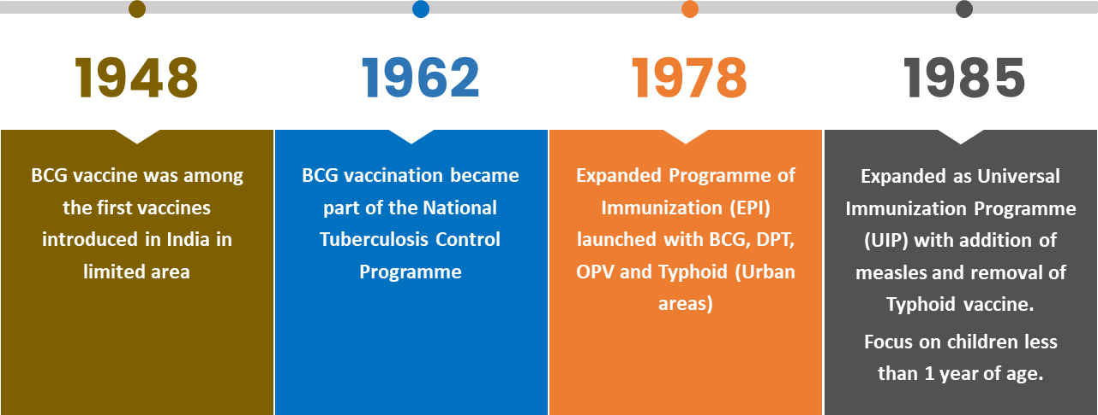
India’s Universal Immunization Programme (UIP)
One of the largest public health programs in the world
YOUR TITLE 05
Green marketing is a practice whereby companies seek to go above and beyond traditional marketing by promoting environmental core values in the hope.
All vaccines under UIP are manufactured in India
India has largest vaccine manufacturing capacity in the world

Slide 4
Roadmap of Introduction & Expansion of New Vaccines
EPI - BCG, OPV, DPT & typhoid-
paratyphoid vaccines
UIP - Vaccine against 6 VPDs-
Measles, DPT, TB, Polio
1985
Key highlights: UIP
1978
1985-2000: 4 vaccines introduced
2001- 2010: 2 vaccines introduced (1 Nationally & 1 Sub-nationally)
2011-2021: 6 vaccines introduced
2002
Hep. B vaccine
piloted
JE Vaccine introduced
2006
Measles 2nd dose introduced,
Hep-B Nationwide
2010
2011
Pentavalent vaccine introduced
RVV introduced
tOPV to bOPV switch
2016
2015
2013
IPV introduced
Penta Nationwide
JE 2nd dose introduced
RVV product change
fIPV 3rd dose introduced
2017
2019
2021
2022
2023
MR, PCV introduced
JE adult
RVV
Nationwide
Td introduced
PCV
Nationwide

Slide 5
Universal Immunization Programme (Scope and Scale in Odisha)
One of the largest Public Health Programmes
Annual target 2025-26
Newborns : 611249
Pregnant women : 726522
Vaccine against VPDs
12 Nos. of Vaccine with 13 Nos. of Vaccine Preventable Diseases including HPV
> 30000 sessions planned per year
~1293 cold chain points for storage and distribution of vaccines
(NCCMIS)

Slide 6

Aim and objectives of UIP
To attain more than 90% full immunization coverage and sustain the gains
To achieve MR elimination
To maintain and sustain Polio free status and Maternal & Neonatal Tetanus elimination
To sustain the robust VPD and AEFI surveillance
To ensure efficient supply chain, cold chain and logistic system for UIP
To provide regular supportive supervision to UIP
Eligible beneficiaries should get all UIP vaccines, to be protected from life threatening Vaccine Preventable Diseases
To ensure accountability framework through regular task force meetings
To expand digitization in UIP
To introduce need based new vaccines

Slide 7
Full Immunization trend ( NFHS)

Slide 8
Concept of Full Immunization Coverage (FIC) Plus
Full Immunization Coverage (FIC) Plus –
Child who has received BCG, 3 doses of OPV, 3 doses of pentavalent and 1 dose of MR by first year of age. This is the historical definition used for survey and evaluation purposes and hence has been continued. - Full Immunization coverage (FIC)
FIC plus
Child who has received all the vaccines given in the Universal Immunization Programme (UIP) by one year of age.
Complete Immunization
Child who has received all the vaccines given in the Universal Immunization Programme (UIP) by two years of age
Zero-dose (operational & reporting purpose)
Child who has not received first dose of pentavalent vaccine by one year of age.

Slide 9
Immunization programme Component
VPDs and Management of outbreaks
VPD Surveillance .
Immunization Schedule.
Planning and Conducting Immunization
Preparation of Micro Plans
Vaccine and Other logistics Management
Alternate Vaccine Delivery
Management of vaccine, Immunization cards etc.
Cold Chain Management
Injection Safety .
Adverse event following immunization .
Records , Reports and Using data for action.
Monitoring & supportive Supervision.
Demand generation for improved coverage

Slide 10
VPDs
Viral diseases
1. Poliomyelitis
2. Hepatitis B
3. Measles
4. Rubella
5. Diarrhoea due to Rota virus
6. Japanese Encephalitis
Bacterial diseases
1.Severe form of childhood Tuberculosis
2. Diphtheria
3. Pertussis
4. Tetanus
5. Haemophilus influenzae Type b related diseases
6. Pneumococcus related diseases

Slide 11
Revised Universal Immunization Schedule

Slide 12
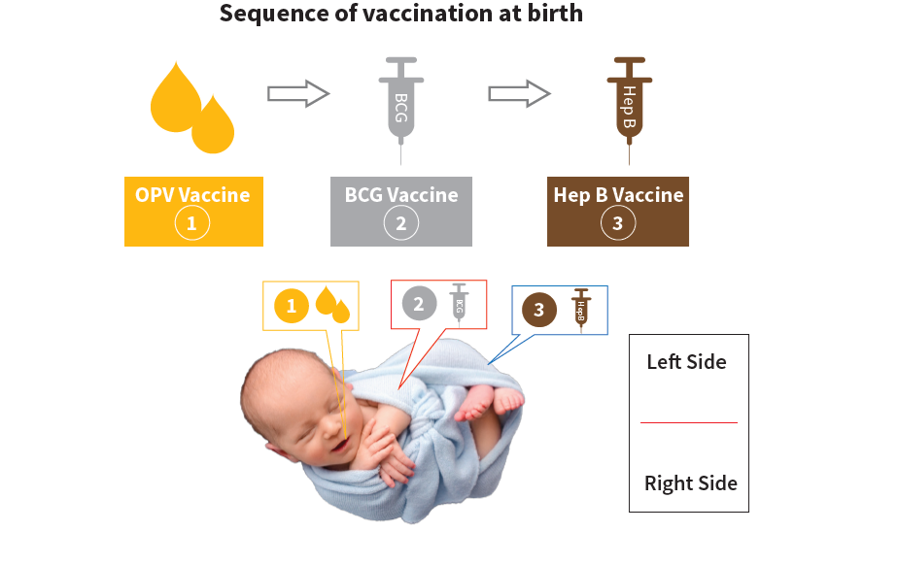
Sequence , Site and Route of Vaccination at birth
Vaccine | Site/Route
OPV | Oral-2drops
BCG | Intradermal (0.05/0.1ml)
Hep-B | IM-0.5ml

Slide 13
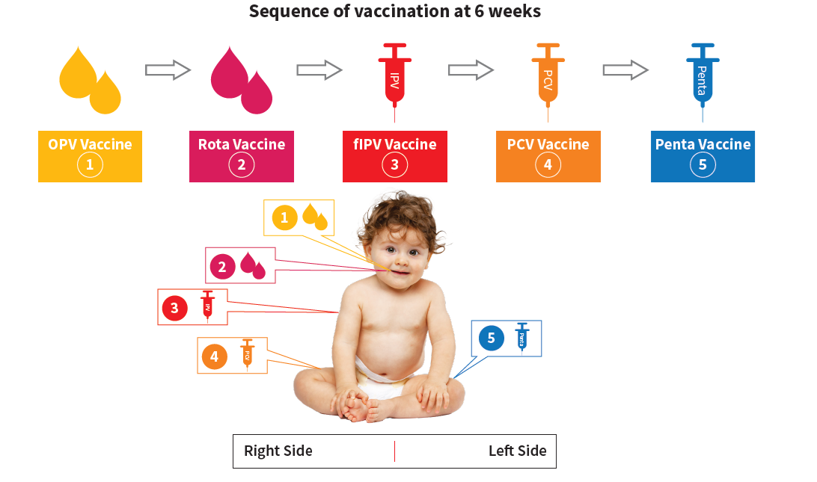
Sequence , Site and Route of Vaccination at 6th Week
Vaccine | Site/Route
OPV | Oral-2drops
Rota | Oral-2ml
fIPV | Intradermal-0.1ml
PCV | IM-0.5ml
Hep-B | IM-0.5ml

Slide 14
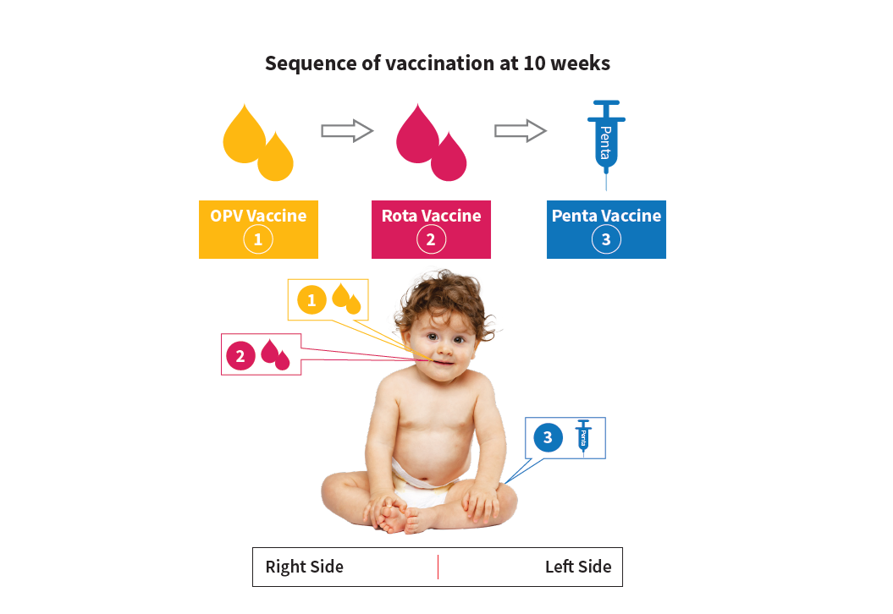
Sequence , Site and Route of Vaccination at 10th Week
Vaccine | Site/Route
OPV | Oral-2drops
Rota | Oral-2ml
Hep-B | IM-0.5ml

Slide 15
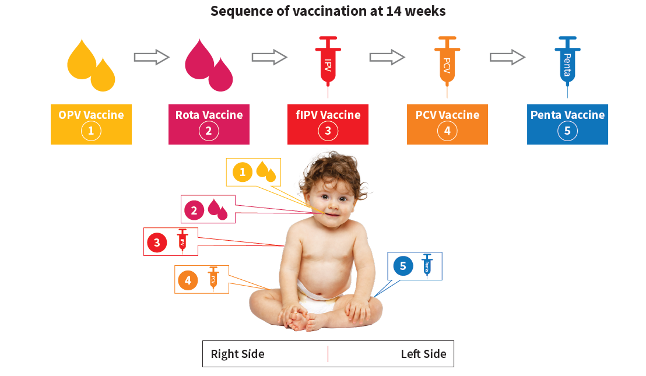
Sequence , Site and Route of Vaccination at 14th Week
Vaccine | Site/Route
OPV | Oral-2drops
Rota | Oral-2ml
fIPV | Intradermal-0.1ml
PCV | IM-0.5ml
Penta | IM-0.5ml

Slide 16
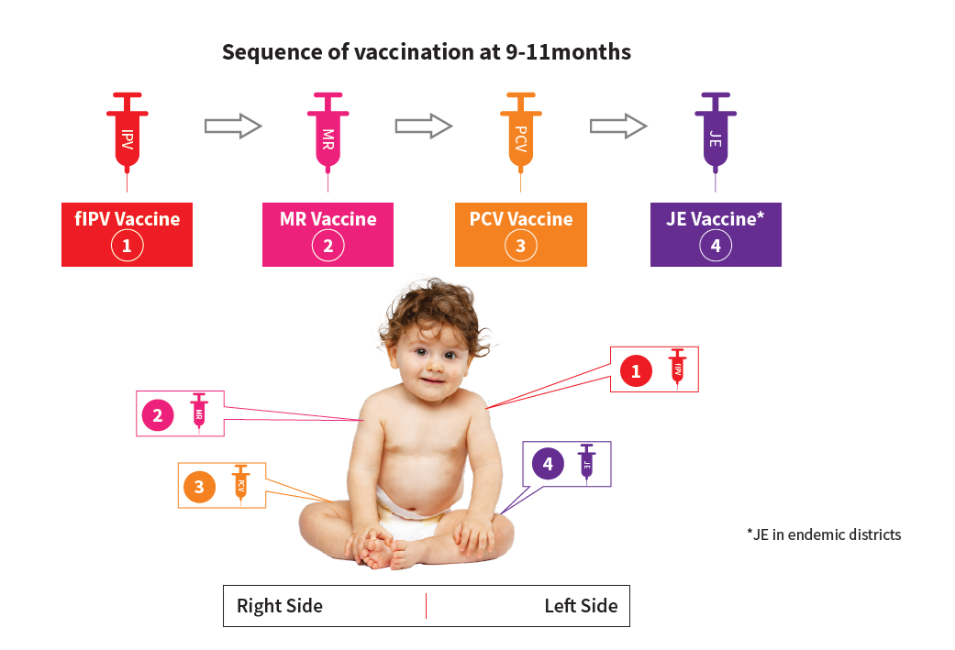
Sequence , Site and Route of Vaccination at 9-11th month
Vaccine | Site/Route
fIPV | Intradermal-0.1ml
MR | Subcutaneous -0.5ml
PCV | IM-0.5ml
JE | IM-0.5ml

Slide 17
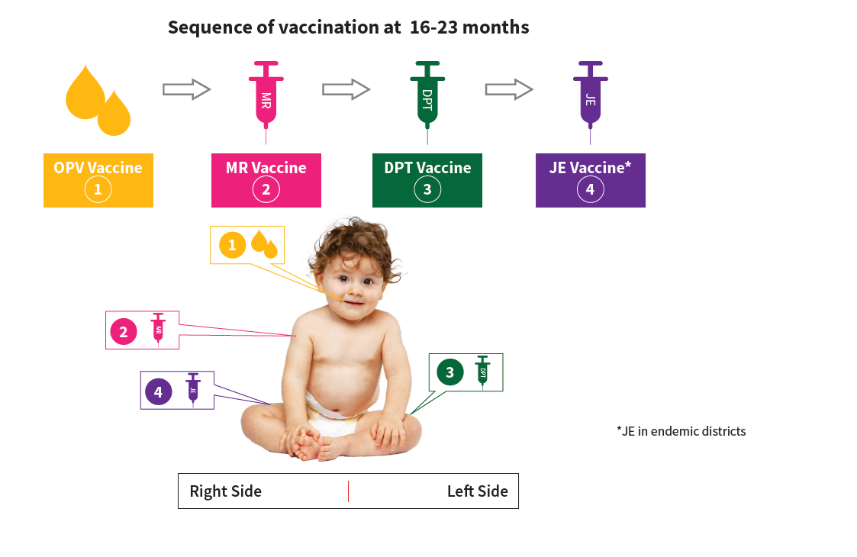
Sequence , Site and Route of Vaccination at 16-23 months
Vaccine | Site/Route
OPV | Oral-2drops
MR | Subcutaneous -0.5ml
DPT | IM-0.5ml
JE | IM-0.5ml

Slide 18
Age | Vaccines given
5-6 years | DPT-Booster 2
10 years | Td
16 years | Td
Pregnant Mother | Td1, 2 or Td Booster**
* in endemic districts only
** one dose if previously vaccinated within 3 years

Slide 19
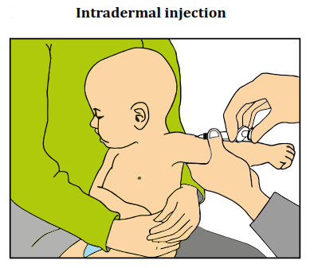
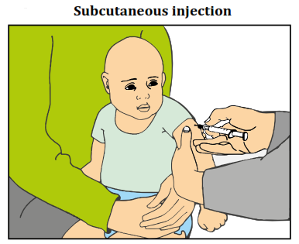
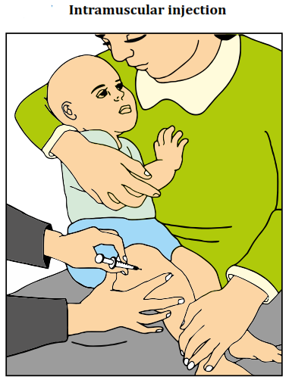
Syringe and needle position for Vaccination

Slide 20
Immunization cold-chain supply system
Vaccine
Manufacturer
Air Transport
(+2° to 8°C &
-15° to -25°C)
Primary Store (GMSD &/State) WIC (+2° to 8°C) & WIF (-15° to -25°C)
Refrigerated / Insulated Van (+2° to 8°C & -15° to -25°C)
State Store WIC (+2° to 8°C) & WIF (-15° to -25°C)
Insulated Van (+2° to 8°C & -15° to -25°C)
PW & Child
Sub-Centre Session Sites
Vaccine Carrier (+2° to 8°C)
Primary Health Centre ILR +2° to 8°C & All Vaccines in ILR
Insulated Van (+2° to 8°C)
District Vaccine Store ILR (+2° to 8°C) & DF (-15° to -25°C)
Ice lined refrigerator is used for storing the vaccine and Diluents .
It maintains the temperature between + 2°C to + 8°C

Slide 21
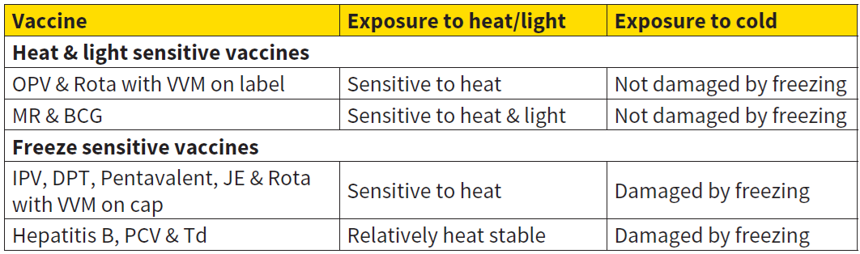
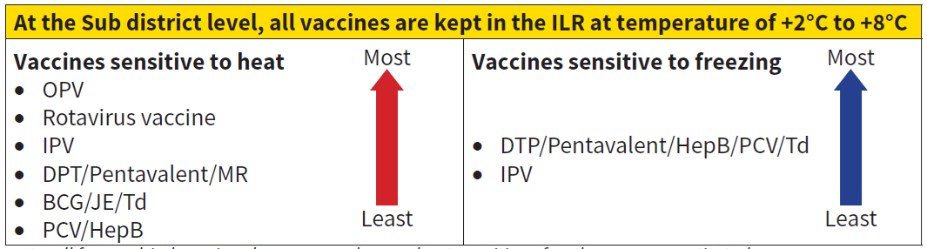
Sensitivity of Vaccine to heat, light and freezing
/ HPV
/ HPV

Slide 22
Vaccine Storage in ILR
HPV Vaccine

Slide 23
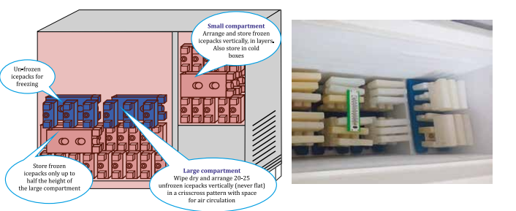
Storage of Icepacks in DF

Slide 24
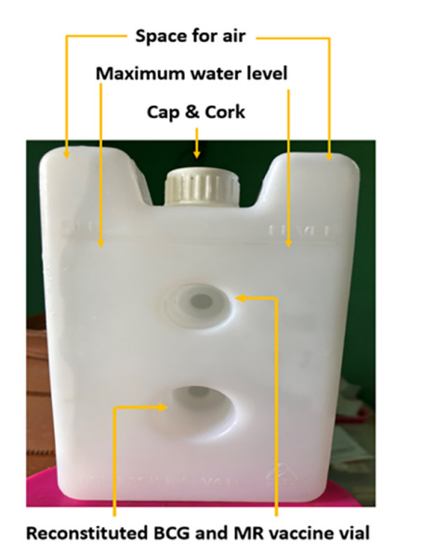
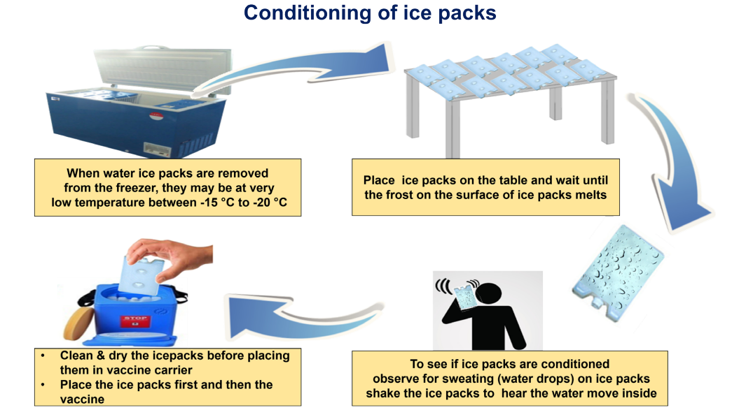
Conditioning of Ice Packs

Slide 25
Vaccine Arrangement at RI session sites

Slide 26
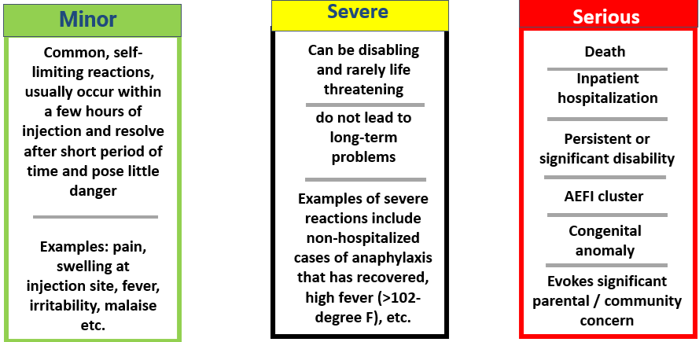
Adverse event following immunization (AEFI)
Definition : Adverse event following immunization (AEFI) is defined as any untoward medical occurrence which follows immunization, and which does not necessarily have a causal relationship with the usage of the vaccine.

Slide 27
WHO cause specific definition of AEFIs
2 Vaccine quality defect-related reaction
An AEFI that is caused or precipitated by a vaccine that is due to one or more quality defects of the vaccine product as provided by the manufacturer.
Eg, Failure by the manufacturer to completely inactivate a lot of inactivated polio vaccine leads to cases of paralytic polio.
3 Immunization error-related reaction
An AEFI that is caused by Inappropriate vaccine handling, prescribing or administration.
Eg, Transmission of infection by contaminated multidose vial
4 Immunization Triggered Stress response
An AEFI arising from anxiety about the immunization.
Eg, Vasovagal syncope in an adolescent following vaccination.
An AEFI that is caused or precipitated by a vaccine due to one or more of the inherent properties of the vaccine product.
Eg, Extensive limb swelling following DTP vaccination.
1 Vaccine product-related reaction
5
Coincidental event
An AEFI that is caused by something other than the vaccine product, immunization error or immunization anxiety.
Eg, A fever occurs at the time of the vaccination, but is in fact caused by malaria.
This is utilized for causality Assessment by State and National AEFI Committees

Slide 28
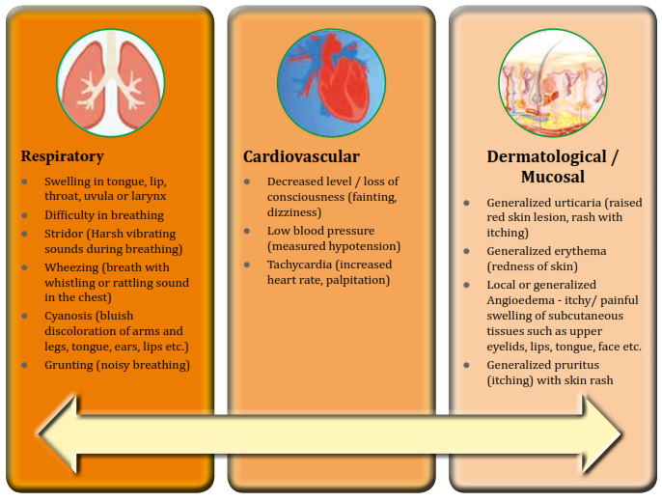
Recognition of Anaphylaxis
A case of anaphylaxis is suspected if following criteria is met: Early onset and rapid progression of more than one sign & symptoms of any of the two systems from the three systems – respiratory, cardiovascular, and dermatological /mucosal

Slide 29
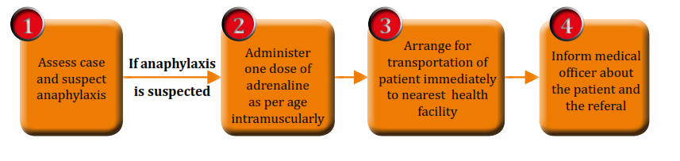
Steps for Initial Management of AEFI

Slide 30
Managing AEFI
Ensure recipients wait for 30 minutes at session site after vaccination
After vaccination, inform the vaccine recipient
About any minor events which may occur
Visit the nearest health facility in case of any adverse event/discomfort/illness
Anaphylaxis kit with inj. adrenaline within expiry date at outreach session site
Inform Medical Officer immediately by telephone about serious/severe AEFIs
Emergency numbers (102, 108, etc.) for transporting case to AEFI management center / higher health facility with vaccinator team

Slide 31
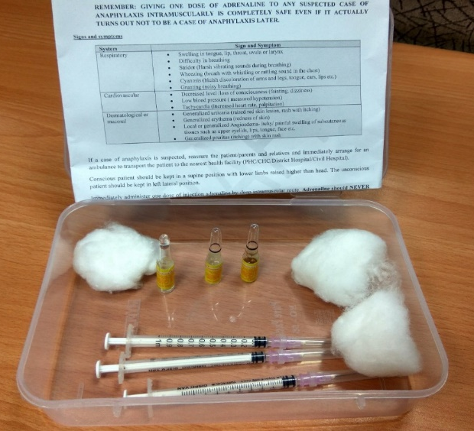
Contents of the Anaphylaxis Kit
1. Dose chart for adrenaline as per age
2. 1 mL ampoule of adrenaline (1:1000) – 3 nos.
3. 1 mL tuberculin syringes / 40 unit insulin
syringes with detachable needle – 3 nos.
4. 24/25 G needles of 1 inch length – 3 nos.
5. Swabs – 3 nos.
6. Up to date contact information of Medical
Officer(s) of PHC/CHC and local ambulance
services.
7. Format for quarterly certification of anaphylaxis
kit by Medical Officer of PHC
Anaphylaxis Kit

Slide 32
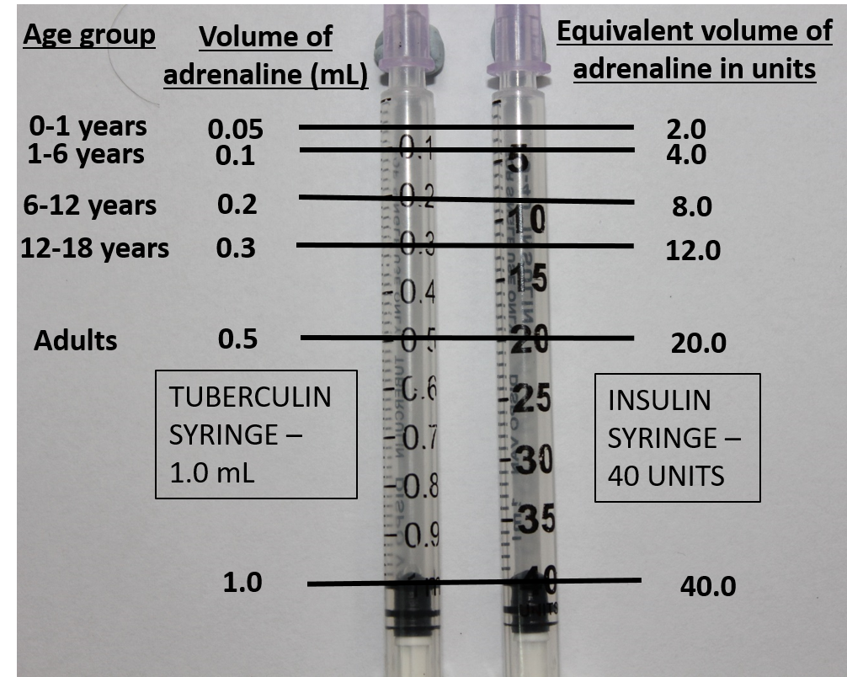
Dose of Adrenaline
Adrenaline is the drug of choice to treat anaphylaxis
Ensure adequate stock of adrenaline for supplying to sessions
Age (in years) | Needle for intramuscular injection | Age specific dose of adrenaline (1:1000) in ml (tuberculin) or units (insulin)
Adults | 1 inch 24G or 25G | 0.5 ml / 20 units
12-18 |  | 0.3 ml / 12 units
6-12 | 1 inch long of 24G or 25G | 0.2 ml / 8 units
1-6 |  | 0.1 ml / 4 units
0-1 |  | 0.05 ml / 2 units

Slide 33
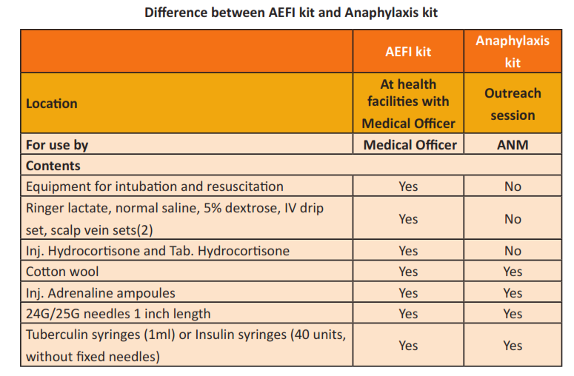
Difference between AEFI Kit and Anaphylaxis kit

Slide 34
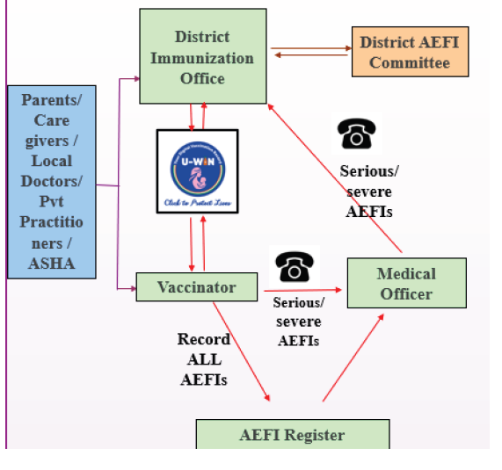
Reporting of AEFIs
All adverse events following any vaccination must be reported.
An AEFI can be reported anytime, irrespective of the time duration between vaccination and adverse event or between adverse event and reporting.
AEFI can be reported after any vaccine, whether:
Given in the UIP schedule or not
Given in routine or campaign mode
Given in a government or private setting
Beneficiary is a child or adult
Record all AEFIs
UIP vaccines- minor, severe and serious ones through U-WIN- SAFEVAC and in AEFI registers (minor).
Non-UIP vaccines- severe & serious through SAFE-VAC.
AEFI registers should be available at health facilities like planning units and CCPs.
Minor AEFIs are not followed up for investigations and causality assessments. They are reported in HMIS every month.

Slide 35
Immunization Wastes Segregation
Immunization Logistic | Particulars | Bags/Containers used
AD Syringes with packing | Cut hub of AD and disposable syringes | White [White coloured translucent, puncture-proof, leak-proof, tamper-proof containers]
 | Plastic part of Syringe | Red [Red coloured non- chlorinated plastic bags (having thickness > 50 micron or containers)]
Vaccine parts | Vaccine adapter & dropper
 | Oral syringe
Gloves | used gloves
Ampoules | Ampoules (plastic)
 | Ampoules (glass) | Blue [Container/ cardboard boxes with blue coloured puncture-proof, temper-proof containers]
Vaccines | Expired vaccine or Discarded vaccine
 | Broken vials
 | Empty unbroken vials
Cotton | Cotton contaminated with Blood or body fluid | Yellow [Yellow coloured non chlorinated plastic bags (having thickness > 50 micron or containers)]
Vitamins | Expired Bottles of Vitamins
Paracetamol | Expired tab/ Syrup

Slide 36
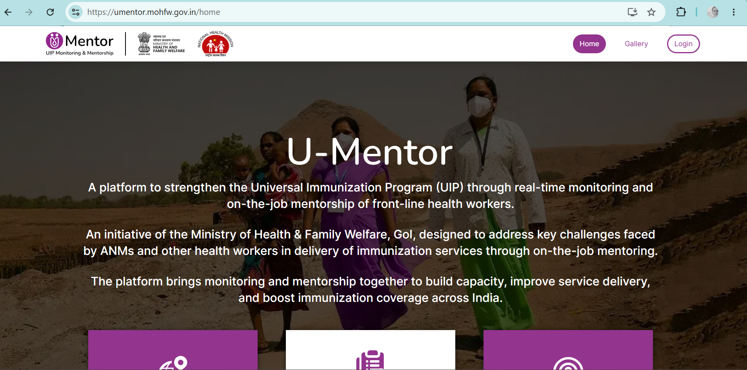
Monitoring and Supervision of RI Programme

Slide 37
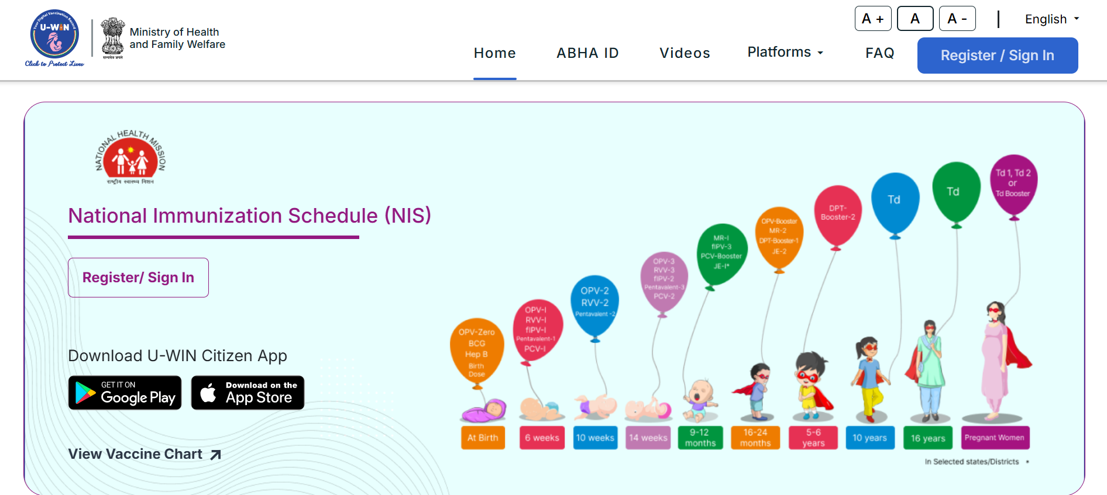
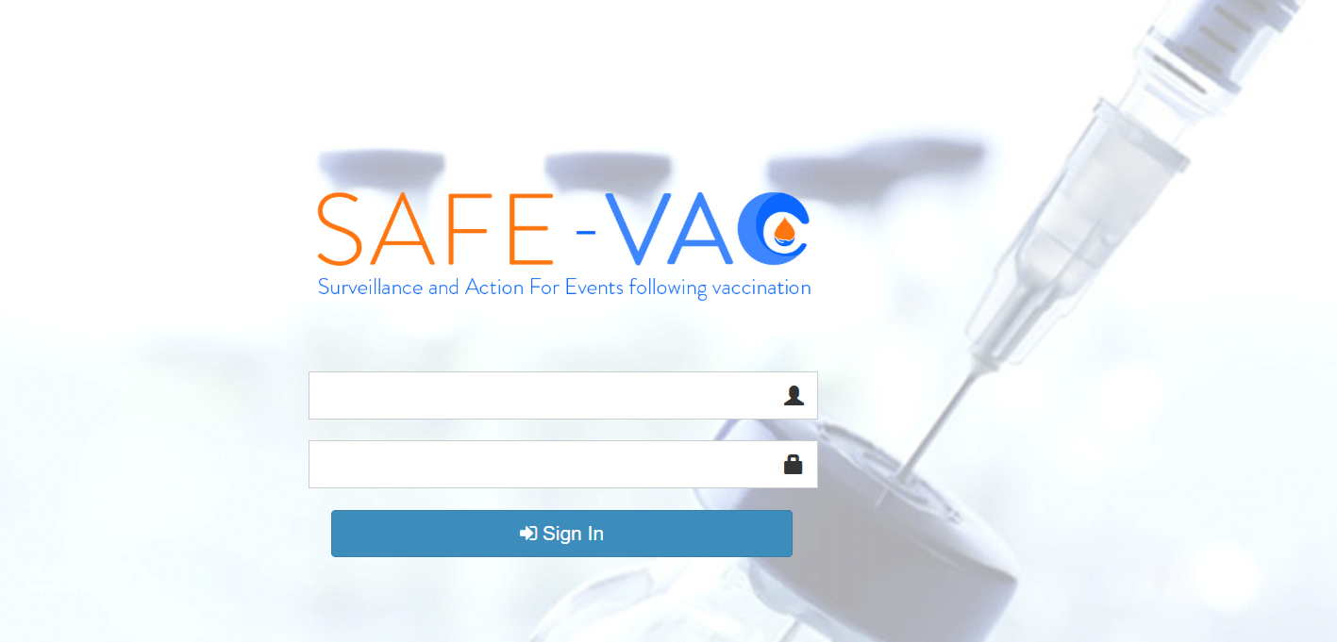
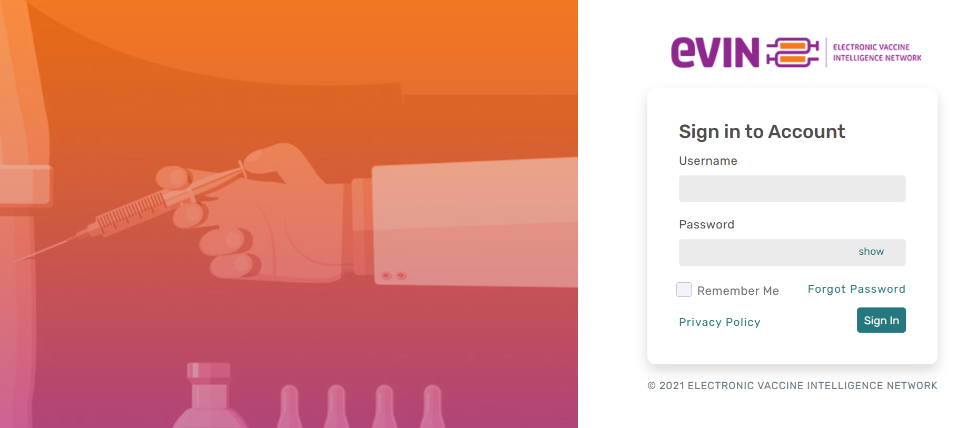
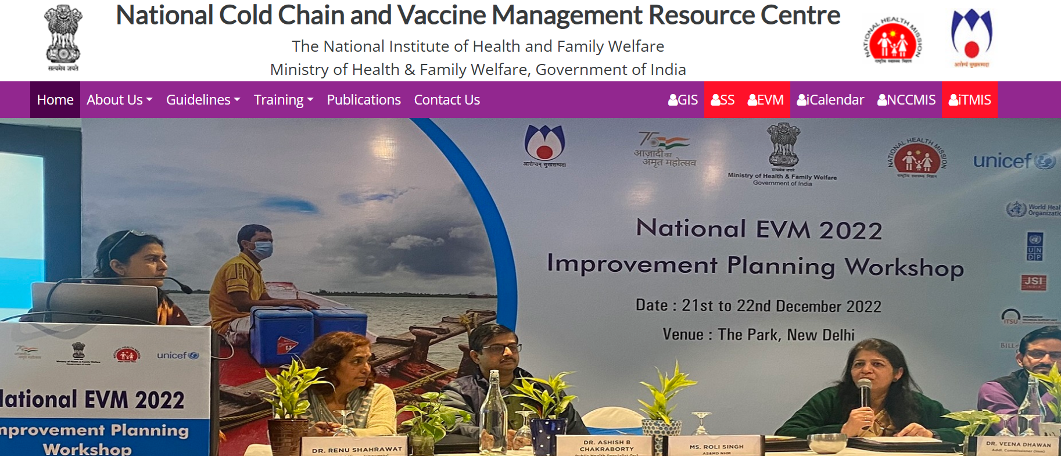
Reporting and recording of RI Programme

