Slide 1
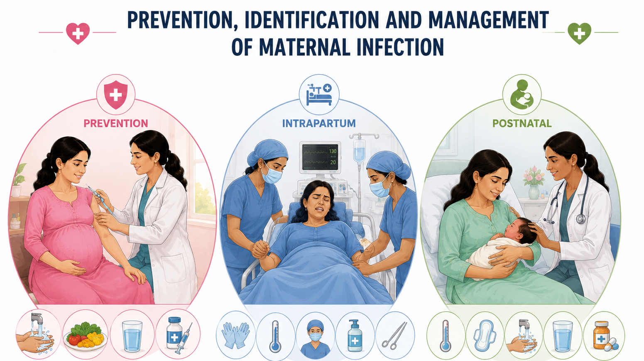
Topic 9

Slide 2
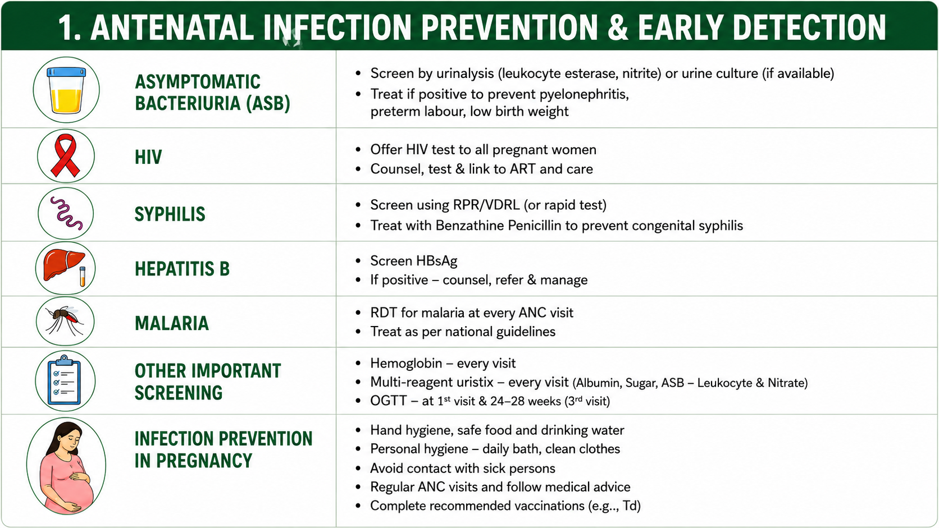

Slide 3
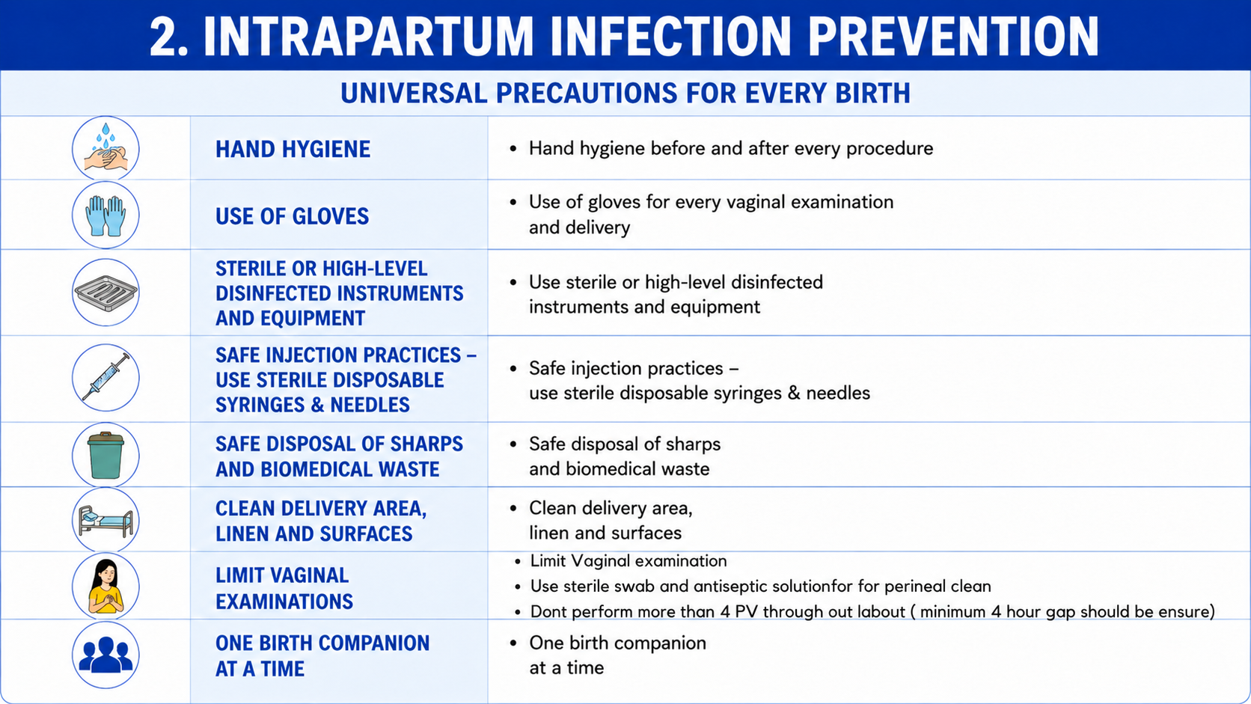

Slide 4
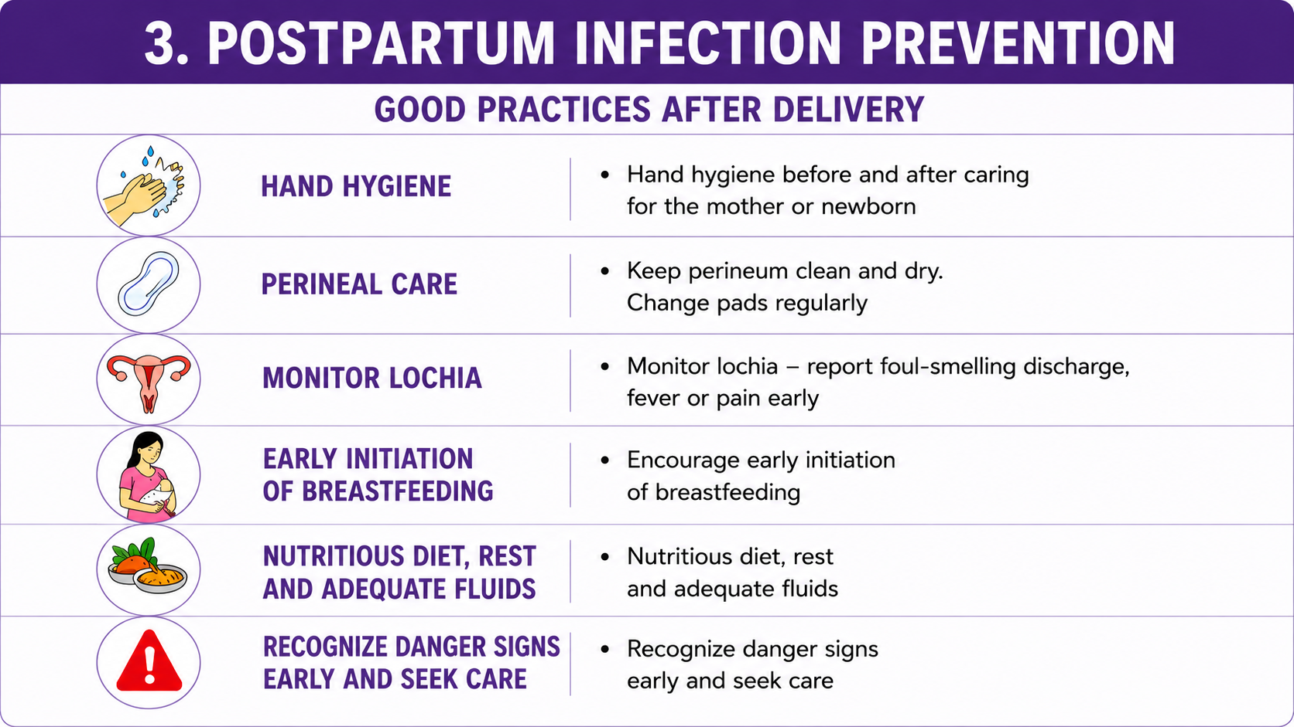

Slide 5
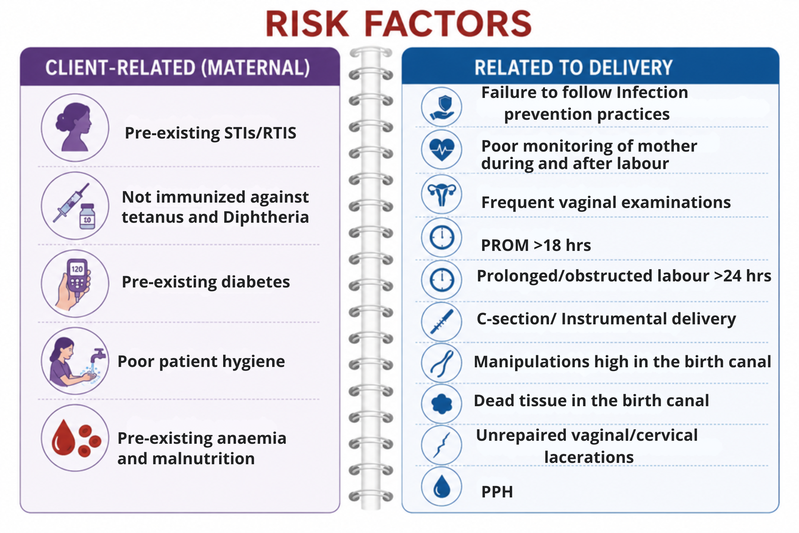

Slide 6
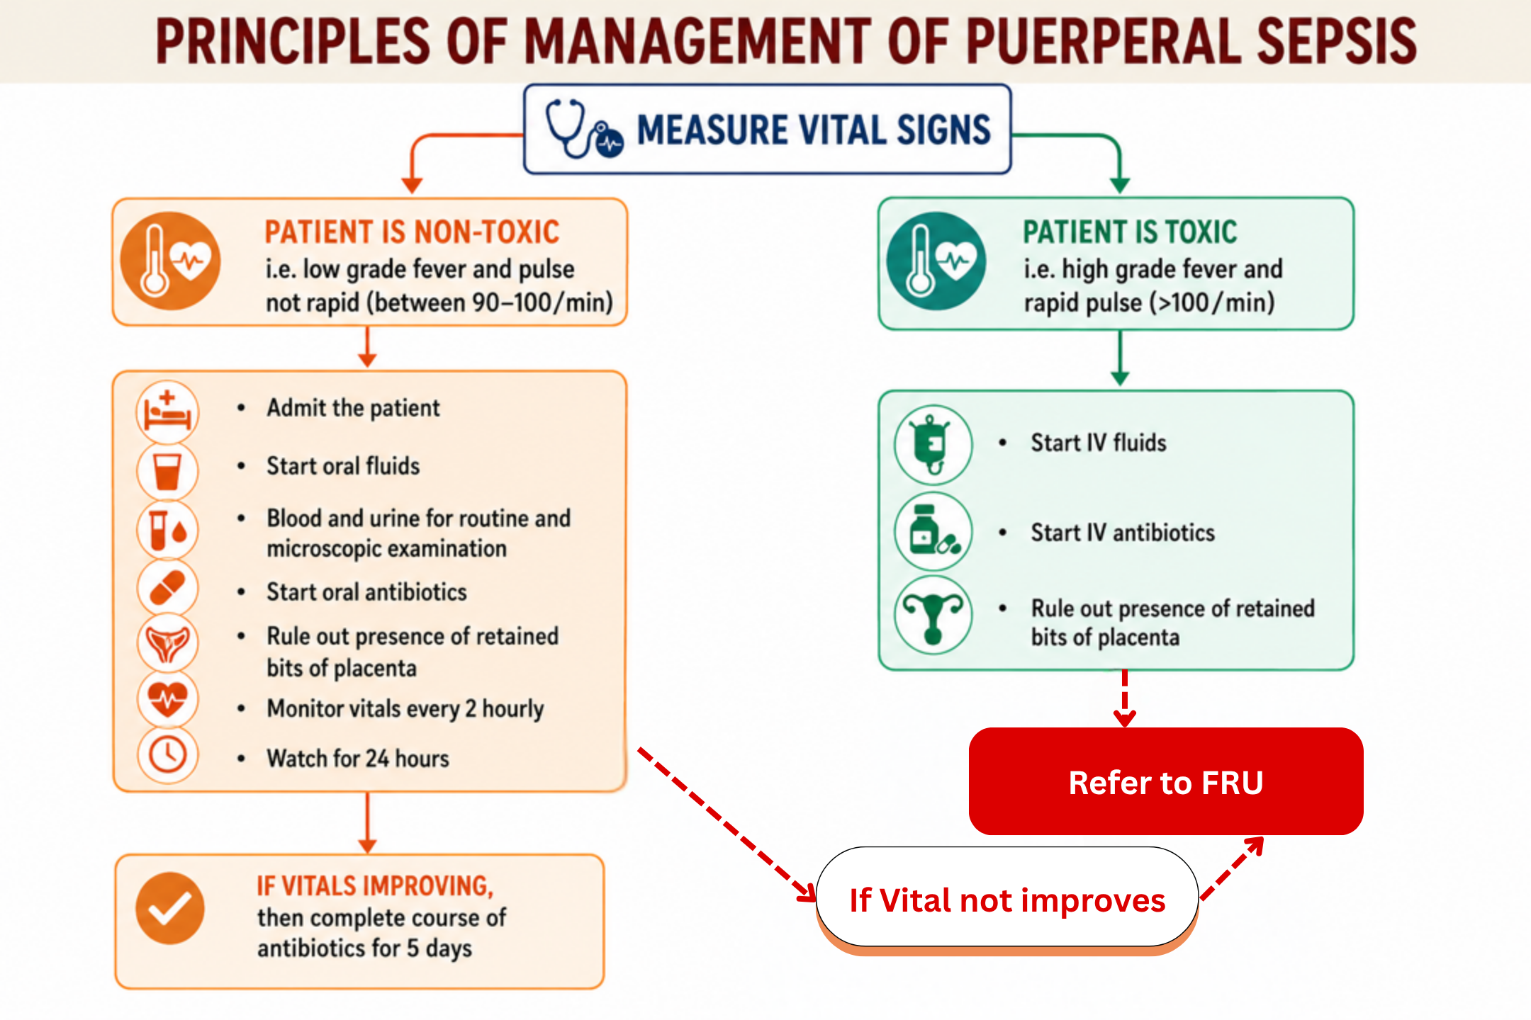

Slide 7
Recommended Antibiotic to Mother
Not very Sick Mother
Very Sick Mother
Piperacillin/Tazobactam 4.5g IV q6h
Metronidazole 400mg iv 8 hourly
Amikacin 15mg/kg body wt iv
Ampicillin 1 gm - 6 hourly oral/ Amoxicillin/ Ceftriaxone + Sulbactam
Metronidazole 400mg - 8 hourly oral
Gentamycin 80 mg, BD Intra Muscularly
As per WHO guidelines- Clinical response evidence based antibiotics should be administered.

Slide 8
Key messages
Puerperal sepsis is one of the leading causes of maternal deaths
Puerperal sepsis is to a great extent preventable
Antibiotics should be given to the woman only if they are indicated
At periphery, ANM should identify the indications for antibiotics and give first dose before referral

