Slide 1
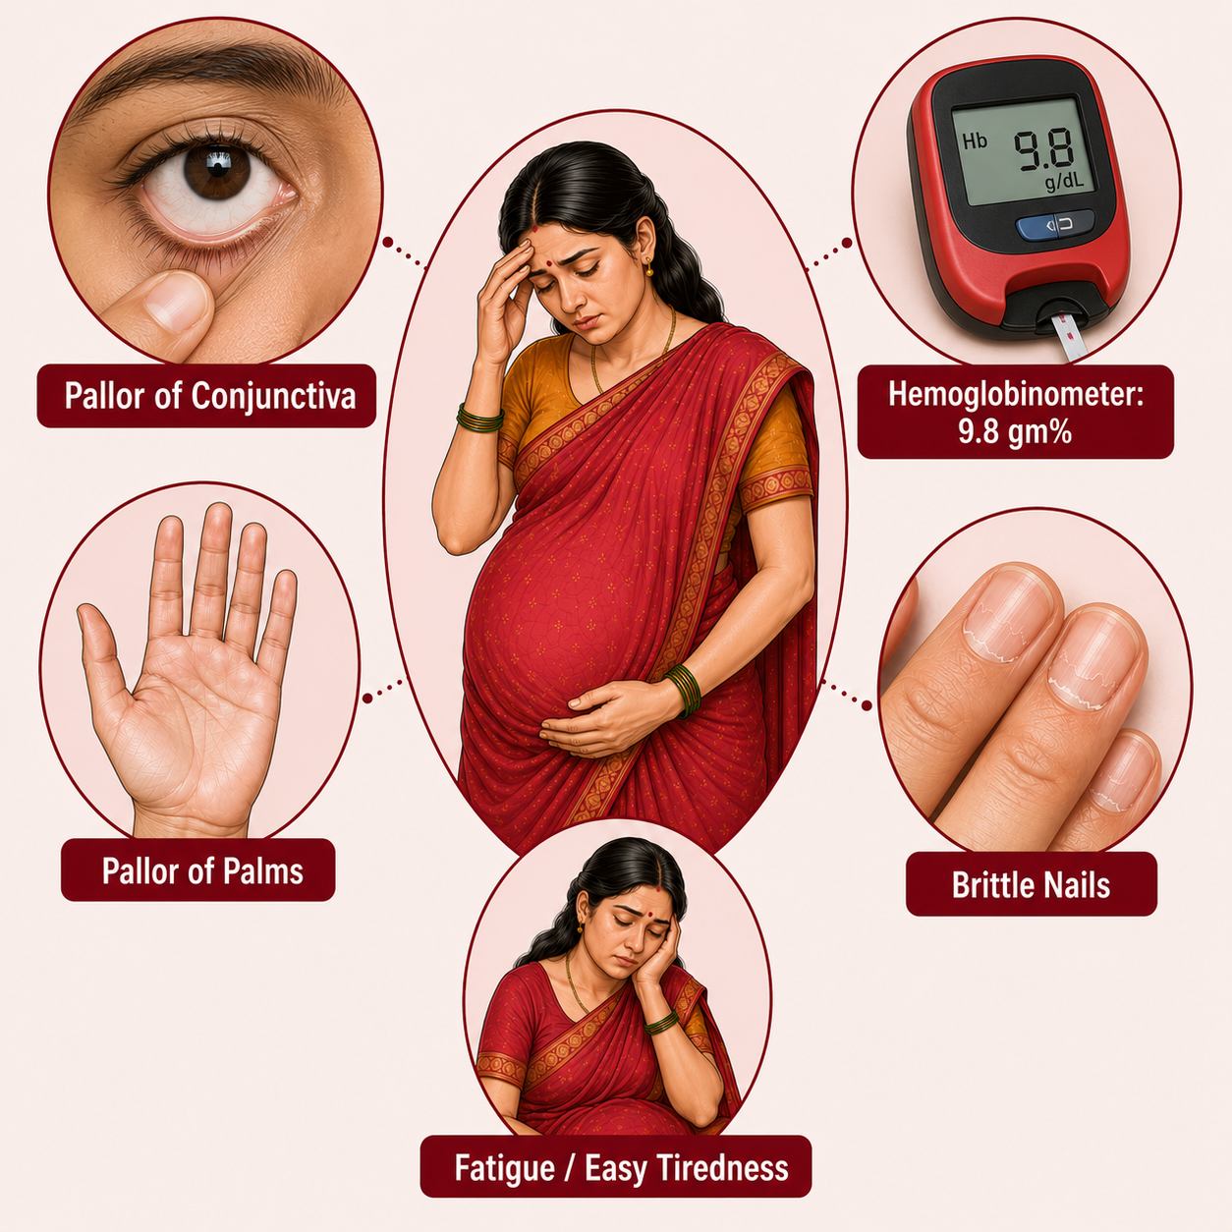
Iron deficiency Anemia in Pregnancy
Topic 2

Slide 2
What is Anaemia ?
Decreased iron in body
Decreased haemoglobin in blood
Reduction in oxygen carrying capacity of blood
Decreased red blood cells

Slide 3
Grades of anaemia in pregnancy
Type of Anaemia | Haemoglobin Concentration
No Anaemia | ≥11 gm/dl
Mild Anaemia | 10 - 10.9 gm/dl
Moderate Anaemia | 7 - 9.9 gm/dl
Severe Anaemia | <7 gm/dl

Slide 4
Risk associated with Anemia in Pregnancy
Effect on mother
Effect on foetus and Newborn
Abortions
Increased rate of infections
Pre-eclampsia
Premature rupture of membranes
Preterm labour
Placental abruption
Postpartum haemorrhage
Puerperal sepsis
Improper development of fetus
Foetal Distress
Birth Asphyxia
Low birth weight
Prematurity

Slide 5



Symptoms of Severe Anaemia
Easy fatigue & weakness
Shortness of breath
Dizziness or light headedness
Cold hands and feet
Headache
Tingling sensation or leg cramps
Irregular Heartbeat
Chest Pain

Slide 6


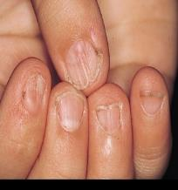

Signs of severe Anaemia
Pallor of conjunctiva, skin, tongue
Inflamed tongue (glossitis)
Inflamed mouth (stomatitis)
Brittle, pale nails
Generalized swelling

Slide 7
Diagnostic equipment for Anemia
Level of Facility | Diagnostic equipment
VHSND | Hemo Cue
Facility Level ANC, PMSMA | CBC
Labour Room | Hemoglobinometer on Arrival, CBC as required

Slide 8
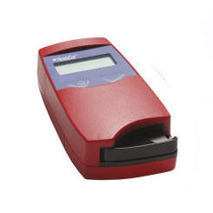
Methods of diagnosis
HemoCue
The blood drop filled micro cuvette is placed in the cuvette holder and pushed to its measuring position
After 15-60 seconds the hemoglobin value of the sample is displayed on the screen and should be recorded.

Slide 9
What is FCM
Ferric Carboxy Maltose (FCM) is an intravenous iron formulation used to treat iron deficiency anemia (IDA), particularly in cases where
oral iron therapy has failed, is not tolerated,
or is unsuitable due to the severity of the anemia.
FCM ensures effective iron delivery to bone marrow and other sites for hemoglobin synthesis.
It replenishes iron stores quickly and raises hemoglobin levels
Injectable FCM

Slide 10

Indications for FCM
To be administered after 1st trimester for anaemia due to iron deficiency in the following conditions:
Severe anaemia (Hb 5-6.9 g/dL) at 13-34 weeks of pregnancy
Moderate anaemia (7 to 9.9 gm/dl) due to iron deficiency
Oral Iron not tolerated / Noncompliant
No improvement or improvement of less than 1 gm / dl after 1 month of oral IFA administration in IDA (Iron Deficiency Anaemia)
Moderate Aneamia after 32 weeks of gestation due to Iron deficiency aneamia.
Can also be administered in lactating mothers if Hb 5-7.9 g/dL

Slide 11

Contraindications for FCM
Iron overload Serum ferritin >150 μg/L
Known hypersensitivity to iron preparation or excipients of Iron Sucrose or FCM
Anemia not caused by iron deficiency
Liver disorder like jaundice, cirrhosis, liver failure
Acute cardiac failure
Known case of thalassemia, sickle cell anemia, hemolytic anemia
Fever, Acute infection/Illness

Slide 12
Comparison between Iron Sucrose and FCM …1
Iron Sucrose
Ferric Carboxy Maltose
Lower stability; relatively short half-life of 5-6 hours
Rapid increase in hemoglobin levels, typically seen within one week of completion of the final dose of the treatment
The expected increase in Hb level for PW with severe and moderate anemia is approximately 2.5 gm/dL and 1.6 gm/dL, respectively 3 weeks after complete calculated dose of IV-IS treatment
Time for administration: 30 minutes
Higher stability, longer half-life of about 16 hours
Rapid replenishment of iron stores with significantly higher Hb rise typically seen within one week and sustained upto 3 to 6 weeks. FCM brings greater and faster Hb increase as compared to IS
The expected increase in Hb level for PW with severe and moderate anemia is approximately 3.6 gm/dL and 2.74 gm/dL, respectively 4 weeks after complete calculated dose of FCM treatment
Time for administration: 15 minutes

Slide 13
Comparison between Iron Sucrose and FCM …2
Iron Sucrose
Ferric Carboxy Maltose
Dose: Need of multiple visits to deliver the required dose
Maximum dose in one sitting: 200 mg
Maximum dose in one week: 600 mg
Maximum dose in one pregnancy is 1000 mg i.e 5 doses of 200 mg Inj. Iron Sucrose over 2 weeks
Administration: After preparation using 0.9% Normal Saline, the initial phase of the infusion should be at a rate of 20-30 drops per minute for the first 5 minutes, subsequently increasing to 80-90 drops per minute
Dose: Maximum dose and total replacement dose can be given in a single infusion,
Maximum dose in one sitting: 1000 mg
Maximum dose in one pregnancy is 1500 mg
Administration: After preparation using 0.9% Normal Saline, the initial phase of the infusion should be of 20-30 drops per minute for the first five minutes and after that drop rate can be increased to 100-120 drops per minute

Slide 14
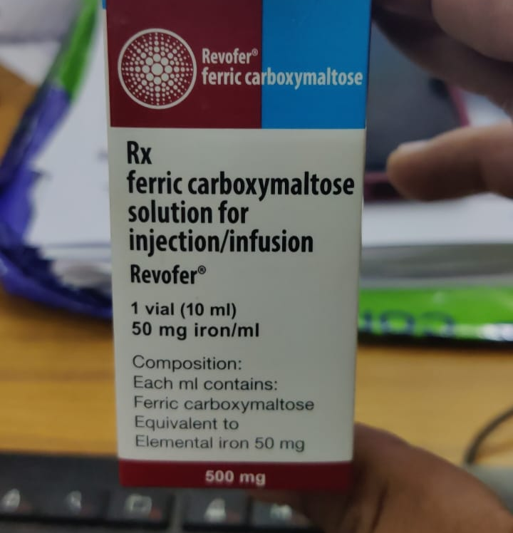
Dose Calculation of FCM
Total Iron deficit (mg)= 2.4 x Body wt (kg) x (11 – actual Hb in gm/dl) + 500
If wt is more than 35 kg allowance for store is 500
If wt is less than 35 kg allowance for store is 15 mg per kg
FCM is available in 10 ml (50 mg iron) & 20 ml vials
Administer with 100 ml of 0.9% normal saline over 15 mins
Maximum dose per session 1000 mg, subsequent doses can be planned on 7th and 14th days

Slide 15
Administration of FCM
Administered as IV infusion under supervision of MO at PHC/CHC/ SDH/DHH/MCH
Vitals to be monitored before, during and after administration
BP, heart rate, respiratory rate, temperature, fetal heart rate
Patency of canula to be checked by flushing normal saline to avoid discoloration of skin due to extravasation of FCM
PW to be observed for 30 mins for adverse events following infusion
Test dose is not required

Slide 16
Precautions for FCM administration
Kit for managing adverse events must be kept ready
Hand hygiene to be performed before and after procedure
Sterile and disposable IV infusion set, IV canula and syringe must be used
Patency of canula must be ensured to prevent extravasation of iron and permanent staining of skin.
Remaining unused drug in the vial must be discarded

Slide 17
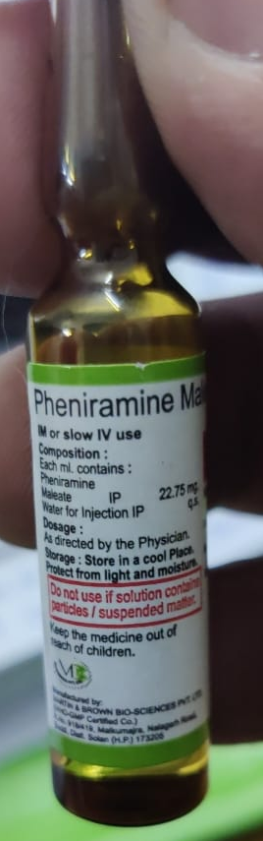
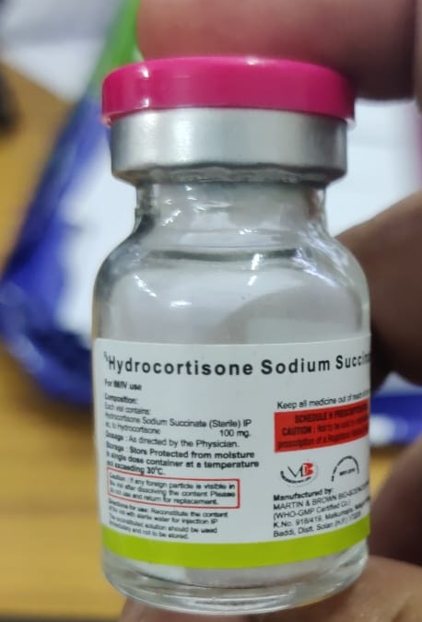
Management of adverse events following FCM administration
Kit to be kept ready
5 ml syringe – 1
2 ml syringe – 1
Inj. Pheneramine Maleate – 1 ampoule
Inj. Hydrocortisone – 1 vial
Source of Oxygen
Mention batch number and expiry date of both drugs on the top of kit
In case of adverse reaction, stop FCM administration, administer 1 amp (2ml) of Inj. Pheneramine Maleate IV, 1 vial of Inj. Hydrocortisone IV (100 mg in 5 ml).
If not responding Inj. Adrenaline 0.5ml IM may be administered to relieve symptoms

Slide 18
FOLLOW UP ACTIONS AFTER ADMINISTRATION
Check Hb level 4 weeks after administration
If there is no improvement or less than 1 gm/dl increase in Hb, look for other causes of anemia
IFA tablets need not be given for 3 months post full dose of infusion. Revaluate after 3 months regarding course of action.
Counsel the pregnant woman and family regarding appropriate diet.

Slide 19
