Slide 1

Topic: 1

Slide 2
Importance of Care for Newborn at Birth
Most of the neonatal deaths occur during delivery or on the day of birth
Even for the deaths occurring in the rest of neonatal period, care given at the time of birth is an important influencer
A lot of deaths of newborns due to hypothermia, asphyxia and infection can be prevented by providing essential newborn care to all newborns immediately after birth

Slide 3
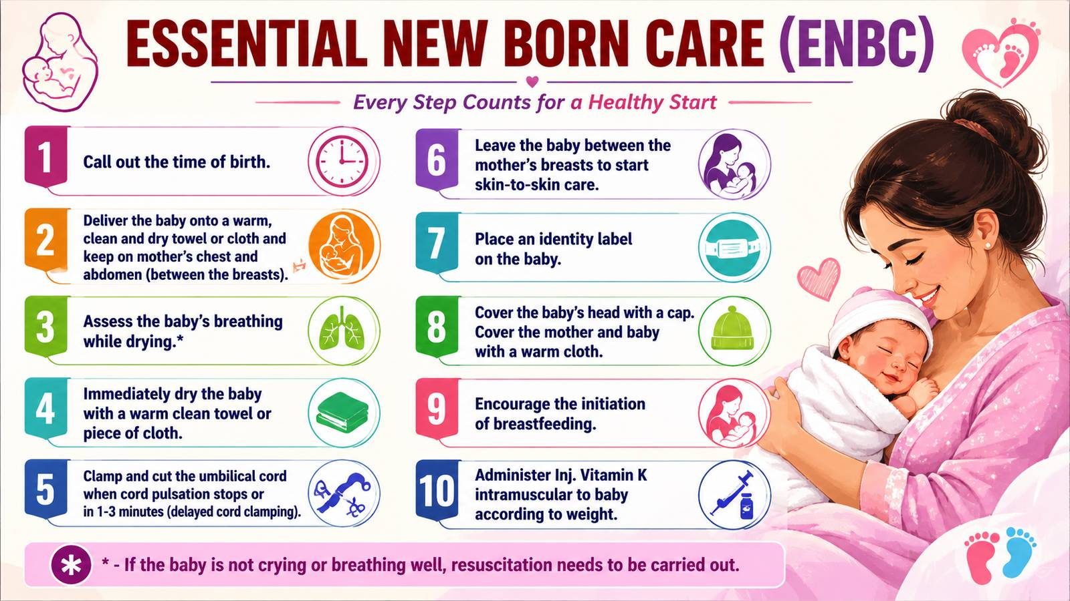

Slide 4
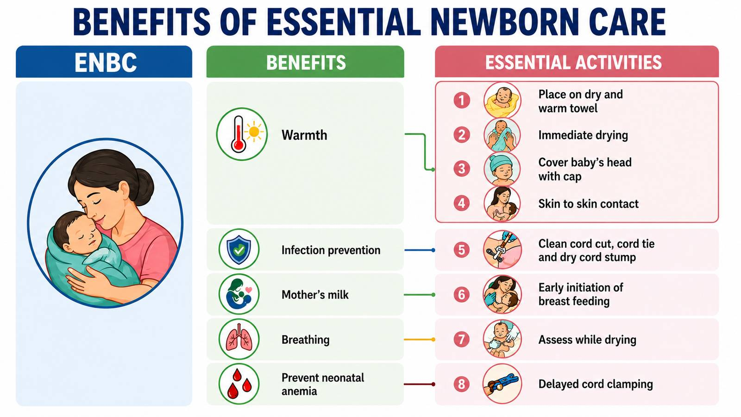

Slide 5
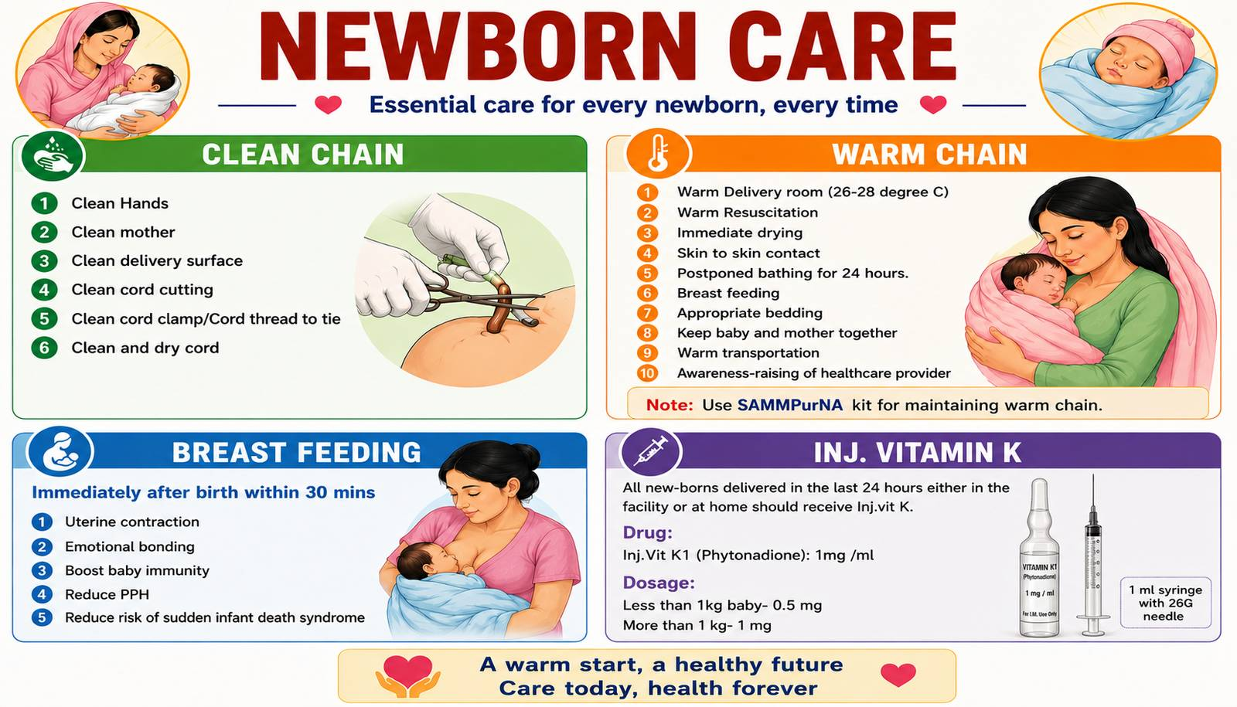

Slide 6
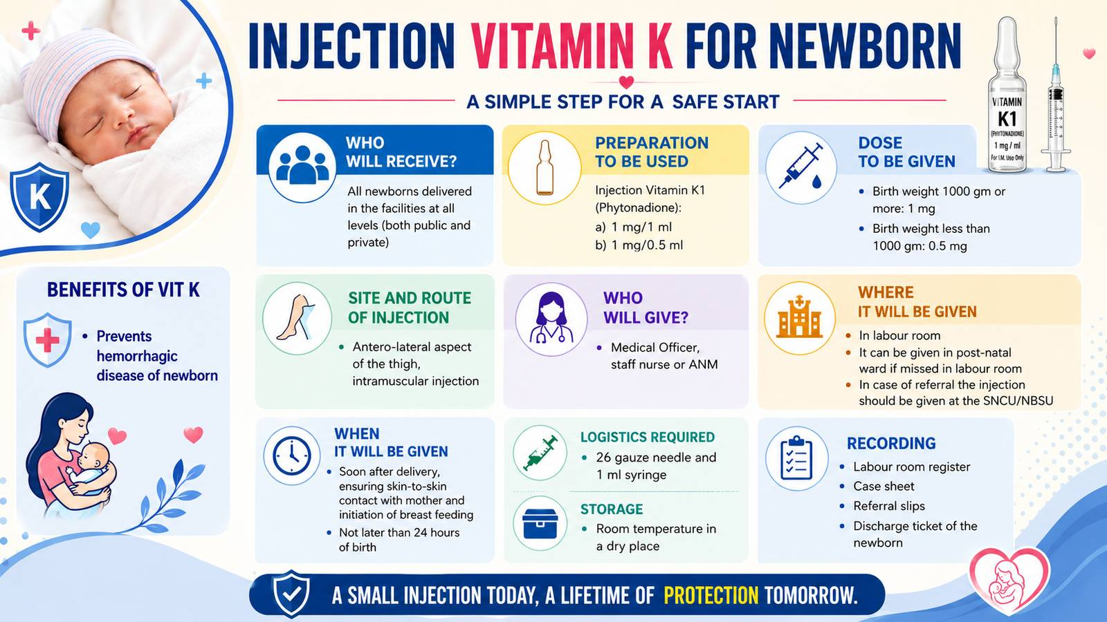

Slide 7
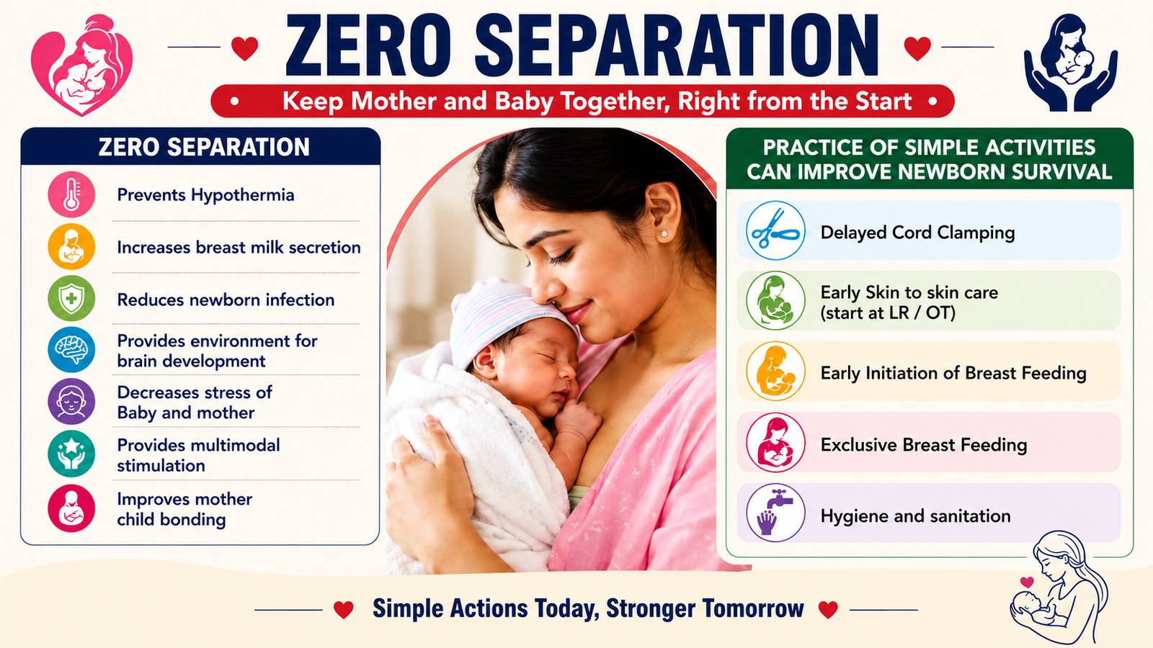

Slide 8
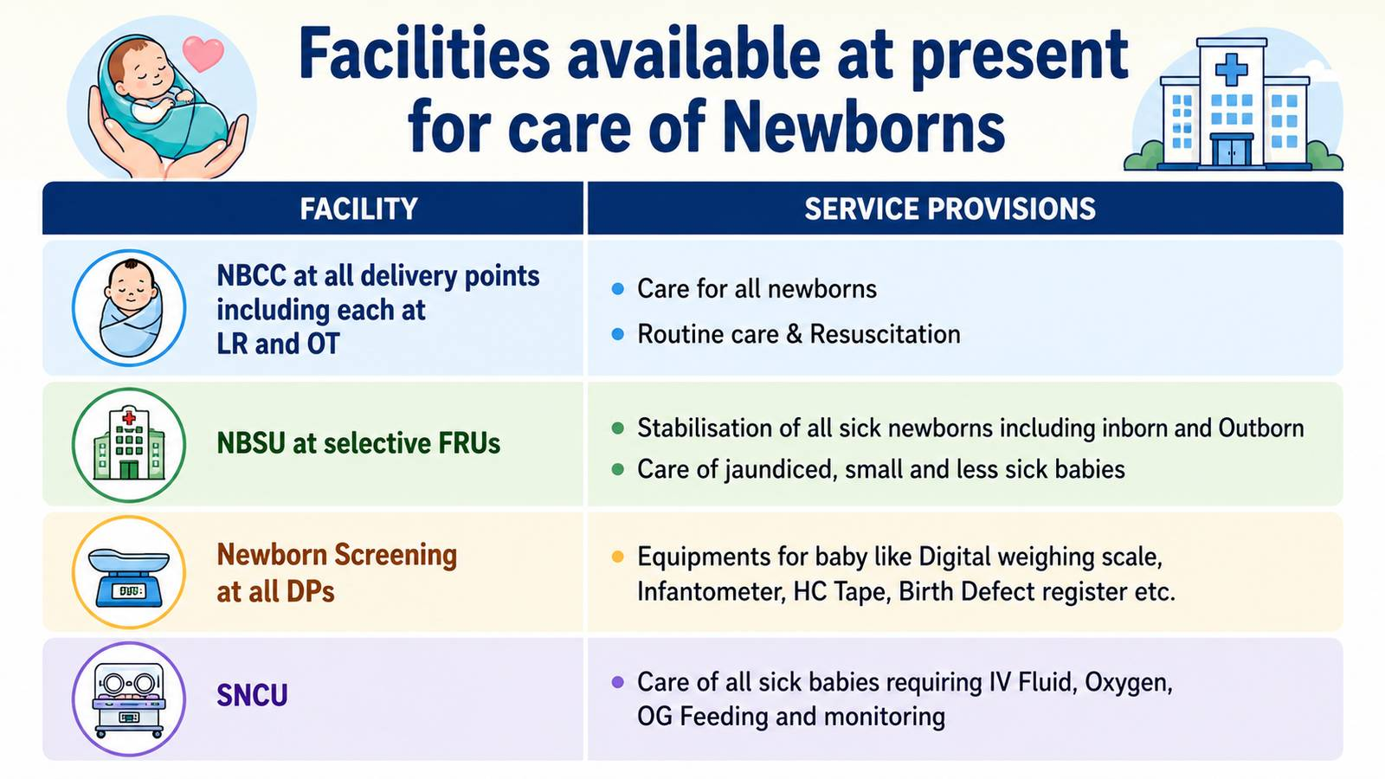

Slide 9
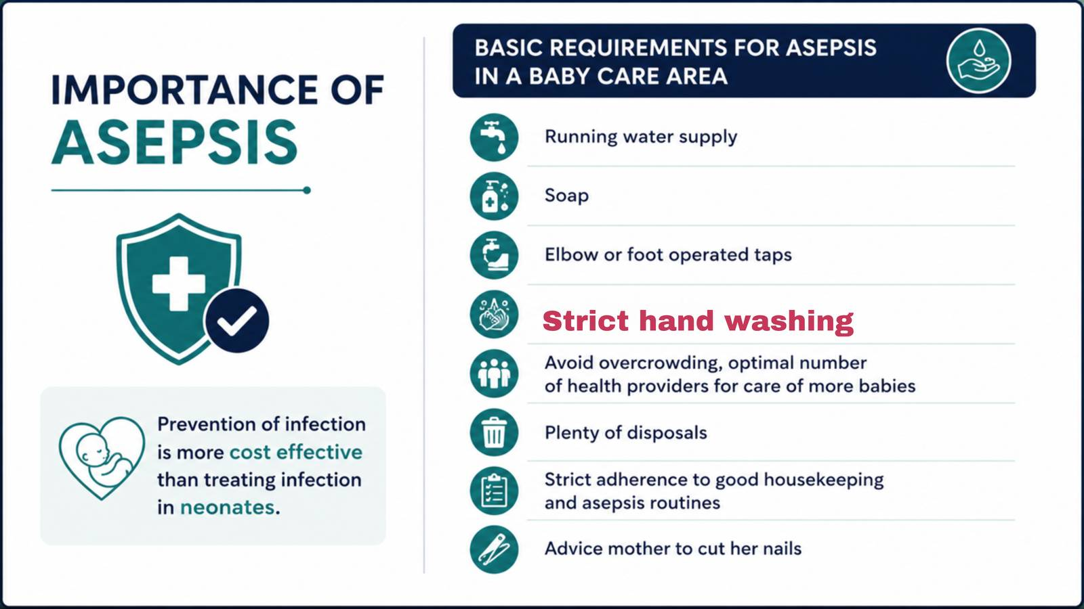

Slide 10


Slide 11
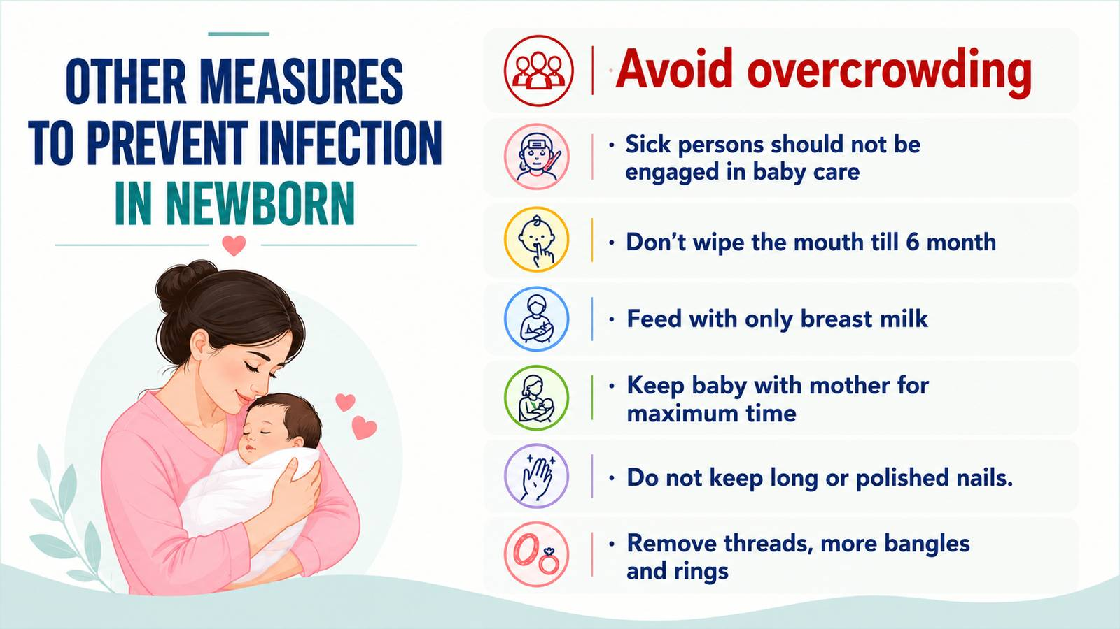

Slide 12



Monitoring of Baby (Delivery Case-sheet)

Slide 13


Slide 14
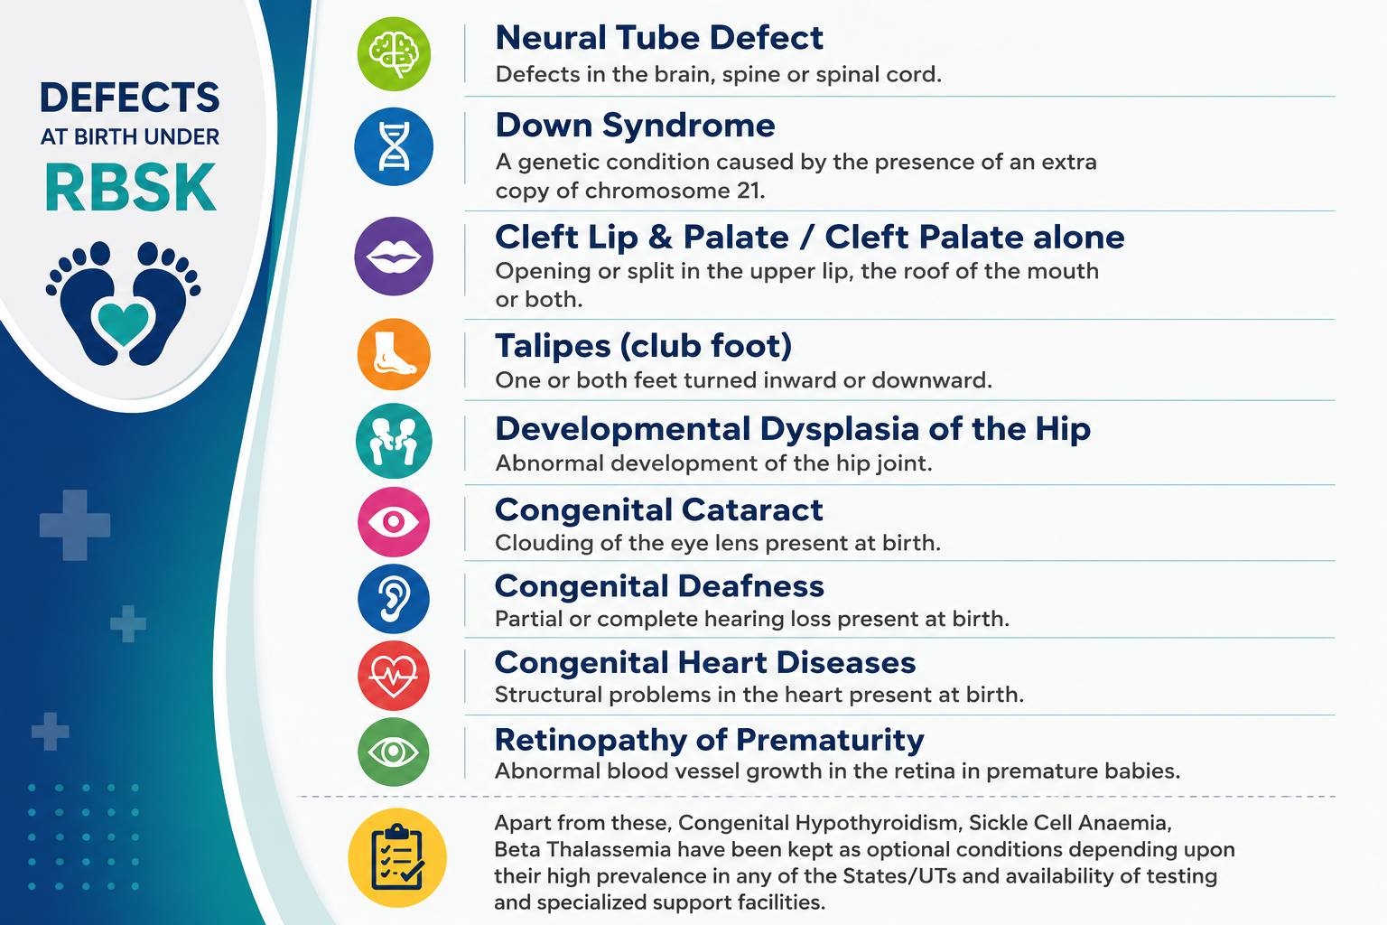

Slide 15
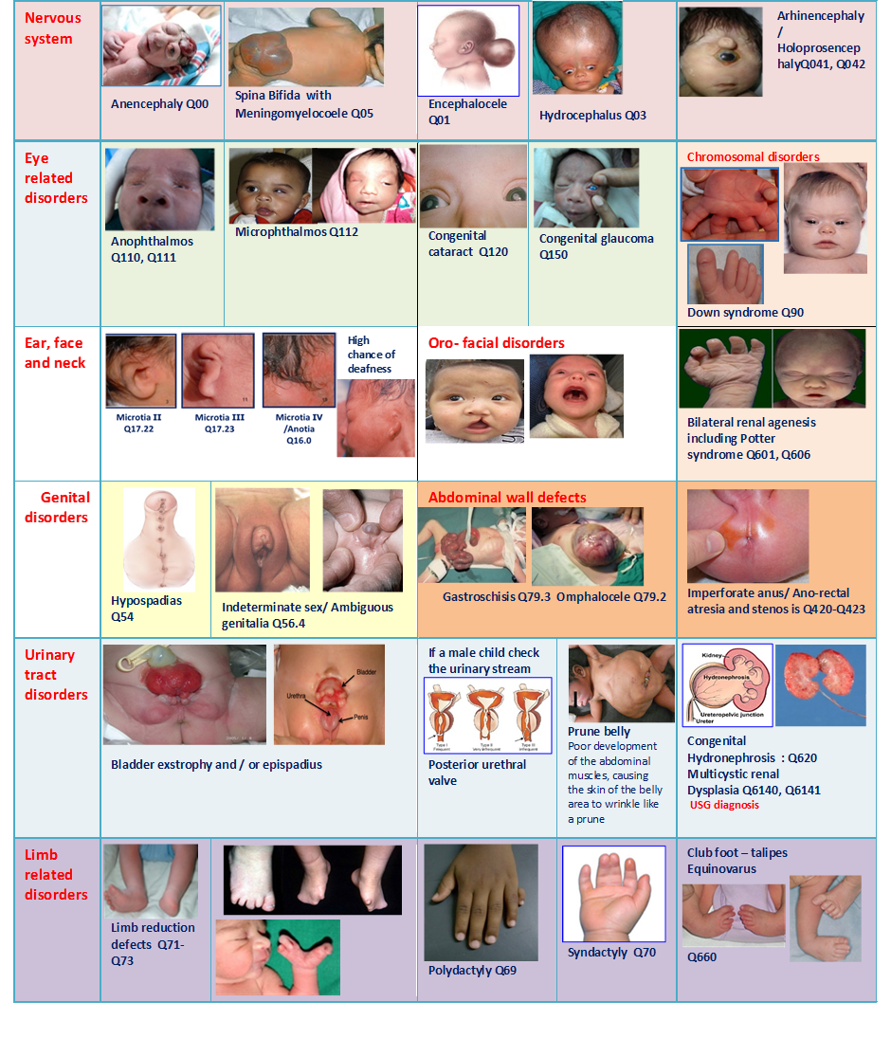

Slide 16
RoP IEC

Slide 17
