Slide 1

Thermal Control (KMC)
Topic: 3

Slide 2
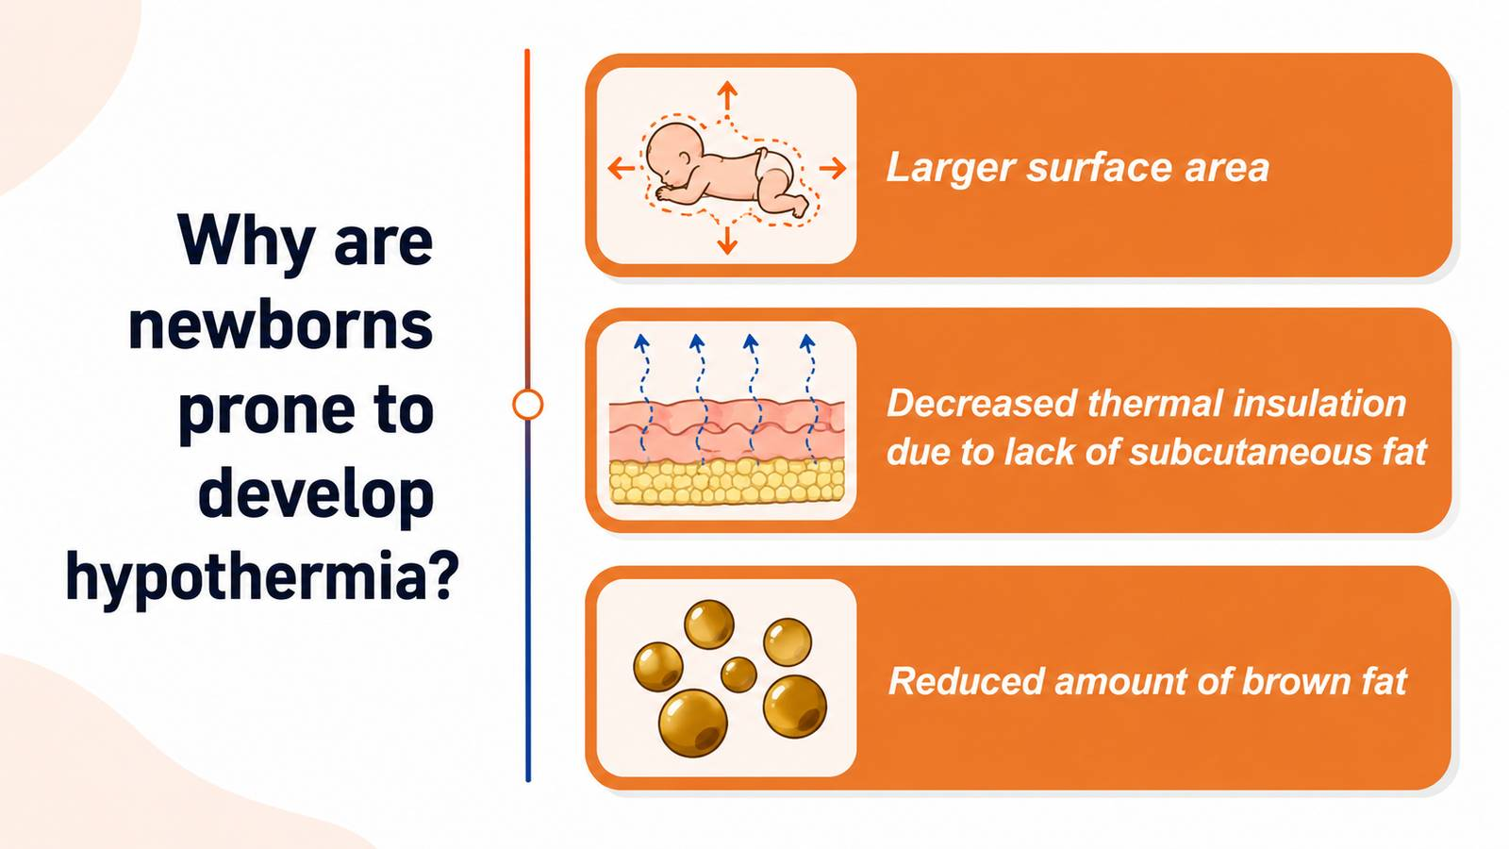

Slide 3
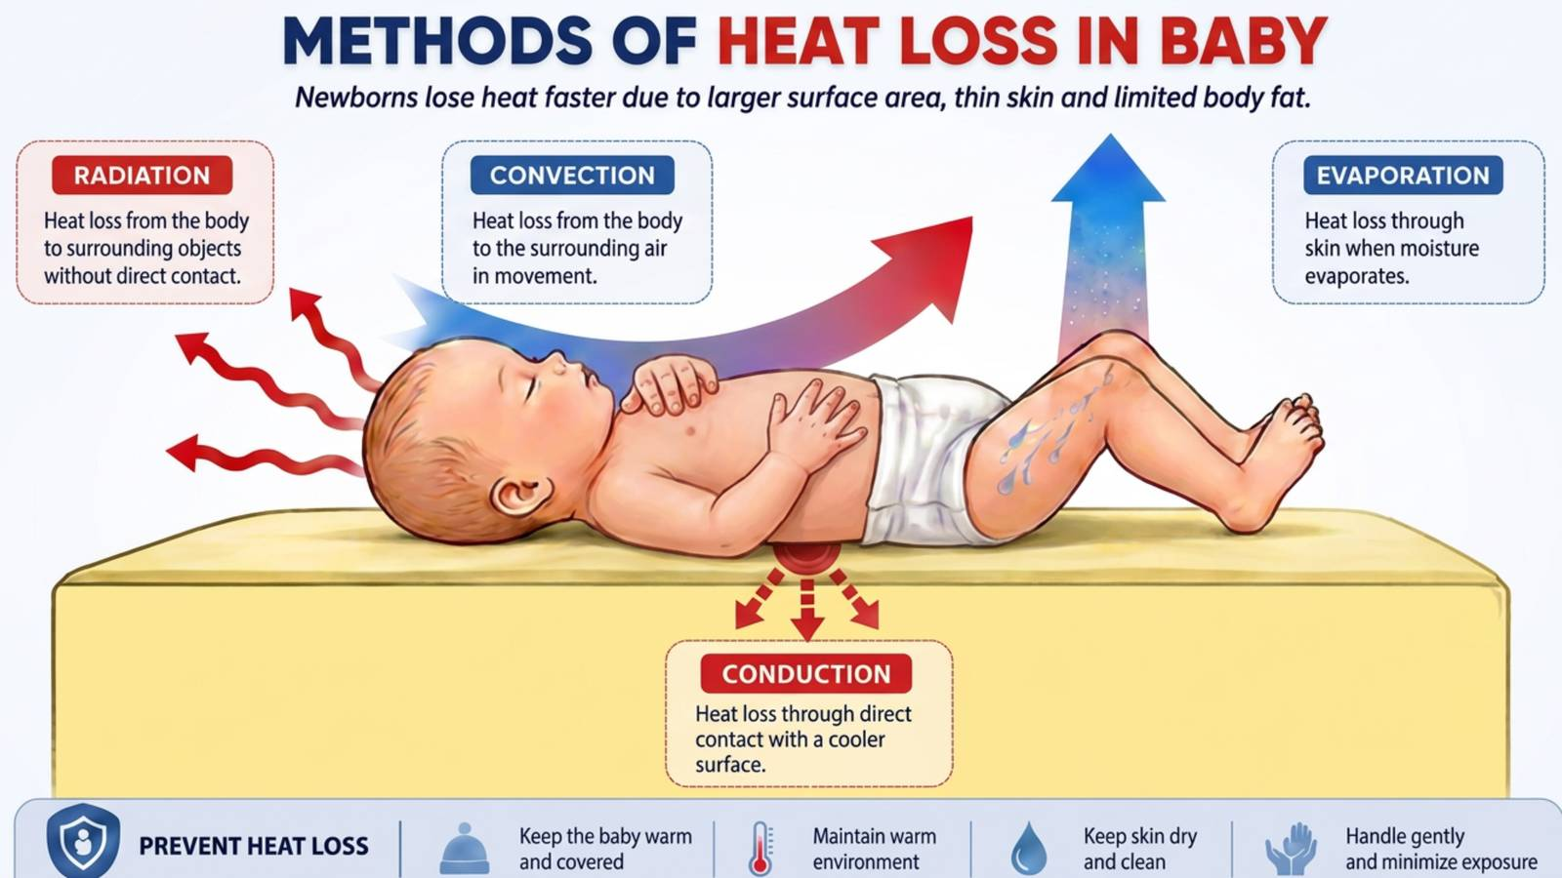

Slide 4
ASSESSMENT OF TEMPERATURE BY TOUCH
Feel by touch Trunk | Feel by touch Extremities | Interpretation
Warm | Warm | Normal
Warm | Cold | Cold stress
Cold | Cold | Hypothermia

Slide 5
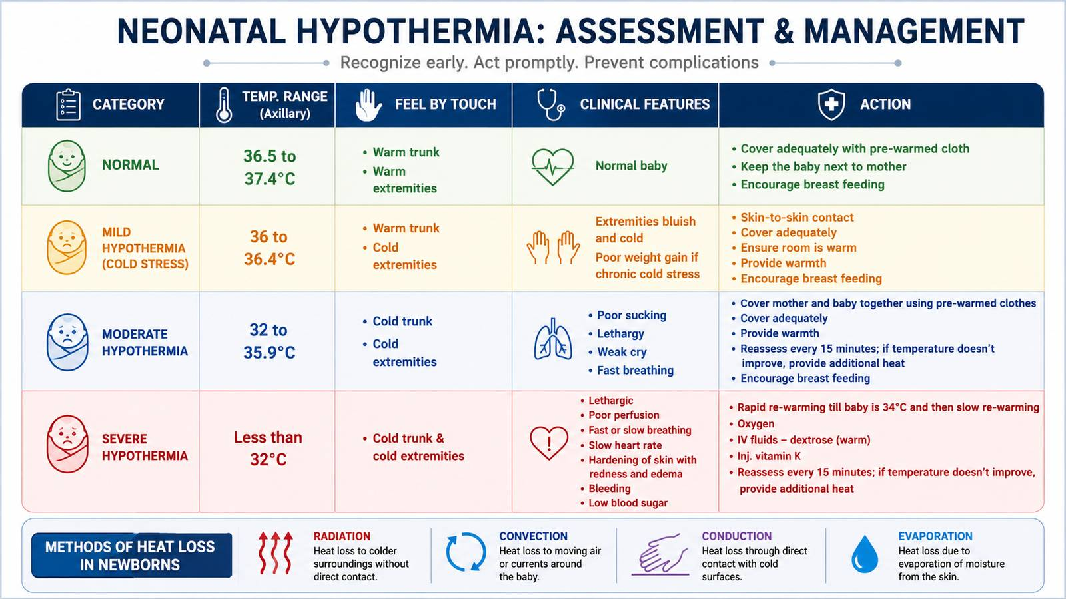

Slide 6
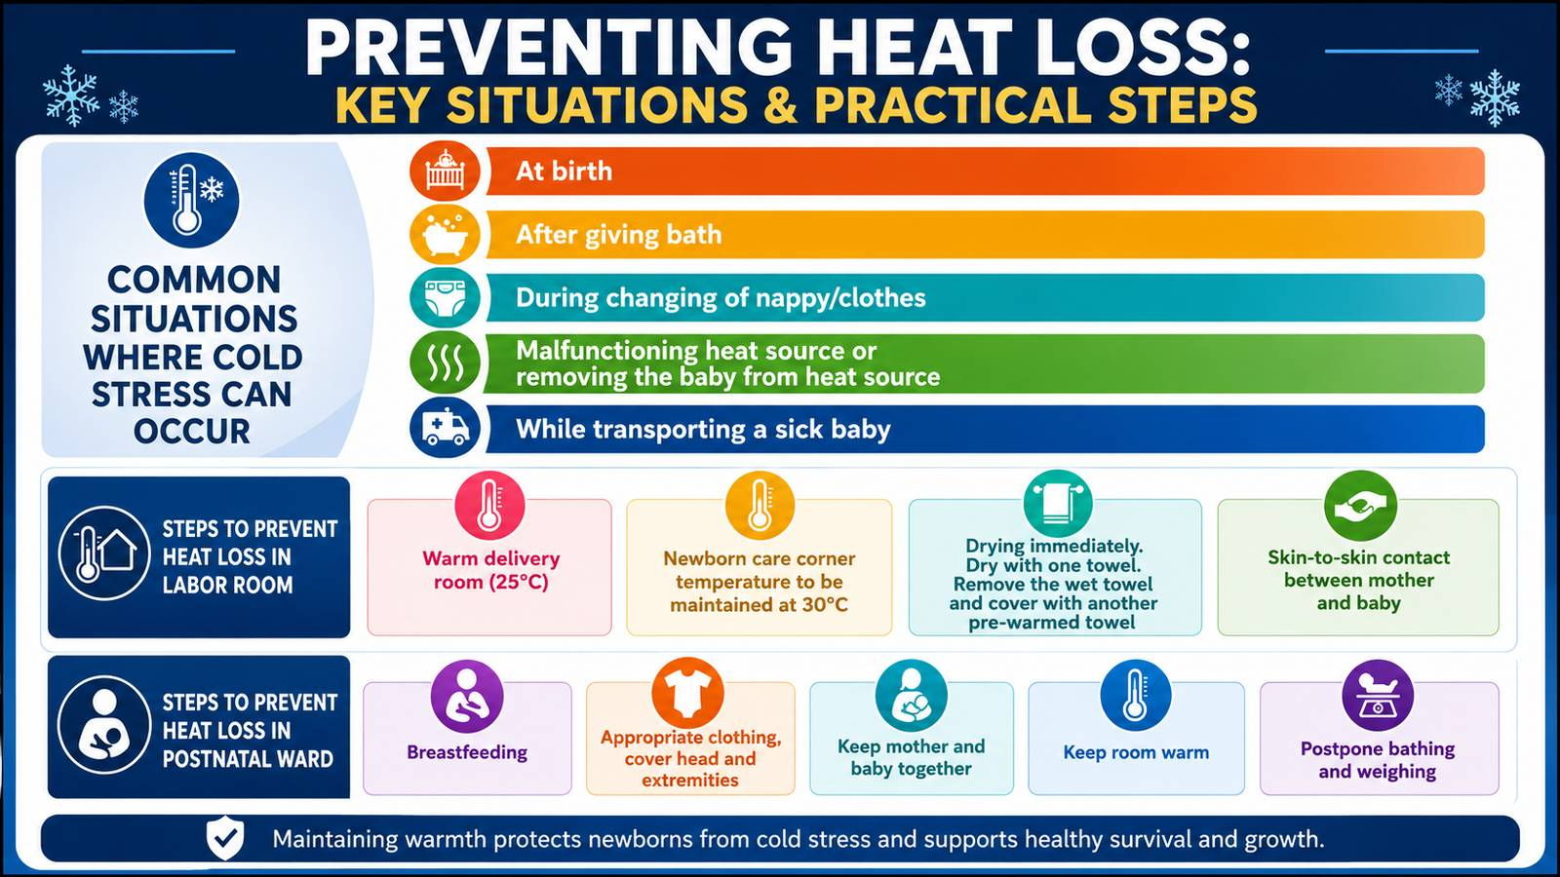

Slide 7
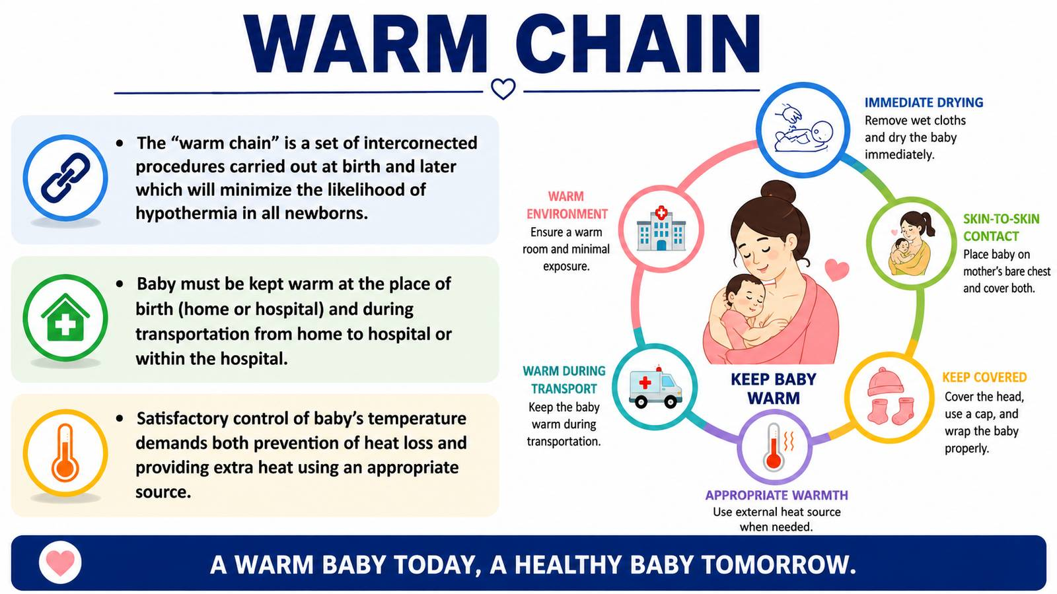

Slide 8
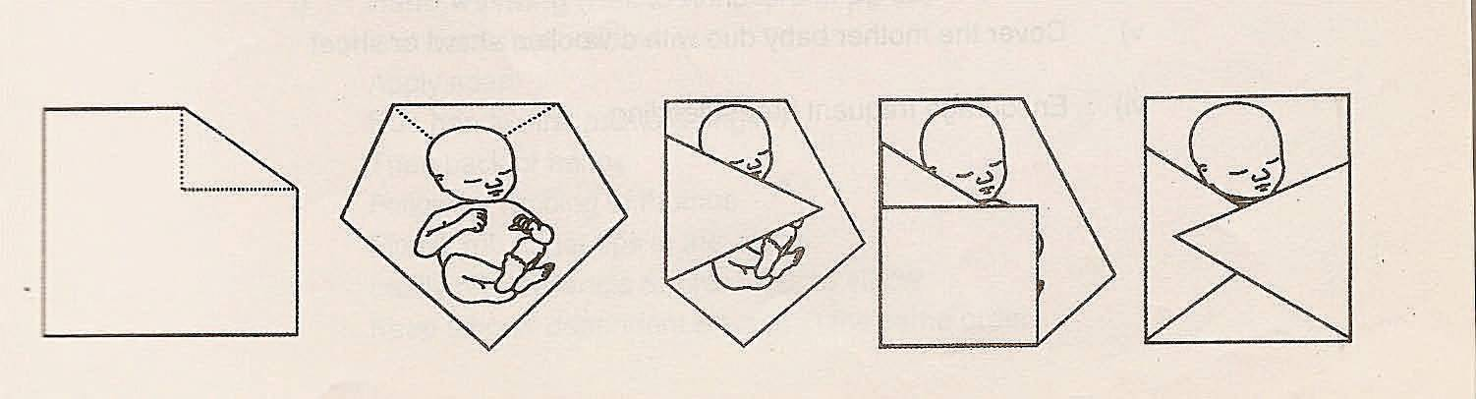
Wrapping and covering a baby

Slide 9
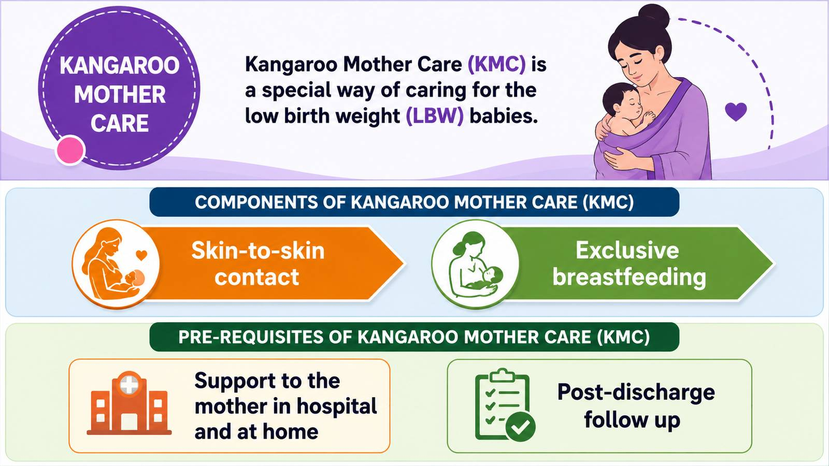

Slide 10


Slide 11
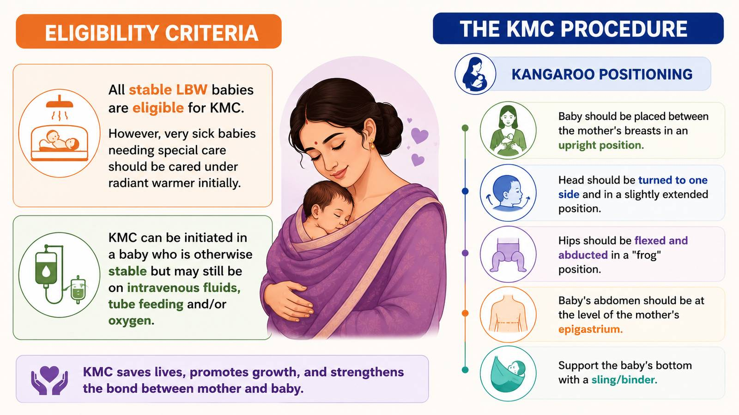

Slide 12
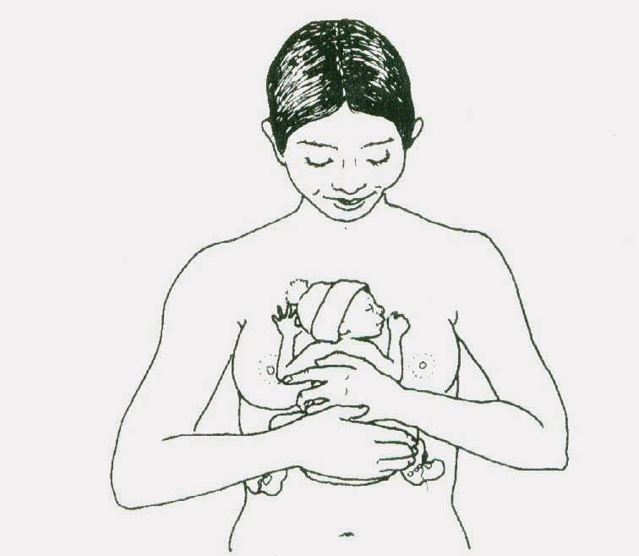
Kangaroo positioning

Slide 13
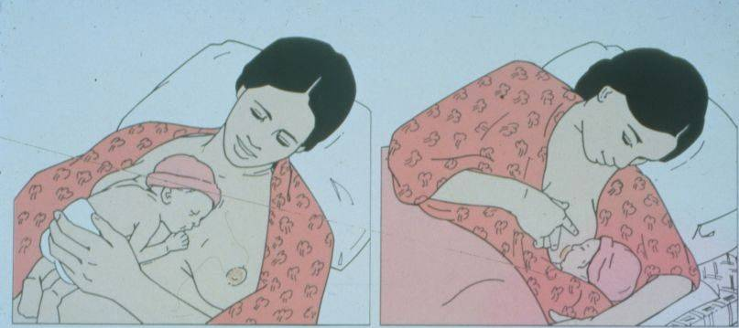
THE KANGAROO METHOD
Place baby in this position
Then cover with clothes
Notes:
176

Slide 14
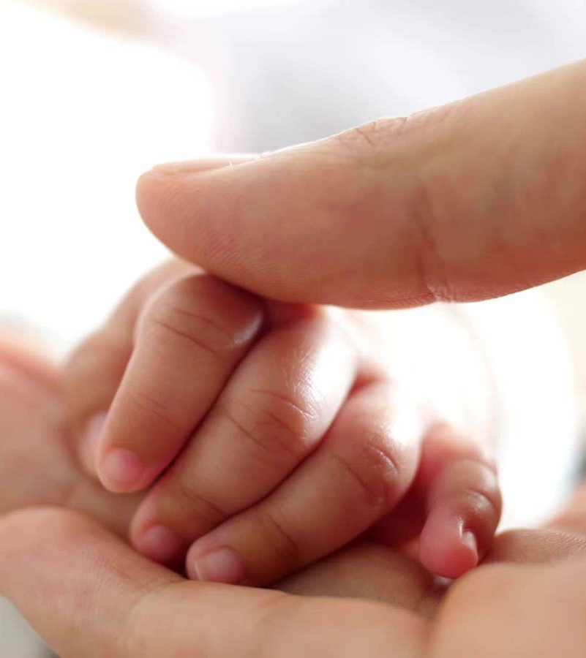
Monitoring
Ensure that baby's neck is not too flexed or too extended, breathing is normal, and feet and hands are warm during KMC

Slide 15
Duration of KMC
Sessions that last less than one hour should be avoided
The length of skin-to-skin contacts should be gradually increased up to 24 hours a day, interrupted only for changing diapers.

Slide 16
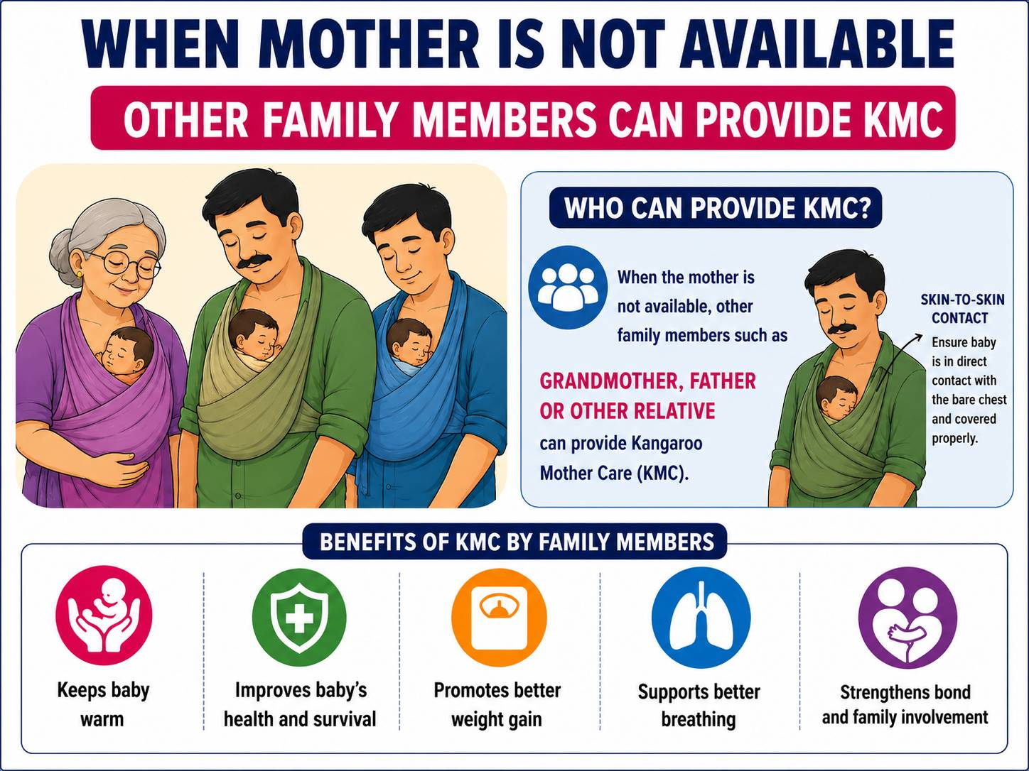

Slide 17
