Slide 1
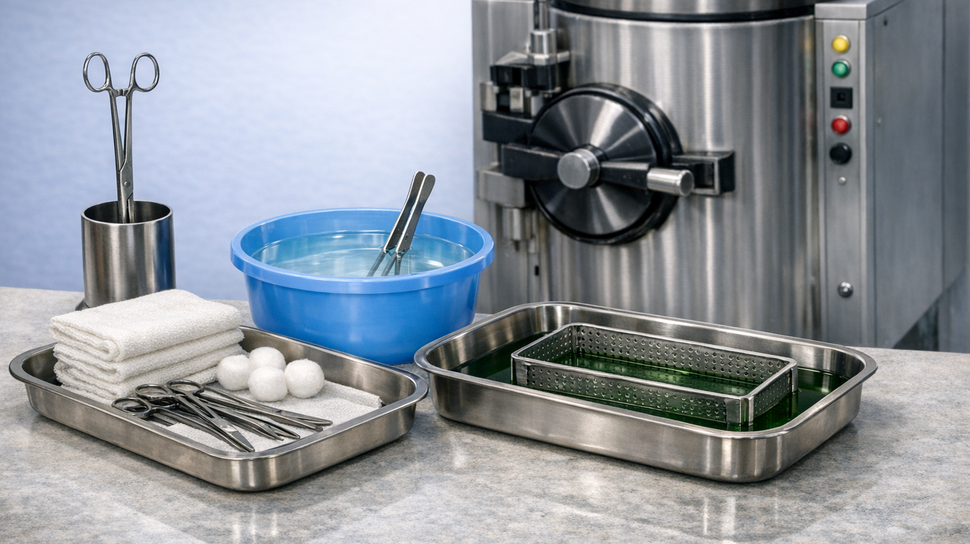
Instrument Processing
Topic: 10

Slide 2
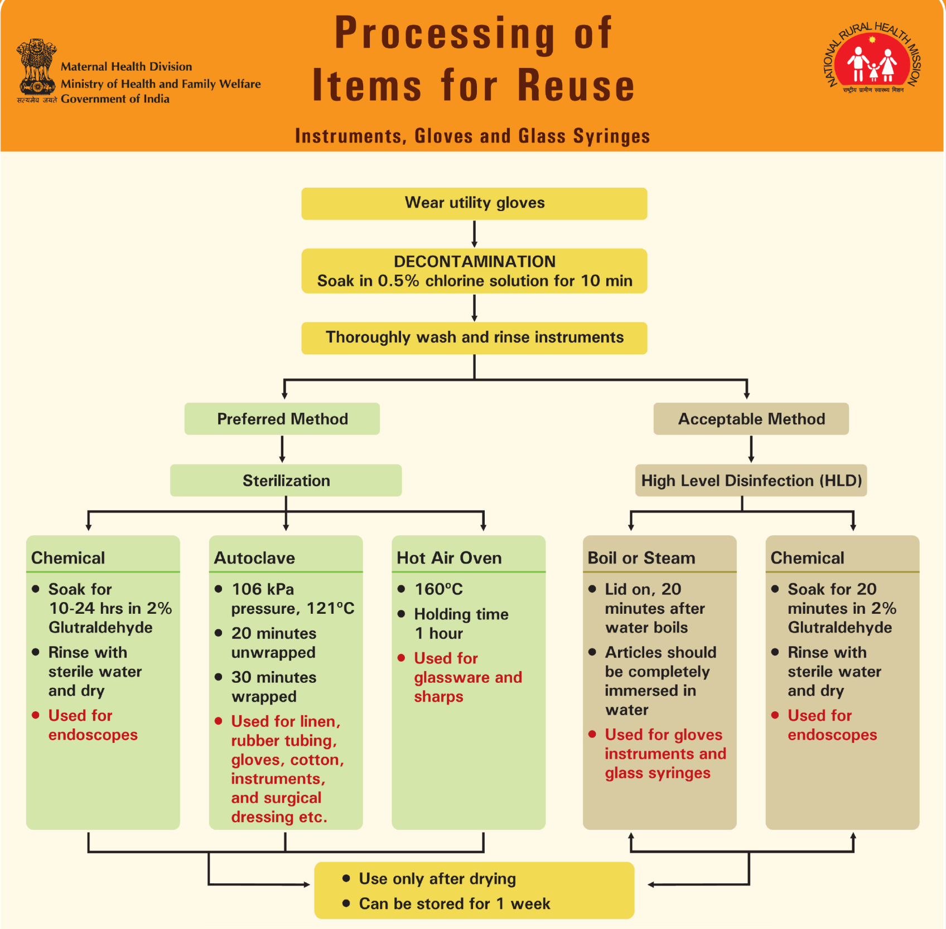
0.5% for 30 mins as per state Kayakalp guideline

Slide 3
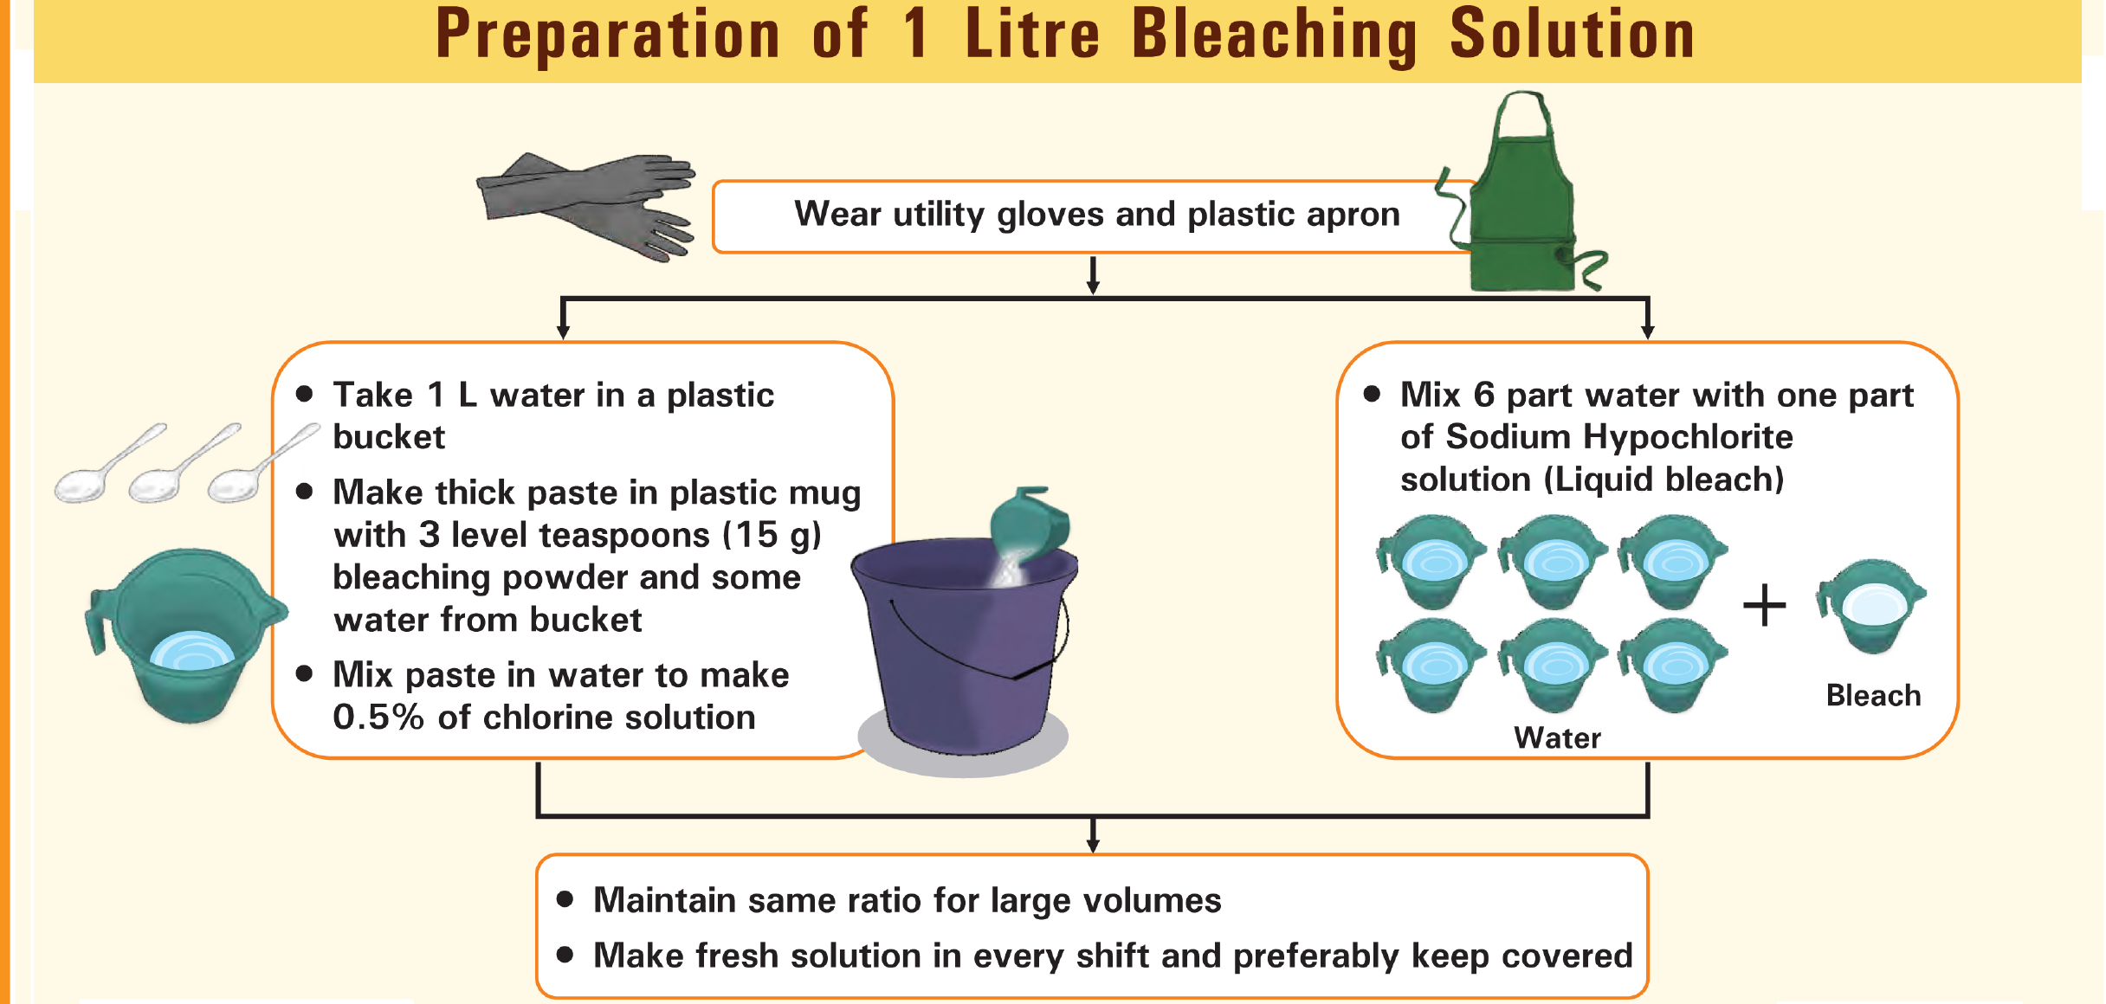
3.5%

Slide 4
Hypochlorite solution available concentration and dilution
Available concentration | Desired Concentration | Dilution
3.5% | 0.5% | 6 part of water and 1 part of Hypochlorite solution
3.5% | 1% | 2.5 part of water and 1 part of Hypochlorite solution
5% | 0.5% | 9 part of water and 1 part of Hypochlorite solution
5% | 1% | 4 part of water and 1 part of Hypochlorite solution
Bleaching powder | 0.5% | 1 litre water 15 gms Bleaching powder
Bleaching powder | 1 % | 1 litre water 30 gms Bleaching powder

Slide 5
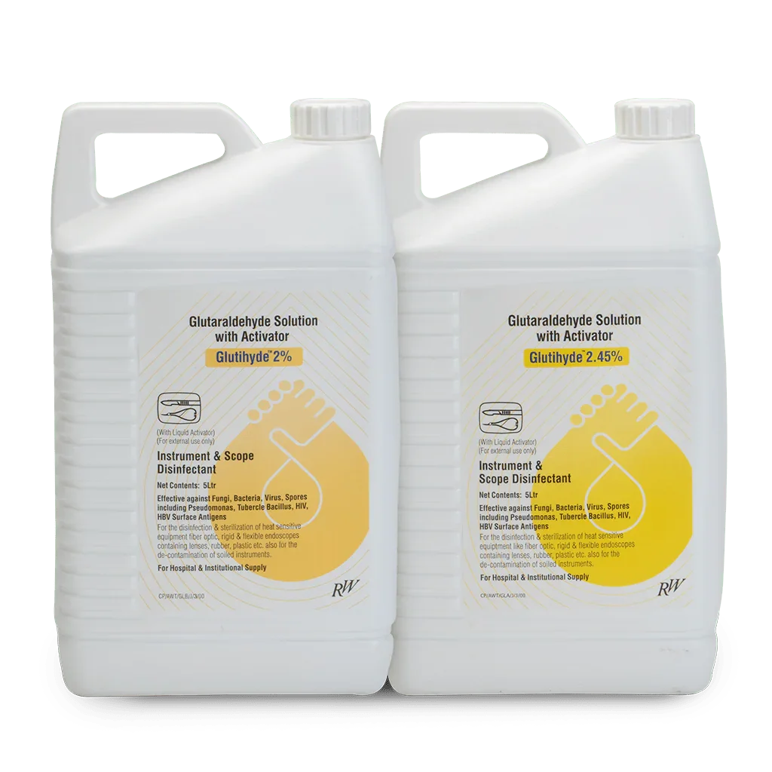
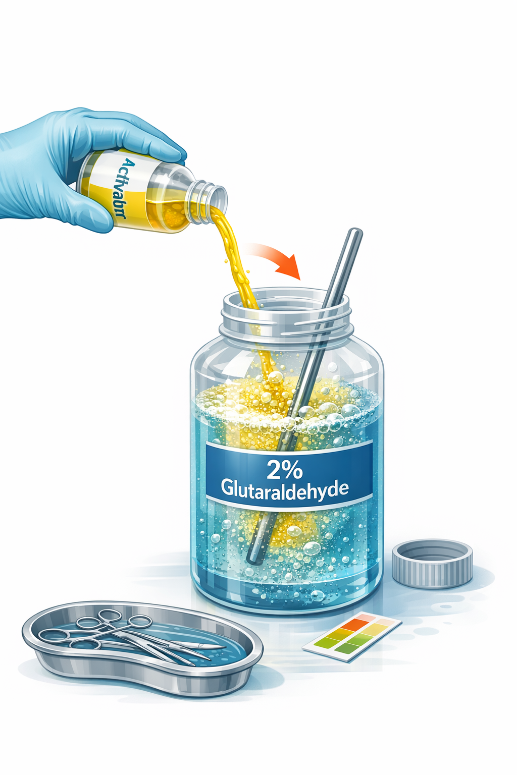
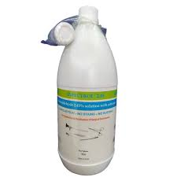
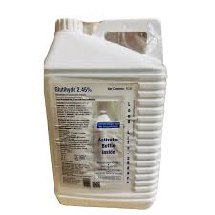
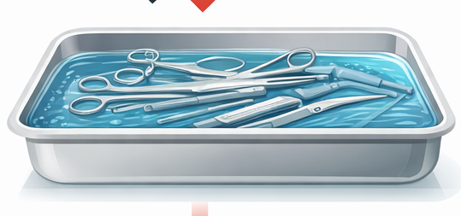
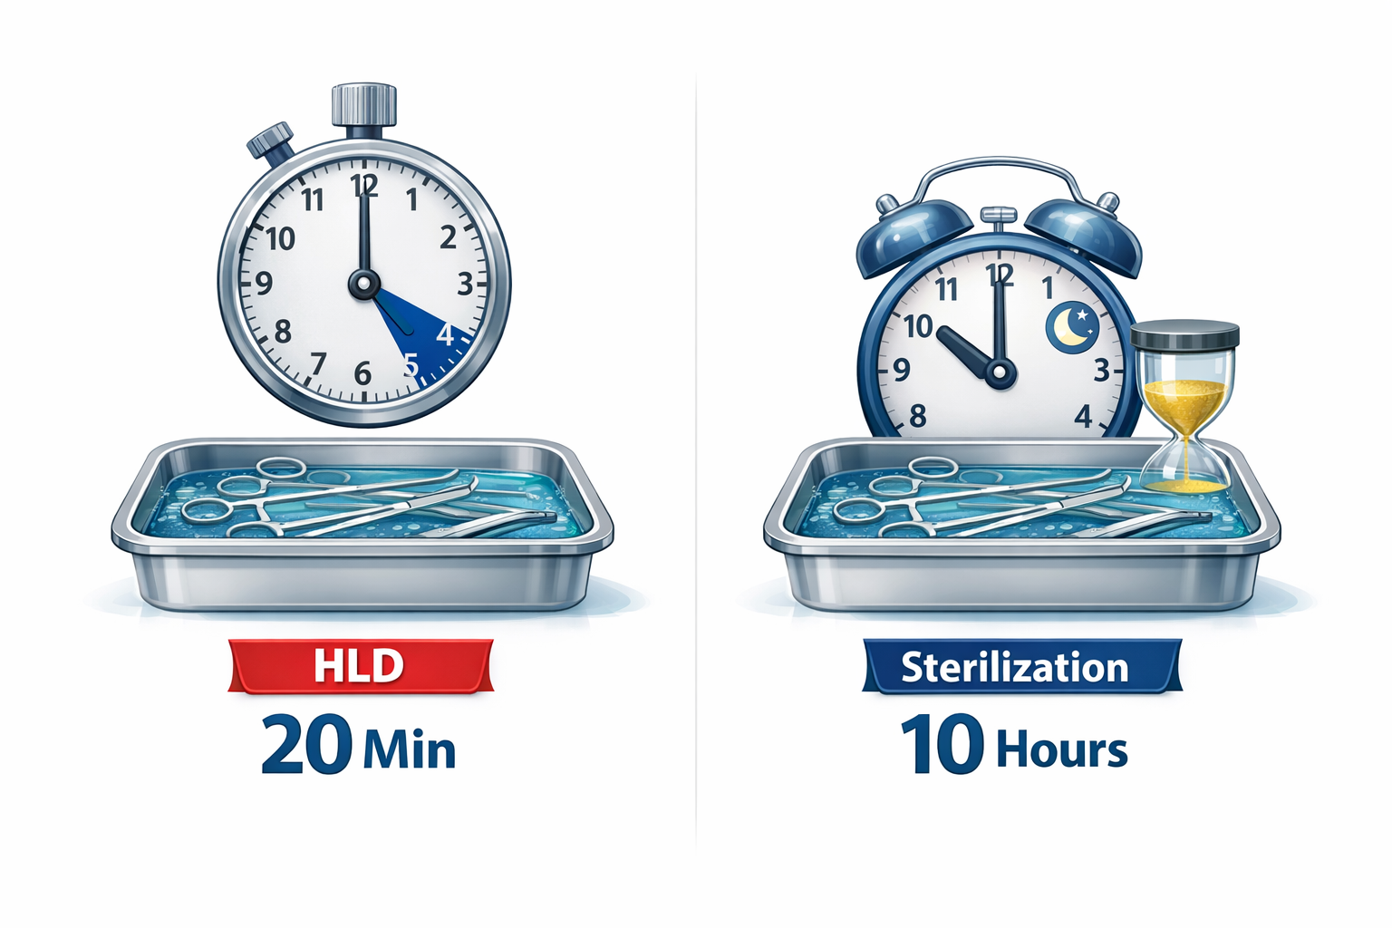
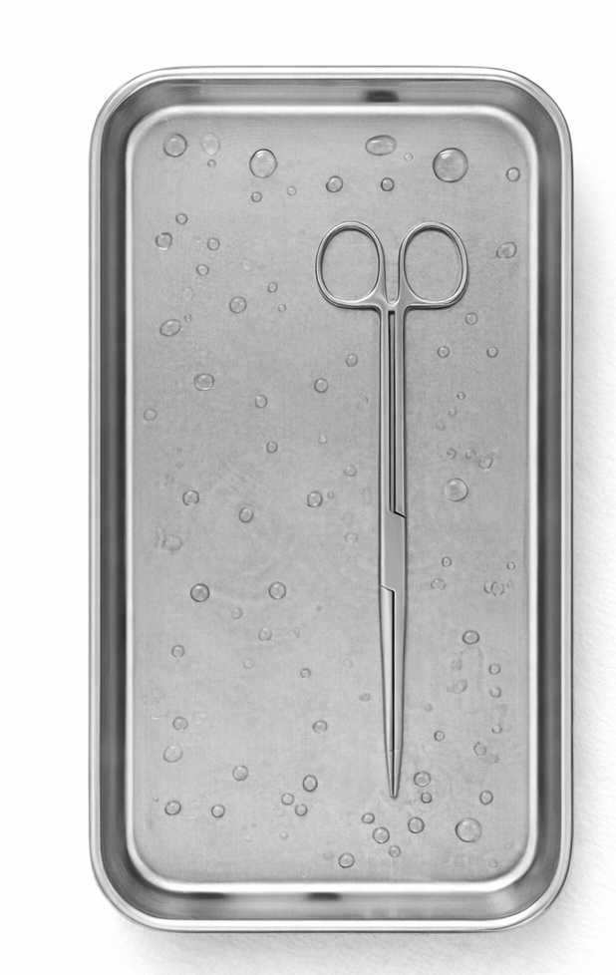
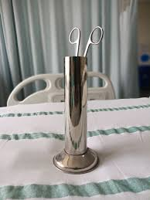
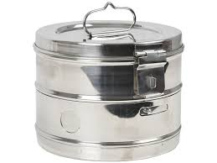
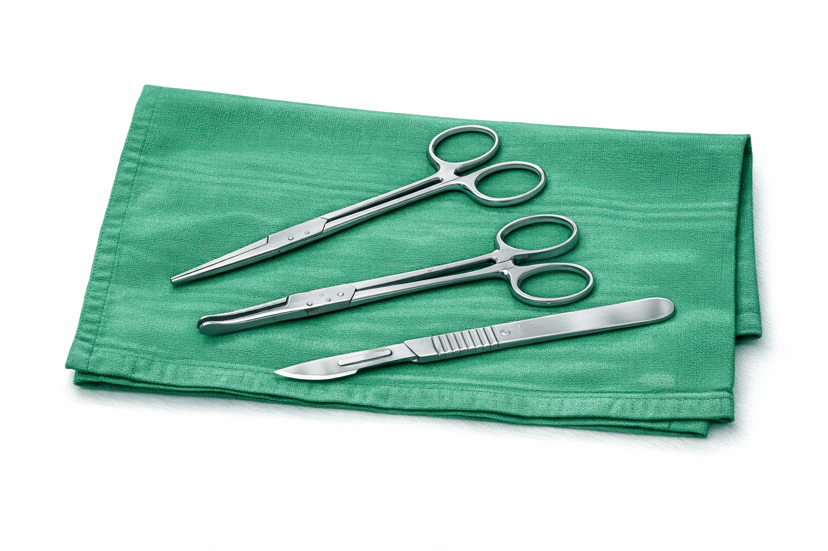
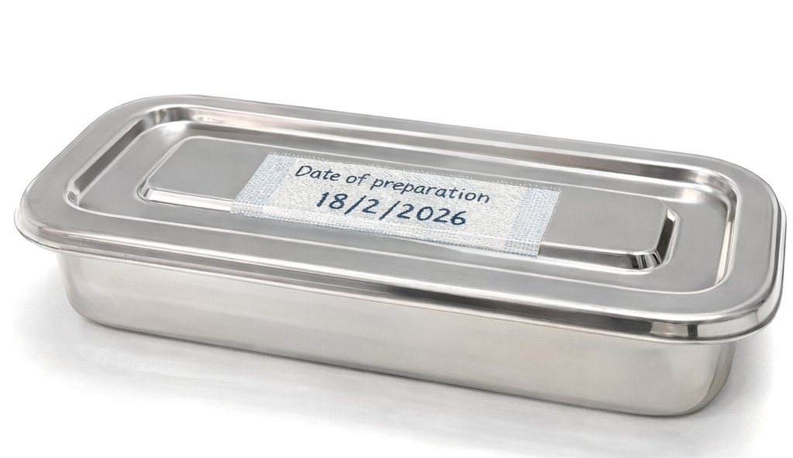
High Level disinfection/ Chemical sterilization
3. Once activator is Added 2% Glutaraldehyde can be use upto 14 days, if 2.45% of glutaraldehyde solution mixture can be used upto 28 days. (If Looking opaque or dirty change immediately)
Read the leaflet for instruction
1. Glutaldehyde minimum 2% is only acceptable Chemical HLD/Sterilization for instruments.
4. Keep instrument fully immerge in Glutaraldehyde solution 20 mins for HLD and 10 hours for Sterilization. (Count the time from the period of Last added instrument in solution)
2. Add activator in the liquid. ( Package together)
Date of adding of Activator to be mentioned in Bottle and Tray.
6. Air dry use sterile cloth or store in a container if not used with in time period again follow HLD/Sterilization.
5. Remove with sterile gloves or Sterile Cheatle forcep. Rinse in sterile water/Normal saline.
Notes:
360

Slide 6
