Slide 1



STANDARD OPERATING PROCEDURE
TRANSPORTATION OF HIGH-RISK PREGNANCIES TO MCHs / FUNCTIONAL FRUs
Topic: 3

Slide 2


REFERRAL LINKAGE
Tagging Calls to the Right FRU
108 Emergency Call Centre
The 108 Emergency Call Centre shall ensure that referral calls from the concerned blocks are linked to the respective tagged FRUs, as indicated in Annexure I.
Referring Facilities (Block Level)
Referring facilities at the block level (SC/PHC/CHC/SDH) shall initiate referrals to the tagged FRU, unless diversion is required due to unavoidable circumstances.

Slide 3


CALL & DISPATCH
Confirming High-Risk Status and Dispatch
Confirmation of High-Risk Status
If the call from HRP is given to 108 from home by ASHA/or attendant of pregnant women, then confirmation of high risk status will be made by ensuring the RED card availability with delivery case or by enquiring of any complicated condition/ danger sign condition. In such cases, the delivery case is to be referred to the functional FRU as per the tagged block list.
Call Centre Action
The call centre shall dispatch the ambulance and simultaneously send an SMS to the referral nodal officer of the tagged facility to ensure advance preparedness for receiving the patient.

Slide 4



REFERRAL SLIP
Who Signs the Referral Slip
Receiving the Patient
The 108 EMAS /Janani driver shall receive the patient along with a properly filled referral slip signed by the Medical Officer of the referring facility.
Below CHC Level (PHC / Sub Centre)
In facilities below CHC level, ie., PHC, the Medical Officer/AYUSH doctor who ever has treated the case, shall sign the referral slip. In case of non-availability of Medical Officer, senior nursing officer/ on duty nursing officer of the facility/and HW(F) in case of sub center shall sign the referral slip.
Night Hours
If the referral is done during night hours the available MO /Nursing officer will give the referral slip to the maternity case while referring.

Slide 5



HANDOVER
Receiving the Patient at the Facility
Receiving Facility Preparedness
Recording the Handover
The receiving MCHs/FRUs shall ensure preparedness for receiving referred high-risk pregnancy (HRP) cases and maintain effective communication with the referring facility and the 108 EMAS/Janani driver.
The 108 Janani driver/EMAS shall hand over the patient at the referred facility along with the referral slip and handover the referral case to the facility and record the details in the handing over app by the 108 EMAS/Janani driver.
Photo & Digital Signature
District Monitoring
While handing over, both photograph and digital signature will be obtained through the app from the person to whom patient will be handed over at the facility level.
District authorities shall monitor adherence to the tagging mechanism and review referral patterns during routine review meetings.

Slide 6



SUSTAINING THE SOP
Sensitization, Retagging & Reporting
Sensitization of Field Staff
All 108 Janani drivers/EMAS/ Service providers / NHM PMU staff shall be sensitized on the SOP for referral of high-risk pregnancies at district and block level
Retagging of Facilities
Monthly Status Update
In case of any change in the functionality status of FRU, transfer of specialist manpower, any infrastructural related issues OT or Labour Room, the district will inform to State for retagging of the facilities.
The update on the FRU status is to be given to State on the monthly basis by CDM& PHO.

Slide 7





PROCESS AT A GLANCE
Referral Flow: Call to Handover
1
108 Call Received
Referral linked to tagged FRU
↓
HRP Status Confirmed
RED card / danger signs checked
2
↓
Ambulance Dispatched
SMS sent to referral nodal officer
3
↓
Referral Slip Signed
By MO / AYUSH / Nursing Officer
4
↓
Patient Handed Over
Photo & digital signature recorded
5

Slide 8
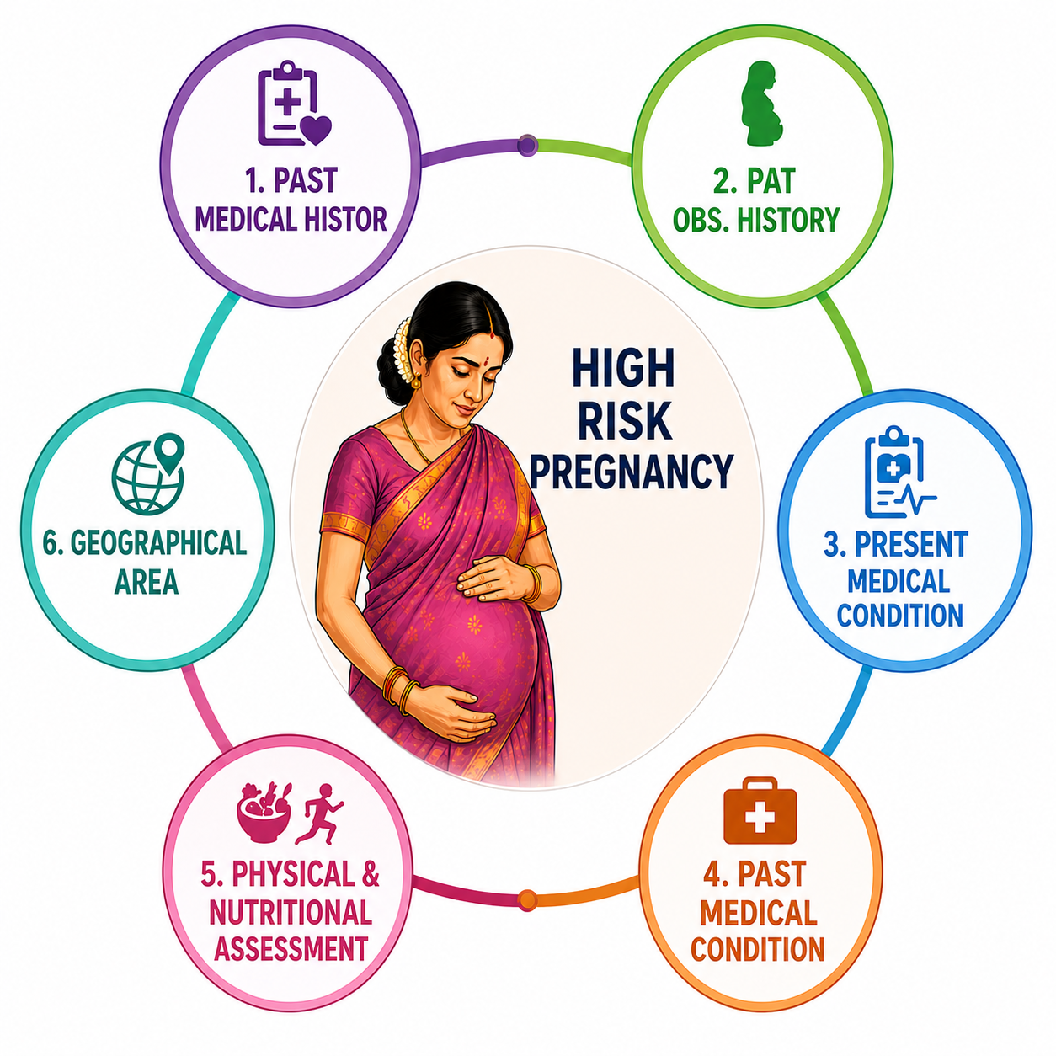
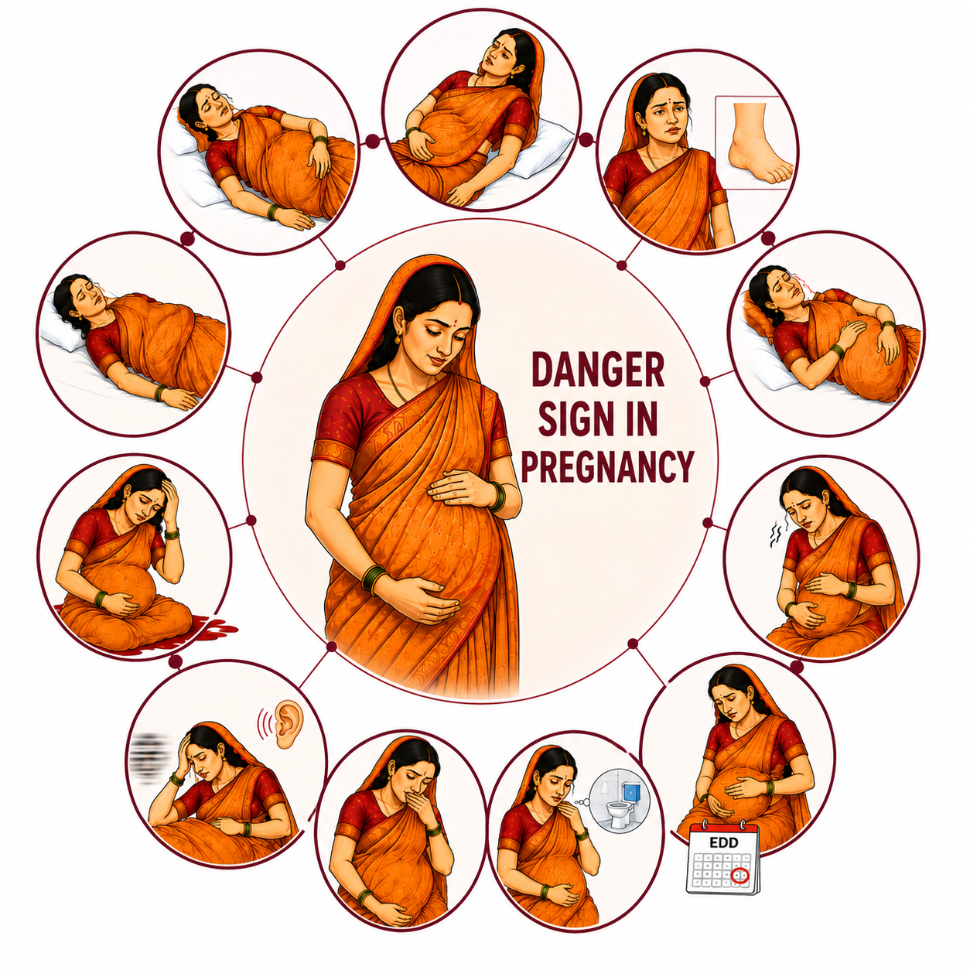
Topic:4

Slide 9
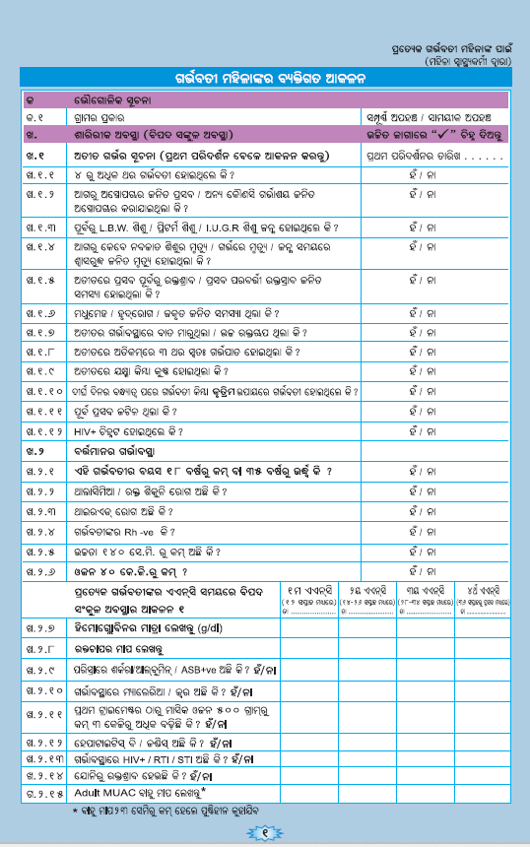
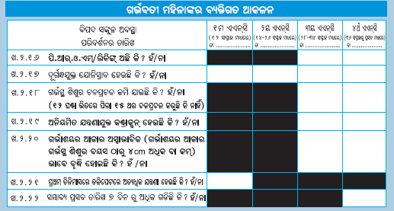
HRP condition in MCP card

Slide 10
S.L. No | High risk Condition (History) | S.L. No | High risk Condition (Current pregnancy)
1 | Previous LSCS | 19 | Geographically hard to reach area
2 | Any other Surgery involving Uterus | 20 | Grand Multi ( Morethan 4 Preganancy)
3 | Previous H/O LBW | 21 | Age less than 18 years
4 | Previous H/Opreterm | 22 | Age morethan 35 years
5 | Previous H/O IUGR | 23 | Thallassemia
6 | H/O Newborn Death | 24 | Sickle cell Disease
7 | H/O Still Birth | 25 | Hypothyroidism
8 | H/O Birth asphyxia related death | 26 | Rh(-ve)
9 | H/O APH in previous Pregnancy | 27 | Height less than 140 cms
10 | H/O PPH in previous Pregnancy | 28 | Weight less than 40 kgs
11 | H/O Diabetes | 29 | Severe Aneamia
12 | H/O Hypertension | 30 | Hypertensive disorder of pregnancy
13 | H/O Kidney disease | 31 | Gestational Diabetes Mellitus
14 | H/O Hypertensive disorder of pregnancy in previous pregnancy | 32 | Asymptomatic Bacteriuria
15 | H/O Minimum 3 spontaneous Abortion | 33 | Malaria
16 | H/O TB or Leprosy | 34 | Weight gain less than 500gms or more than 3 kgs in a month after 1st trimester
17 | H/O conceive after long period/ IVF | 35 | Hepatitis B
18 | H/O High risk during previous pregnancy | 36 | HIV (+ve)
 |  | 37 | STI/RTI
 |  | 38 | Vaginal Bleeding
 |  | 39 | Adult MUAc less than 23 cms
 |  | 40 | PROM/ Leaking
 |  | 41 | Foul smelling Vaginal Discharge
 |  | 42 | Decrease Fetal Movement
 |  | 43 | Irregular preterm contraction
 |  | 44 | Abnormal Fundal height ( morethan 3 from estimated Gesttaional age)
 |  | 45 | extreme pain in lower abdomen during 1st trimester
 |  | 46 | Post term ( more than 7 days from EDD)

Slide 11
HRP Condition to be evaluate in 1st visit
S.L. No | High risk Condition (History) | S.L. No | High risk Condition (Current pregnancy)
1 | Previous LSCS | 19 | Geographically hard to reach area
2 | Any other Surgery involving Uterus | 20 | Grand Multi ( Morethan 4 Preganancy)
3 | Previous H/O LBW | 21 | Age less than 18 years
4 | Previous H/Opreterm | 22 | Age morethan 35 years
5 | Previous H/O IUGR | 23 | Thallassemia
6 | H/O Newborn Death | 24 | Sickle cell Disease
7 | H/O Still Birth | 25 | Hypothyroidism
8 | H/O Birth asphyxia related death | 26 | Rh(-ve)
9 | H/O APH in previous Pregnancy | 27 | Height less than 140 cms
10 | H/O PPH in previous Pregnancy | 28 | Weight less than 40 kgs
11 | H/O Diabetes
12 | H/O Hypertension
13 | H/O Kidney disease
14 | H/O Hypertensive disorder of pregnancy in previous pregnancy
15 | H/O Minimum 3 spontaneous Abortion
16 | H/O TB or Leprosy
17 | H/O conceive after long period/ IVF
18 | H/O High risk during previous pregnancy

Slide 12
HRP Condition to be evaluate in every visit/Subsequent visit
S.L. No | High risk pregnancy | 1st ANC | 2nd ANC | 3rd ANC | 4th ANC
1 | Hemoglobin ( Severe Aneamia), Write the value
2 | Blood pressure ( For Hypertensive disorder of pregnancy)
3 | Is there Albumin, Sugar or ASB + in urine ( Yes/ NO)
4 | Malaria during pregnancy/ Fever ( Yes/ No)
5 | Weight gain less than 500gms or more than 3 kgs in a month after 1st trimester. (yes/ No)
6 | Hepatitis B / Jaundice ( Yes/ No)
7 | HIV +/STI+/RTI+ During Pregnancy (Yes/ No)
8 | Vaginal Bleeding during pregnancy
9 | Adult MUAC (<23 cm)
10 | PROM/ Leaking
11 | Foul smelling Vaginal Discharge
12 | Decrease Foetal Movement (15 movements/12 Hours)
13 | Irregular/painful contraction
14 | Abnormal Fundal height ( more than 4cm from estimated Gestational age)
15 | Extreme pain in lower abdomen during 1st trimester
16 | Post term ( more than 7 days from EDD)
Notes:
Danger Signs in present Pregnancy
PROM/ Leaking
Foul smelling Vaginal Discharge
Decrease Foetal Movement (15 movements/12 Hours)
Irregular/painful contraction
Abnormal Fundal height ( more than 4cm from estimated Gestational age)
Extreme pain in lower abdomen during 1st trimester
Post term ( more than 7 days from EDD)

Slide 13
PMSMA and MCP card HRP alignment (1/2)
S.L. No | PMSMA HRP Condition | MCP card HRP
1 | HIV | HIV
2 | Syphilis | Syphilis
3 | Severe Anemia | Hemoglobin less than 7gm%
4 | PIH | BP >140/90mmhg, Urine albumin
5 | GDM | Urine sugar, OGTT
6 | Hypothyroidism | Thyroid problem
7 | Tuberculosis | H/O TB
8 | Malaria | Malaria
9 | Previous LSCS | Previous LSCS
10 | Cephalo-Pelvic Disproportion
11 | BOH | Prev. LBW, Preterm, IUGR, newborn deaths, Previous H/O APH , H/O PPH, more than 3 abortion, H/O PIH or eclampsia, primary / Secondary infertility, IVF
12 | Twins/Multiple Pregnancy
13 | Hepatitis B | Hepatitis B

Slide 14
PMSMA and MCP card HRP alignment (2/2)
S.L. No | PMSMA HRP Condition | MCP card HRP Alignment
14 | Abnormal FHR
15 | Teenage Pregnancy | If pregnancy less than 18 years
16 | High Fever | Fever
17 | RTI/STI | RTI/STI
18 | H/O Still Birth | Previous Still birth
19 | Congenital Malformation
20 | Negative Blood Group | Rh -ve
21 | Early primi | If pregnancy less than 18 years
22 | Elderly Primi | If 1st pregnancy more than 35 years
23 | Grand multipara | More than 4 pregnancy
24 | Short Stature | Height less than 140cms
25 | Others Specify | Geographically Hard to reach area, Prev. Surgery involving Uterus, H/O Diabetes, Heart disease, Kidney disease, H/O Leprosy. Any Pregnancy more than 35 years, Thalassemia, SCD, weight less than 40kgs,ASB, inappropriate wt gain , MUAC Less than 23cm

Slide 15
The expert committee unanimously recommended the following investigation for all ANC cases at the facility level:
CBC
ABO Grouping and RH Typing
TSH
OGTT/GCT
HIV
HBsAg
HCV
VDRL
Gazelle Test (Haemoglobinopathies)
Urine ME/RE

Slide 16
Following investigations are recommended for every delivery cases at the time of admission for delivery at facility:
CBC
Random Blood Sugar
Urine ME/RE
LFT/RFT
ECG (if available at facility)

Slide 17
Follow up Tracking for HRP
once every 4 weeks until 24 weeks gestation
once every 2 weeks from 24 to 36 weeks gestation
weekly thereafter until delivery.
Patients must report immediately if any discomfort or danger signs manifest.

