Slide 1

Pharmacy Stock and Billing System
MediStock - a Java project
Presented by: Rangapuram Nandini-2610040053 , Ch Girish-2610030172 ,Spandana-2610030067
Bhavesh-2610040019 , Priyanka – 2610040083 , Tanvika - 2610030116

Slide 2

Problem Statement
Small pharmacies track medicine stock and bills manually in notebooks
Manual records are slow and cause calculation mistakes in discount and GST
Expired medicines can be sold by mistake
Low stock and near-expiry medicines are noticed too late
Need: a simple system to manage stock, prevent unsafe sales and generate correct bills
2

Slide 3

Abstract
MediStock is a console-based Java application built using Object-Oriented Programming. It lets a pharmacist add, search, delete and restock medicines, and sell medicines with an automatic bill that includes discount and 12% GST. The system blocks the sale of expired medicines and of quantities above the available stock, warns about low-stock and near-expiry medicines, and reports total stock value and daily sales. Medicines are stored in an ArrayList, and inheritance is used to handle prescription medicines separately.
3

Slide 4

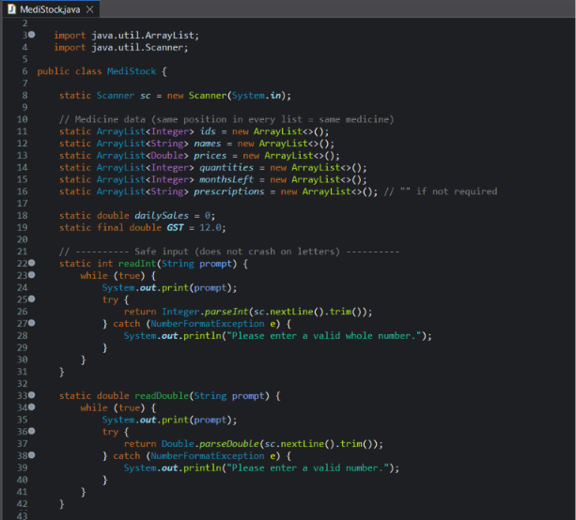
Inputs Code:
4

Slide 5

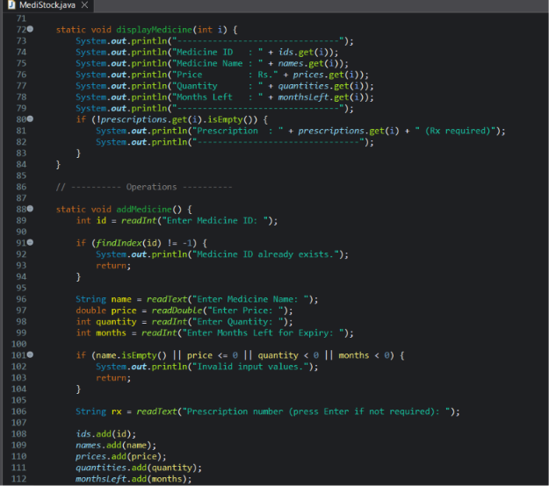
Input Code:
5

Slide 6

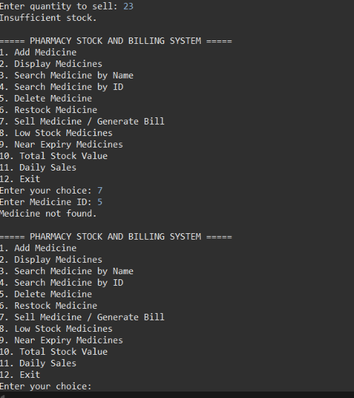
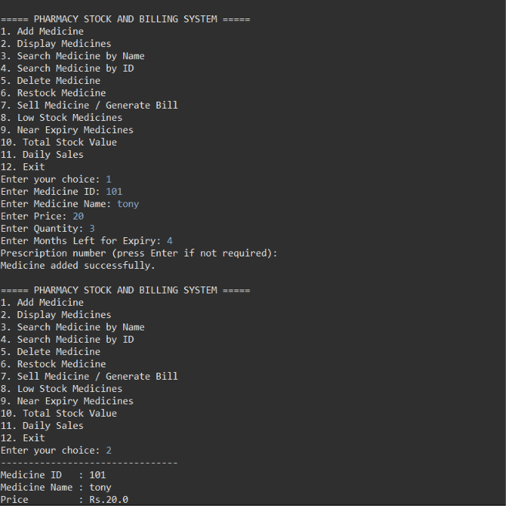
Output:
6

Slide 7

Outcome
Billing is faster, with correct discount and GST calculation
Expired medicines can no longer be sold by mistake
Low-stock and near-expiry medicines are flagged in time
Total stock value and daily sales are available instantly
Program handles wrong input without crashing
7

Slide 8

Future Enhancements
Permanent storage using files or a MySQL database (JDBC)
Graphical interface using JavaFX or Swing
Multiple medicines in one bill with a printable receipt
Staff login and admin access
Supplier management and automatic reorder alerts
8

Slide 9
THANK YOU
8

