Slide 1
Restaurant Performance Analysis : Report

Slide 2
Insights
Business Objectives
Process of Analysis And Recommendation’s
Assumptions on Analysis
Limitations
Additional Business Insights
Next Steps for the Restaurant

Slide 3
Business Objectives:
The primary objectives of this analysis are to answer key business questions that will help improve the restaurant’s menu offerings, streamline operations, and boost sales.
Specifically, the analysis seeks to:
Identify the top-selling product at the restaurant.
Determine which days the top-selling products perform better.
Analyze customer ordering patterns to understand behavior.
Conduct a market basket analysis (bucket analysis) to design a combo meal menu that could potentially increase sales and customer satisfaction

Slide 4
Process of Analysis And Assumptions
Top-selling Product
Sales Trend over Time
Customer Order Pattern
Basket Analysis for combo Meals

Slide 5
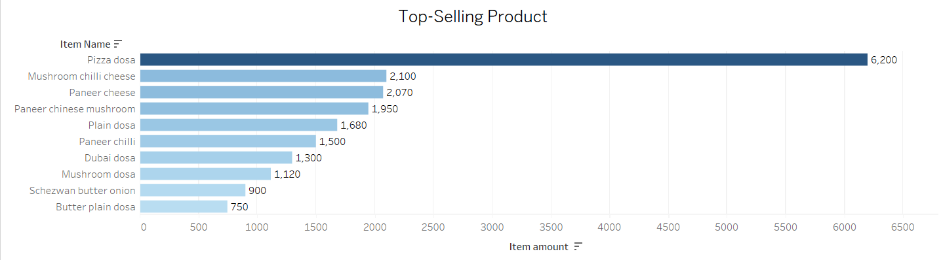
From the analysis, it was determined that Pizza dosa consistently leads in sales, contributing to a substantial portion of the restaurant’s revenue.
Visualization: A detailed bar chart in Tableau shows that Pizza dosa surpasses all other items in terms of sales volume. The chart provides a clear comparison of product performance, helping decision-makers quickly understand which items are driving the most revenue.
Recommendation: Given its popularity, Pizza dosa could be further highlighted in marketing campaigns or bundled with complementary items to enhance its sales potential.

Slide 6
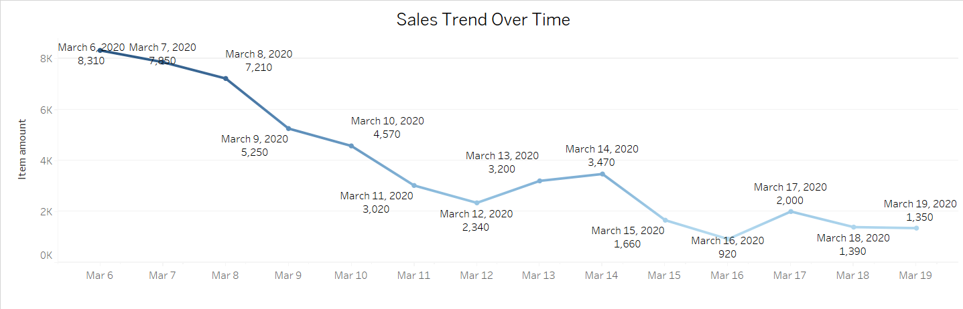
Sales showed a sharp decline from March 6 to March 19, with minor recovery around March 17; consider implementing mid-week promotions to boost weekday sales.
Visualization: The graph displays a consistent decrease in daily sales starting from 8,310 units on March 6 to 920 units by March 16, with a brief recovery to 2,000 units on March 17 before declining again to 1,350 units by March 19.
Recommendation: Introduce targeted mid-week promotions around March 16-17 to leverage the temporary spike and counter the overall downward trend in sales.

Slide 7
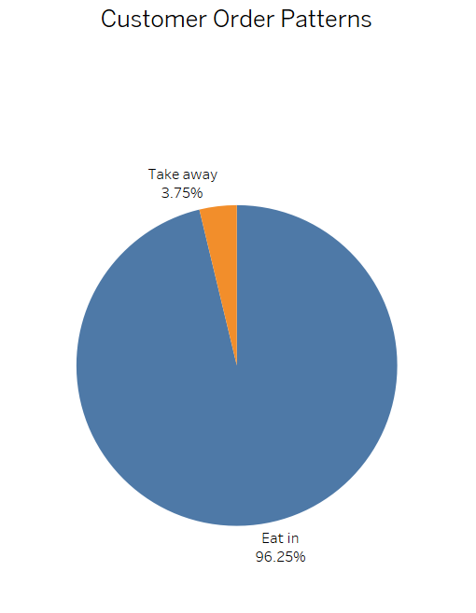
The data reveals a strong preference for dine-in orders (96.25%), indicating the need to enhance the in-house experience while exploring opportunities to boost takeaway sales.
Visualization:
The pie chart shows that 96.25% of orders are for dine-in, while only 3.75% are for takeaway.
Recommendation:
Focus on enhancing the dine-in experience and promote takeaway services to increase customer engagement.

Slide 8
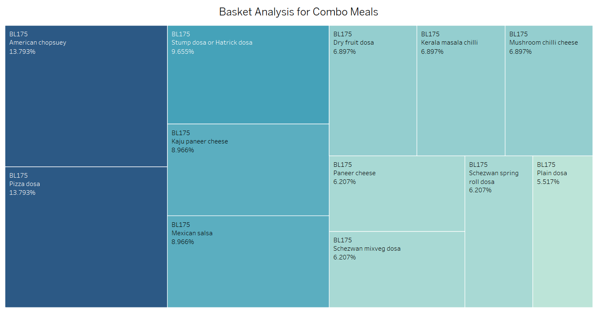
The basket analysis reveals that "American Chopsuey" and "Pizza Dosa" are the top-selling items, suggesting an opportunity to create appealing combo meals to boost sales.
Visualization:
The basket analysis shows that "American Chopsuey" (13.79%) and "Pizza Dosa" (13.79%) are the most frequently paired items, indicating strong customer preference for these dishes in combo meals.
Recommendation:
Based on the basket analysis, the restaurant should consider creating combo meals featuring "American Chopsuey" and "Pizza Dosa" together, potentially increasing sales by appealing to customer preferences for these popular items.

Slide 9
Assumptions:
Top-Selling Product
Assumption: “Pizza dosa” popularity stems from customer loyalty and effective promotional campaigns.
Sales Trend over Time
Assumption: Sales peak during weekends, influenced by higher foot traffic and social gatherings.
Customer Order Pattern
Assumption: The strong dine-in preference (96.25%) indicates a successful experience but reveals an opportunity to improve takeaway service awareness and appeal.
Basket Analysis for Combo Meals
Assumption: The pairing of "American Chopsuey" and "Pizza Dosa" suggests a strong opportunity for combo meal promotions.

Slide 10
Limitations
Despite the robust analysis, several limitations should be acknowledged to provide a balanced view of the insights:
Seasonality:
  The data does not account for seasonal changes in customer preferences, which might significantly impact sales. For example, some items may perform better during summer or winter.
Data Completeness:
  The analysis assumes that the data provided is complete and representative of all sales transactions. Missing or inaccurate data may skew the results and lead to misleading conclusions.
External Factors:
  External factors such as special promotions, marketing campaigns, or changes in menu pricing were not factored into the analysis. These factors could influence customer purchasing behavior and alter the sales dynamics.
Limited Time Period:
  The analysis is based on data from a specific time period. Long-term trends may not be captured, and insights could change if the analysis covers a different or broader timeframe.
Customer Segmentation:
  The analysis does not include customer demographic data, such as age or income, which could provide a deeper understanding of customer behavior and preferences.

Slide 11
Additional Business Insights
Menu Optimization: Consider removing low-selling items from the menu, like "Plain Dosa," and replace them with more popular options to streamline offerings.
Targeted Promotions: Launch promotional campaigns for high-performing items, especially on weekends, to capitalize on peak sales periods.
Customer Preferences: Focus on enhancing dining experiences for "Eat In" customers, who constitute 96.25% of orders, by improving ambiance and service during peak hours.
Combo Meal Marketing: Promote combo meals based on the market basket analysis to encourage customers to try complementary dishes together.
Feedback Loop: Implement regular customer feedback sessions to understand preferences and tailor menu offerings accordingly.
Seasonal Offerings: Consider introducing seasonal dishes or limited-time offers that align with customer preferences to stimulate interest and sales.
Cross-Selling Opportunities: Train staff to suggest add-ons or combos during peak ordering times to increase average order value.
These insights can help refine the restaurant's strategy, improve customer satisfaction, and enhance profitability.

Slide 12
Next Steps for the Restaurant
Data-Driven Menu Changes: Review sales data regularly to identify and modify underperforming items. Add seasonal dishes based on order trends.
Advanced Analytics Tools: Invest in tools like Tableau for visualizing trends and deeper sales insights.
Regular Review Process: Hold monthly or quarterly meetings to discuss performance using analytics.
Staff Training: Train staff on data analytics for better decision-making.
Customer Feedback: Capture and analyze feedback to guide menu and service improvements.
Campaign Evaluation: Measure the impact of promotions to refine strategies.
Staffing Efficiency: Optimize staff schedules based on peak sales times.
Cross-Promotional Strategies: Use basket analysis to create combo offers and increase order value.

Slide 13
Thankyou

