Slide 1
PARAPHRASE IDENTIFICATION AND COMPARATIVE ANALYSIS WITH FINE TUNED AND PROMPT BASED LLM MODEL
Rahul nandi
Final Thesis PRESENTATION
MARCH 2025

Slide 2
Introduction
Paraphrase identification is a critical NLP task to determine whether two sentences convey the same meaning.
It is essential for several NLP tasks like plagiarism detection, question-answering performance improvement, text summarization, and machine translation etc.,
The primary approach are used for paraphrase detection:
Lexical similarity- Based on word-level overlap.
Semantic similarity – Captures deeper contextual meaning.
Typically, paraphrase identification relies on similarity scores. However, this research explores Large Language Models (LLMs) using Prompt-Based Learning and Fine-Tuned Transformer Models to determine whether two sentences are similar or not.
Explored Large Language Models (LLMs) models like GPT-3.5-turbo, GPT-4o-mini, Llama-3.2-1B, Llama-3.2-3B, Mistral-7B, ModernBERT, & T5 models.
It analyzes the trade-offs in terms of accuracy, computational efficiency, and cost.

Slide 3
Research Questions & Scope
Research Questions:
How well do fine-tuned and prompt-based LLM models perform in paraphrase identification?
How do encoder-based (ModernBERT), decoder-based (Llama-3.2-1B, Llama-3.2-3B, Mistral-7B, GPT-3.5-turbo, GPT-4o-mini), and encoder-decoder-based models (T5) compare in paraphrase detection?
Which approach, fine-tuned or prompt-based, proves to be more effective?
In-Scope:
Dataset: Analysis of MRPC Dataset for paraphrase identification.
Only 7 LLM models are used. (As mentioned above)
Training Techniques: QLoRA & LoRA for fine-tuning.
Out of Scope:
Hybrid models (e.g., ensembles of encoder and decoder models).
Multilingual paraphrase detection (only English is considered).
Training models from scratch (only pretrained models with fine-tuning are used).

Slide 4
Aim and Objectives
To explore and evaluate various paraphrase datasets and select the most suitable one for this study.
To perform paraphrase identification using both fine-tuned and prompt-based LLM models to assess their effectiveness in real-world applications.
To conduct a comparative analysis between prompt-based models and fine-tuned models, evaluating their strengths, limitations, and trade-offs for paraphrase identification.
To optimize resource utilization by applying techniques like LoRA and QLoRA (4-bit quantization) for efficient fine-tuning of large-scale models.
To analyze the performance of LLM models using key metrics such as accuracy, precision, recall, F1-score, and inference time to provide a holistic evaluation.

Slide 5
Literature Review
Paper Name | Author & Year | Dataset | Method | Performance Measure
Hybrid System for Plagiarism Detection on A Scientific Paper | (Al-Jibory and Al-Tamimi, 2021) | PAN-PC-11 | Text Preprocessing with average of Jaccard and Cosine Similarity | A: 0.96, R: 0.86, F: 0.86, Plag-Det score: 0.86
Enhancing automatic plagiarism detection: Using Doc2vec model | (Setha and Aliane, 2022) | PAN-PC-2009 and Ara-Plag corpora | Doc2vec-Arabic | P: 0.8, R: 0.9, F1: 0.85
 |  |  | Doc2vec-English | P: 0.9, R: 0.99, F1: 0.94
Machine Learning Models for Paraphrase Identification and its Applications on Plagiarism Detection | (Hunt et al., 2019) | Quora Question Pairs | LSTM | A: 0.8
A Hybrid Deep Learning Architecture for Paraphrase Identification | (Kubal and Nimkar, 2018) | MRPC + Quora Question Pairs | Word2vector + Hybrid Deep Learning (LSTM+CNN) | A: 0.7766, P: 0.83271, R: 0.8138, F1: 0.8231
 |  |  | GloVe + Hybrid Deep Learning (LSTM+CNN) | A: 0.7849, P: 0.8393, R: 0.8203, F1: 0.8297
 |  |  | Context2vec + Hybrid Deep Learning (LSTM+CNN) | A: 0.7988, P: 0.8503, R: 0.8310, F1: 0.8406
Textual Plagiarism Detection Using Embedding Models and Siamese LSTM | (Saeed and Taqa, 2022b) | PAN-PC-11 | Siamese LSTM + word2vec | P: 0.924, R: 0.917, F1: 0.816
 |  | Webis-CPC-11 | Siamese LSTM + word2vec | P: 0.902, R: 0.896, F1: 0.793
Note: A- Accuracy, R- Recall, P: Precision, F1: F1-score

Slide 6
Literature Review (cont.)
Paper Name | Author & Year | Dataset | Method | Performance Measure
Convolution Neural Network Based Syntactic and Semantic Aware Paraphrase Identification | (Zhang et al., 2017) | MRPC | CNN | A: 0.77, F1: 0.84
Paraphrase Bidirectional Transformer with Multi-Task Learning | (Ko and Choi, 2020) | MRPC | BERT-large + WWM + Multi model | A: 89.21, F1:92.28
Paraphrase Identification Based on ResNeXt | (Li et al., 2020b) | MRPC | ResNeXt | A: 0.85
Paraphrase Recognition via Combination of Neural Classifier and Keywords | (Wang et al., 2018) | MRPC | Bi-LSTM+Similarity Distance | A: 0.80, F1: 0.86
 |  | SICK |  | A: 0.87
Automated Plagiarism Detection Model Based on Deep Siamese Network | (Zhang et al., 2022) | MRPC | BERT+Bi-LSTM | A: 0.919, P: 0.938, R: 0.956, F1: 0.943
A Paraphrase Identification Approach in Paragraph Length Texts | (Saqaabi et al., 2022) | MRPC | SBERT | A: 72, F1:82
 |  | Webis-CPC-11 |  | A: 64, F1:63
Note: A- Accuracy, R- Recall, P: Precision, F1: F1-score

Slide 7
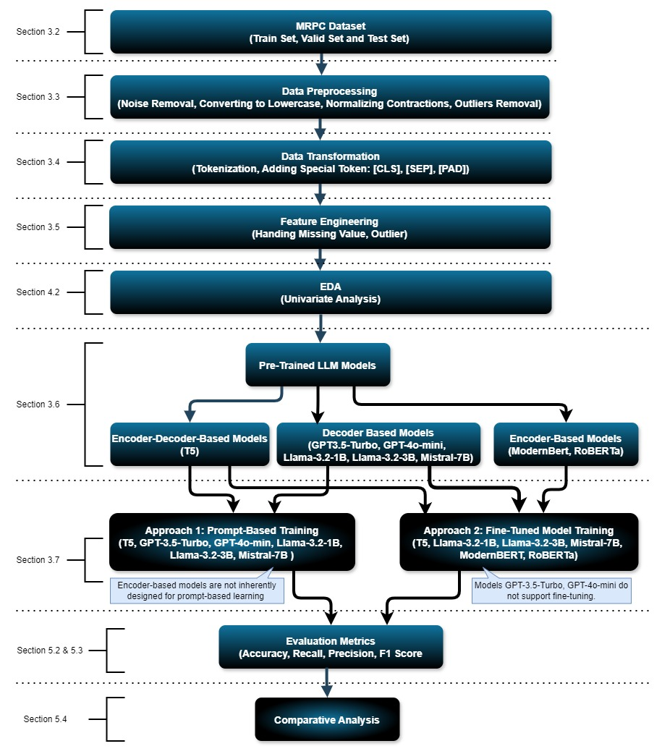
Methodology

Slide 8
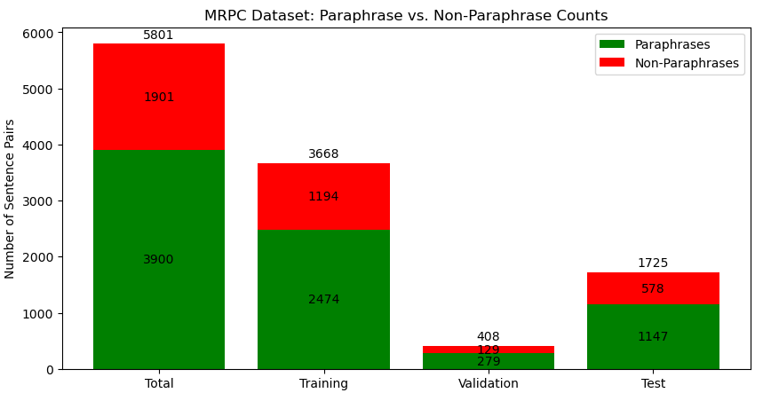
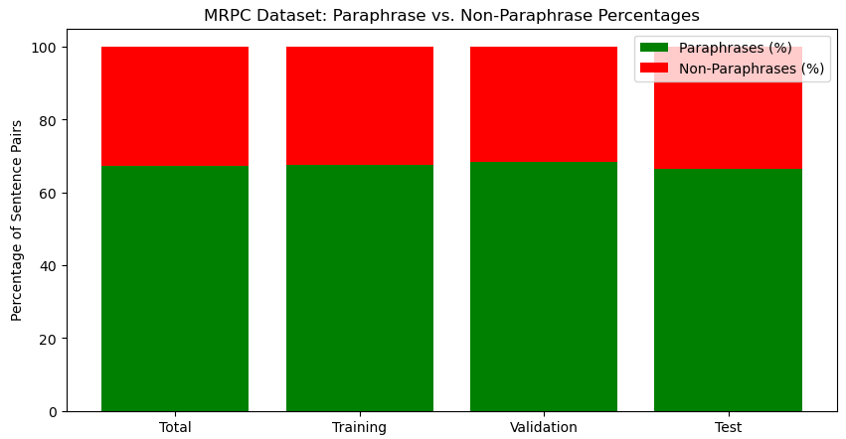
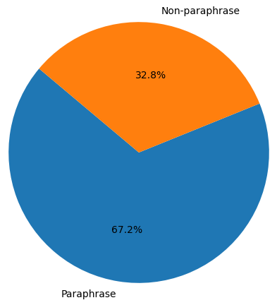
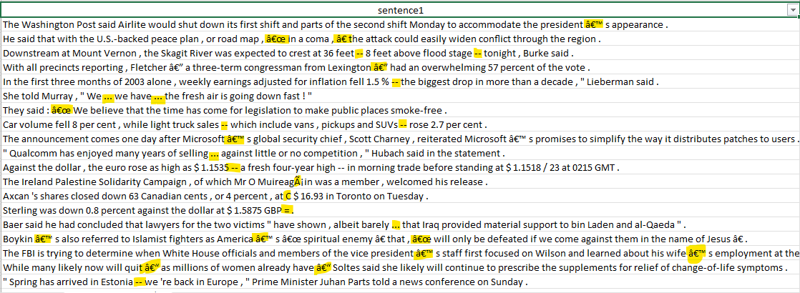
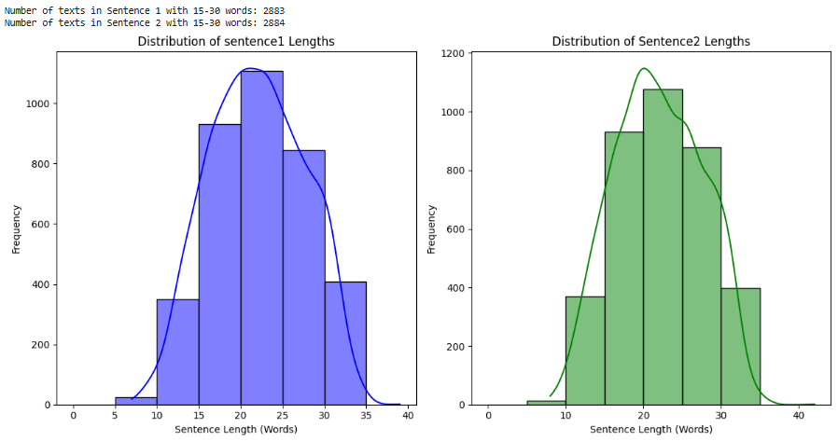
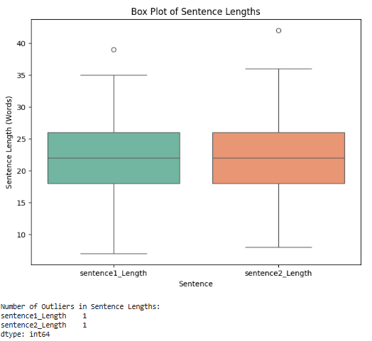
Exploratory Data Analysis (EDA)
Figure 1: Dataset Overview Figure 2: Dataset Split Figure 3: Data Distribution
Figure 4: Noise in Dataset Figure 5: Distribution plots for sentence length Figure 6: Outlier

Slide 9
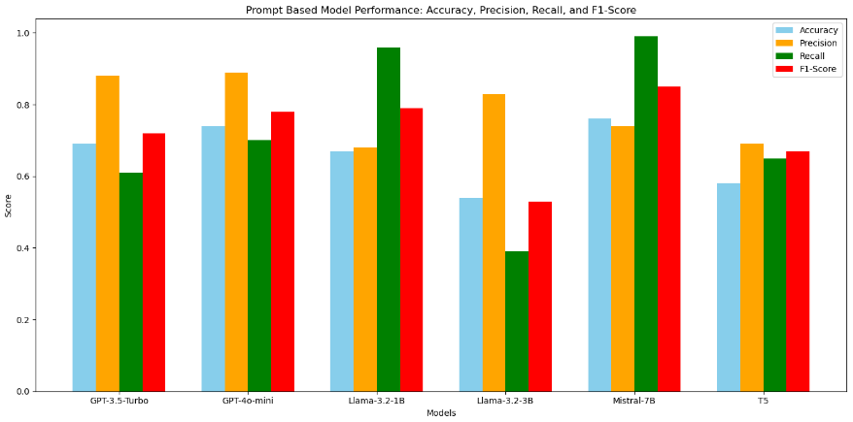
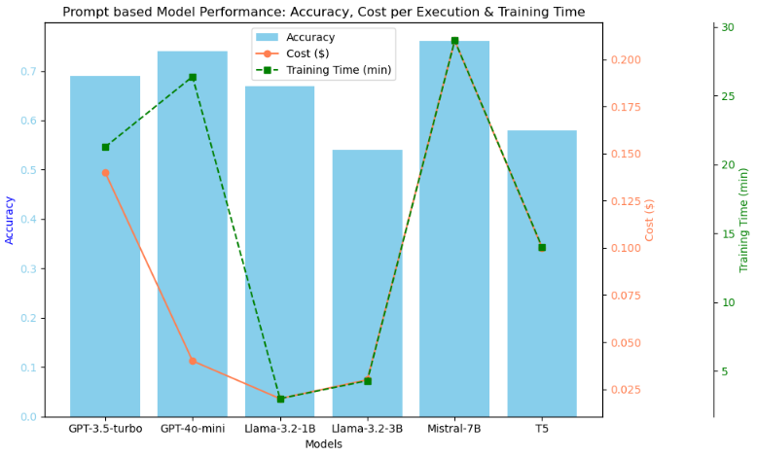
Prompt-based Models Performance
Performance Comparison Prompt-based Models
Model | GPT-3.5-Turbo | GPT-4o-Mini | Llama-3.2-1B | Llama-3.2-3B | Mistral-7B | T5
Access Method | OpenAI API | OpenAI API | HF Download | HF Download | HF Download | HF Download
Optimal Temperature | 0.5 | 0.5 | 0.2 | 0.3 | 0.1 | 0.1
Optimal Max New Tokens | 4 | 4 | 4 | 4 | 6 | 5
Avg. Execution Time (mins) | ~21.27 | ~26.38 | ~3 | ~4.3 | ~29 | ~14
Cost Type | API Cost | API Cost | Cloud Cost | Cloud Cost | Cloud Cost | Cloud Cost
Cost per Execution ($) | ~0.14 | ~0.04 | ~0.02 | ~0.032 | 0.21 | ~0.1
Total Cost to Tune ($) | ~0.90 | ~0.40 | ~0.21 | ~0.33 | ~2.10 | ~0.50
Memory Usage (GB) | N/A | N/A | ~5 GB | ~8 GB | ~15 GB | ~5 GB
Fine-Tuning Support | No | No | Yes | Yes | Yes | Yes
Accuracy | 0.69 | 0.74 | 0.67 | 0.54 | 0.76 | 0.58
Precision | 0.88 | 0.89 | 0.68 | 0.83 | 0.74 | 0.69
Recall | 0.61 | 0.70 | 0.96 | 0.39 | 0.99 | 0.65
F1 Score | 0.72 | 0.78 | 0.79 | 0.53 | 0.85 | 0.67
Fig. 7: Accuracy, Precision, Recall, and F1-Score
Fig. 8: Accuracy, Cost per Execution & Training Time

Slide 10
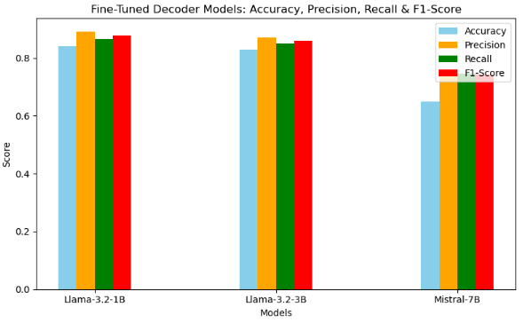
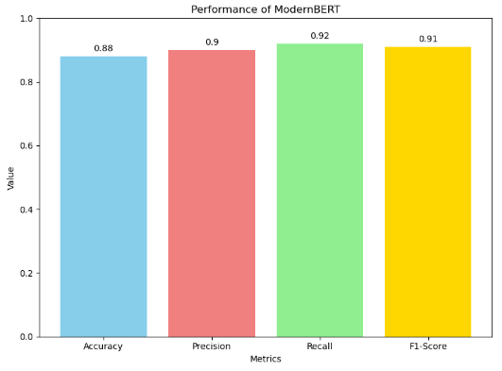
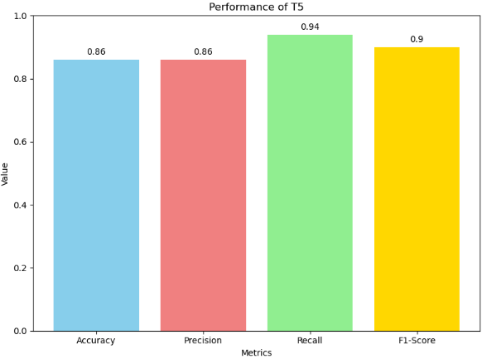
Fine-tuned based models PERFORMANCE
Performance Comparison between encoder, decoder & encoder-decoder based Models
Model Name | Llama-3.2-1B | Llama-3.2-3B | Mistral-7B | Modern BERT | T5-Base
Access Method | HF Download | HF Download | HF Download | HF Download | HF Download
Cost Type | Cloud Cost | Cloud Cost | Cloud Cost | Cloud Cost | Cloud Cost
Single GPU Used | NVIDIA A5000 | NVIDIA A5000 | NVIDIA A100 | NVIDIA RTX5000 | NVIDIA RTX5000
Memory Usage (GB) | ~6 GB | ~12 GB | ~32 GB | ~3 GB | ~6 GB
Prompt-Based Support | Yes | Yes | Yes | No | Yes
Optimal Learning Rate | 2.00E-04 | 2.00E-05 | 2.00E-05 | 2.00E-05 | 1.00E-05
Optimal Batch Size | 16 | 16 | 32 | 8 | 8
Optimal LoRA Dropout | 0.07 | 0.1 | 0.1 | - | -
Optimal Low Rank Size | 16 | 16 | 8 | - | -
Optimal LoRA Scaling | 32 | 32 | 32 | - | -
Execution Time (mins) | ~22 | ~60 | ~90 | ~11 | ~16
Cost per Execution ($) | ~0.30 | ~0.50 | ~1.25 | ~0.083 | ~0.12
Total Cost (Tuning) ($) | ~15 | ~20 | ~5 | ~1 | ~1.4
Accuracy | 0.841 | 0.83 | 0.65 | 0.88 | 0.86
Precision | 0.892 | 0.87 | 0.741 | 0.90 | 0.86
Recall | 0.865 | 0.85 | 0.745 | 0.92 | 0.94
F1-Score | 0.878 | 0.86 | 0.743 | 0.91 | 0.90
Fig. 9: Decoder Models
Fig. 10: Encoder Model
Fig. 11: Encoder-Decoder Model

Slide 11
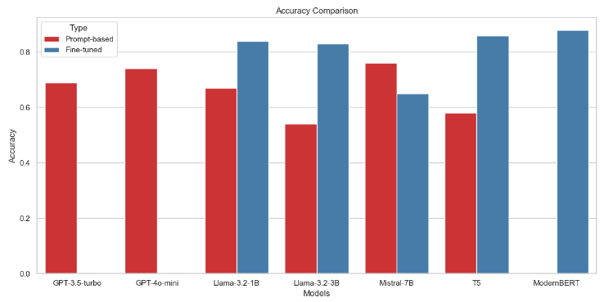
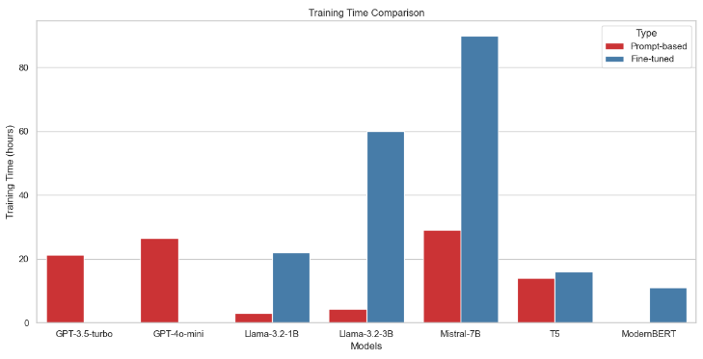
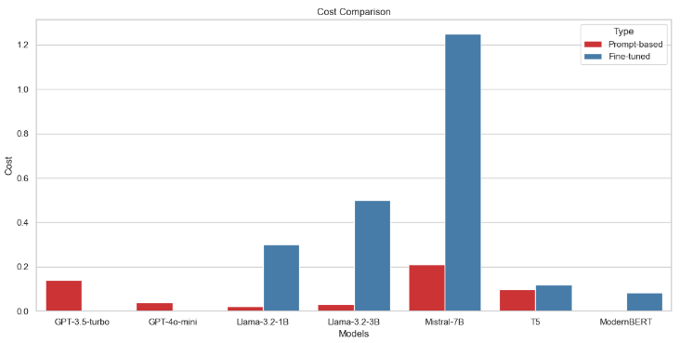
Comparison between Prompt-based and Fine-tuned based
Fig. 12: Accuracy Comparison
Fig. 13: Training Time Comparison
Fig. 14: Cost Comparison

Slide 12
Conclusion
Fine-tuned models consistently outperformed prompt-based models in accuracy, F1-score, and domain-specific adaptation.
ModernBERT emerged as the most cost-efficient and highest-performing fine-tuned model.
Prompt-based models provide a quick inference solution with lower execution costs but suffer from lower accuracy and generalization issues.
Small decoder-based models (Llama-3.2-1B) are better than large-scale models (Mistral-7B) in performance and computational efficiency.
Fine-tuned models are best suited for fixed datasets, where training is done once and used repeatedly for a specific task.
Prompt-based models are ideal for dynamic datasets, where different types of data require a generalizable approach without additional fine-tuning.

Slide 13
Future Recommendations
Explore hybrid approaches that combine prompt-based and fine-tuned methods, such as using prompt-based models for initial filtering and fine-tuned models for final classification.
Conduct experiments on larger and more diverse datasets to improve model robustness and generalizability.
Investigate advanced fine-tuning techniques, such as adapter modules or sparse fine-tuning, to enhance efficiency while maintaining high accuracy.
Optimize quantization strategies for smaller models to balance performance and resource consumption in real-world applications.

Slide 14
Video And code Link
https://github.com/nandir2512/LJMU-MS-Research-GenAI

Slide 15

By Rahul Nandi
https://www.linkedin.com/in/rahul-nandi-28716239/

