Slide 1
miBiome internship learnings
DHRISHIT KHANDHAR

Slide 2
01.
FIRST GENERATION SEQUENCING

Slide 3
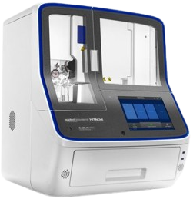
SANGER SEQUENCING
FACTORS TO BE USED
Radioactive primer: so that fragments can be viewed under autoradiography
DNA Polymerase/other DNA replicating enzyme
dNTPs (deoxyribonucleotide triphosphates): Free DNA nucleotides - A, T, G, C
ddNTPs (dideoxyribonucleotide triphosphates): chain-terminating blocks. DNA Polymerase will recognise this molecule due to the absence of oxygen at the 2nd and 3rd carbons, and will terminate the replication.

Slide 4
PROCEDURE
First, a radioactive primer will be added to a DNA solution containing an unknown sequence.
The DNA strand and buffer are then separated by heating them to 100 °C.
Then, the sequence will be added to four containers, each containing one of the four ddNTPs.
As DNA Polymerase starts replicating the chain, the ddNTPs will terminate the sequence at random intervals, but only where their complementary base pairs are present.
For example, the amplified sequence put into a flask containing a ddATP will terminate when the original sequence reaches one of the ‘Ts’. Similarly, the amplified sequence in a flask with ddGTP will terminate when the original sequence reaches one of the ‘Cs’.
Hence, a new sequence of random length will emerge.

Slide 5
PROCEDURE
After the new sequences have been produced, they are sorted based on size using a denaturing page (or polyacrylamide gel electrophoresis).
The DNA sequences will move from a cathode to an anode. The smaller molecules will migrate further down, and the larger ones will remain closer to the cathode.
Since the new sequence is being produced in the 5’ to 3’ direction, the larger molecules are said to approach the 3’, and hence the area closer to the cathode in the gel electrophoresis plate is labelled as 3’.
Then, looking at the different bands on the gel electrophoresis plate, the original sequence can be determined.

Slide 6
Since this process was too labour-intensive and inefficient, however, a more streamlined approach was needed. Hence, Applied Biosystems found that fluorescence can be used to replace radioactivity as a safer and less time consuming method.

Slide 7
02.
SECOND GENERATION SEQUENCING

Slide 8
ILLUMINA SEQUENCING
FACTORS TO BE USED
DNA or RNA samples: for nucleic acid extraction
Fragmentation tools: physical, enzymatic, or chemical
Adapters and barcodes: for library preparation and multiplexing
PCR reagents: for amplification
Illumina flow cell: as a surface for cluster generation
Sequencing reagents: fluorescently labeled nucleotides with reversible terminators
Illumina sequencing instrument
Bioinformatics software: for data analysis

Slide 9
PROCEDURE
NUCLEIC ACID EXTRACTION
DNA or RNA is isolated from the sample using standard purification methods (like buffers).
LIBRARY PREPARATION
The DNA is fragmented into smaller pieces using endonucleases.
Short adapter sequences are attached to both ends of each fragment; they allow fragments to bind to the flow cell and include barcodes for sample identification if multiplexing.
The library may be amplified by PCR to ensure enough material for sequencing.

Slide 10
PROCEDURE
CLUSTER GENERATION (BRIDGE AMPLIFICATION)
The prepared library is then loaded onto the Illumina flow cell, which is coated with oligonucleotides complementary to the adapters.
Each DNA fragment binds to the flow cell and is amplified in place (bridge amplification), forming millions of clusters of identical DNA fragments. Each cluster represents a single original fragment, generating a strong enough signal for detection.
SEQUENCING BY SYNTHESIS (SBS)
The sequencing instrument adds fluorescently labeled nucleotides, one at a time, to the clusters.
Each incorporated nucleotide emits a unique fluorescent signal, which is detected by the instrument.
The reversible terminator chemistry ensures only one nucleotide is added per cycle, improving accuracy. The terminator and fluorescent label are then removed, and the cycle repeats until the DNA fragment is fully sequenced.

Slide 11
DATA COLLECTION AND ANALYSIS
The instrument records the fluorescence from each cluster at every cycle, generating raw sequence data.
Bioinformatics software converts these signals into DNA sequences, aligns them to a reference genome (if available), and performs further analysis such as variant calling or gene expression profiling
IMPROVEMENTS TO THE PROCEDURE
Enhanced Chemistry: Newer chemistries, such as XLEAP-SBS, have improved sequencing speed, data quality, and output, while reducing costs and turnaround times.
Multiplexing and Barcoding: The use of unique dual indexes (barcodes) allows multiple samples to be sequenced together in a single run, increasing throughput and reducing costs.

Slide 12
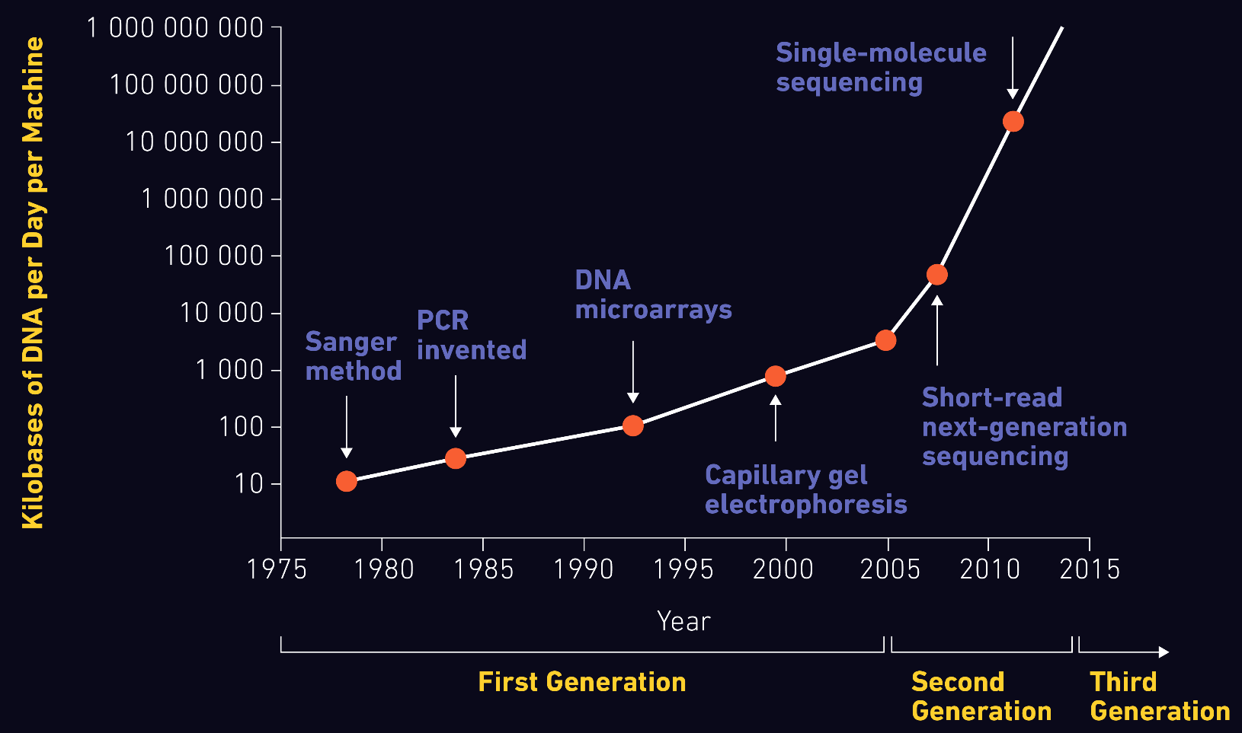
THE EVOLUTION OF SEQUENCING
0.5 GB
IN 1977 USING SANGER SEQUENCING (SHORT READ)
60 GB
IN 2017 USING OXFORD NANOPORE (LONG READ)

Slide 13
THANK YOU

