Slide 1
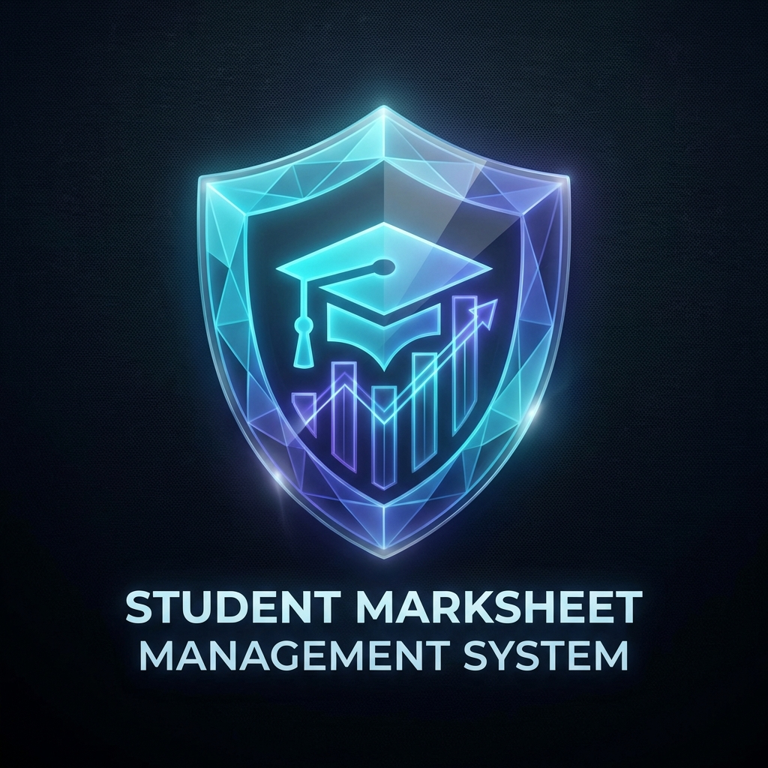
STUDENT MARKSHEET WEB-PORTAL
Advanced Academic Management System

Slide 2
Project Overview
Seamlessly manage academic records for multi-semester systems.
Dual-access infrastructure: Admin Control & Student Insight.
Automated results processing with high-integrity data streams.
Built for speed, efficiency, and futuristic user interaction.

Slide 3
Admin Control Hub
Centralized Dashboard for semester-wise data navigation.
Secure Node Injection: Add and update student profiles in real-time.
Dynamic Subject Configuration for flexible academic mapping.
Instant Registry Sync with transactional integrity.

Slide 4
Student Experience
Quick Identity Verification via Matrix Identifier (Reg No).
Interactive Marksheets with clear visual performance cues.
Legacy Data Access: View records across all past semesters.
Mobile-responsive design for on-the-go academic tracking.

Slide 5
Calculation Logic
Priority Weighting: Calculations focused strictly on CORE subjects.
Threshold Analysis: Automated 40% Pass/Fail determination per subject.
Percentage & Grade Aggregation based on global core performance.
Visual Grade Indicators (A to D, and FAIL) for instant feedback.

Slide 6
Cognitive Summary (AI)
Deep-dive analysis of student performance across all CORE nodes.
Intelligent Career Mapping: Pattern recognition in subject strengths.
Trajectory Prediction: Suggesting paths like AI Research, Cloud Architecture, etc.
Personalized insights to guide future academic specializations.

Slide 7
Technology Stack
Frontend: HTML5, Tailwind CSS, Spline (3D), JavaScript ES6+
Backend: Node.js, Express.js
Data: RESTful APIs, JSON Storage System
Styling: Cyber-Futuristic dark theme with Glassmorphism

Slide 8
Design Philosophy
Futuristic Theme: Glassmorphism and Neon accents (Cyan/Indigo).
High-Contrast Hierarchy for maximum readability.
Micro-animations for a responsive, 'living' interface feel.
Clean, spacious layouts to reduce cognitive load.

Slide 9
User Interaction (UX)
Premium Loading Sequences: Spline-based coin animation.
Smooth Transitions between portals and semester views.
Toast Notifications for instant user feedback.
Intuitive navigation with direct data synchronization.

Slide 10
Security & Integrity
Multi-factor Admin Verification using secure auth keys.
Identity Isolation: Data restricted to verified users.
Data Validation on every entry to prevent corruption.
Read-only views for critical marksheet summaries.

Slide 11
System Scalability
Modular Subject Injection: Add new data layers easily.
Horizontal Semester Scaling Term-by-Term.
Componentized Architecture for AI expansion.
Cloud-ready foundation for large-scale institutional deployment.

Slide 12
Future Roadmap
Transition to SQL-based Relational Database.
Native Mobile App development (iOS/Android).
Real-time Notification Hub for faculty and parents.
Blockchain integration for tamper-proof transcript verification.

Slide 13
Conclusion
Summary: Transformed academic record management into a strategic asset.
Impact: Faster processing, enhanced transparency, AI-driven guidance.
Ready for Q&A.

