Slide 1

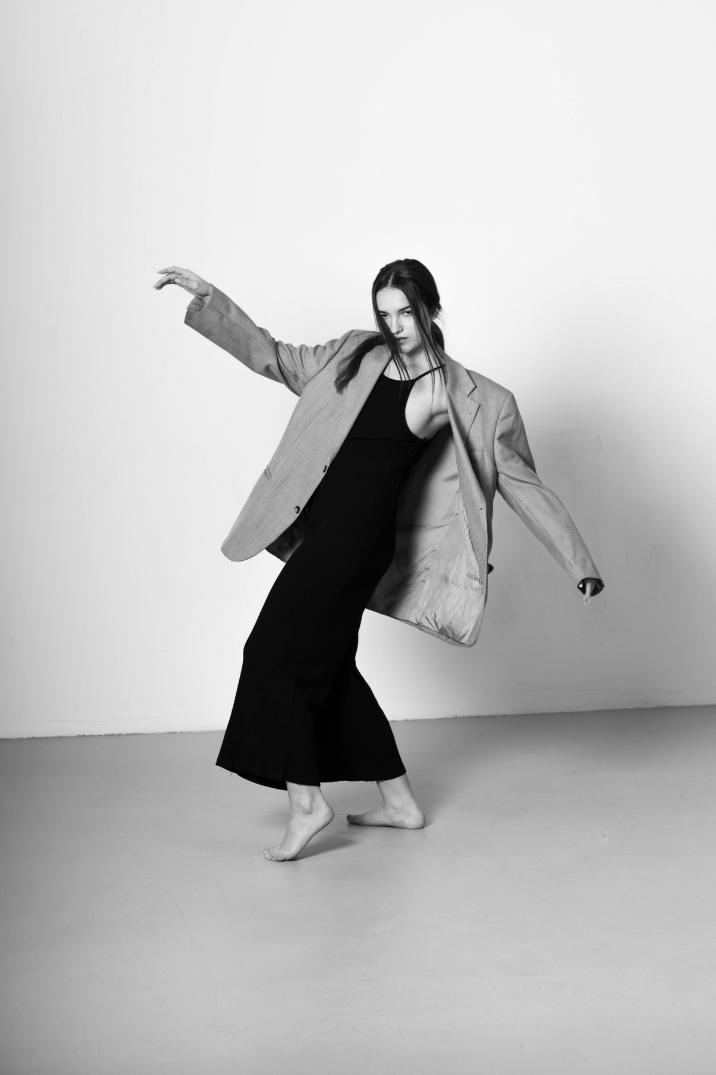








+123-456-7890
hello@reallygreatsite.com
ABOUT ME
A Graphic Designer with six years of experience working as the lead designer of Studio Shodwe and overseeing the individual project for brand development. Hard worker and have experience in leading a team of designers, and I can’t wait to implement my skill and experience in your company.
AVERY DAVIS
UI/UX DESIGNER
WORK EXPERIENCE
Professional Graphic Designer
Studio Shodwe ( 2023 - Now )
Created original graphic of the booth display for the Borcelle autumn fashion event.
Collaborated with the sales team to create the sales content for the promotion campaign of the Ingoude Company’s 10th Anniversary.
SKILL
Visual Design
Professional Graphic Designer
Interaction Design
Studio Shodwe ( 2020 - 2022 )
Created a new in-store display for a local apparel store that increased sales by 20% after three months of the installation.
Created the festival banner for the local food festival in June 2015, which has successfully attracted more than 2000 people from other cities.
Usability Testing
User-Centric Mindset
EDUCATION
Responsive Design
Bachelor of Arts in Communication Visual Design
Continuous Learning
Connor Hamilton University
2010 – 2014
Typography

