Slide 1


Diabetes Prediction using Machine Learning
This project uses patient health data (age, BMI, glucose level, etc.) to train machine learning models that classify whether a person is diabetic or not, improving early detection and prevention.

Slide 2
Lack of accessible tools for predicting diabetes using basic health measures.
Difficulty in early identification of individuals at high risk of diabetes.
Inability to interpret complex medical data for quick diabetes screening.
Overdependence on clinical tests without early check.
Limited automation in detecting diabetes patterns from patient records.
Problem Statements

Slide 3
Data Cleaning using ML models
Dataset name: diabetes_prediction.csv
Total rows: 100000
Total columns: 9
Column Name | Non-Null | Dtype
gender | 100000 | object
age | 100000 | float64
hypertension | 100000 | int64
heart_disease | 100000 | int64
smoking_history | 100000 | object
bmi | 100000 | float64
HbA1c_level | 100000 | float64
blood_glucose_level | 100000 | int64
diabetes | 100000 | int64
Missing Data Imputation: No null values found.
Duplicate Data : Removed 3854 duplicate rows.
Encoding : df[‘gender’] and df[‘smoking_history’] were encoded to integers.

Slide 4
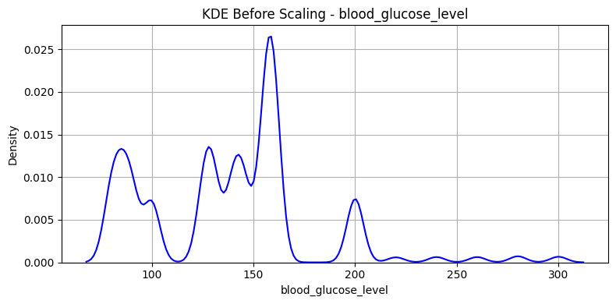
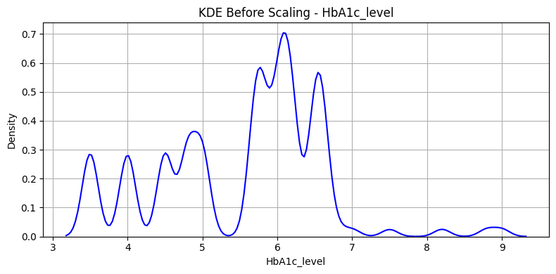
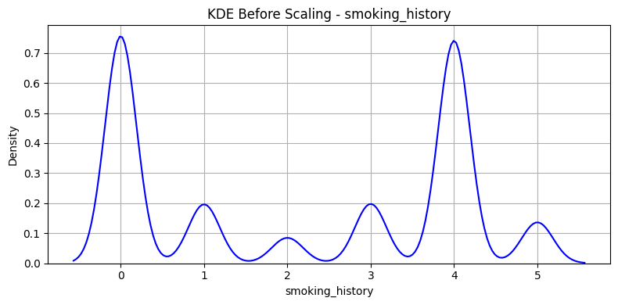
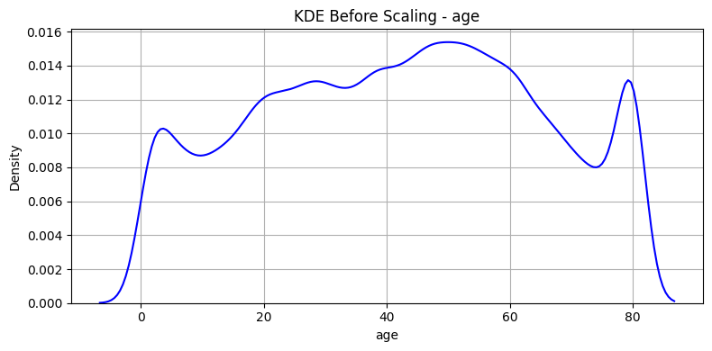
Data Visualization

Slide 5


Feature Scaling
All features are brought to a uniform scale, enhancing visibility and interpretability.
Variations across all features are now comparable and equally represented.
MinMax Scaling
Standard Scaling
Scales the data between 0 and 1.
Centres to mean = 0 and std = 1.

Slide 6
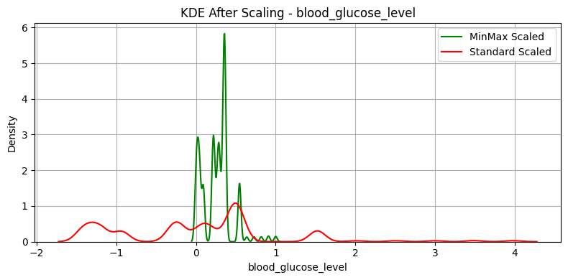
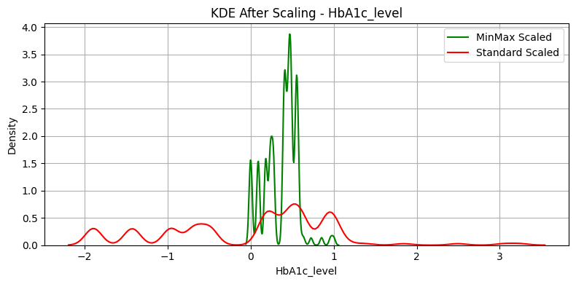
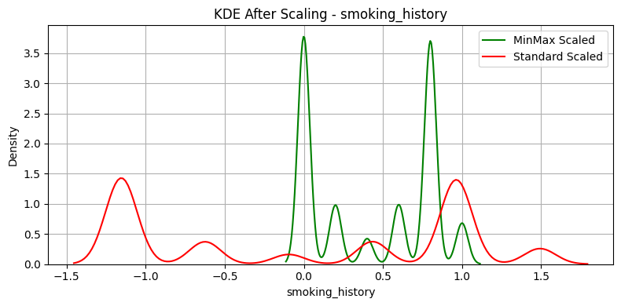
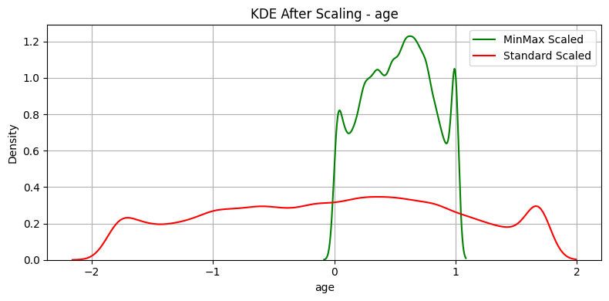
Advanced Data Visualization

Slide 7





Machine Learning Algorithms
( For Data Training )
Logistic Regression
Decision Trees
Random Forest
A statistical model that estimates the probability of a binary outcome using a logistic function.
A flowchart-like model that splits data based on feature values to make decisions or predictions.
Builds multiple decision trees and combines their outputs for improved accuracy.
KNN
Support Vector Machines (SVM)
A non-parametric algorithm that classifies data based on the majority class of its nearest neighbors.
A supervised learning model that finds the optimal hyperplane to separate classes with maximum margin.

Slide 8
Algorithm Results
Model | MSE | RMSE | MAE | Accuracy
Logistic Regression | 0.0413 | 0.2032 | 0.0413 | 0.9587
KNN | 0.03865 | 0.1966 | 0.03865 | 0.96135
Random Forest | 0.02935 | 0.1713 | 0.02935 | 0.97065
Decision Tree | 0.04795 | 0.2190 | 0.04795 | 0.95205
SVC | 0.03765 | 0.1940 | 0.03765 | 0.96235

Slide 9
Comparison
Accuracy
Logistic Regression | 95%
KNN | 96%
Random Forest | 97%
Decision Tree | 95%
SVC | 96%

Slide 10

Conclusion and Future Benefits
Feature scaling and proper preprocessing had a big impact on the results.
Random Forest emerged as the best model, giving over 97% accuracy with minimal errors.
This approach could be turned into a tool for screening high-risk individuals.
In future, this model can help in early detection of diabetes, support remote healthcare, and reduce treatment costs. It can be integrated into health apps for quick risk checks and expanded to detect other diseases in the future.

Slide 11
Thank You

