Slide 1

Health, Just a Tap Away!

Slide 2
The MediCare App
The MediCare App is a digital healthcare platform designed to connect patients with doctors for both online consultations and offline clinic visits.
The application data is managed using SQL in a relational database environment.
The system consists of two relational tables Doctors and Consultations.
Doctor information is stored in a master doctors table, while consultation details are maintained in a separate consultations table to ensure data normalization and avoid redundancy.

Slide 3
How does this System works?
The Doctors table includes doctor_id as the primary key, along with doctor_name, specialization, city, and available_mode indicating whether the doctor is available online or offline.
The Consultations table includes consultation_id as the primary key, along with patient_name, age, gender, consultation_date, consultation_type indicating online or offline mode, doctor_id as a foreign key, and fees.
The doctor_id acts as the primary key in the Doctors table and as a foreign key in the Consultations table.

Slide 4
Problem Statement
Retrieve consultation records where the consultation fee exceeds 1,000.
Identify doctors who are exclusively available for online consultations.
Retrieve the 10 most recent consultation records based on consultation date.
Compare total revenue generated from online and offline consultations.

Slide 5
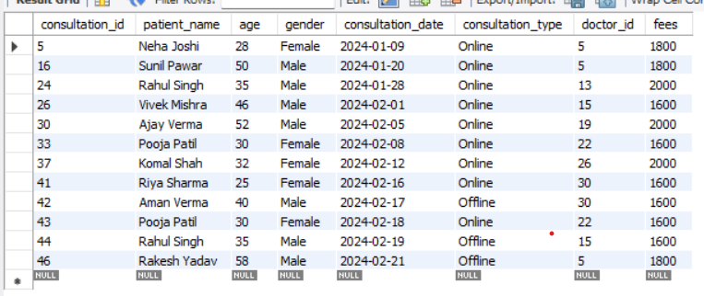
Retrieve consultation records where the consultation fee exceeds 1,000.
SELECT*FROM consultations WHERE fees > 1500;

Slide 6
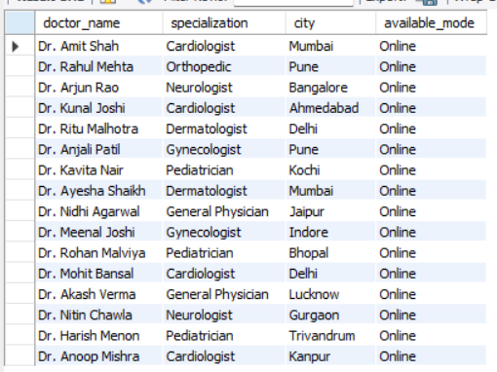
Identify doctors who are exclusively available for online consultations.
SELECT doctor_name, specialization, city, available_mode FROM doctors WHERE available_mode = 'Online';

Slide 7
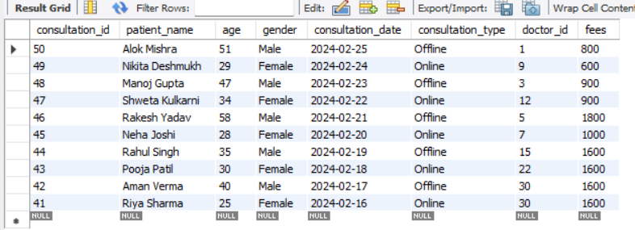
Retrieve the 10 most recent consultation records based on consultation date.
SELECT *FROM consultations ORDER BY consultation_date DESC
LIMIT 10;

Slide 8

Compare total revenue generated from online and offline consultations.
SELECT d.available_mode, SUM(c.fees) AS total_revenue FROM consultations c INNER JOIN doctors d ON c.doctor_id = d.doctor_id GROUP BY d.available_mode;

Slide 9
Conclusion
The MediCare App provides an efficient platform for online and offline doctor consultations.
The relational database design ensures organized data storage and avoids redundancy. SQL queries help generate meaningful insights for decision-making and performance analysis.
Overall, the system improves healthcare accessibility, efficiency, and data management.

Slide 10
Thankyou

