Slide 1
Medicare Outpatient Hospitals
A Data-Driven Case Study of Hospital Charges, Medicare Payments & Billing Variation (CY 2023)
By : Nandita Sharma
Github: https://github.com/nandita96

Slide 2
WHAT WE'LL COVER
The Questions to Answer
Q1
How big is the gap between what hospitals bill and what Medicare actually pays?
Q2
Which procedures (APCs) drive the most national spending?
Q3
Does billing behavior vary meaningfully by state?
Q4
Do rural hospitals charge and get paid differently than urban hospitals?
Q5
Which charges are true outliers — and which are real, explainable extremes?
Q6
How much extra does Medicare pay for unusually costly "outlier" cases?
Q7
How concentrated is spending among a small number of large hospitals?
2

Slide 3
THE DATASET
What We're Working With
116,799
3,311
70
rows (provider x Comprehensive APC)
unique hospitals, 50 states
Comprehensive APC procedure groups
What each row means
Each row = one hospital's average billing & payment stats for one Comprehensive APC (bundled procedure group) in 2023:
Medicare beneficiaries seen, services billed, average submitted charge, average Medicare-allowed amount, average Medicare payment, and outlier payment activity.
Medicare Outpatient Hospitals Case Study — CY 2023
3

Slide 4
METHODOLOGY
Cleaning the Data & Handling Outliers
Missing data
Clean currency columns
Check shape /datatype of the data
Data errors-> negatives, zeros, impossible values, duplicate keys
Statistical distribution
Outliers using IQR
RUCA Classification (Recoding)
Urban/Metro→ Urbanized areas ≥50,000 Micropolitan → Urban clusters 10,000–49,999 Small Town / Rural → Urban clusters <10,000 + rural areas
Benefit: Reduces multiple detailed commuting classifications into three meaningful groups, making the data easier to visualize, compare, and interpret.
Medicare Outpatient Hospitals Case Study — CY 2023
4

Slide 5
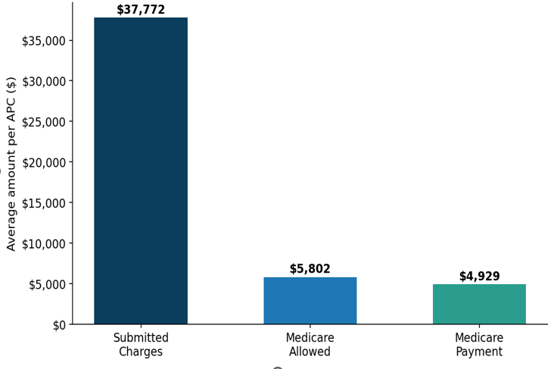
INSIGHT 1
The Big Gap
Hospital bills vs what medicare actually pay?
6.1x
6.1x
MEDIAN MARKUP
Hospitals bill about six times
what Medicare ends up paying.
That's not a typo — it's the middle
of the pack, not a rare outlier.
Medicare Outpatient Hospitals Case Study — CY 2023
5

Slide 6
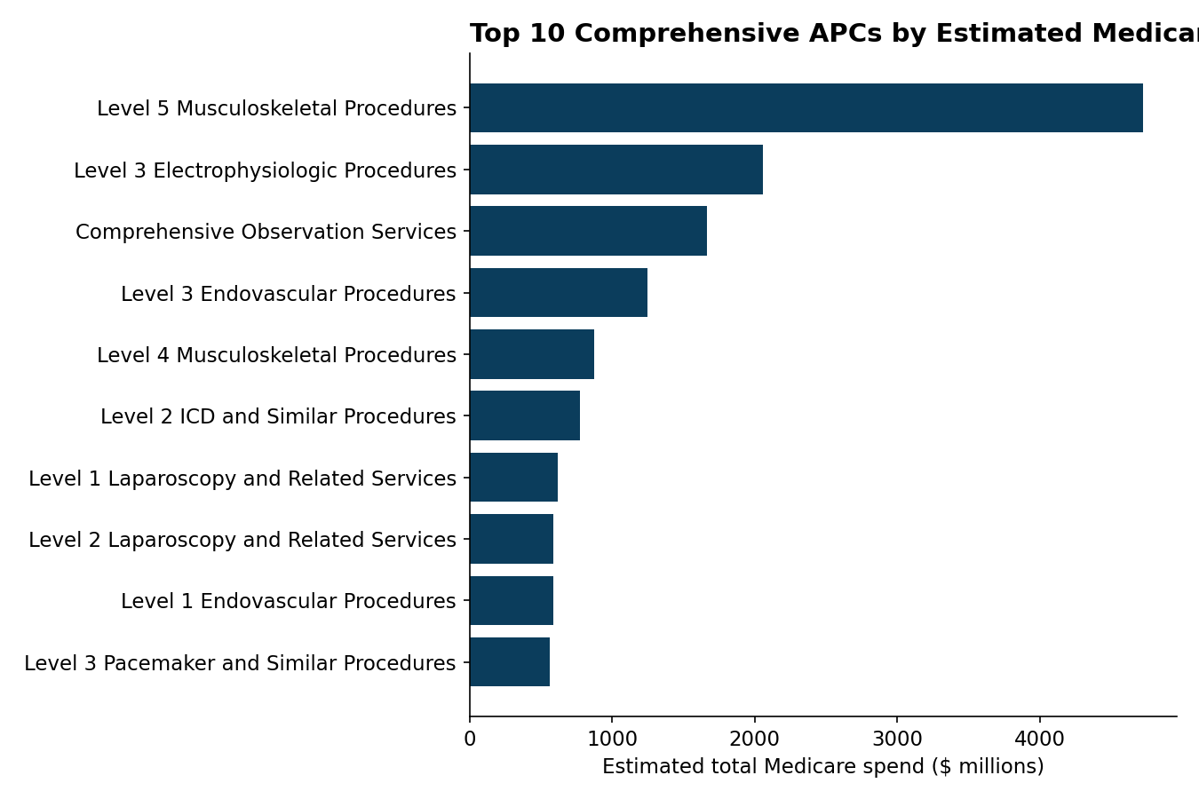
INSIGHT 2
Where The Money Goes
$4.7B
est. spend on the #1 APC group alone
Level 5 Musculoskeletal Procedures alone: ~$4.7B in estimated Medicare spend.
Electrophysiologic and Observation services round out the top 3.
Medicare Outpatient Hospitals Case Study — CY 2023
6

Slide 7
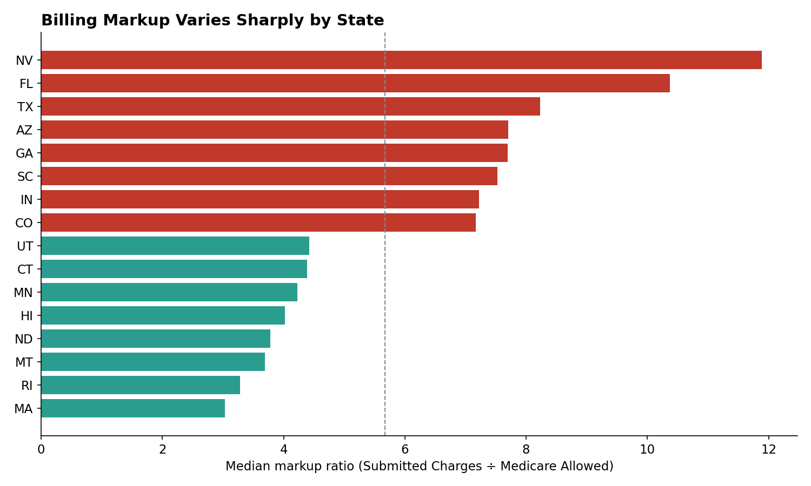
INSIGHT 3
Billing behaviour varies by state
~4x
gap between highest- and lowest-markup states
Nevada and Florida hospitals show the highest median markups (10–12x).
Massachusetts and Rhode Island sit near 3x — roughly a third of NV/FL.
Medicare Outpatient Hospitals Case Study — CY 2023
7

Slide 8
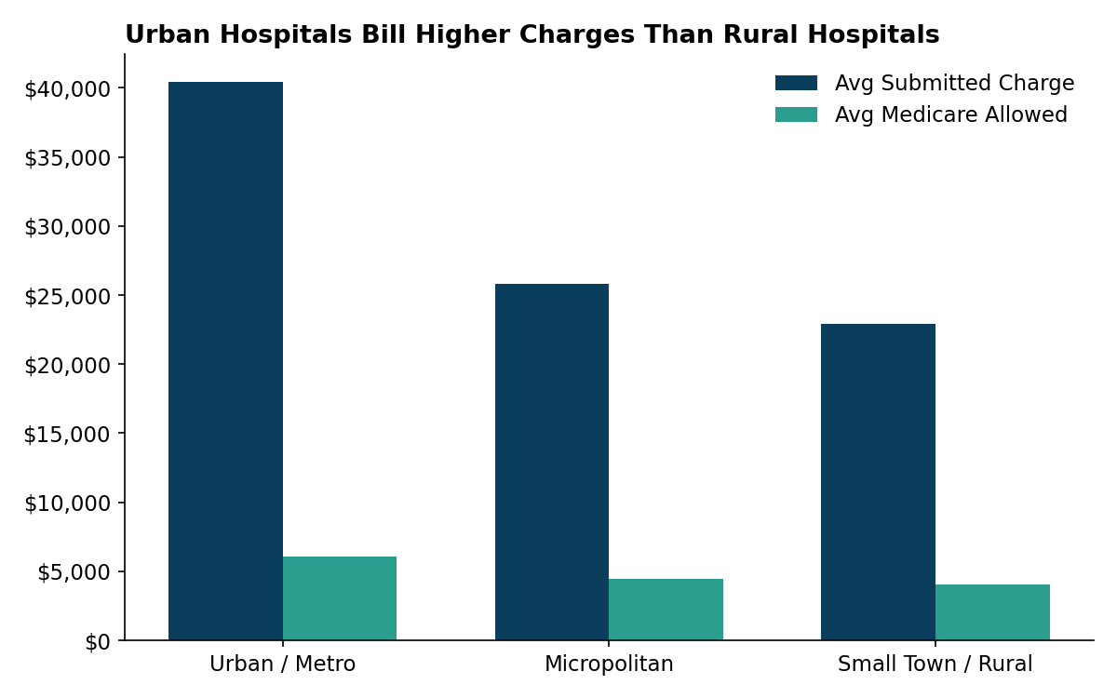
INSIGHT 4
Urban Hospitals Bill (and Get Paid) More
Urban hospitals bill almost double rural ones — but Medicare barely notices the difference.
Urban markup ratio (6.3x) is modestly higher than rural (5.1x).
Urban/metro hospitals average $40,413 submitted charges vs. $22,916 for small-town/rural.
Medicare's allowed amount also scales with setting ($6,104 urban vs. $4,026 rural) — reflecting real cost-of-care differences.
Medicare Outpatient Hospitals Case Study — CY 2023
8
Notes:
higher average bill in the city than in a small town. 2x

Slide 9
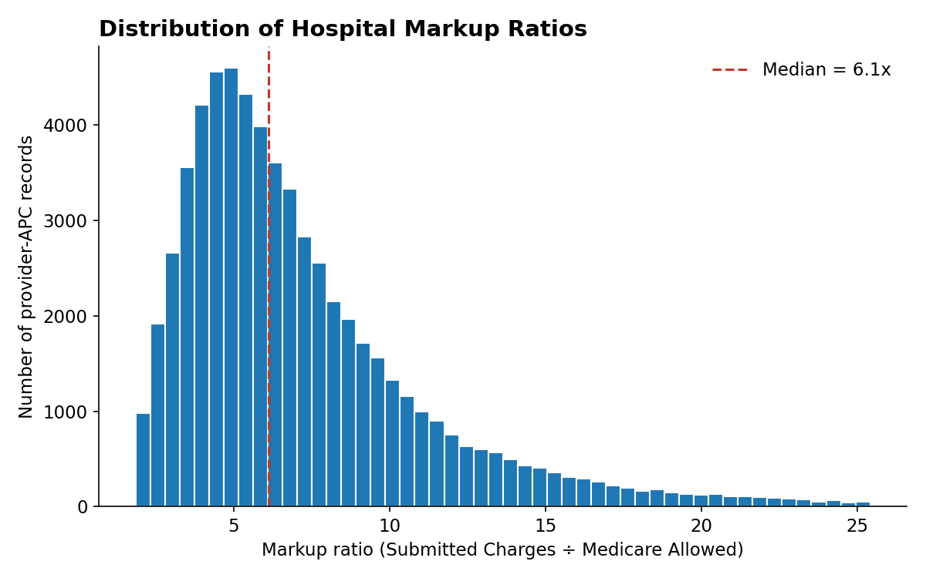
INSIGHT 5
Extreme Markups Are Real, Not Data Errors
5.7%
of records sit above the statistical outlier fence
A right-skewed distribution: most records cluster 4–9x, with a long tail past 20x.
I verified: no duplicate keys, no negative/zero values — the tail is genuine hospital pricing behavior worth flagging to stakeholders, not deleting.
Medicare Outpatient Hospitals Case Study — CY 2023
9

Slide 10
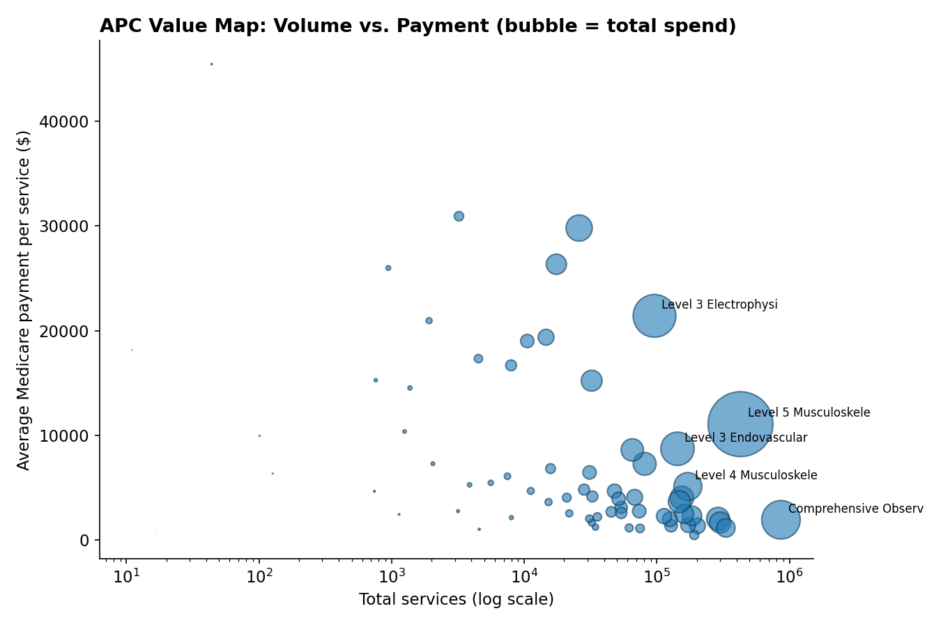
BONUS VIEW
Volume vs Payment
High-volume, lower-payment services (e.g., Observation) sit bottom-right.
Low-volume, high-payment services (e.g., ICD implants) sit top-left.
Bubble size = total estimated spend — showing which APCs matter most on a cost-times-volume basis.
Medicare Outpatient Hospitals Case Study — CY 2023
12

Slide 11
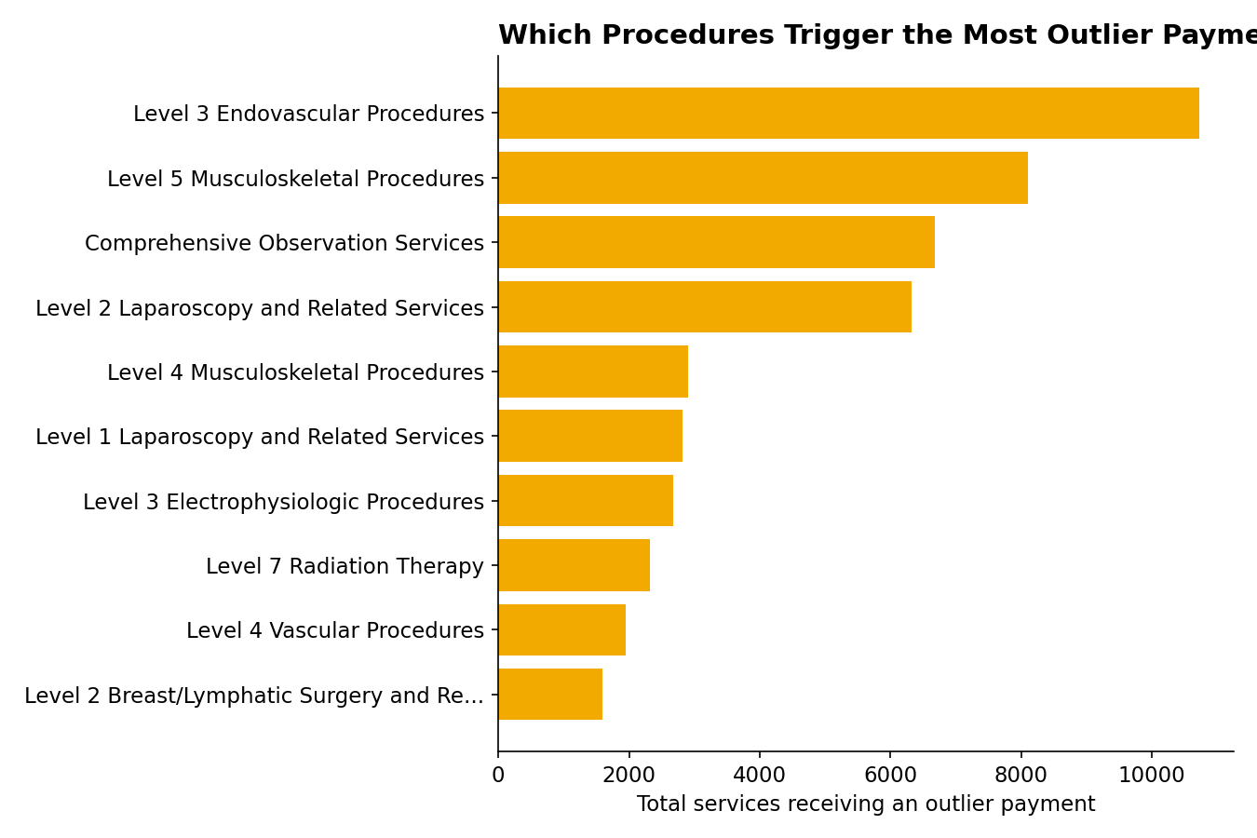
INSIGHT 6
Outlier Payments Cluster in Complex Procedures
Endovascular procedures trigger the most outlier-payment services (~10,700).
Radiation Therapy has the highest average outlier payment per service (~$1,672).
These are CMS's own cost-based outlier payments — a safety valve for unusually expensive individual cases, separate from the charge/markup story.
Medicare Outpatient Hospitals Case Study — CY 2023
10

Slide 12
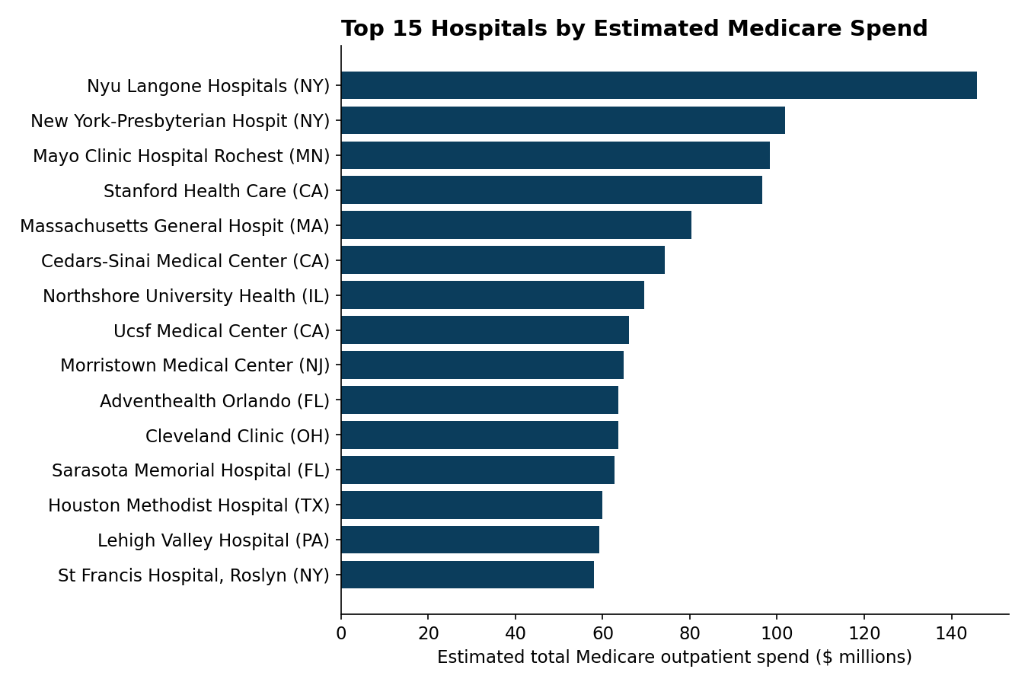
INSIGHT 7
Spending Is Concentrated in Large Academic Centers
12.6%
of spend from just the top 50 hospitals
NYU Langone, NewYork-Presbyterian, and Mayo Clinic Rochester top the list.
The top 50 hospitals (1.6% of all hospitals) account for 12.6% of estimated in-scope Medicare spend.
Concentration is real but not extreme — Medicare outpatient spend is fairly distributed across thousands of hospitals.
Medicare Outpatient Hospitals Case Study — CY 2023
11

Slide 13
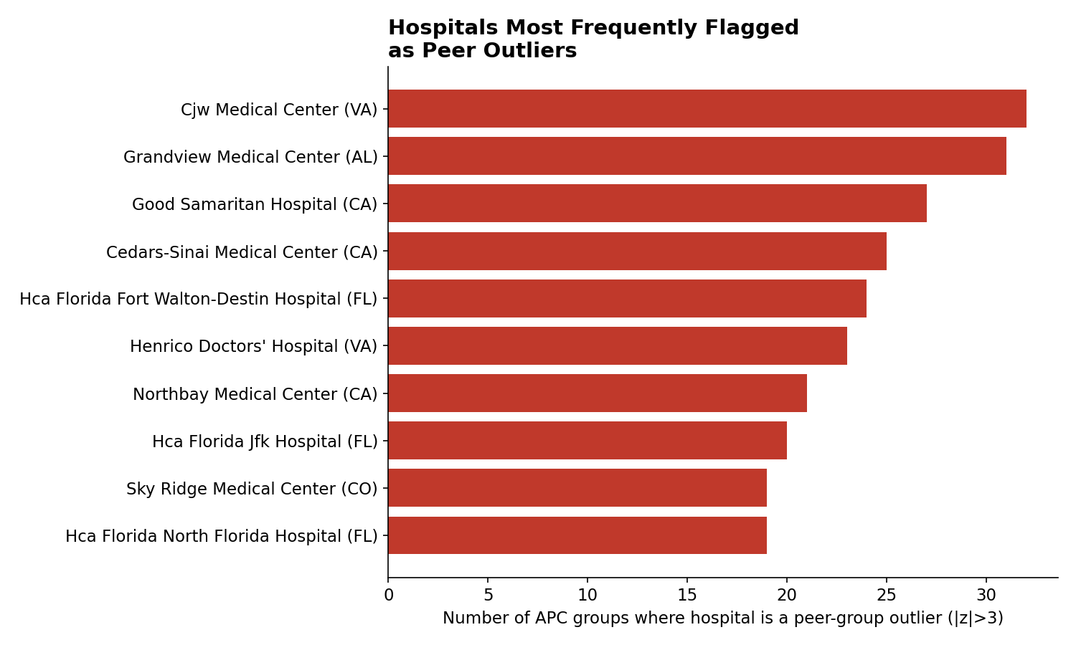
OUTLIER DETECTION
Peer-Group Method: Outliers vs. Same-Procedure Hospitals
2.0%
of records are outliers vs. same-procedure peers
Method: within each APC (procedure group), flag hospitals whose submitted charge is >3 standard deviations from the peer mean for that SAME procedure — an apples-to-apples comparison.
1,271 provider-APC records (2.0%) are peer outliers.
Medicare Outpatient Hospitals Case Study — CY 2023
13

Slide 14
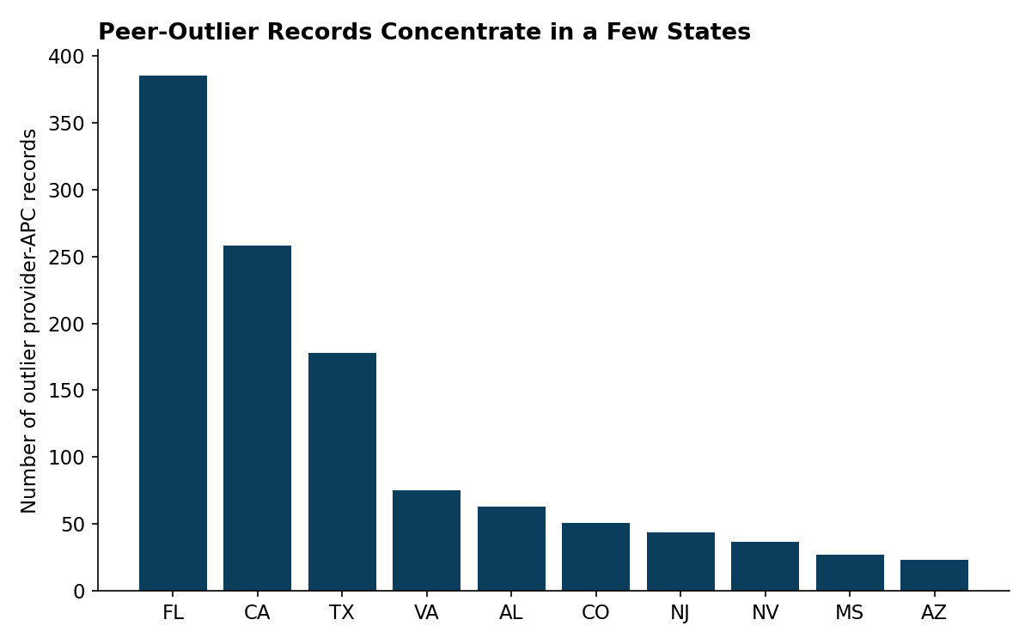
OUTLIER DETECTION
Peer Outliers Cluster in Urban Hospitals & a Few States
Florida, California, and Texas together account for over half of all outlier records.
This mirrors the state-markup pattern from Insight 3 — the same states with high average markups also produce the most extreme individual outliers.
Medicare Outpatient Hospitals Case Study — CY 2023
14

Slide 15
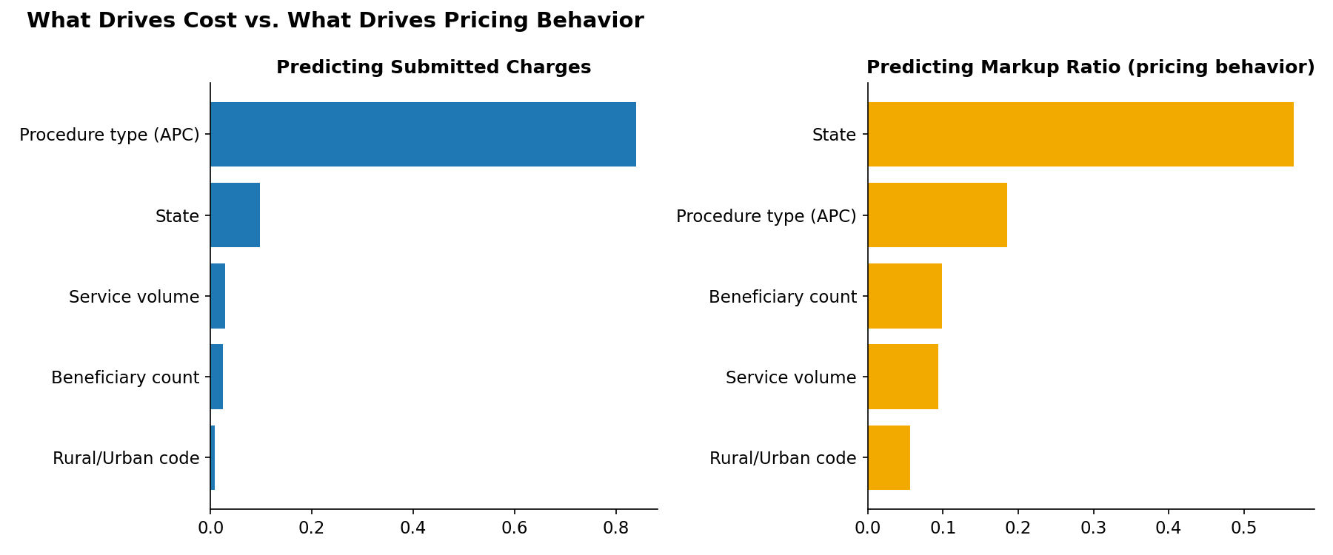
BONUS ANALYSIS
What Actually Predicts Cost?
I trained a Random Forest on procedure type, state, rural/urban code, service volume, and beneficiary count to rank what predicts (A) the raw charge amount, and (B) the markup ratio — pricing behavior net of what procedure is being done.
Takeaway: the procedure itself explains most of the raw dollar amount (as expected) — but once that's controlled for, STATE is the single biggest predictor of markup behavior (57%), bigger than the procedure type itself. Local market/regulatory environment drives pricing more than clinical complexity does.
Medicare Outpatient Hospitals Case Study — CY 2023
15

Slide 16
Executive Summary
Key Take Away
6.1x
Hospitals bill 6x times what Medicare pays — for the typical outpatient service.
4x
The most aggressive states (NV, FL) mark up nearly 4x more than the gentlest (MA, RI).
2x
Urban hospitals bill about double what rural ones do — Medicare's payment barely moves.
57%
A hospital's state predicts its markup better than the procedure itself does.
The price tag says more about a hospital's zip code than about your diagnosis.
8

Slide 17
APPENDIX
Data Preparation: Approach & Assumptions
Approach
Key Assumptions
1. Profiled shape, types, and missingness before touching values.
2. Converted currency-string columns ($ and commas) to numeric.
3. Diagnosed missingness against the methodology doc rather than assuming it was random.
4. Checked for structural errors (negatives, zeros, duplicate keys) before any statistical outlier work.
5. Built one clean analysis frame (rows with usable core metrics) instead of overwriting the raw file.
• Statistical outliers (extreme markup ratios) are treated as real hospital behavior, not data errors, and are kept in all totals/averages.
• "Cost" is analyzed at the average-per-APC level provided in the file, not per individual claim (the file doesn't include claim-level data).
• Peer group = hospitals billing the identical APC code, controlling for procedure-mix differences.
16

Slide 18
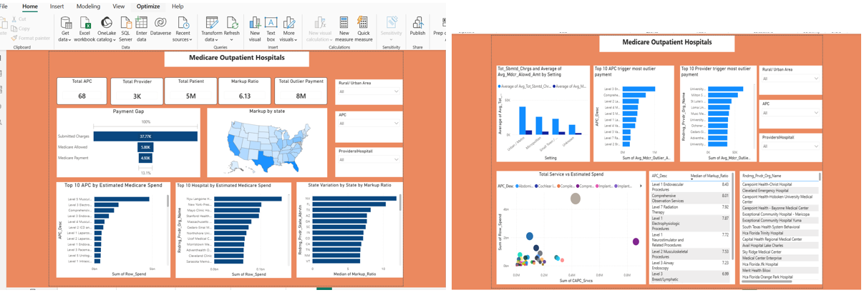
Power BI report snippet

