Slide 1
Prediction of Shear and Flexural Strength of Reinforced Recycled Aggregate Concrete Beam: Machine Learning Approach
Nandita Kamath, Subhasis Pradhan and Sudhirkumar V. Barai

Slide 2

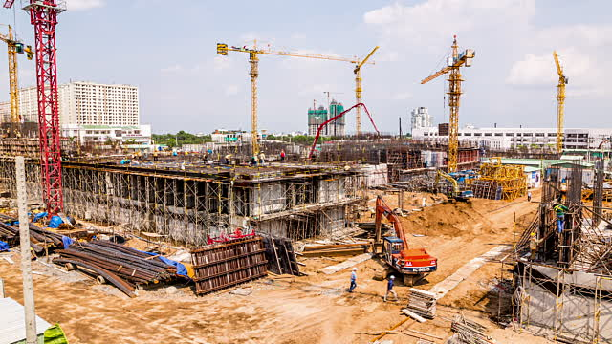



Background
Depletion of natural resources
Natural Aggregate
Construction and Demolition Waste
Huge amount of construction work
Concrete
Industrialization and Urbanization
C&D
Waste
Growth in Population and Economy

Slide 3
Background
India invests around 10% of the GDP on construction activities.
Central Pollution Control Board, Ministry of Environment, Forests & Climate Change, India
Approximately 25 to 30 million tonnes of C&D waste is generated in India and only 5% of which is processed to extract RA.
Approximately 70% to 80% of its total volume of concrete is occupied by aggregates.
IS: 383 (2016) suggests for the replacement of RCA upto
100% lean concrete
20% plain concrete
25% reinforced concrete

Slide 4
Background
The aggregate yielded by crushing of waste parent concrete is known as Recycled Aggregate (RA).
The concrete in which natural aggregate is replaced partially or fully by RA is known as Recycled Aggregate Concrete (RAC).
Waste concrete (C&D waste)
Recycled coarse aggregate (RCA)
Recycled fine aggregate (RFA)
Recycled aggregate (RA)

Slide 5
Questions to be Addressed
1- Can we prepare structural concrete using 100% recycled coarse aggregate (RCA)?
2- How to design the recycled aggregate concrete (RAC) mix with 100% RCA?
3- How is the mechanical performance of RAC got affected?
4- Does it affect the performance of structural members (beam, column and slab)?

Slide 6
Process to Address the Questions
Material Processing and Its Characterization
Recycling Process of RCA
Characterisation of RCA
Mix Proportioning and Mixing Approach
Mix Design Method
Performance Evaluation of Concrete
Beam
Column
Structural Applications
Fresh Stage
Hardened Stage
Macro Level
Slab
Life Cycle Assessment and Cost Analysis
Mixing Approach
Fracture Behaviour
Micro and Meso Level

Slide 7
Particle Packing Method (PPM)
Particle Packing Method (PPM) is a process of optimization of aggregate proportion in the mixture.
Smaller particles fill up the voids between large particles.
Coarse aggregate_{L}
Cement paste
Coarse aggregate_{S}
Fine aggregate
This study could serve as the thumb rule for mix design of RAC with improved mechanical properties.

Slide 8
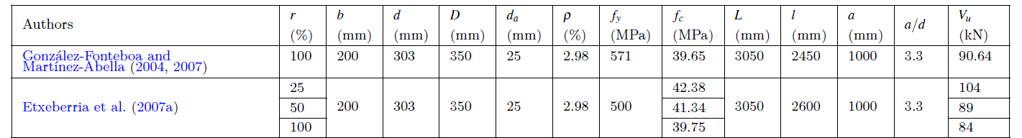
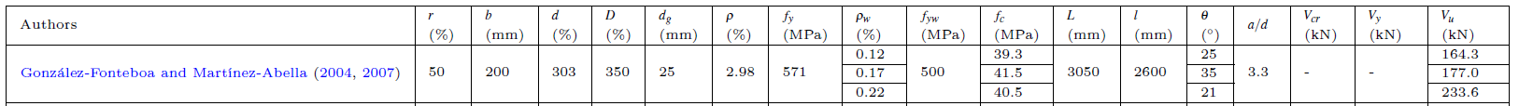
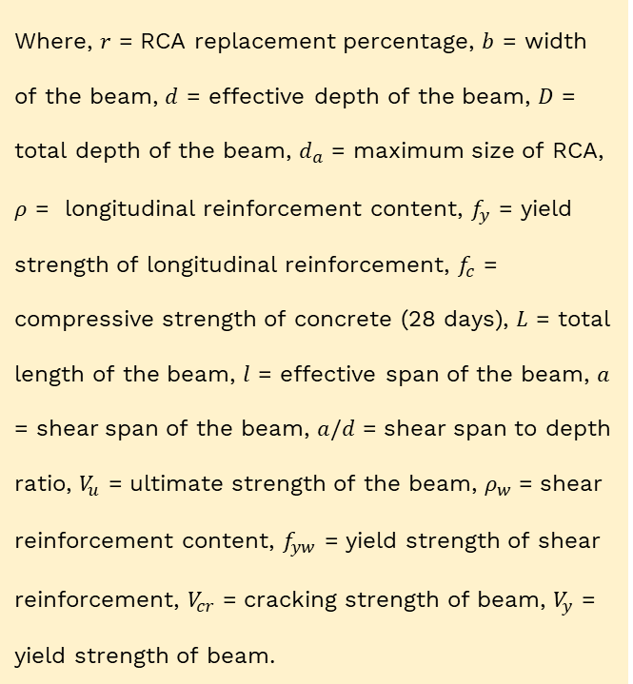
Database
Database of RAC Beams without Shear Reinforcement (91 data)
Database of RAC Beams with Shear Reinforcement (96 data)
Where, $r$ = RCA replacement percentage, $b$ = width of the beam, $d$ = effective depth of the beam, $D$ = total depth of the beam, $d_{a}$ = maximum size of RCA, $ρ$ = longitudinal reinforcement content, $f_{y}$ = yield strength of longitudinal reinforcement, $f_{c}$ = compressive strength of concrete (28 days), $L$ = total length of the beam, $l$ = effective span of the beam, $a$ = shear span of the beam, $a/d$ = shear span to depth ratio, $V_{u}$ = ultimate strength of the beam, $ρ_{w}$ = shear reinforcement content, $f_{yw}$ = yield strength of shear reinforcement, $V_{cr}$ = cracking strength of beam, $V_{y}$ = yield strength of beam.
Database of RAC Beams without Shear Reinforcement
Database of RAC Beams with Shear Reinforcement

Slide 9
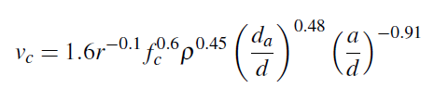
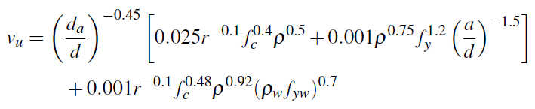
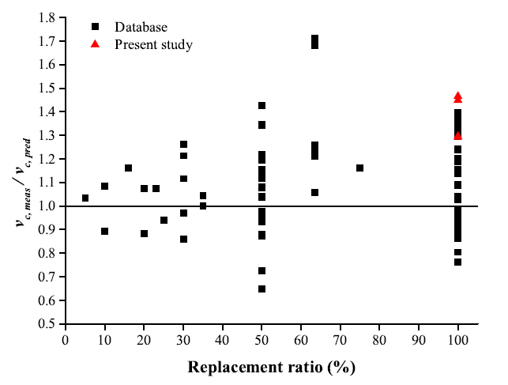
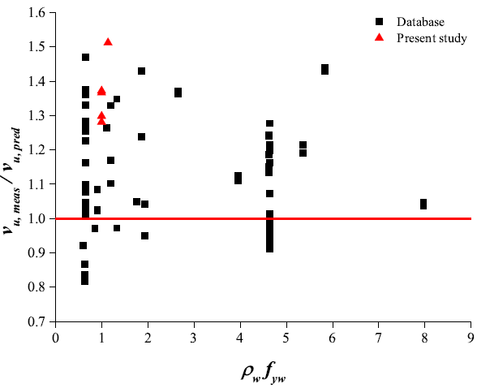
Derived Expressions for Ultimate Strength Prediction
RAC Beams without Shear Reinforcement
RAC Beams with Shear Reinforcement
$v_{c, meas}/v_{c, pred}$ → Average value 1.08 and CoV 0.17
$v_{u, meas}/v_{u, pred}$ → Average value 1.14 and CoV 0.14

Slide 10
Application of Machine Learning

Slide 11
Model Development & Project Workflow
To Predict Shear Strength of RAC Beams with/without Shear Reinforcement
Define Objectives
Data Preparation
Feature Analysis
Model Building
Model Evaluation
Calculate mathematical efficiency of model to estimate performance:
Coefficient of Determination
Root Mean Squared Error
Mean Absolute Error
Root Relative Squared Error
Data Wrangling to flag outliers
Statistical Data Analysis to gauge spread of data (Mean/Median/Range)
Updating any missing values and removing unwanted variables
Analysis of all Input Parameters that affect Target Variable
Data Exploration to Categorize Input Features (Categorical/Continuous Variable)
Correlation Plot to determine relation between continuous variables.
Selection of most relevant features with respect to target variable
Randomly Splitting Data into Training & Testing Sets
Selecting Supervised ML algorithms

Slide 12
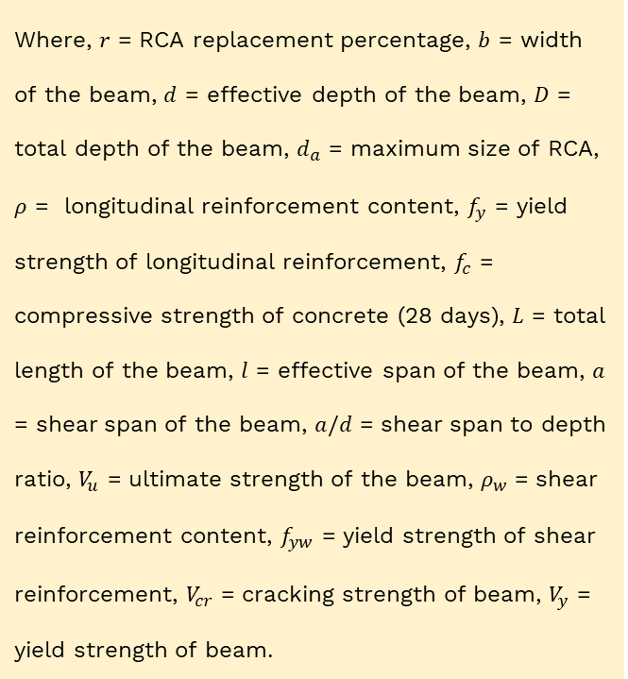
Database
Database of RAC Beams without Shear Reinforcement (91 data) – Database 1
Database of RAC Beams with Shear Reinforcement (96 data) – Database 2
Where, $r$ = RCA replacement percentage, $b$ = width of the beam, $d$ = effective depth of the beam, $D$ = total depth of the beam, $d_{a}$ = maximum size of RCA, $ρ$ = longitudinal reinforcement content, $f_{y}$ = yield strength of longitudinal reinforcement, $f_{c}$ = compressive strength of concrete (28 days), $L$ = total length of the beam, $l$ = effective span of the beam, $a$ = shear span of the beam, $a/d$ = shear span to depth ratio, $V_{u}$ = ultimate strength of the beam, $ρ_{w}$ = shear reinforcement content, $f_{yw}$ = yield strength of shear reinforcement, $V_{cr}$ = cracking strength of beam, $V_{y}$ = yield strength of beam.
Database of RAC Beams without Shear Reinforcement
Database of RAC Beams with Shear Reinforcement

Slide 13
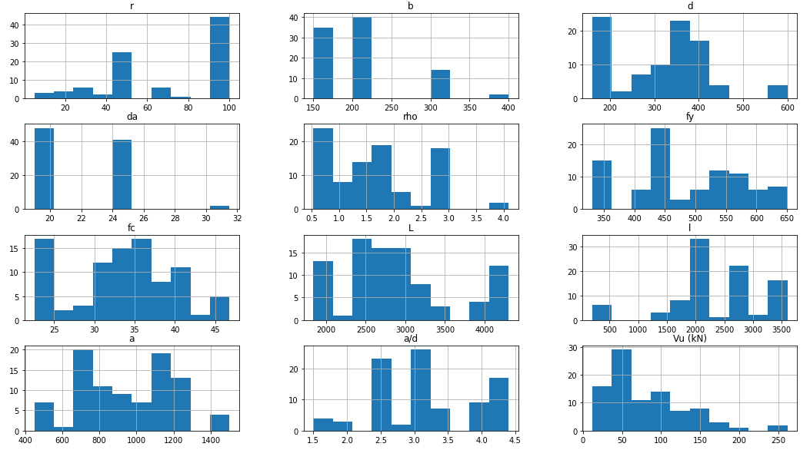
Visual Exploratory Data Analysis
Distribution of the predictor variables for Database 1

Slide 14
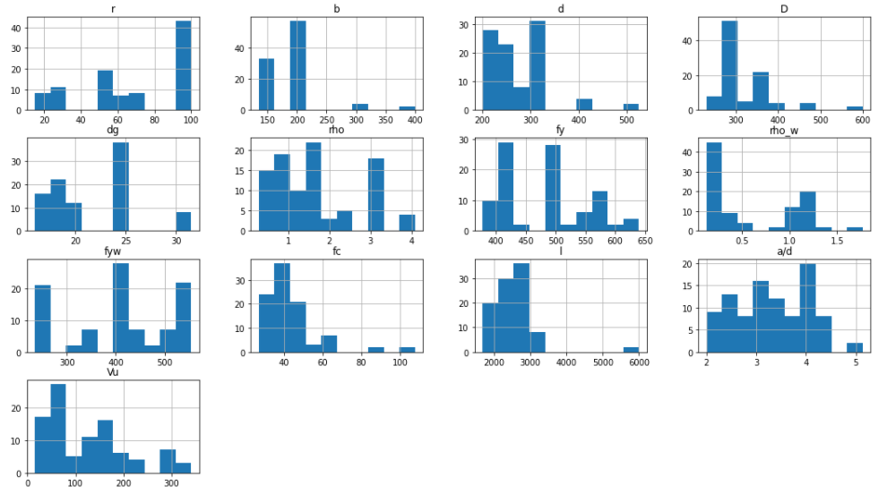
Visual Exploratory Data Analysis
Distribution of the predictor variables for Database 2

Slide 15
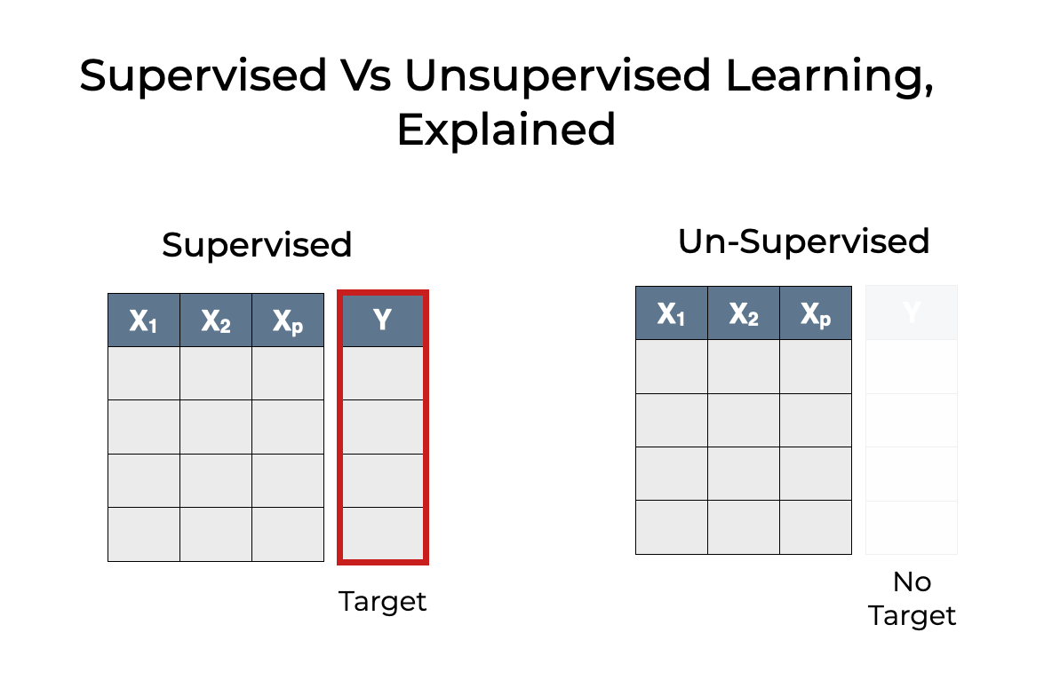
Determination of Learning Approach
The Database consists of predictor (input) variables pertaining to beam characteristics and the target (output) variable, Shear Strength of RAC beam.
Since the Target Variable is available and continuous, a Supervised Regression model is chosen.

Slide 16
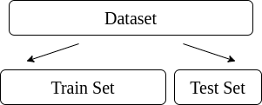
Splitting of Dataset
The existing dataset is shuffled, selected at random and divided 2 sets; Training and Testing with a 70-30% ratio. The training set is used to build the model and the testing set is used to validate it.

Slide 17
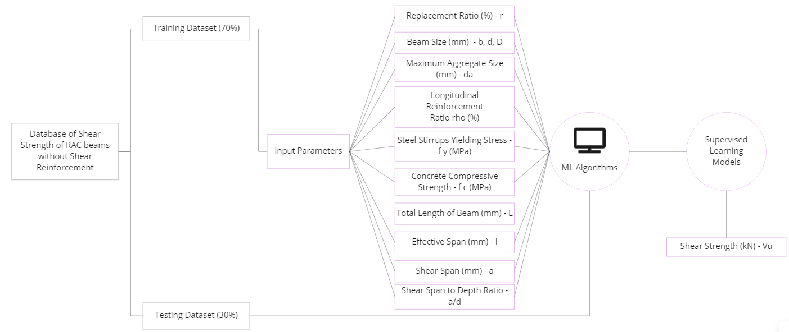
Framework ML Model – RAC Beams without Shear Reinforcement

Slide 18
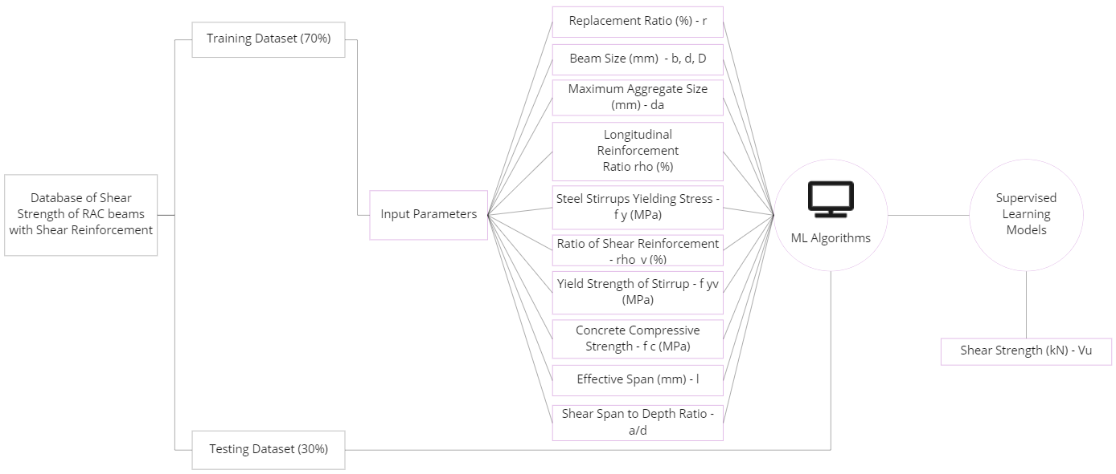
Framework ML Model – RAC Beams with Shear Reinforcement

Slide 19
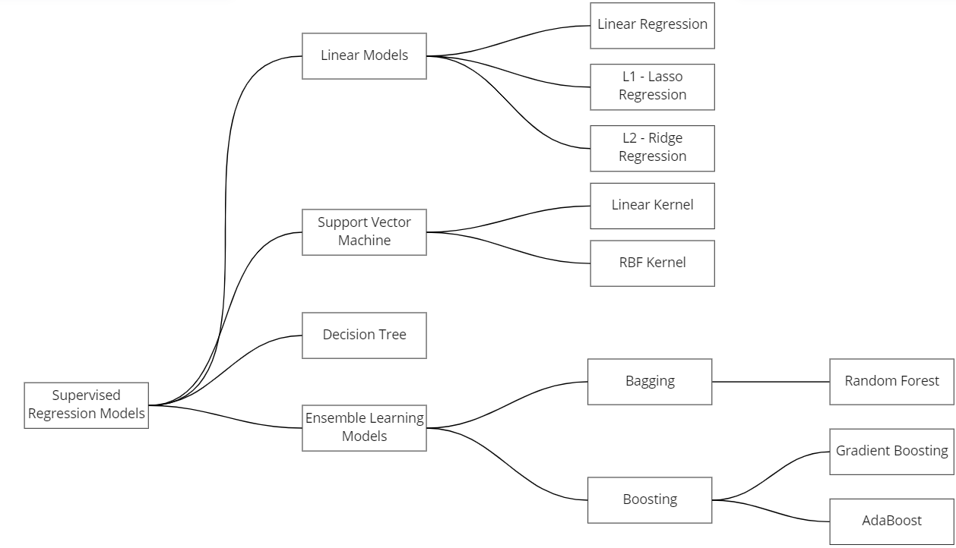
ML Models Trained

Slide 20
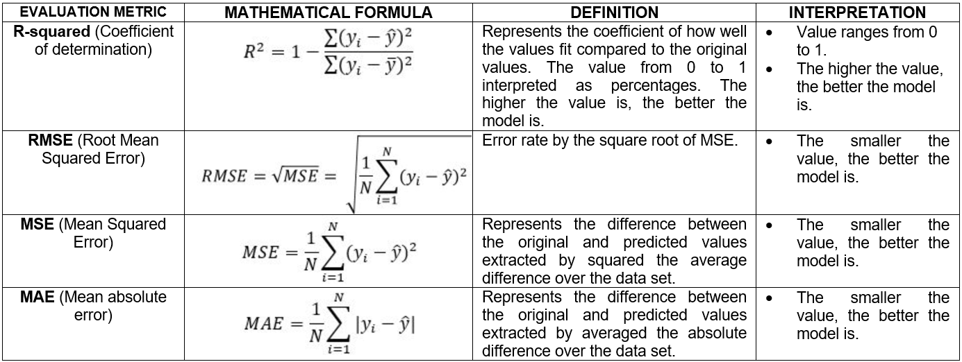
Model Evaluation
Common Evaluation Metrics for Supervised Learning

Slide 21
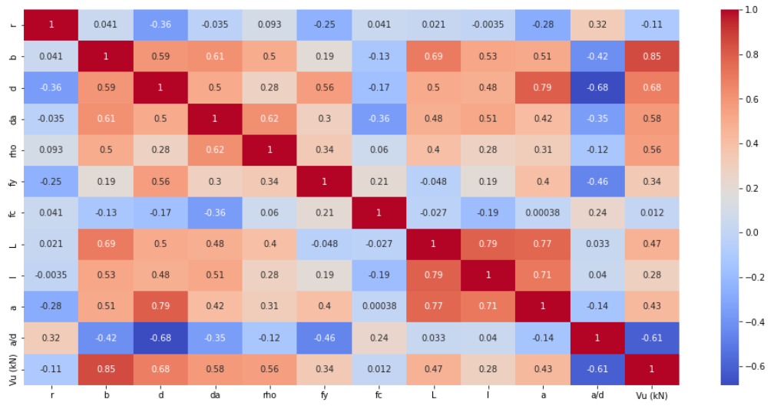
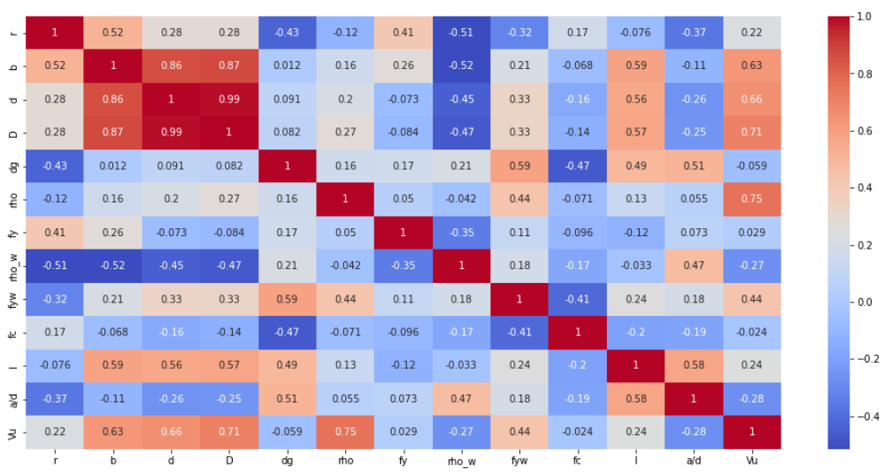
Feature Analysis
Without Shear Reinforcement
Without Shear Reinforcement
Heat maps of correlation matrix are plotted to determine the relation of input parameters on target variable – shear strength
A negative correlation indicates an inversely proportional relation (downward trend)
A positive correlation indicates a directly proportional relation (upward trend)
Absolute correlation value closer to 1 indicates high intensity of relation.
A dark blue or red color indicates high correlation.

Slide 22
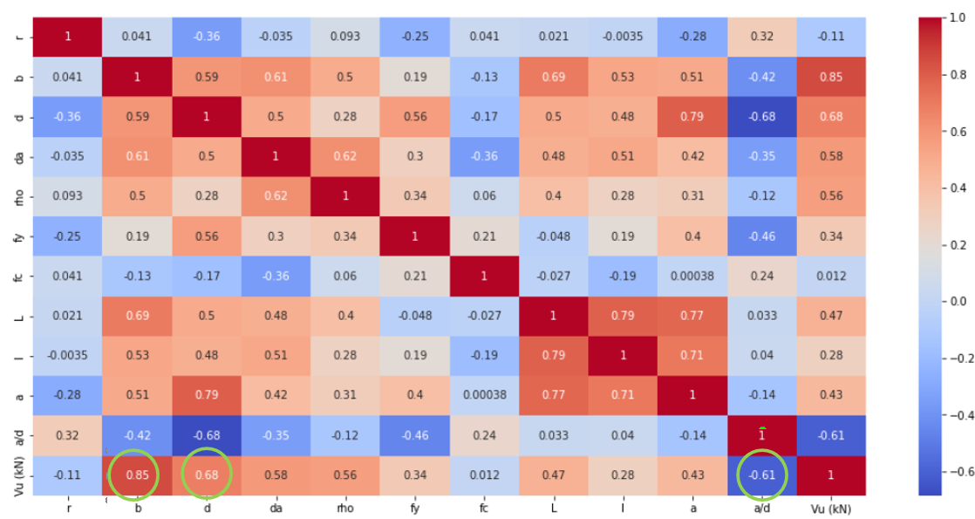
Validation with Existing Literature (Dataset – 1)
Beam size followed by the ratio of a/d effects shear strength the most. This result was also found by Shahnewaz and Alam, from the study of Meta-model of Optimal Prognosis to identify the important parameters.

Slide 23
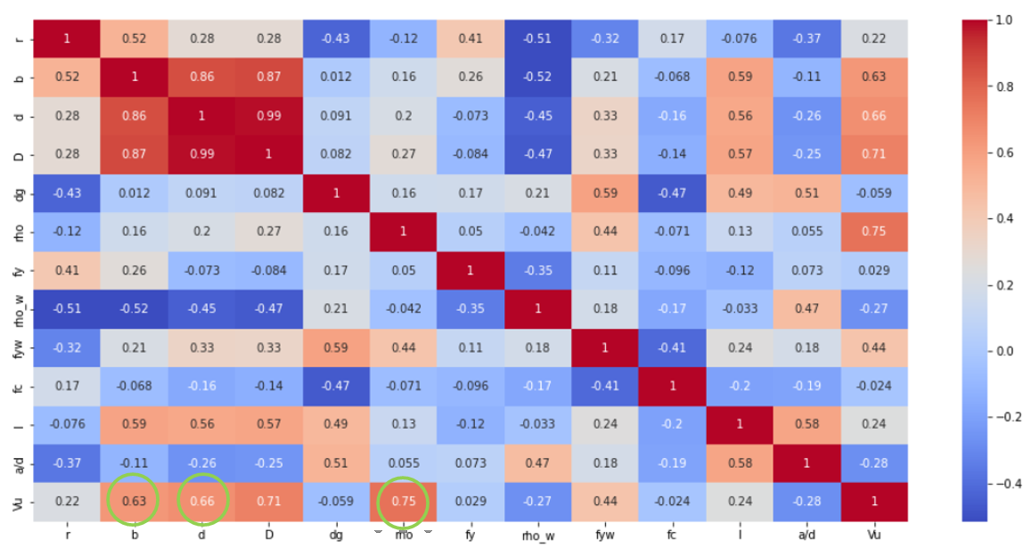
Validation with Existing Literature (Dataset – 2)
Longitudinal reinforcement ratio followed by beam size effects shear strength the most. This result was also found by Rahman & Ahmed while predicting shear strength of steel fiber reinforced concrete beams.

Slide 24
Accuracy Scores for RAC Beams with Shear Reinforcement
MODEL | R² | RMSE | MSE | MAE
Linear Regression | 0.943 | 19.24 | 370.18 | 16.17
L2 (Ridge) Regression | 0.938 | 20.07 | 402.80 | 16.71
L1 (Lasso) Regression | 0.92 | 26.00 | 676.00 | 21.25
Support Vector Machine (Linear Kernel) | -0.092 | 73.95 | 5468.60 | 60.53
Support Vector Machine (RBF Kernel) | 0.003 | 80.25 | 6440.06 | 66.33
Decision Tree | 0.466 | 58.72 | 3448.04 | 32.27
Multi Layer Perceptron Regression (ANN) | -0.17 | 62.68 | 3928.78 | 43.71
Random Forest | 0.896 | 24.66 | 608.12 | 17.06
Gradient Boosting | 0.93 | 21.73 | 472.19 | 13.95
AdaBoost | 0.773 | 21.82 | 476.11 | 17.20
R-Squared, RMSE, MSE & MAE scores have been
calculated to understand the performance of each model
However, for regression models, R-Squared and RMSE
scores are considered to select an efficient model
NOTE:
Both Linear Regression and Gradient Boosting offer very high and close accuracy for the dataset.
This explains lowest MAE value for Gradient Boosting
Linear Regression Model gave highest accuracy of 94.2%

Slide 25
Accuracy Scores for RAC Beams without Shear Reinforcement
MODEL | R² | RMSE | MSE | MAE
Linear Regression | 0.905 | 17.79 | 316.48 | 13.37
L2 (Ridge) Regression | 0.907 | 17.67 | 312.23 | 13.23
L1 (Lasso) Regression | 0.907 | 17.63 | 310.82 | 13.47
Support Vector Machine (Linear Kernel) | 0.626 | 24.76 | 613.06 | 20.19
Support Vector Machine (RBF Kernel) | -0.117 | 61.1 | 3733.21 | 46.01
Decision Tree | 0.878 | 19.88 | 395.21 | 12.44
Random Forest | 0.895 | 17.93 | 321.48 | 12.54
Gradient Boosting | 0.916 | 16.87 | 284.60 | 10.55
AdaBoost | 0.904 | 18.41 | 338.93 | 13.47
Gradient Boosting Model gave highest accuracy of 93.5%

Slide 26

Validation
The selected model is applied on testing set and results are plotted
Scatter plot of Original and Predicted values form a slope very close to 45$°$.

Slide 27
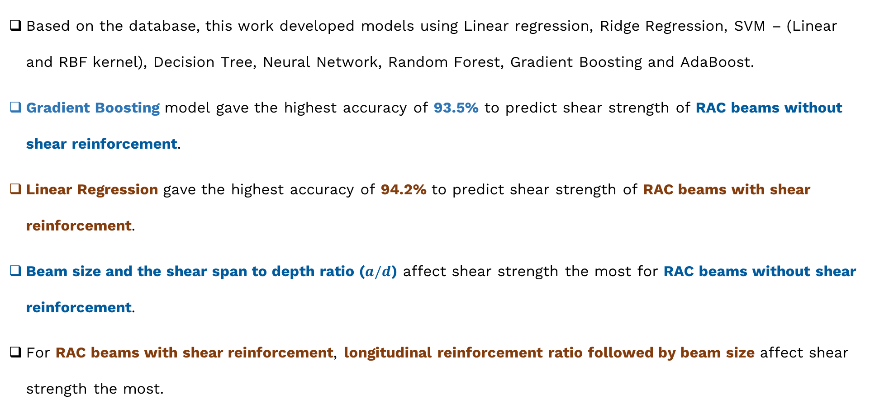
Conclusions
Based on the database, this work developed models using Linear regression, Ridge Regression, SVM – (Linear and RBF kernel), Decision Tree, Neural Network, Random Forest, Gradient Boosting and AdaBoost.
Gradient Boosting model gave the highest accuracy of 93.5% to predict shear strength of RAC beams without shear reinforcement.
Linear Regression gave the highest accuracy of 94.2% to predict shear strength of RAC beams with shear reinforcement.
Beam size and the shear span to depth ratio ($a/d$) affect shear strength the most for RAC beams without shear reinforcement.
For RAC beams with shear reinforcement, longitudinal reinforcement ratio followed by beam size affect shear strength the most.

Slide 28
References
Cheng, M. Y., Chou, J. S., & Cao, M. T. (2017). Nature-inspired metaheuristic multivariate adaptive regression splines for predicting refrigeration system performance. Soft Computing, 21(2), 477-489.
Gandomi, A. H., Alavi, A. H., Mohammadzadeh Shadmehri, D., & Sahab, M. G. (2013). An empirical model for shear capacity of RC deep beams using genetic-simulated annealing. Archives of Civil and Mechanical Engineering, 13(3), 354-369.
Kara, I. F. (2011). Prediction of shear strength of FRP-reinforced concrete beams without stirrups based on genetic programming. Advances in Engineering Software, 42(6), 295-304.
Pérez, J. L., Cladera, A., Rabuñal, J. R., & Martínez-Abella, F. (2012). Optimization of existing equations using a new Genetic Programming algorithm: Application to the shear strength of reinforced concrete beams. Advances in Engineering Software, 50, 82-96.
Zhang, T., Oehlers, D. J., & Visintin, P. (2014). Shear strength of FRP RC beams and one-way slabs without stirrups. J. Compos. Constr, 18(5), 04014007.
Rahman, J., Ahmed, K. S., Khan, N. I., Islam, K., & Mangalathu, S. (2021). Data-driven shear strength prediction of steel fiber reinforced concrete beams using machine learning approach. Engineering Structures, 233, 111743.
Pradhan, S., Kumar, S., & Barai, S. V. (2018). Shear performance of recycled aggregate concrete beams: An insight for design aspects. Construction and Building Materials, 178, 593-611.
Wakjira, T. G., Ebead, U., & Alam, M. S. (2022). Machine learning-based shear capacity prediction and reliability analysis of shear-critical RC beams strengthened with inorganic composites. Case Studies in Construction Materials, 16, e01008.
Shahnewaz, M., & Alam, M. S. (2020). Genetic algorithm for predicting shear strength of steel fiber reinforced concrete beam with parameter identification and sensitivity analysis. Journal of Building Engineering, 29, 101205.

Slide 29
Thank you!!!

