Slide 1
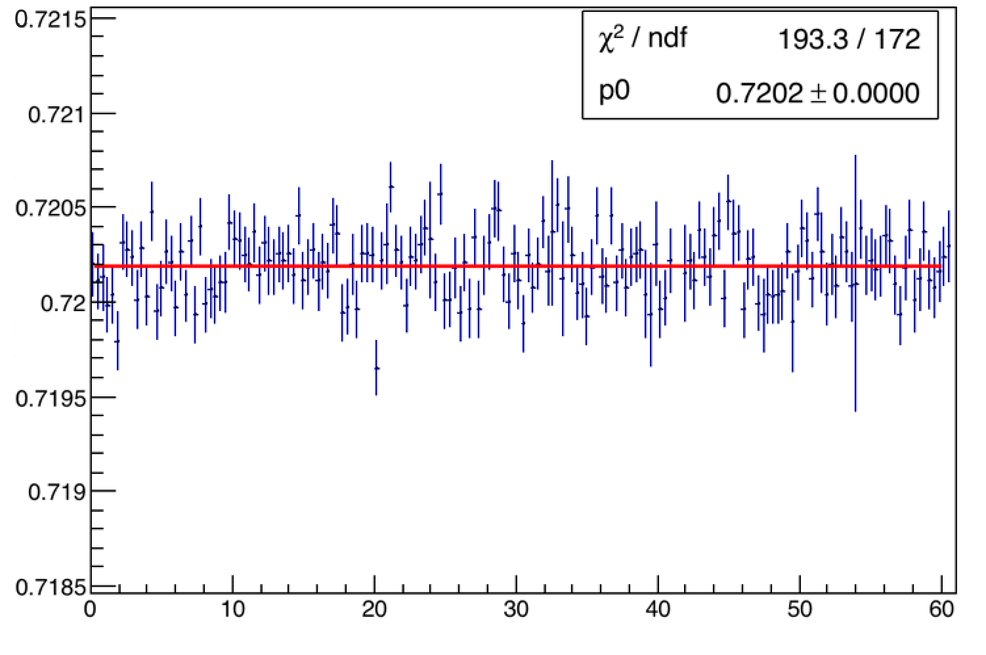
0.7215
0.721
0.7205
0.72
0.7195
0.719
0.7185
χ² / ndf 193.3 / 172
p0 0.7202 + 0.000
A2:A1
0 20 40 60
Time (hrs)

Slide 2
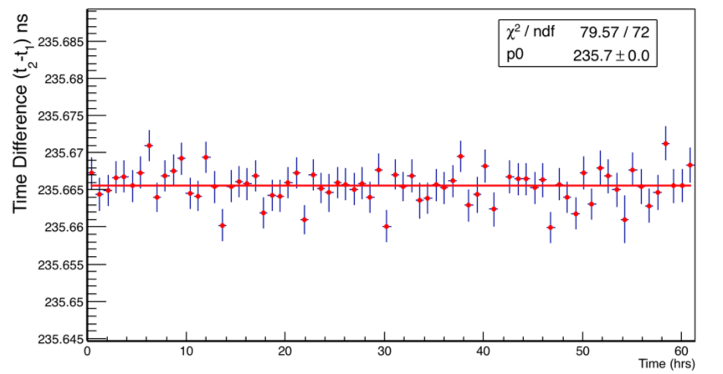
χ² / ndf 79.57 / 72
p0 235.7 + 0.0
235.68
235.67
235.66
235.65
Time Difference (t₂ –t₁) ns
0 20 40 60
Time (hrs)

