Slide 1
LM Analysis – compare old and new PMT’s –60 hrs Dataset Run# 15921 to 15991 22/4 - 1:09 pm to 25/4 – 2:20 am

Slide 2
Old and New PMTs
Calorimeter | Old PMT | New PMT
11 | 25 | 5
12 | 26 | 0
13 | 27 | 6
18 | 28 | 8
20 | 29 | 4
Started looking at calo 18 – will look at other after this.

Slide 3
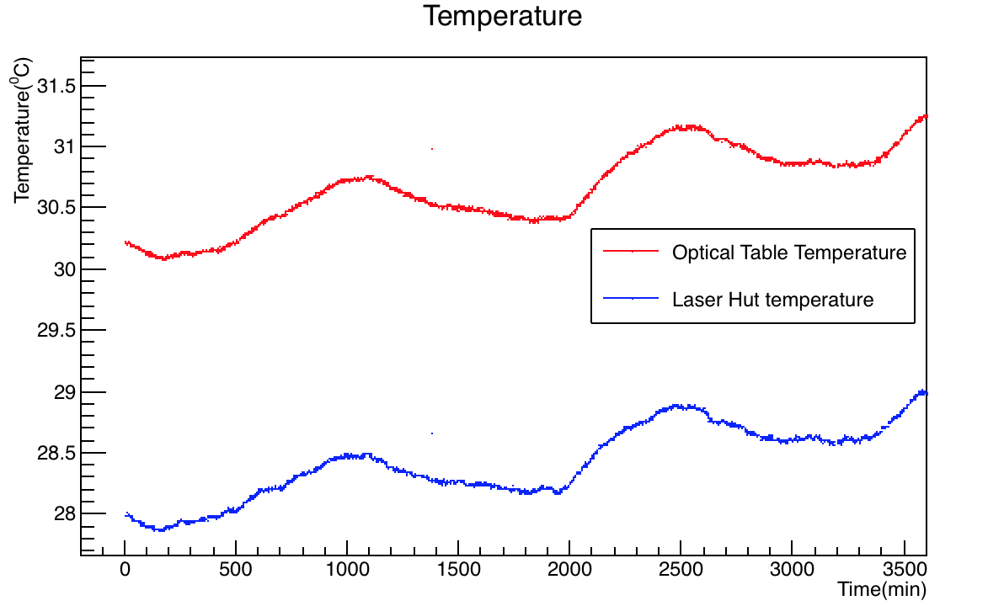
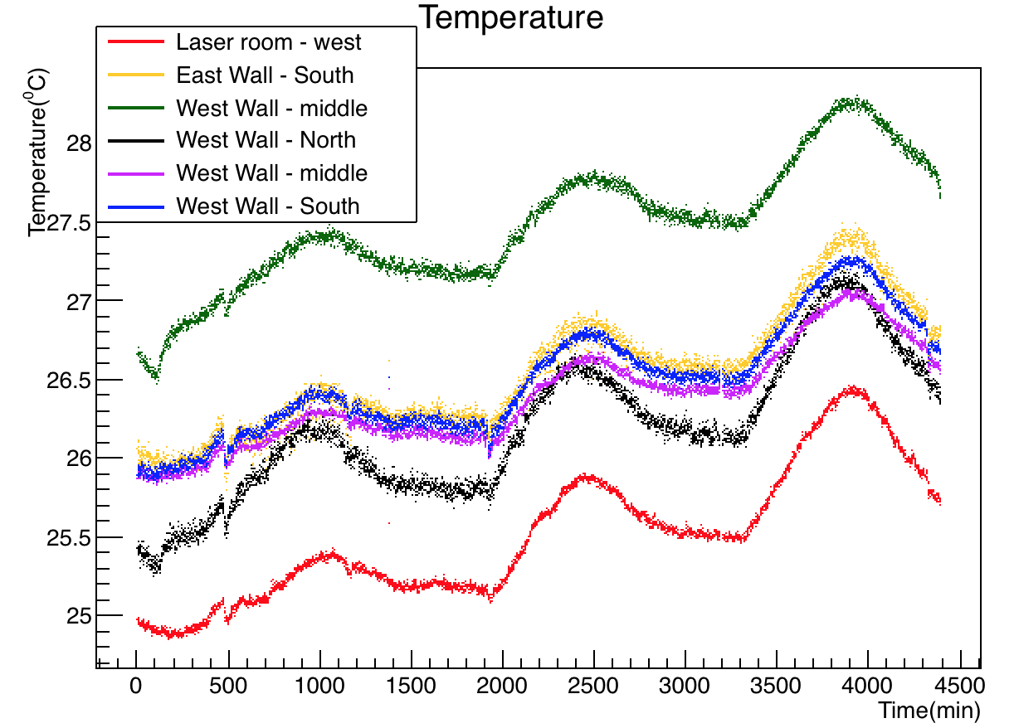
Temperature Variation
West of laser hut – Calos 0,1 ..4
West wall middle – Calos 11,12,
Essentially for these calos, west of laser hut is ok – red graph in right plot.

Slide 4
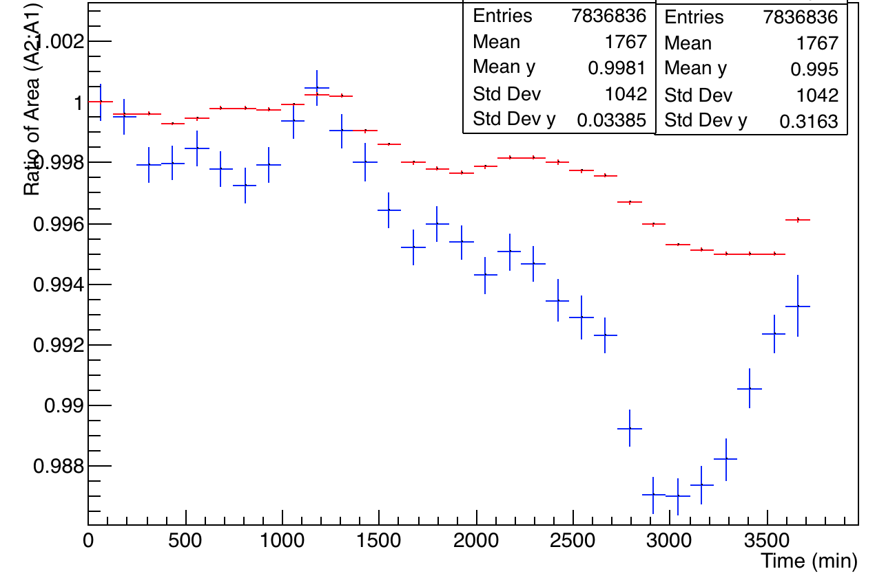
Comparison of old and new PMTs for Calo 18
New PMT – Calo 18, channel 8
Old PMT – Calo 18, channel 28

Slide 5
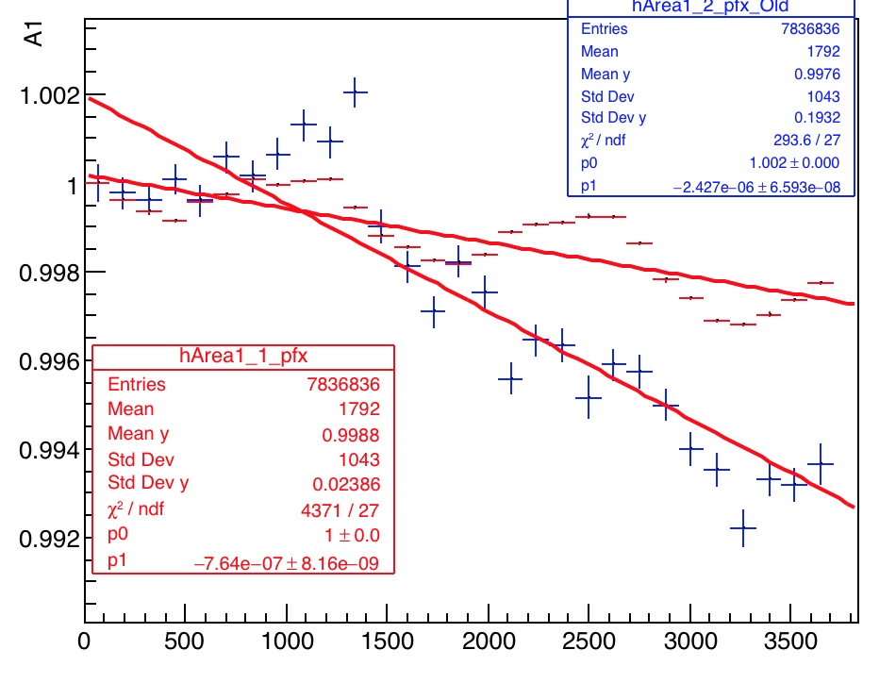
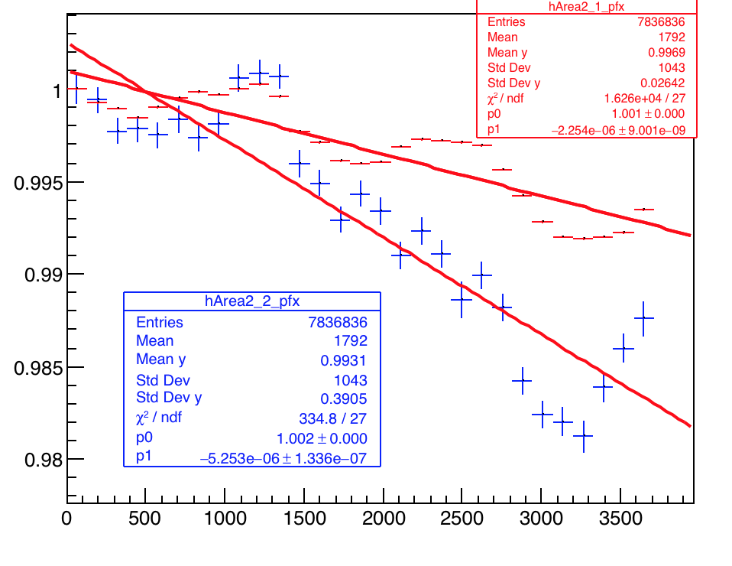
Comparison of old and new PMTs for Calo 18
Normalized area first pulse
Normalized area second pulse
Old PMTs almost 2.5 to 3 times greater drop than new ones

Slide 6
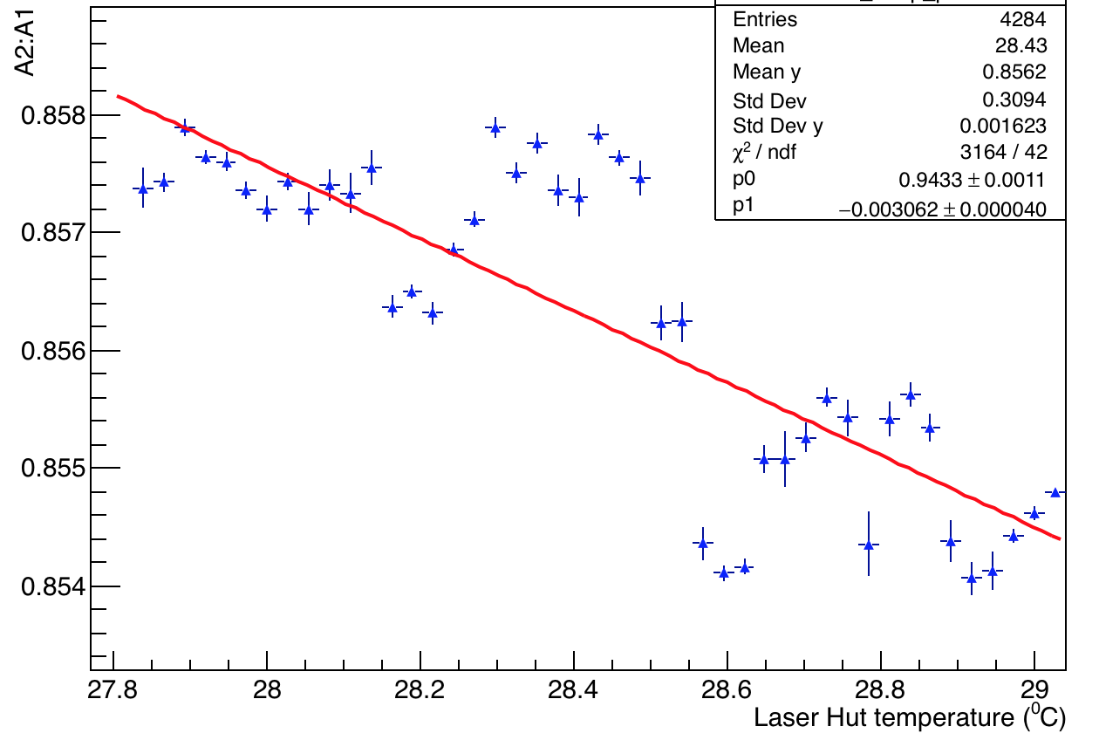
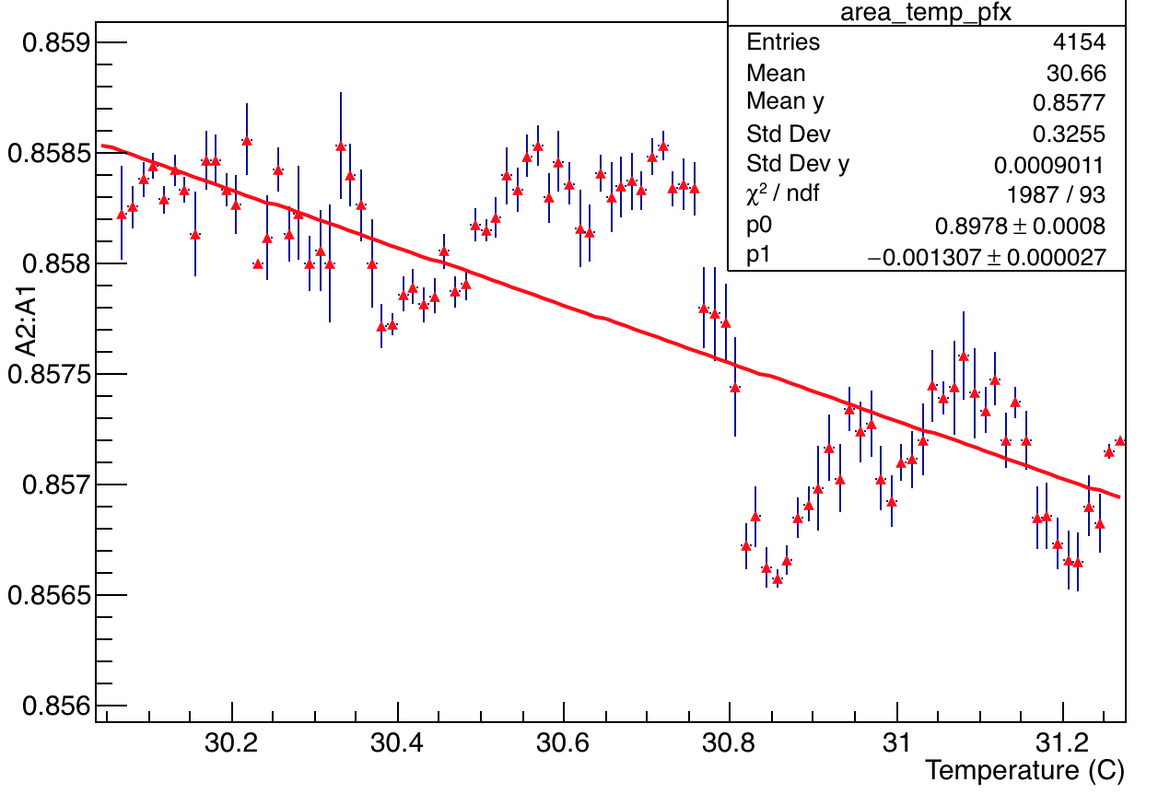
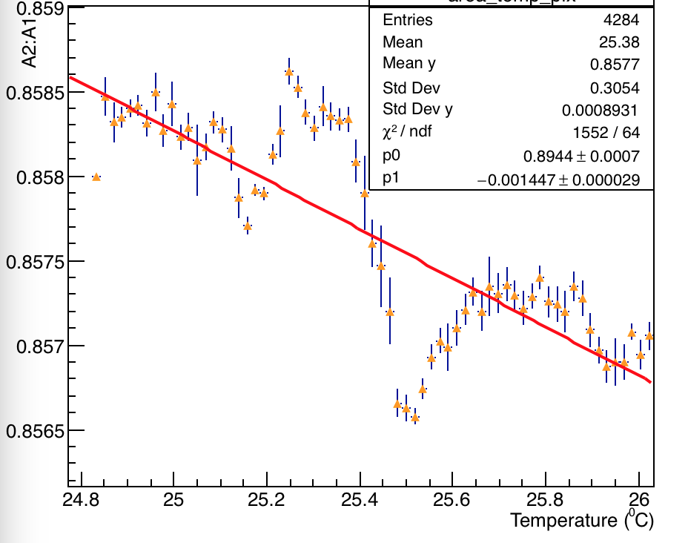
New PMT Channal 8 of calo 18 – Temperature vs. Area ratio
Laser Hut Temperature
Optical Table Temperature
Hall Temperature

Slide 7
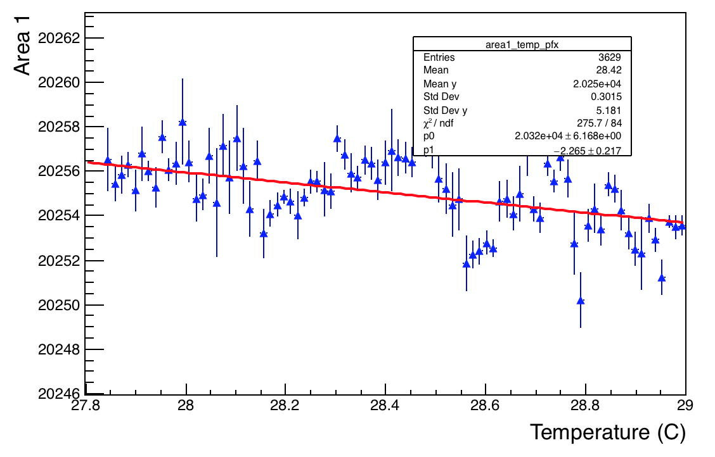
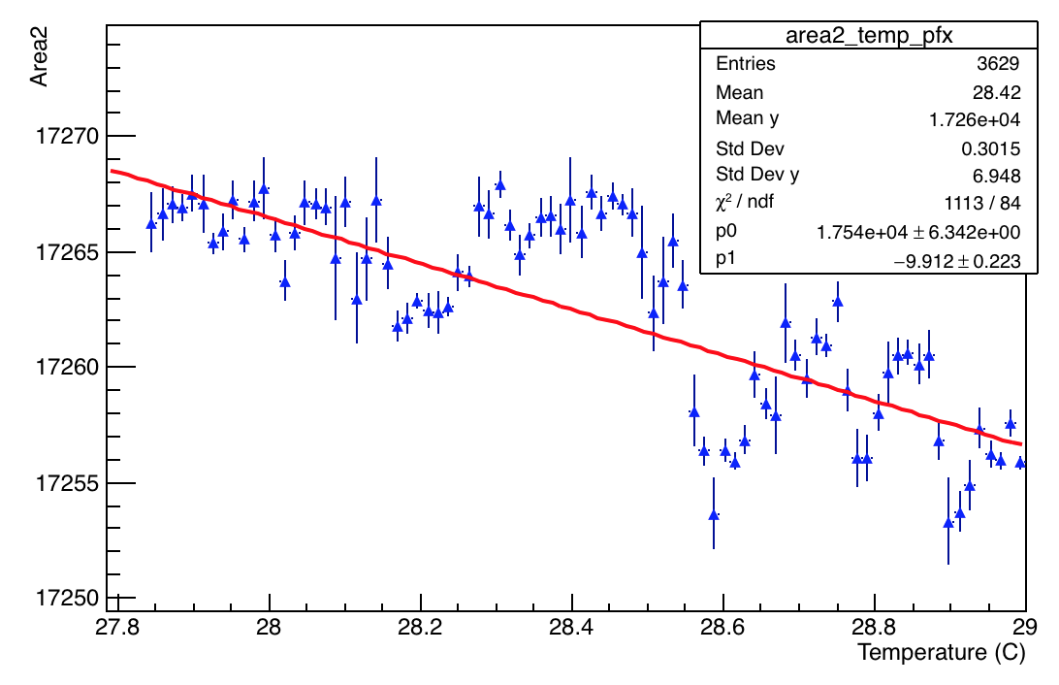
New PMT Ch 8 – Laser hut temperature vs. Areas
Slope of area2 almost 4 times > area1 => area2 contributes to greater loss in the ratio A2:A1

Slide 8
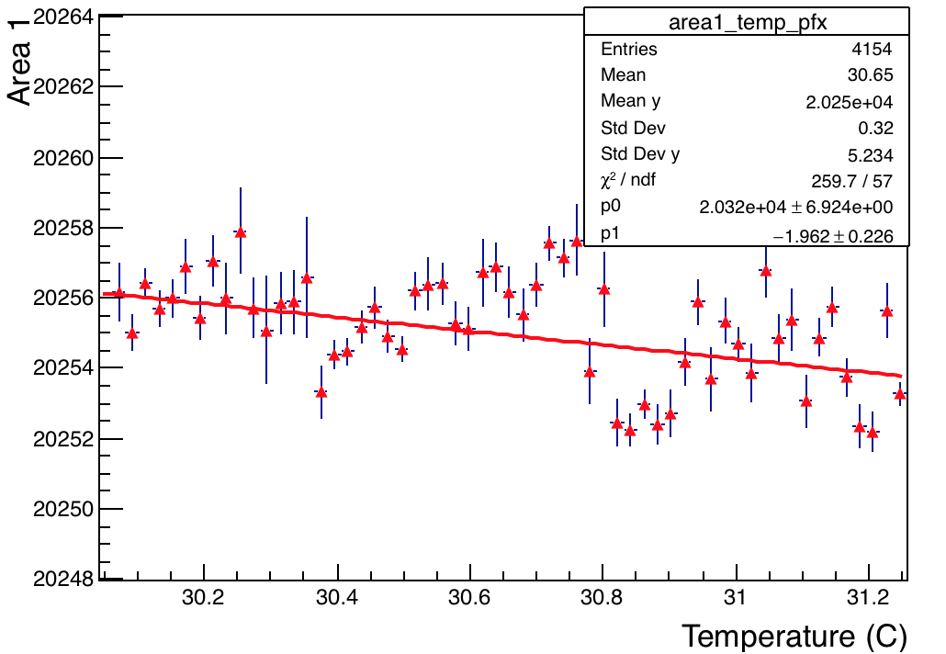
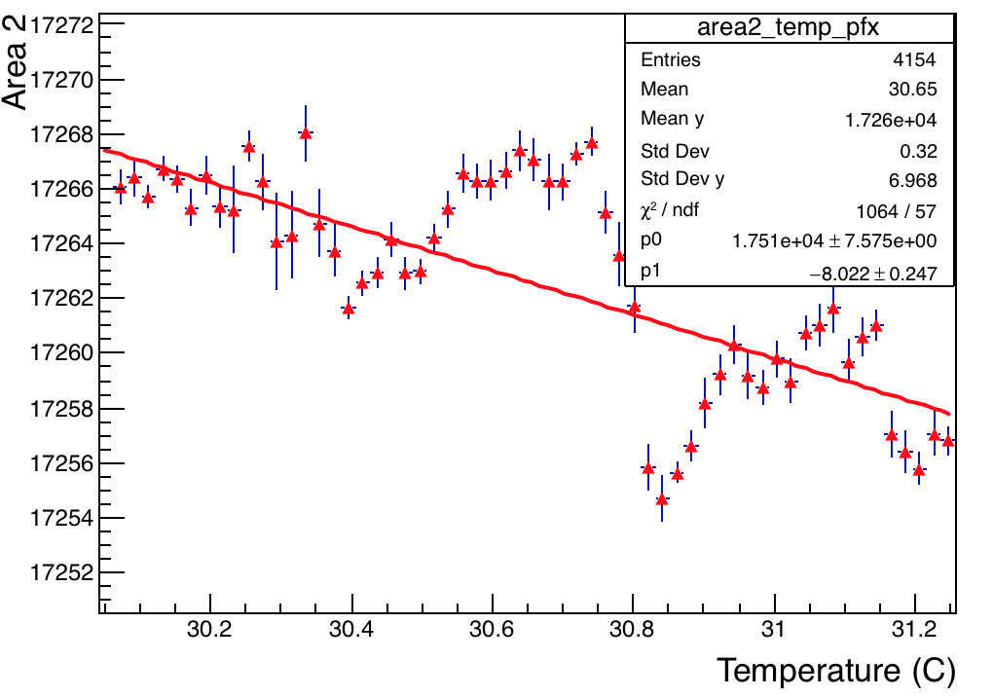
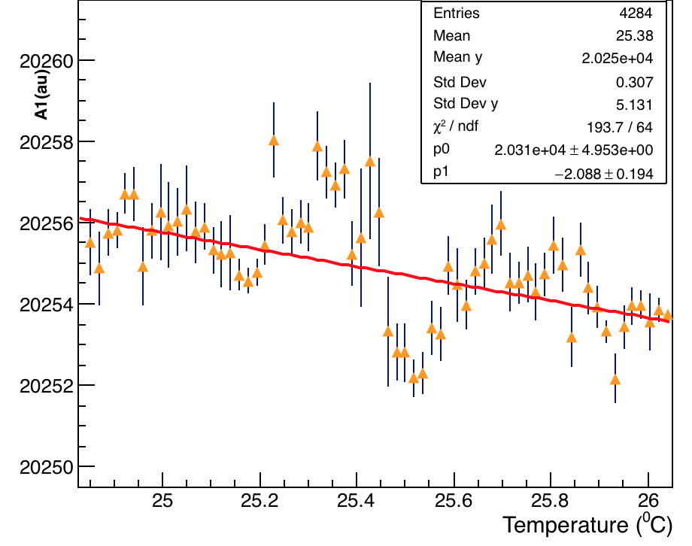
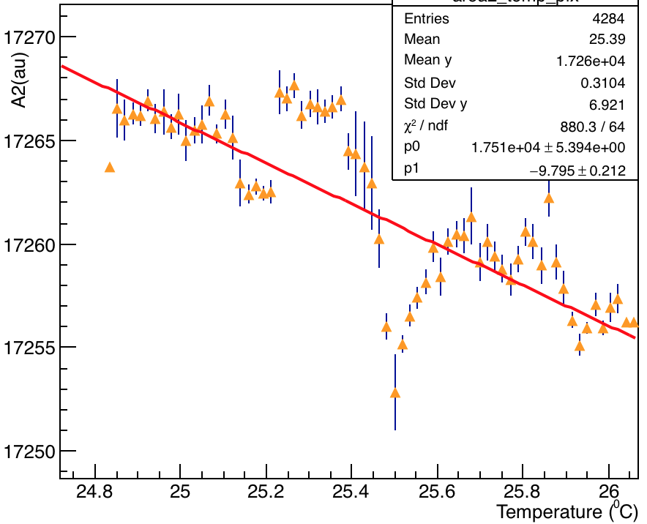
New PMT Ch 8 – Optical table temperature vs. Areas
Slope of A2 almost 4 times > A1 => A2 contributes to greater loss in the ratio A2:A1

Slide 9
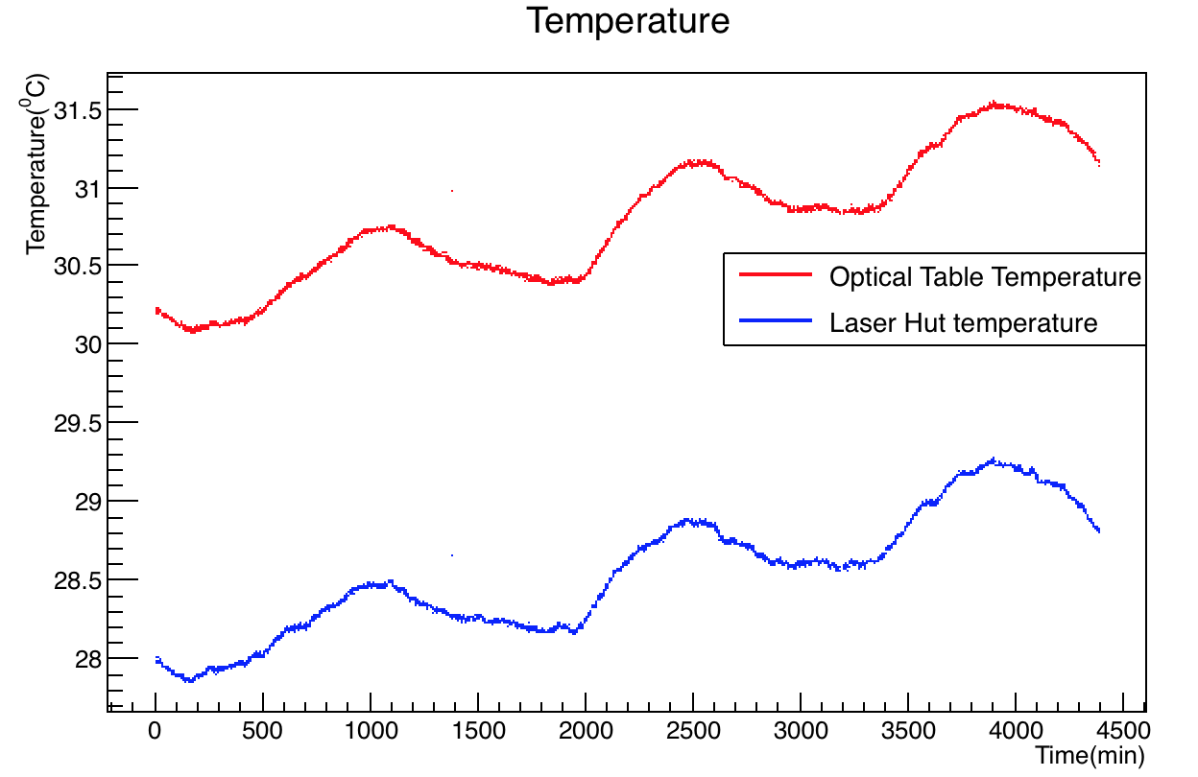
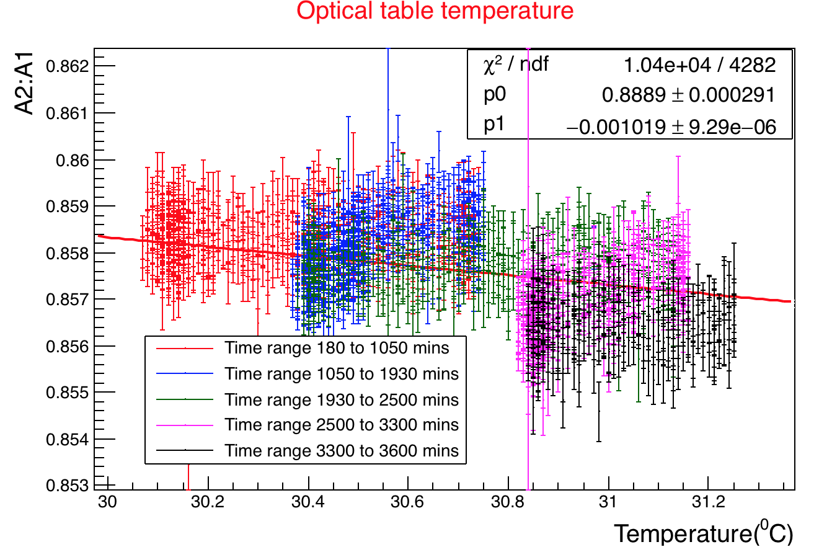
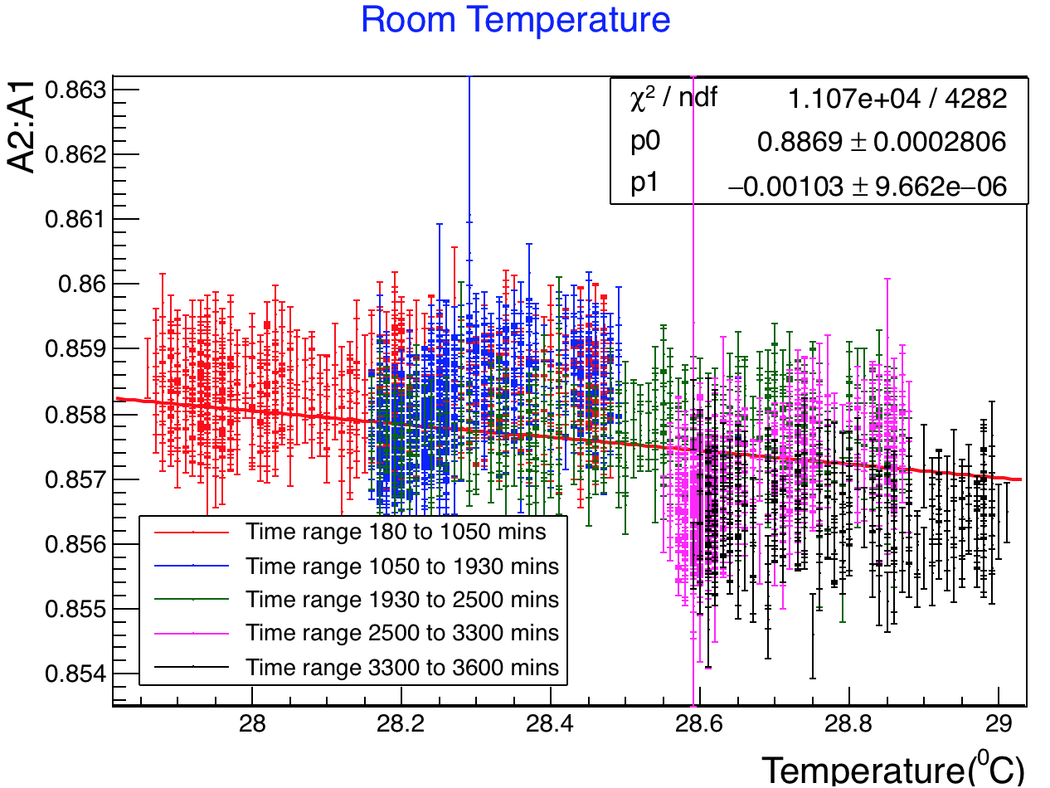
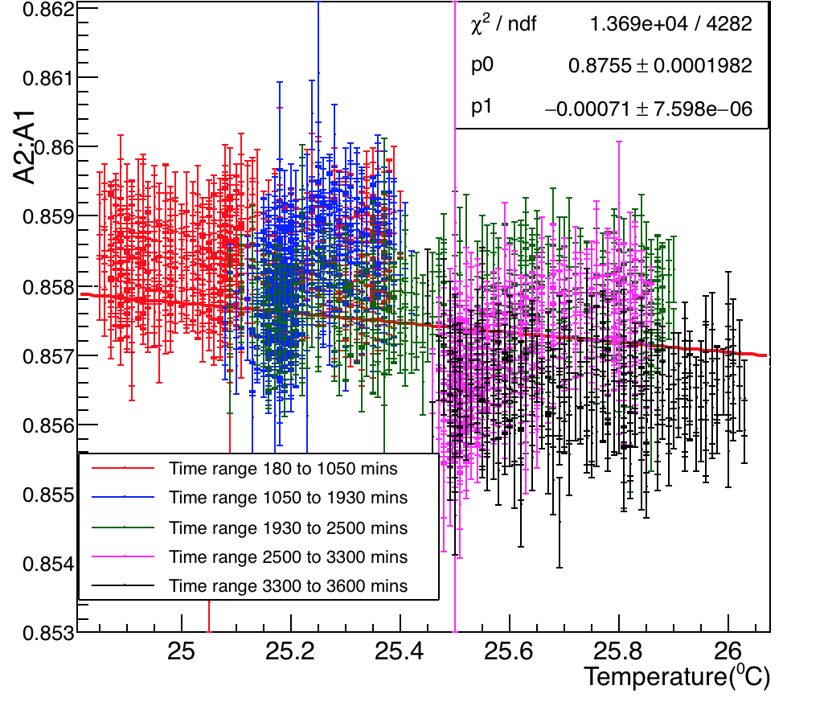
Channal 8 of calo 18 – Temperature Studies
Hall Temperature

Slide 10
Old PMT Channal 28 of calo 18 – Temperature vs. Area ratio
Laser Hut Temperature
Optical Table Temperature
Hall Temperature

Slide 11
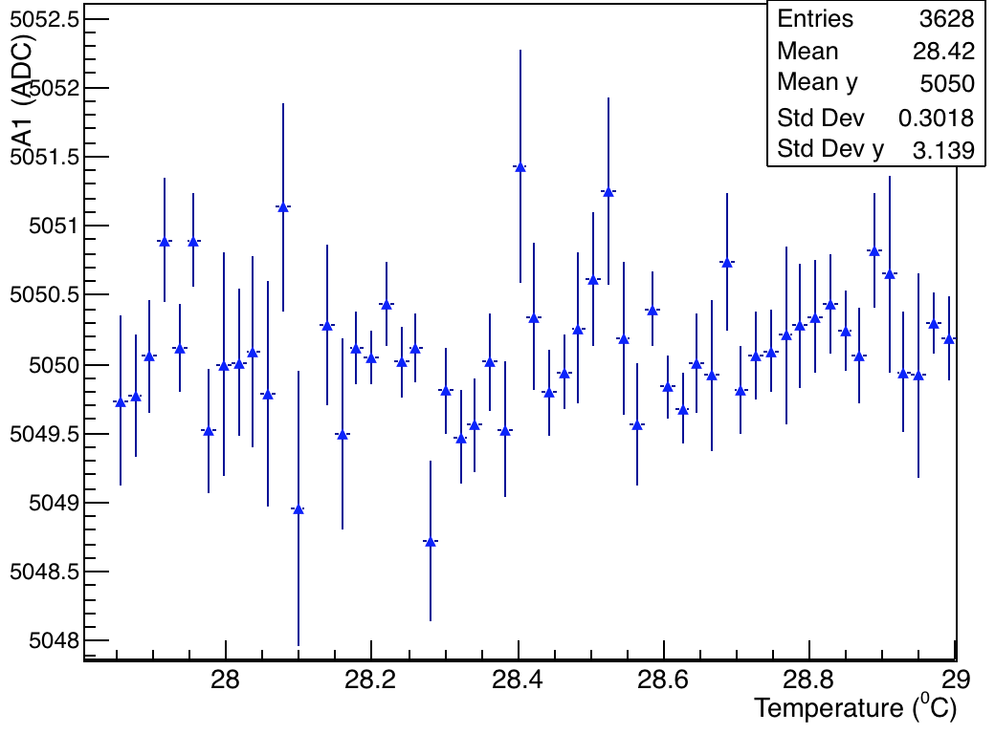
Old PMT Ch 28 – Laser hut temperature vs. Areas
Slope of area2 almost 4 times > area1 => area2 contributes to greater loss in the ratio A2:A1

Slide 12
Old PMT Ch 28 – Optical table temperature vs. Areas
Slope of A2 almost 4 times > A1 => A2 contributes to greater loss in the ratio A2:A1

Slide 13
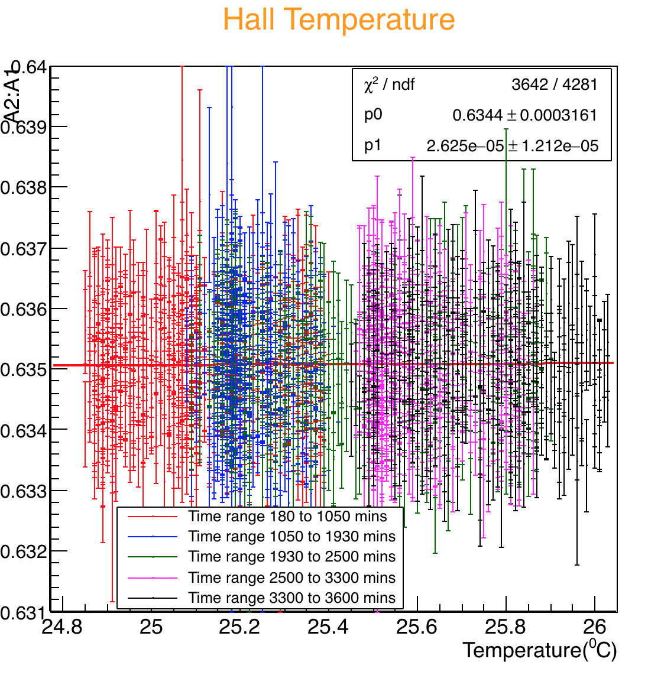
Channal 28 of calo 18 – Temperature Studies
Hall Temperature

Slide 14
Backup slides

Slide 15
Channal 28 of calo 18 – Temperature Studies
I fitted every slice in time to see the effect. Shown for Hall temperature
Hall Temperature

Slide 16
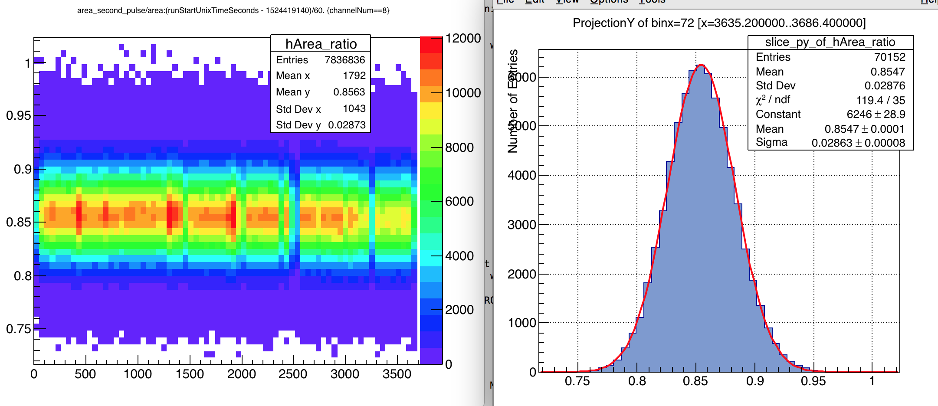
Some Studies/Observations – bin size changes error on the profile – e.g. bin 72
Error = 0.028/sqrt(70152)
=1.05e-4
Fine binning. Bin size = 50 min

Slide 17
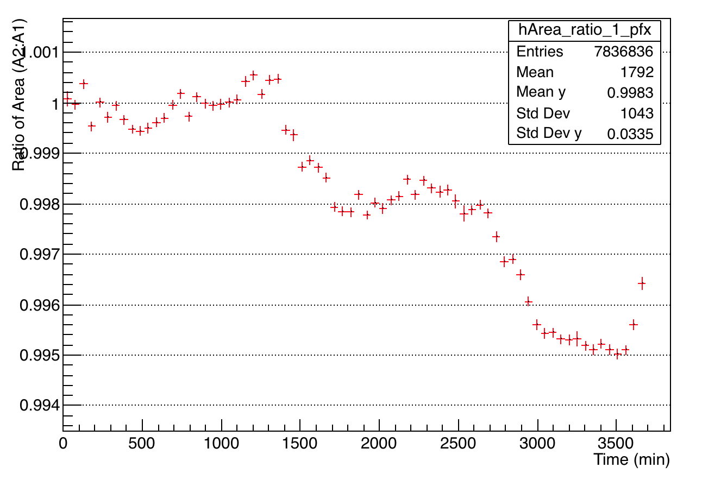
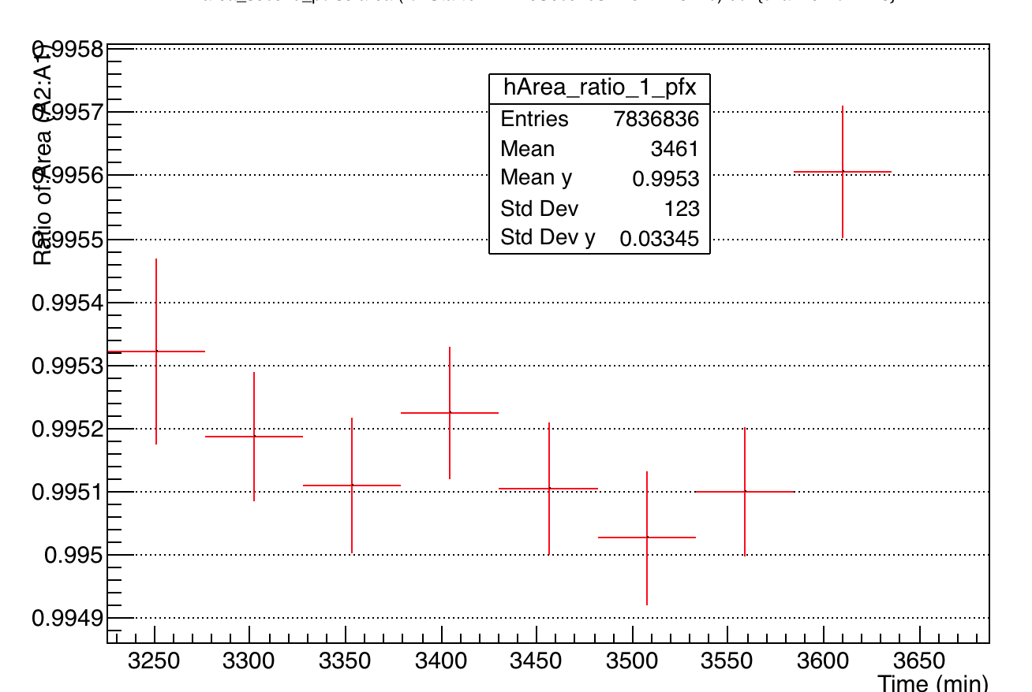
Some Studies/Observations – bin size changes error on the profile – e.g. bin 72
Error bin 72 = 1.04e-4

Slide 18
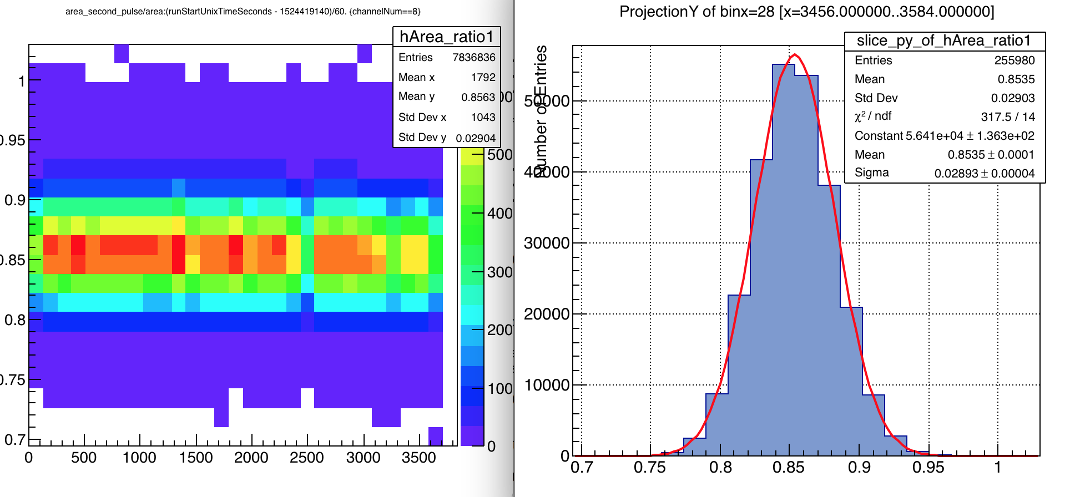
Some Studies/Observations – bin size changes error on the profile – e.g. bin 28
Error = 0.0289/sqrt(255980)
=5.7e-5
Slightly coarse binning. Bin size = 50 min

Slide 19
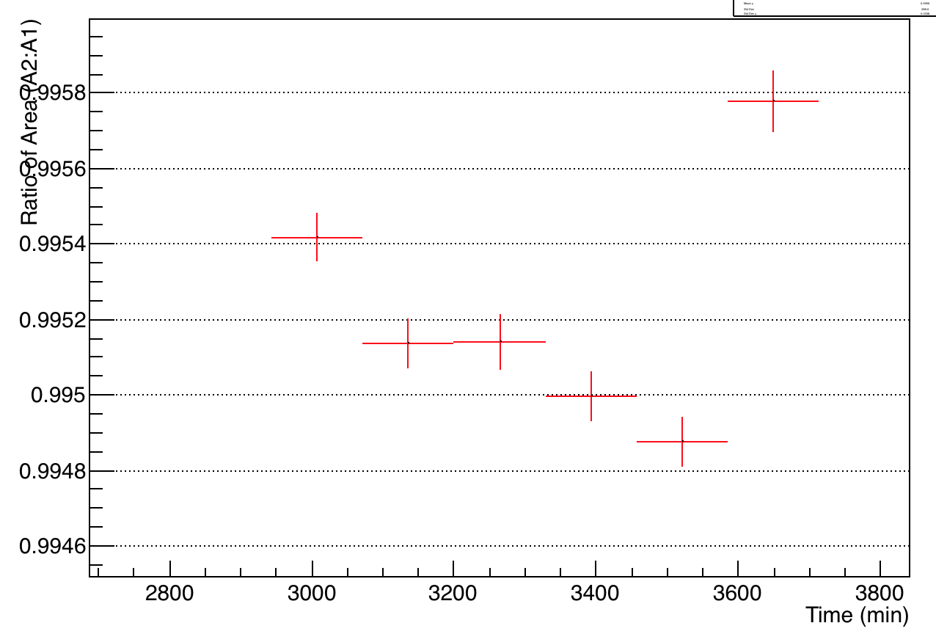
Some Studies/Observations – bin size changes error on the profile – e.g. bin 28
Error bin 28 = 6.7e-5

Slide 20
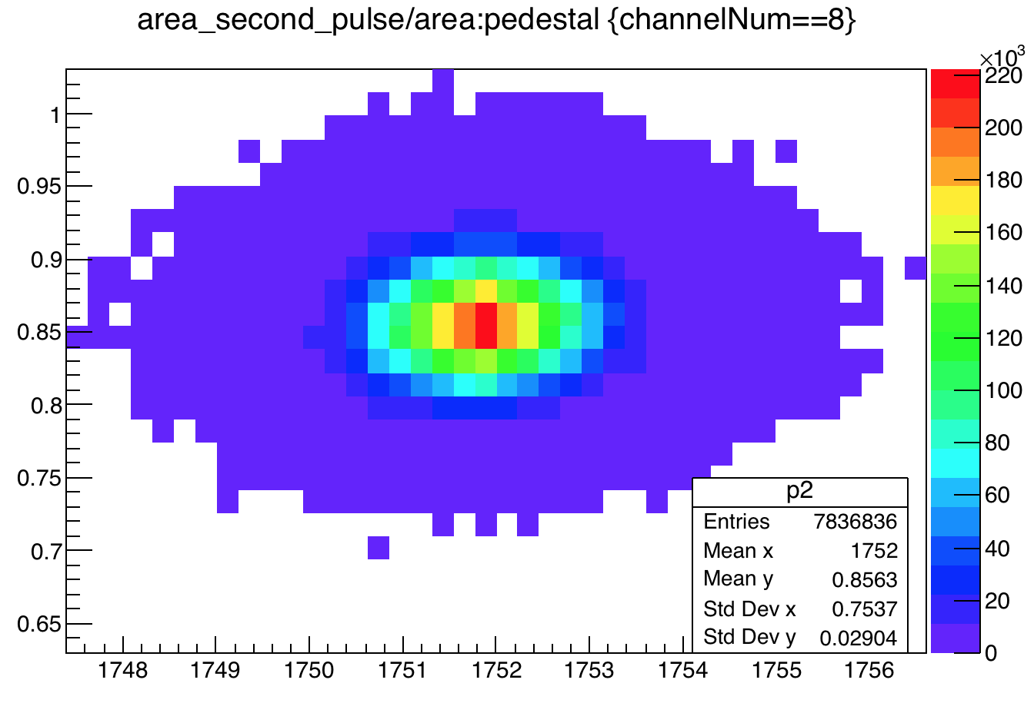
Correlation between Ped / area ratio

Slide 21
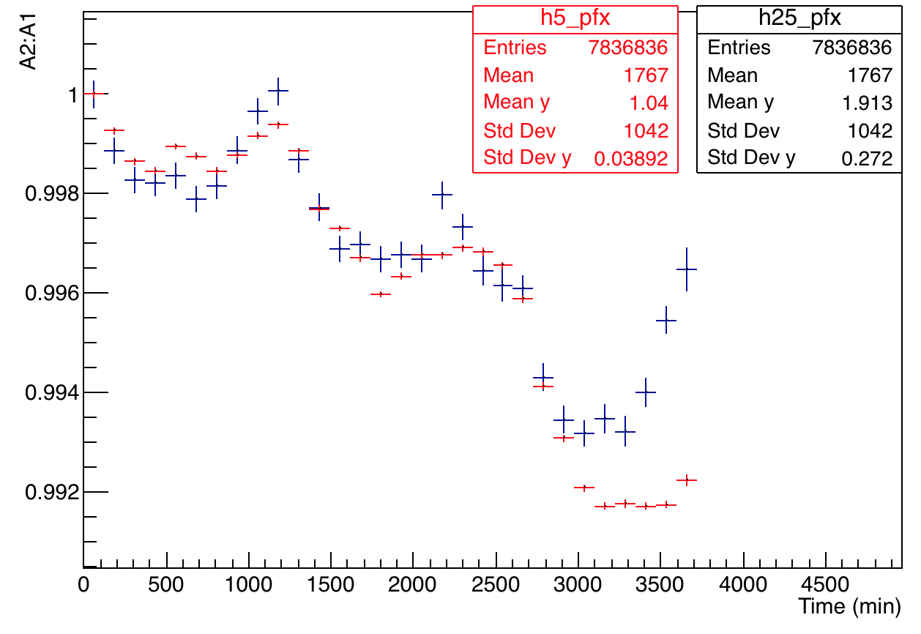
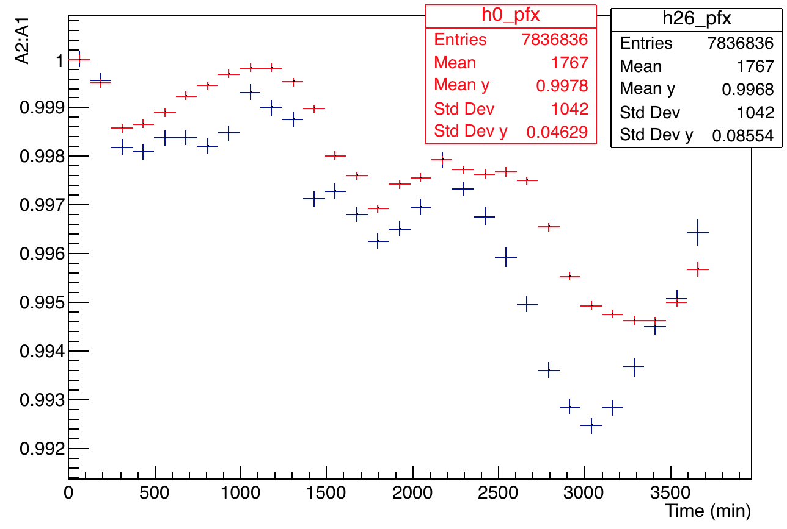
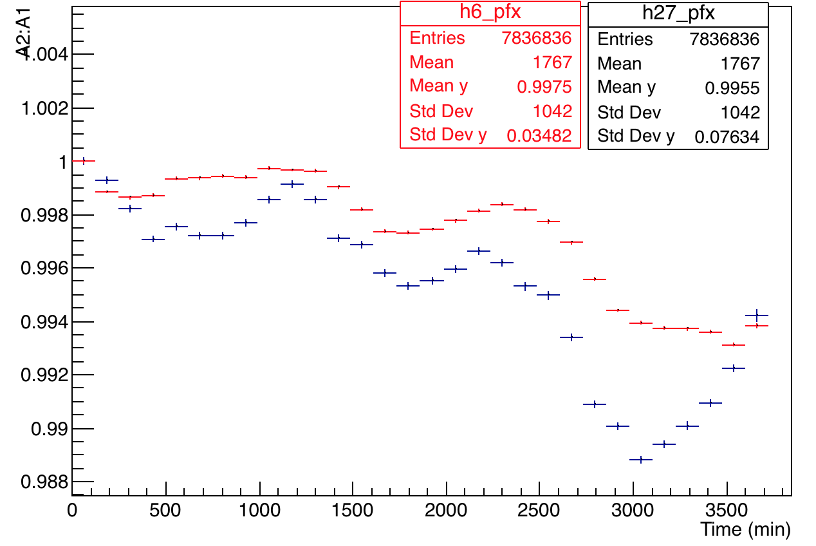
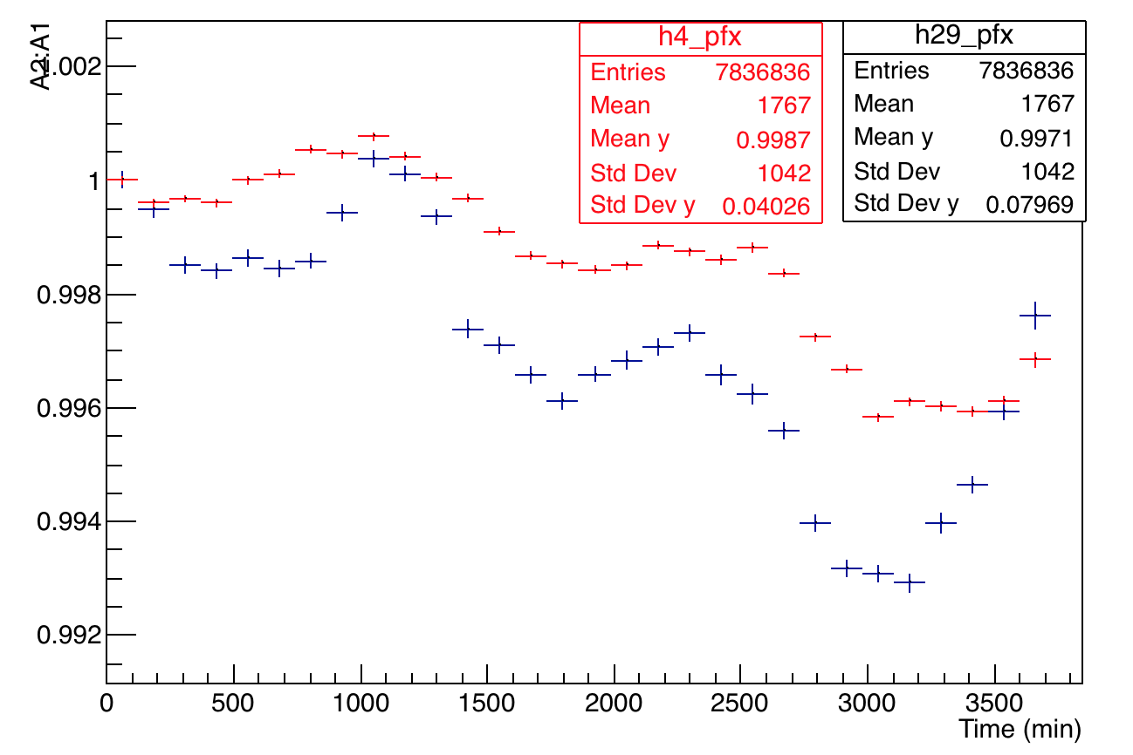
All Other Channels
Calo 11
Calo 12
Calo 13
Calo 20

