Slide 1
Gain Simulation Studies – Effect of SM and LM
Graziano Venanzoni
Nandita Raha

Slide 2
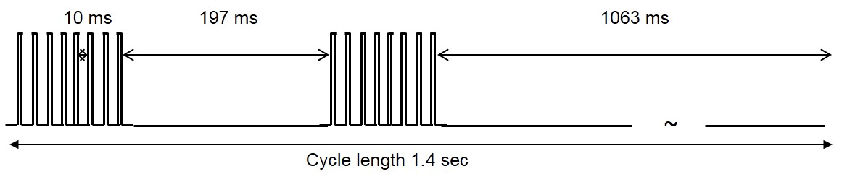
Beam Structure
Two bunches of 8 fills each.
Gap between fills is 10 ms – out of fill (have 4 pulses with a separation of 200 us each)
Gap between bunches is 197 ms
Each fill is 2 ms (have 4 in fill pulses at 30, 230 and 430 us)
Short term gain: Case 1: Infill gain function is the BV sagging pulse for the SiPM
Long term

Slide 3
Scheme used
Calculate gain subruns wise – each subrun = 4 cycles. S = SiPM gain function and M= Monitor (Source Monitor) gain function. Net gain effect is average over all subruns, i:
G = <(S/M)_{i} / <S/M>_{OOF}>

Slide 4
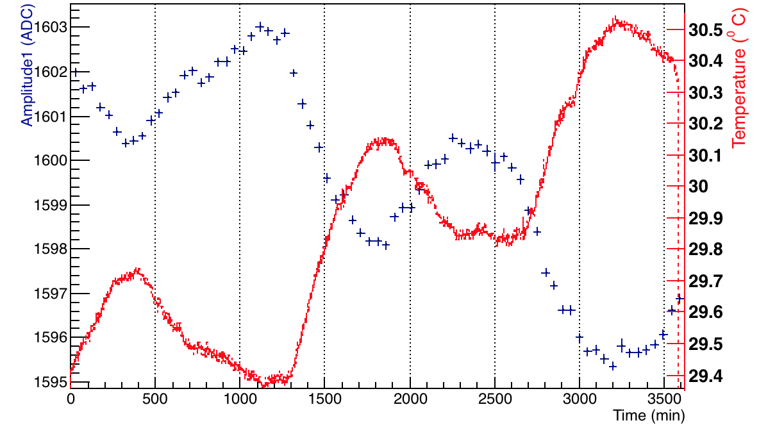
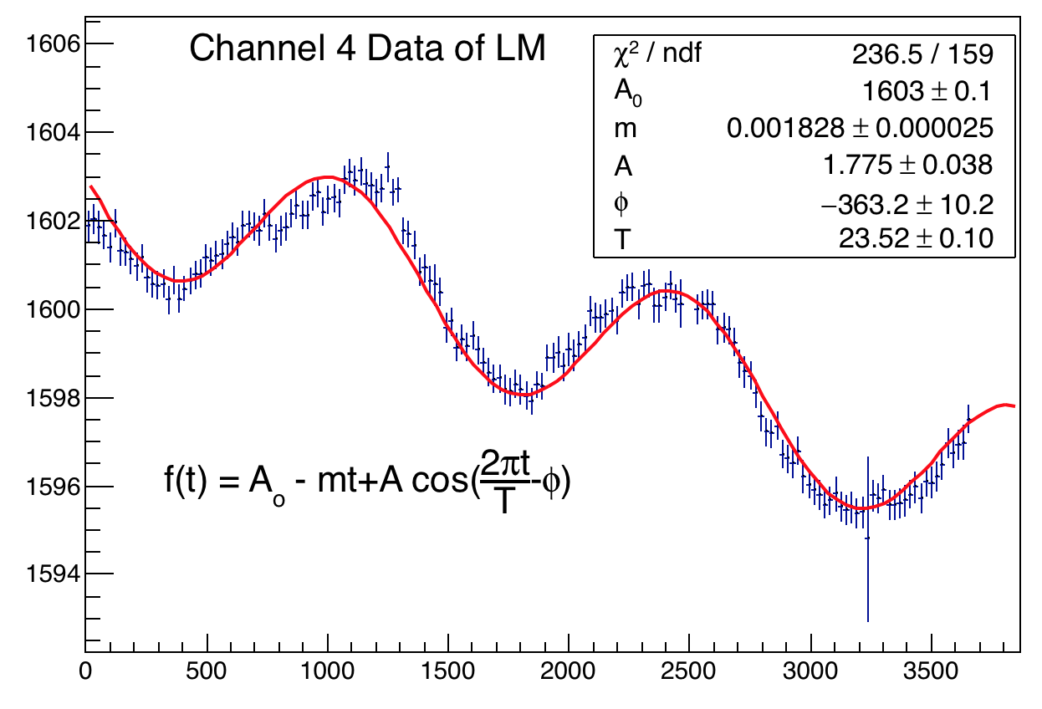
Amplitude(Gain) function used for 60 hrs (example)
Overlaid temperature and amp 1 on the same plot
Fitted a linear sinusoidal to the data. Reduced chi2 better than just a linear fit.

Slide 5
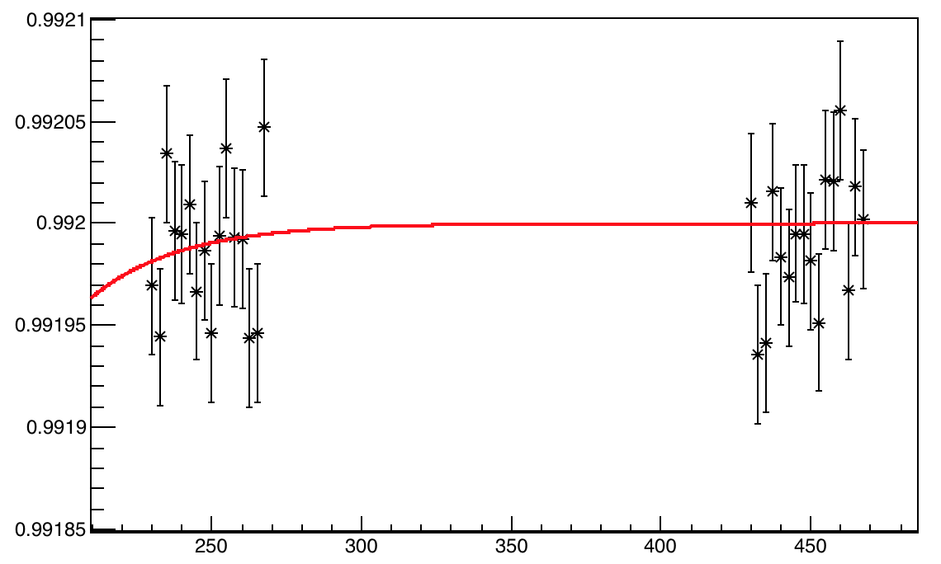
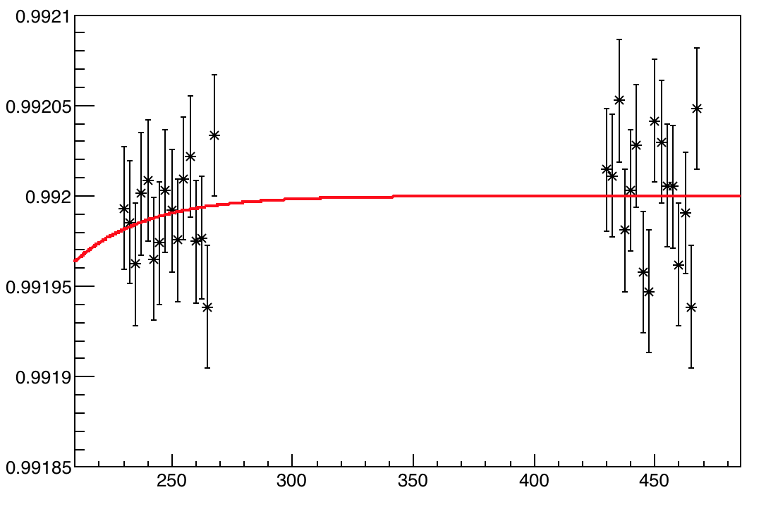
Short term fill – no LM considered
Case I: Simple infill gain is a BV sagging with a constant and a laser (drift 5% for 60 hrs). Out of fill: Const with same laser drift. No. of events: 4.32e6. One subrun = 4 cycles.
Case II: Same as above with an additional sinusoidal + linear effect (inverse temperature) No. of events: 4.32e6. One subrun = 4 cycles.
No major difference

Slide 6
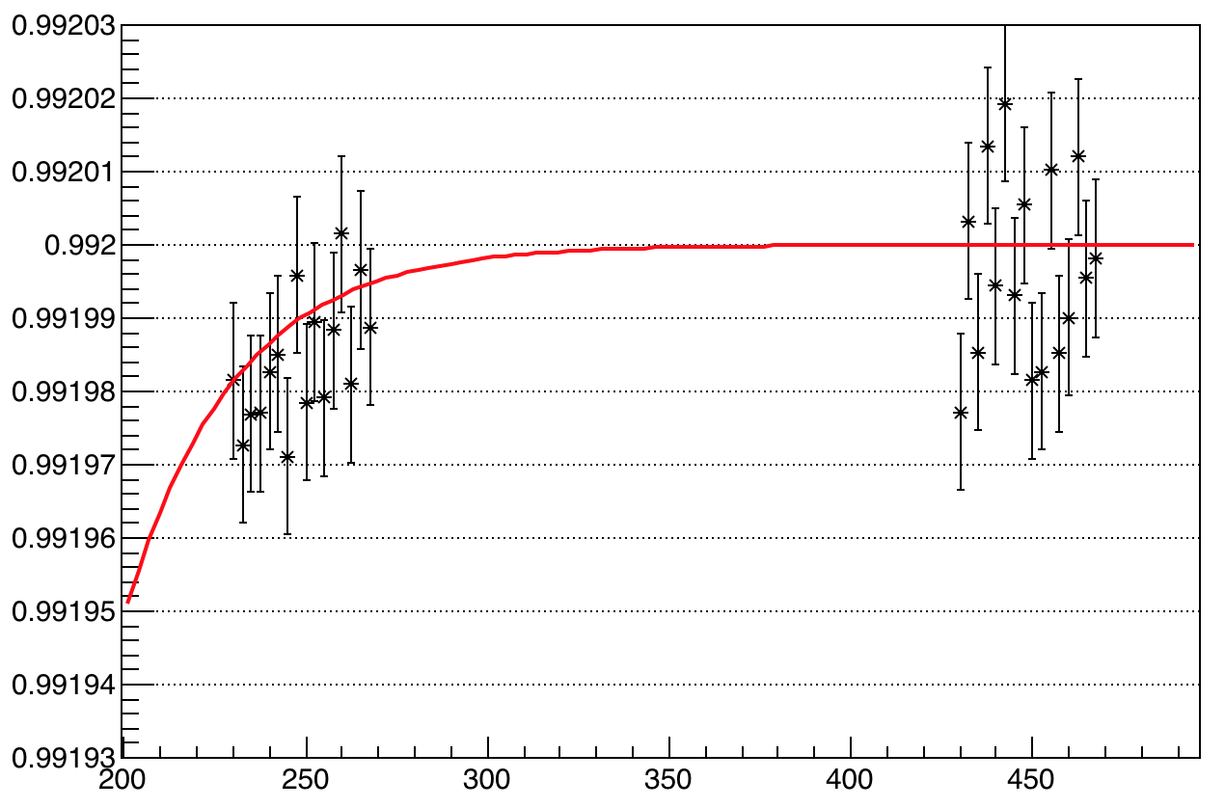
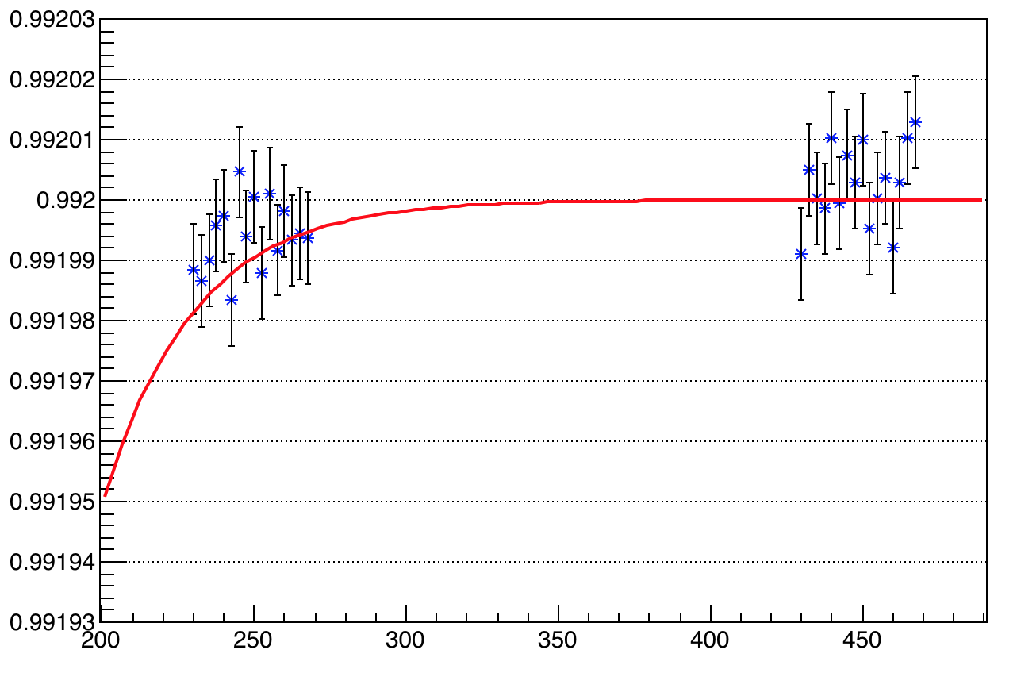
Two different schemes - testing
Case I:
G = <(S/M)_{i} / <S/M>_{OOF}>
Case II:
G = <(S/<M>_{IF})_{i} / <S>_{OOF}/M>_{OOF}>
Different errors and range – used same scale for both cases

