Slide 1
LM Analysis – compare old and new PMTs –60 hrs Dataset Runs 15920 to 15990 22/4 - 1:09 pm to 25/4 – 2:20 am

Slide 2
Old and New PMTs
Calorimeter | Old PMT | New PMT
11 | 25 | 5
12 | 26 | 0
13 | 27 | 6
18 | 28 | 8
20 | 29 | 4
Looking at calo 20 in detail – overall behaviour of all channels in back up. Since the amplitude is free from jitter of the pedestals, I used the amplitude instead of area for this presentation (though area plots are the same). Details of amplitude of first pulse here, as it will have the effect of temperature of the PMT alone.

Slide 3
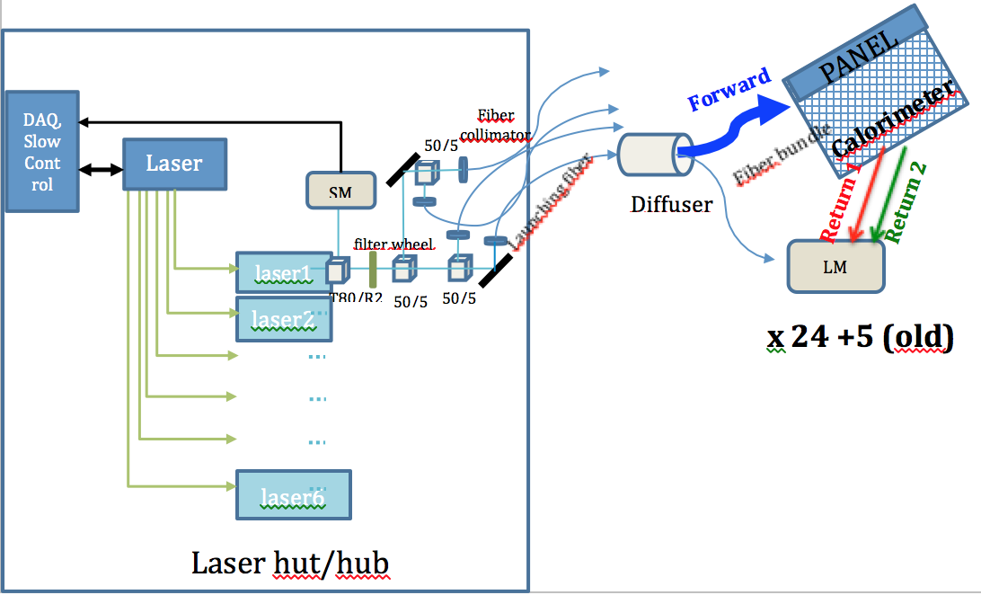
Long term stability / fluctuation
“Forward” component of signal which goes to calos
“Return” component which comes back from calos
Correction to be applied only if the “return” signal changes. To check this use old and new PMTs.
Red – signal of the New PMT
Green – signal of Old PMT
R = A2:A1 of new PMT and R’ = A’2:A’1 of old PMT. In the ratio of these ratios could indicate the stability of the return signal i.e. R: R’ (new:old)
Courtesy: A. Fioretti, C. Gabbanini, and G. Venanzoni

Slide 4
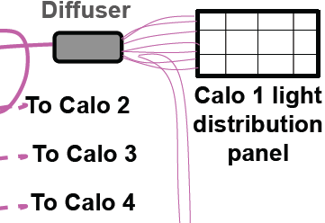
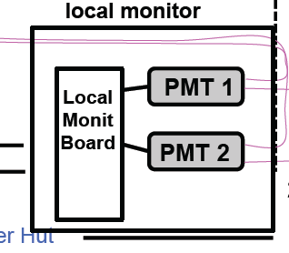
LM (after discussion with INO Colleagues)
Foward
A2=L*F*B, F= forward eff; B=Bacw eff
IF F Gain Sipm should be corrected; IF B no
R=A2/A1 ← most of the effect due to F → apply to Gain corr
DR=R_PM1/R_PM2 sensitive to B1/B2 (no to Gain corr)
Backward
A2
Fibra quarzo
WFD g-2 (scheda “Corradi”)
Local DAQ (scheda “Napoli”) & eventualmente ai WFD g-2
Fibra PMMA

Slide 5
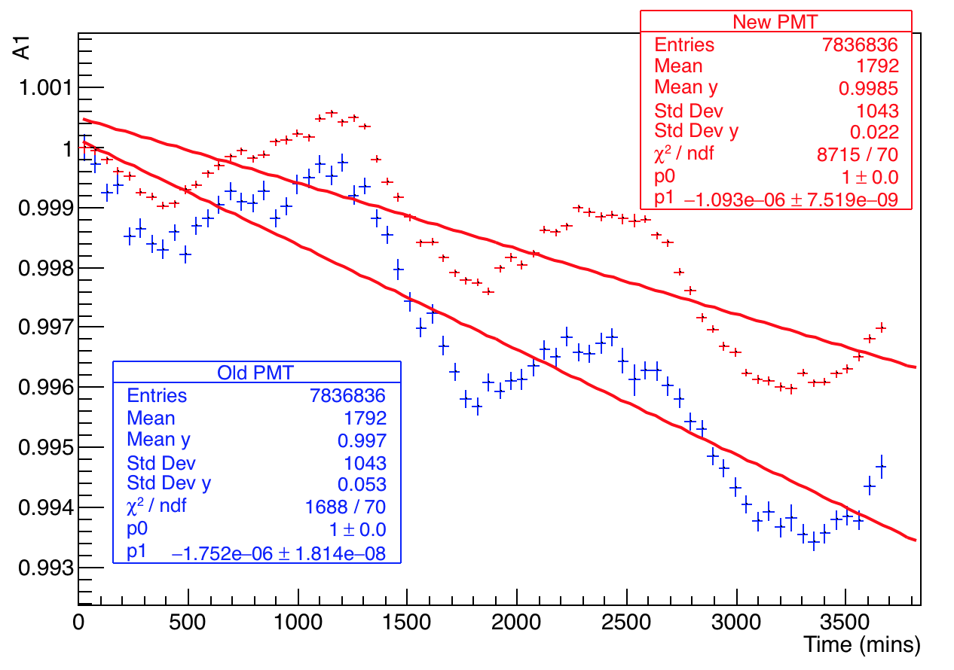
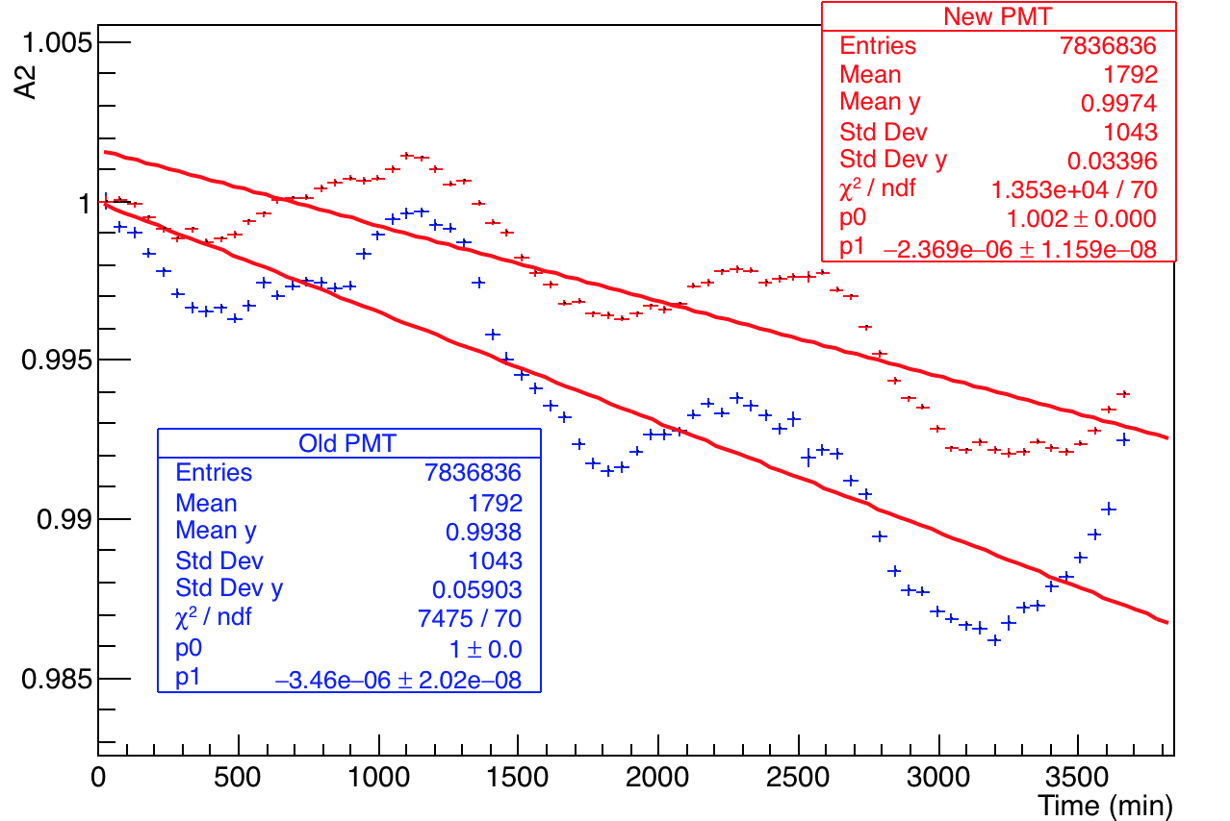
Comparison of old and new PMTs for Calo 20
Normalized area first pulse
Normalized area second pulse
Old PMTs about 1.5 times greater drop than new ones

Slide 6
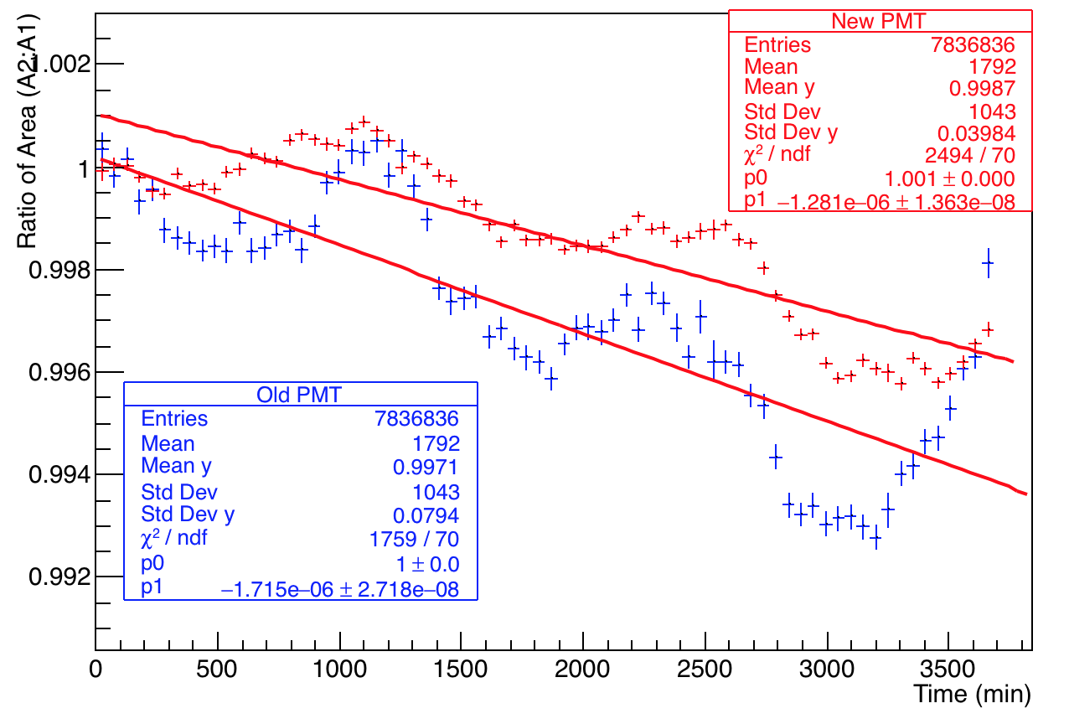
Comparison of old and new PMTs for Calo 20
New PMT – Calo 20, channel 4
Bin size = 50 mins.
Old PMT – Calo 20, channel 29

Slide 7
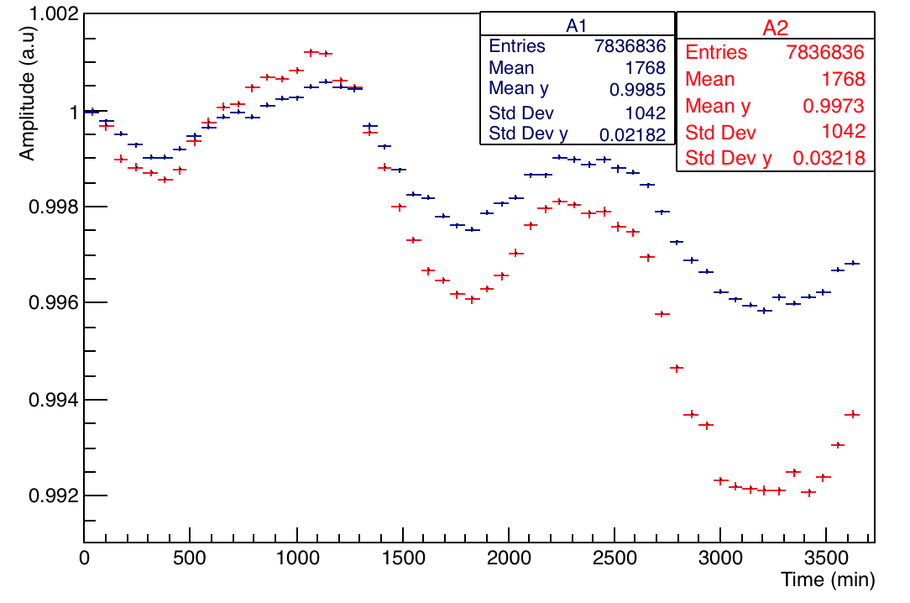
New PMT – channel 4 for Calo 20
Normalized area first and second pulse overlaid
Normalized A2:A1 for old and new PMT

Slide 8
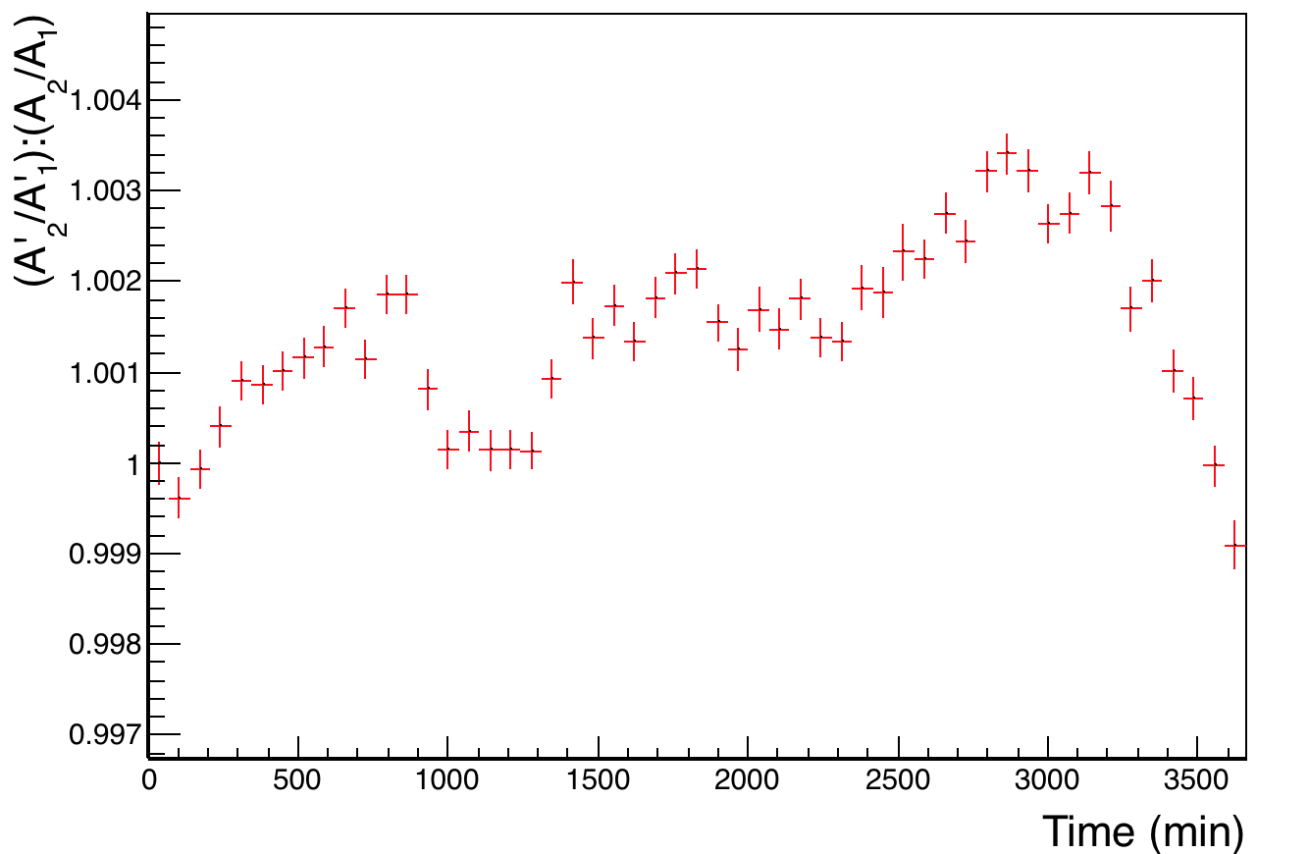
Ratio of ratios for Calo 20
R = A2:A1 of new PMT and R’ = A’2:A’1 of old PMT. The ratio of these ratios R: R’ (new:old) is not very stable => The “return” component is not stable.

Slide 9
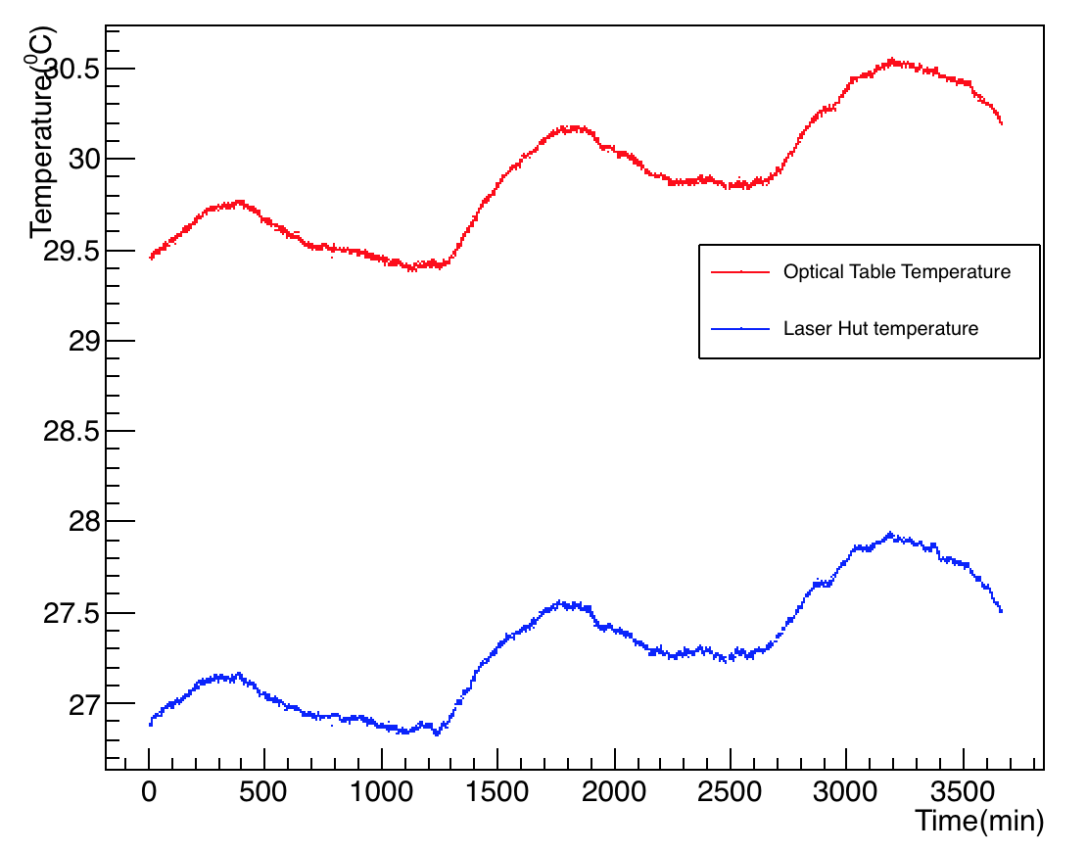
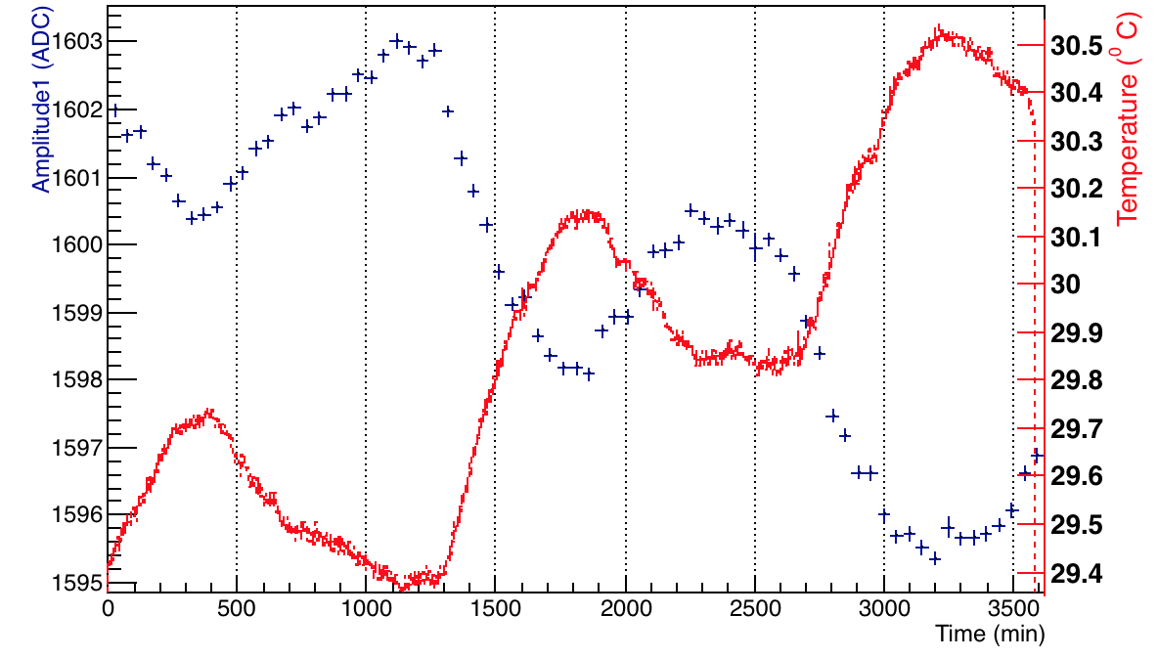
Temperature Variation – Channel 4
Optical table temperature
Overlaid temperature and amp 1 on the same plot
Laser hut temperature
Note: The temperature plots changed due to some additional calibration corrections applied. This resulted in re analysis and and different correlation of temperature with gain.

Slide 10
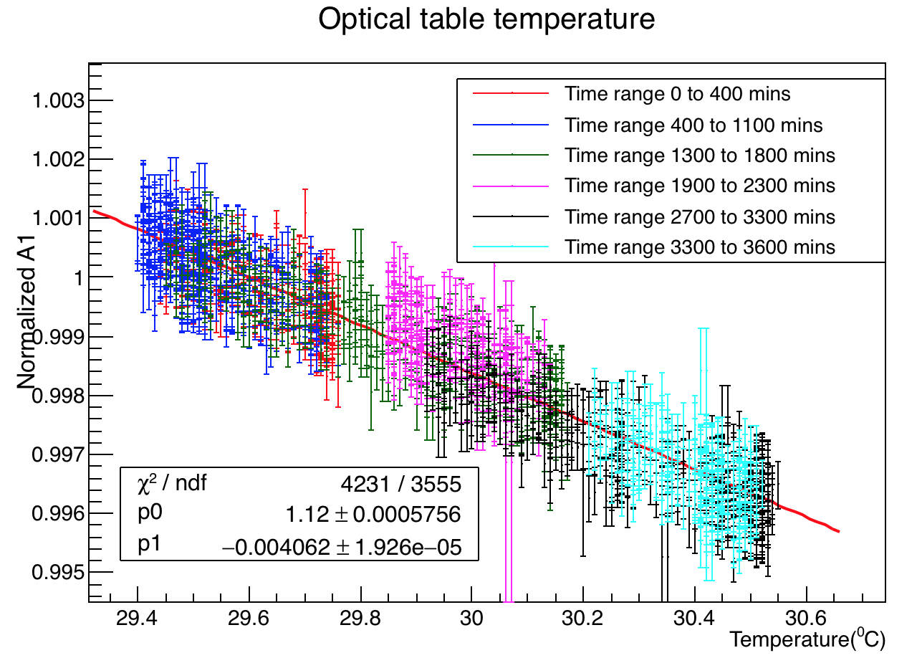
Channel 4 New PMT – Temperature vs. Amp1
Optical Table Temperature
Behaviour of each time slice. A simple graph appears to show similar trend for each part (anticorrelated with temperature).

Slide 11
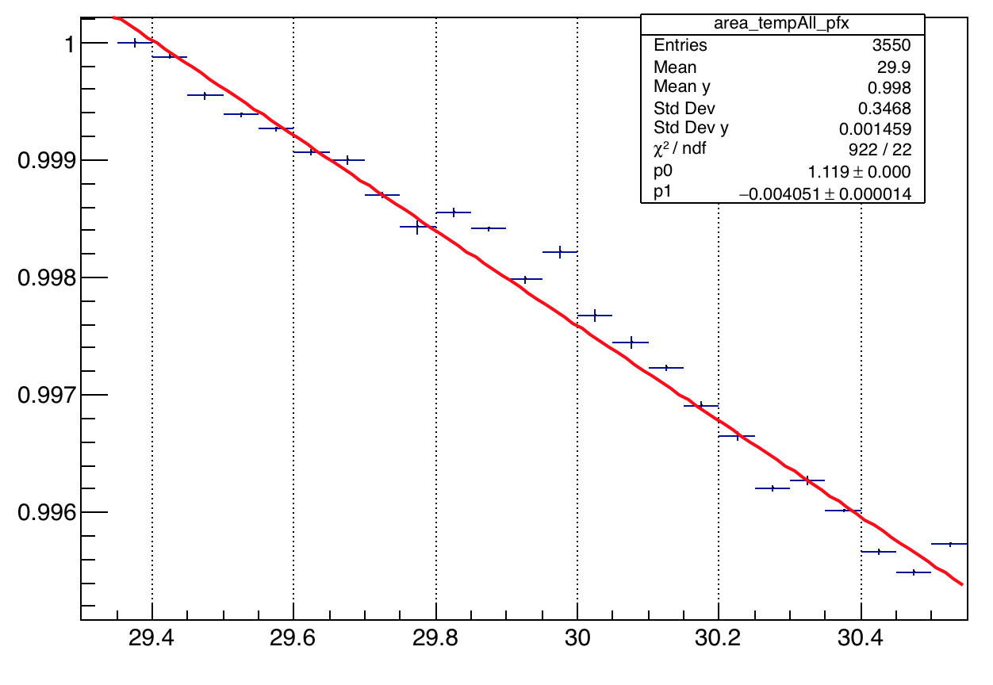
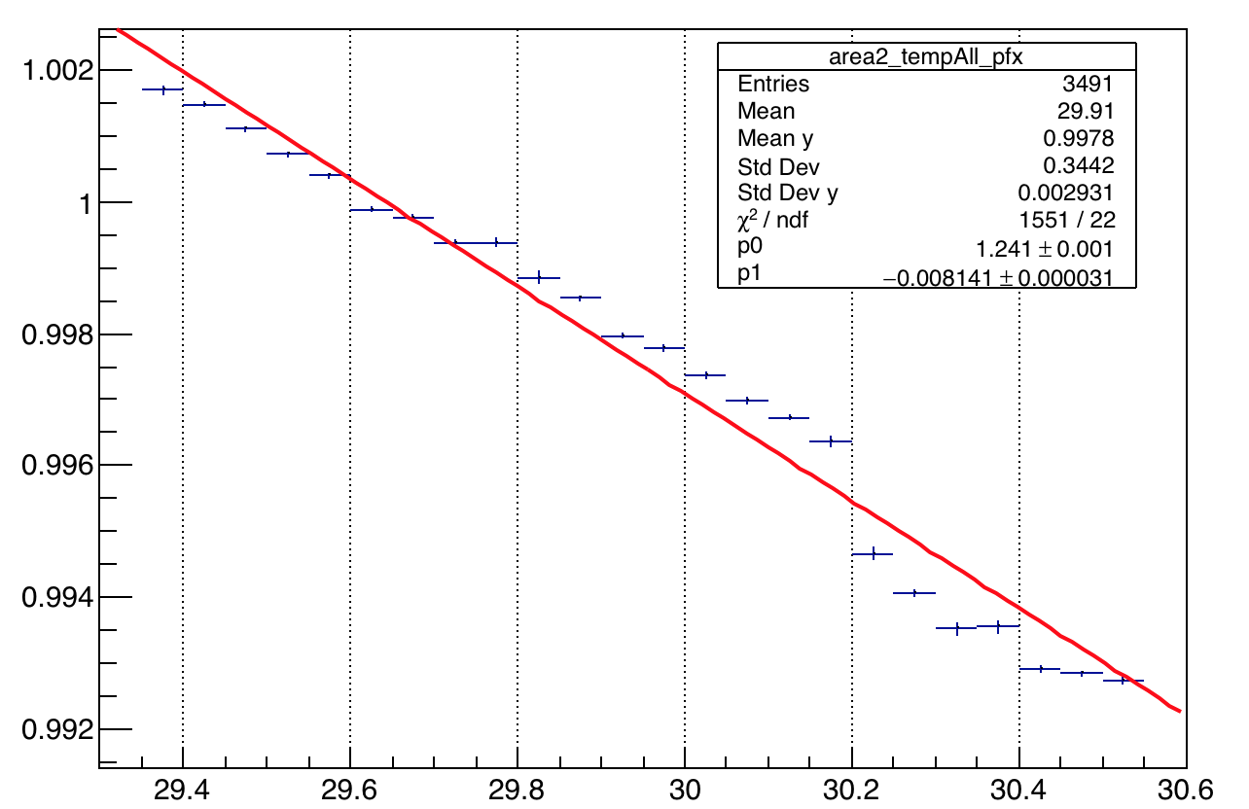
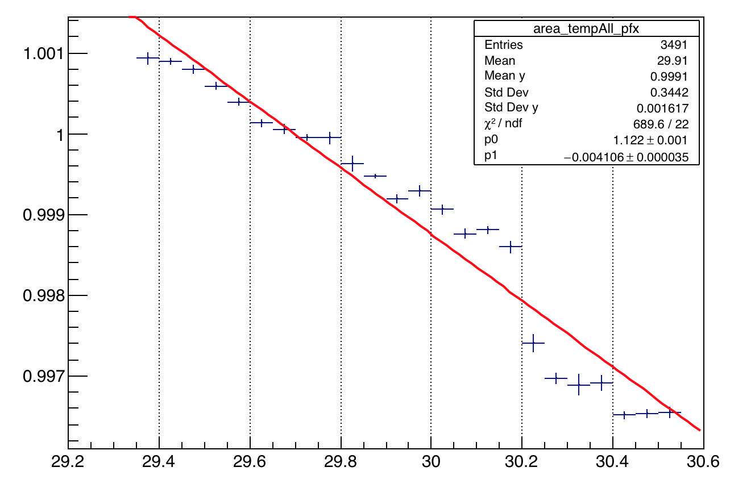
Amplitude Vs. Temp
Amp 1
Amp 2
The slope appears to change at 29.8 C.
A2:A1

Slide 12
Back Up Slides

Slide 13
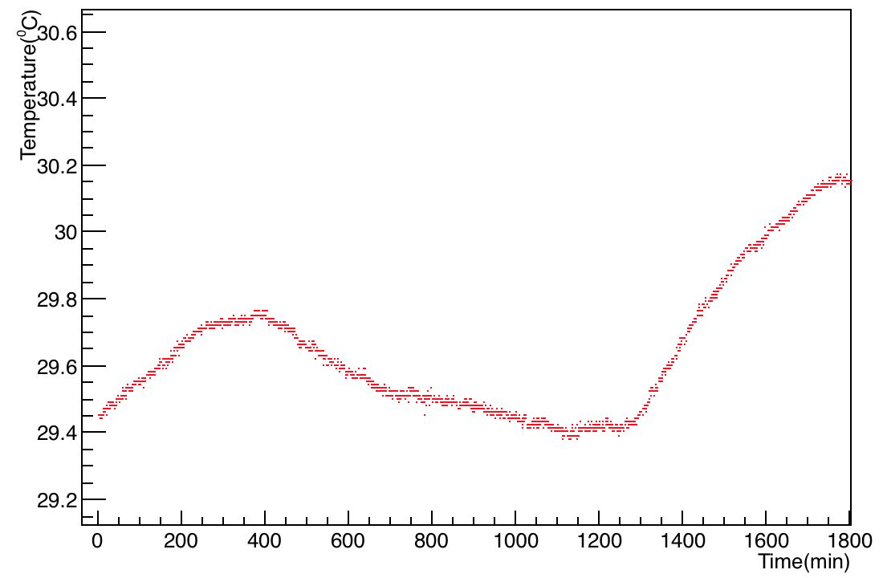
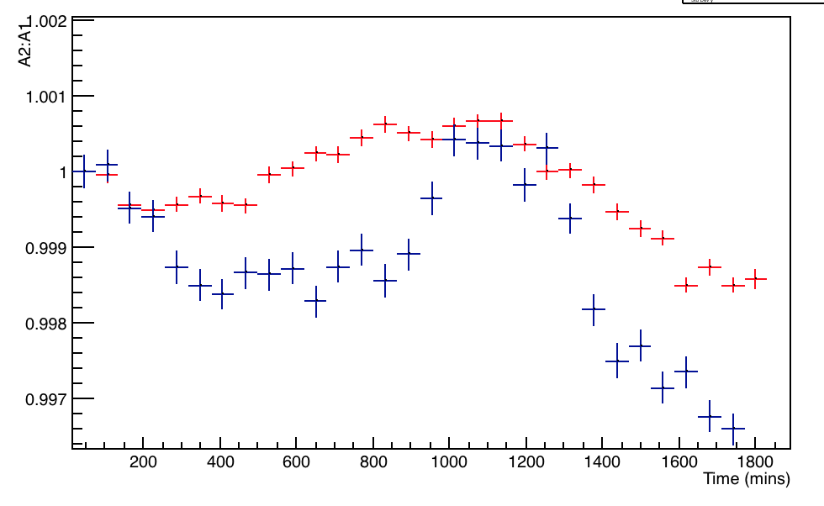
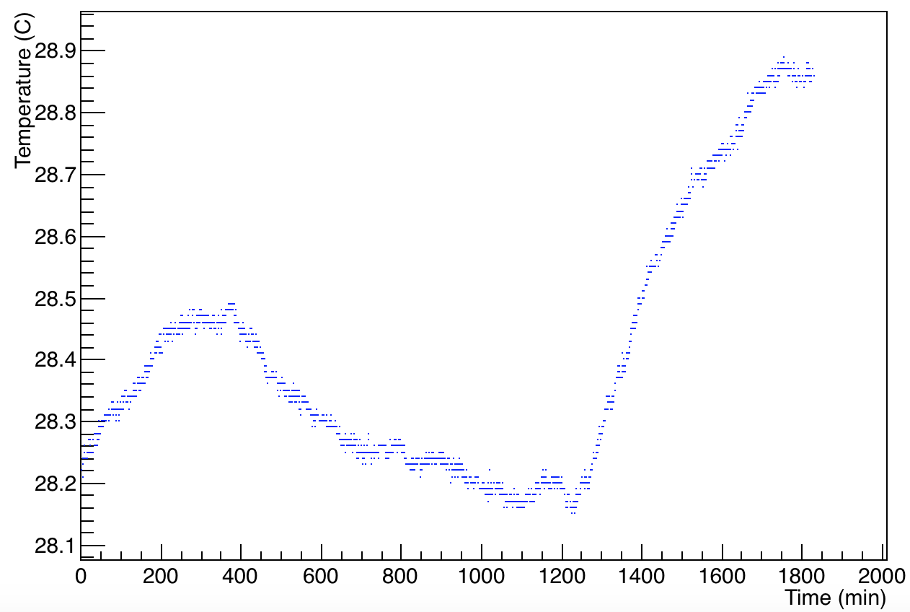
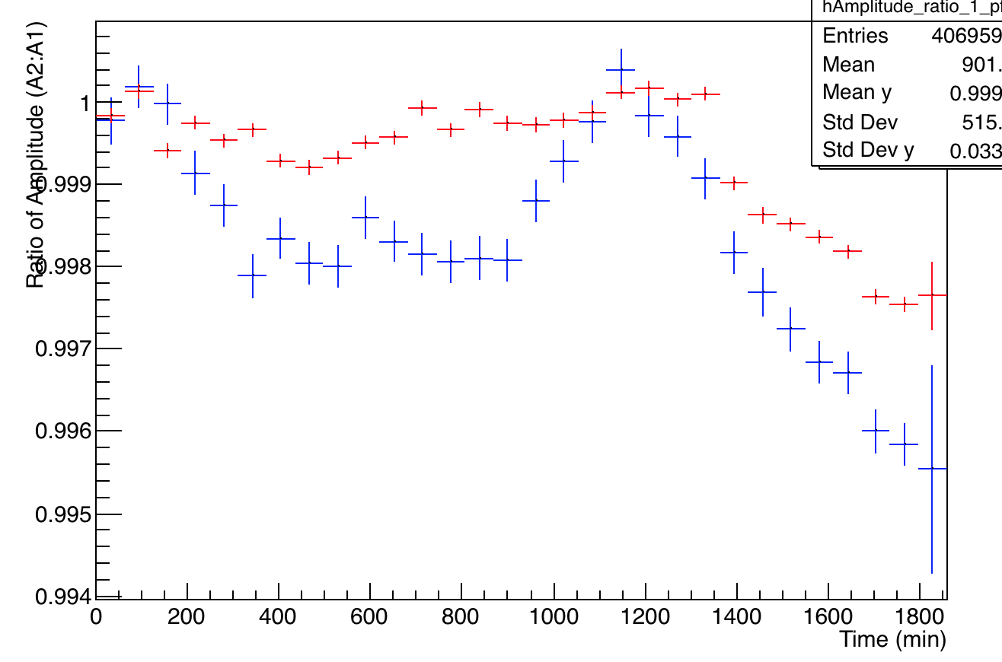
Other data sets
22nd April - 30 hours
11th April - 30 hours

Slide 14
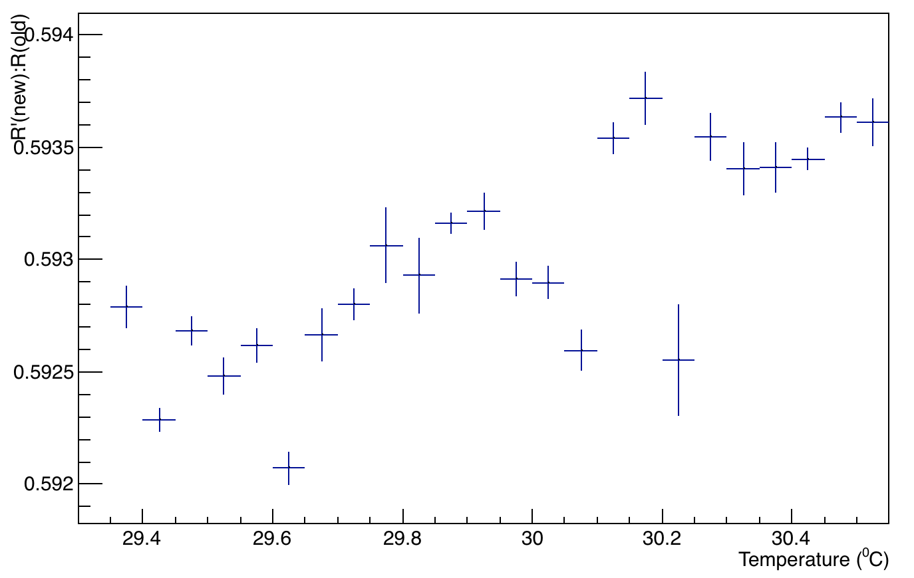
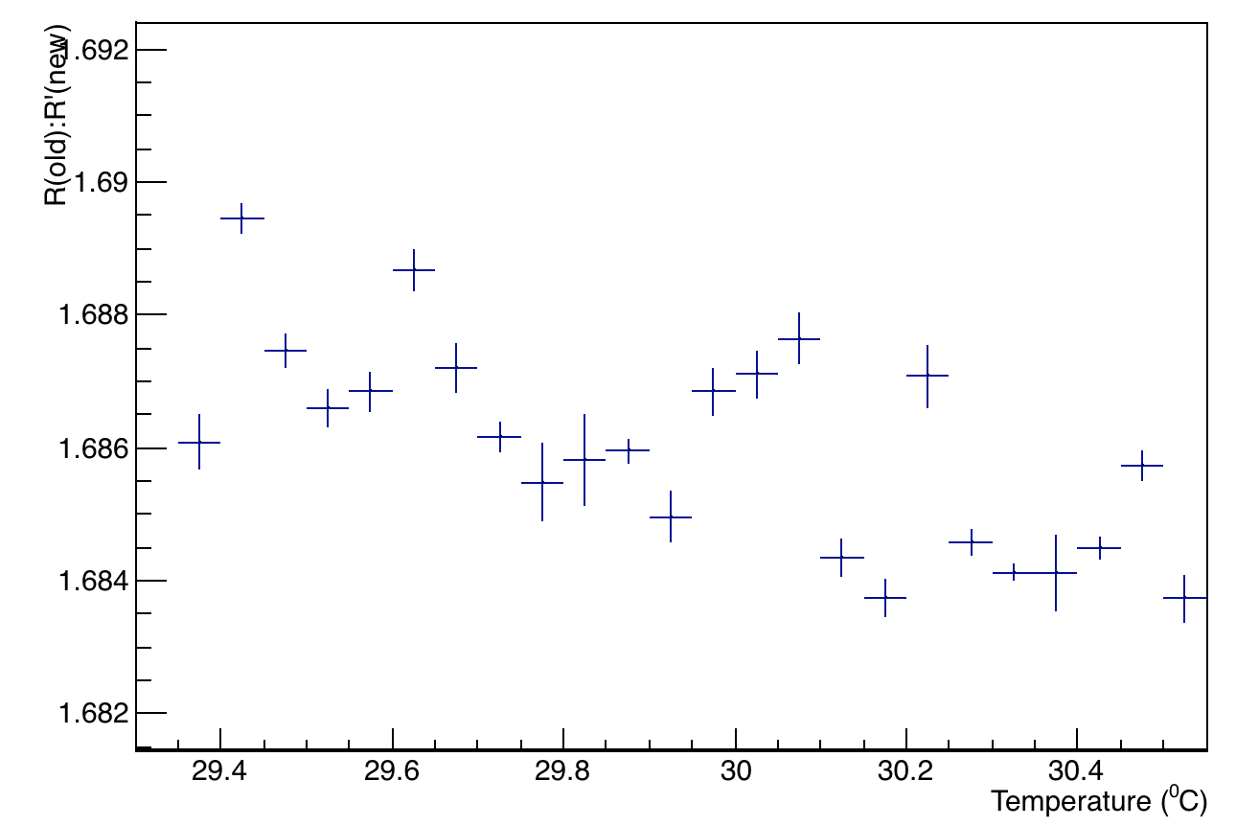
Temperature variation of Ratio of ratios

Slide 15
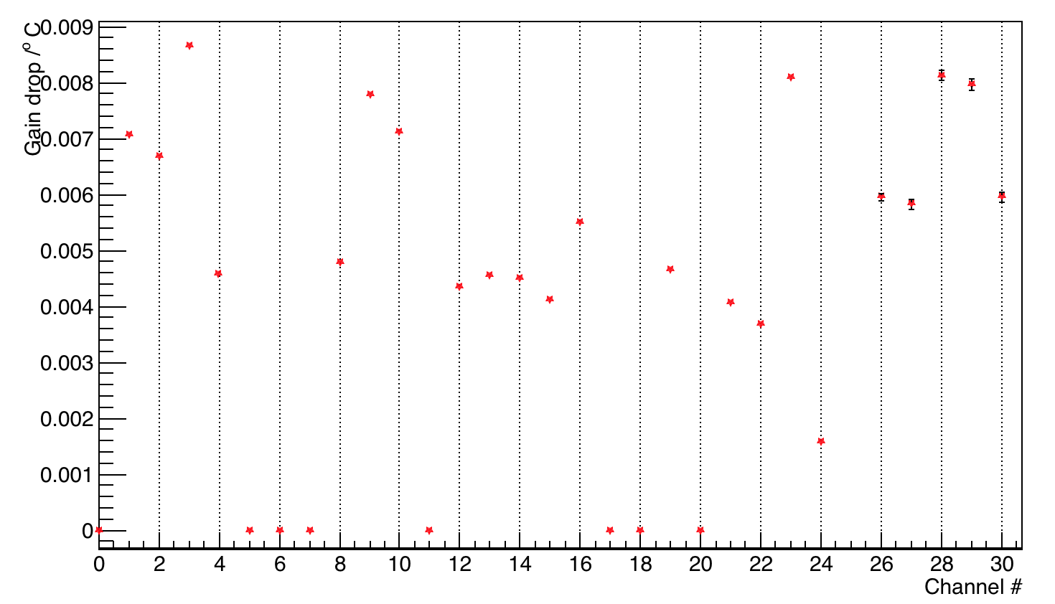
A2:A1 /ºC fpr all channels

Slide 16
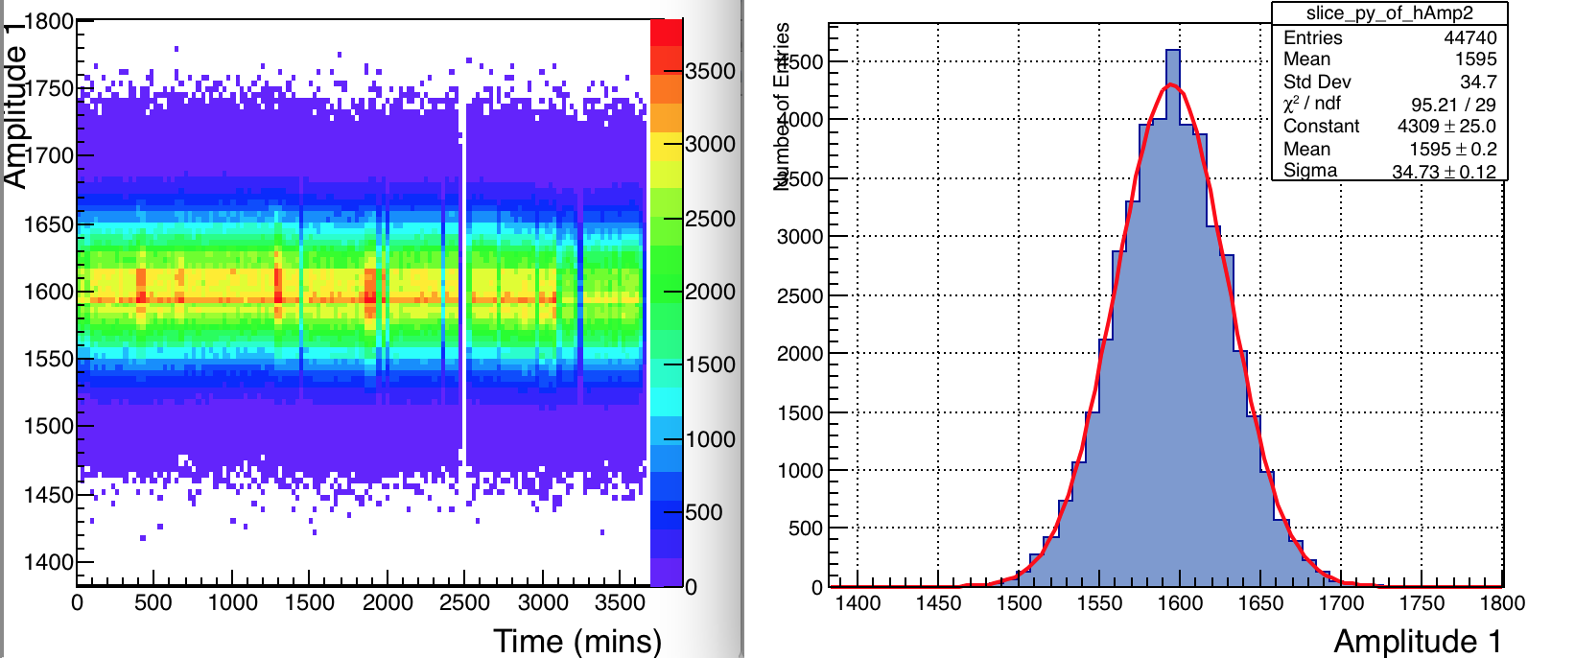
Some Studies/Observations –Scatter plot and projection of a bin – good Gaussian

Slide 17
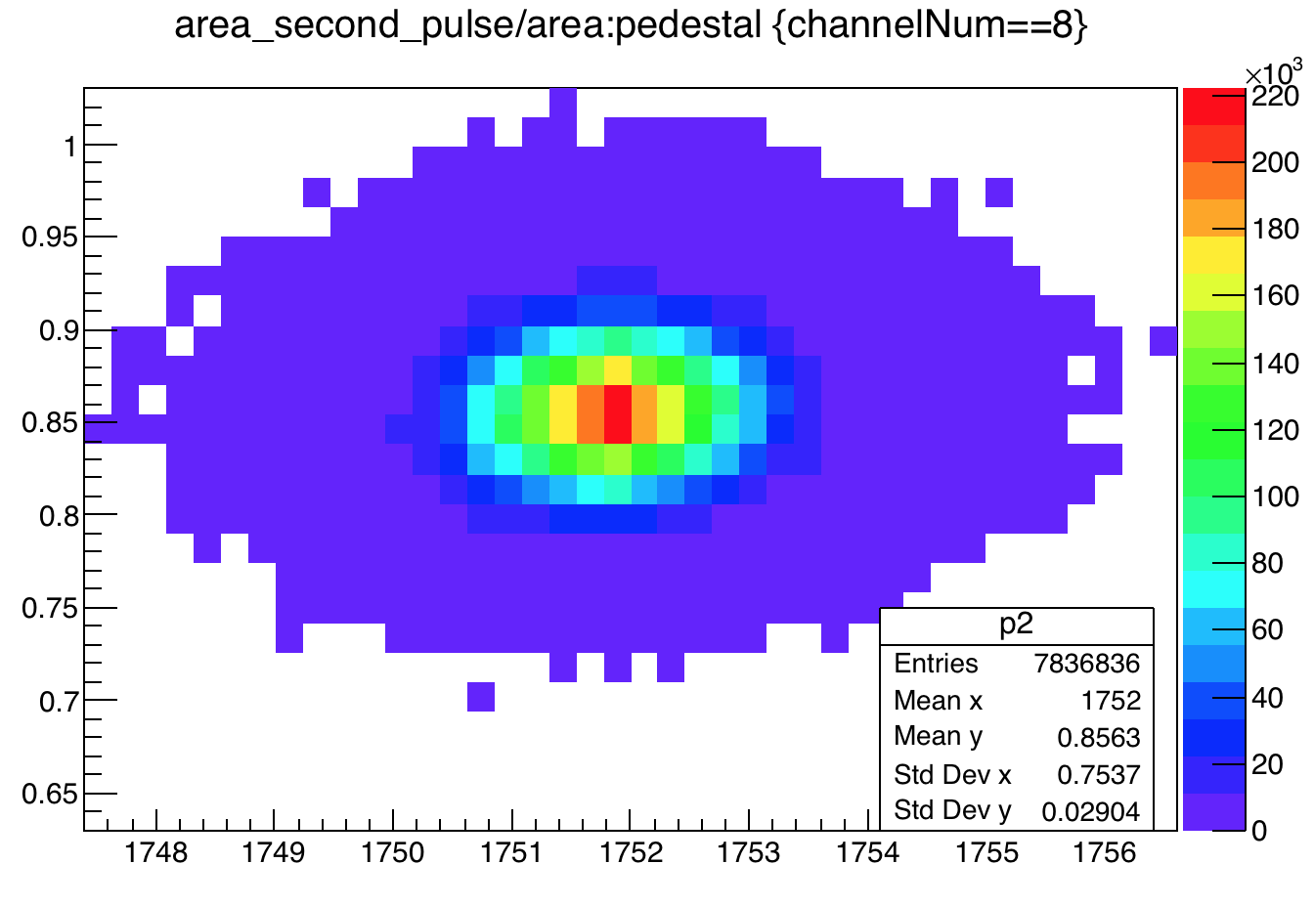
Correlation between Ped / amplitude ratio

