Slide 1
LM Analysis – compare old and new PMTs –60 hrs Dataset Runs 15920 to 15990 22/4 - 1:09 pm to 25/4 – 2:20 am

Slide 2
Old and New PMTs
Calorimeter | Old PMT | New PMT
11 | 25 | 5
12 | 26 | 0
13 | 27 | 6
18 | 28 | 8
20 | 29 | 4
Looking at calo 20 in detail – overall behaviour of all channels in back up. Since the amplitude is free from jitter of the pedestals, I used the amplitude instead of area for this presentation (though area plots are the same). Details of amplitude of first pulse here, as it will have the effect of temperature of the PMT alone.

Slide 3
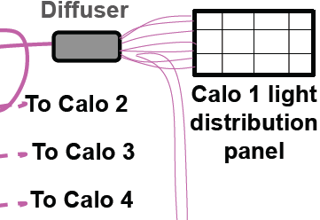
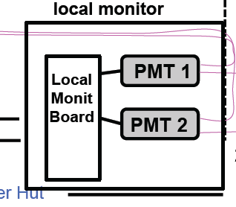
LM (after discussion with INO Colleagues)
Forward
“Forward” component of signal which goes to calos
“Return” component which comes back from calos
Correction to be applied only if the “return” signal changes. To check this use old and new PMTs.
Red – signal of the New PMT
Green – signal of Old PMT
R = A2:A1 of new PMT and R’ = A’2:A’1 of old PMT. In the ratio of these ratios could indicate the stability of the return signal i.e. R: R’ (new:old)
Return
WFD g-2 (scheda “Corradi”)
A2
Quartz Fiber
Local DAQ (scheda “Napoli”) & eventualmente ai WFD g-2
PMMA Fiber
Courtesy: A. Fioretti, C. Gabbanini, and G. Venanzoni

Slide 4
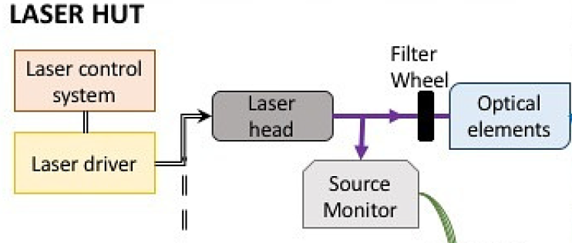
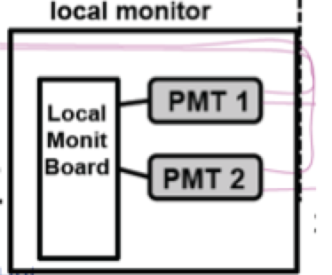

Slide 5
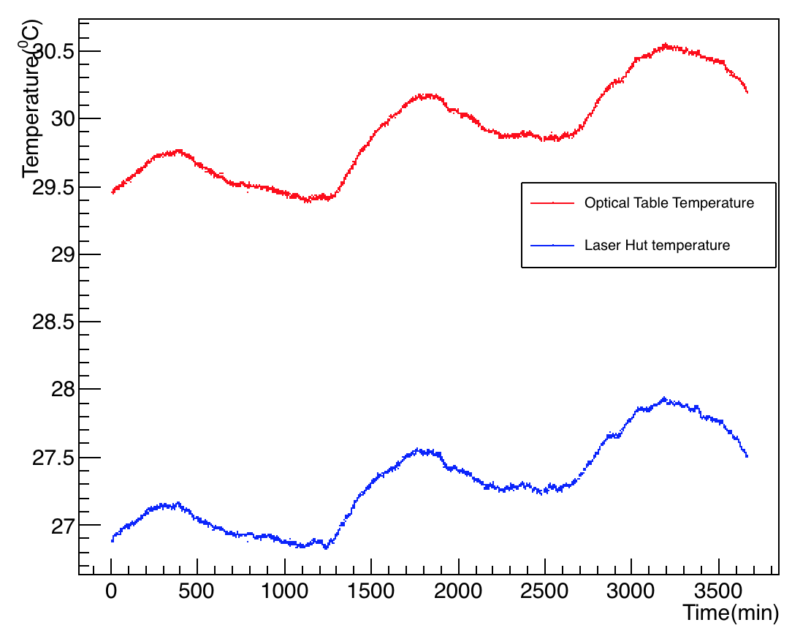
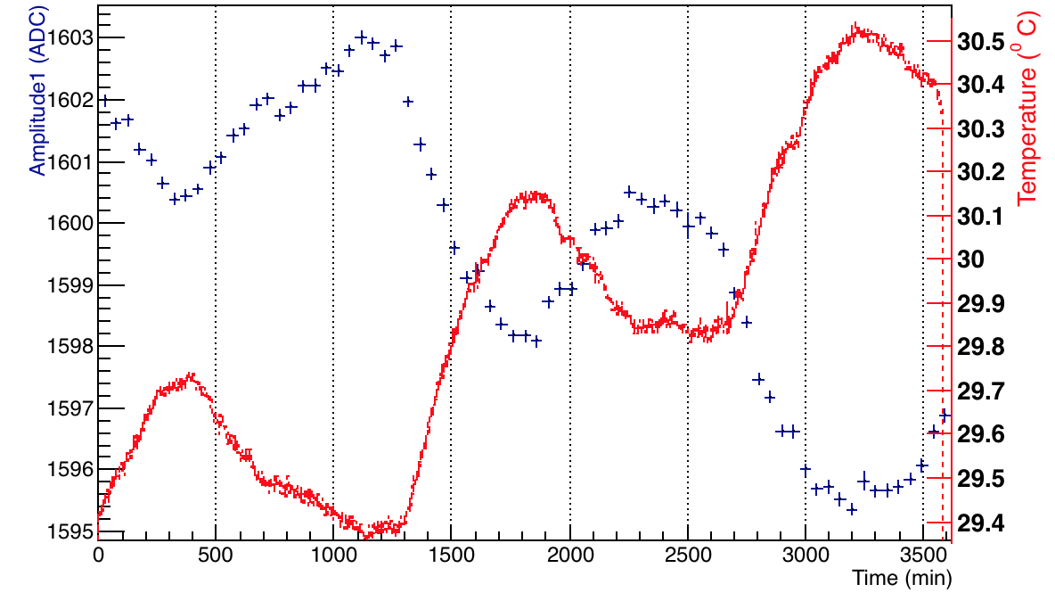
Temperature Variation – Channel 4
Optical table temperature
Overlaid temperature and amp 1 on the same plot
Laser hut temperature
Note: Bottom plot clearly shows a negative temp coefficient – recap of previous work.

Slide 6
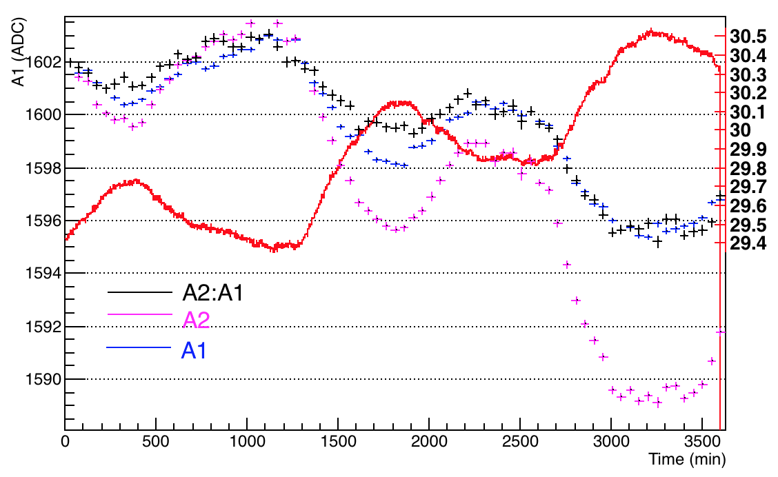
Temperature Variation – Channel 4
Overlaid temperature and A1, A2 and A2:A1 on the same plot, after normalizing all to A1 for consistency
Optical table temperature

Slide 7
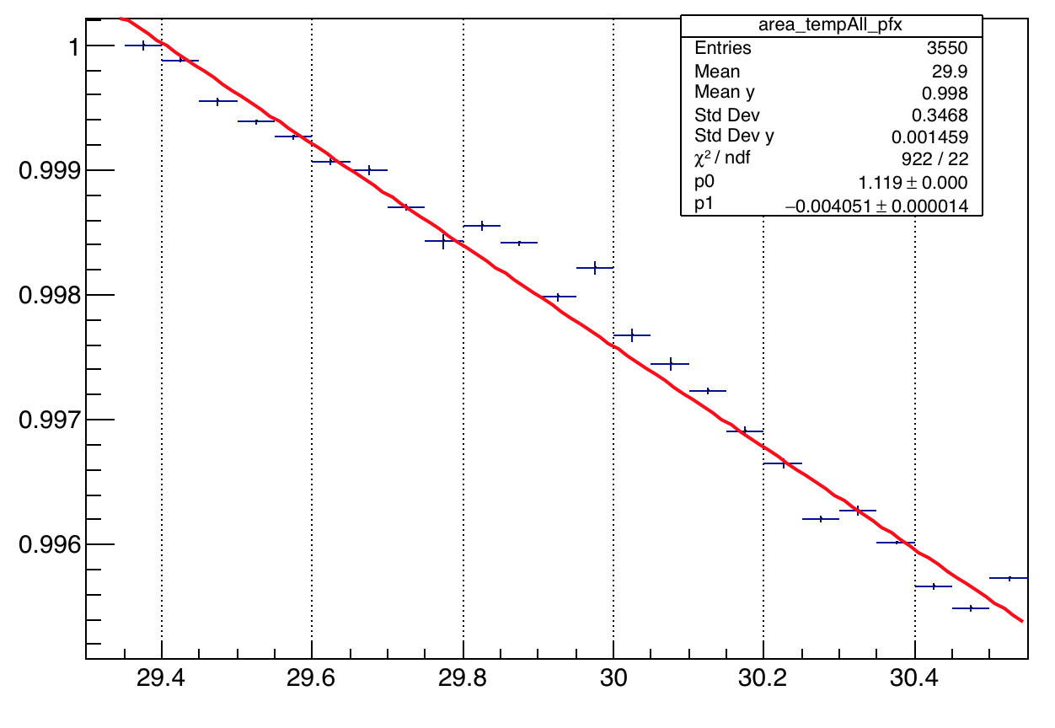
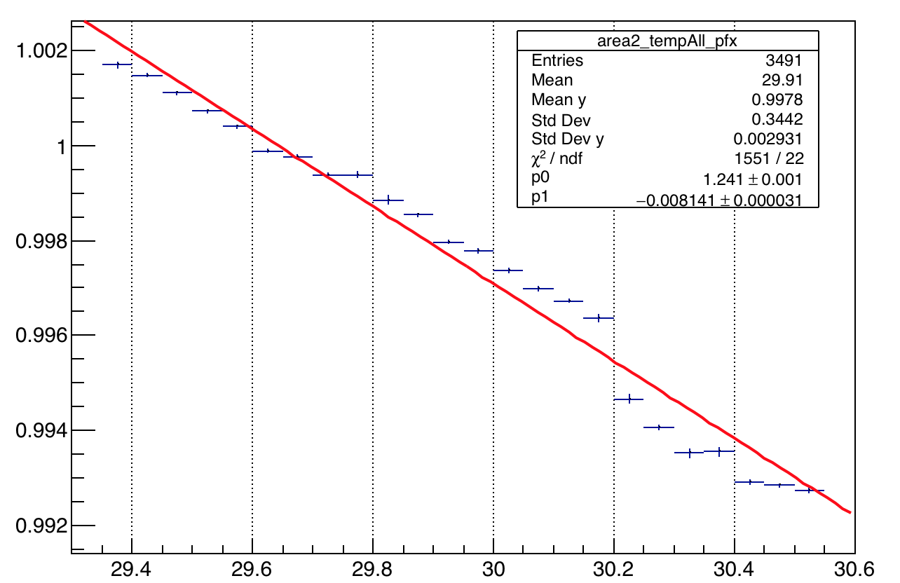
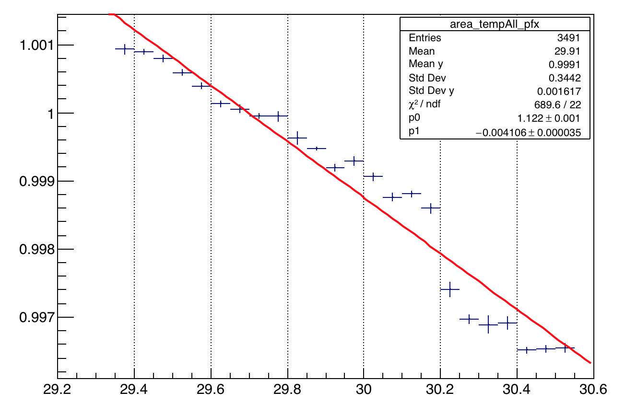
Amplitude Vs. Temp – Channel 4
Amp 1
Amp 2
The slope appears to change at 29.8 C.
A2:A1

Slide 8
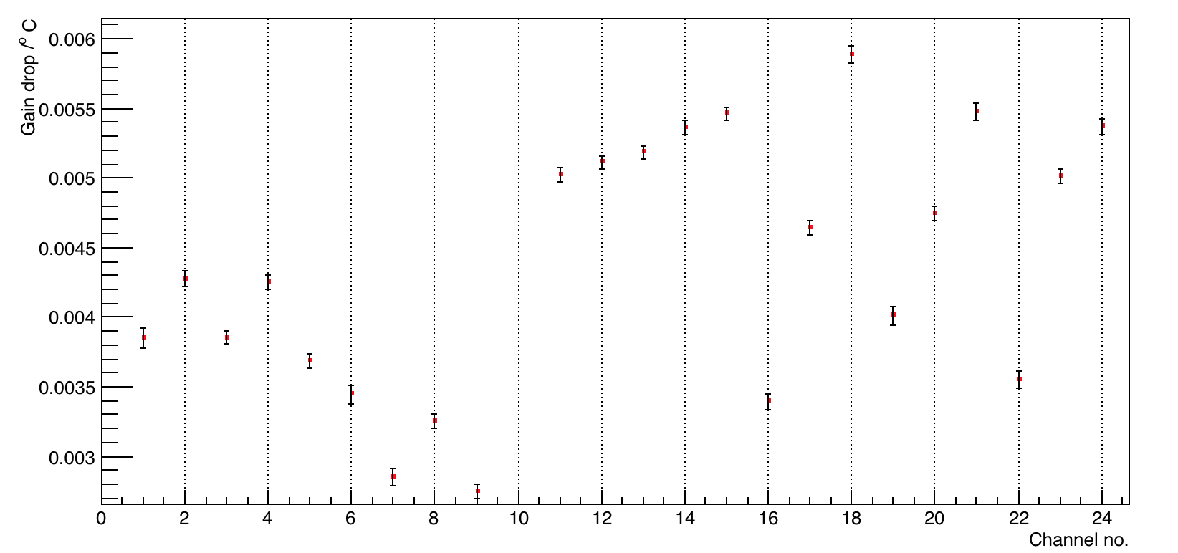
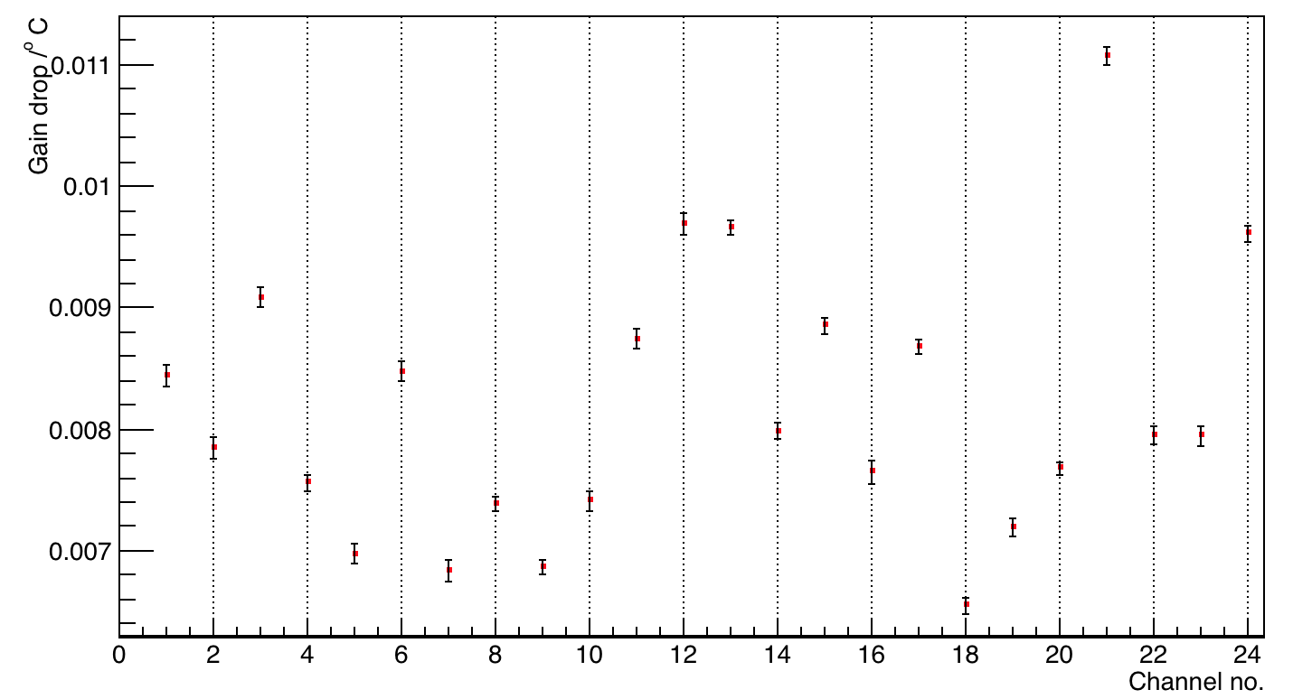
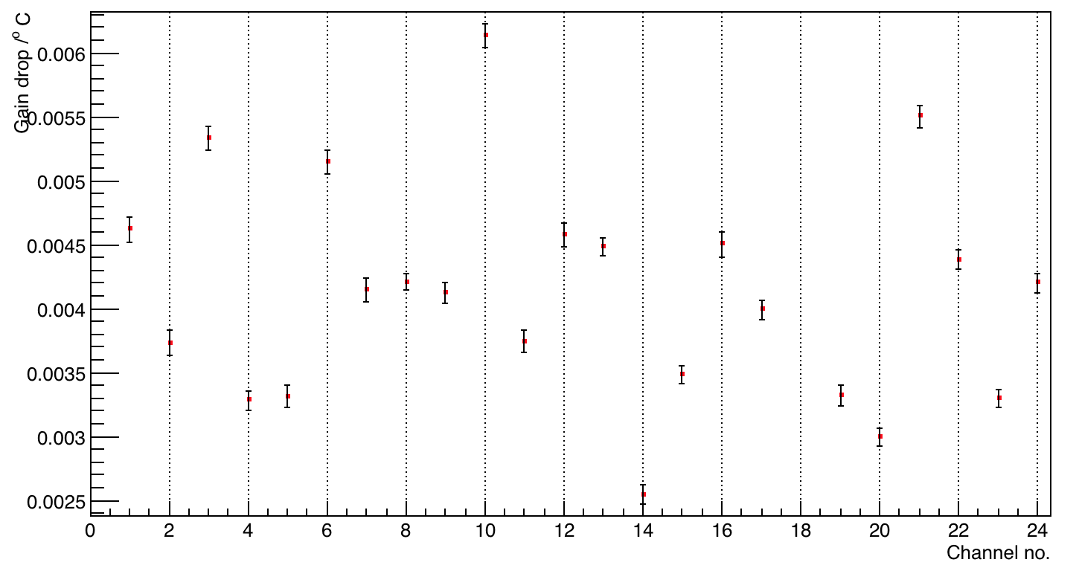
Amplitude Vs. Temp – all channels
Amp 1
Amp 2
A2:A1

Slide 9
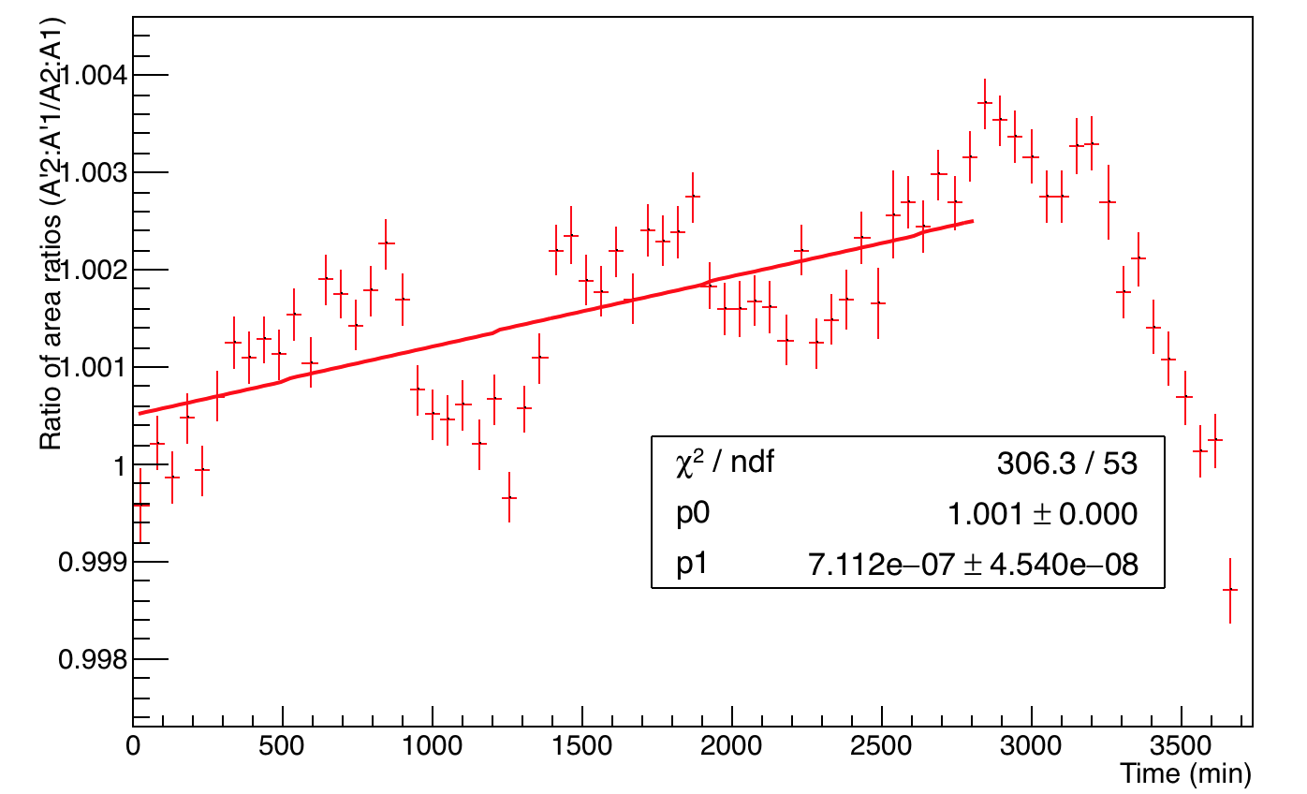
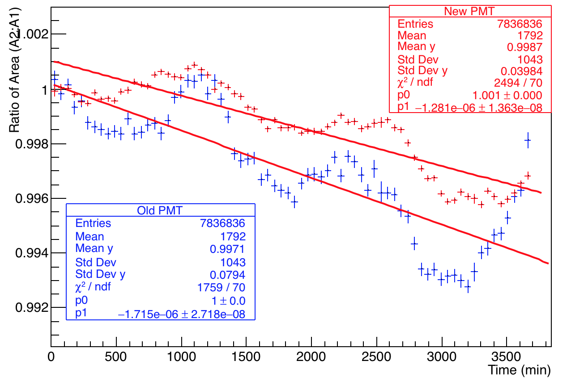
Ratio of ratios for Calo 20
R = A2:A1 of new PMT and R’ = A’2:A’1 of old PMT. The ratio of these ratios R: R’ (new:old) is slightly unstable => The “return” component is not stable.
Fitted with p1 just to get a rough idea of the drop in ratio of ratio’s per min. This is 7e-7/min for calo 20

Slide 10
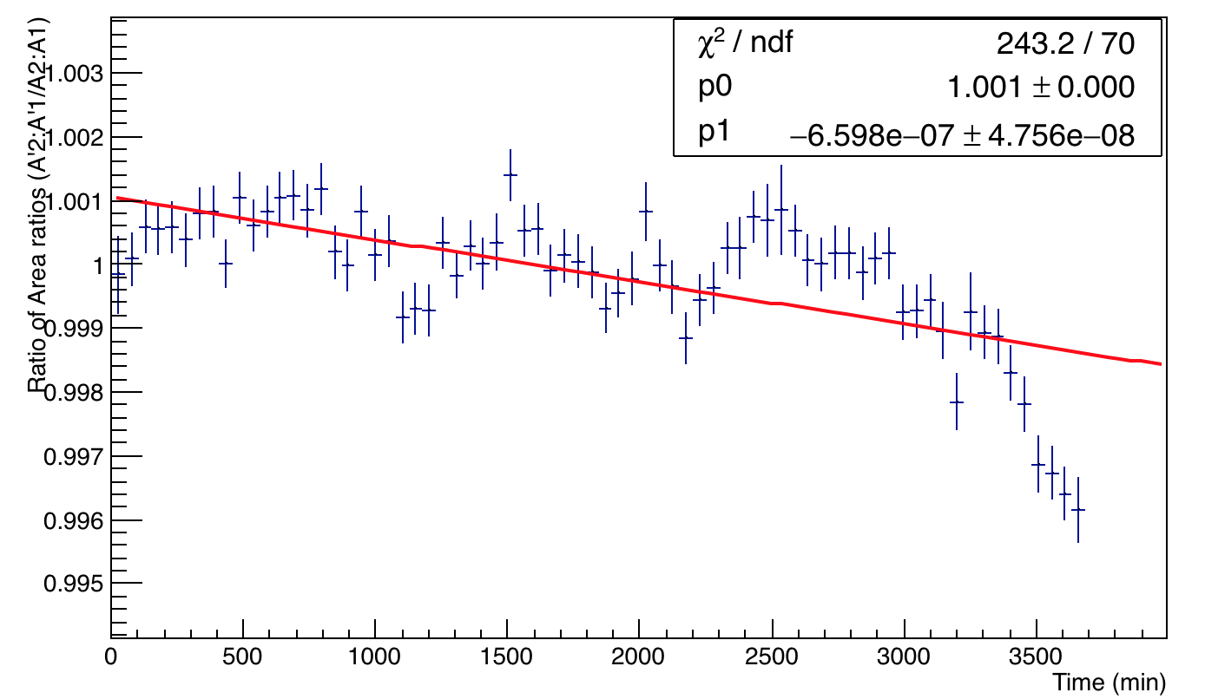
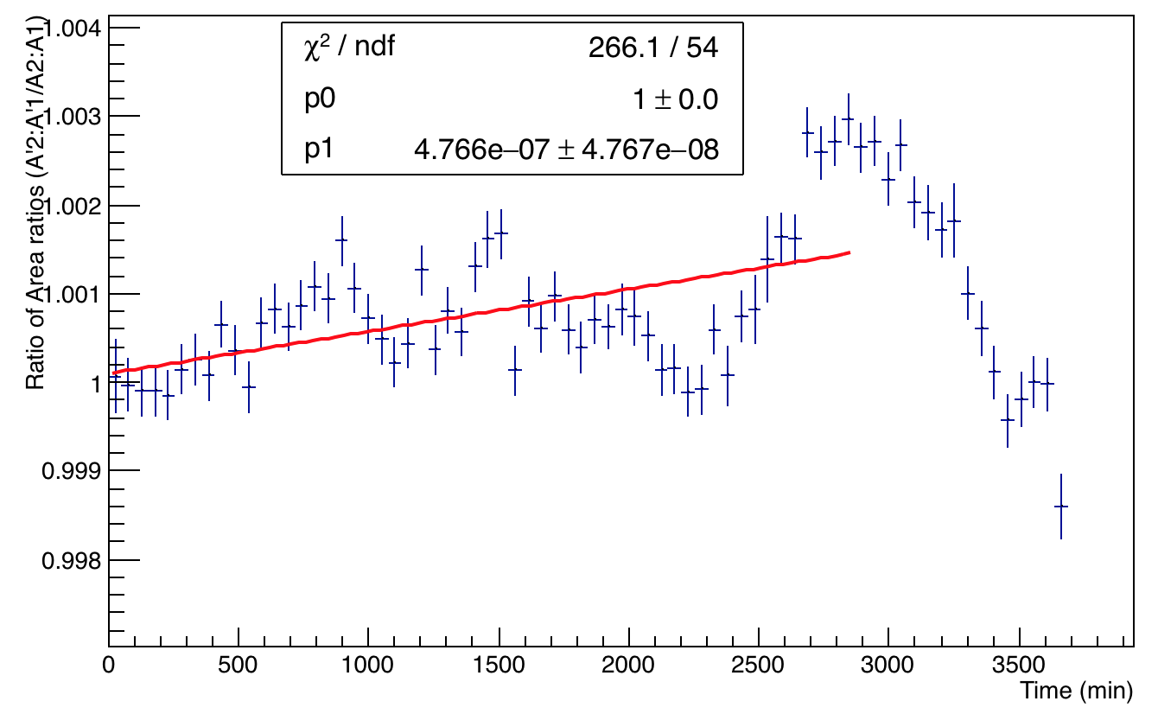
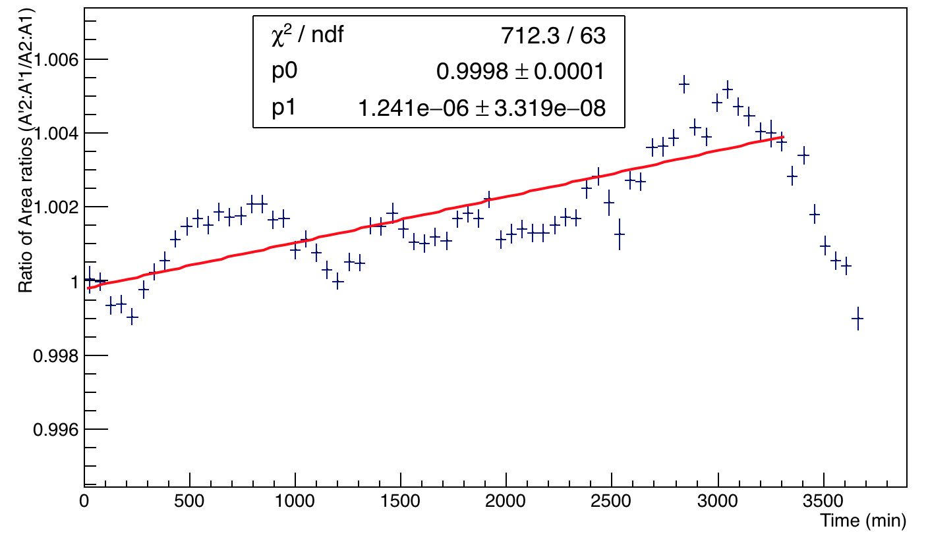
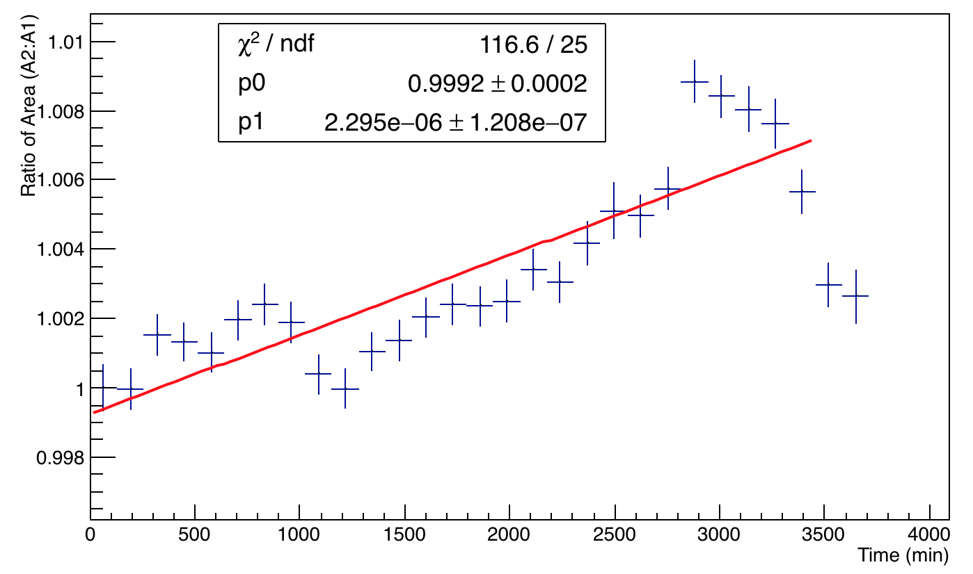
Ratio of ratios other calos
Calo 11
Calo 12
Calo 13
Calo 18

Slide 11
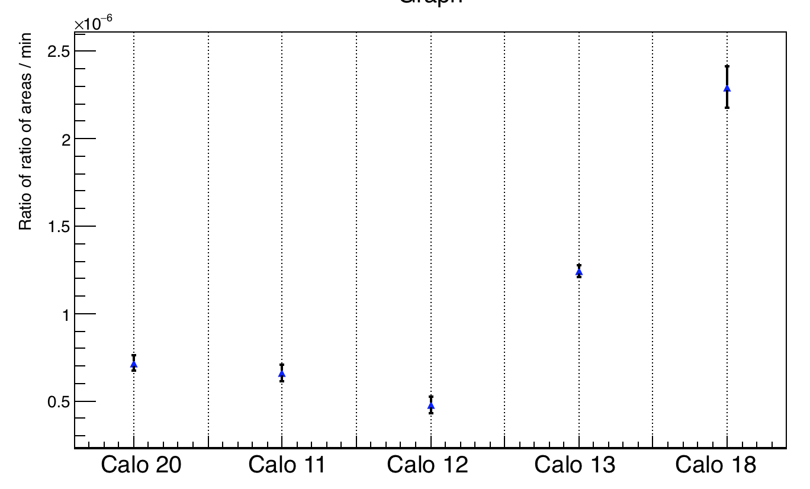
Variation Ratio of ratios/min
Mostly, the drop is of the order of ~10⁻⁷/min

Slide 12
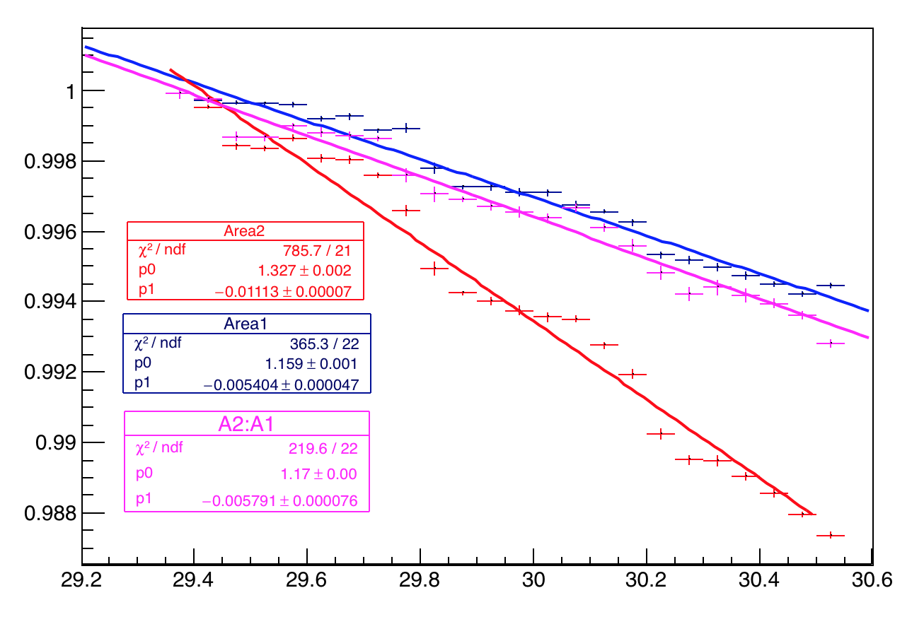
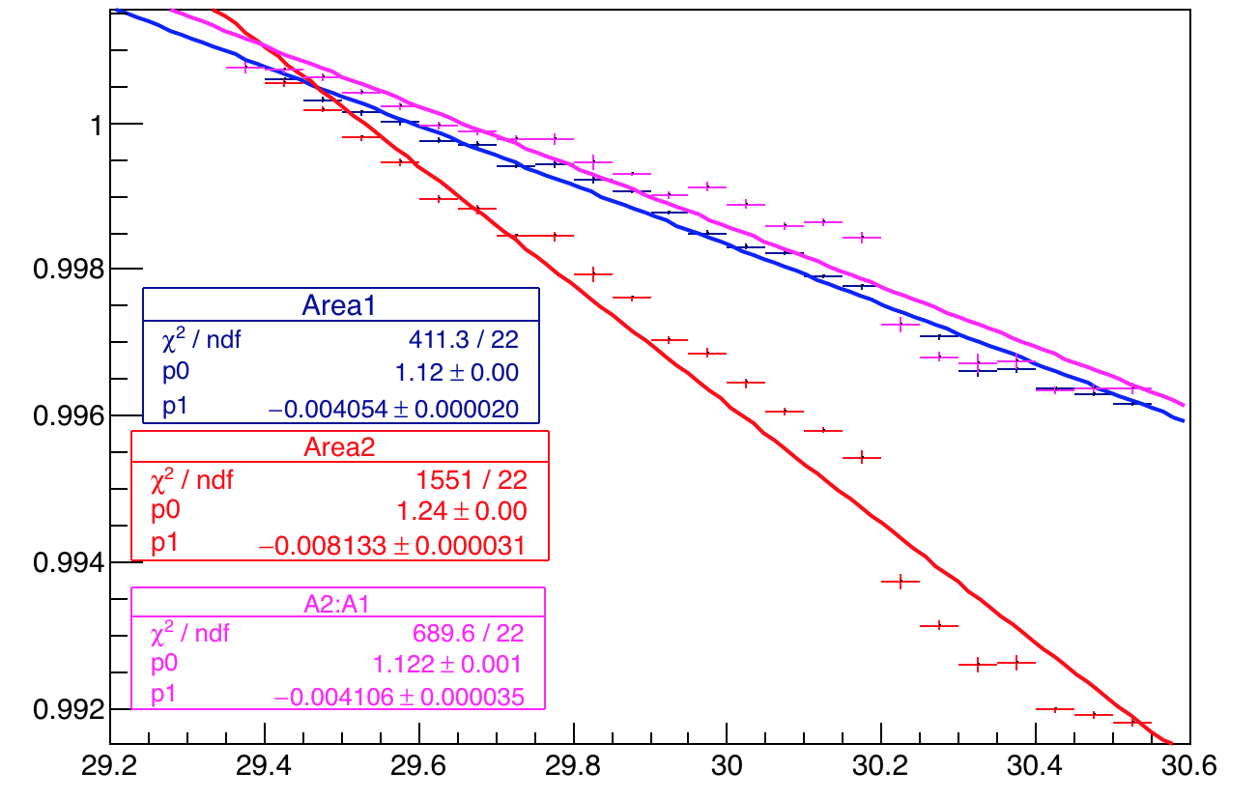
Recap - Temperature variation calo 20
Reminding the temp variations of A1, A2 and A2:A1 for channel 29 and 4– old PMT of calo 20.
Channel 29
Channel 4

Slide 13
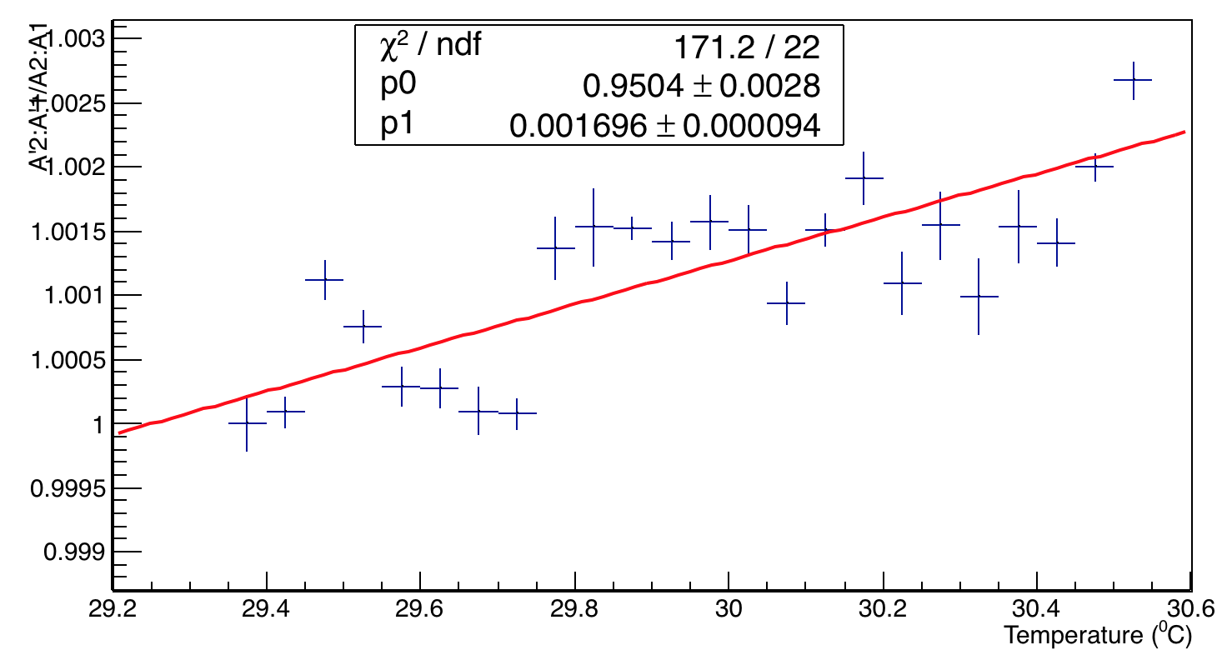
Temperature variation of Ratio of ratios- ch 20
This is to check the variation of any drift of the return signal from the calorimeters with temperature for this dataset.
Change is 0.16% / ⁰C

Slide 14
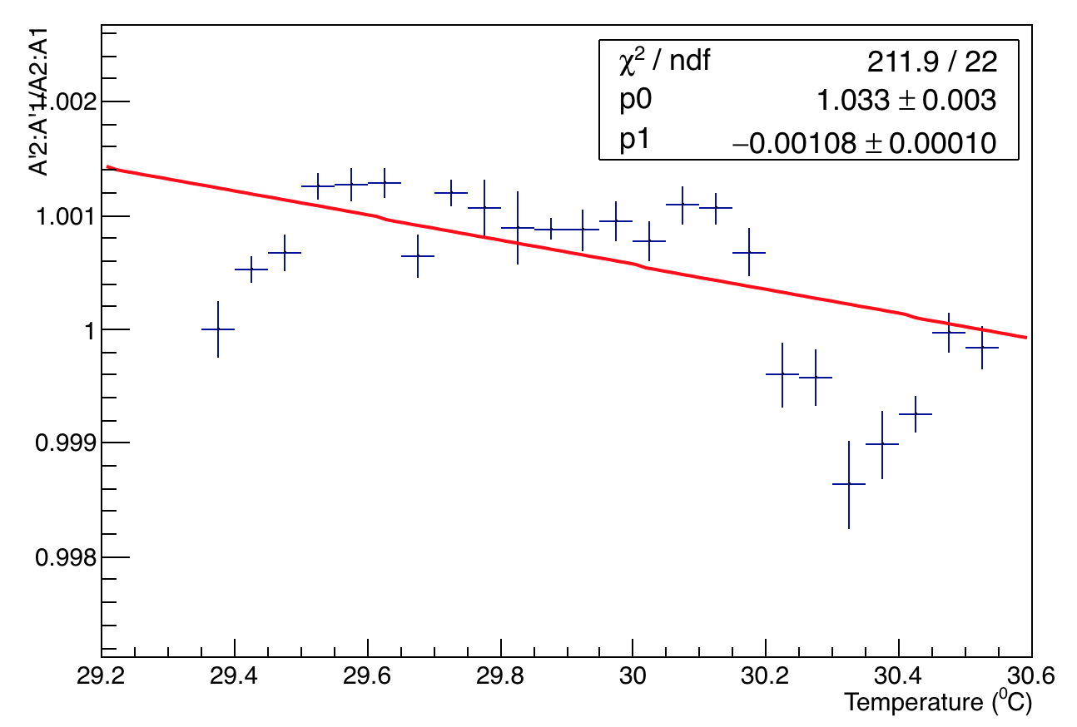
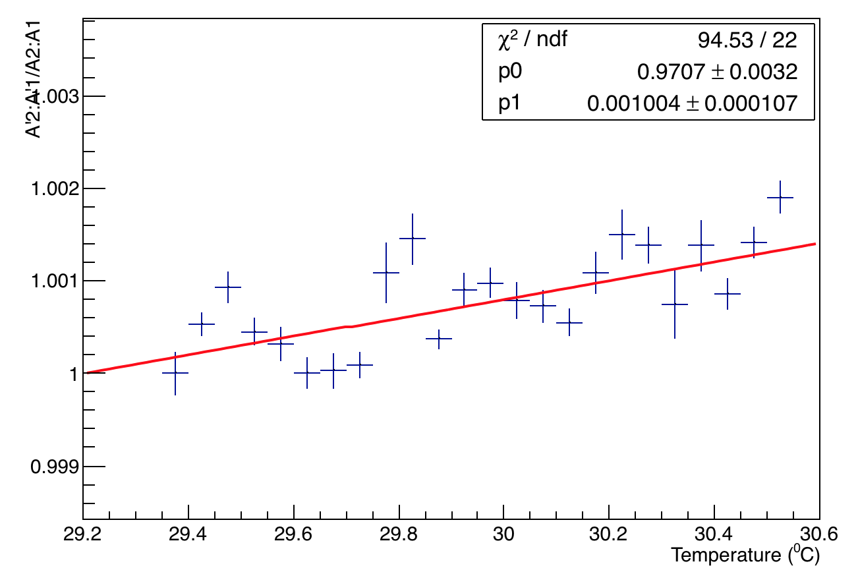
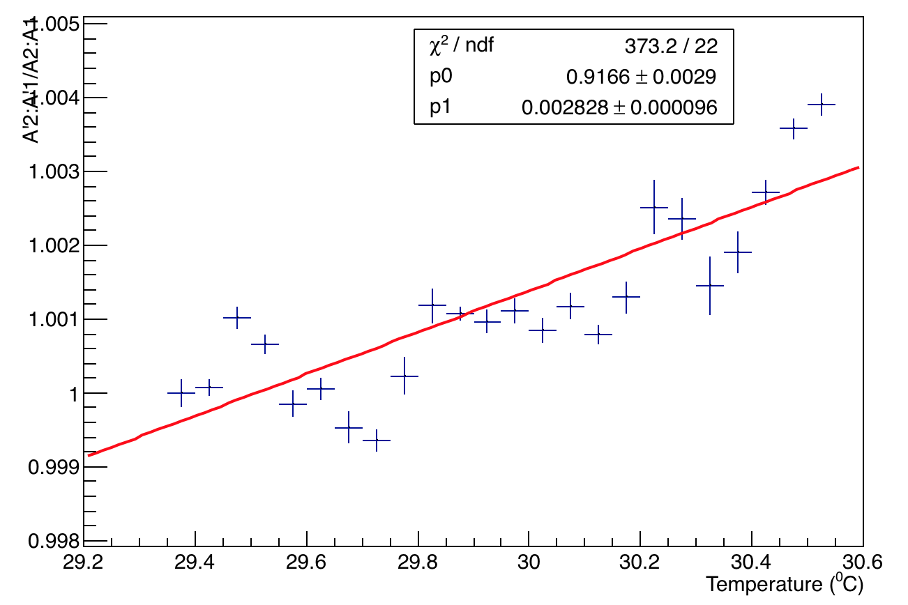
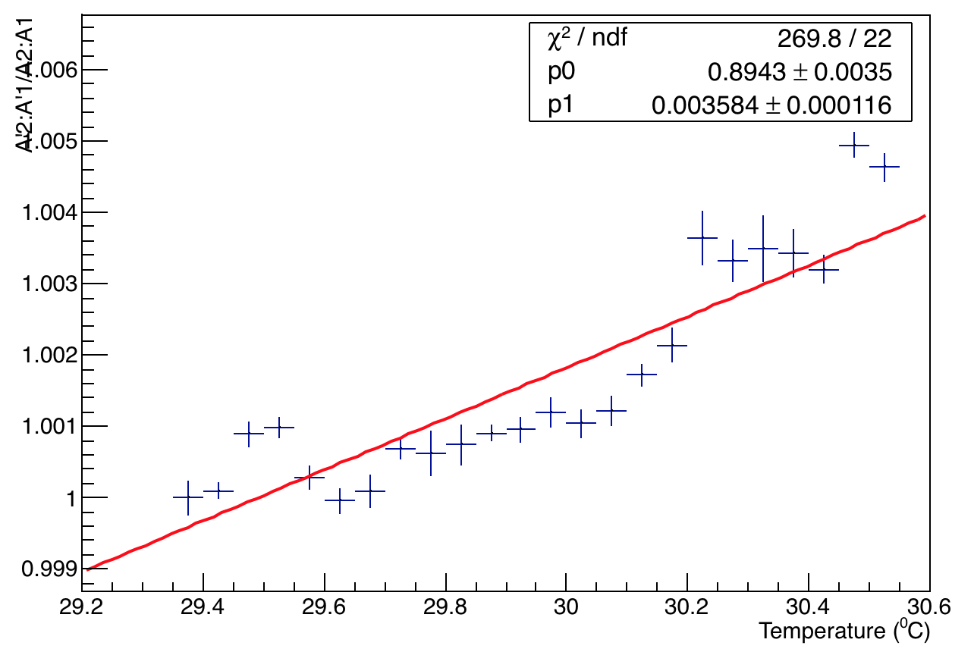
Temperature Vs. Ratio of ratios other calos
Calo 11
Calo 12
Calo 18
Calo 13

Slide 15
Back Up Slides

Slide 16
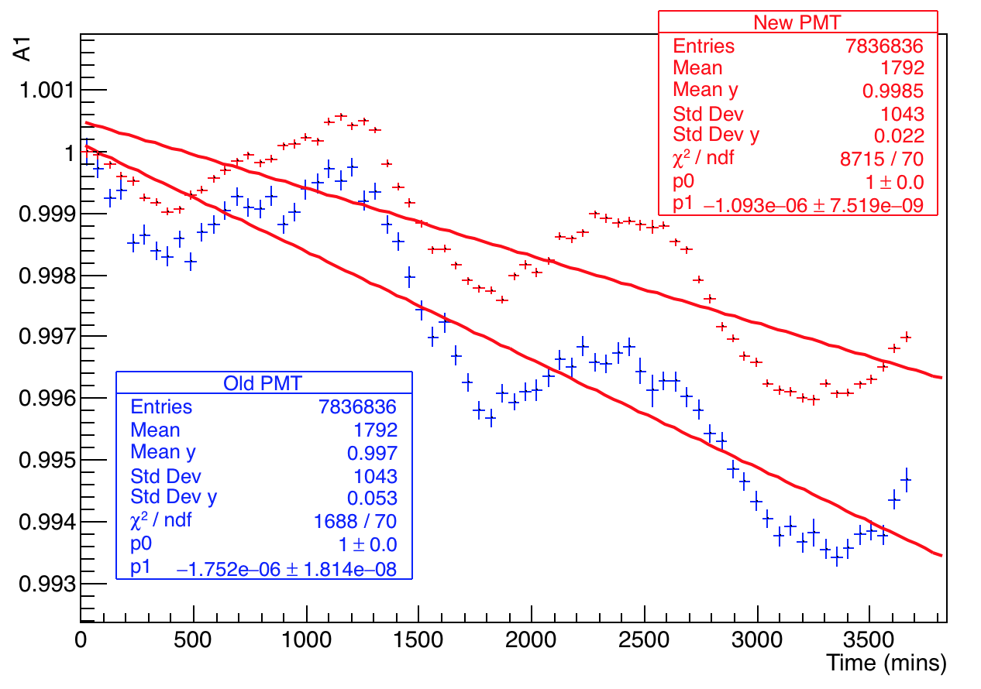
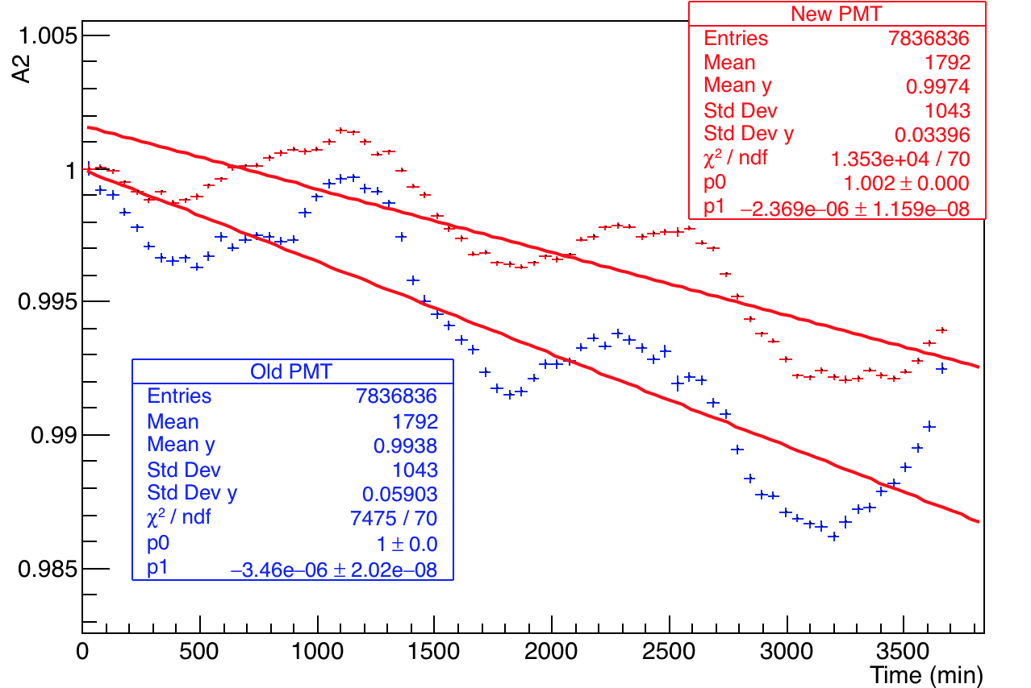
Comparison of old and new PMTs for Calo 20
Normalized area first pulse
Normalized area second pulse
Old PMTs about 1.5 times greater drop than new ones

Slide 17
Comparison of old and new PMTs for Calo 20
New PMT – Calo 20, channel 4
Bin size = 50 mins.
Old PMT – Calo 20, channel 29

Slide 18
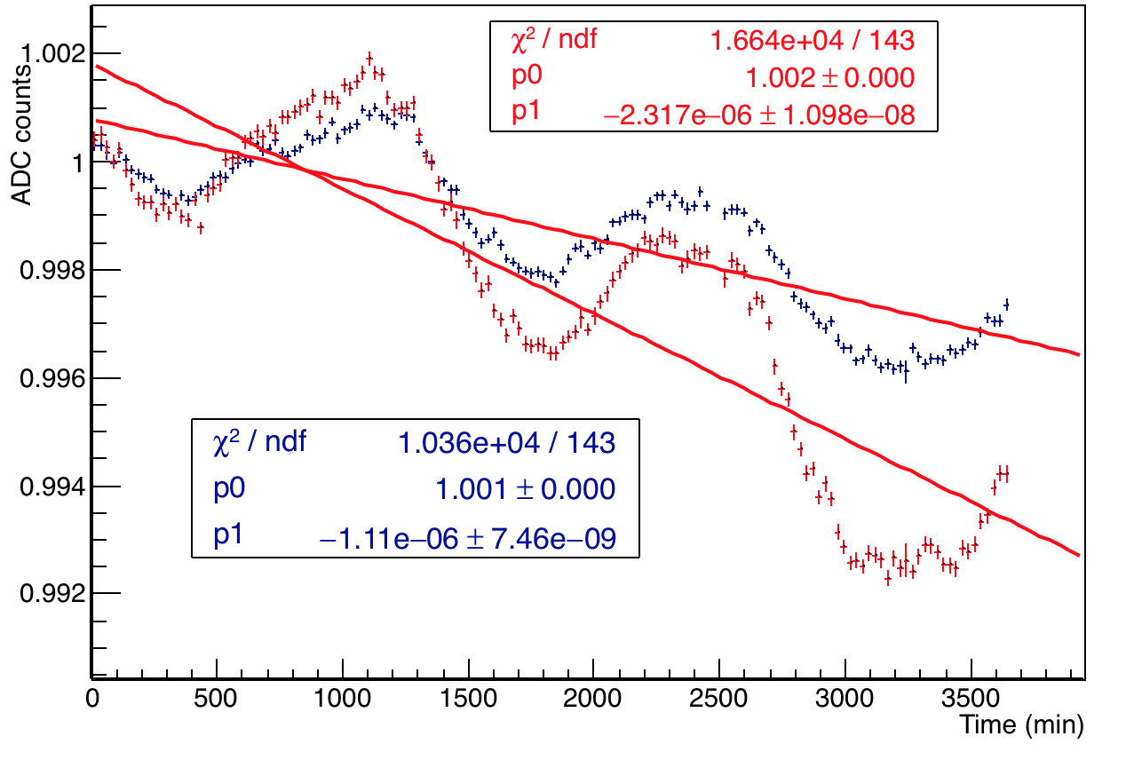
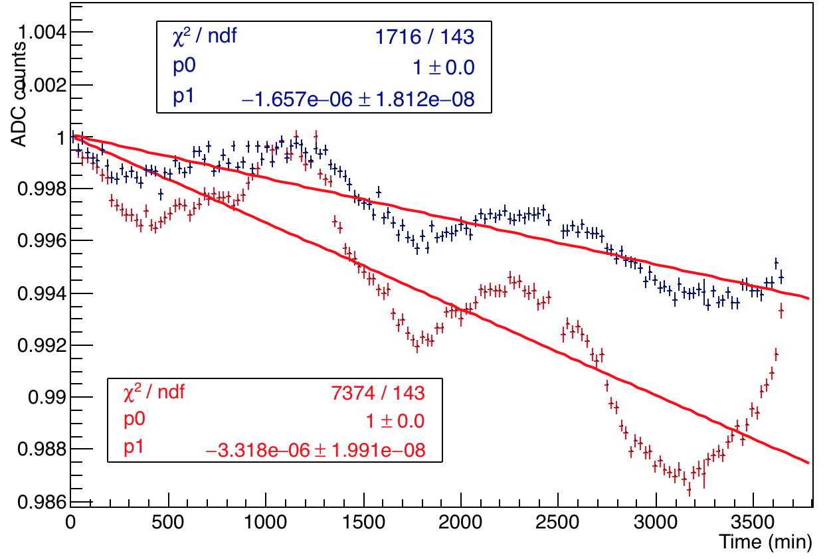
Calo 20 – comparing A2 and A1
Normalized A1 and A2 overlaid – new PMT ch 4 and old PMT ch 29
Channel 4
Channel 29
In both cases the drop in A2 is twice that of A1

Slide 19
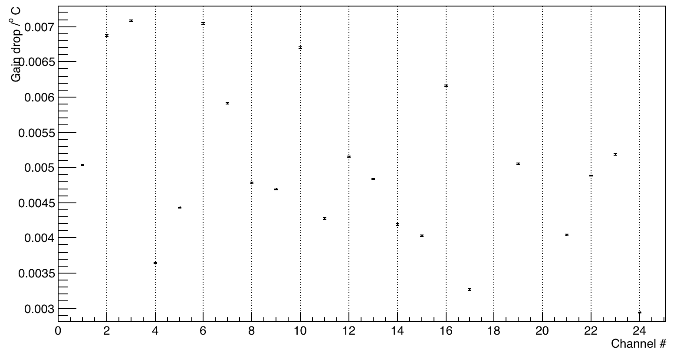
A2:A1 /ºC for all channels

