Slide 1
Datasets and times (for my ref)
Run sets | Start times | End times
60 –hr | - | -
16355-16402 | 4th May 8 am | 6th May 7:30 am
16409-16514 | 6th May 11:17 am | 11th May 4:9 am
17327-17392 | 1.529593e9 21st Jun 9:56:40 | 1.529802e9 24th Jun 10
17431-17560 | 1.52991e9 25th Jun 2 | 1.5303857e9 30th Jun 19:08:20
Calo 18 | Old PMT 28 | New PMT 8
The data set in red is not completely filled – something went wrong in the execution of the job in the grid

Slide 2
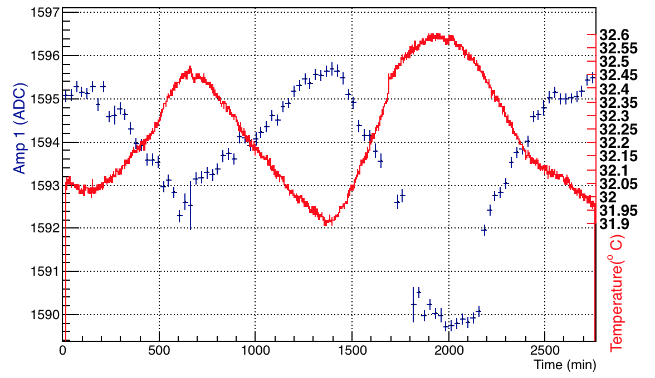
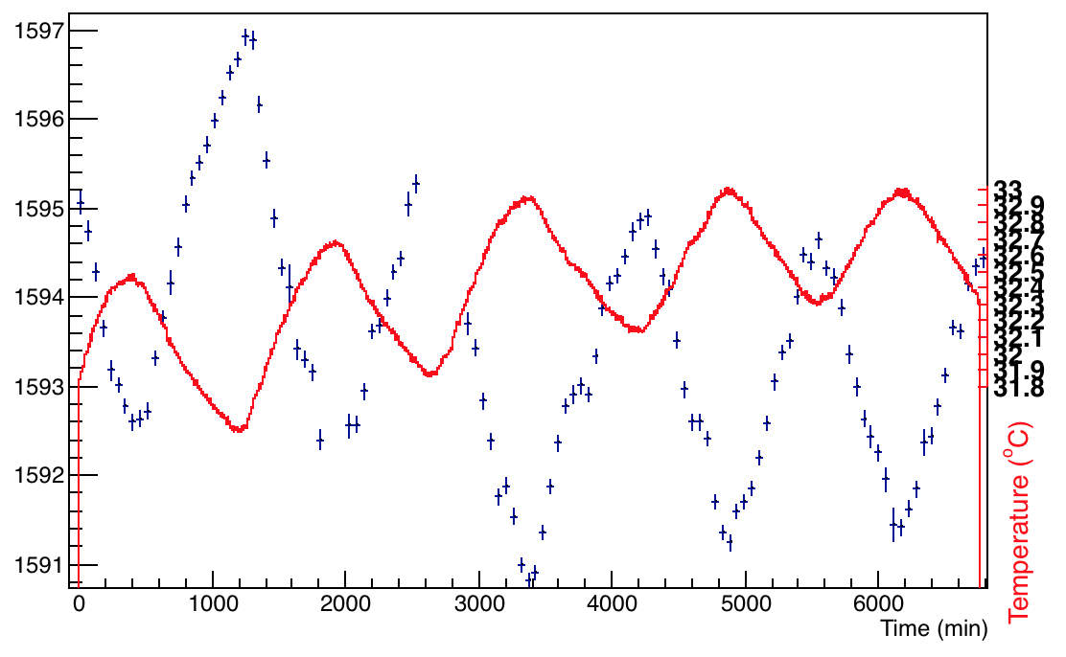
Different datasets – Channel 4 and temperature
Channel 4, Amplitude 1
48 hrs
16355-16402
16409-16514

Slide 3
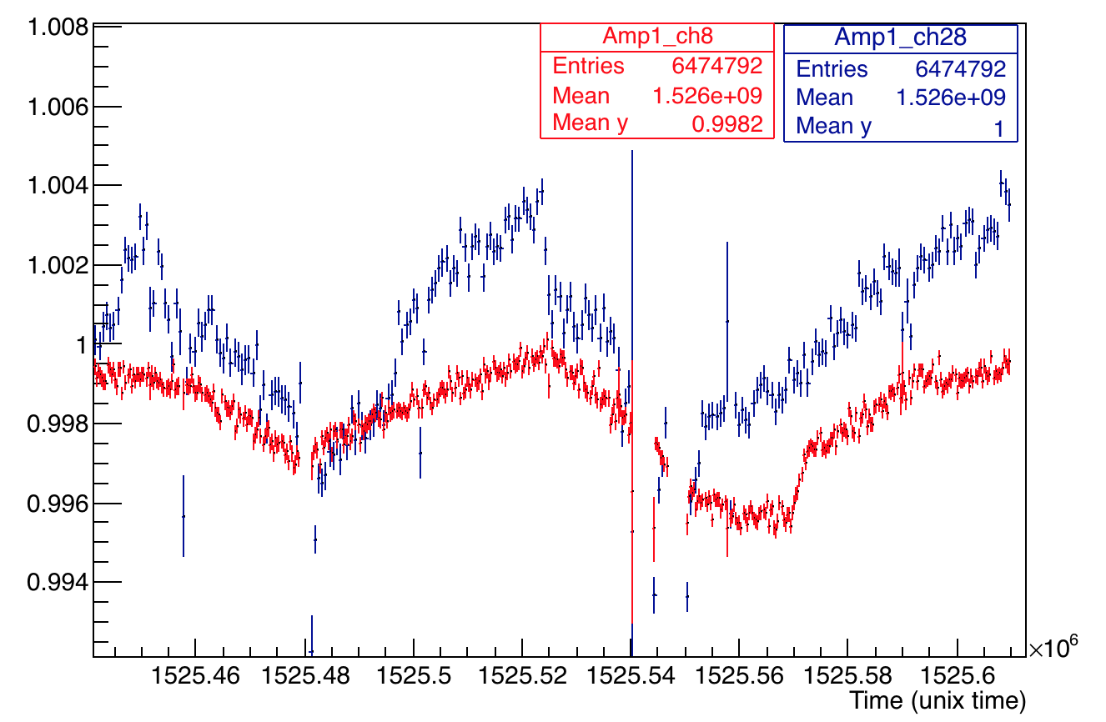
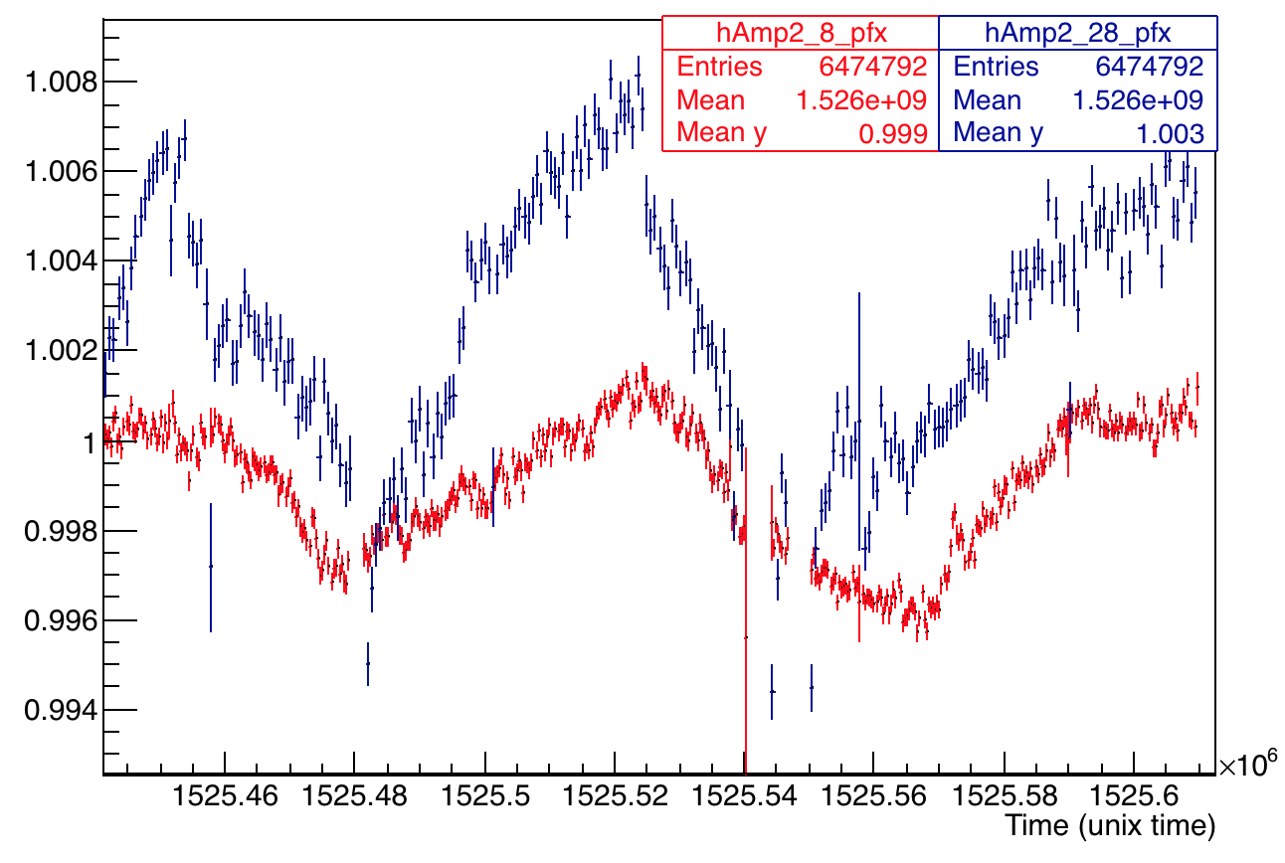
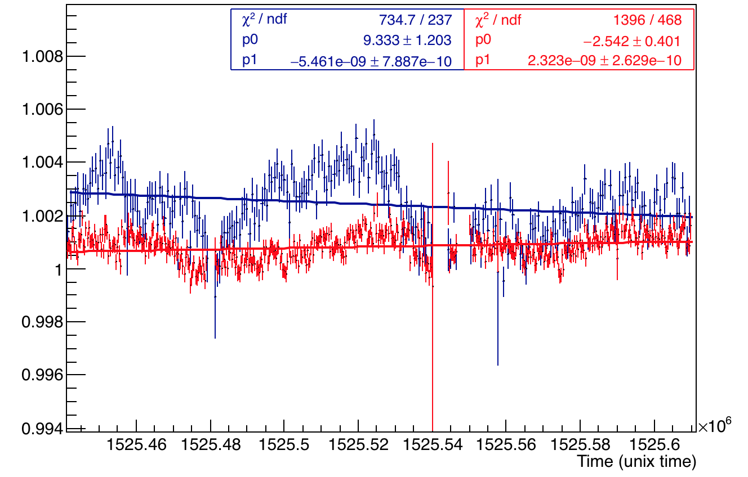
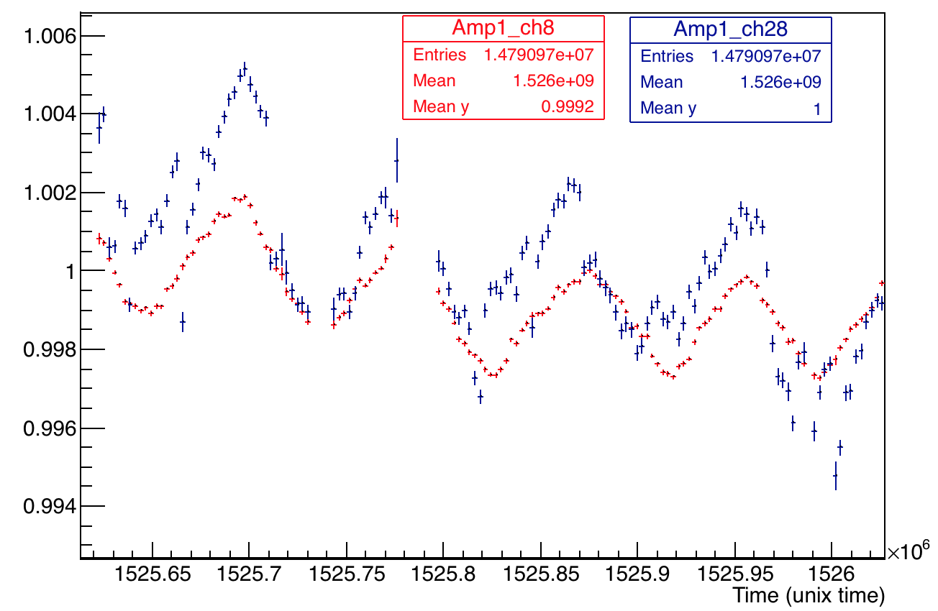
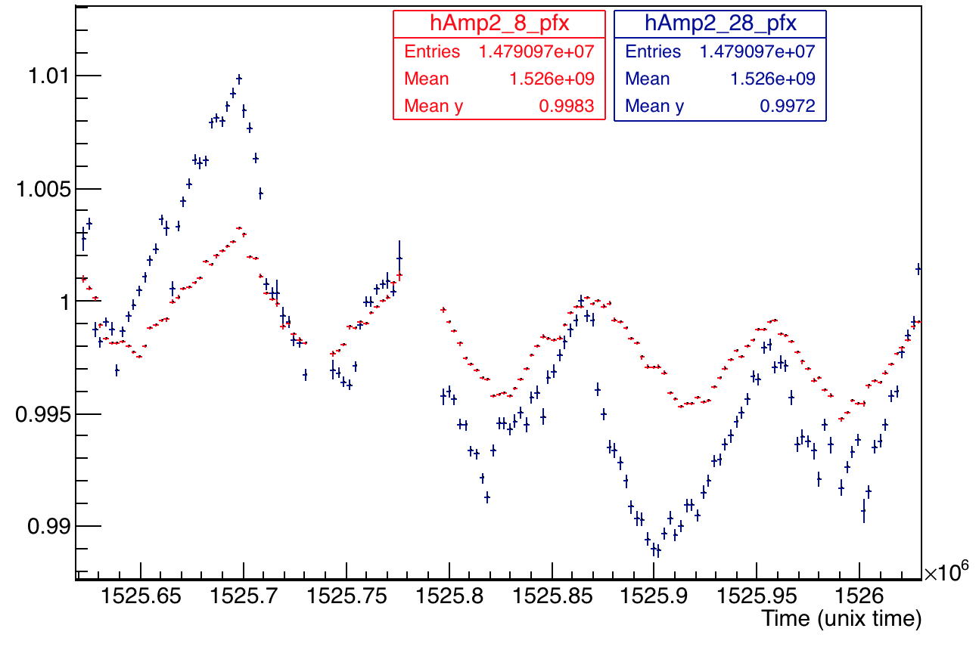
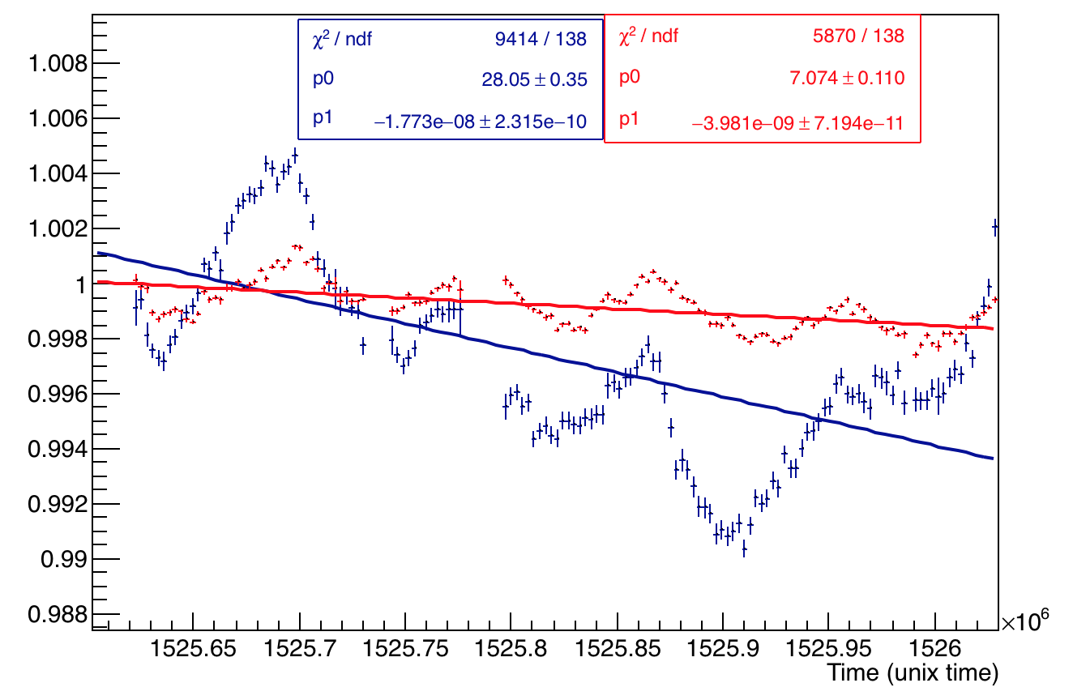
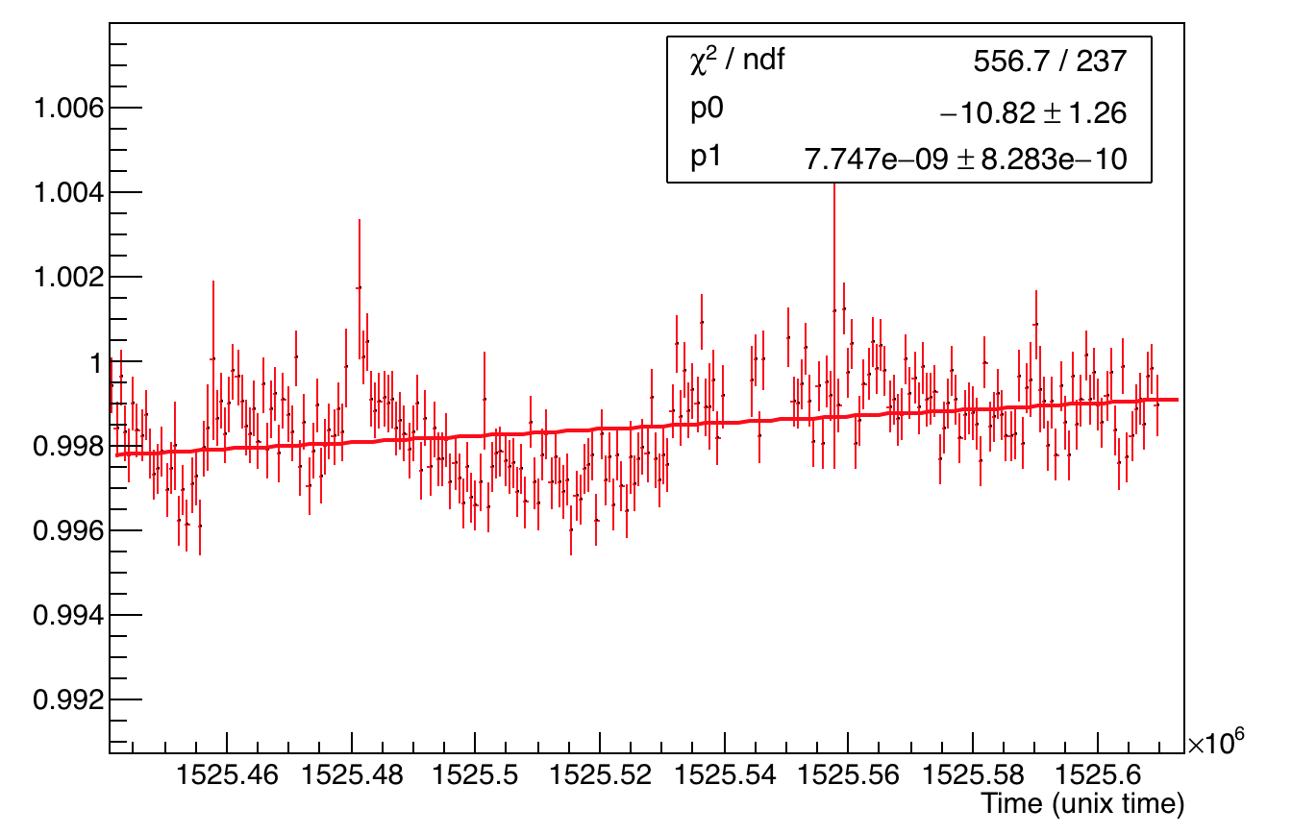
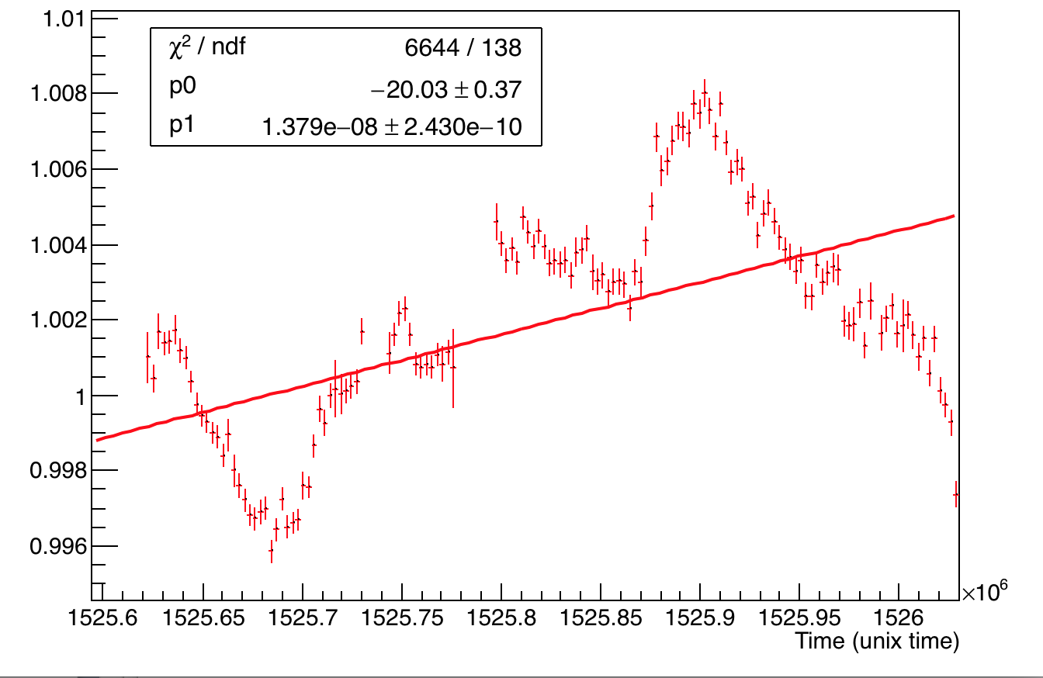
Channel 28 and 8 overlaid – amplitudes
16355-16402
A1
A2
A2:A1
~ 48 hrs
16409-16514
A2:A1
~ 113 hrs
A1
A2
Bin Size ~ 9 min
With ~ 25000 events
16355-16402
16409-16514
A’2:A’1/A2:A1
~ 113 hrs
A’2:A’1/A2:A1
~ 113 hrs
~ 48 hrs

Slide 4
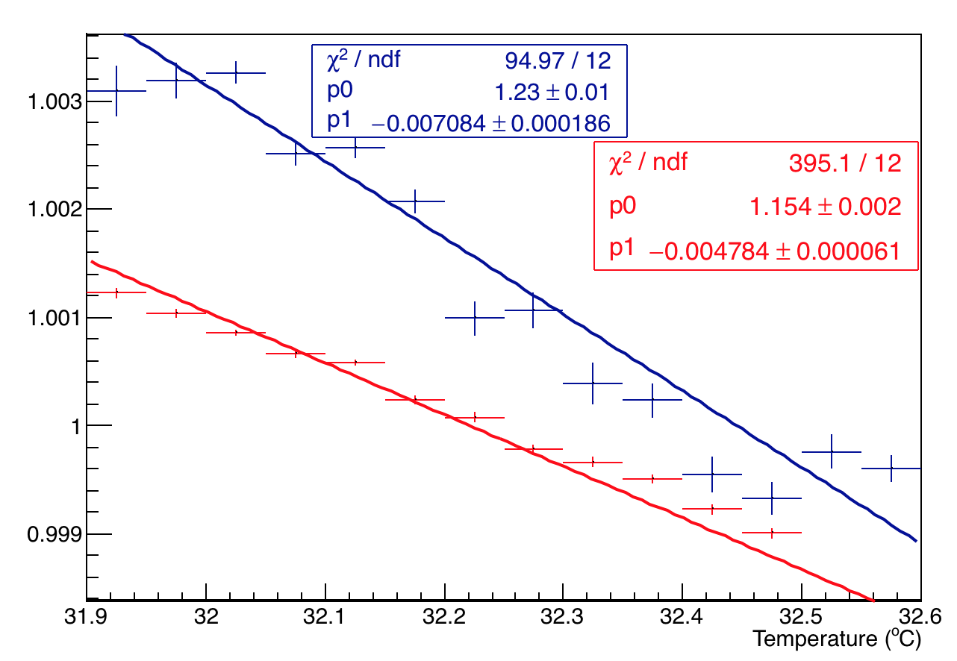
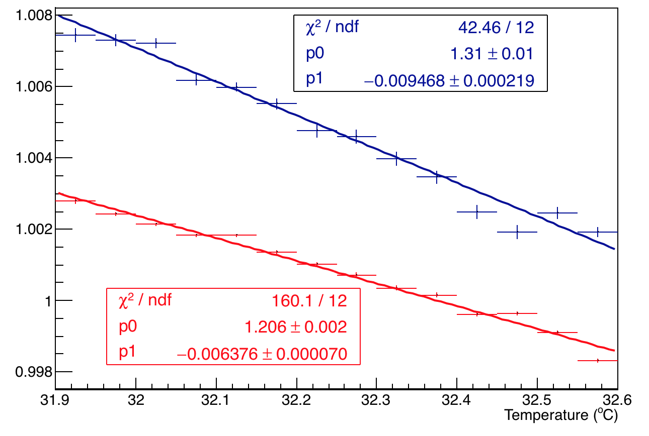
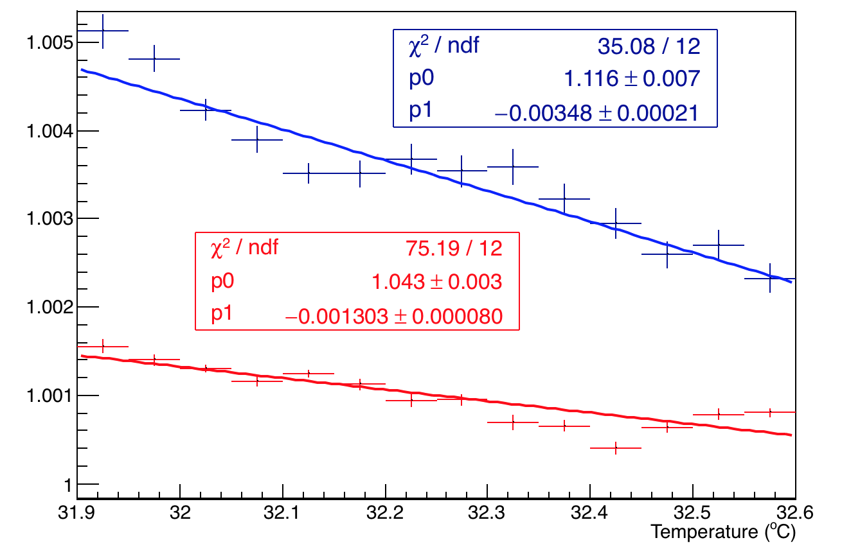
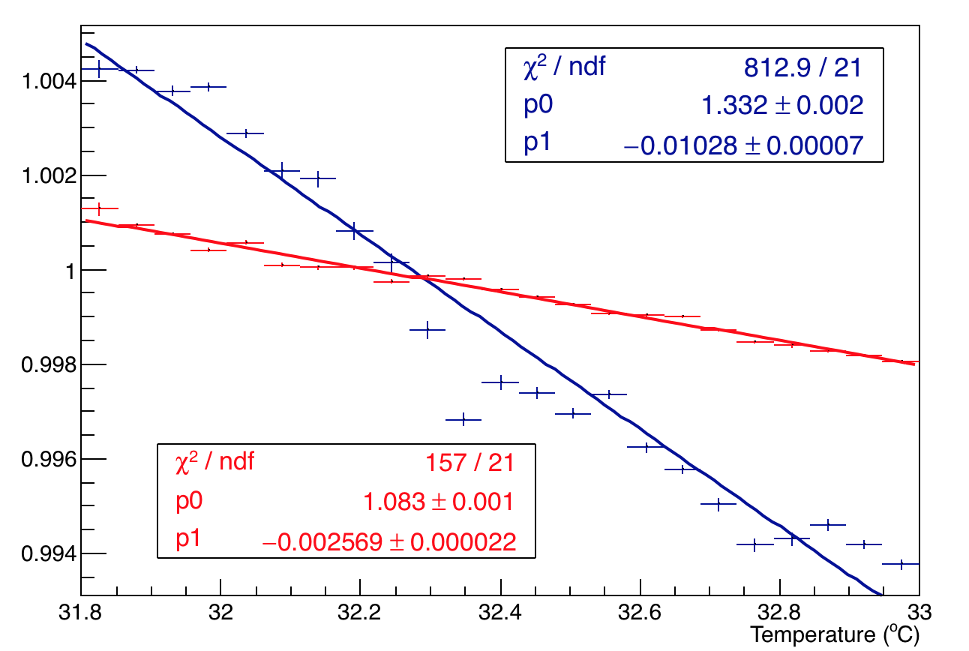
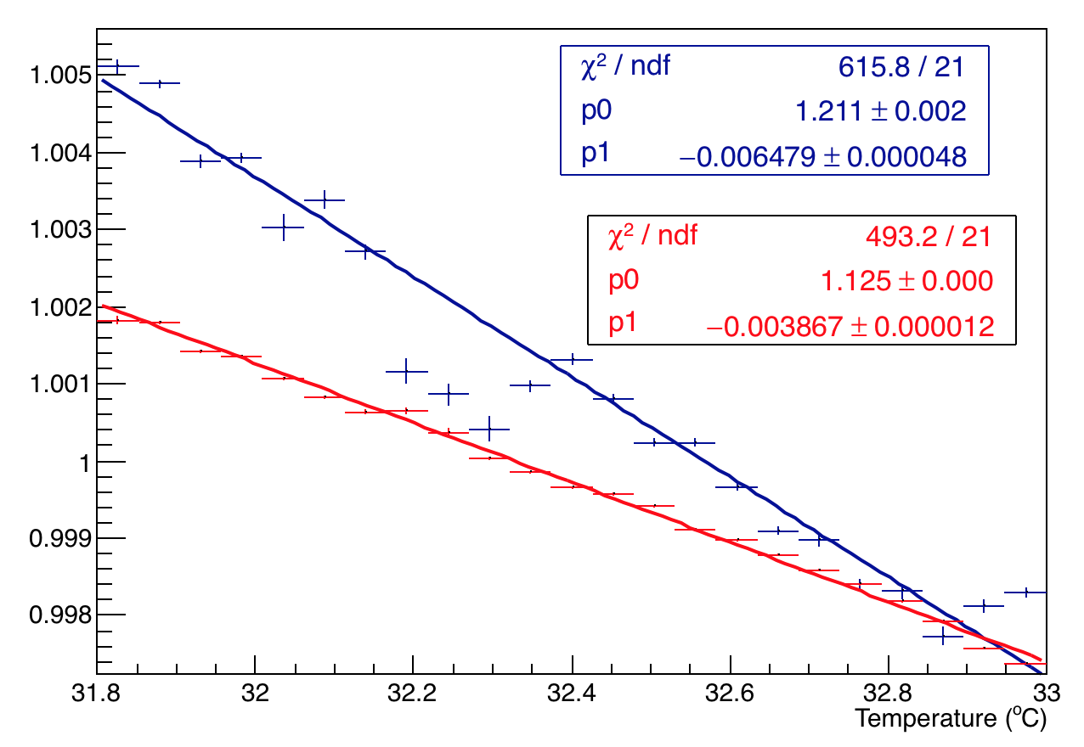
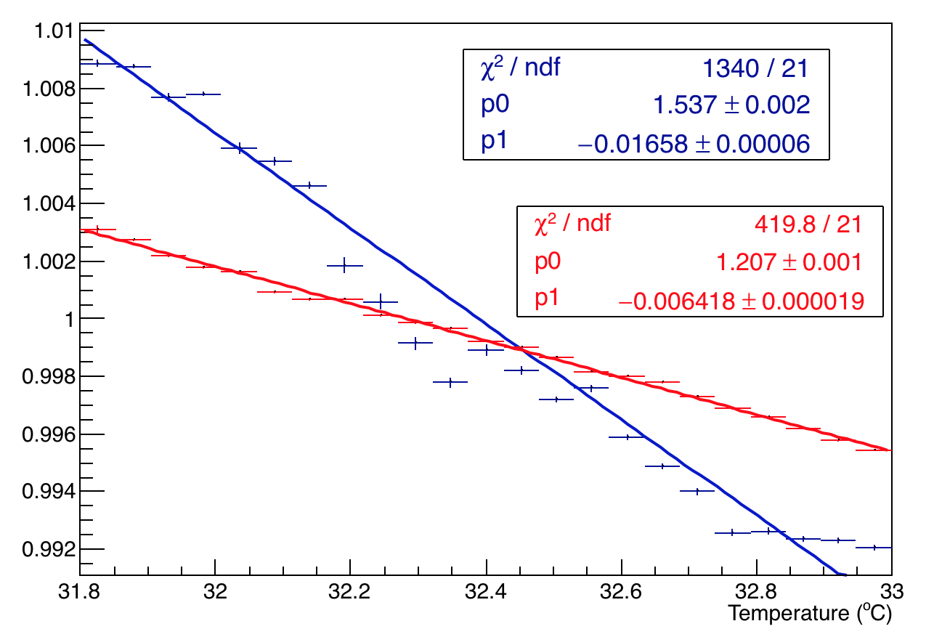
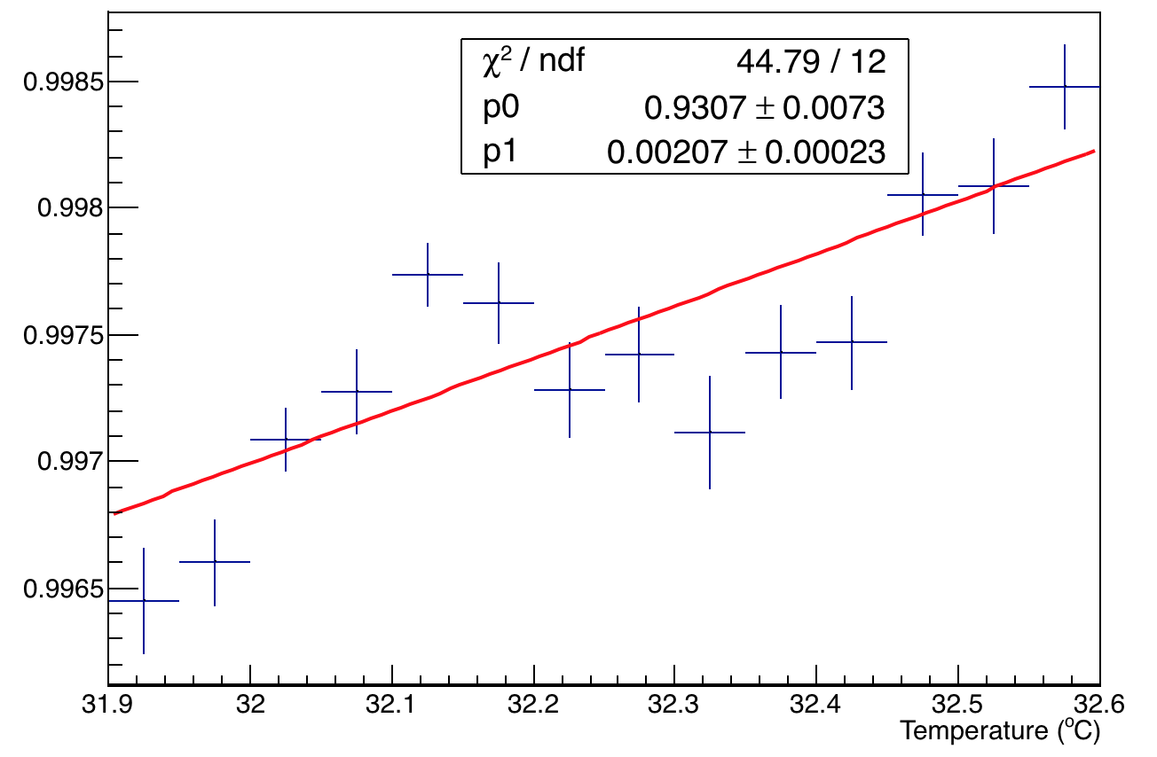
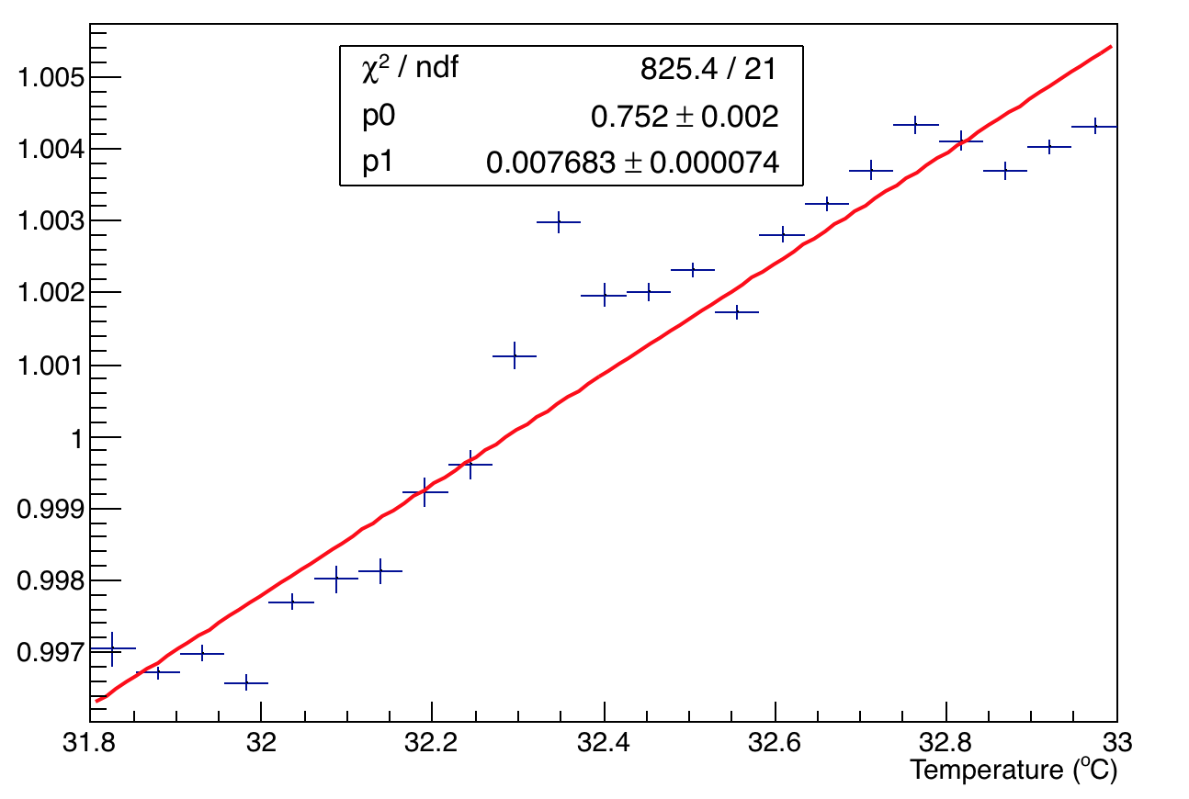
Channel 28 and 8 overlaid – Temp Vs. Amp
16355-16402
A1
A2
~ 48 hrs for 0.7 ºC temp
Temp range: 31.9 to 32.6 ºC
A2:A1
16409-16514
A1
A2
A2:A1
~ 113 hrs for 1.2 ºC temp
Temp range: 31.8 to 33 ºC
16355-16402
16409-16514
A’2:A’1/A2:A1
A’2:A’1/A2:A1
~ 113 hrs
~ 48 hrs

Slide 5
Comparing Temp Vs. Amp - All data
 | A1/C (-) |  |  | A2/C (-)
Ch | 60 hr | 48 hr | 113 hr | 60 hr | 48 hr | 113 hr
8 | 0.27%+2.1e-5 | 0.47%+6.1e-5 | 0.38%+1.2e-5 | 0.79%+2.49e-5 | 0.64%+7e-5 | 0.64%+1.9e-5
28 | 0.73%+6.85e-5 | 0.7%+1.86e-4 | 0.65%+4.8e-5 | 1.56%+9.46e-5 | 0.94%+2.1e-4 | 1.65%+6e-5
 | A2:A1/C (-) |  |  | R = A'2:A'1/A2:A1 per C
Ch | 60 hr | 48 hr | 113 hr | 60 hr | 48 hr | 113 hr
8 | 0.48%+3.14e-5 | 0.13%+8e-5 | 0.25%+2.2e-5 | 0.34%+1.06e-4 | 0.2%+2.3e-3 | 0.76%+7.4e-5
28 | 0.8%+9.99e-5 | 0.34%+2.1e-4 | 1%+7e-5

