Slide 1
Effect of Temperature on Local Monitors – Preliminary studies

Slide 2
Run sets / Data sets
Run 13966 – one 50 min run
Runs 15345-15352, 15355-15360, 15363-15366, 15378 - 11th April (but a few runs missing)
Runs 14462-14477, 14483-14492 – 1st April

Slide 3
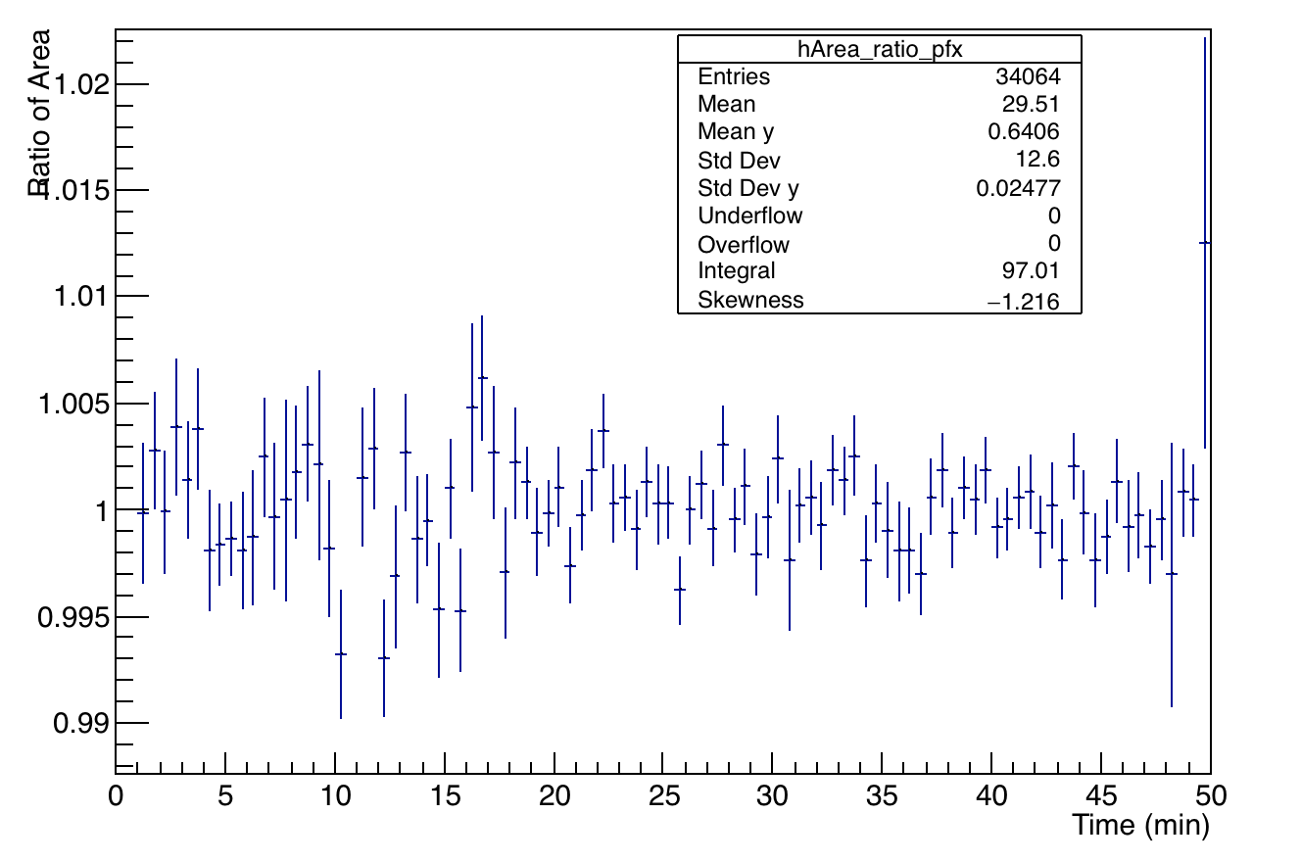
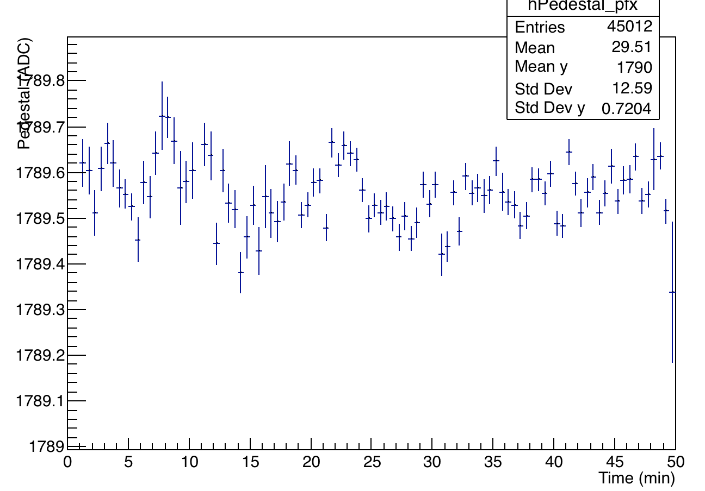
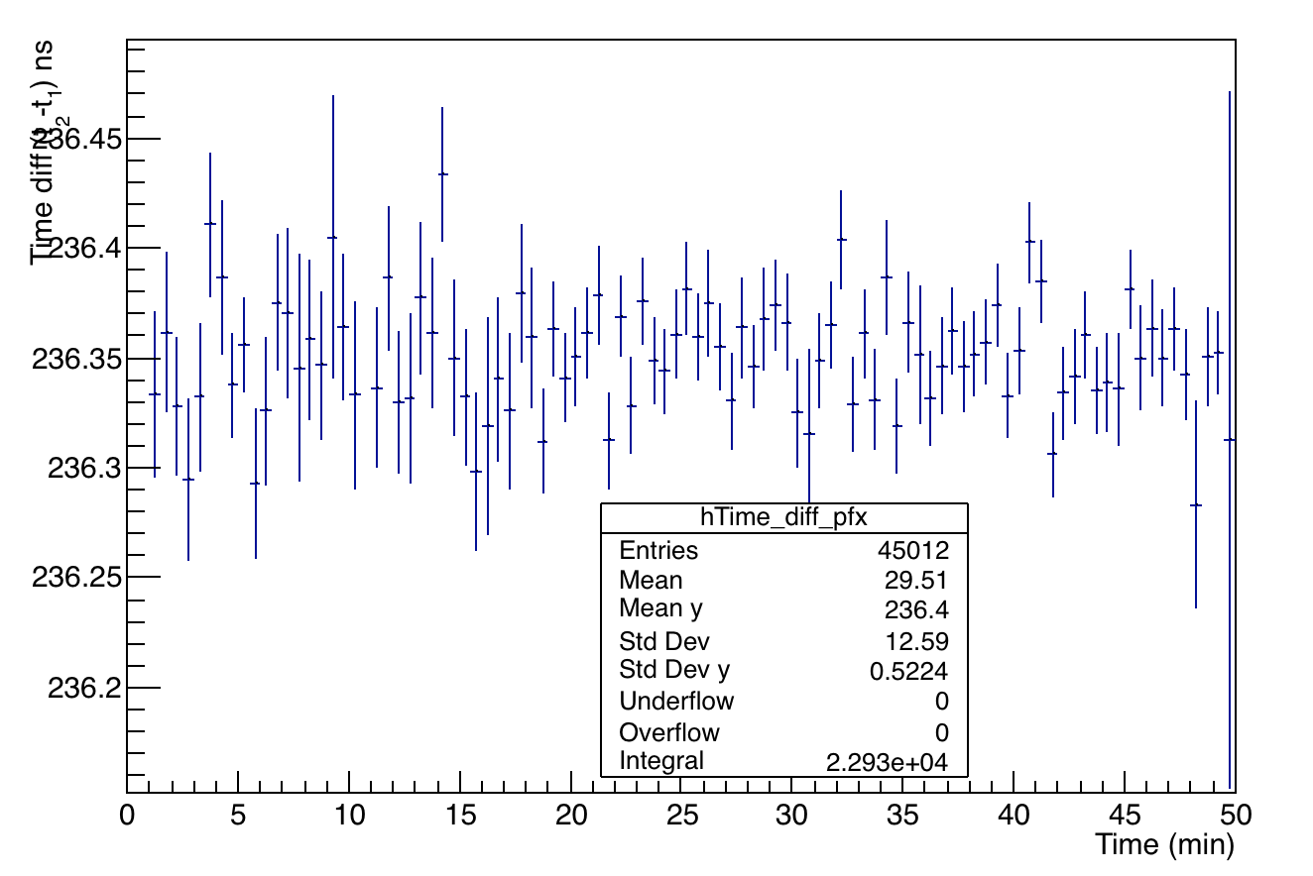
Run 13966 – Study one channel (9)
Normalized to average area-ratio
Time ordered

Slide 4
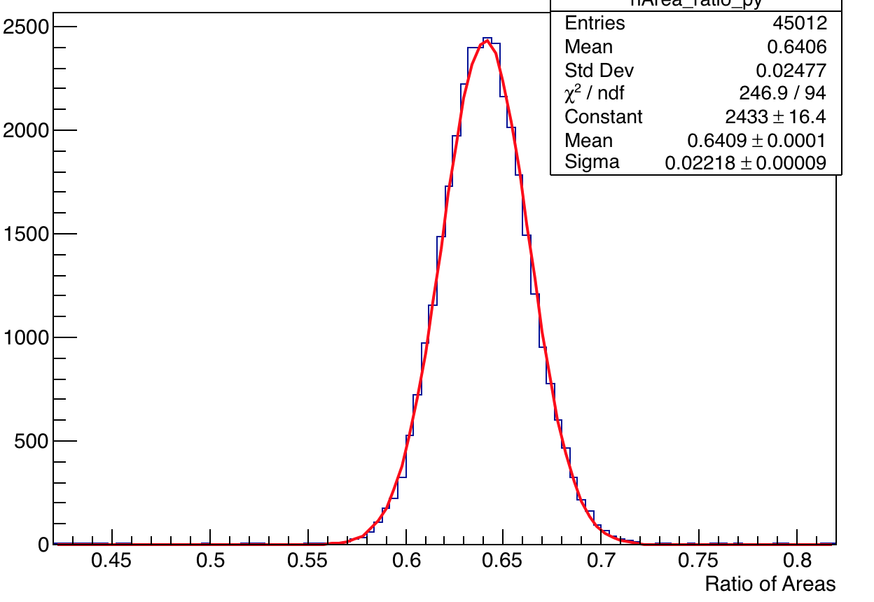
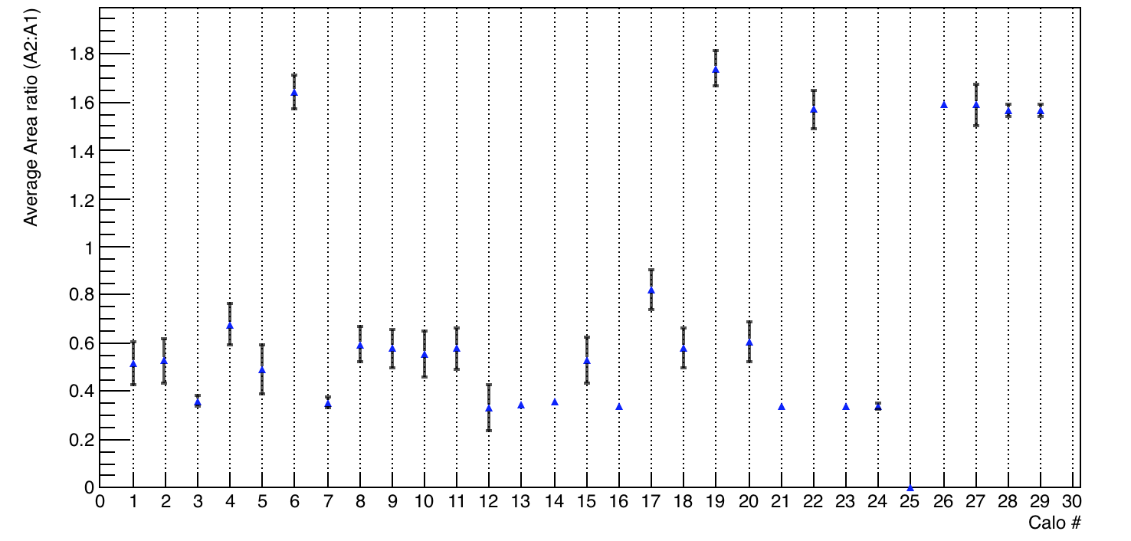
Run 13966 – Study energy ratio A1:A2 – all channels
Plotted – Mean with
error as from the Guassian
fit of the distribution
Increase error by sqrt(chi2/ndf)
Channel 4

Slide 5
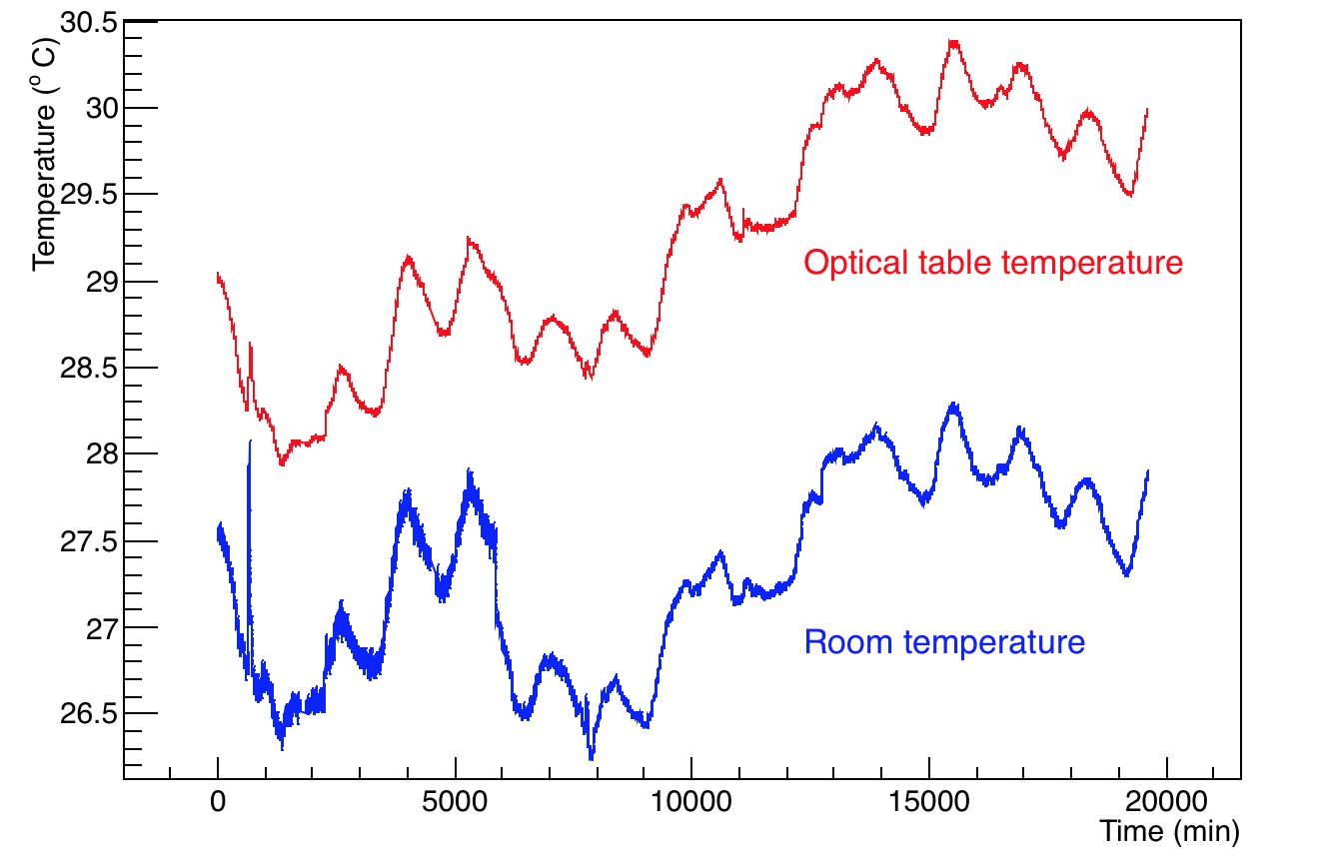
Temperature Variation
Data from when production started – approx. 22nd Mar to 1st April

Slide 6
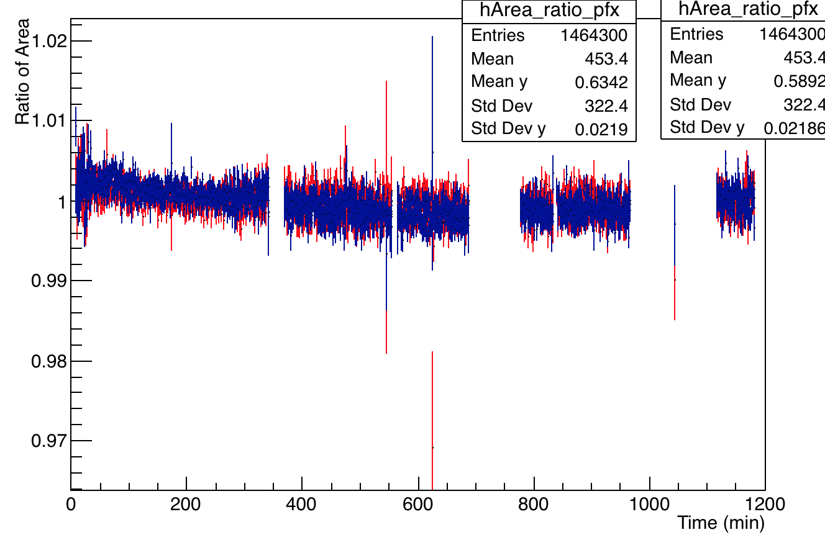
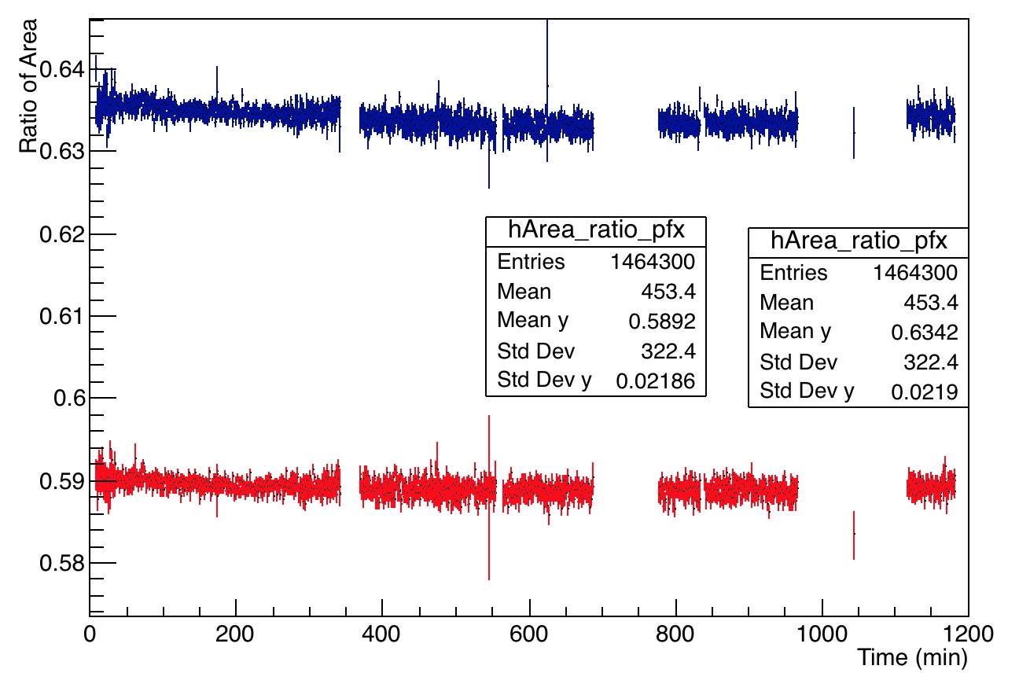
Run set of 11th April 15345 – 15378
Not a very stable dataset – all channels show the trend as below:
Normalized to average value
Channel 10
Channel 2

Slide 7
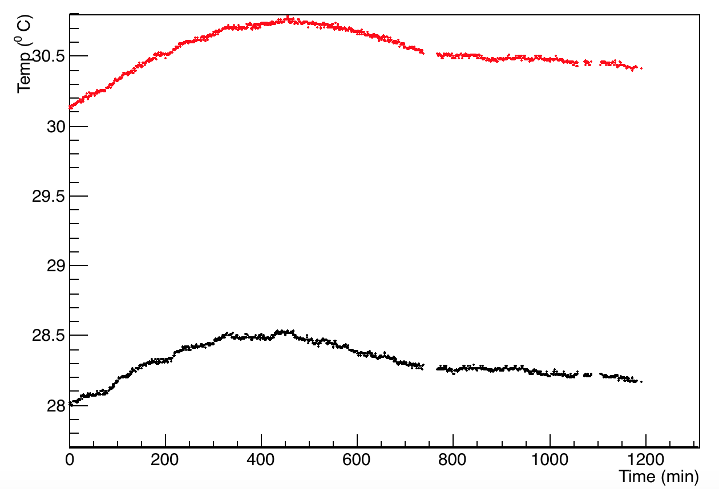
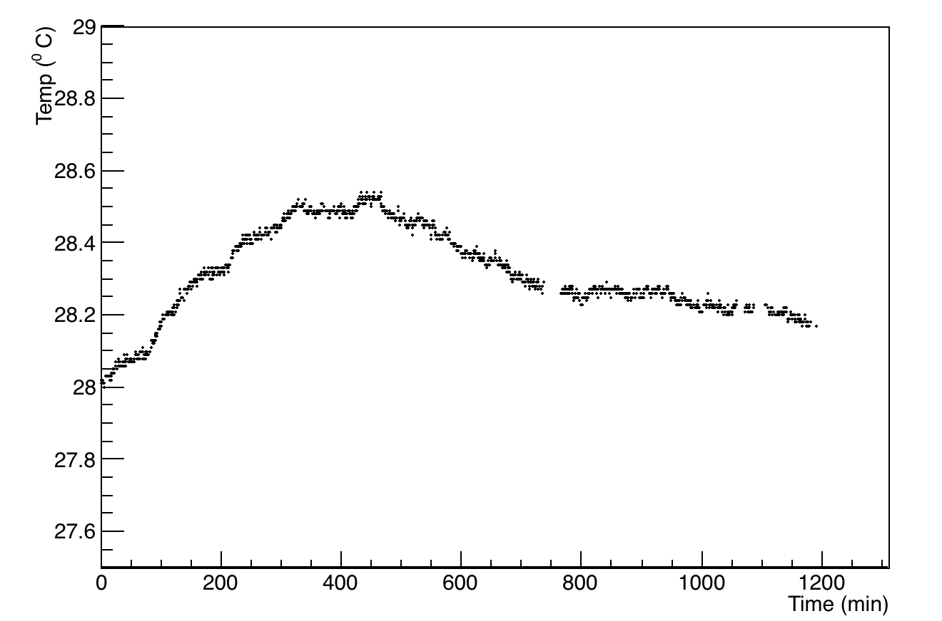
Run set of 11th April – temperature studies
Optical Table temperature
Room temperature
Room temperature

Slide 8
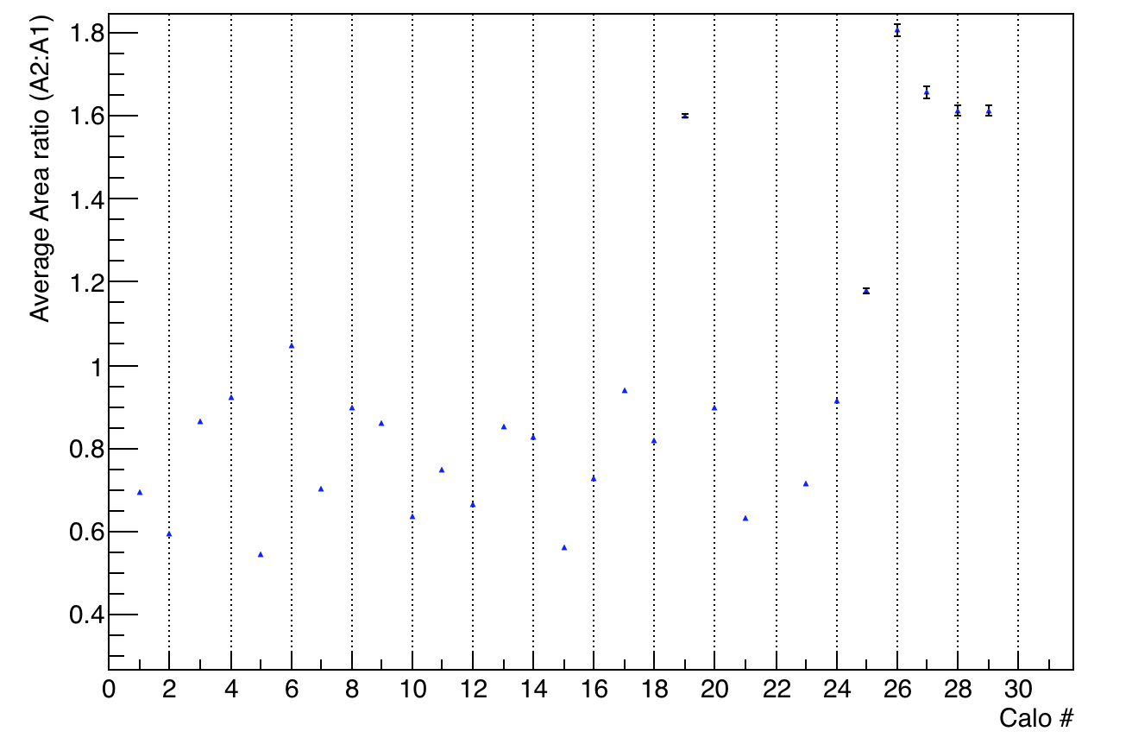
Run set of 1st April 14462 – 14492

Slide 9
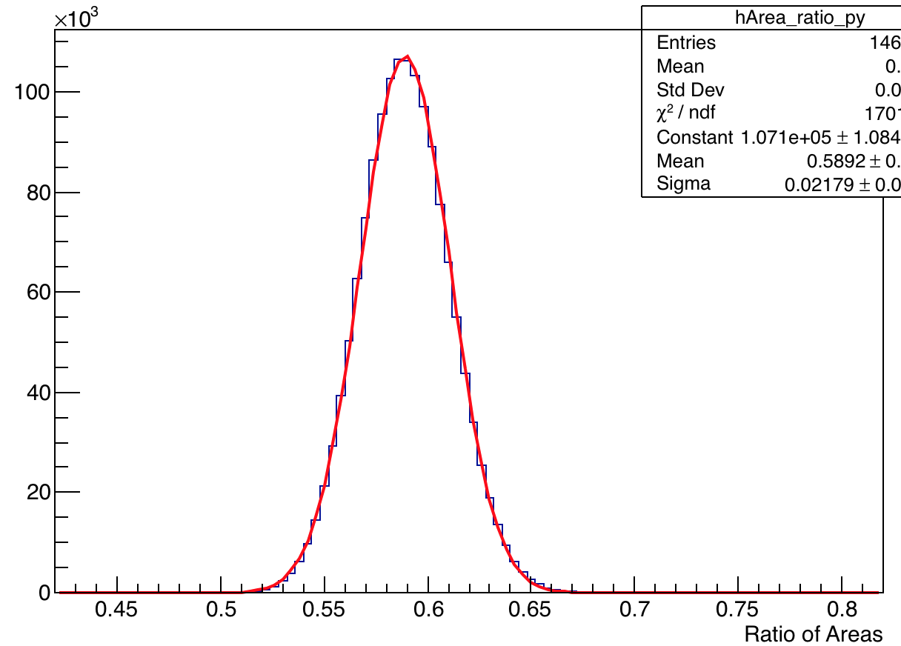
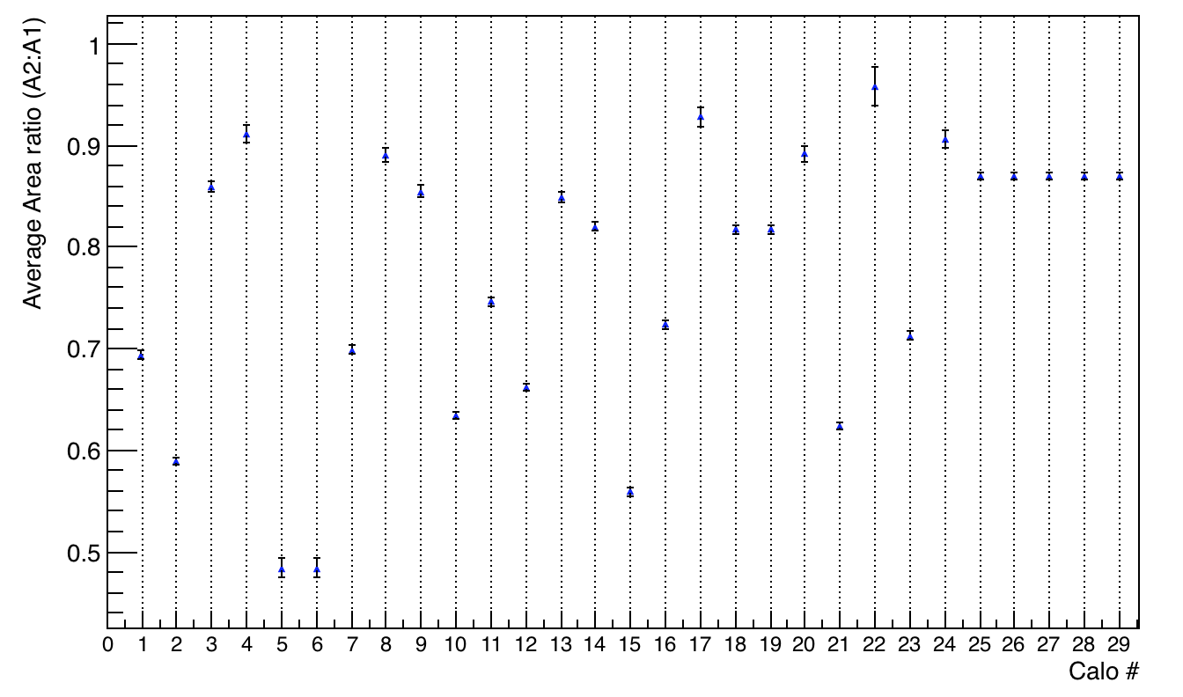
Run set of 11th April 15345 – 15378
Plotted – Mean with
error as from the Guassian
fit of the distribution
Channel 2

