Slide 1
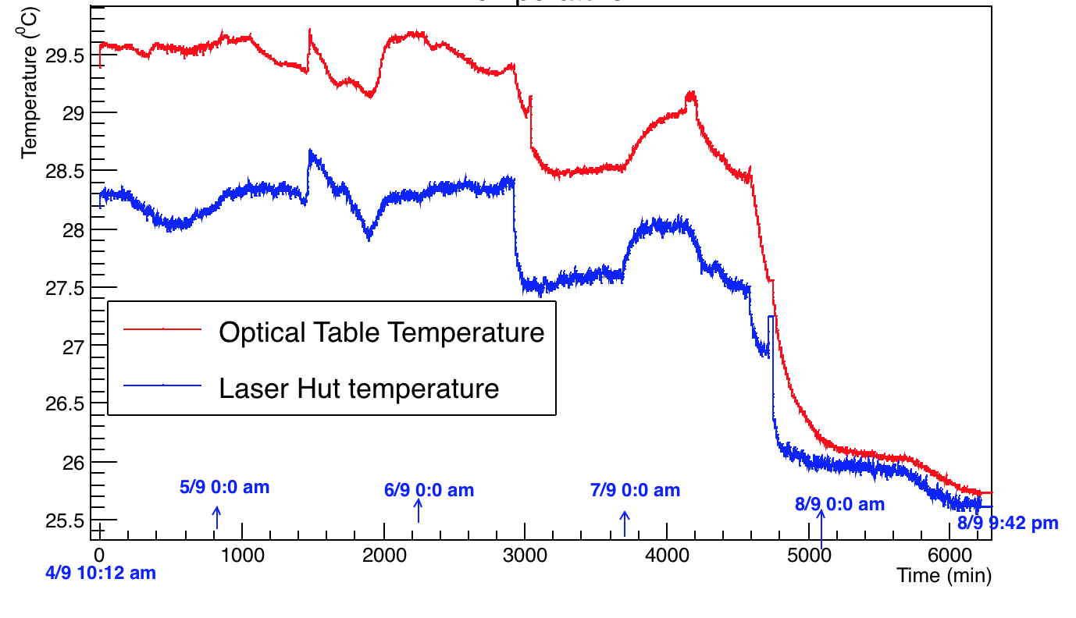
Temperature Data

Slide 2
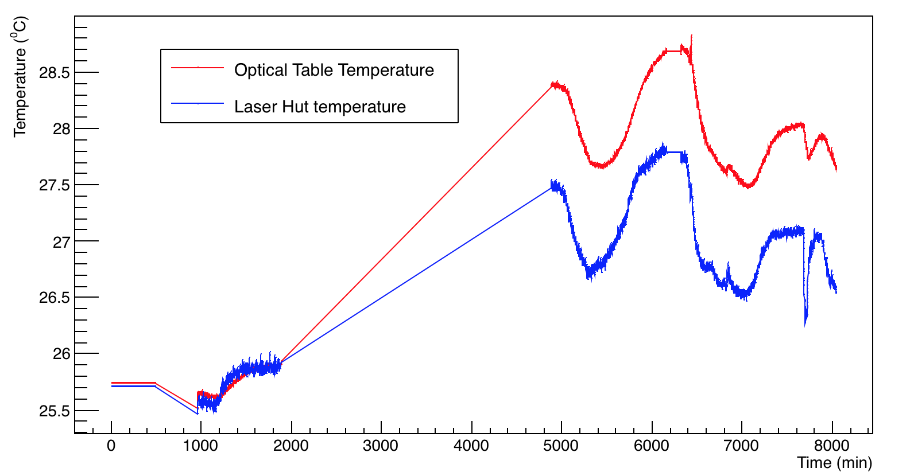
Temperature Data
No Data
8/9 23:09
9/9 15:02
10/9 06:29
12/9 08:25
14/9 13:04

