Slide 1
Analysis of Runs 18413
A study of all channels of run 18413.
Discarded data beyond 11 am (the intervention)
Displayed A1 and A2 on the same plot for channels 0 to 5 and also channels 23 and 24
Plotted graphs of drops in A1 / sec for channels 0 to 22 (expecting a similar behaviour)
Channels 11, 12, 13, 15, 17 and 18 (if we count from 0) have a negative drop (decrease in gain) while other have an increase in gain.
Same is not true for A2 except channel 11 which is the only negative drop channel.
Note – I either used a same scale or at least the same range of scale for all plots.

Slide 2
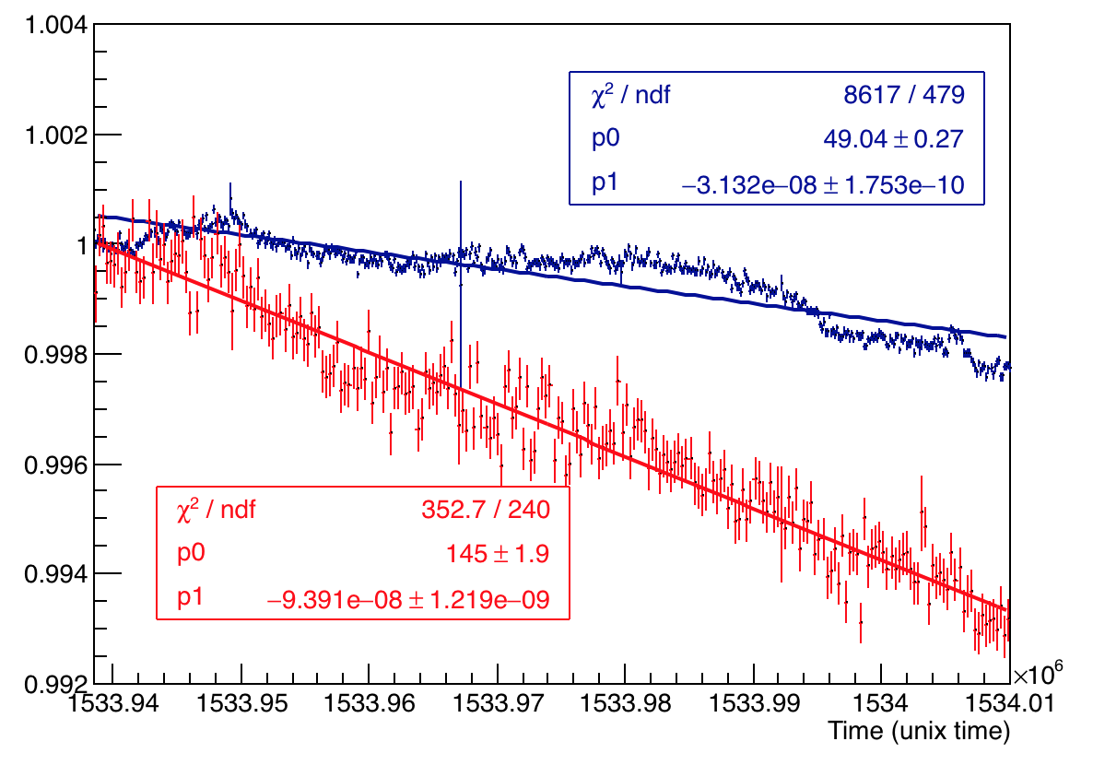
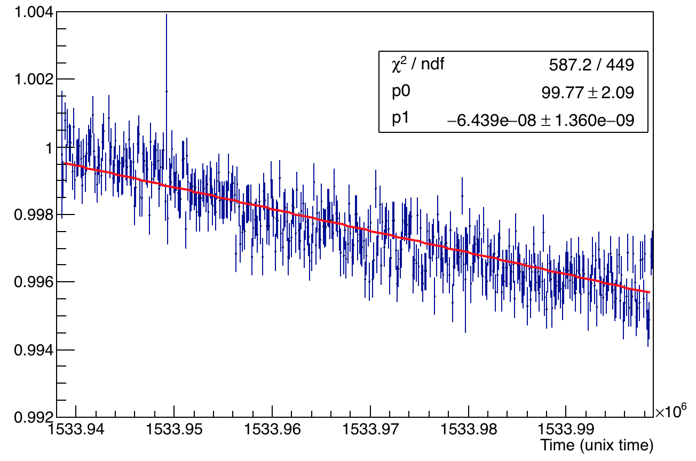
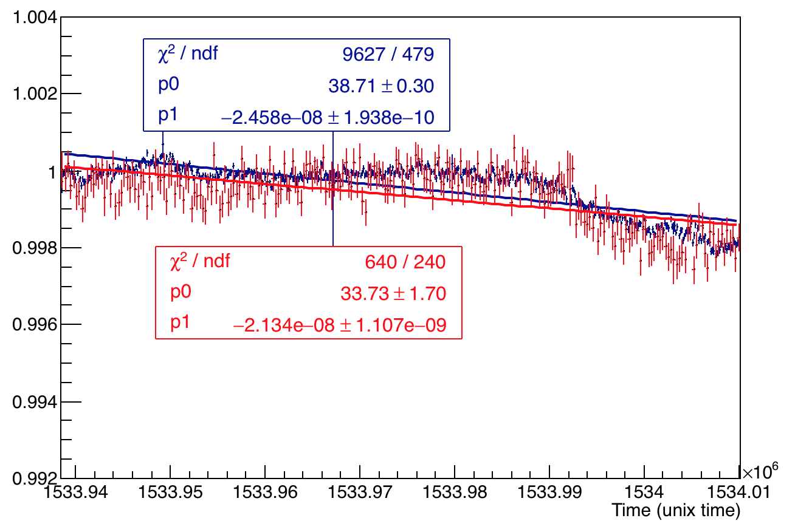
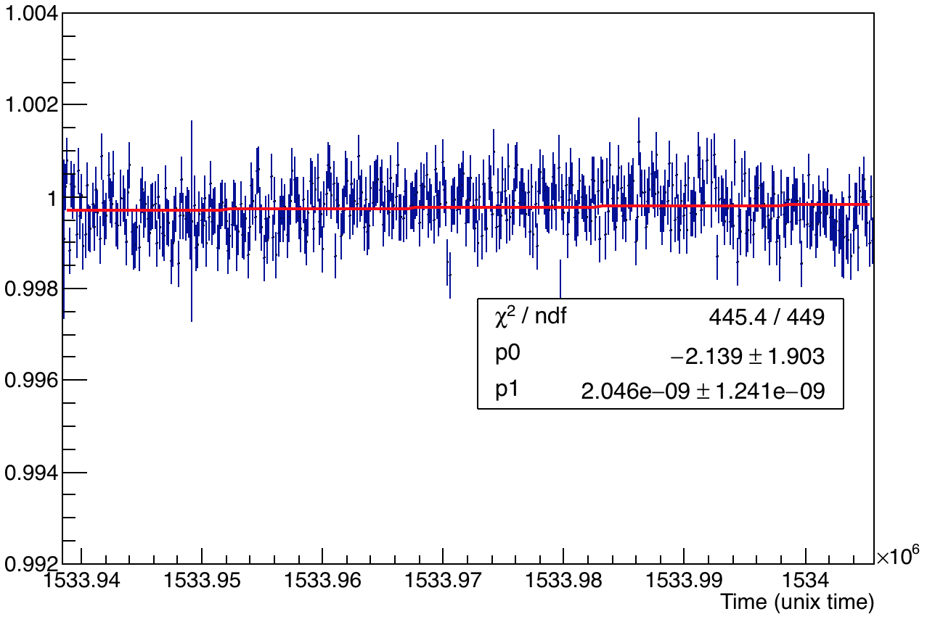
All channels A1 and A2 overlaid and A2:A1
PMMA Channel 23
A2:A1
Silica Channel 24
A2:A1

Slide 3
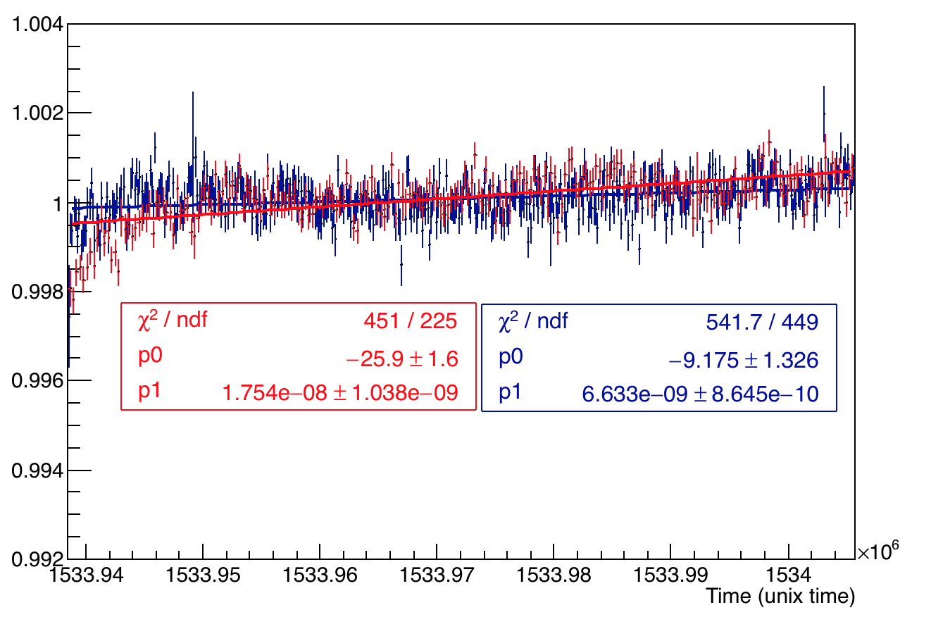
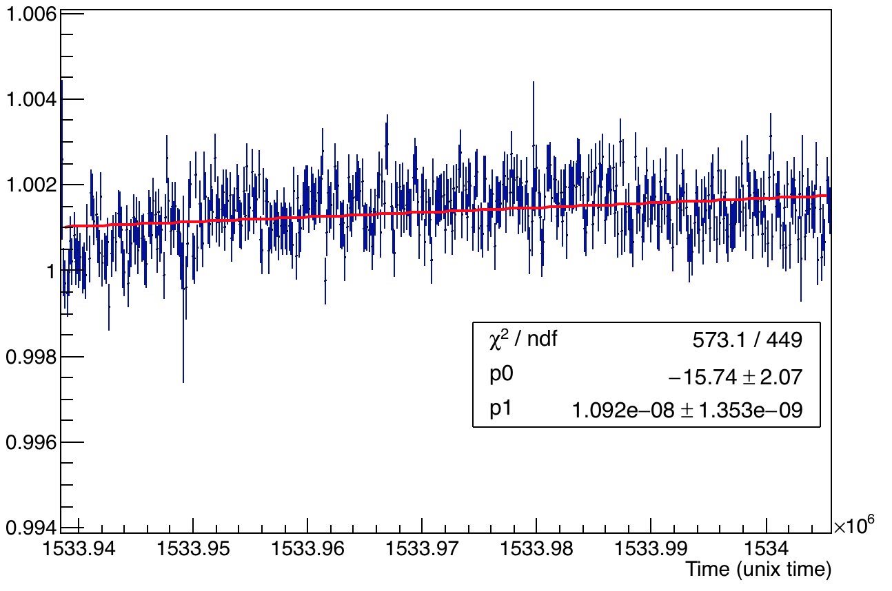
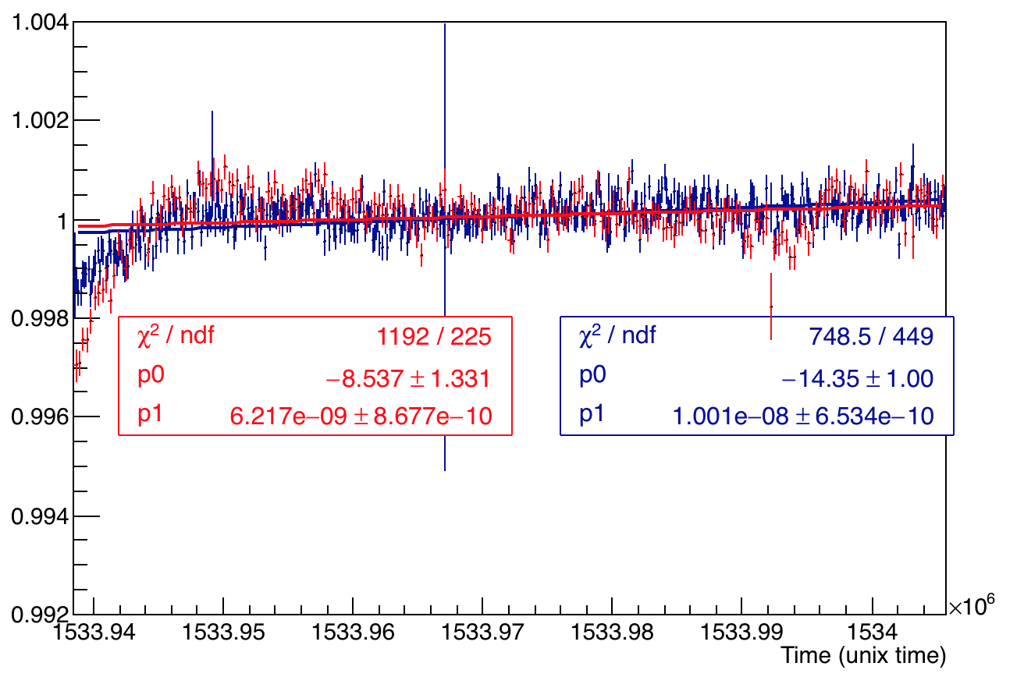
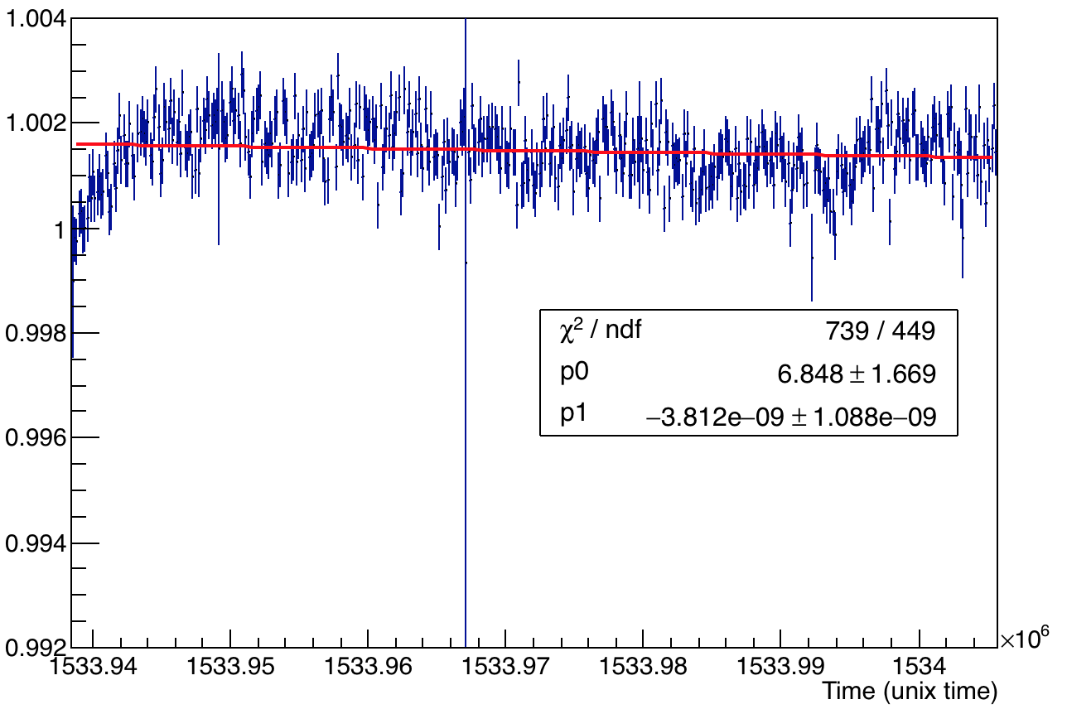
All channels A1 and A2 overlaid and A2:A1
Channel 0
A2:A1
Channel 1
A2:A1

Slide 4
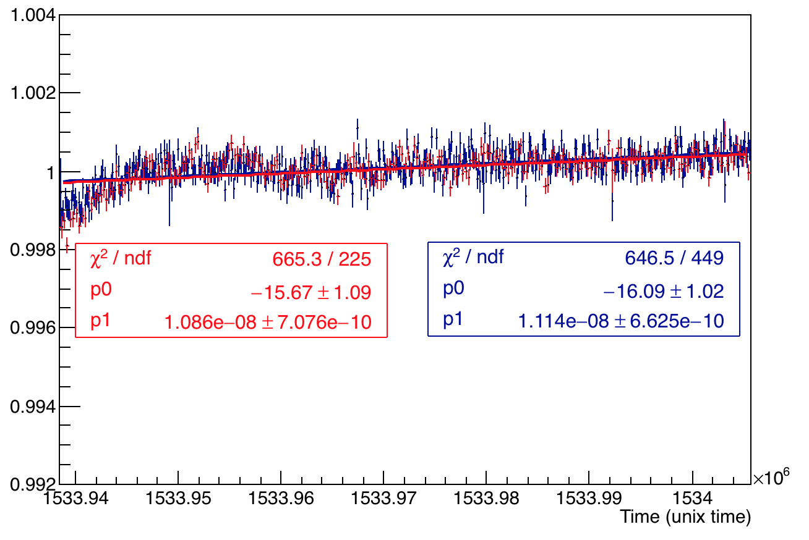
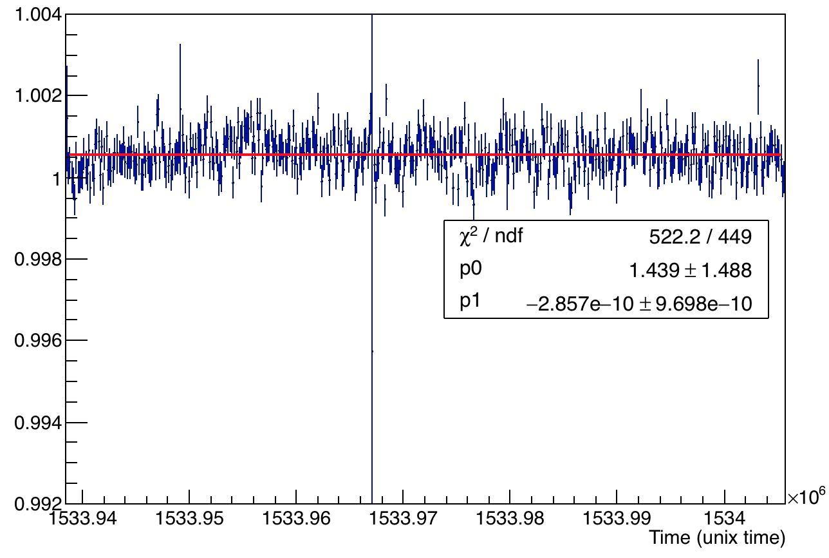
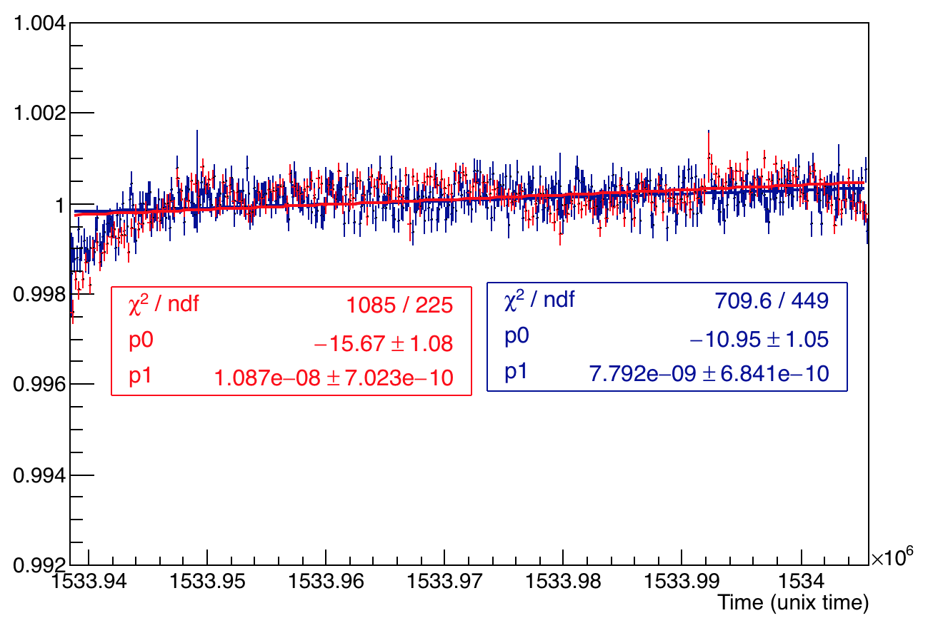
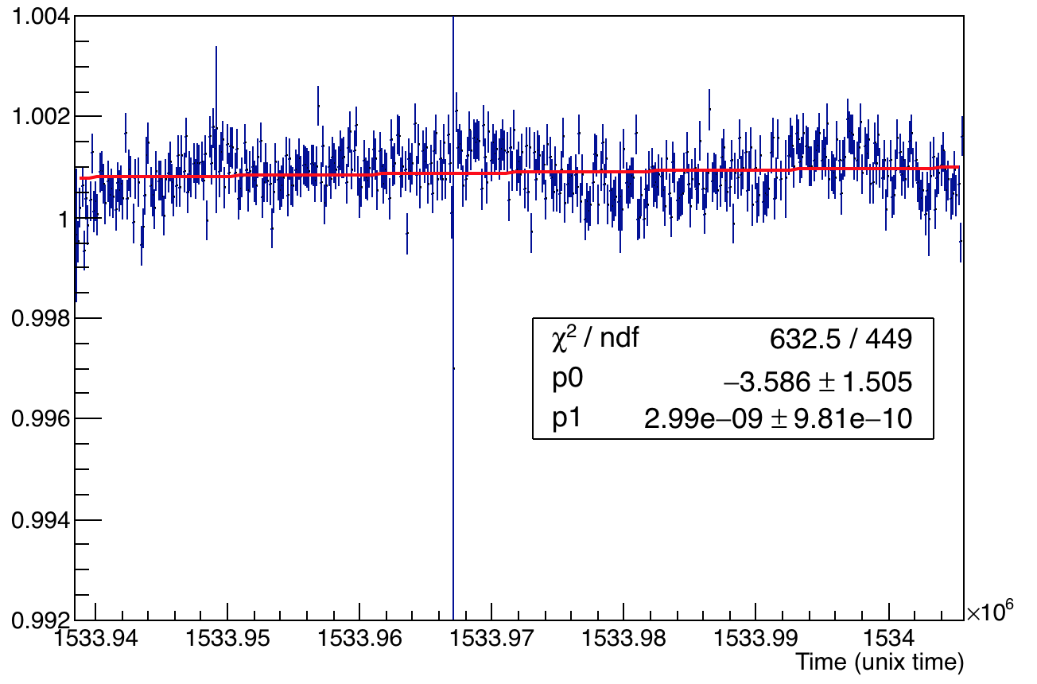
All channels A1 and A2 overlaid and A2:A1
Channel 2
A2:A1
Channel 3
A2:A1

Slide 5
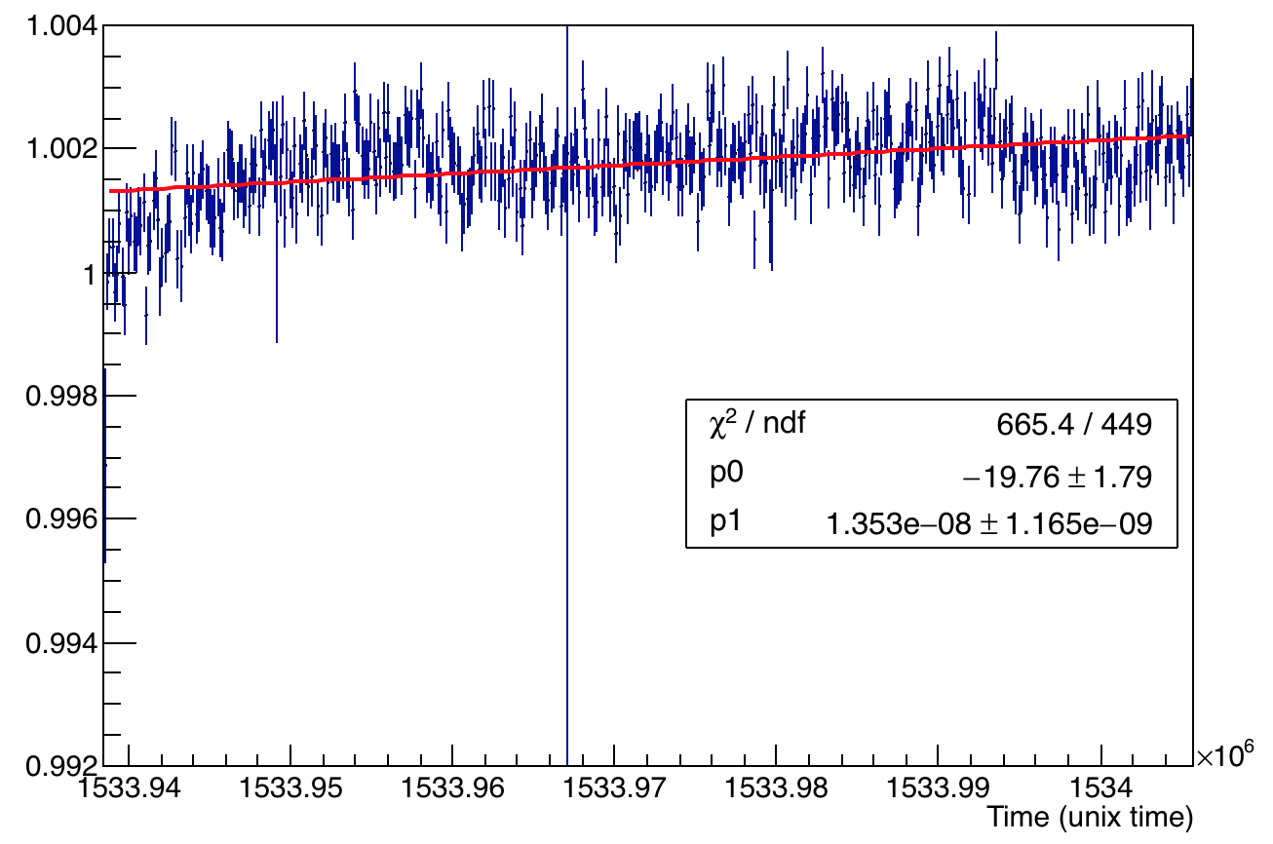
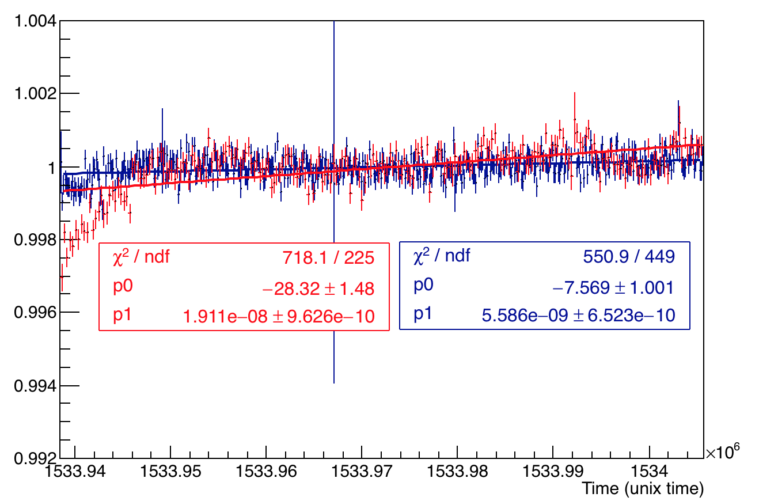
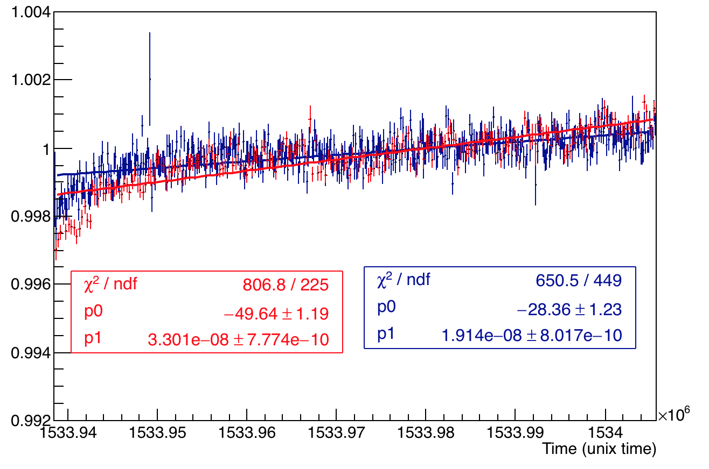
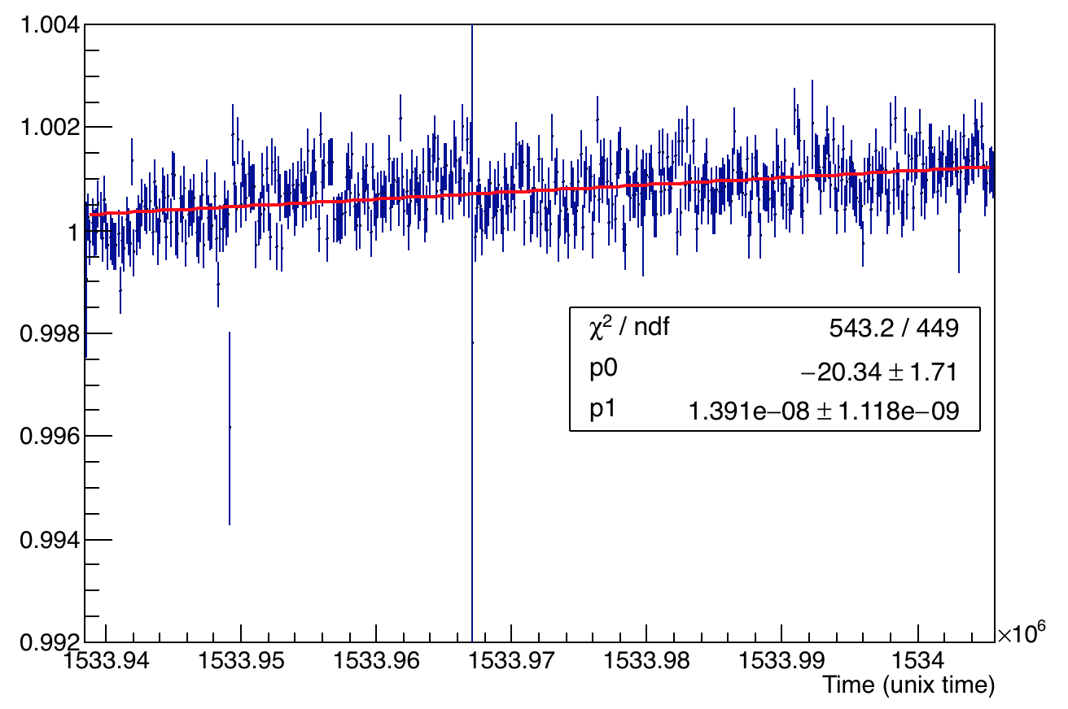
All channels A1 and A2 overlaid and A2:A1
Channel 4
A2:A1
Channel 5
A2:A1

Slide 6
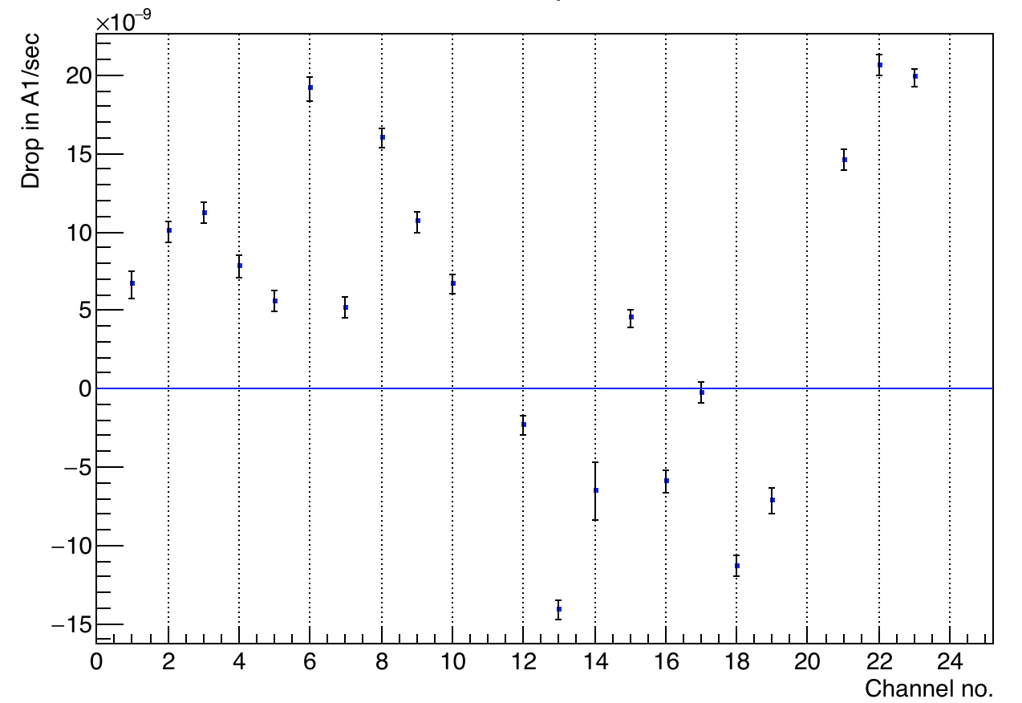
Plot of drop in A1 for all channels

Slide 7
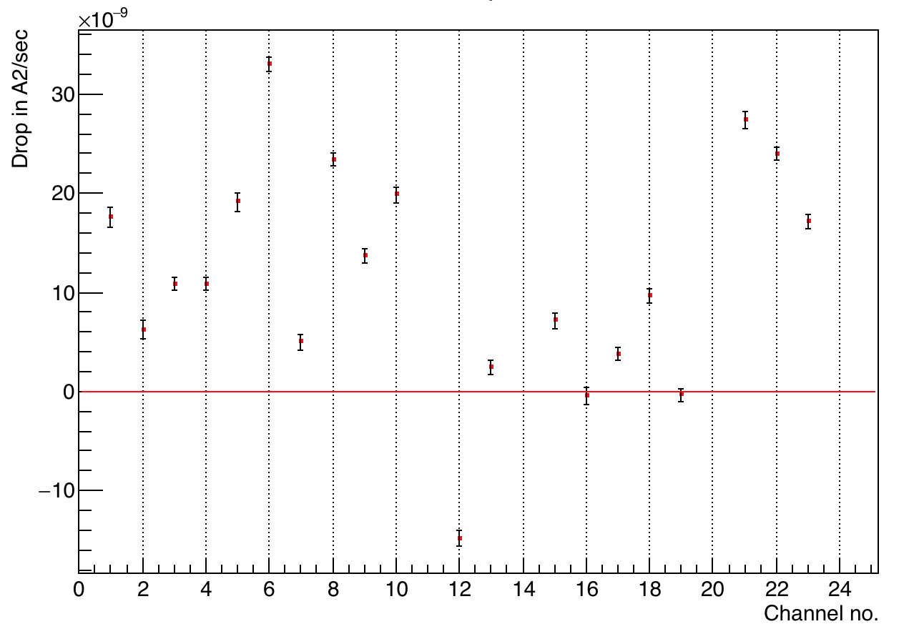
Plot of drop in A2 for all channels

Slide 8
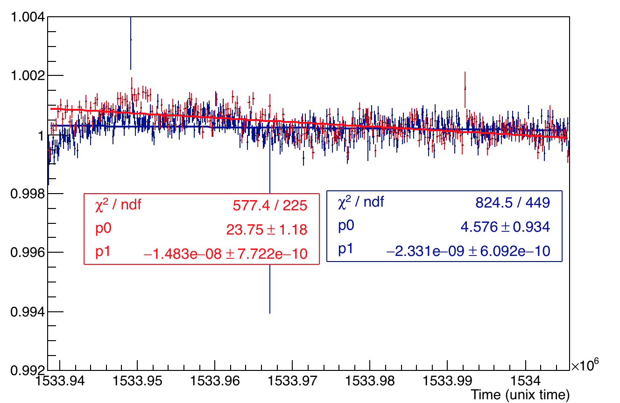
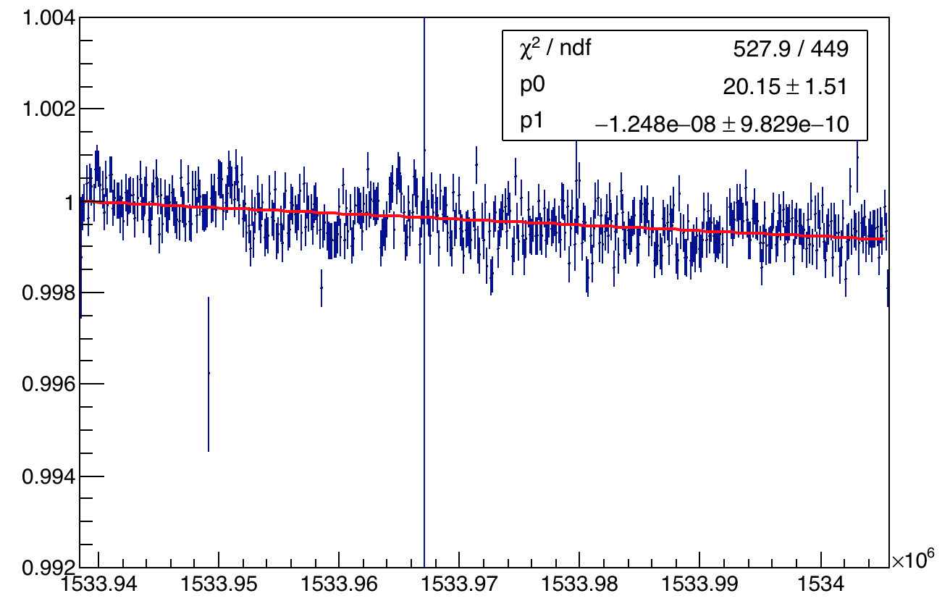
Checking A1 and A2 with negative drop
The plots here are the case of channel 11 (please read as 12 in the previous plots). It does not signify much, because these drops are very low. Since the temperature first falls and then rises we expect a drop in A1, A2 etc. (-ve correlation), but in most cases except this one we see a rise in A1 or A2.
Channel 11
A2:A1

Slide 9
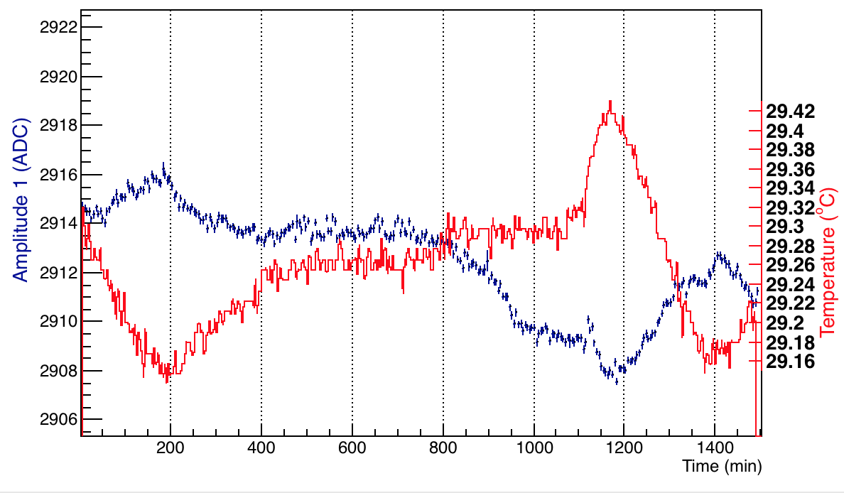
Conclusions – revisit temperature
The almost stable A2:A1 for all channels with silica connector shows almost no effect of temperature on the light chain transmission/distribution due to silica (or probably no loss in light transmission).
But I was expecting A1 of these channels to vary inversely with temp. like channel 23 on the right as that represents the PMT gain.
Only A1 of channel 23 and 24 show a negative correlation with temperature as expected (shown above and in slide2).

