Slide 1
DQM and Database
Nandita Raha, Antonio Gioiosa

Slide 2
Summary
Current Status of the DQM
Brief Architecture of the DQM
Source monitor plots – run summary (actual values)
Normalized plots of PMT, PiDs
Conditional Database
Uses of this database
Future plans

Slide 3
Brief Architecture – Basics of DQM
Backend + Server Side
Client Side
Uses HTML/client side javascripts
Retrieves data structures
Receives sockets to communicate with the server
Node.js
Art Side – Publisher, ZeroMQ
Stores the average history of required histograms using Plot types from art modules
ZeroMQ Registers data structures or histograms
Node - Creates i/o sockets, GETs files

Slide 4
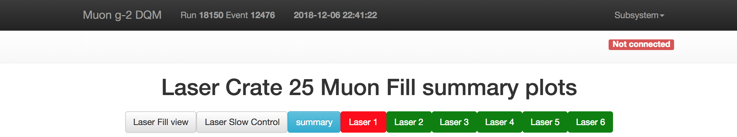
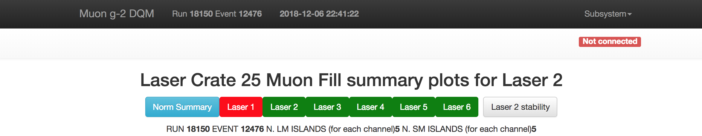
Overall picture – my contribution
Run summary - Source monitor plots (actual values)
Normalized plots of PMT, PiDs, and PiD2:PiD1

Slide 5
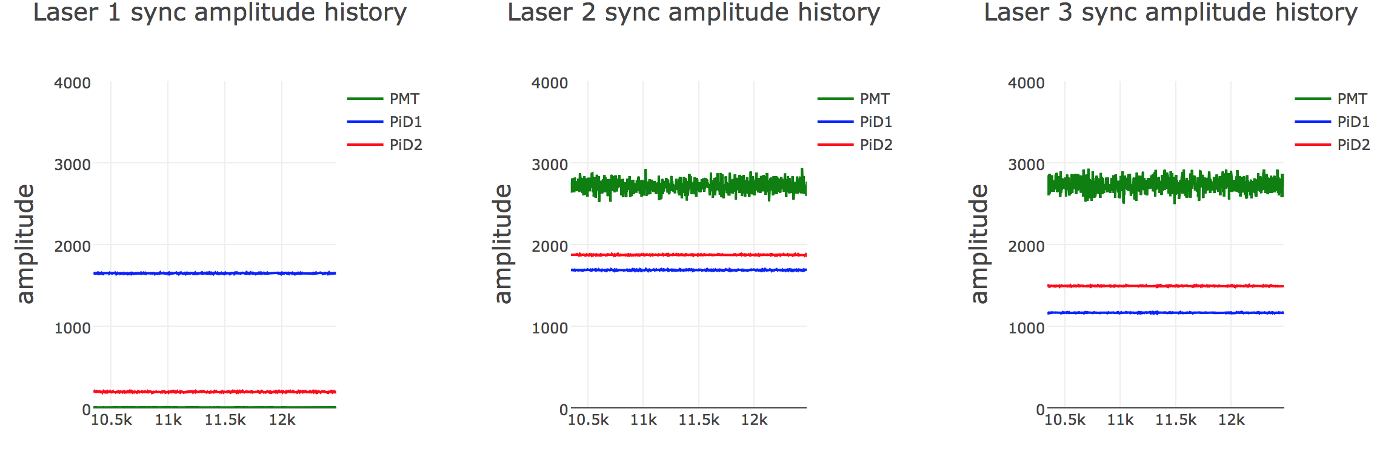
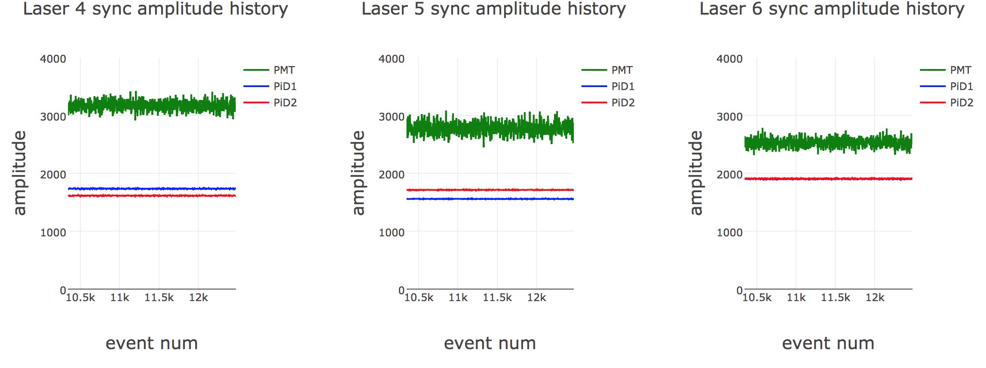
Run summary plots of SM signals – PiD1, PiD2, PMT

Slide 6
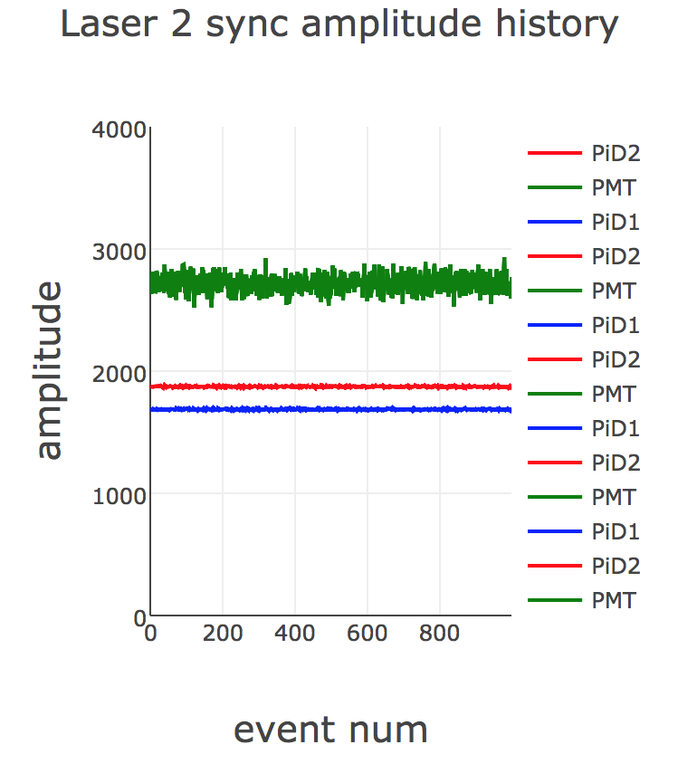
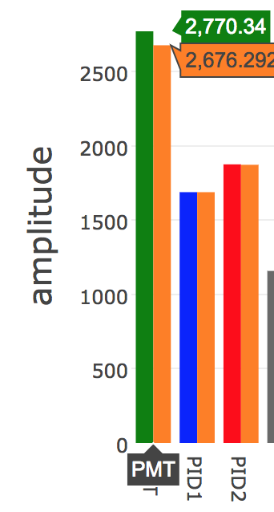
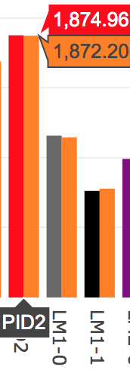
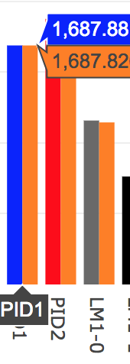
Verification SM signals – Laser 2

Slide 7
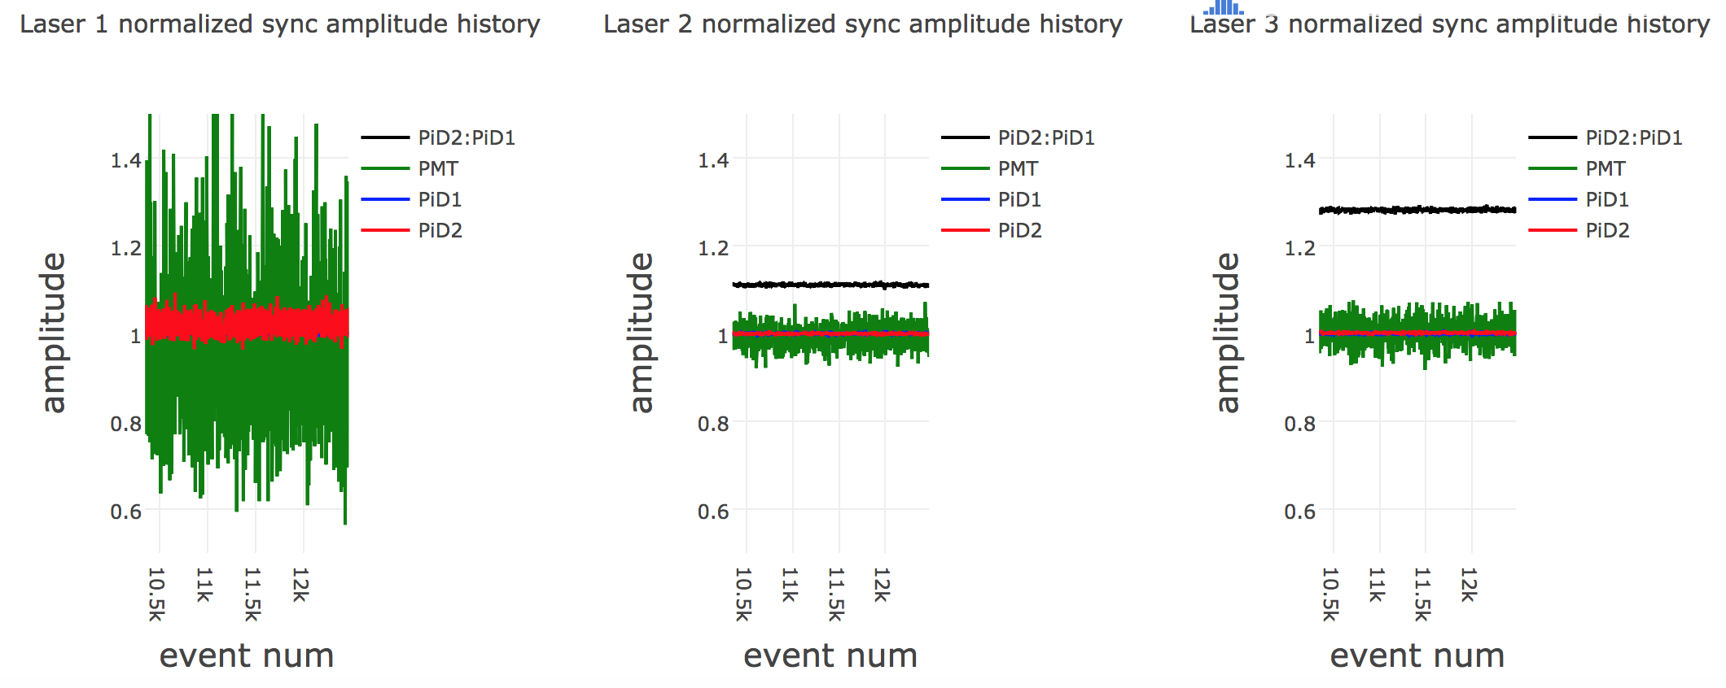
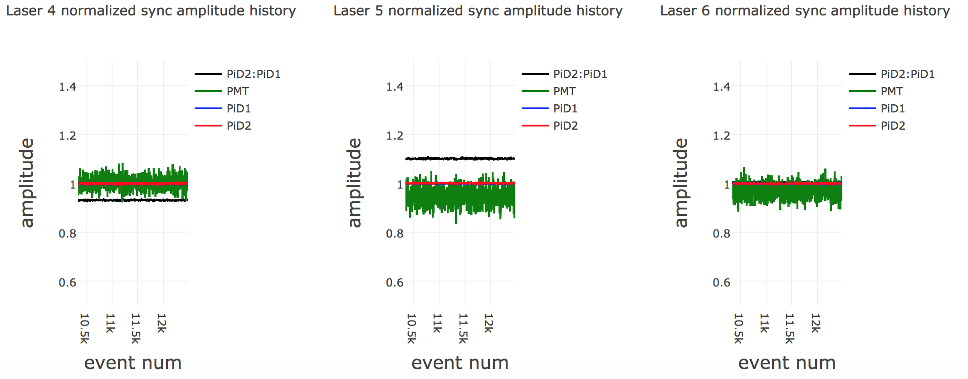
Overlaid SM signals –PiD2:PiD1, Normalized PiD1, PiD2, PMT

Slide 8
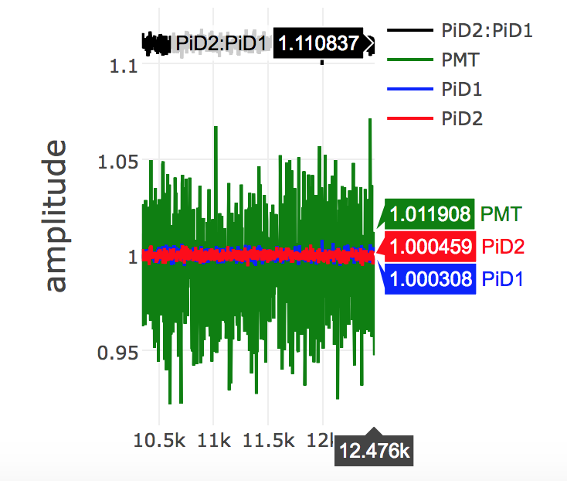
Verification for Laser 2
PiD2:PiD1 = 1874.96/1687.88
1.11084

Slide 9
ConDB – Conditional DataBase
Conditional Database
Definition and uses of this database
Current work and future plans

Slide 10
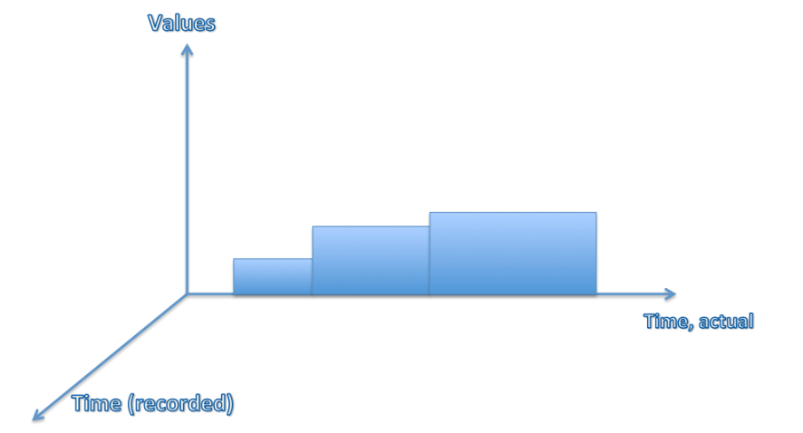
ConDB – Conditional DataBase
Conditions data record the state of the system at the time events were collected.
Conditions data vary with time. Each value, or set of values, describes the state of the system during a limited interval of time and referred to as the Interval Of Validity (IOV.)
Useful when many clients run simultaneously on interactive and GRID resources – so read this data is stored in central databases or files.
Well applicable for data changing with time – like as calibration, alignment, attenuation, pedestal, etc. for detector channels.

Slide 11
Laser Calibration from FHICL files to ConDB
Laser OOF calibration data in a zillion FHICL files. Use cat:
> cat /cvmfs/gm2.opensciencegrid.org/specials/OOFDB/60h/ run15974/subrun99.fcl
> xtalCorr: [ 0.93647, 0.947338, 0.935881, 0.938746, ...1]
Array size 1297 (24 calo x 54 crystals + 1 bool)
Transfer these to the conDB using some scripts (by Igor)
Current Status:
Look at data at
http://dbweb5.fnal.gov:9090/gm2_con_prod/app/data
f=oofgain_condb_test&t=15921000000
t has run and subrun number. 15921000000 => run 15921 subrun 0.

Slide 12
Structure of the data table
The structure of calibration table is currently like:
15921000000.000000
15921000001.000000
channel, corrconst, isgood
bigint, double precision, boolean
100, 0.982577, True
101, 0.986715, True
102, 0.982656, True
....
1st column channel: last 2 digits – xtal index (0 to 53); First 1 or 2 digits - calorimeter index.
2nd column corrconstant: the gain constant.
3rd column isgood: a flag marking if this row is valid. Currently the third column is read from the last number in the 1297 number arrays from the out-of-fill constants FHiCL files stored on cvmfs.

Slide 13
ConDB - Tags
Tagging:
Users can put a text tag on a particular condition, like version “v1.0” on the database.
Users can tag before recalibrating, to remember their current state, and they can tag after recalibration – version control
Supersede a calibration set with a better one and keep it all straight in the DB

Slide 14
Uses and Future Steps
DQM - helpful for debugging purposes, checking stabilities, comparing with averages etc.
DQM - Summary histograms for debugging purposes for SM implemented (can add LM?)
ConDB – only a few subruns have been added -ongoing work in progress
Plan to tag calibration sets for various run groups in ConDB

Slide 15
Back up

Slide 16
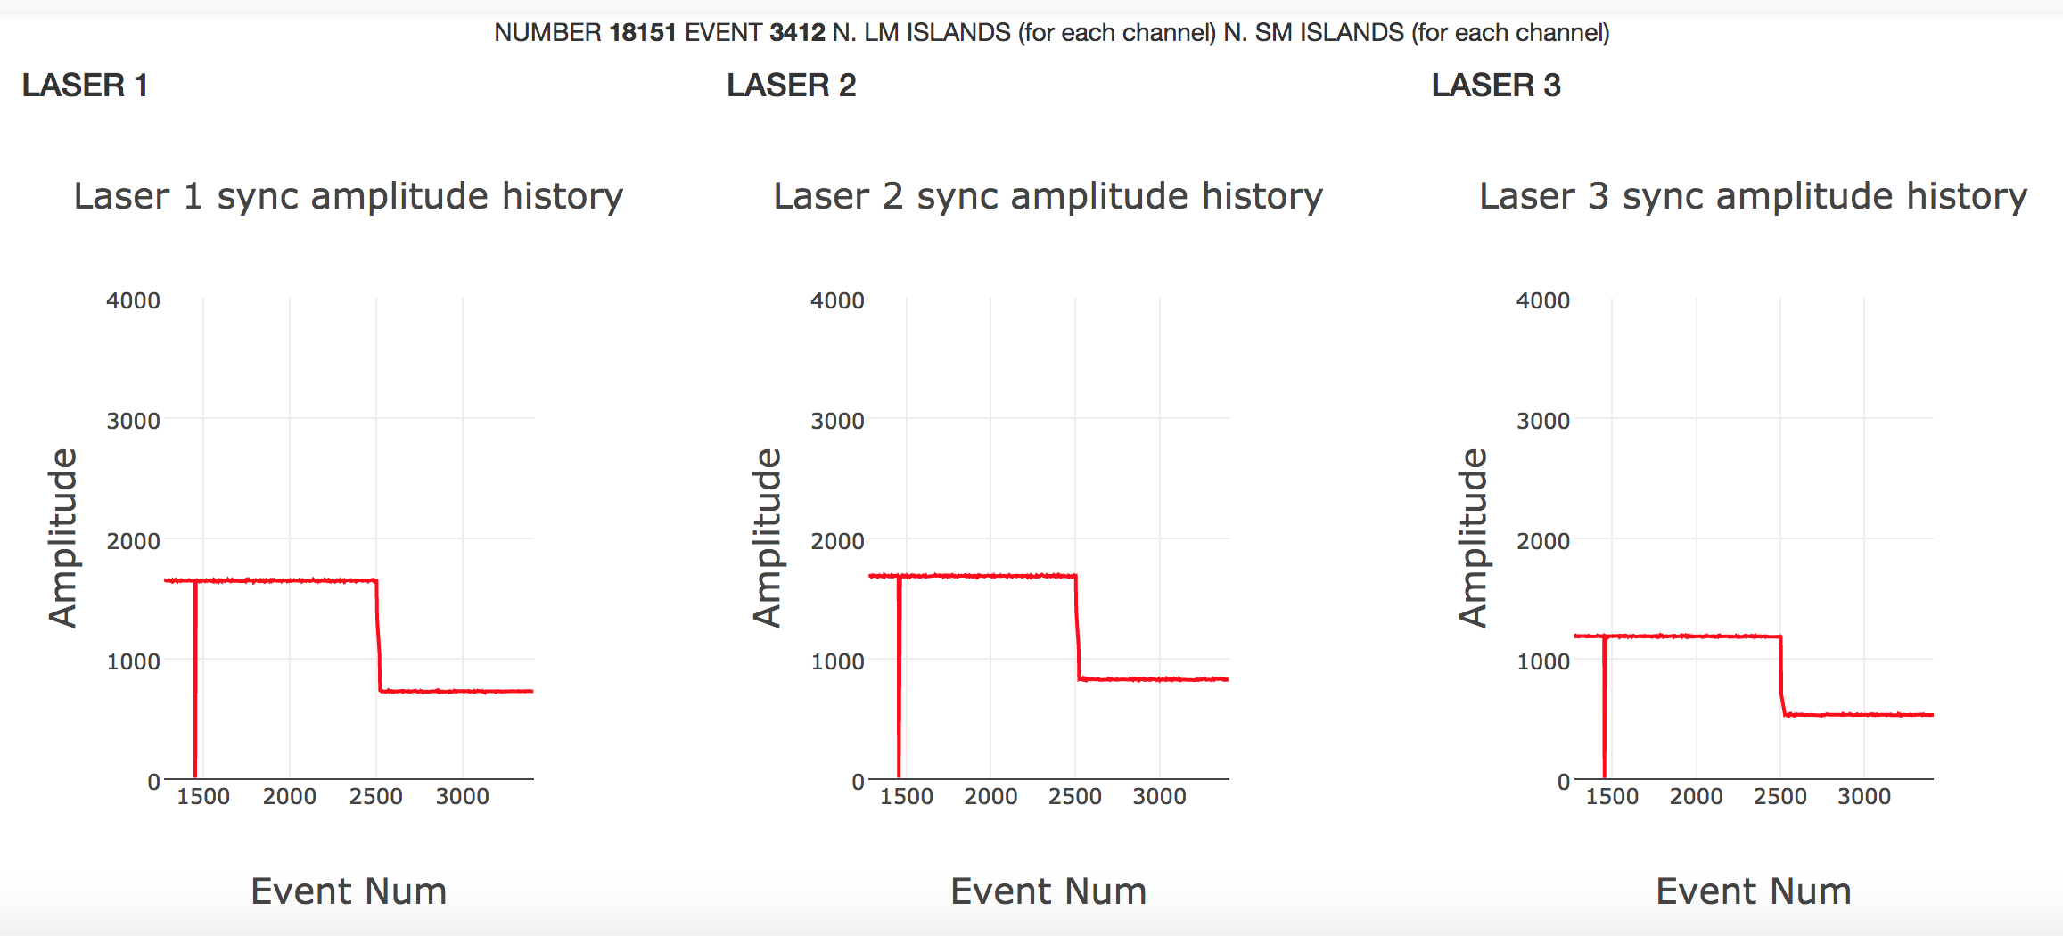
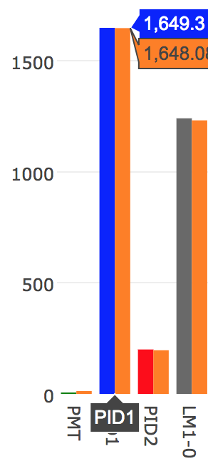
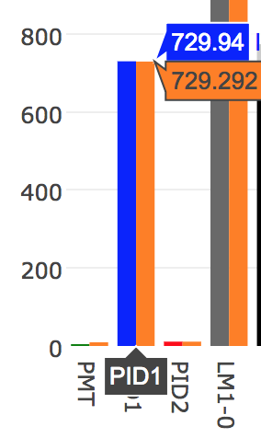
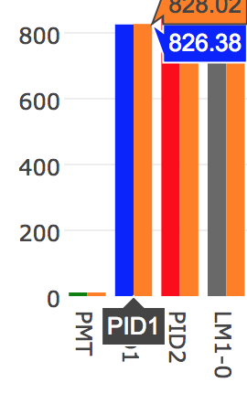
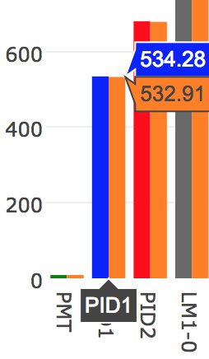
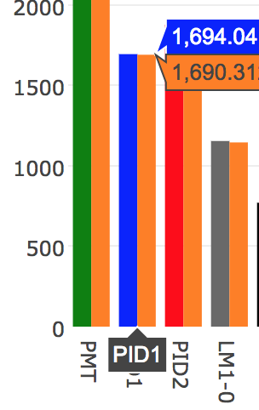
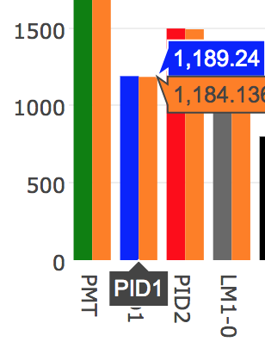
Unstable – SM PiD1 for laser 1, Run 18151??

