Slide 1
Current Status of the DQM
Nandita Raha, Antonio Gioiosa

Slide 2
Brief Architecture - Basics
Backend + Server Side
Client Side
Uses HTML/client side javascripts
Retrives data structures
Opens sockets to communicate with the server
Node.js
Art Side
Stores the average history of required histograms using Plot types from art modules
Registers data structures

Slide 3
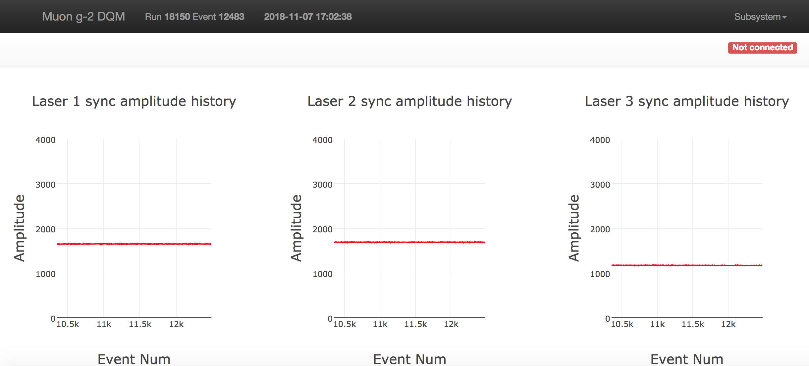
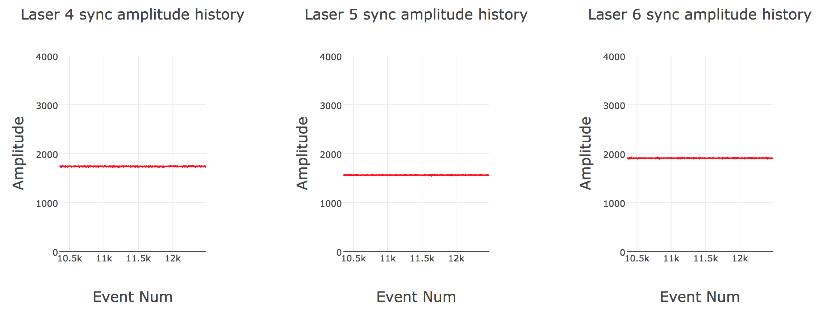
New Plots – Source Monitors PiD1

Slide 4
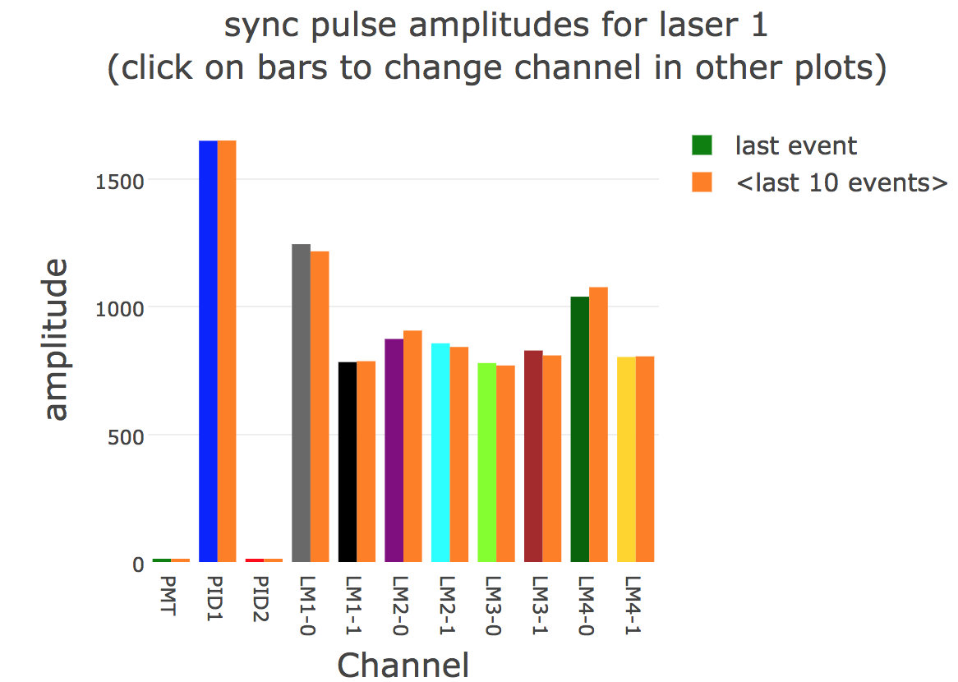
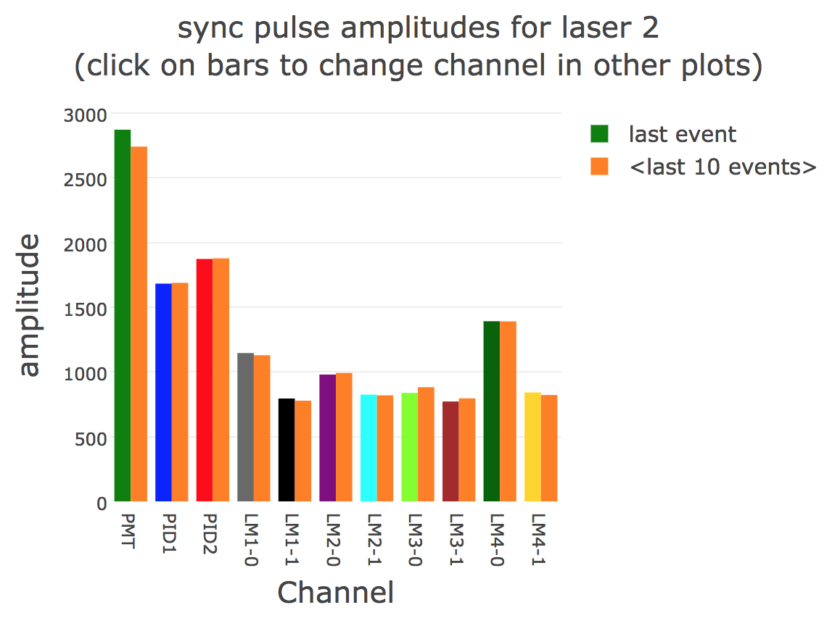
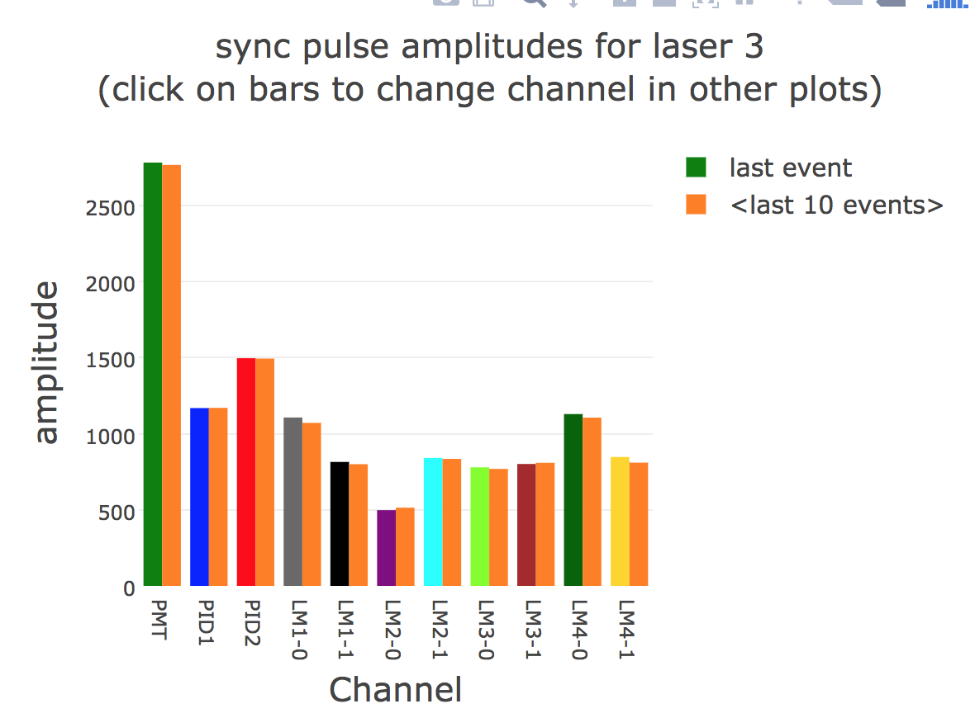
Comparing/Verifying plots – SM PiD1
1649.76
1681.92
1168.78

Slide 5
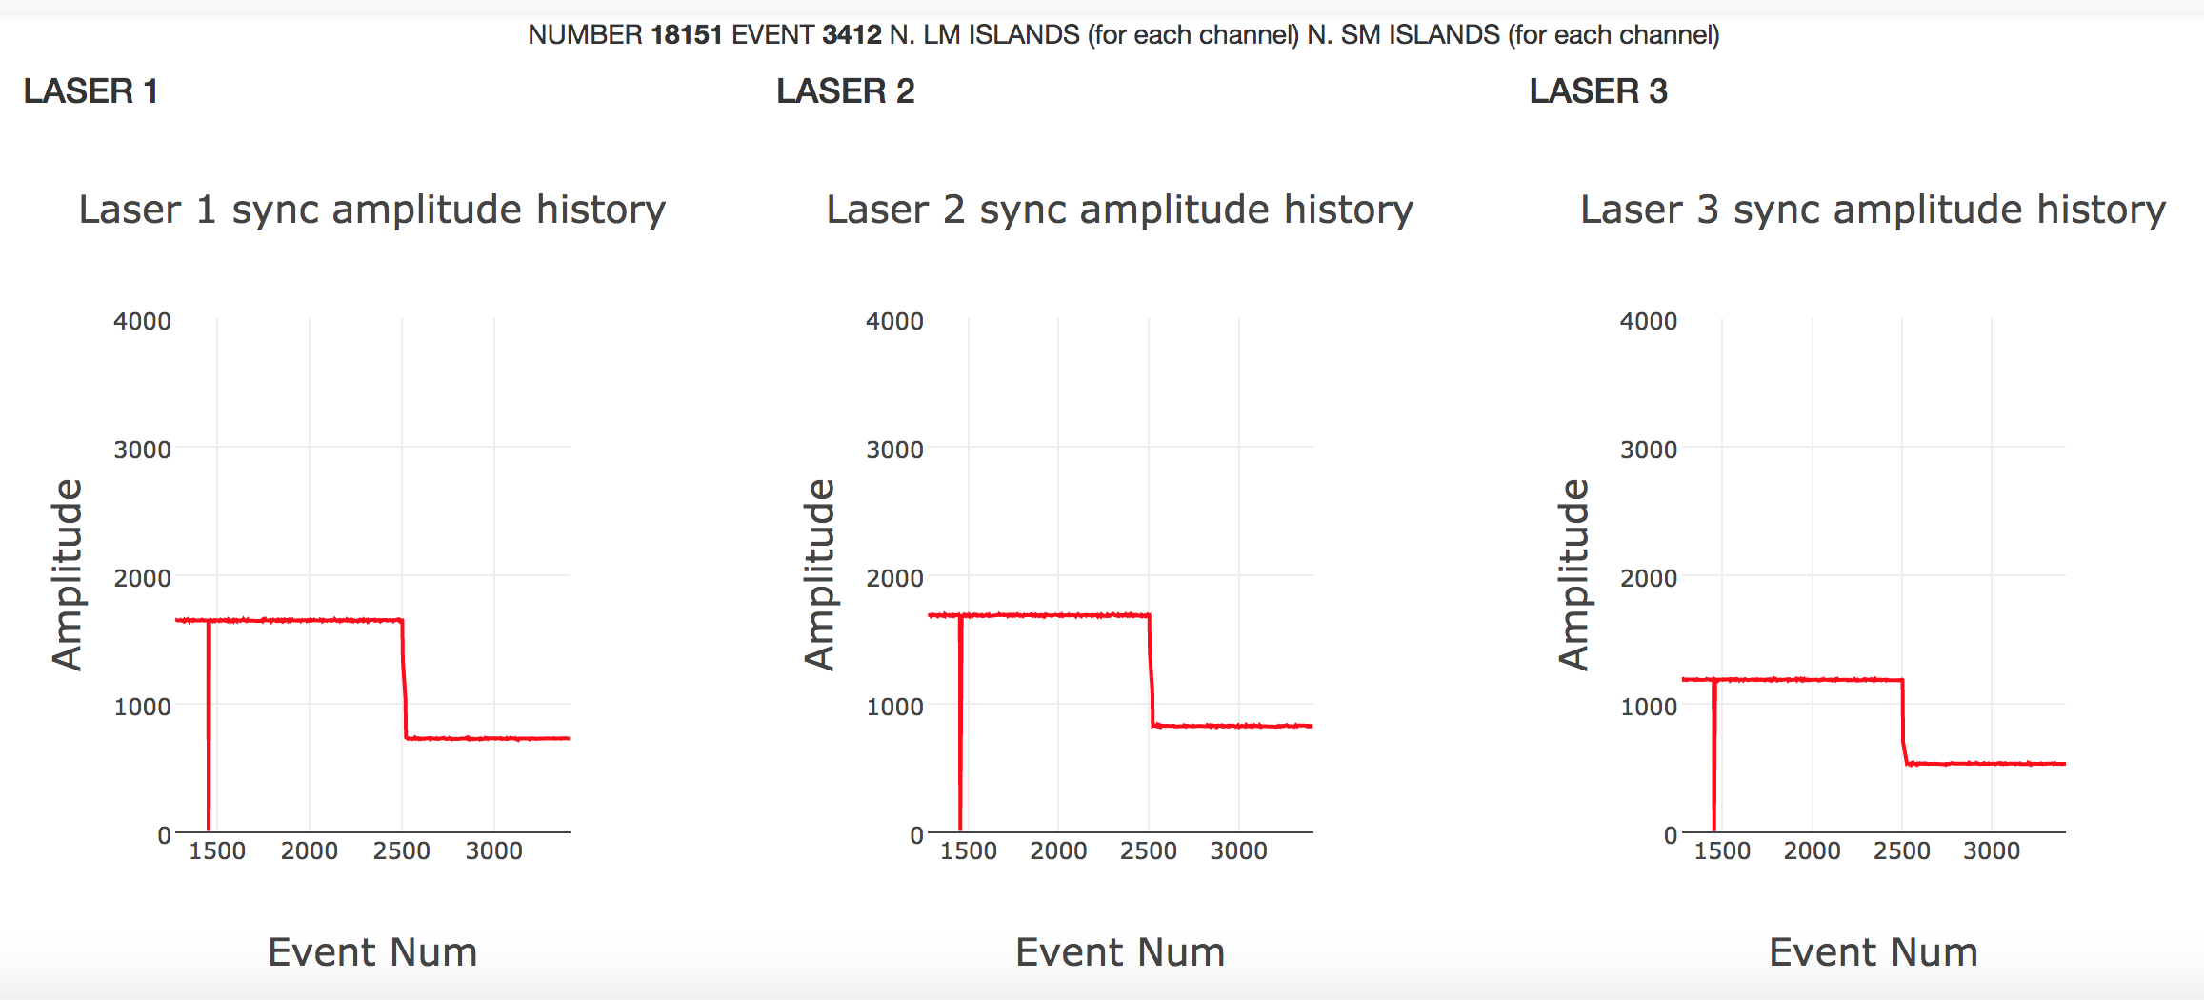
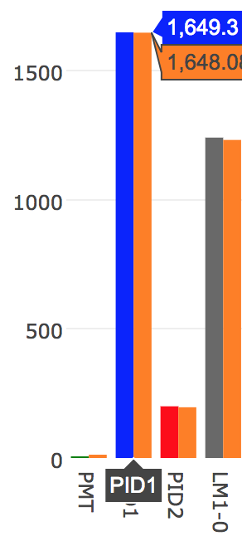
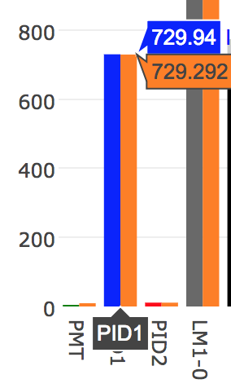
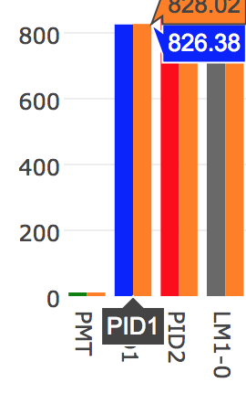
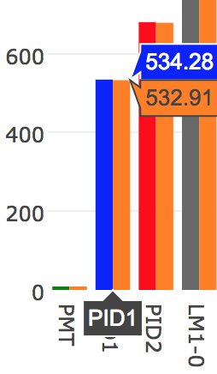
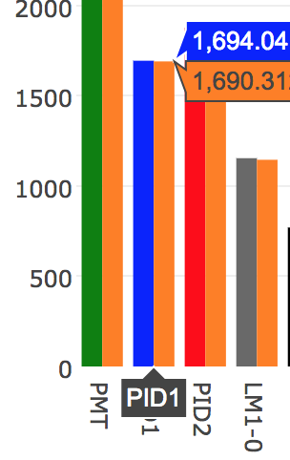
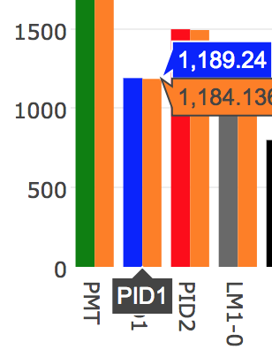
Unstable – SM PiD1 for laser 1, Run 18151??

Slide 6
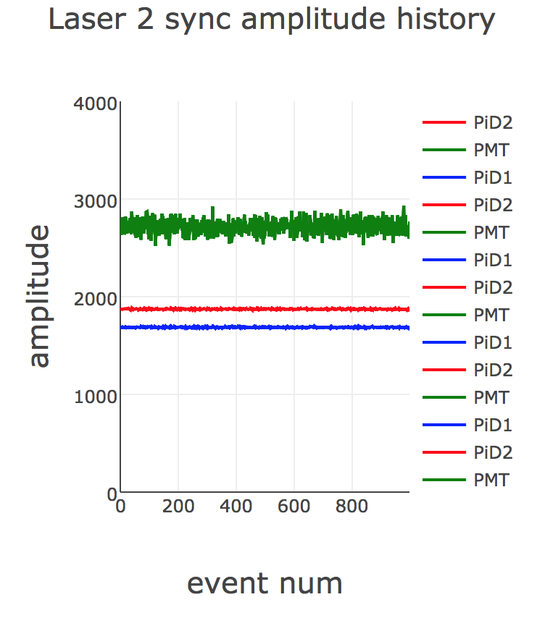
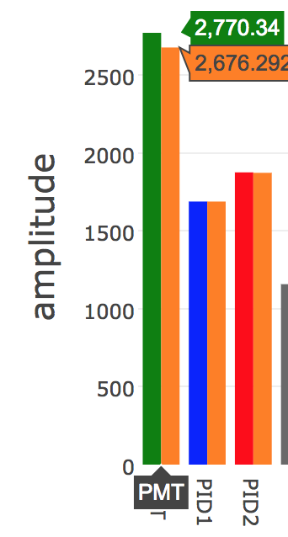
Overlaid SM signals – PiD1, PiD2, PMT

Slide 7
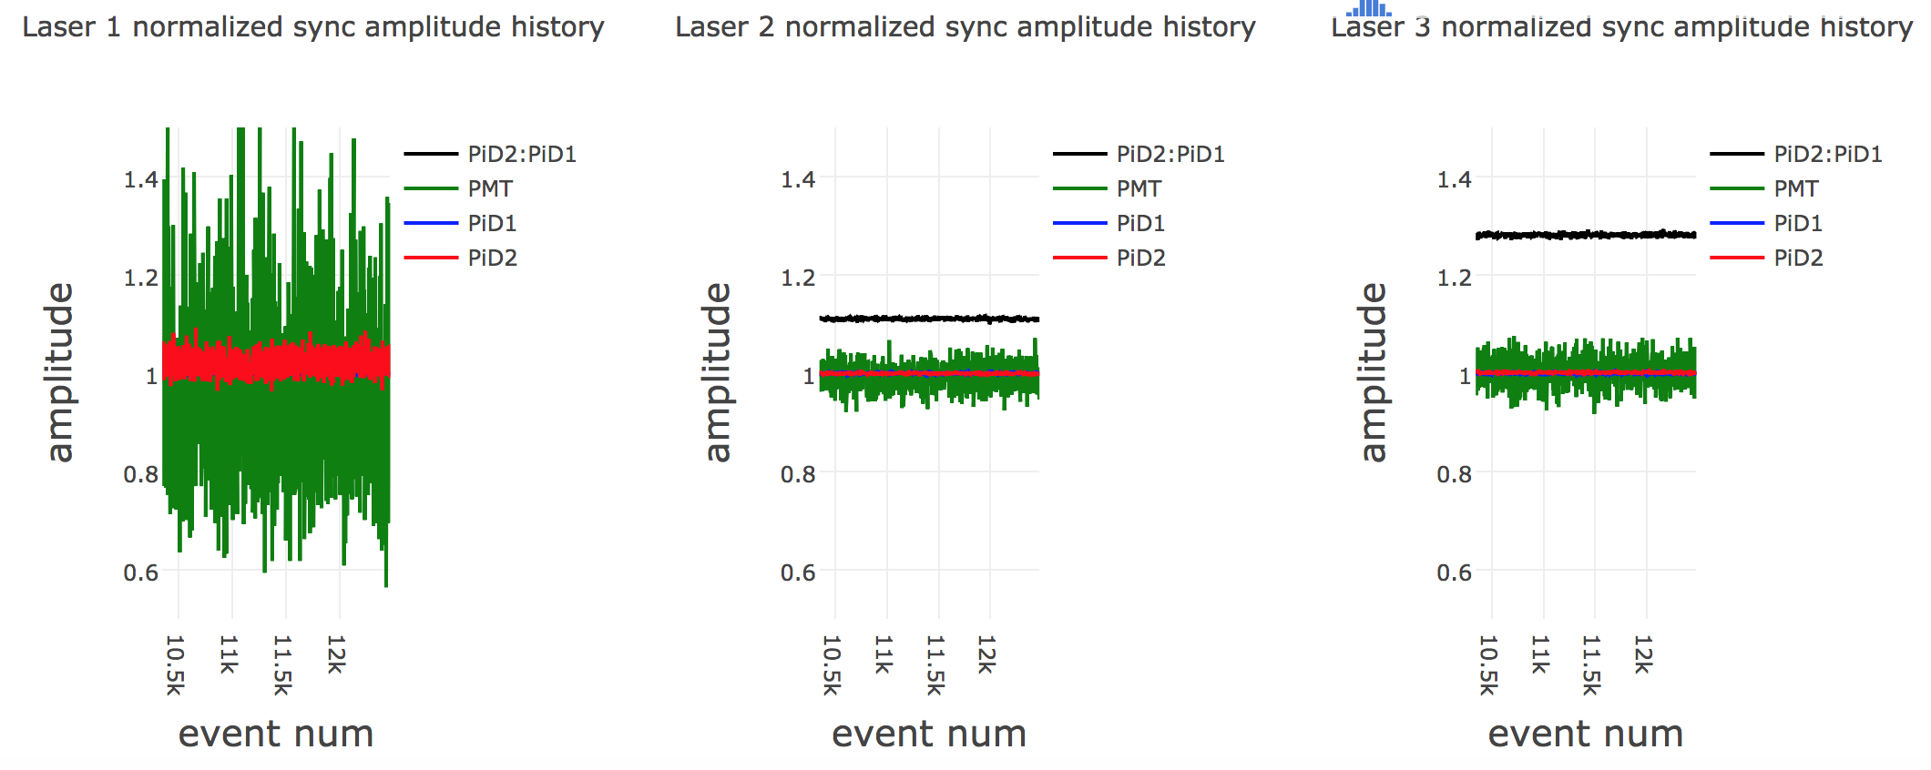
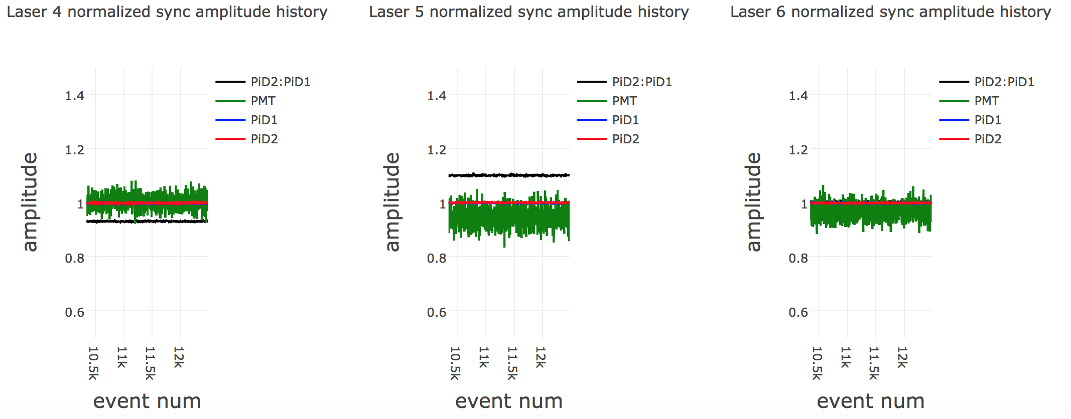
Overlaid SM signals –PiD2:PiD1, Normalized PiD1, PiD2, PMT

Slide 8
ConDB – Conditional DataBase
What is it?
Conditions data record the state of the system at the time events were collected. Conditions data could apply to a detector, accelerator, cryogenic system, collaboration, etc. Measurements include the alignment of a tracking device, or the temperature measured by a sensor, or many other conditions. For a given data item, each conditions data object has an interval for which it is valid it and may exist in more than one version.

Slide 9
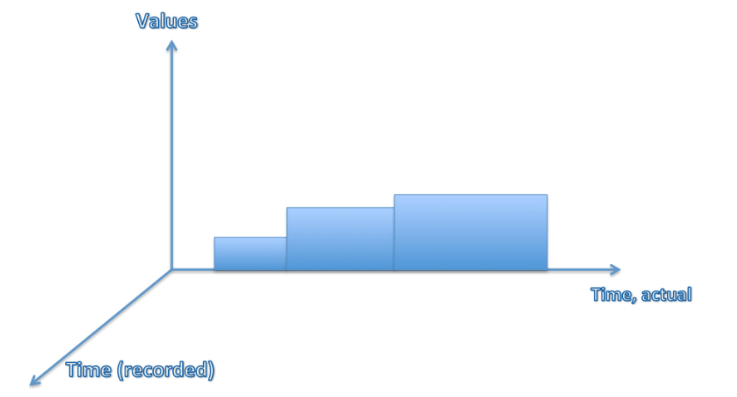
ConDB – Conditional DataBase
Why is it used?
Conditions data vary with time. Each value, or set of values, describes the state of the system during a limited interval of time, sometimes referred to as the Interval Of Validity (IOV.)
Courtesy Katherine Lato (taken from wiki redmine)

Slide 10
ConDB – Conditional DataBase
Where is it used?
This information is required for processing and analysis of experiment data and thus access is required by many clients running simultaneously on interactive and GRID resources. Much of this data is stored in central databases or files, and approaches to scale the delivery to thousands of clients are needed.
The configuration data, system state data, and calibration data are stored in the database with a version and a time validity range, although the interval could be open-ended. The interval of validity provides the set of events for which conditions data must be taken into account in reconstruction algorithms. Conditions data may be recalculated to take advantage of a later software release, or other changes, to gain a more precise picture of the system performance. So the conditions data may exist in more than one version. Conditions metadata can be tagged to ensure reproducible extraction of conditions data.

Slide 11
ConDB – Conditional DataBase
Simple examples
To understand in general terms, the use of a conditions database, consider a digital camera as a simple detector. Each pixel of the camera sensor can be described by its sensitivity to the light and amount of noise the pixel produces.
The user wants to record the pedestal and gain for each image taken. Pedestal adjusts the black level (darkness) of an image by adding a fixed offset to the video image's pixel values. Gain adjusts the white level (brightness) of an image by multiplication so that lighter pixels are affected more than darker pixels. Both pedestal and gain are used to increase an image's overall brightness.
The user measures these conditions periodically to better process raw images captured by the camera. A 20 MP camera could be represented by 20 million channels in the database.
Typical representation:
S = p + (g x L ) where S = Signal,
p - pedestal
g - gain
L - light
The user can construct the actual light (L = S-p/g) with the variables, p and g, recorded as conditions information in a database to allow for reconstruction.

Slide 12
Uses and Future Steps
Helpful for debugging purposes, checking stabilities, comparing with averages etc.
Ongoing work in progress
Need to add other summary histograms for debugging purposes
Thanks to Antonio for the help!!

