Slide 1
Current Status of the DQM
Nandita Raha, Antonio Gioiosa

Slide 2
Brief Architecture - Basics
Backend + Server Side
Client Side
Uses HTML/client side javascripts
Retrives data structures
Opens sockets to communicate with the server
Node.js
Art Side
Stores the average history of required histograms using Plot types from art modules
Registers data structures

Slide 3
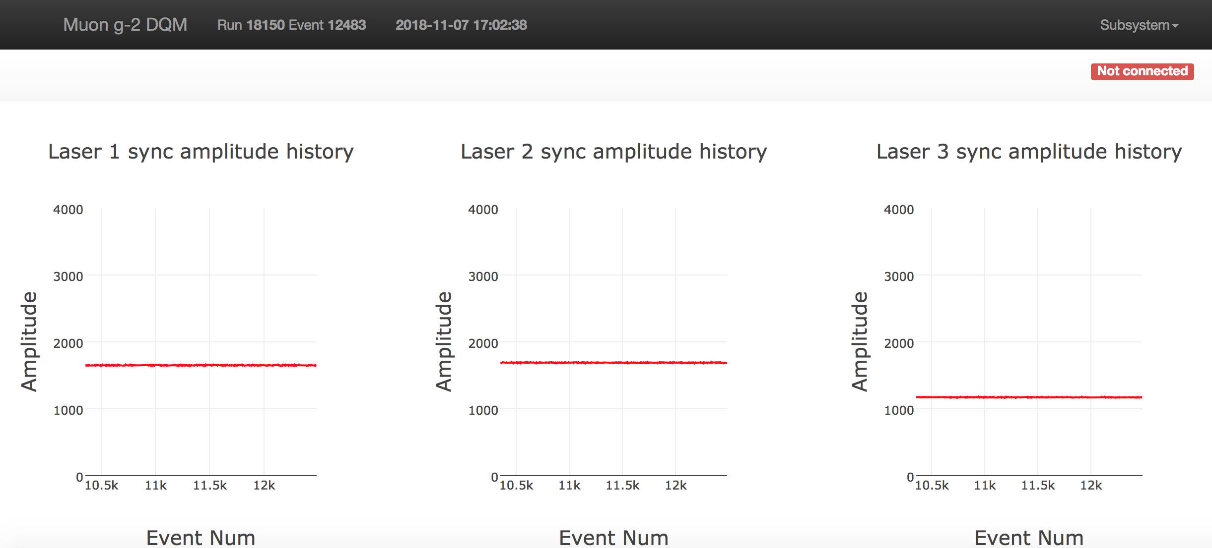
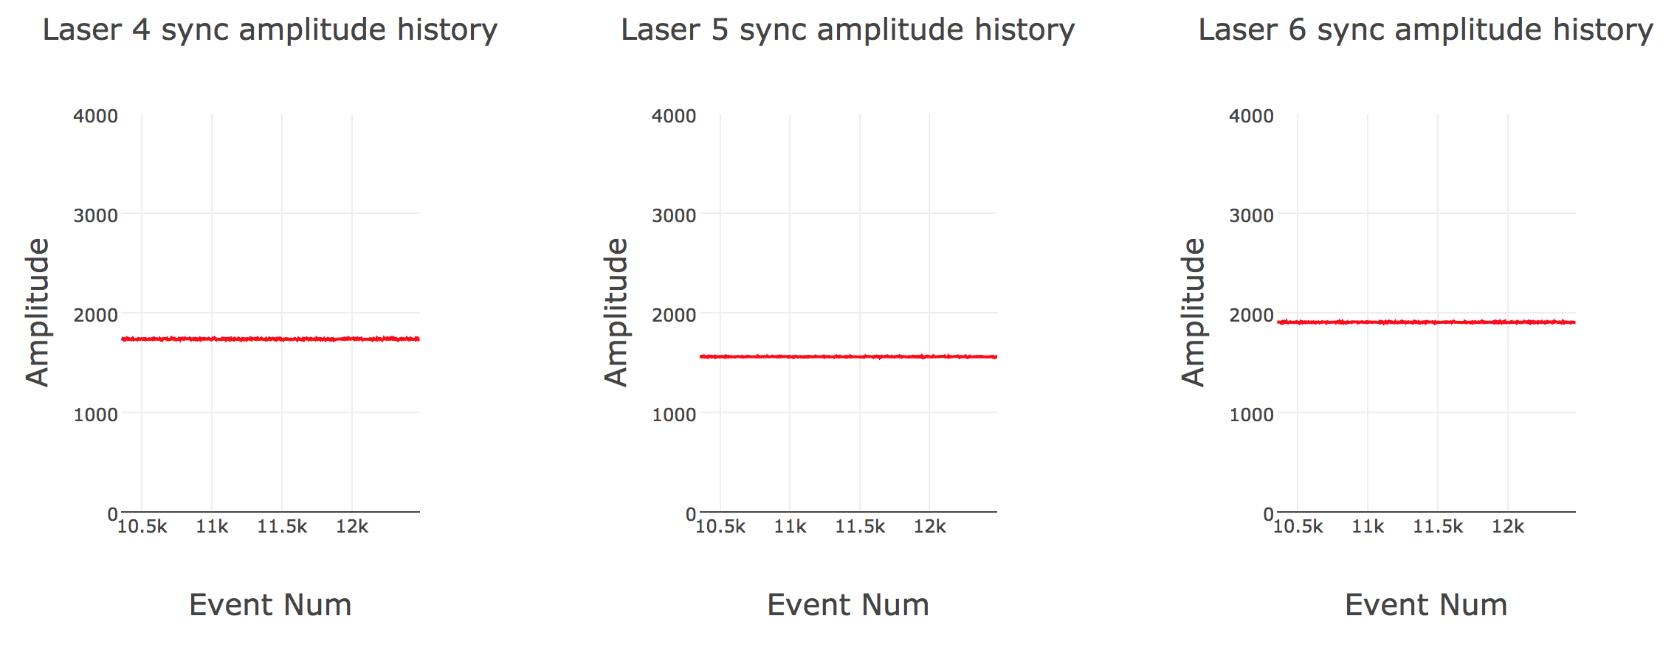
New Plots – Source Monitors PiD1

Slide 4
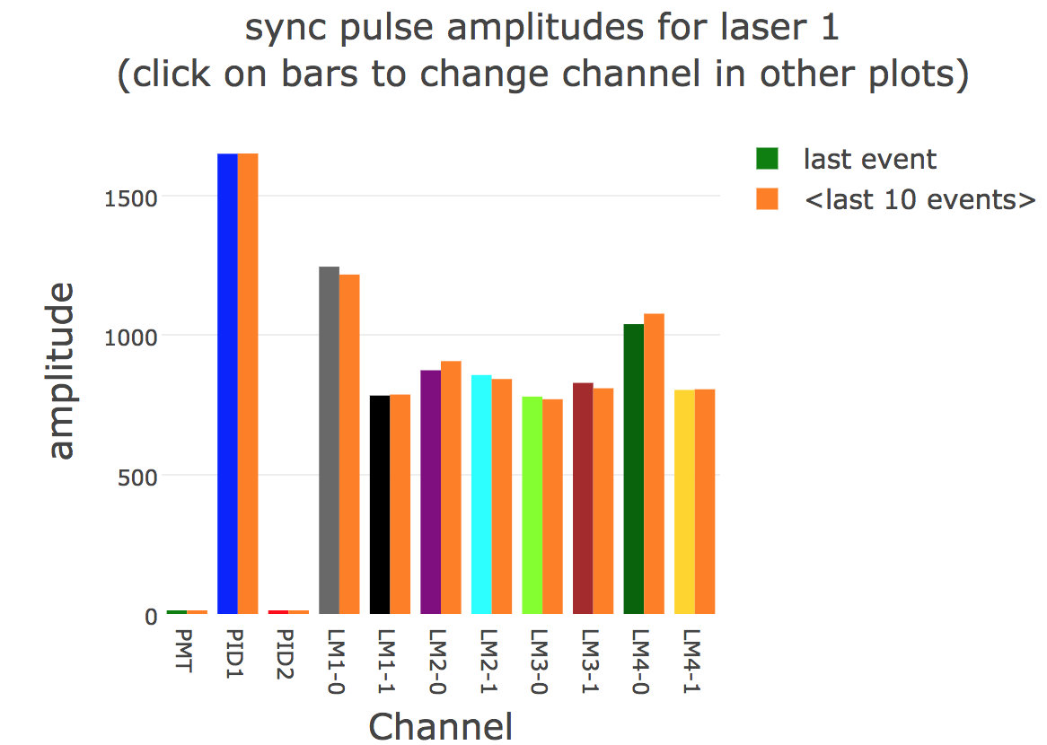
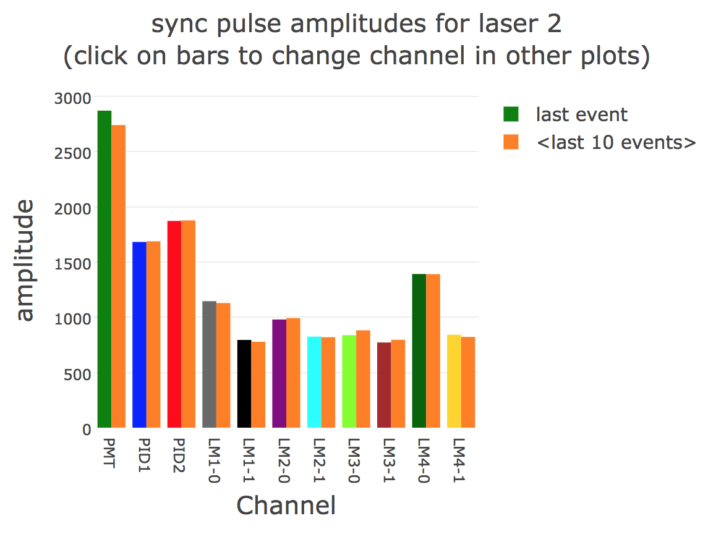
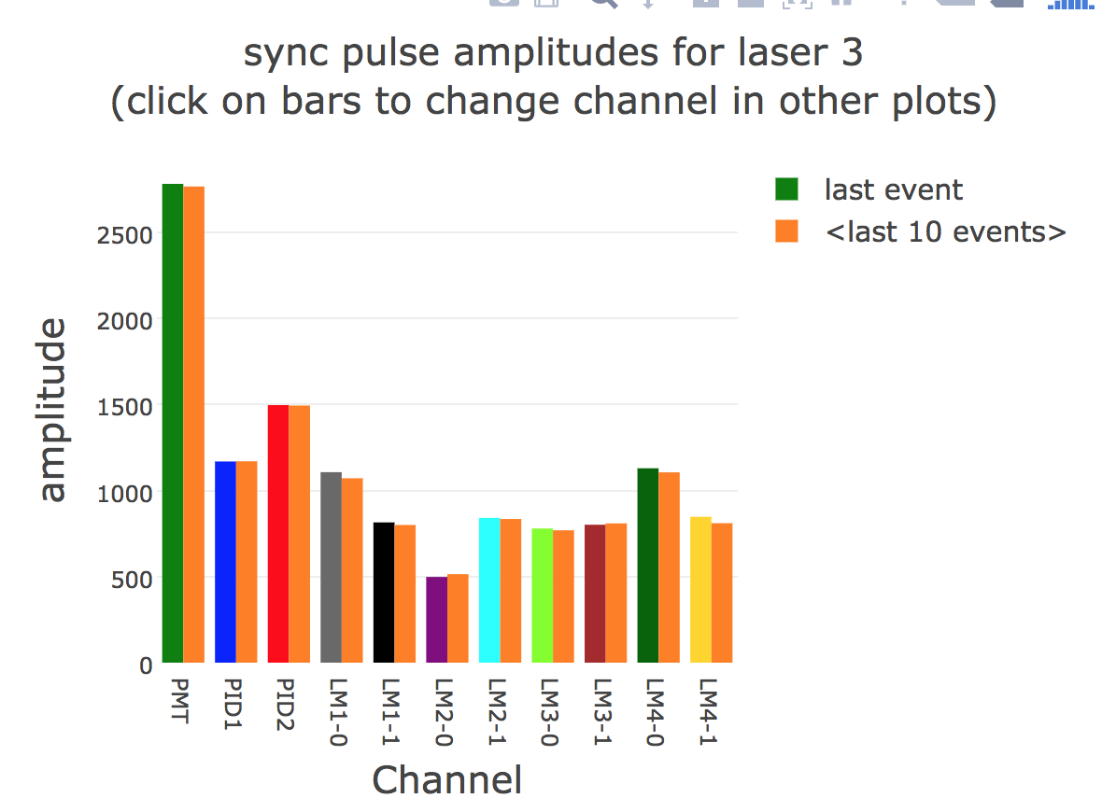
Comparing/Verifying plots – SM PiD1
1649.76
1681.92
1168.78

Slide 5
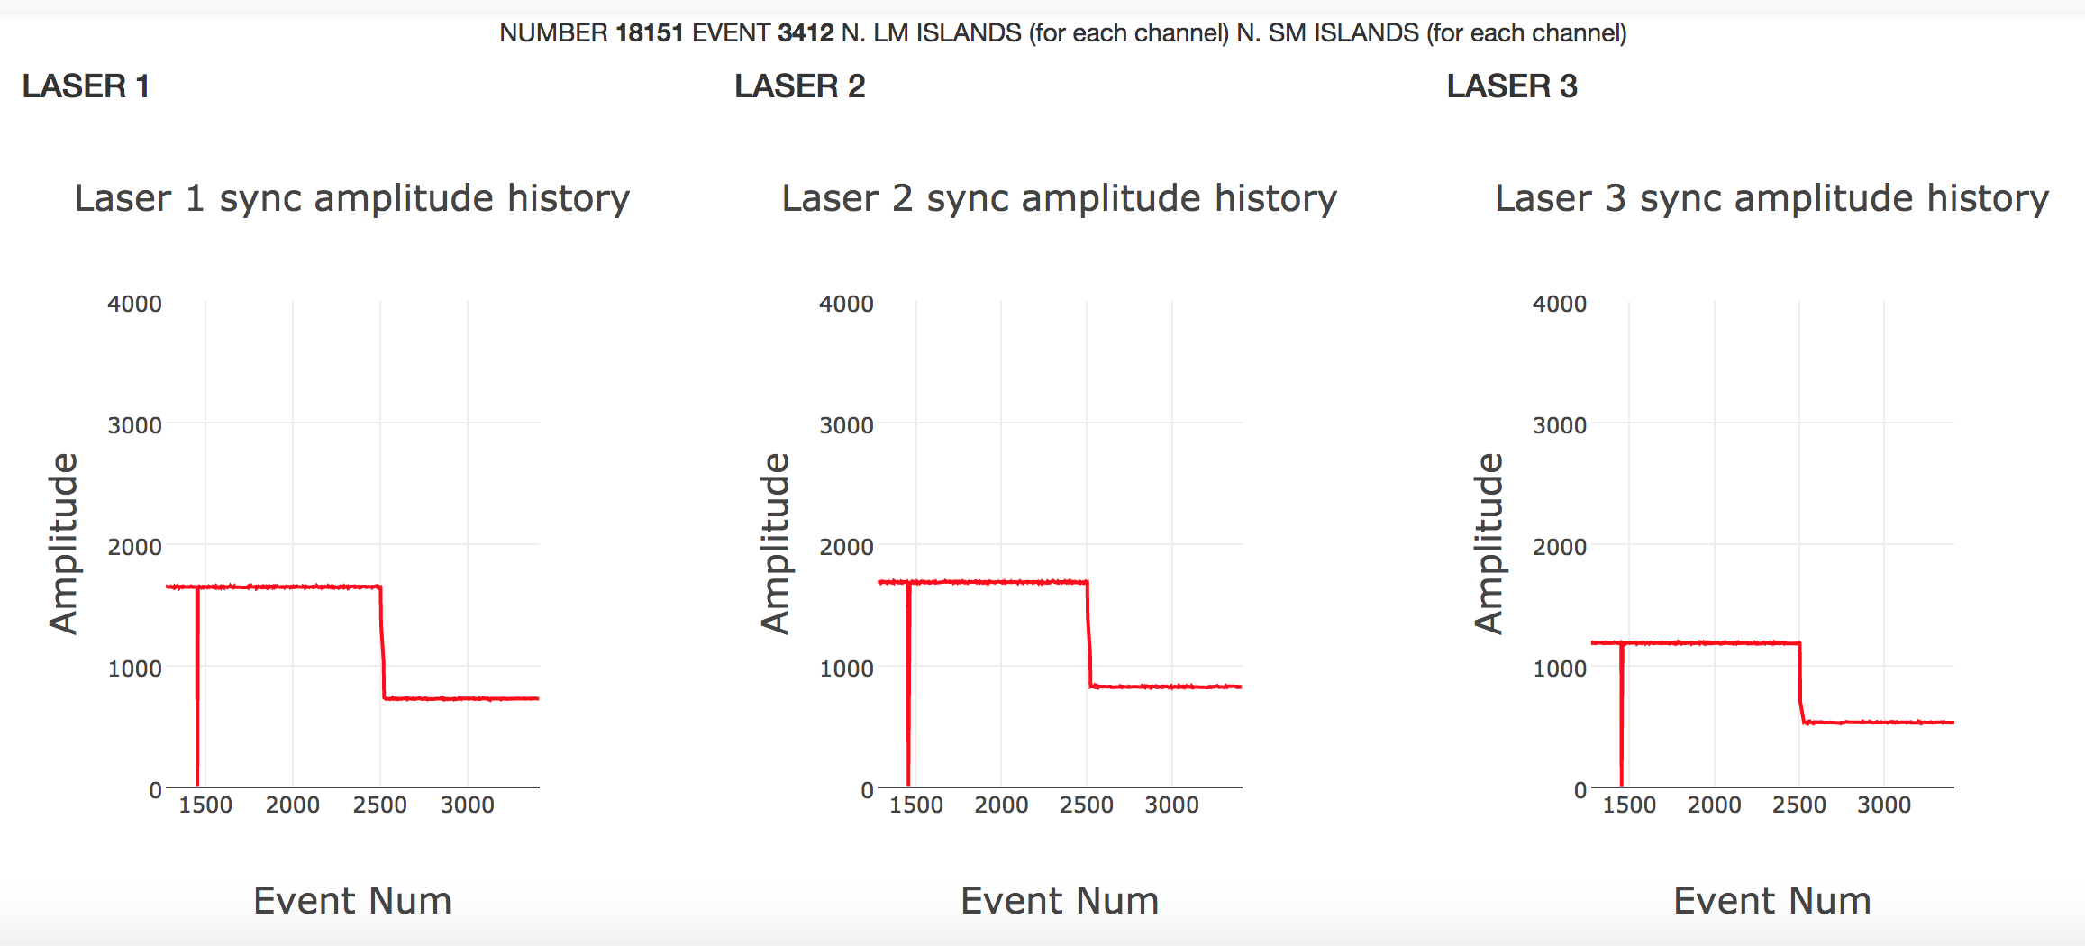
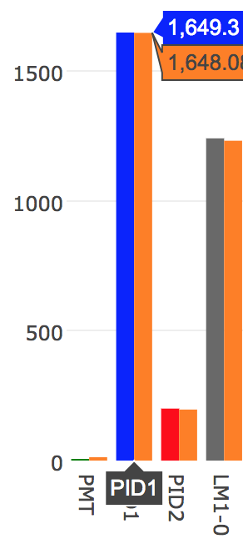
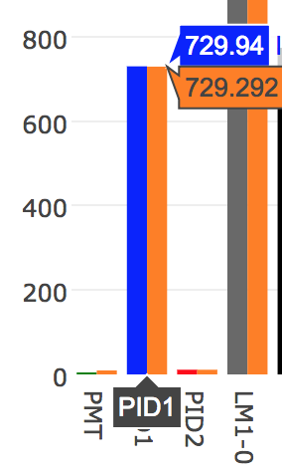
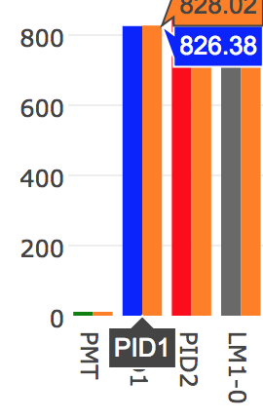
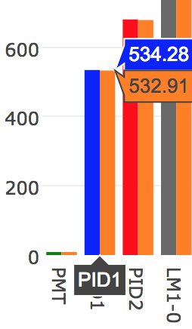
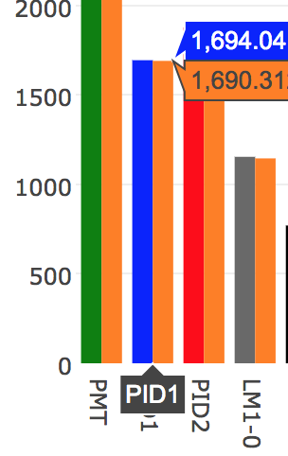
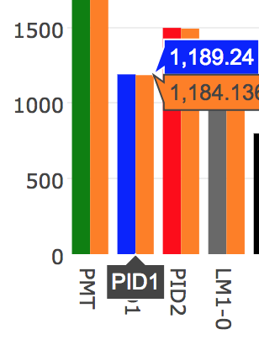
Unstable – SM PiD1 for laser 1, Run 18151??

Slide 6
Uses and Future Steps
Helpful for debugging purposes, checking stabilities, comparing with averages etc.
Ongoing work in progress
Need to add other summary histograms for debugging purposes
Thanks to Antonio for the help!!

Slide 7
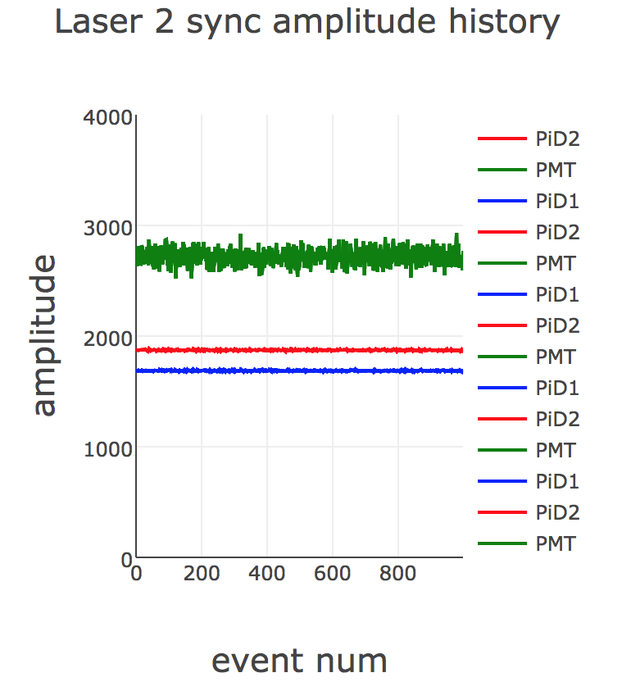
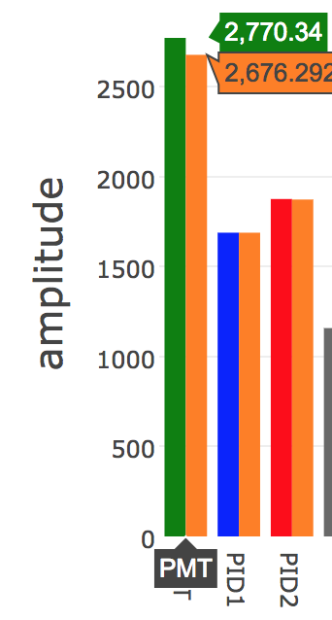
Overlaid SM signals – PiD1, PiD2, PMT

