Slide 1
Simulation – Positron shower leakage

Slide 2
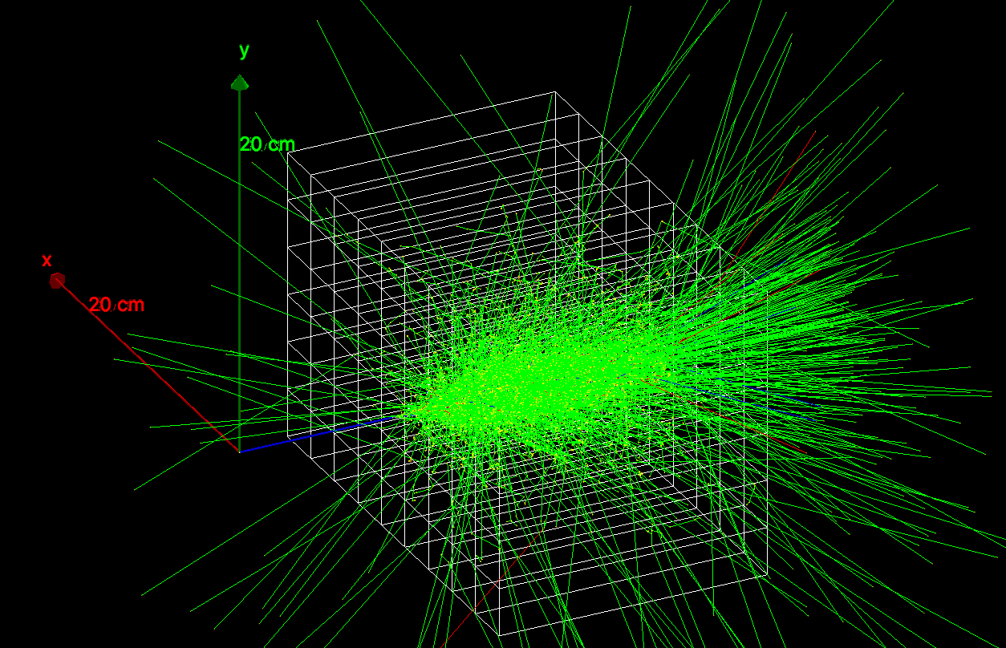
Positrons through Lead-Fluoride crystal
9x6 PbF2 crystals (2.5x2.5x14 cm3)
10000, 3.1 GeV positrons shot on center of crystal #22 normally.
Repeated the same for top and bottom positions of crystal 22

Slide 3
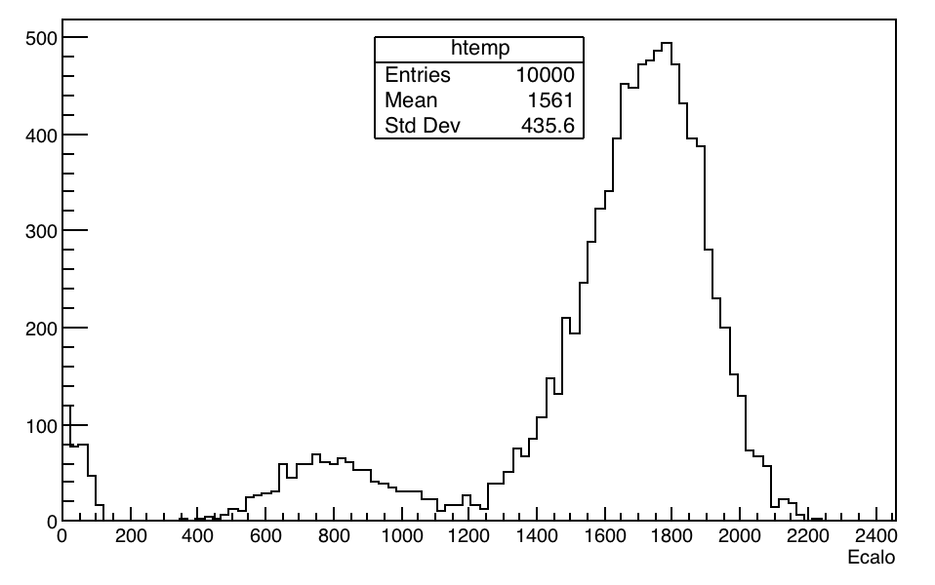
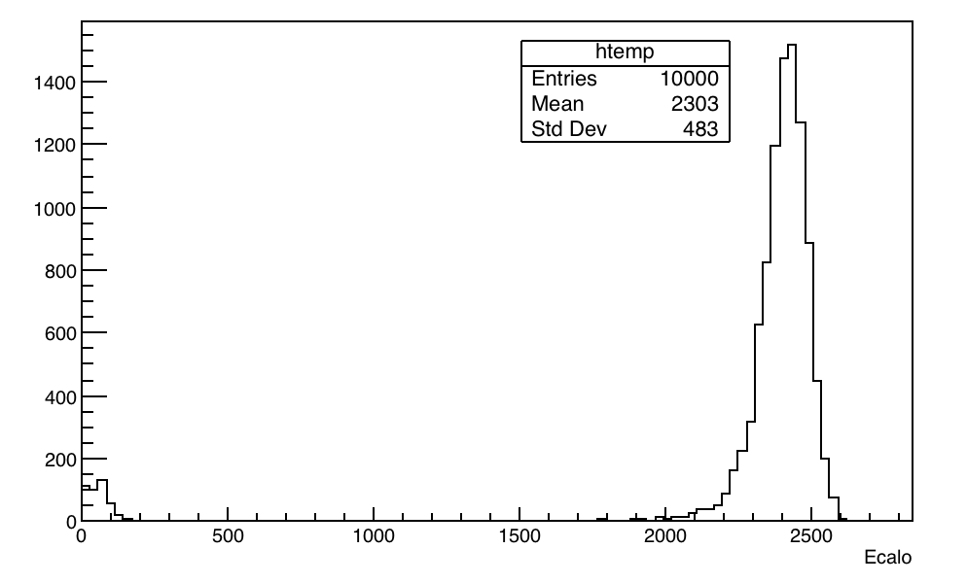
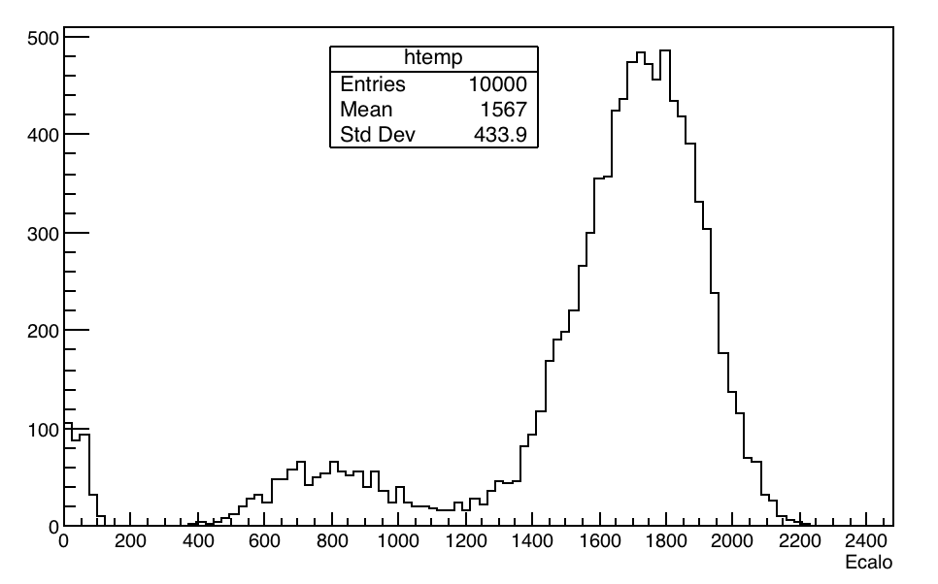
Positrons through Lead-Fluoride crystal
Energy spectrum of all 9x6 crystal for the three positions (top, center and bottom)

Slide 4
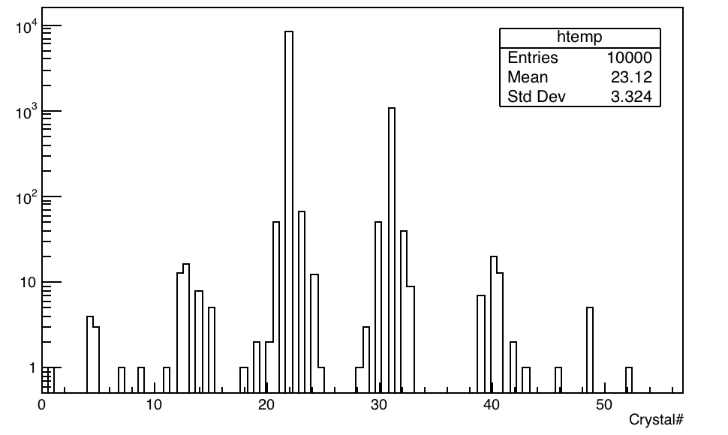
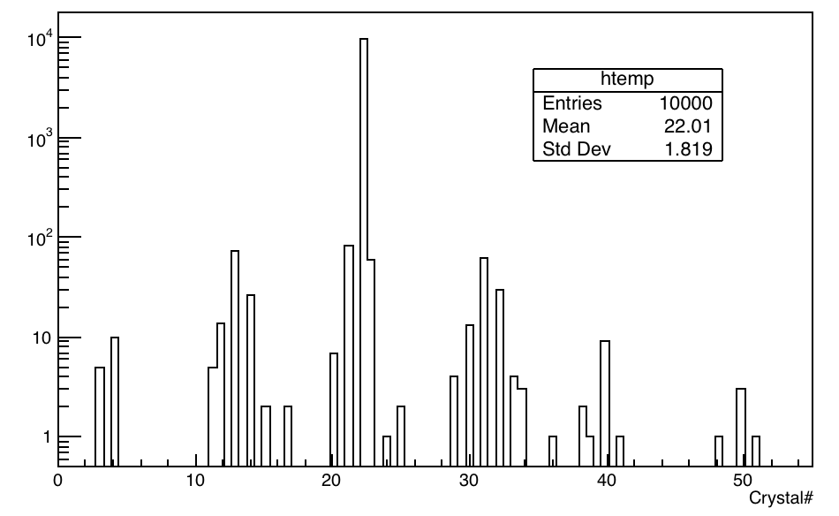
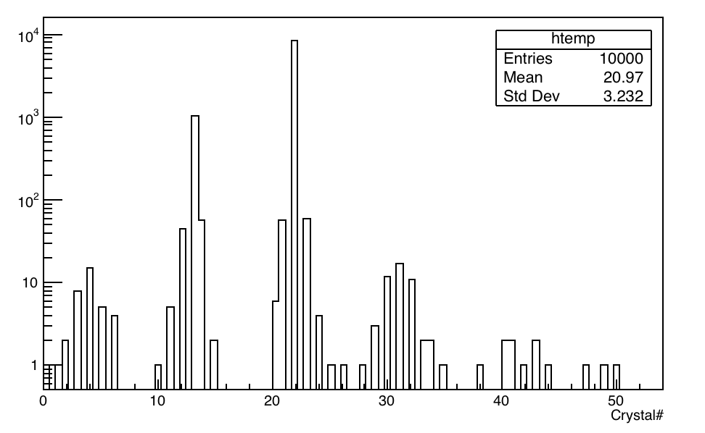
Positrons through Lead-Fluoride crystal
Occupancy or number of hits distribution of all 9x6 crystal for the three positions (top, center and bottom)

Slide 5
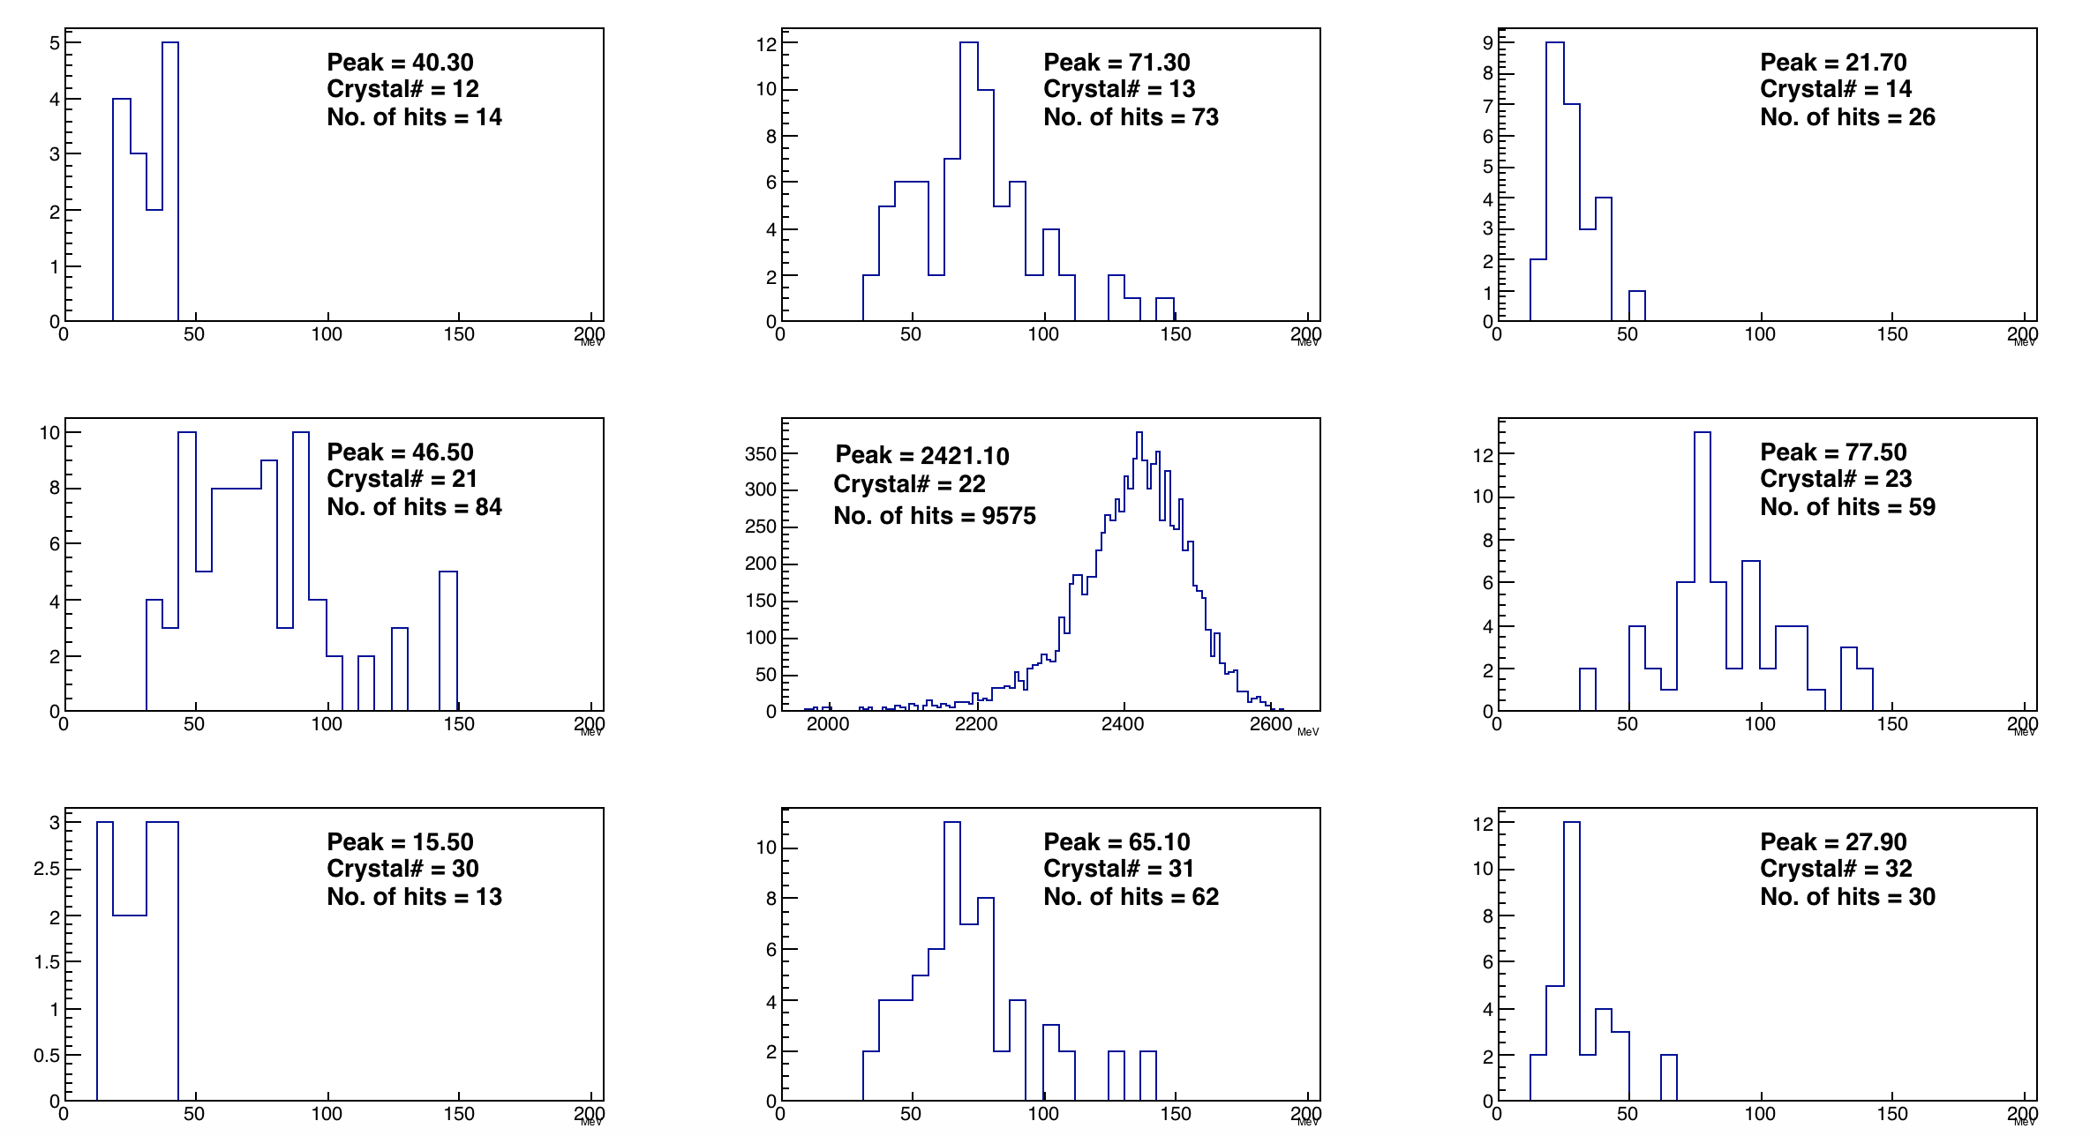

Slide 6
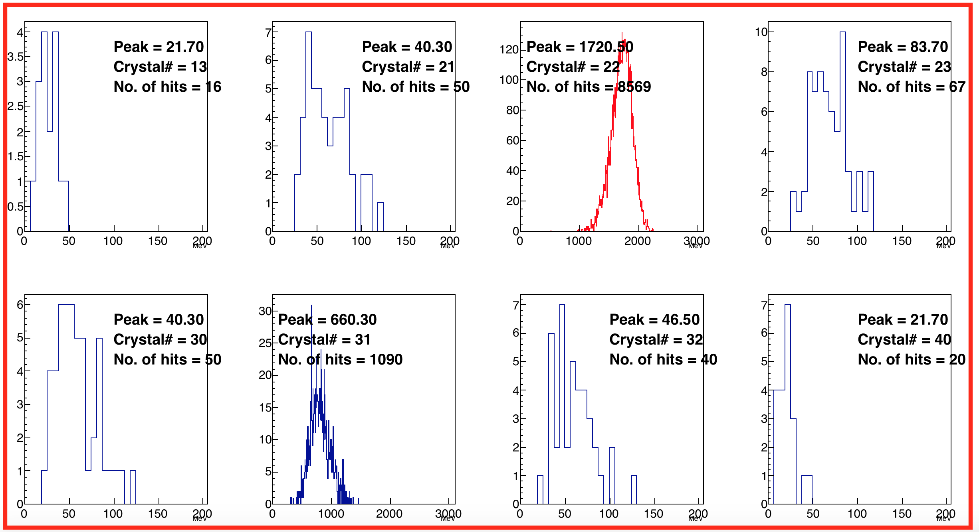

Slide 7
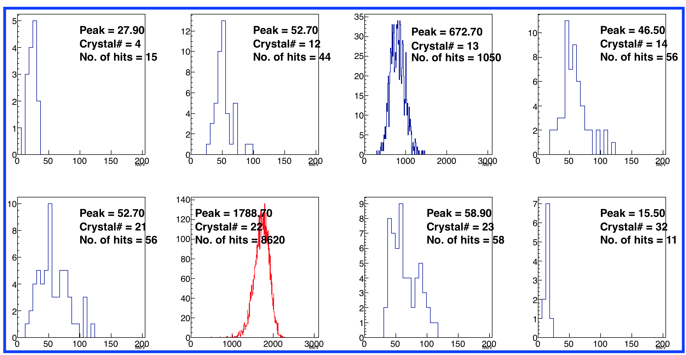

Slide 8
Positrons through Lead-Fluoride crystal
Total energy of all positrons from a 3.1 GeV muon beam incident normally at the center of crystal 22.

