Slide 1
Energy Equalization using Lost Muons

Slide 2
Summary
Start with 60 hr data – looking at MIPs for triplets for every crystal in MeV – Investigating the current equalization
Detect crystals with anomalous/bad MIP.
Compare the same with 9 days dataset.
Check if an additional equalization will improve MIP distribution or equalization in general
Use the 60 hr dataset to find the new constant and apply to the 9 days and endgame dataset to check for any improvement

Slide 3
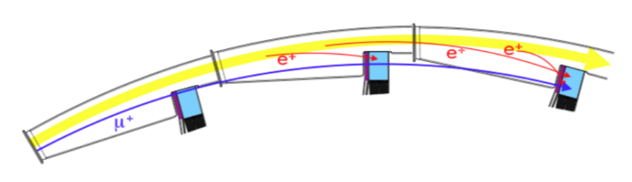
Lost Muons Triplet energy spectrum
Last Calo
Calo 4
Calo 5
Calo 3
Found the MIP distribution of sum of E0, E1 and E2 for each calo (corresponds to all energies of the triplet), as explained in the figure.
E1
E2
E0
Calo 3
Last Calo
Calo 2
Calo 4
E1
E2
E0
Last Calo
Calo 2
Calo 1
Calo 3
E1
E2
E0

Slide 4
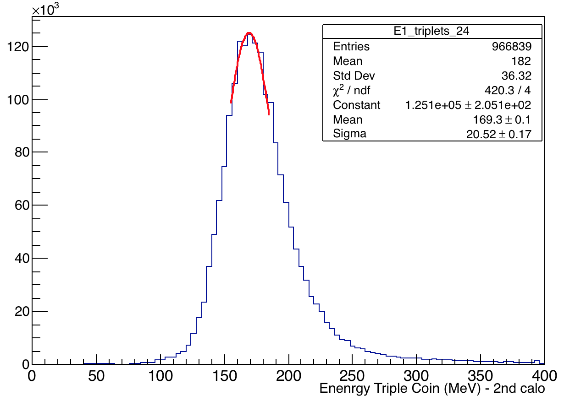
Lost Muons Triplet energy spectrum
Fitted each plot for every crystal with a Gaussian (just about the peak + 15 MeV) and plotted a histogram of all crystals and a graph of MIP Vs. Crystal No to locate the calo and crystals.
All triple coincidences of lost muons with # of hits =1 on crystal 23

Slide 5
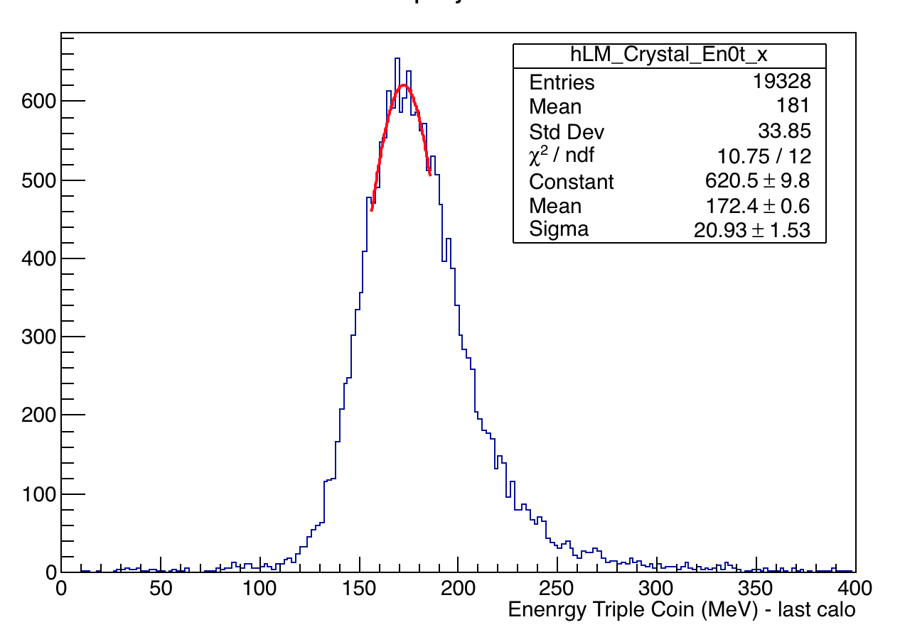
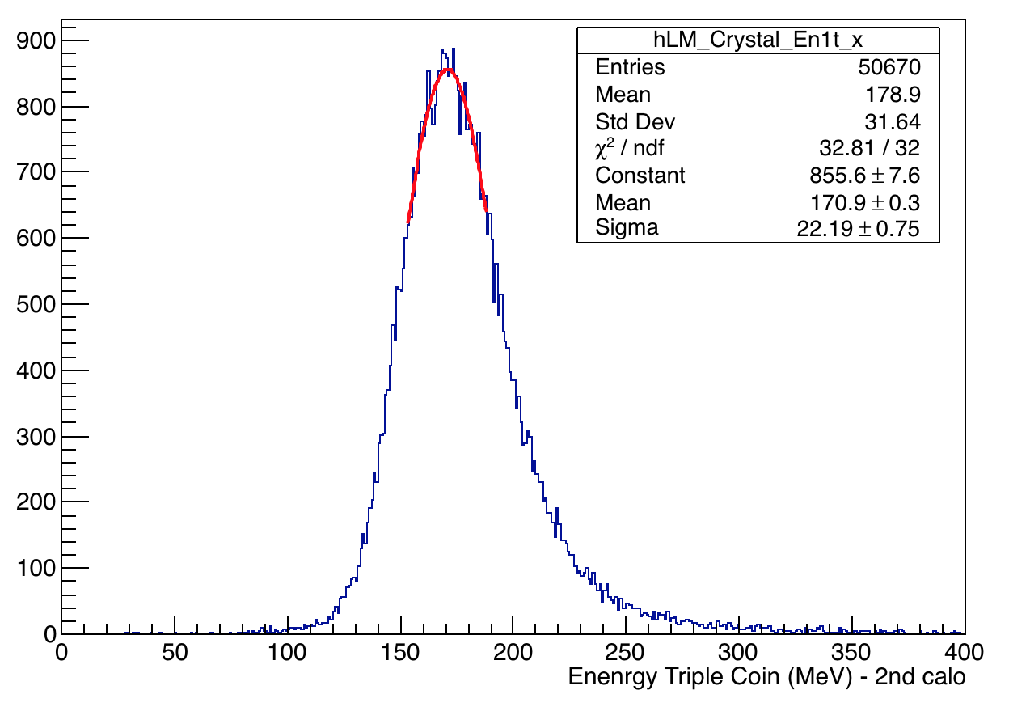
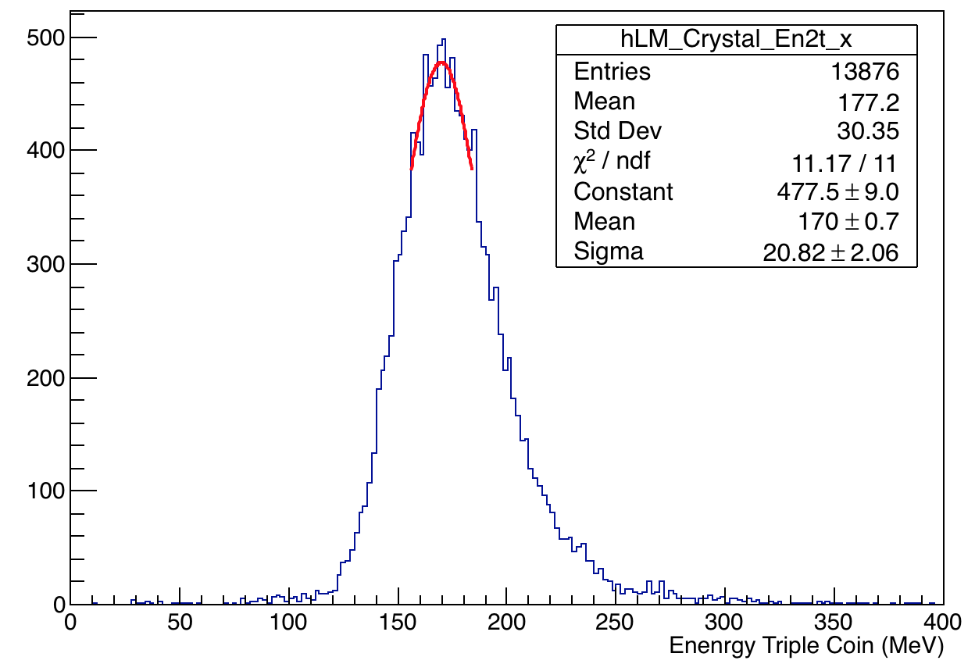
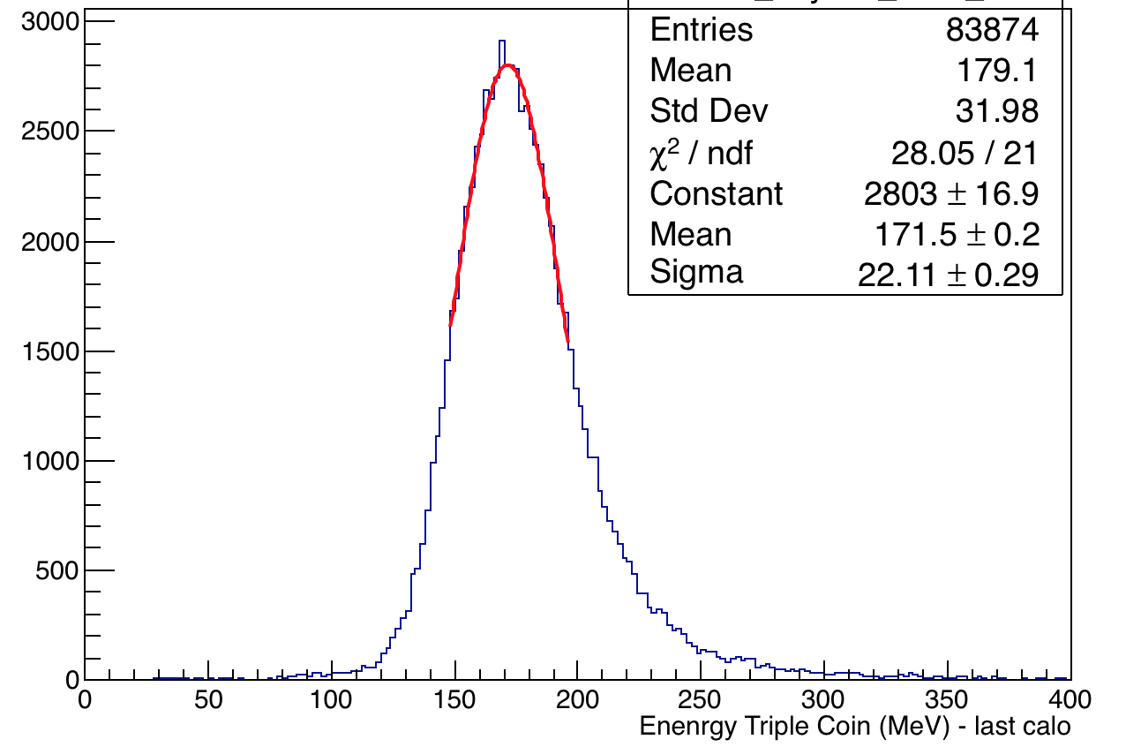
Calo 1 – all Xtals – Checking Equalization of 60 hrs
E0
E1
E0+E1+E2
E2

Slide 6
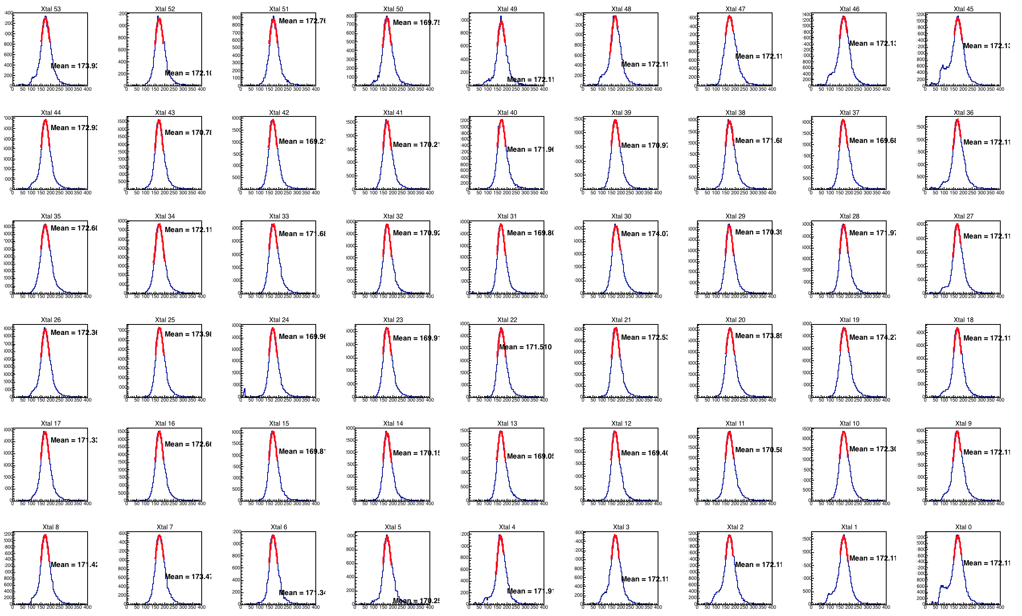
Calo 1 – all Xtals – Checking Equalization of 60 hrs – E0+E1+E2

Slide 7
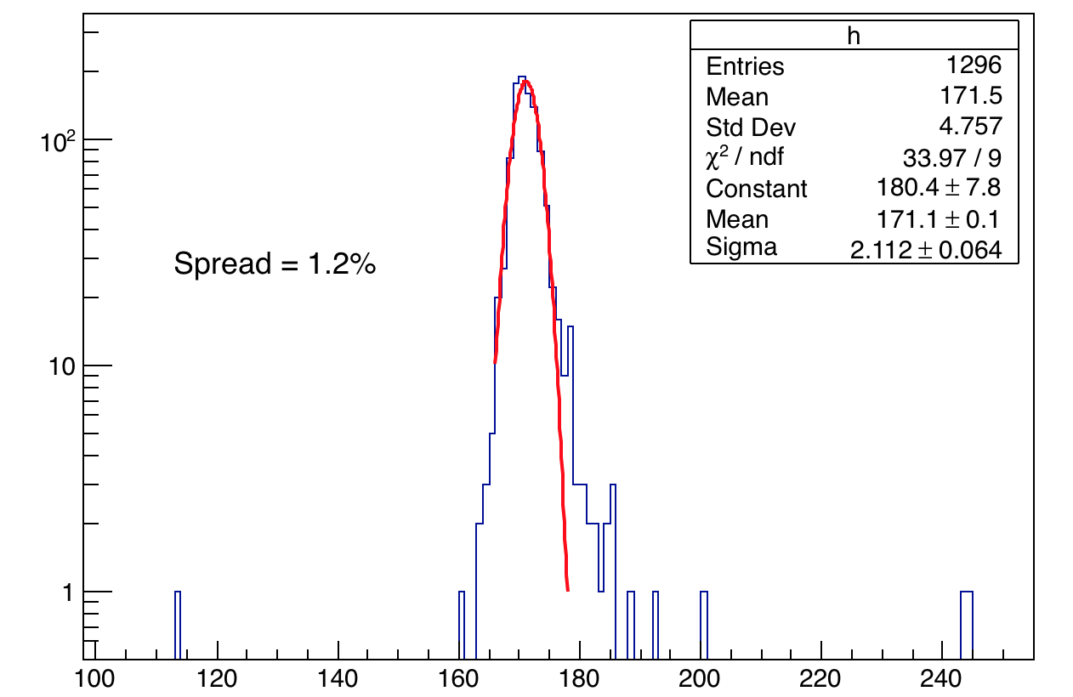
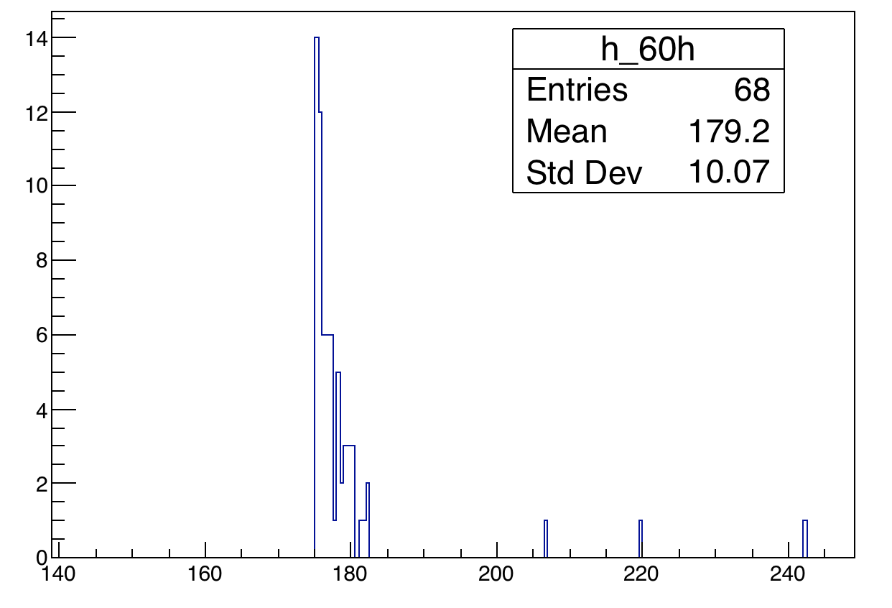
All calos – all Xtals – Checking Equalization of 60 hrs
Fitted each plot for every crystal with a Gaussian (just about the peak) and plotted their distribution. Spread (σ/mean) is ~1%
Separated crystals with lower statistics. Very few such events have higher/lower energy.

Slide 8
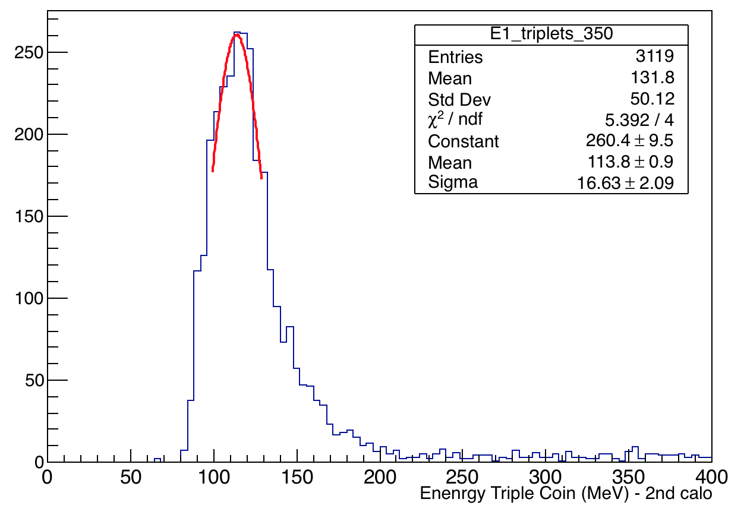
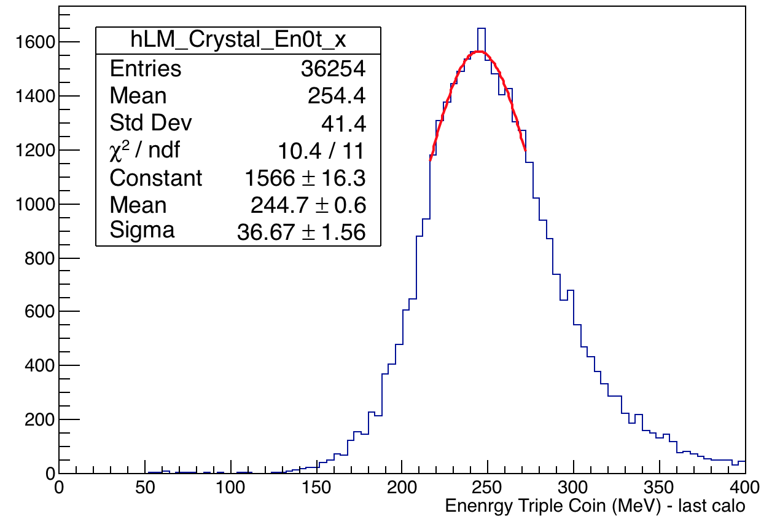
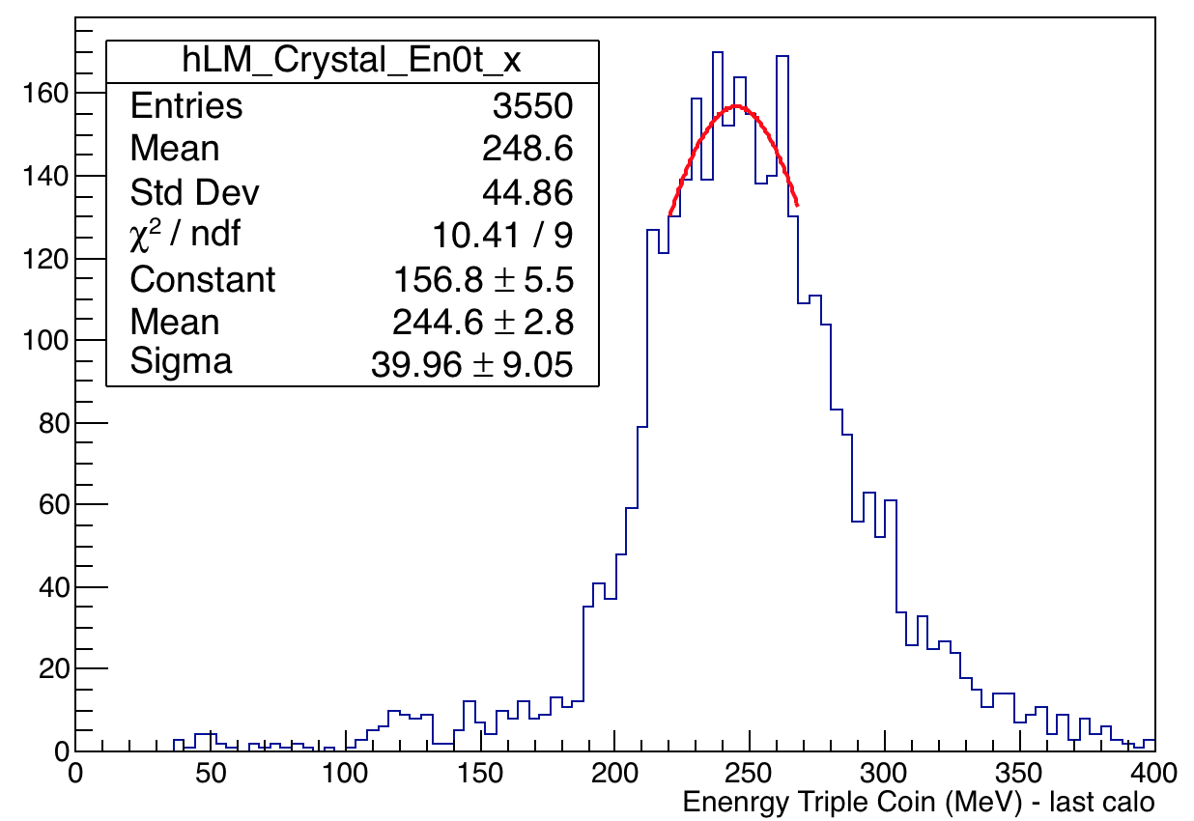
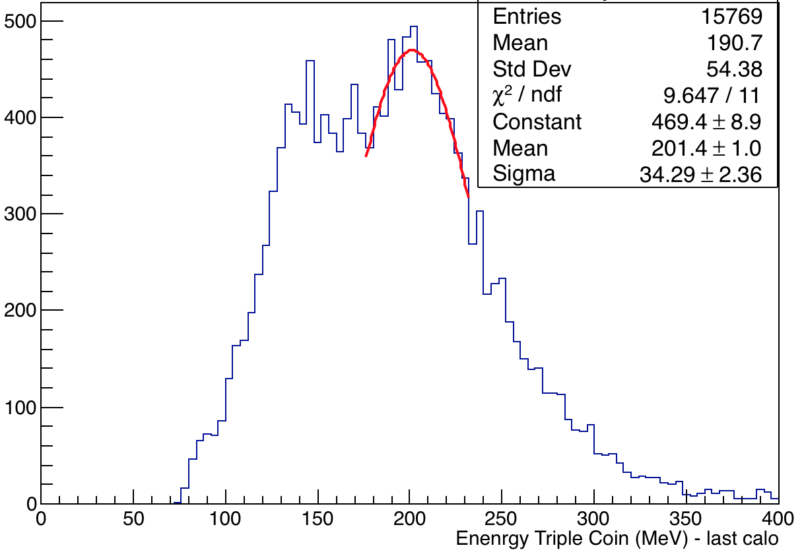
Bad crystals with reasonable stats
All xtal and calo # with MIP <150 or >180 MeV
C:10 X:19
C:4 X:25
C:16 X:12
C:4 X:34

Slide 9
Data set 9 days (Part 1 - one fourth)
Have similar stats as 60 hr – so can be compared for anomalies
Distribution of MIP peaks are similar and same xtals have a problem
Compared anomalous/bad xtals – C:4 X:25, C:4 X:34, C:10 X:19 and C:16 X:12 of both datasets
Compare all xtals with MIP <160 or >180 MeV

Slide 10
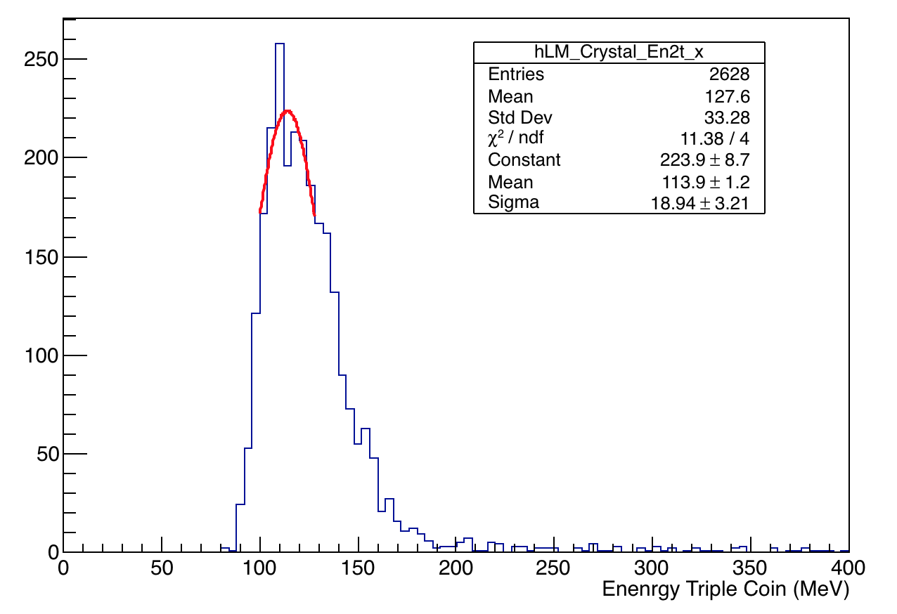
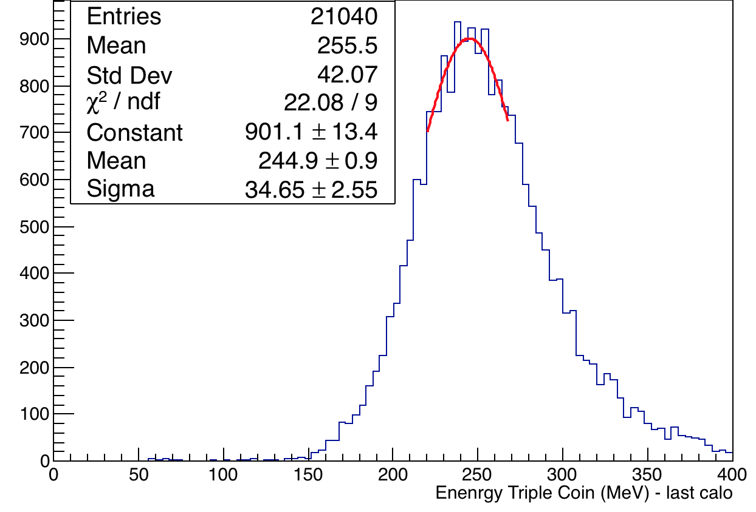
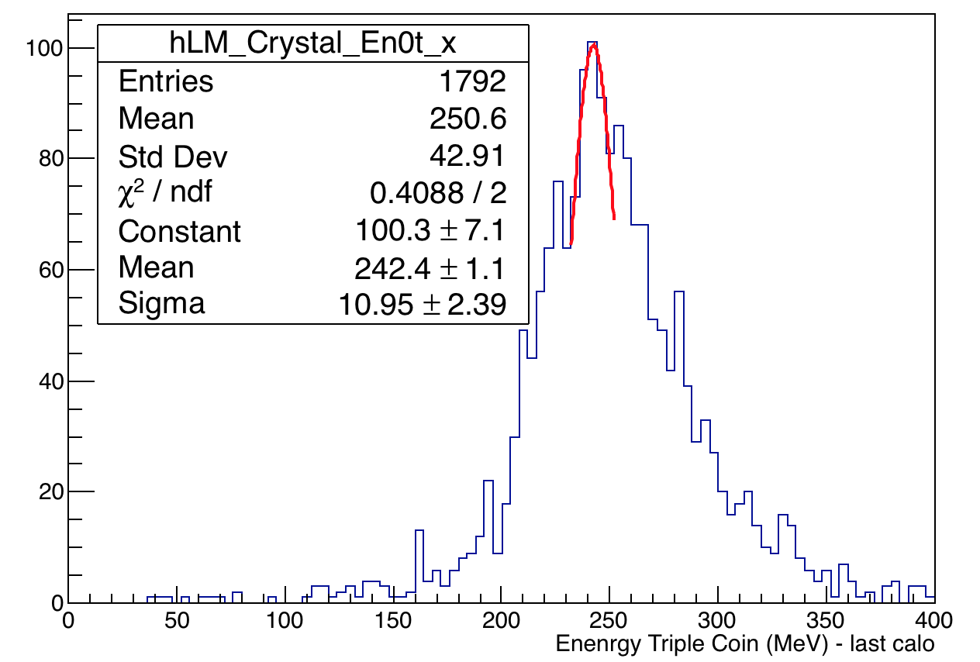
Compare 9 days (Part 1) with 60 hrs
Bad crystals (detected from 60 hrs set) only
Part 1 – 9days
60 hrs
C:4 X:25
C:10 X:19
C:16 X:12

Slide 11
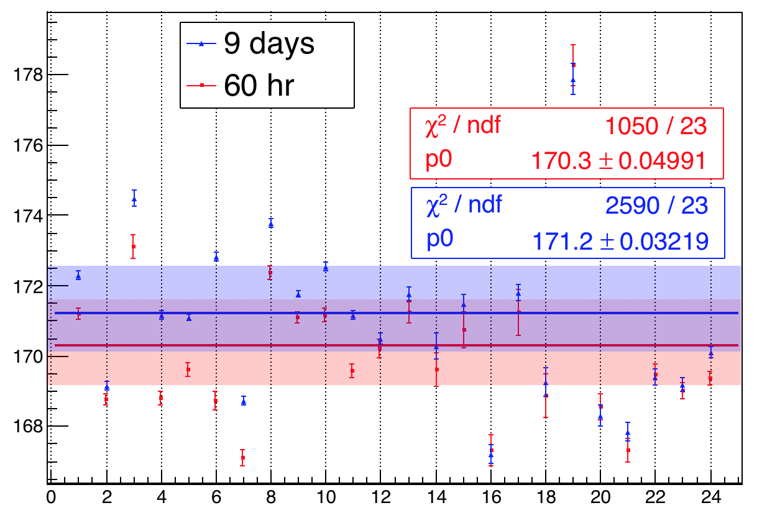
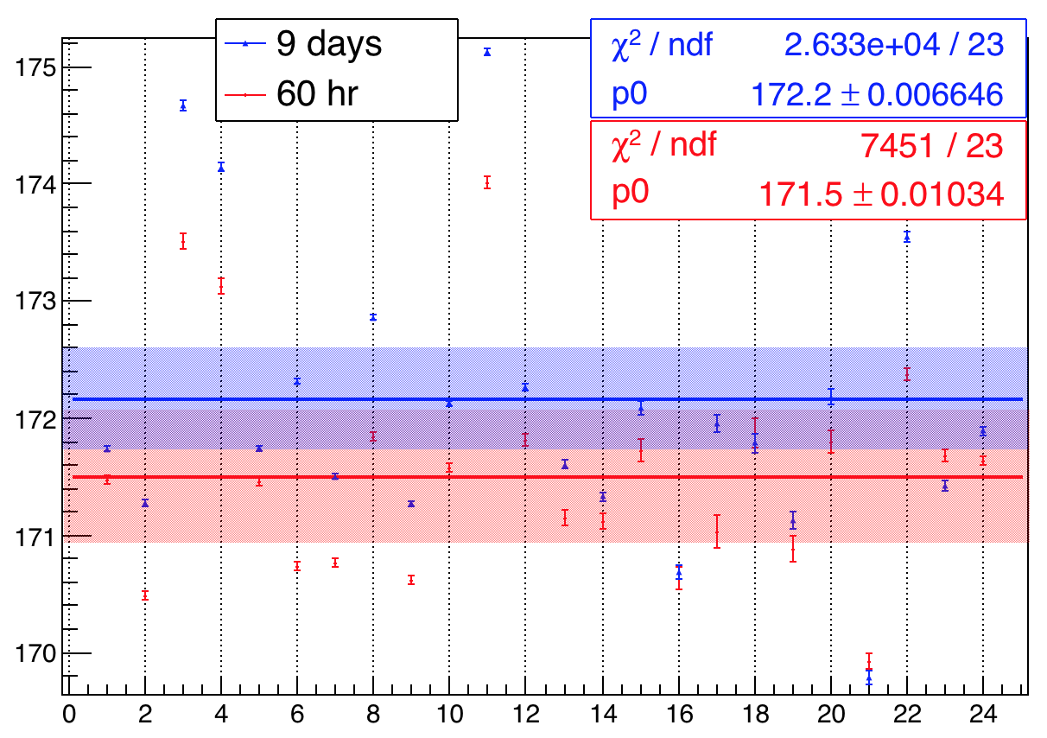
Comparing all Calos – 60 hr and full 9 days
Compared Xtal 22 (a central xtal used for previous calibration) for all calos 60 h(rms 2.3) and 9 days(rms 2.27) dataset
MIP (MeV)
Compared Weighted avg all calos 60 h(rms 1.19) and 9 days(rms 0.94) dataset
Calo #
MIP (MeV)
Note: Analyzed the full 9 days dataset and have same bad crystals. These confirm results of docdb:16874
Calo #

Slide 12
Equalization – new constants
Compared MIP distribution of crystals of both datasets – by fitting the Gaussian distributions.
Found the distribution of the ratio of the two datasets – i.e. MIP_{9d}:MIP_{60h} (should be around unity).
If the spread of the ratio distribution is lower than the spread of the individual distributions then we can expect an improvement with new equalizations.

Slide 13
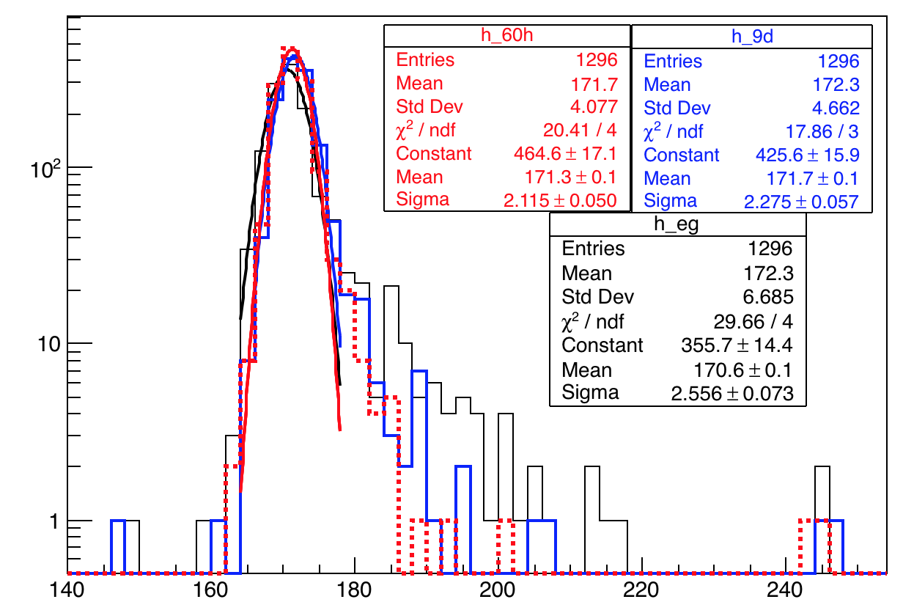
Comparing all Calos and Xtals all datasets – 60 hr, 9 days and End Game
9 Days
60 hr
Spread = 1.33%
Spread = 1.23%
End Game
Spread = 1.49%
Energy (MeV)
MIP of full 9 days endgame and 60 h align well with mean at 170 MeV (all a spread < 1.5%).Means the equalization is fine and laser system is stable/ in good working condition. Lost muon energy spectra are also very consistent.

Slide 14
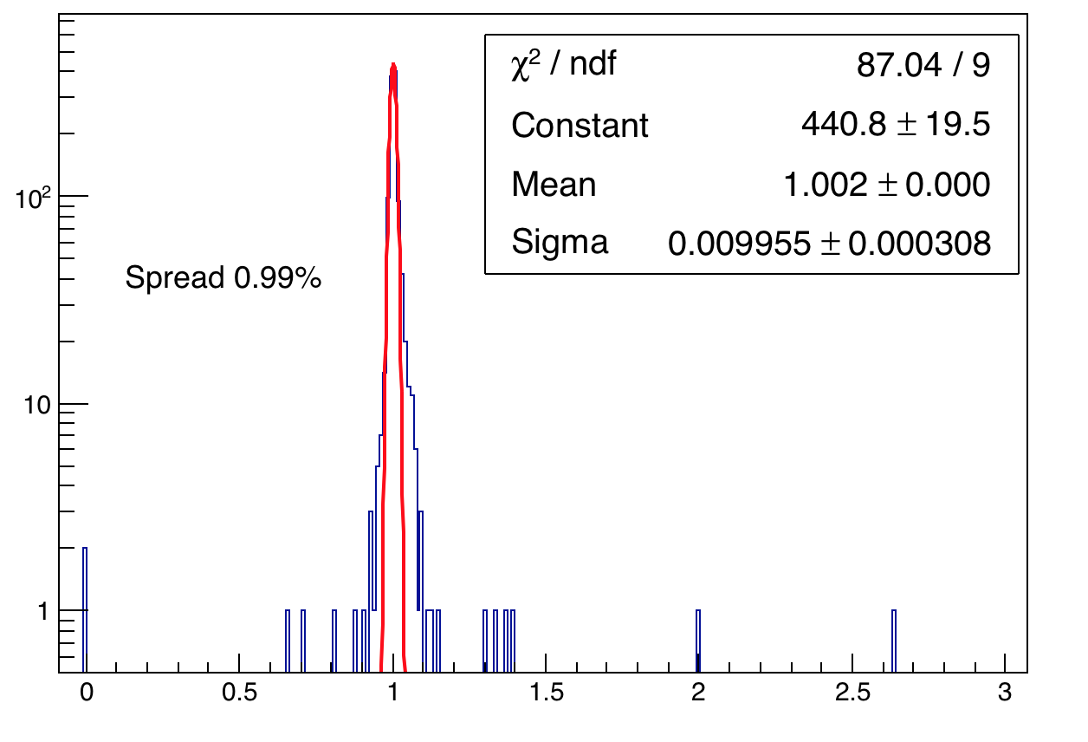
Ratio of distribution of 90 days to 60 hr
This spread is < 60h and 9days MIP individually.
An additional equalization constant might improve equalization results. Observe the same for ratios of end game to 9 days.
MIP_{9d}:MIP_{60h} – peak ratio at 1. Spread of 0.99%
Procedure: Found an average MIP constant for every crystal using E_{i}/<E_{i}>, where <E_{i}> is the average MIP energy obtained from 60 h dataset
Applied this correction to the 9 days dataset, by diving these constants obtained from 60 hrs to each crystal of 9 days dataset.

Slide 15
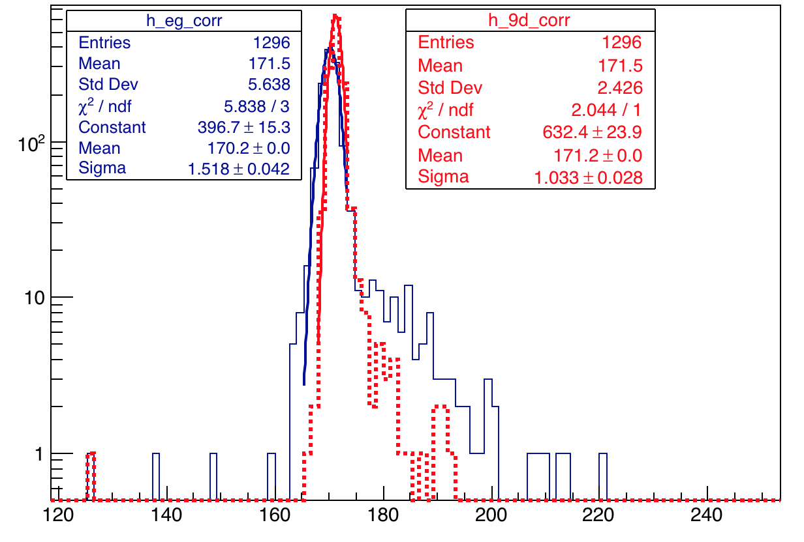
Additional Correction of 9 days Using 60 hrs
Spread = 0.89%
Spread = 0.60%
C:4 X:34
Energy (MeV)
The spread of the Gaussian changed from 1.3% to 0.6% for 9 days and from 1.49% to 0.89 for end game which an improvement with new equalization constants.

Slide 16
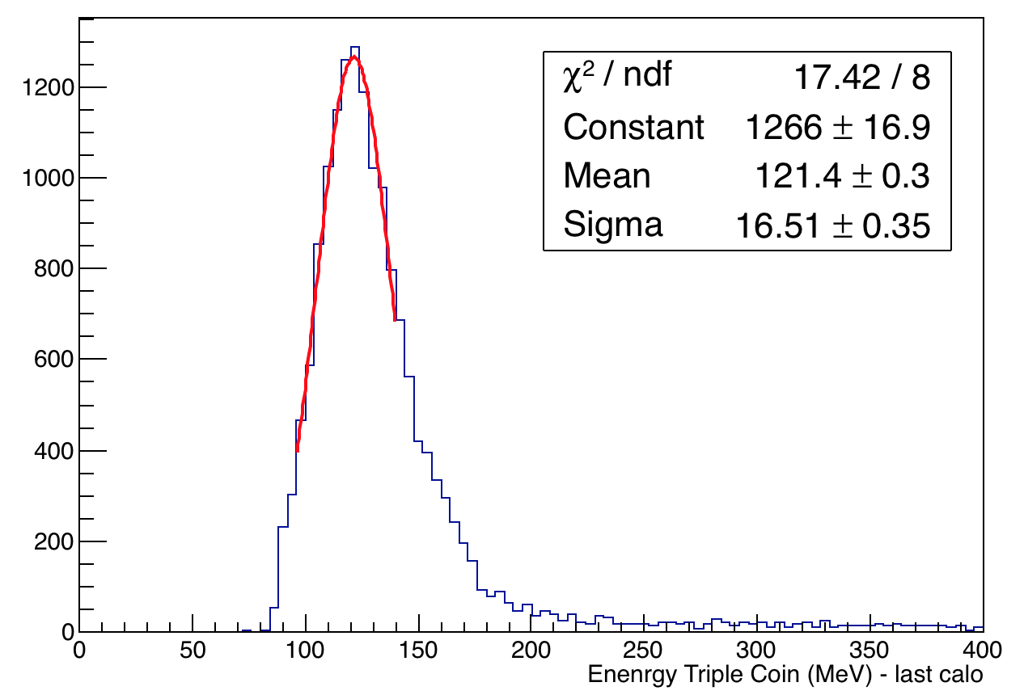
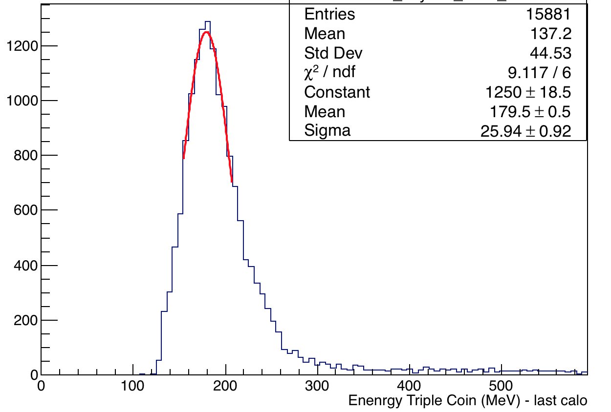
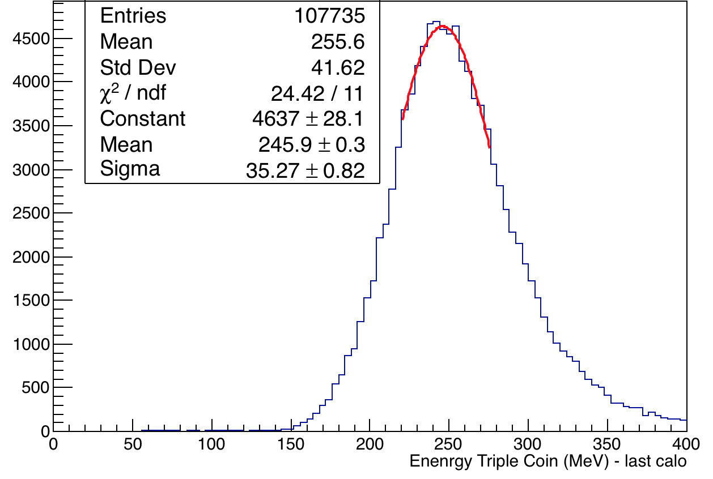
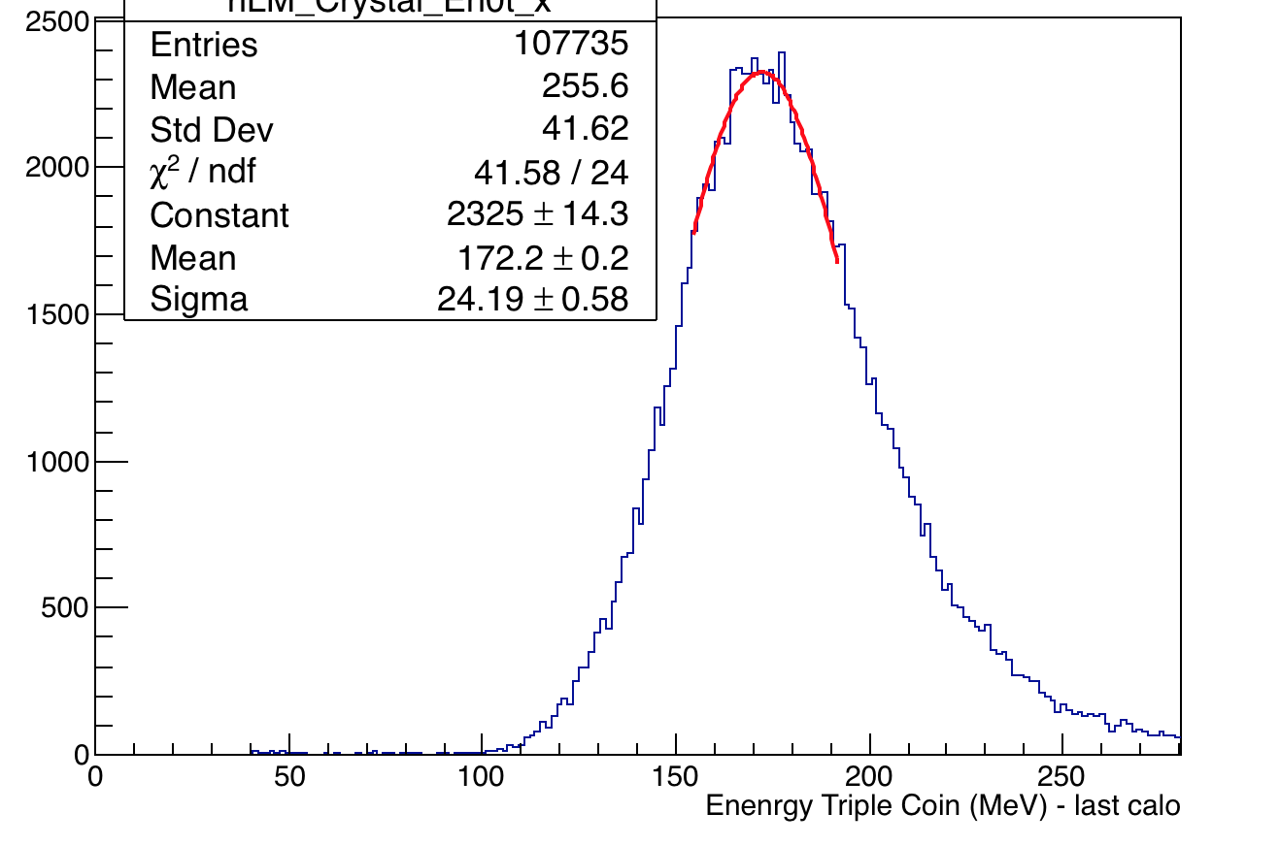
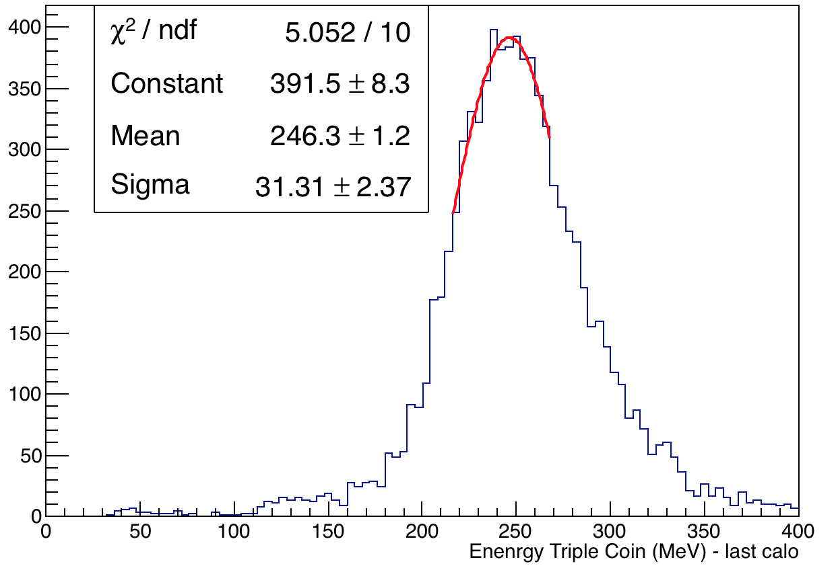
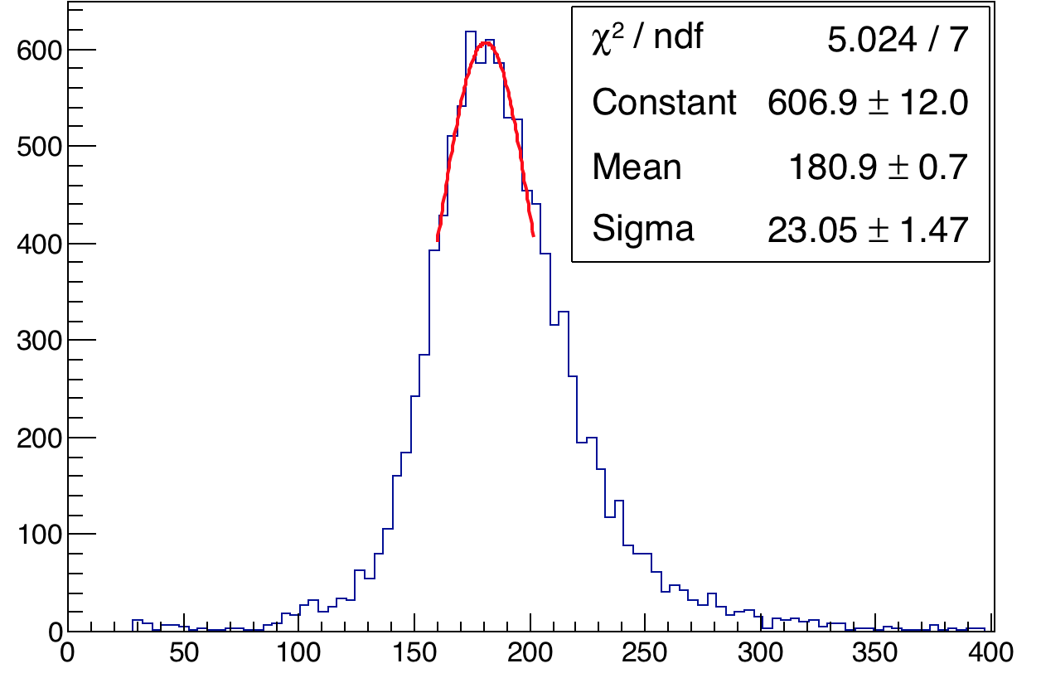
Bad crystals after Correction of 9 days - fixed
C:4 X:25
C:4 X:25
After
Before
C:10 X:19
C:10 X:19
C:16 X:12
C:16 X:12

Slide 17
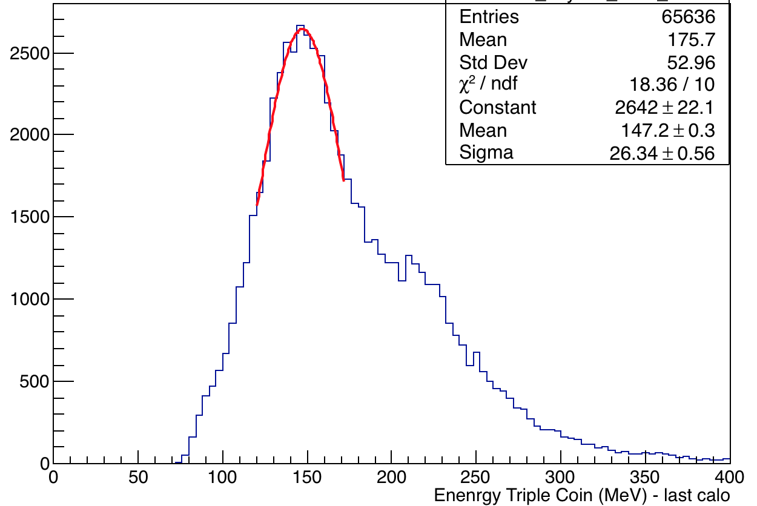
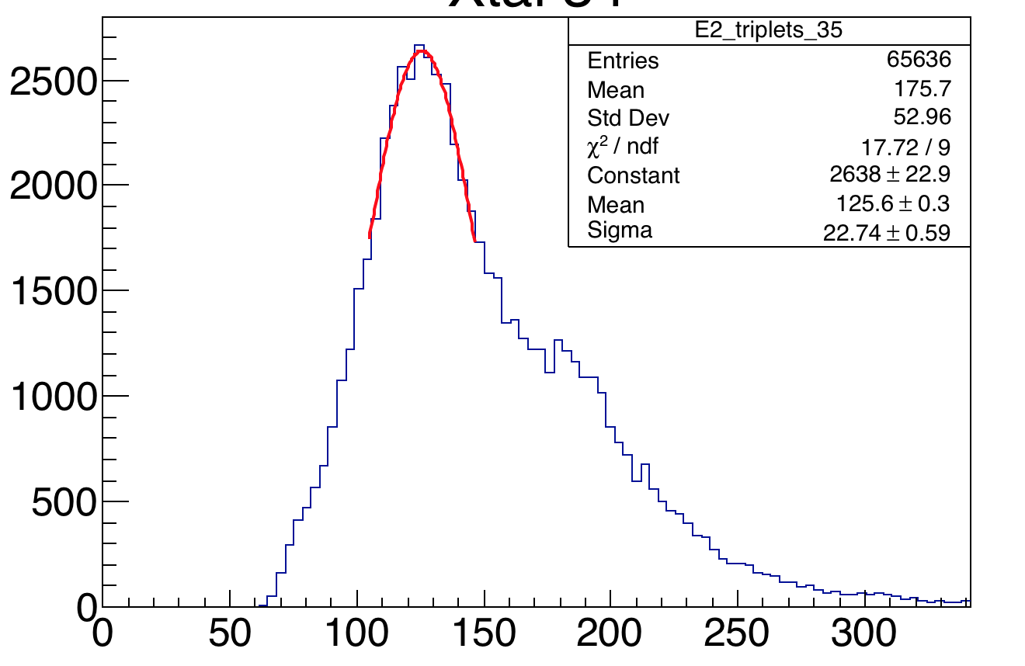
Bad crystals after Correction of 9 days – reflection – C:4 X:34
9 days
60 hrs
C:4 X:34
Before correction
Equalization constant is 1.17683
Only crystal that is out of range.
Seems to be a reflection?
C:4 X:34
After correction

Slide 18
Conclusions
The MIP energy distribution is quite stable for all crystals for datasets 60h, 9 days and endgame and shows a maximum spread of 1.5%. This is less than the 3% fluctuation in the end point energy of 3.1 MeV – which means that the lost muons are suitable for energy equalization.
Detected crystals with anomalous/bad MIP which are C:4 X:25, C:4 X:34, C:10 X:19 and C:16 X:12 for all datasets studied – this matches the studies of docdb 16874.
A distribution of the ratio of MIP_{9d}:MIP_{60h} has a spread <1% which proves an additional correction will improve the MIP distribution.
Applied an additional equalization that improves MIP distribution or equalization in general by almost 50% for 9 days and endgame dataset ( using the 60 hr dataset to find the new constant)

Slide 19
Back up

Slide 20
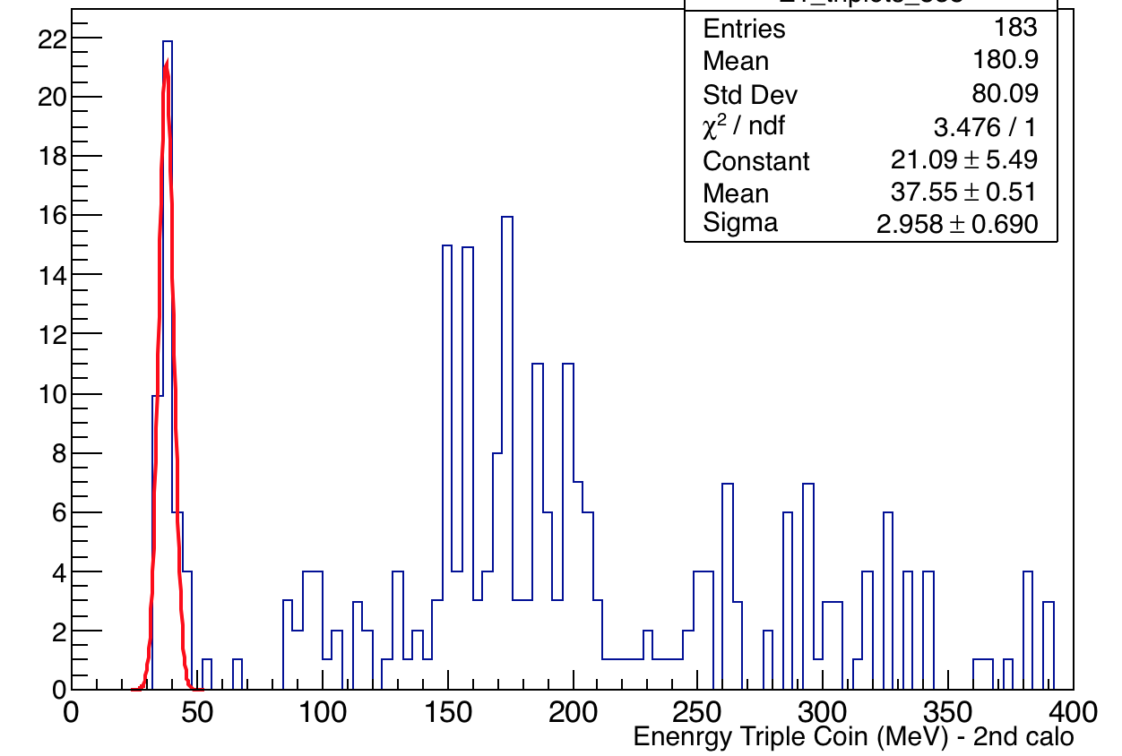
All calos – all Xtals – Checking Equalization of 60 hrs
Fitted each plot for every crystal with a Gussian (just about the peak) and pl
Calo 16 Xtal 47
Abnormal termination of minimization.
Potential problem to fit around the peak??
These are all edge crystals –
Fixed - gaussian fit about mean (180.9)
Added all three energies E0, E1 and E2 corresponding to each calo. Increased statistics considerably and improved the distribution.

Slide 21
List of bad channels – MIP>180 &<160
Note blue is with a different calibration applied
60 Hour Dataset
Calo:21 Xtal:8
Calo:20 Xtal:16
Calo:9 Xtal:17
Calo:22 Xtal:17
Calo:23 Xtal:17
Calo:18 Xtal:20
Calo:18 Xtal:40
Calo:17 Xtal:41
Calo:18 Xtal:53
Calo:4 Xtal:25
Calo:10 Xtal:19
Calo:16 Xtal:12
Calo:4 Xtal:34
9 days:
Calo:18 Xtal:8
Calo:20 Xtal:8
Calo:21 Xtal:8
Calo:16 Xtal:17
Calo:18 Xtal:23
Calo:3 Xtal:26
Calo:4 Xtal:26
Calo:5 Xtal:26
Calo:6 Xtal:26
Calo:20 Xtal:44
Calo:16 Xtal:53
Calo:17 Xtal:53
Calo:18 Xtal:53
Calo:19 Xtal:53
Calo:20 Xtal:53

Slide 22
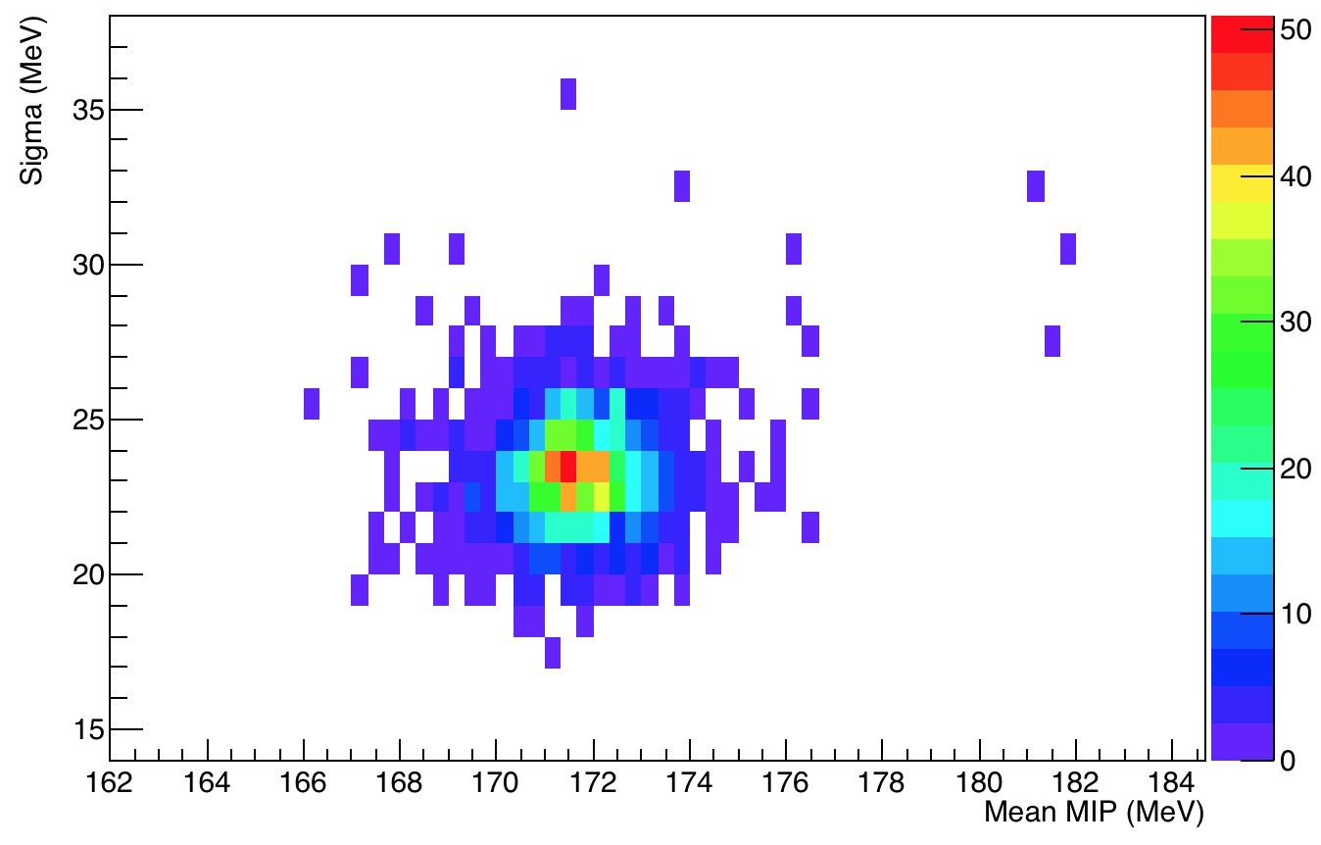
Scatter plot of Mean Vs. Sigma of fits – 60 hr
Tail of the distribution with MIP >180 correspond to C:16 X12, C:10 X:19 etc.

