Slide 1
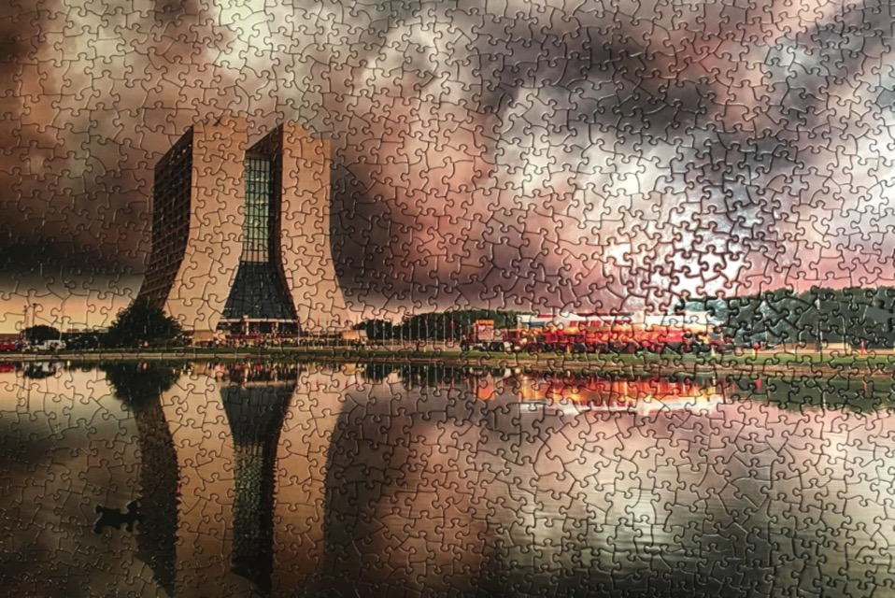
Calibration System of the the Muon g-2 Experiment at Fermilab
Nandita Raha, INFN Pisa
International School on Muon Dipole Moments and Hadronic Effects

Slide 2
Outline
Theoretical Background and Basic Technique
Experimental Setup and Systematics
Laser Calibration System
Local Monitors of the Laser Calibration System
Stability of the Local Monitors – time evolution studies
Stability of the Local Monitors – temperature studies
Conclusions
Notes:
2

Slide 3
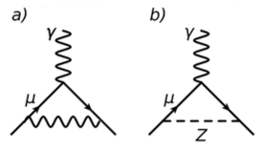
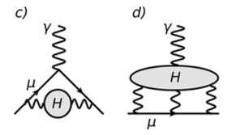
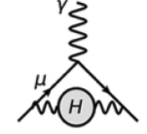
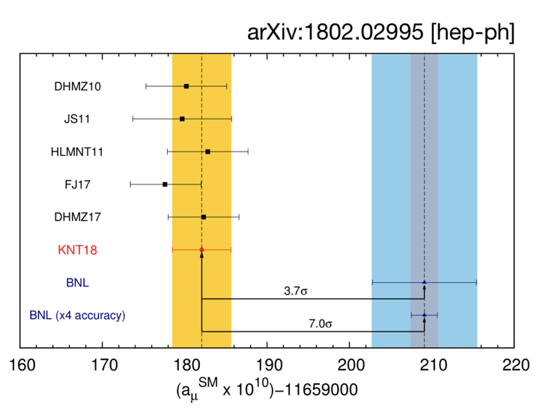
Muon g-2: The Basics
with g = 2 for a tree level anomaly (Dirac)
g = 2(Dirac) + Ο(10⁻³)_{QED} + Ο(10⁻⁹)_{EW} + Ο(10⁻⁷)_{QCD} + NP (?)
g_{SM} + g_{NP?} =
+
+
+
+
NP
3.7 σ
7 σ
3
Notes:
3

Slide 4
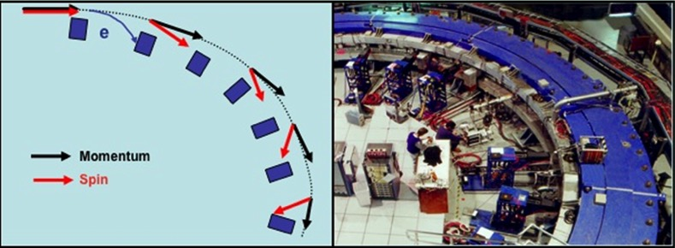
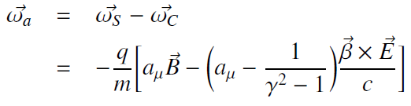
Muon g-2: The Experiment
with g = 2 for a tree level anomaly (Dirac)
B
Magic p = 3.09 GeV at γ = 29.3
4
Notes:
4

Slide 5
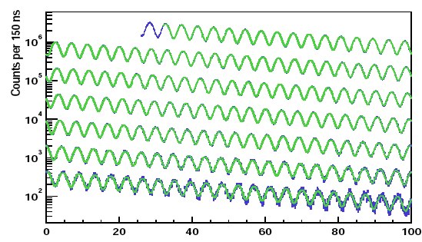
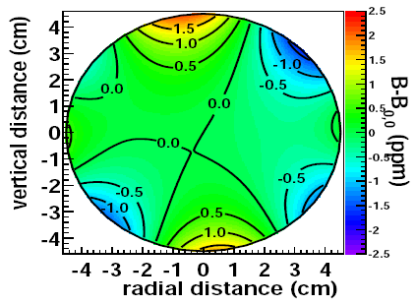
Muon anomalous moment measurement
Measure B → via NMR → recast a_{μ} in terms of proton precession frequency, ω_{p} (at B in its rest frame).
Muonic hyperfine experiment gives μ_{μ}/μ_{p} at ~26 ppb precision (ref. arXiv:1203.5425)
E821 data: e⁺ with E > 1.8 GeV
ω_{a}
ω_{p}
Systematic effects in the positron spectrum due to:
Pileup, gain stability
Beam Effects, Muon losses
5

Slide 6
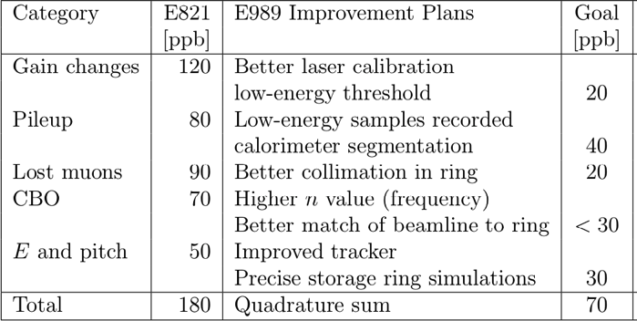
Systematic Improvements on ω_{a}
Systematics on ω_{a} 180 →70 ppb compared to E821. Achieved by:
Improved Calorimeters
Much improved Laser control system
New Straw Tracker (two installed in run1)
Key element:
Laser
Calo + Laser
Calo + Laser
Inflector + Kicker
Tracker

Slide 7
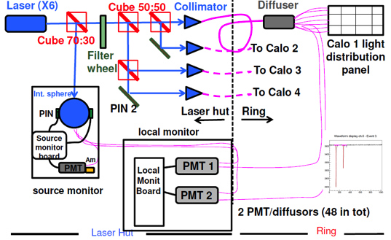
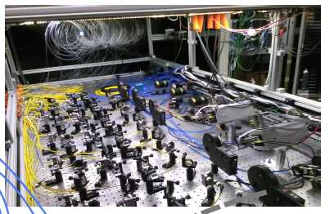
Monitoring / Calibration of Calorimeters - Laser
Laser calibration system –Optical fibers carry laser shots to each of the 1296 calorimeter crystals. One laser head sends light to 4 calos as shown in the right fig.
6 SM (source monitors - 2 pin diodes + 1 PMT) to check and correct for laser light fluctuations.
24 LM (local monitors) each with two PMTs that are used to check stability of the light distribution chain.
The picture on left shows the entire laser calibration system in the laser hut of the experimental hall.
7
Notes:
Make more slides – three points – explaining – Laser light on calo for calibrating them. SM to check fluctuations of Laser light and LM to check stability of the optical system

Slide 8
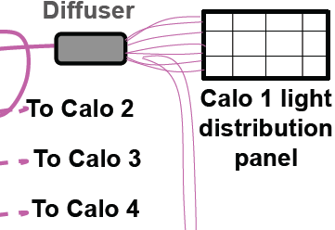
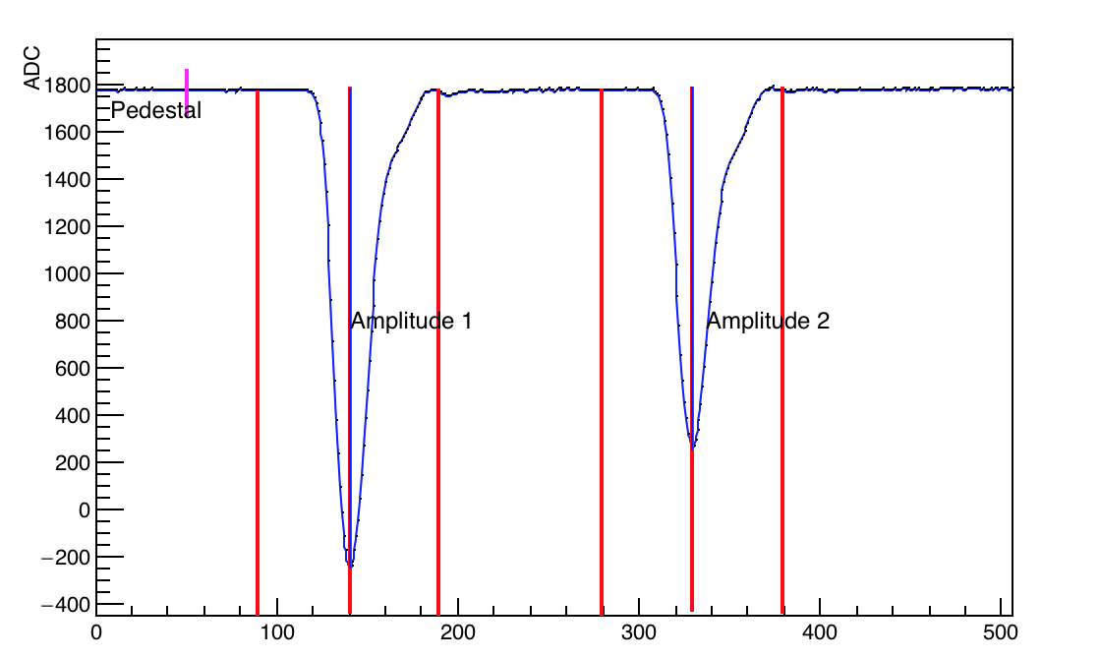
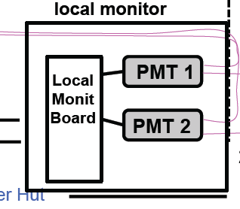
Local Monitors - details
A2=L*F*B, F= forward eff; B=Back eff
If F Gain changes SiPM should be corrected; IF B no
correction depends on R=A2/A1
Foward
Backward
A2
Quartz Fibre
WFD g-2
Local DAQ & eventually to WFD g-2
PMMA Fibre

Slide 9
LM Analysis – time evolution studies for 60 hours dataset 22/4 - 1:09 pm to 25/4 – 2:20 am

Slide 10
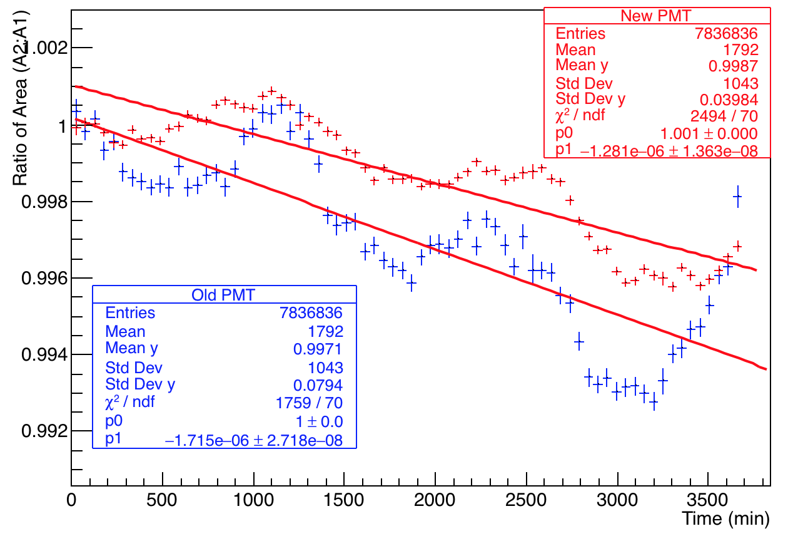
Comparison of old and new PMTs for Calo 20
New PMT – Calo 20, channel 4
Bin size = 50 mins.
Old PMT – Calo 20, channel 29

Slide 11
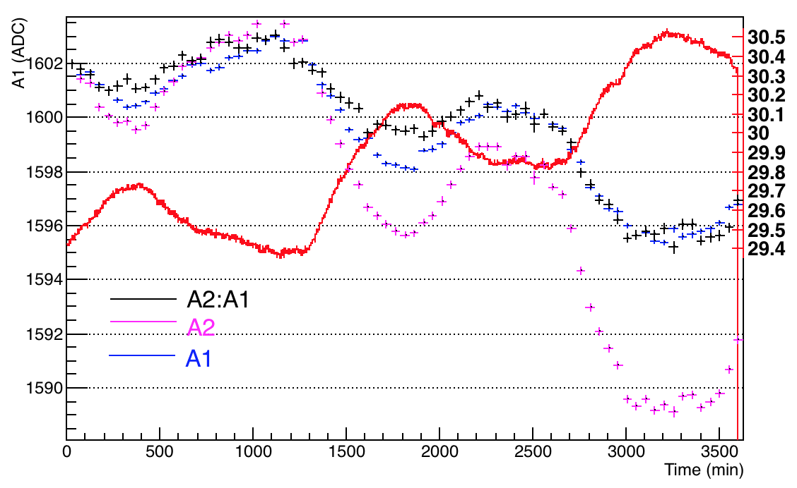
Temperature Variation – Channel 4
Overlaid temperature and A1, A2 and A2:A1 on the same plot, after normalizing all to A1 for consistency
Optical table temperature
Temperature (ºC)

Slide 12
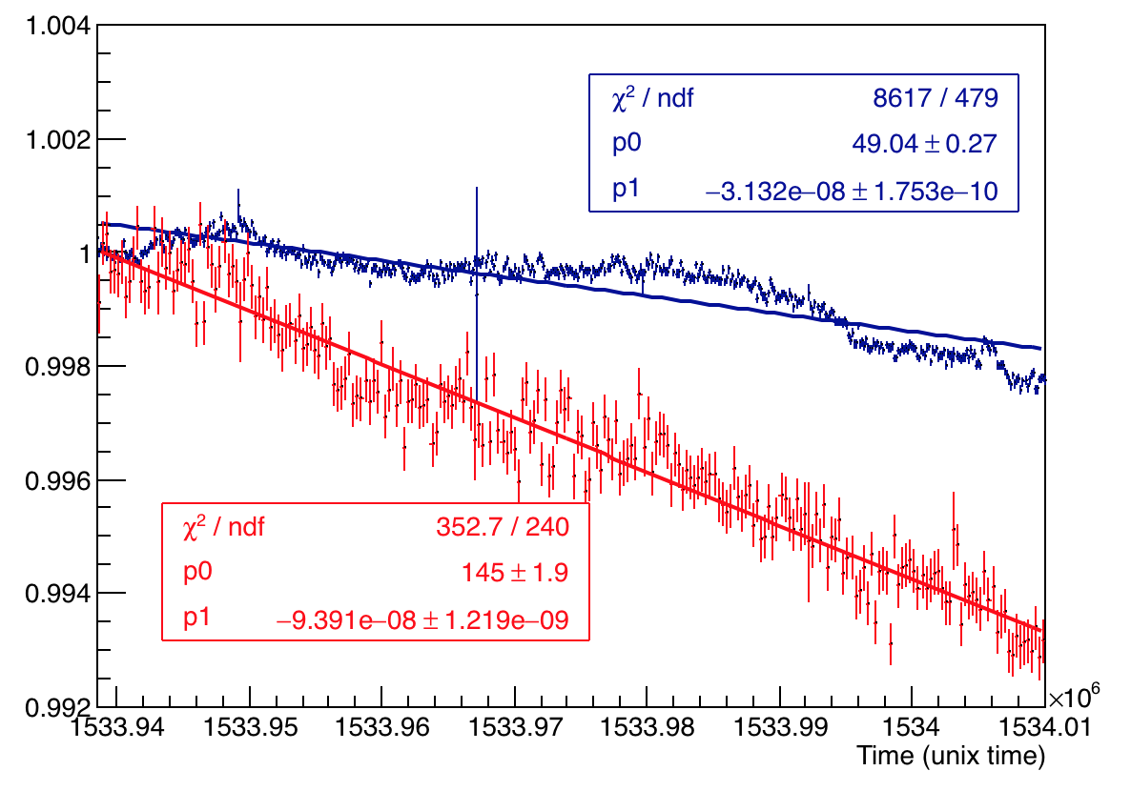
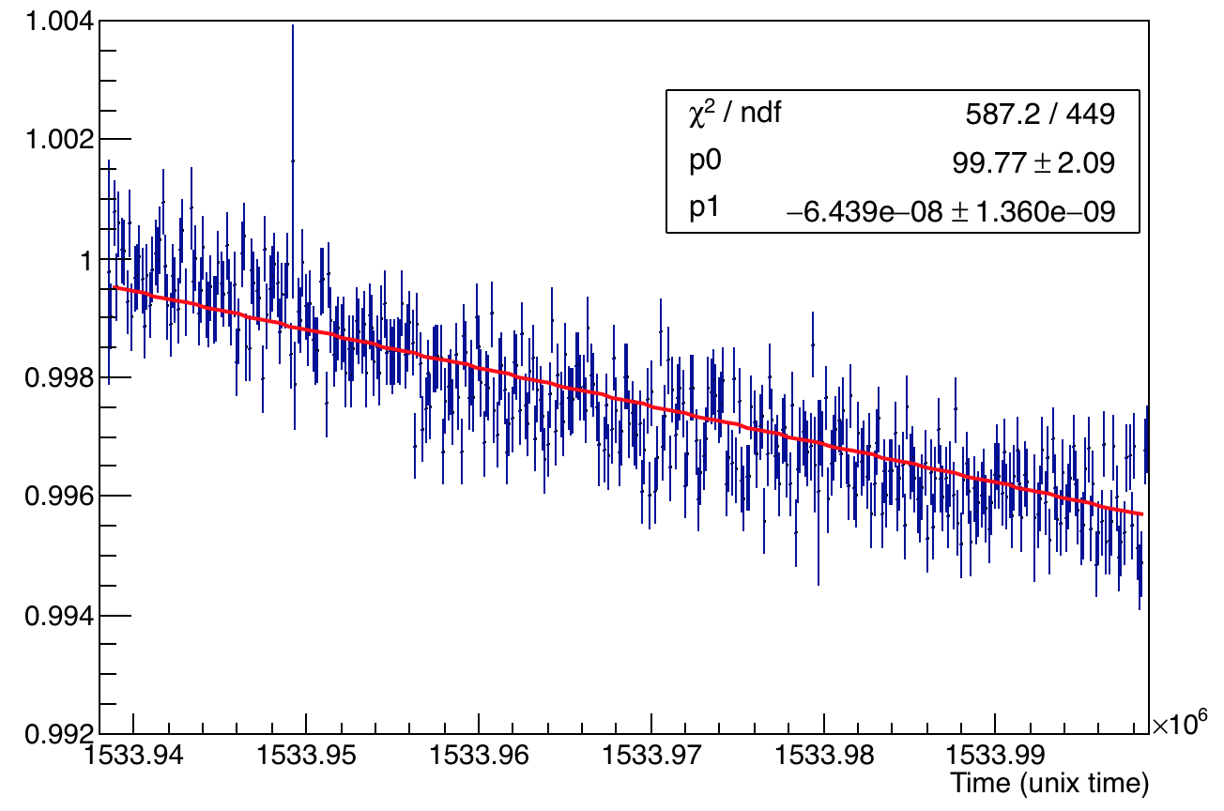
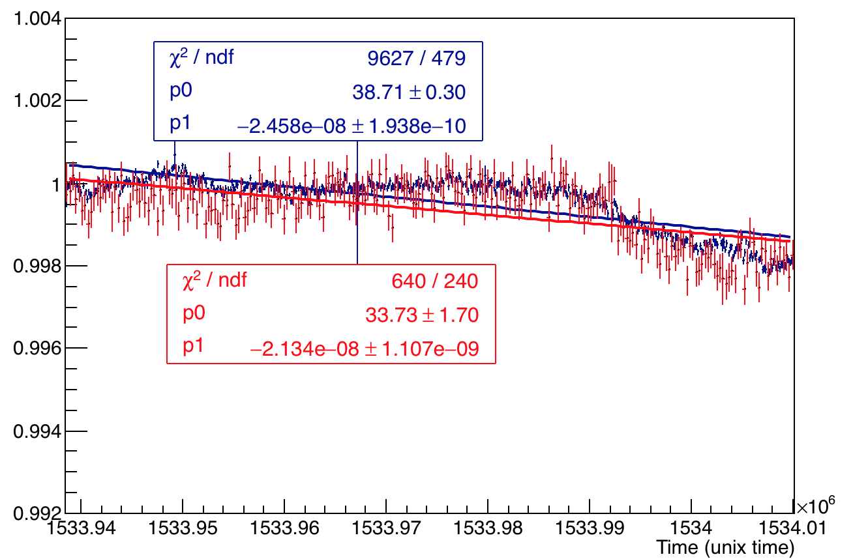
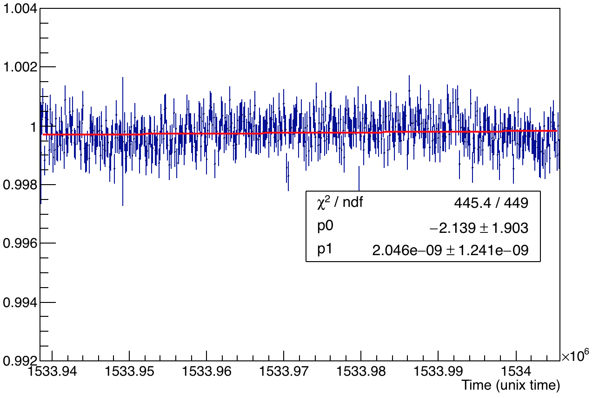
A1 and A2 overlaid and A2:A1 – 20 hr test dataset
A2:A1
PMMA Channel 23
Silica Channel 24
A2:A1

Slide 13
LM Analysis – temperature studies of 60 hr dataset 22/4 - 1:09 pm to 25/4 – 2:20 am

Slide 14
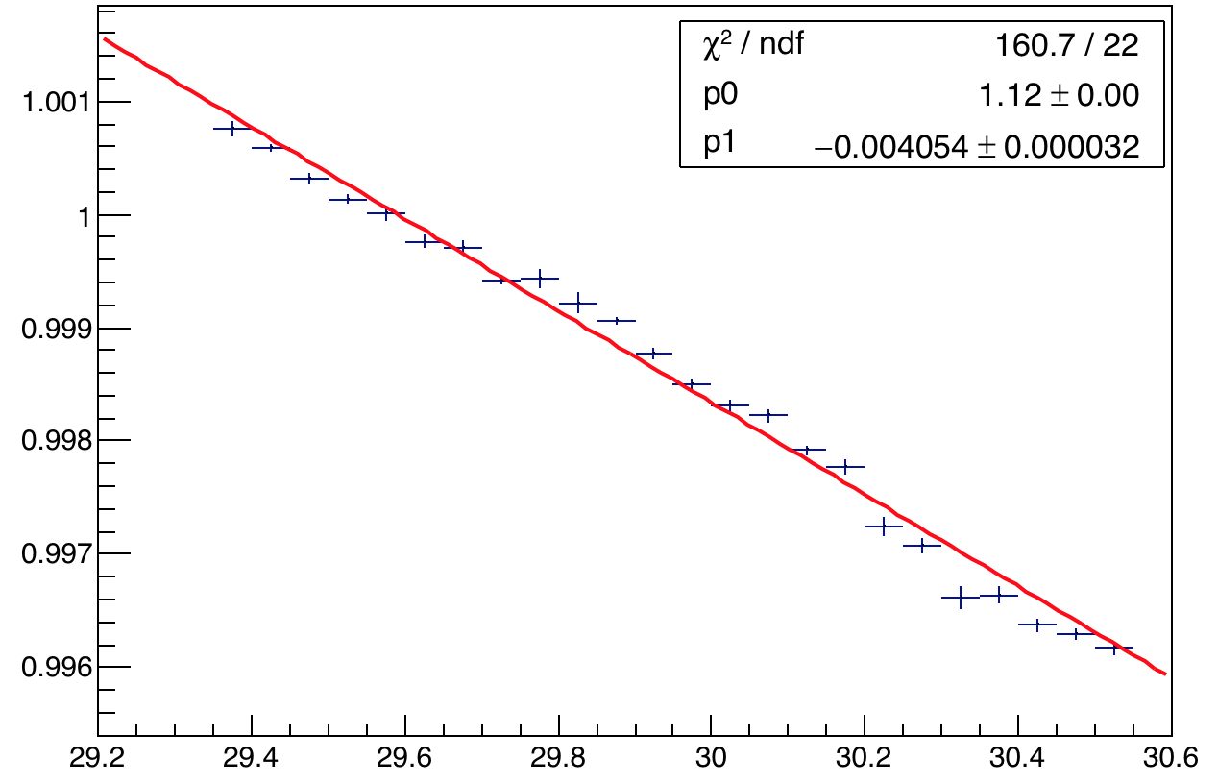
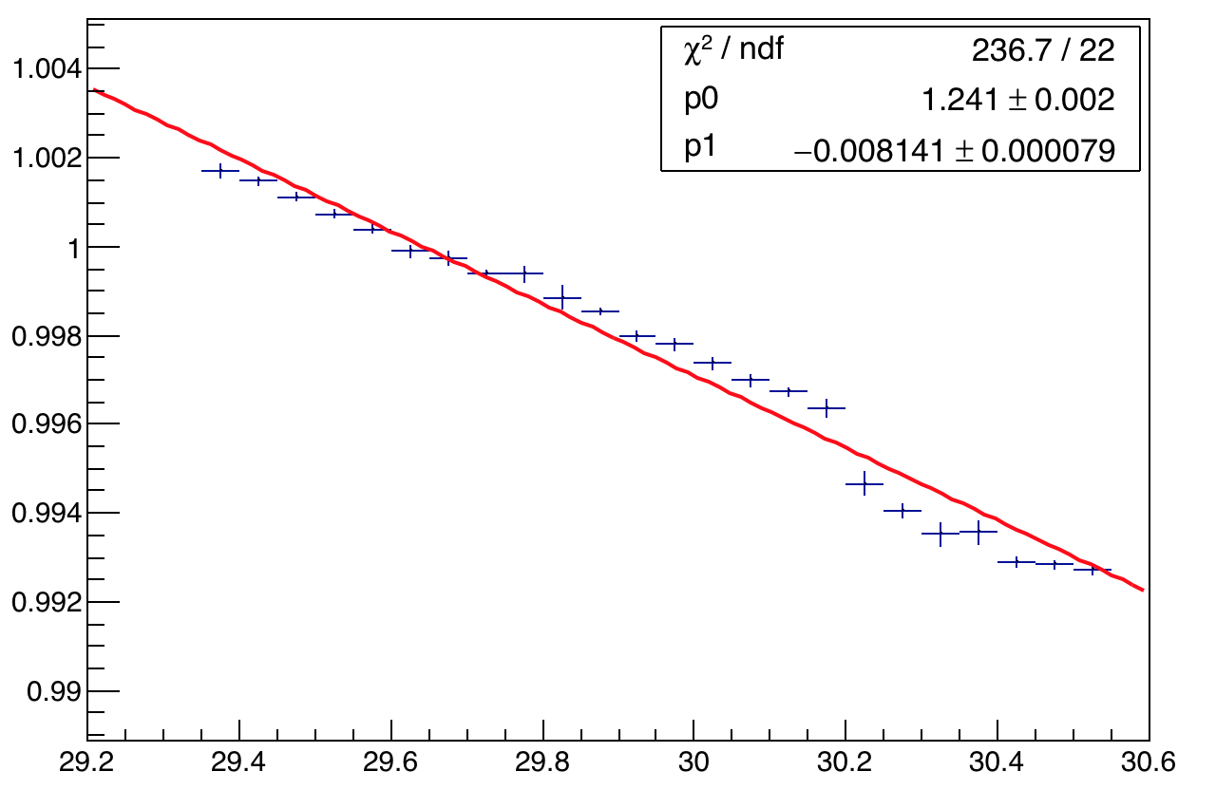
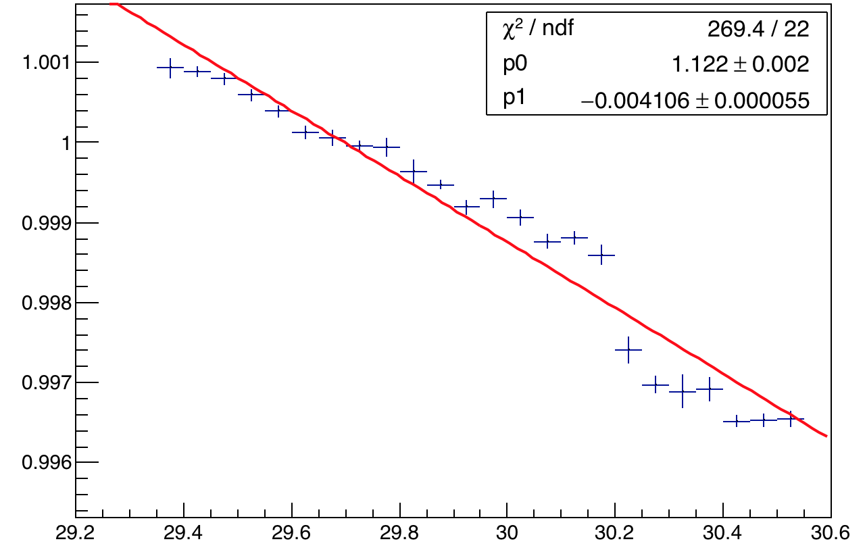
Amplitude Vs. Temp – Channel 4
A1
A2
Temperature (ºC)
Temperature (ºC)
The slope appears to change at 29.8 C.
A2:A1
Temperature (ºC)

Slide 15
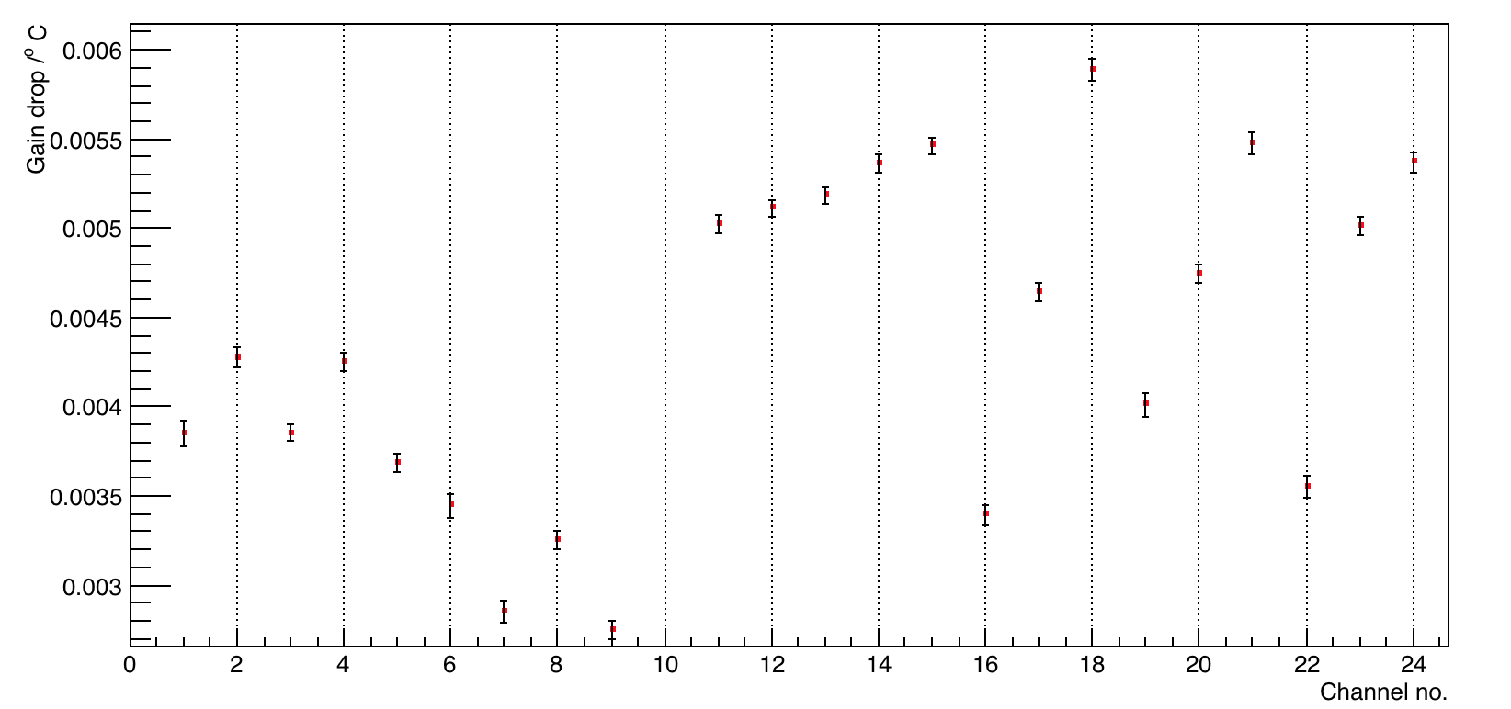
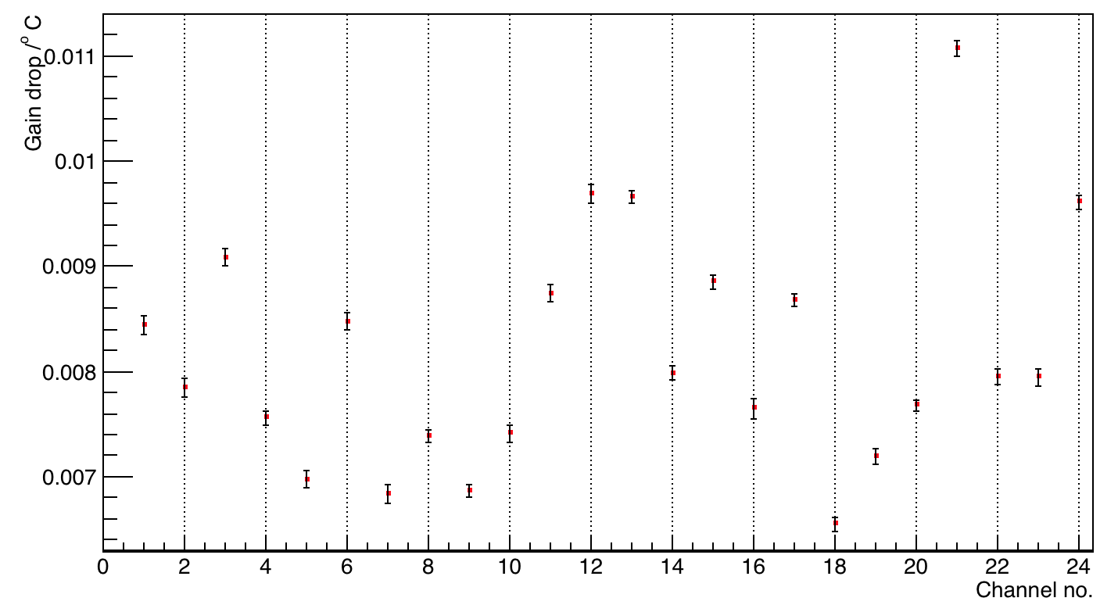
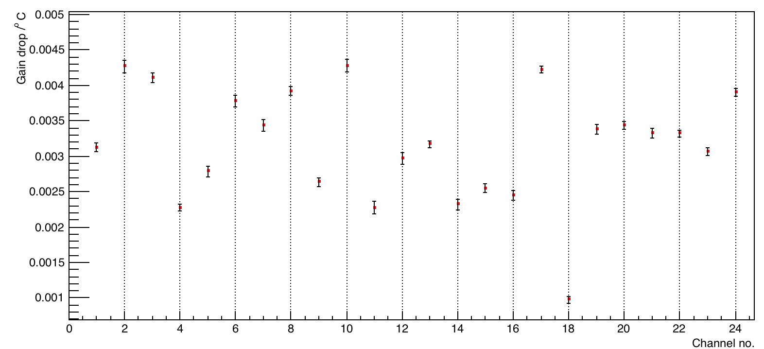
Amplitude Vs. Temp – channels 1 - 24
Amp 1
Amp 2
Results obtained by linear fits of each channel.
A2:A1

Slide 16
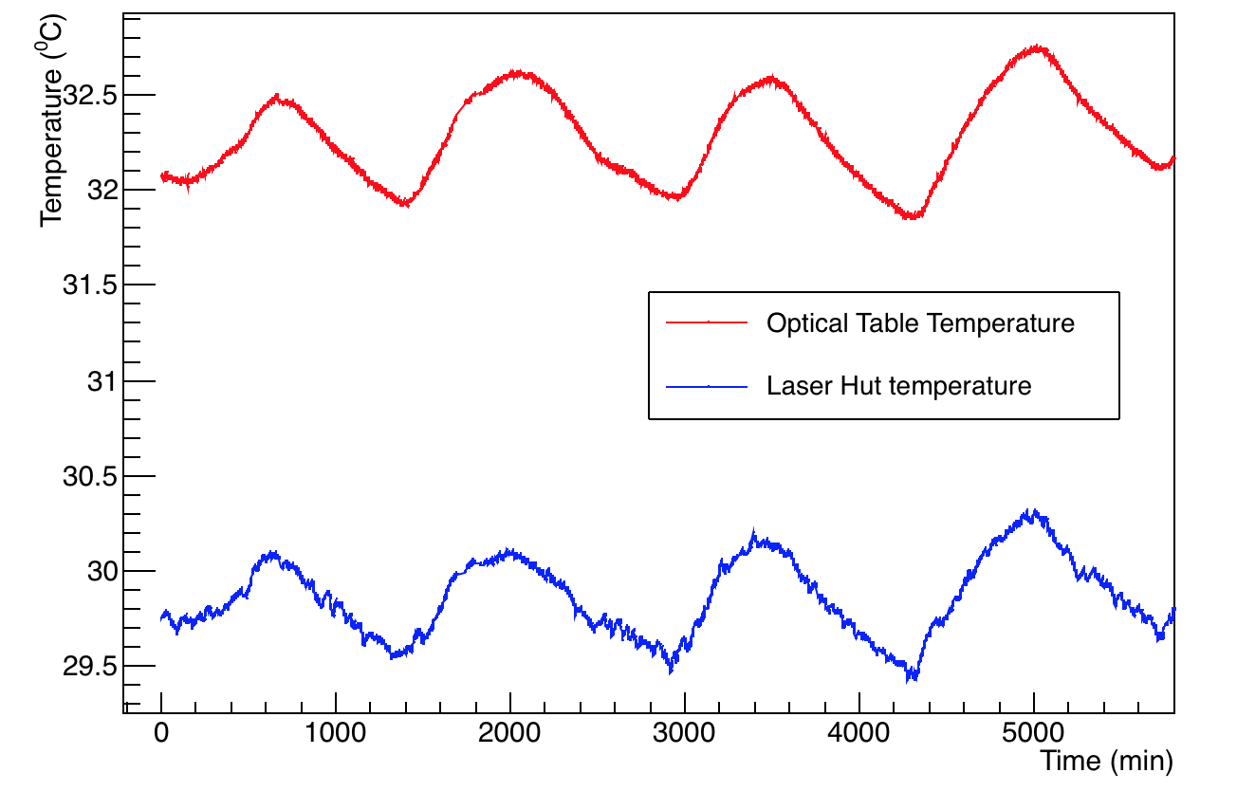
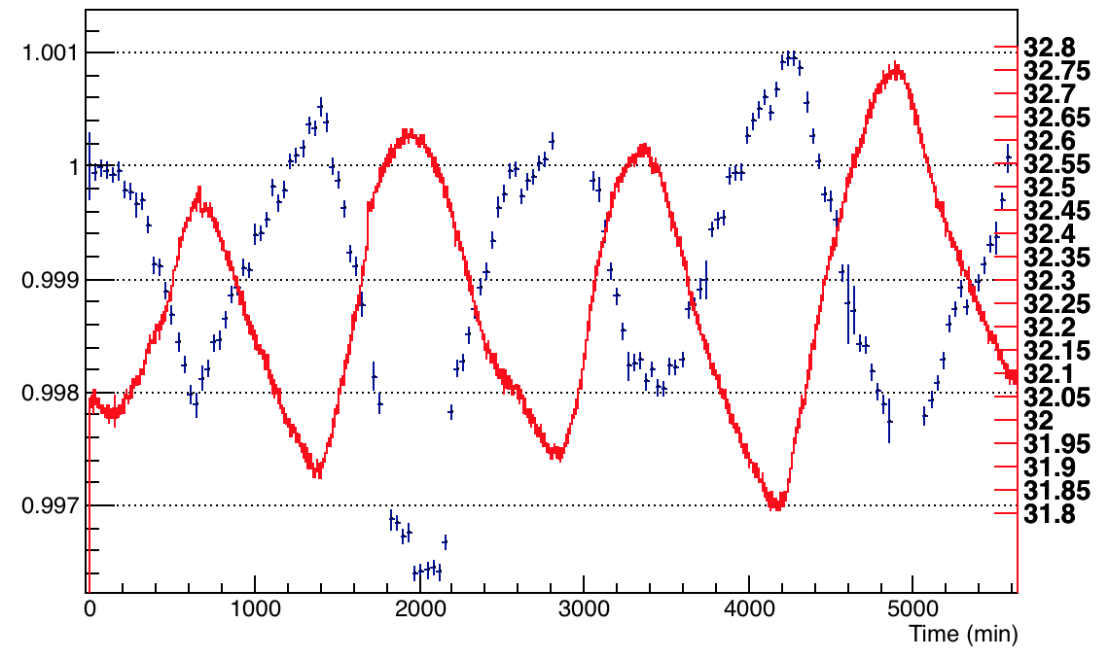
100 hours dataset – Temperature Vs. A1 – Channel 4
A different dataset confirming the negative temperature coefficient of gain with temperature. Around the temperature of 32.65 ºC, we had a couple of bad runs which causes a small distortion (red circle below).
A1 normalized
Thus, a cross check with another dataset and another channel confirms similar results
A1 (Normalized)
Temperature (ºC)

Slide 17
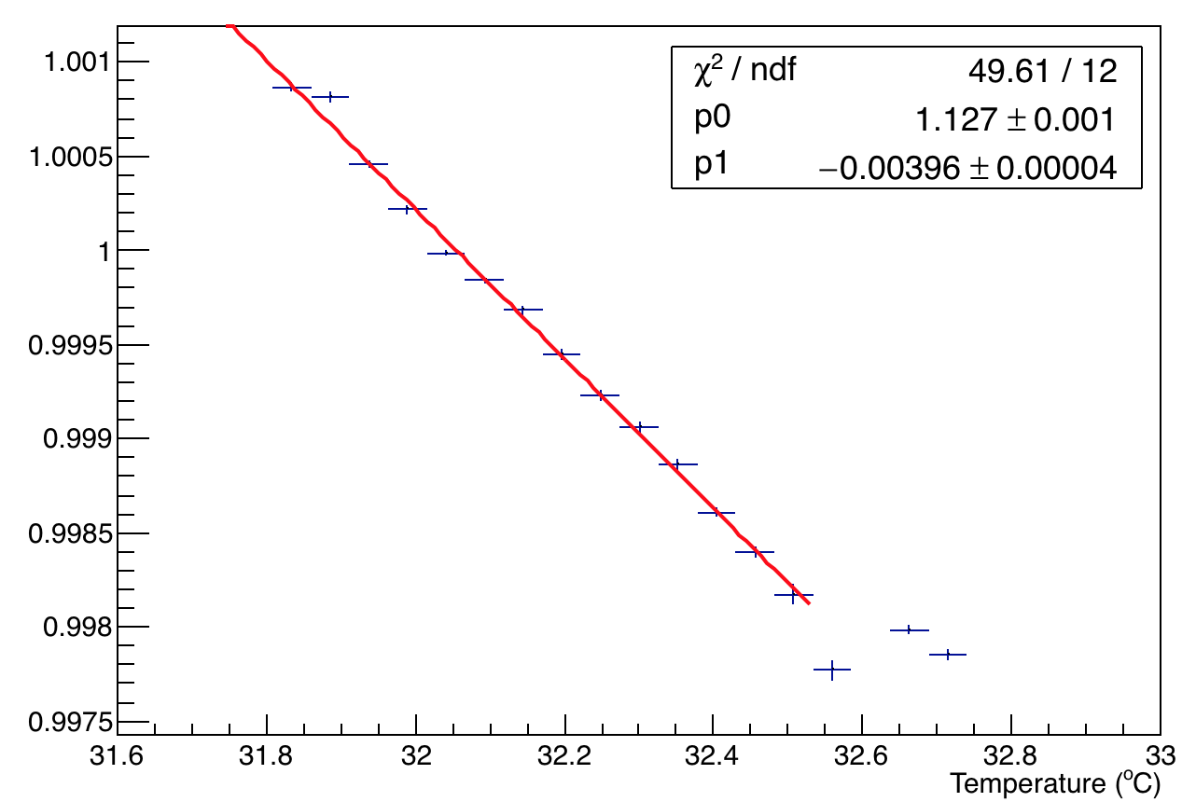
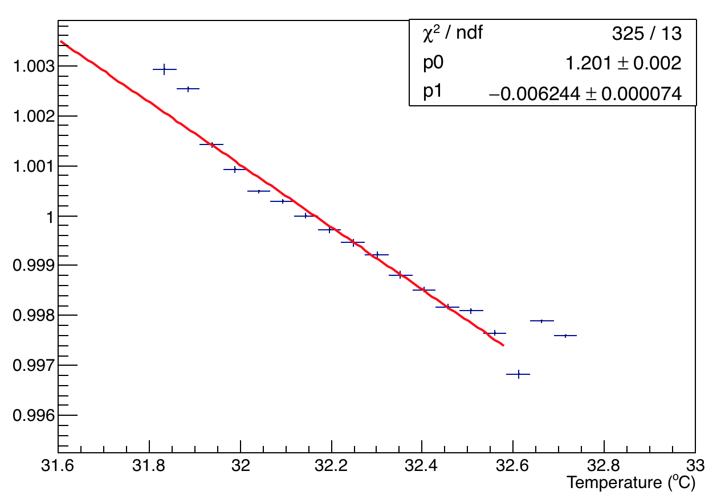
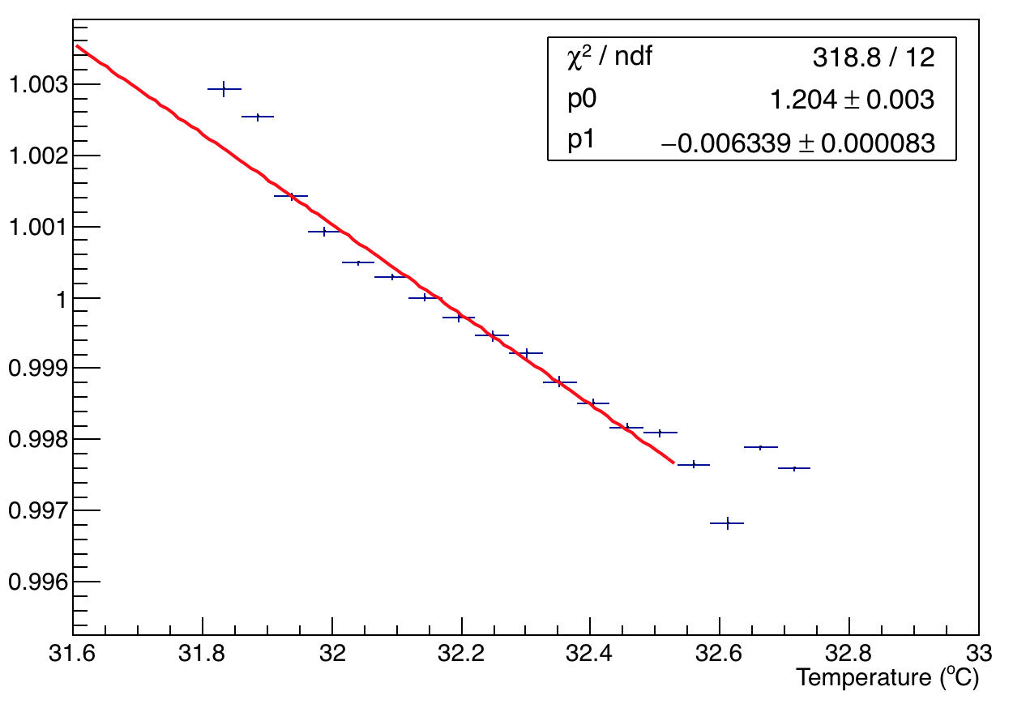
Temperature studies of 100 hour dataset
A1
A2
New PMT – Silica fiber both forward and return directions
A2:A1

Slide 18
Conclusions
Variation of A1 with temperature shows a negative correlation of PMT gain with temperature (as expected).
A2:A1 is almost constant with time for the (for longer time ranges some variation appears especially for the old PMTs)
Channels 0 to 23 i.e. the new PMTs (refer slide 9) show a comparatively stable A2:A1 drop with temperature (it ranges from ~0.1% to 0.45%) which is much better than the old PMTs and confirms a reasonably stable behaviour (in gain) which meets the required precision of the experiment.
Thank You!!

Slide 19
Back up slides

Slide 20
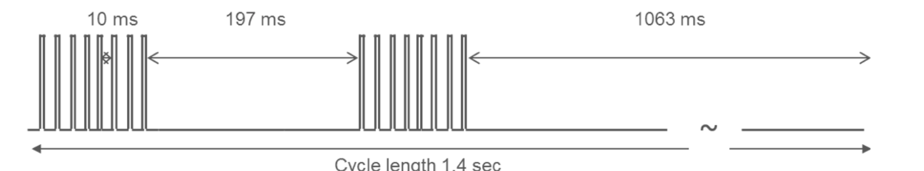
Back up and other basic info
About laser used – PicoQuant(LDH-P-C-405M), max pulse energy 1 nJ, pulse width 700 ps @ wavelength 405+10 nm max. repetition rate 40 MHz.
Beam fill structure: Fill is 600 us each. Has 3 out of fill windows of 10 ms, ~200 ms and ~1000 ms
Pulse quality display in next slides

Slide 21
Calorimeters
24 calo – each divided in a grid of 9x6 PbFl Cerenkov crystals read out with SiPM – 1 calo 54 SiPM (for better pileup) @ 800 MSPS, uTCA crates read by a MIDAS/U DAQ
energy res of 50 MeV at 2 GeV.
Pile up separation 4.5 ns and time res 25 ps at 3 GeV
Additionally have 3 straw trackers 128 straws Ar:CO2 gas – would help track positrons

Slide 22
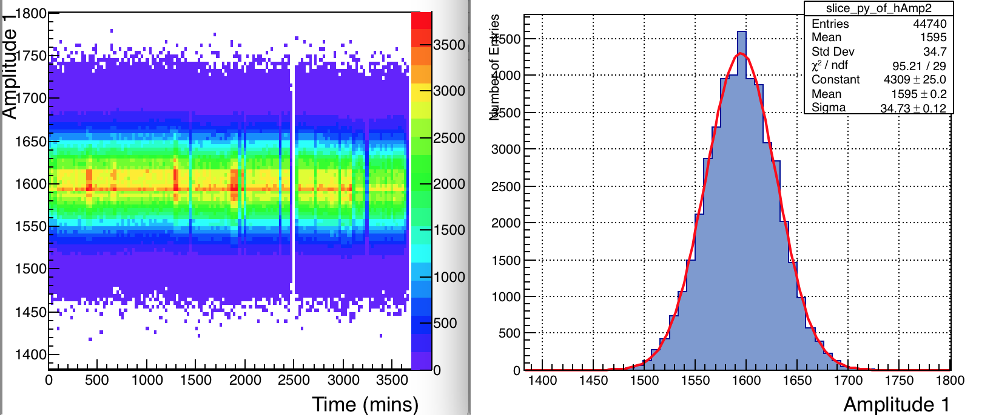
Some Studies/Observations –Scatter plot and projection of a bin – good Gaussian

Slide 23
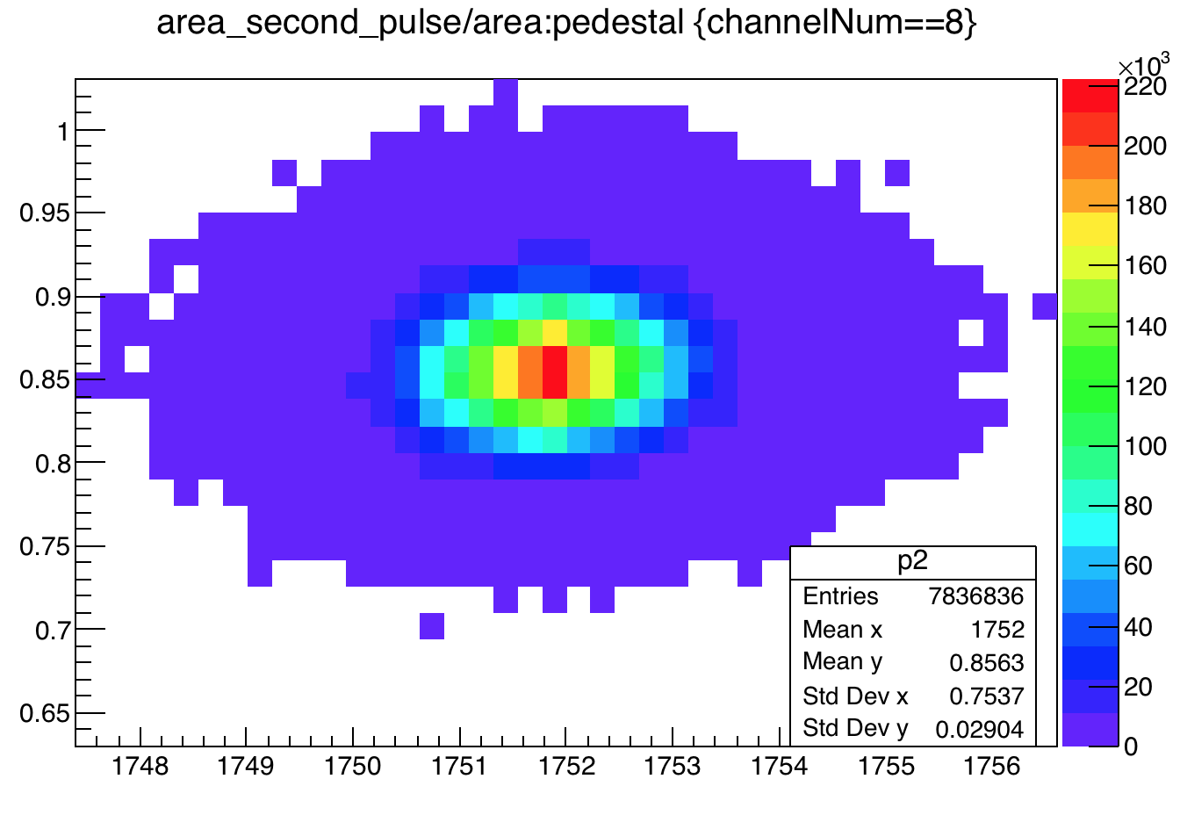
Correlation between Ped / amplitude ratio

Slide 24
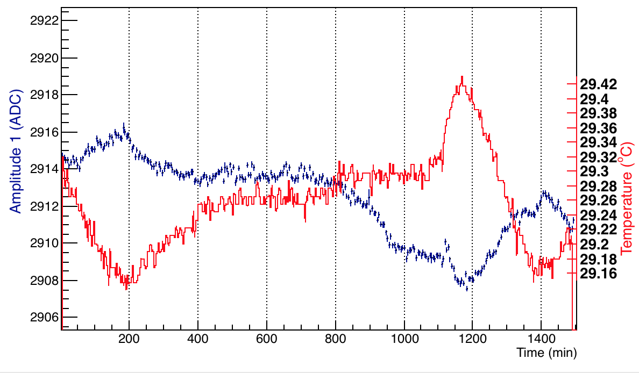
Revisit temperature
A1 with temp overlaid. Again shows negative correlation. Analyzed till 1100 mins. Explains plots of slide 12.

