Slide 1
Status of the Local monitors – follow up
N. Raha, INFN Rome2

Slide 2
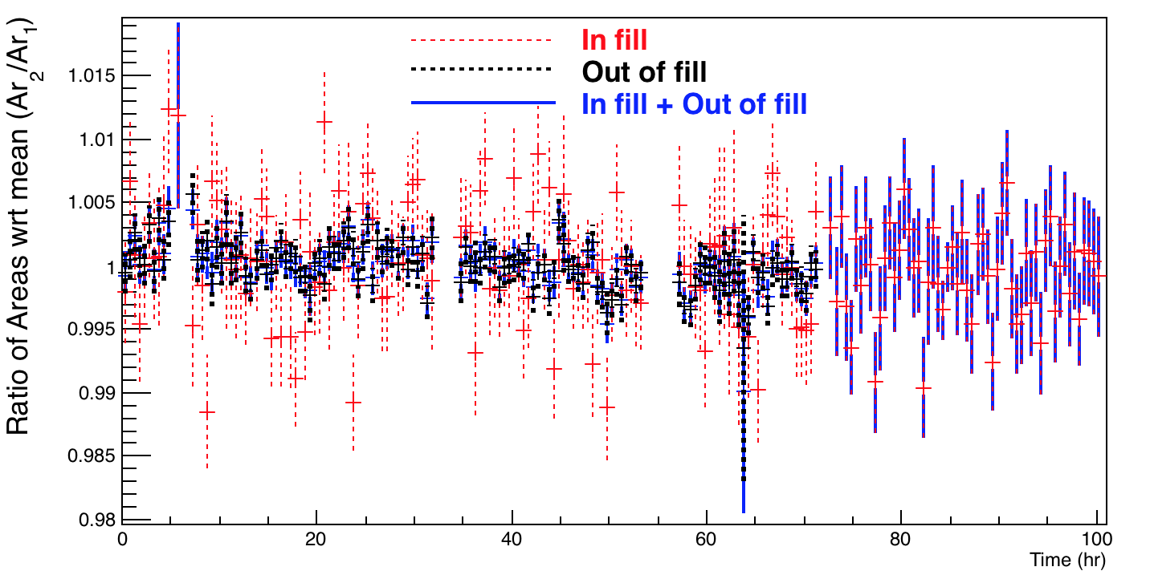
Local Monitor - updates
Updated the amplitude studies with Areas instead. No particular difference found.
Channel 10 (same as before for the same data set) checked for consistency.

Slide 3
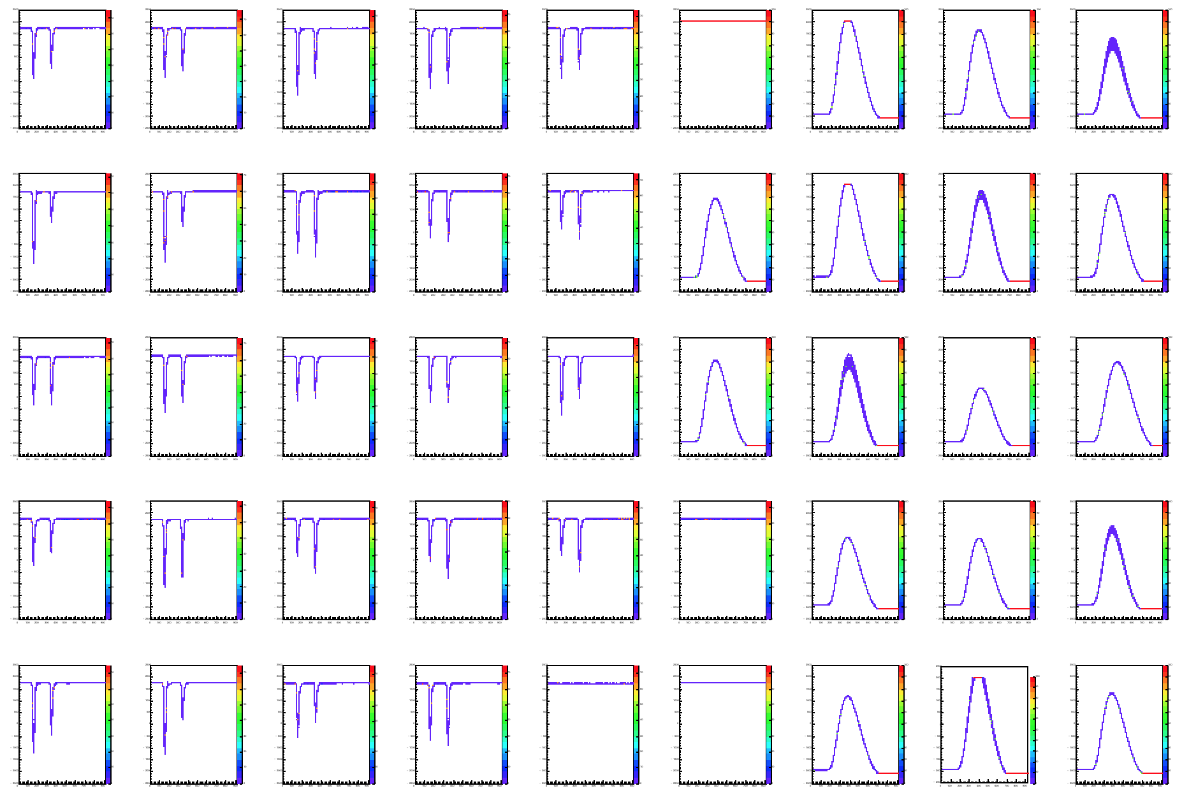
Laser Monitoring System
Map of the laser monitoring system from reconstruction. The red block shows the 17 SMs (SM6 PMT not working shown by red cross and channel 15, 20 and 19 are not connected shown by blue crosses) and the rest show the 24 LMs.
LM
SM

Slide 4
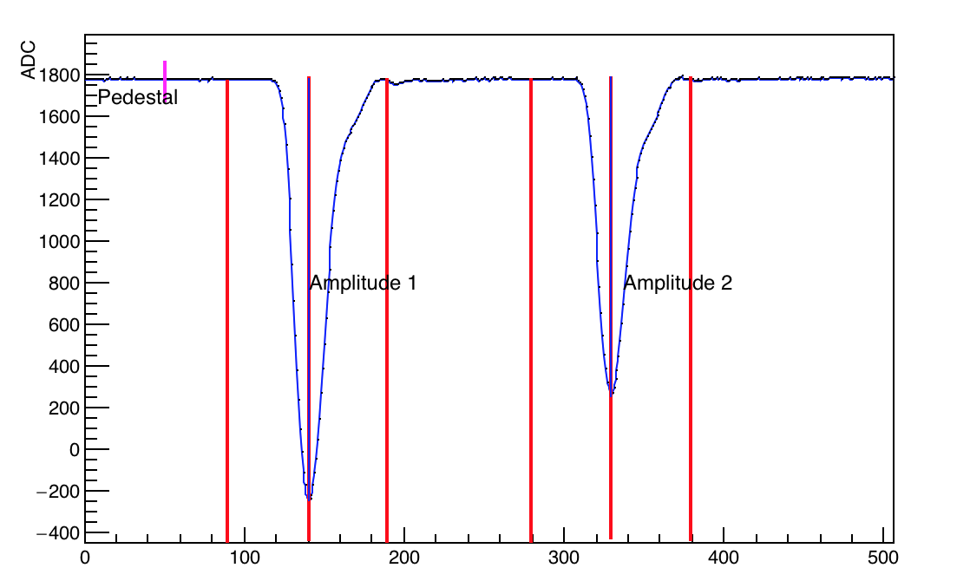
Parameter definitions
Pedestal: Average first 50 samples
Amplitude: Pedestal subtracted peak sample
Area window: + 50 samples from peak.
Sample number
Note: Same definitions for SM too.

Slide 5
Offline Studies
Studies of SMs with WFDs and comparison with custom (Naples) electronics:
Signal amplitude
Stability of SMs.
LM studies:
Signal amplitude
Stability of light chain (amplitude ratio of the 2 LM pulses)
PMT Pedestal
Time interval between the two LM pulses

Slide 6
Time Evolution Studies Runs 1791 to 1869 (1st to 4th July) Source Monitors

Slide 7
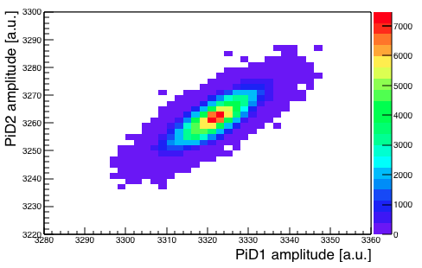
SM from WFDs
Scatter plot between amplitudes of PiD1 and PiD2 shows a strong correlation, for SM4 which, follow the laser light fluctuations.

Slide 8
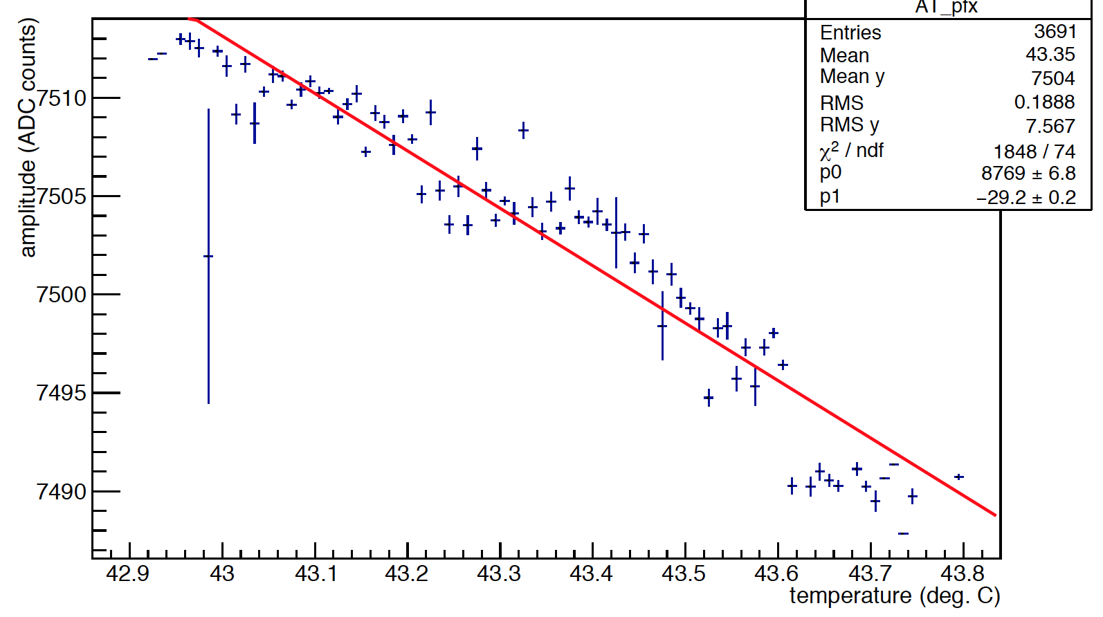
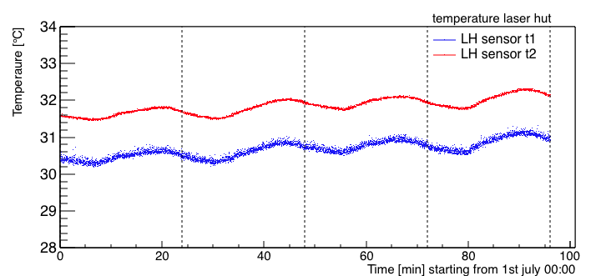
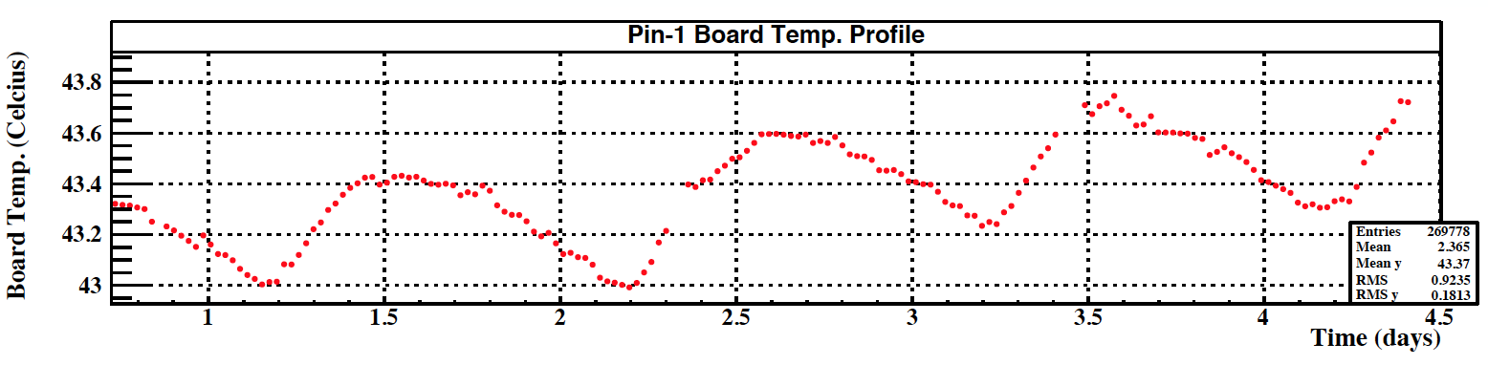
Temperature Dependence
The amplitudes depends both on the ambient temperature (of the laser hut) and on the PiD read-out boards. The board temperature(43 ºC) is higher than the room temperature, but its variation follows the trend of the room temperature.
Laser hut room temperature – read by Slow control
Custom Naples Board of the PIN 1
Gain variation -0.4%/ ºC

Slide 9
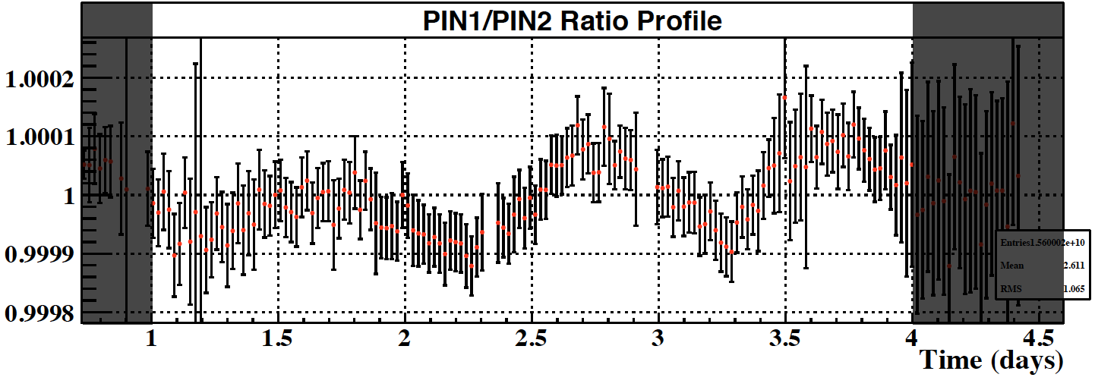
Source Monitor 4
The ratio of amplitudes of PiD1 to PiD2 is a measure of the relative stability of the front end and readout electronics. Compared with two independent systems i.e. WFD’s and custom Naples electronics. Lines correspond to an ~10^{-4.}
Custom Naples Electronics
WFDs

Slide 10
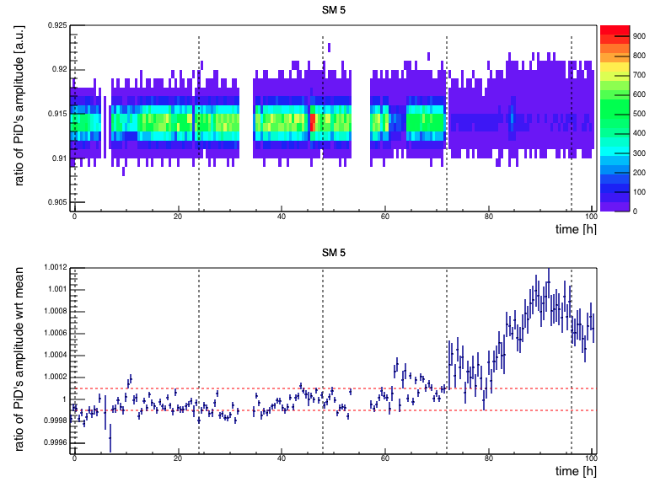
Source Monitor 5
The relative stability is not very good here. Need to investigate the reason for the drifts here. We can’t compare with the custom Naples electronics as SM1, SM5 and SM6 could not be read by their boards.

Slide 11
Summary of SM
Aim to achieve a stability of ~ 10⁻⁴ (stability is measured by the amplitude ratio of PiD1:PiD2).
Check this stability with two independent systems i.e. WFDs and custom Naples electronics .
We see local drift for certain PiDs which we are investigating.

Slide 12
Time Evolution Studies Runs 1791 to 1869 (1st to 4th July) Local Monitors

Slide 13
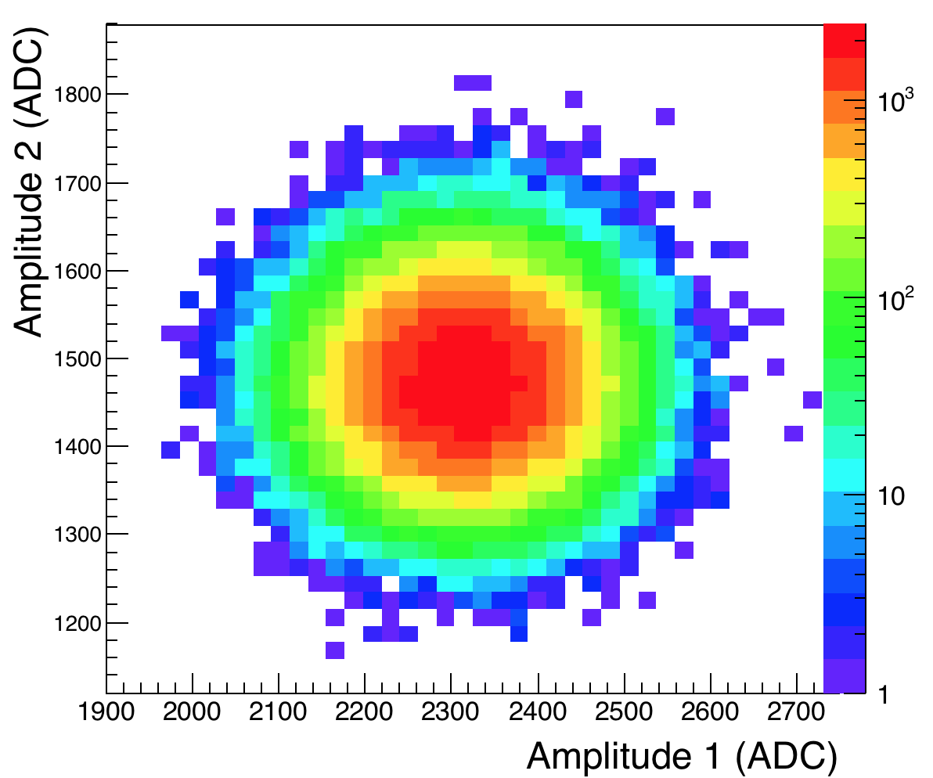
LM Amplitudes
Scatter plot between amplitude 1 and amplitude 2 – almost no correlation for a particular channel – selected this for investigation. PMT fluctuations are larger than laser fluctuation.

Slide 14
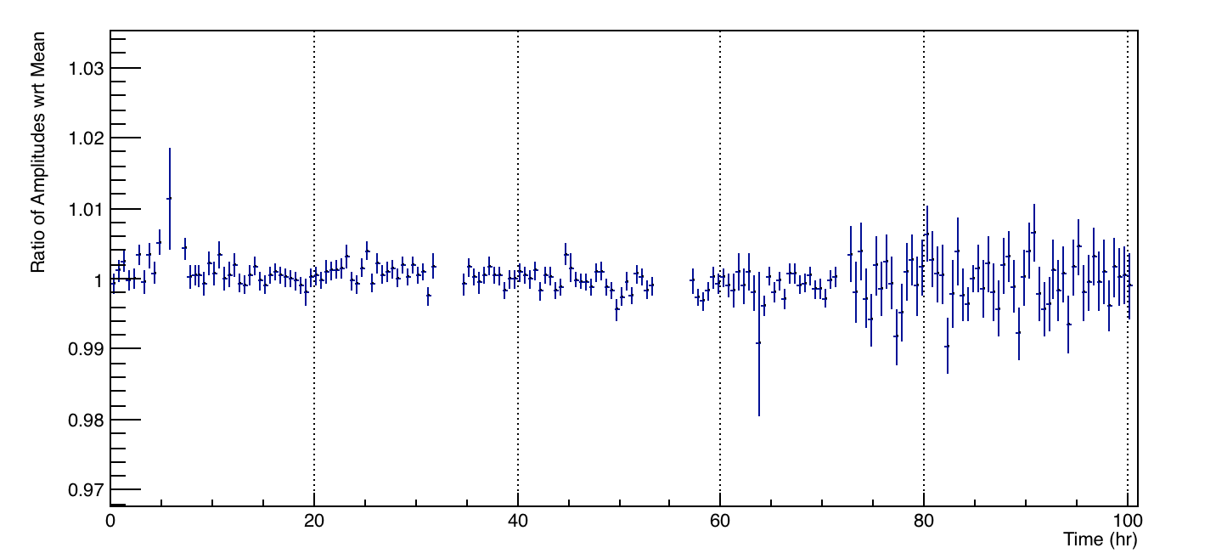
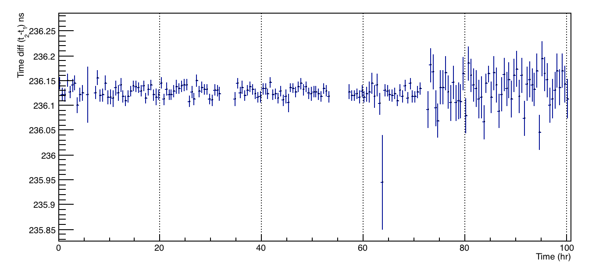
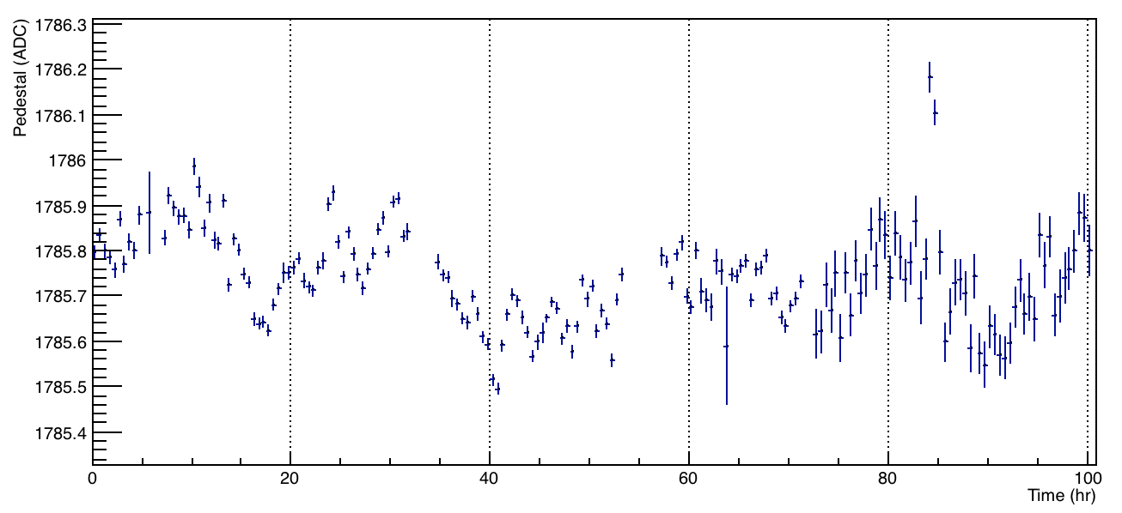
Stability checks – One channel
A₂/A₁
Time difference: t₂ - t₁
Pedestal

Slide 15
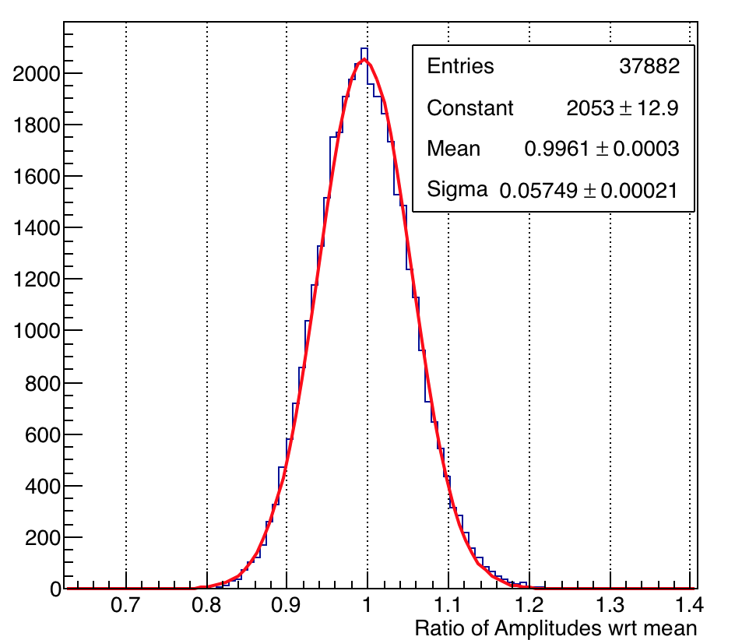
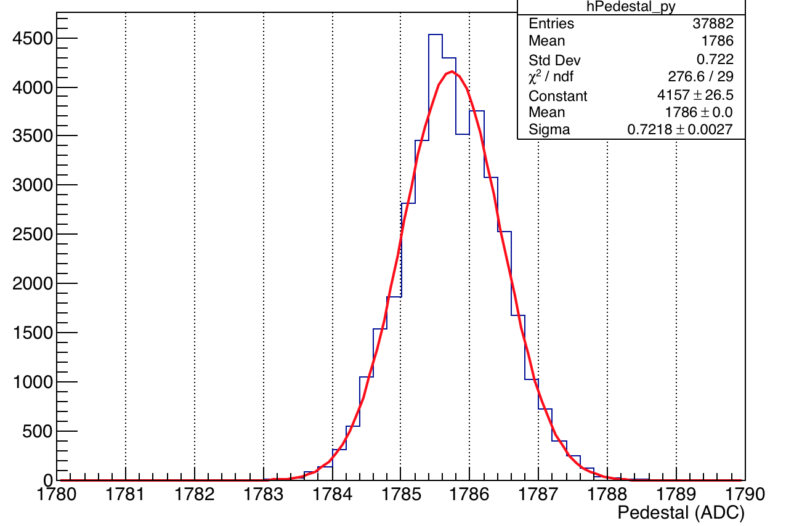
Stability Checks for a Channel
Pedestal
A₂/A₁ wrt mean
Sigma 0.72 counts
Sigma 5.7%
Perform this on all channels and study the variation of sigma (spread) to check stability of pedestal and amplitudes of both pulses. We also investigated the time difference t₂-t₁ for all channel (did not show it since we have just three time bins).

Slide 16
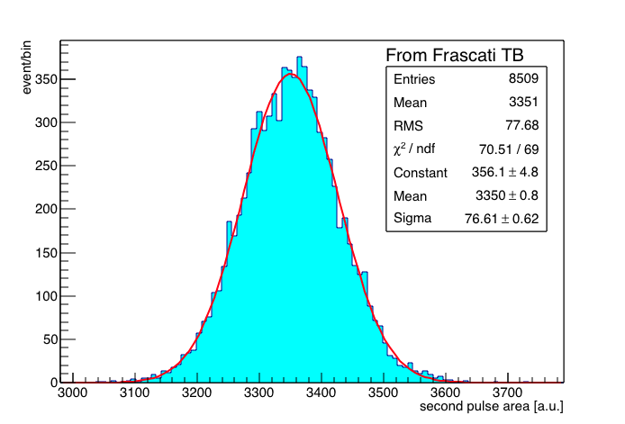
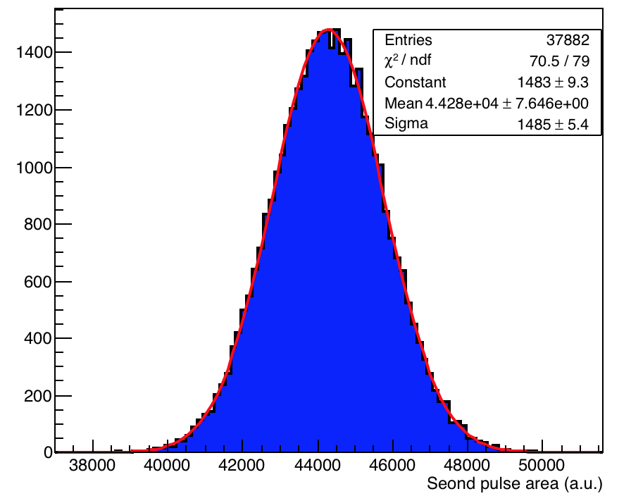
Area Studies
Fitted area distribution of all waveforms of each channel with a Gaussian and plotted the mean values and the reduced χ² . 8th local monitor channel and second pulse area (right plot). Same for Frascati test beam (left). A broader spread un this run is due to smaller number of photo electron arriving at the calorimeter. The main effect corresponds to a factor of on the σ (as observed).
Equivalent pulse energy ~ 2 GeV
Equivalent pulse energy ~ 1 GeV
σ/mean= 2.2%
σ/mean= 3.4%
σ/mean= 2.2%
Runs 1791 to 1869
Courtesy: A. Druitti

Slide 17
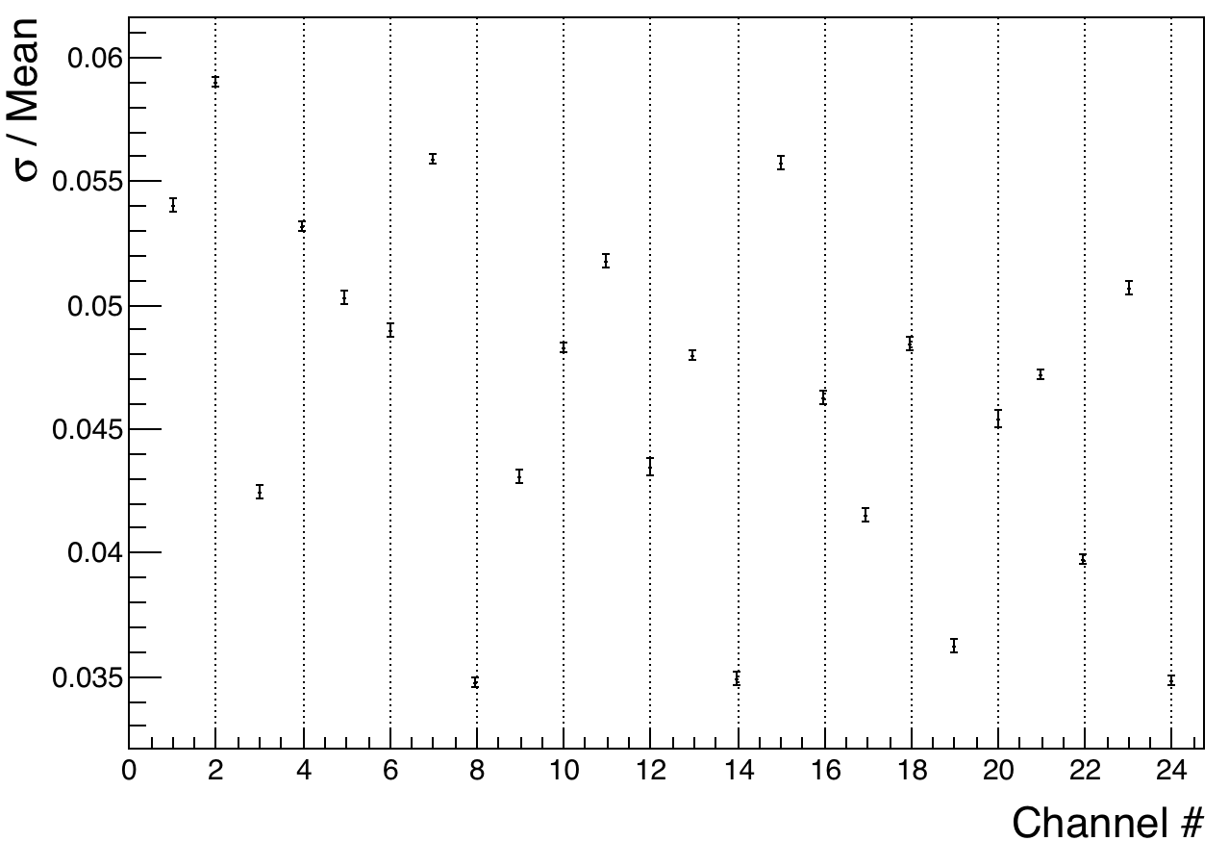
Area A₂ Width Vs. channels
Shows the sigma/mean (width) for all channel.

Slide 18
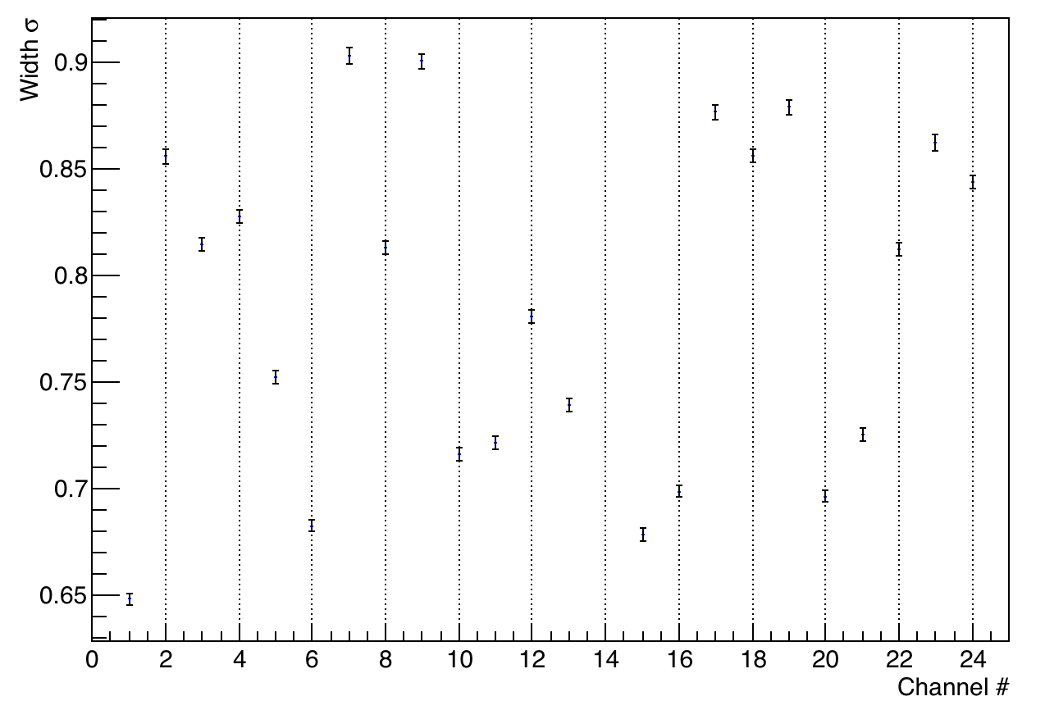
Pedestal Width Vs. channels
Shows the sigma (width) for all channel.

Slide 19
Summary of LM
Ratio σ/mean of area of second pulse varies from 3.4 to 5.9%, higher than the Frascati test beam (~2.5-3%) . A beam of laser light equivalent of 1 GeV compared to Frascati beam (of ~2 GeV), introduces a reduction by a factor of in the width (i.e. ratio σ/mean) which depends on the number of photoelectrons (PE) arriving on the calorimeters .

Slide 20
Conclusion
The stability of the SMs measured by amplitude ratio of PiD1:PiD2 is generally good (of the ~10⁻⁴), but some noise and temperature dependence have been observed, which we need to understand.
LM don’t see too much fluctuations. Optimization of light will stabilize and improve their behaviour.
Redefining the parameters of the pulse ( like pedestals, amplitudes, areas etc.) using a template fit or any other sophisticated fits might help in achieving a better stability of both the SMs and LMs.

Slide 21
Backup Slides

Slide 22
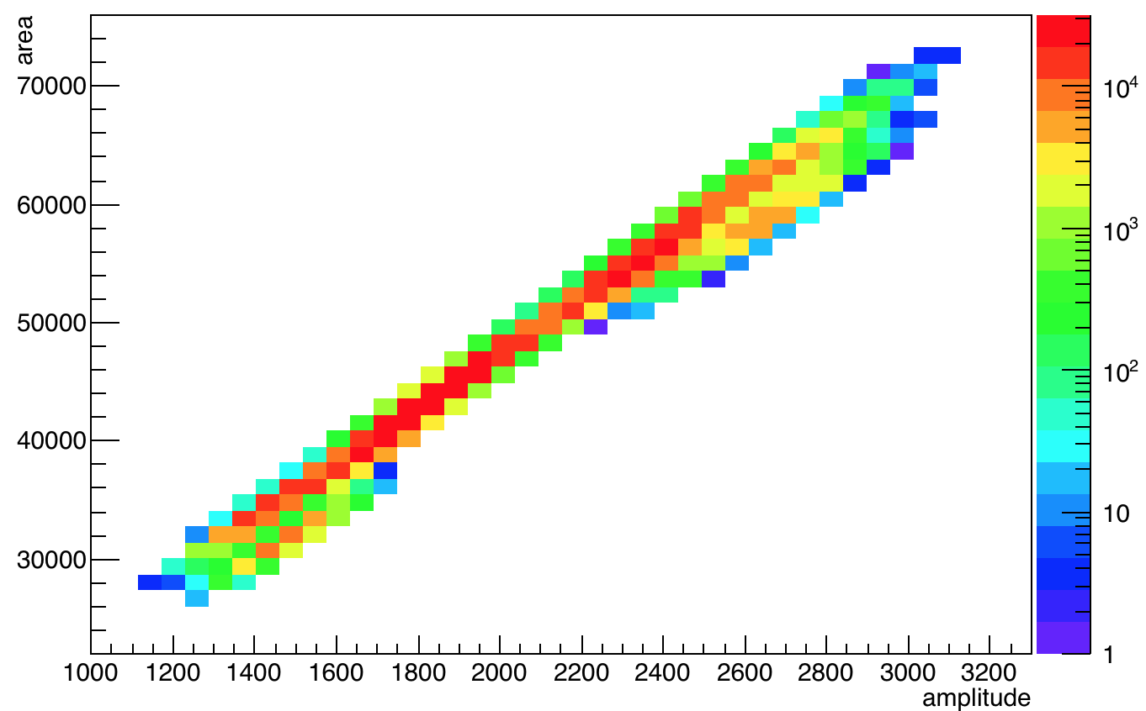
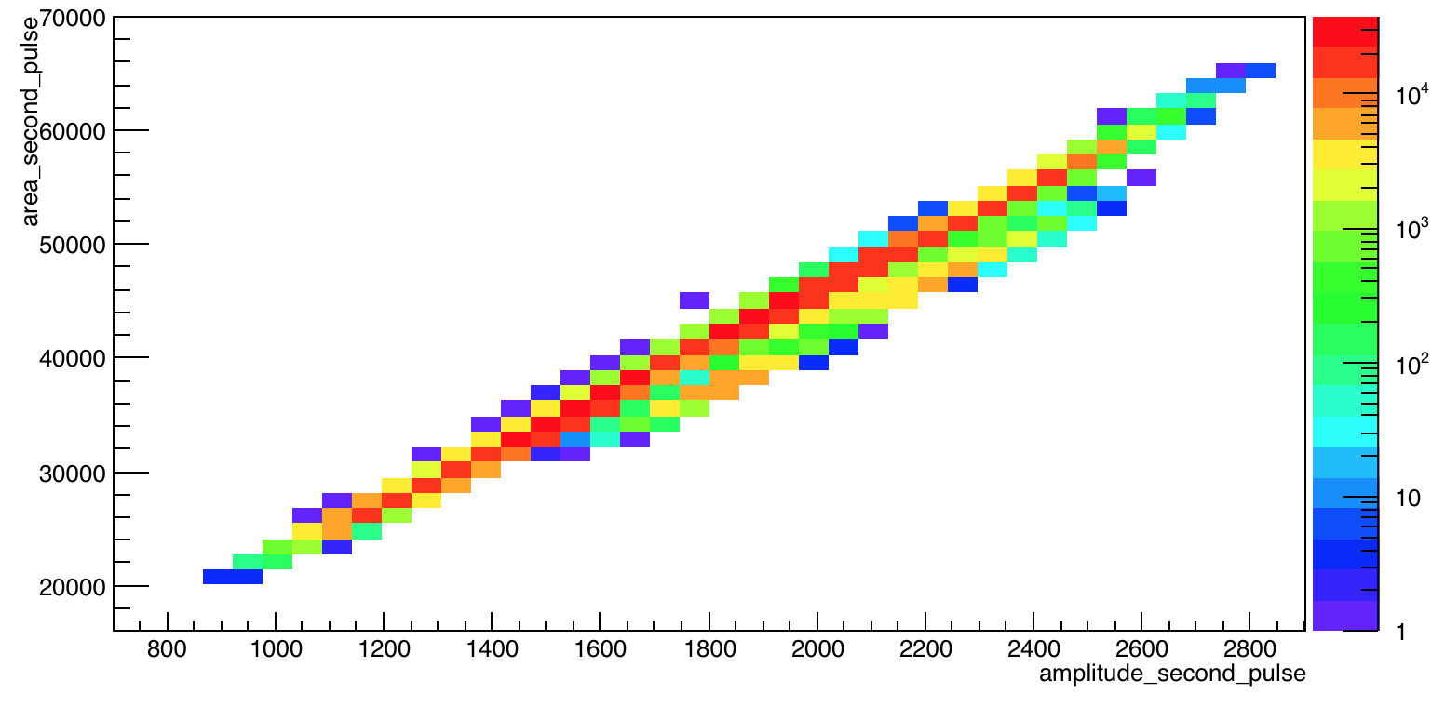
LM: Amplitude Vs. Area
The amplitude and area are proportional as shown 1st pulse (left) and 2nd pulse(right) for channel 1.
Runs 1791 to 1869
1st – 4th July

Slide 23
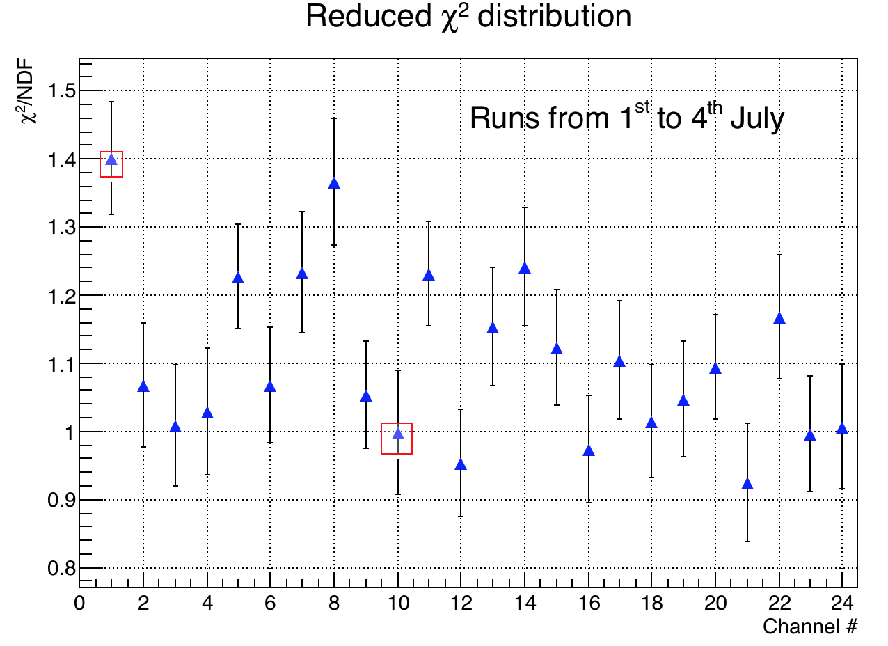
Amplitude Studies – First pulse
The Gaussian distribution of amplitudes for each channel is fitted and the reduced χ² distribution is plotted to chose a suitable channel.
Within a fill
Error is 1/[2*sqrt(NDF)]. Selected channel 10 (calorimeter 15) with least reduced χ² for time evolution studies.

Slide 24
SM1 from WFD’s

Slide 25
SM2 from WFD’s

Slide 26
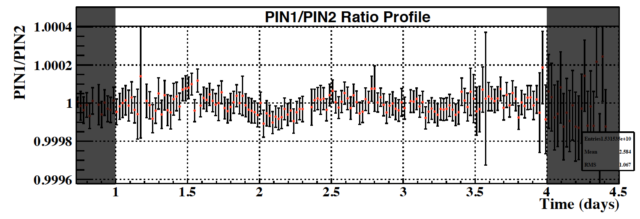
SM2 from custom (Naples) board

Slide 27
SM3 from WFD’s

Slide 28
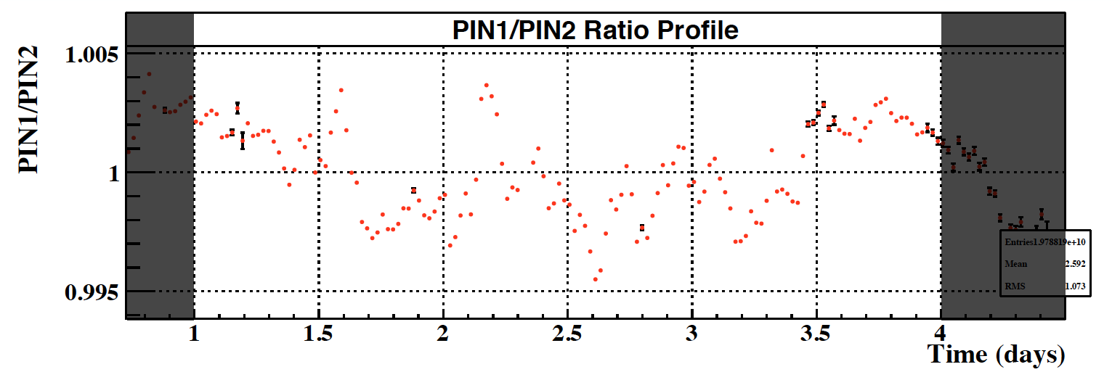
SM3 from custom (Naples) board

Slide 29
SM5 from WFD’s

Slide 30
SM6 from WFD’s

