Slide 1
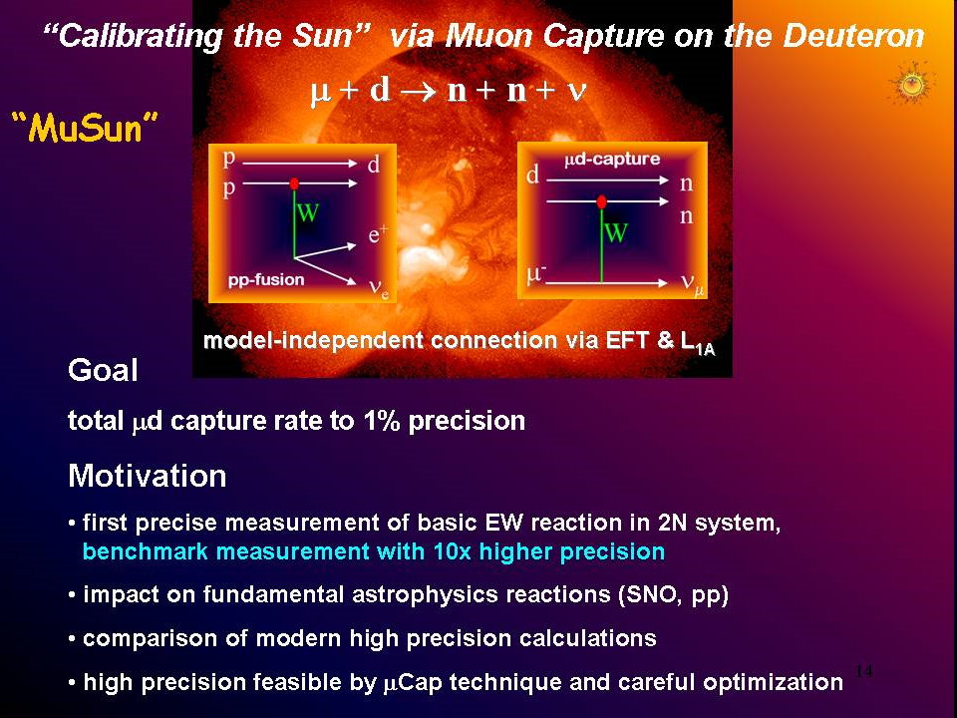

4th Joint meeting of the APS and PSJ, Oct 2014
Measurement of the dμd quartet-to-doublet fusion ratio (λ_{q} : λ_{d}) and the μd hyperfine rate λ_{qd} using the fusion neutrons from μ⁻ stops in D₂ gas.
- Nandita Raha, University of Kentucky for the MuSun Collaboration
V.A. Andreev, E.J. Barnes, R.M. Carey, W. Gohn, V.A. Ganzha, A. Gardestig, T. Gorringe, F.E. Gray, D.W. Hertzog, M. Hildebrandt, L. Ibanez, P. Kammel, B. Kiburg, S.A. Kizilgul. S. Knaack, P.A. Kravtsov, A.G. Krivschich, K. Kubodera, B. Lauss, M. Levchenko, X. Luo, K.R. Lynch, E.M. Maev, O.E. Maev, F. Mulhauser, M.H. Murray, F. Myhrer, A. Nadtochy, K. Neely, C. Petitjean, G.E. Petrov, J. Phillips, R. Prieels, D. Prindle, N. Raha, R. Ryan,G.N. Schapkin, N. Schroeder, G.G. Semenchuk, M.A. Soroka, V. Tishchenko, A.A. Vasilyev, A.A. Vorobyov, N. Voropaev, M.E. Vznuzdaev, F. Wauters, P. Winter.
Nandita Raha

Slide 2
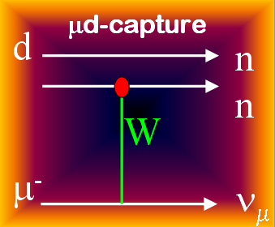
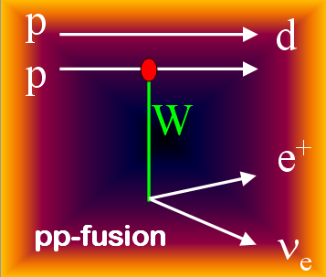
Experimental Goal and Motivation
  Measure muon capture rate in D₂ to a precision better than 1.5%
μ⁻ + d → n + n + ν_{μ}
Quartet
↑↑
μd
Rate Λ_{d} from μd (↑↓) atom
Doublet
↑↓
My Goal: To find relative populations of hyperfine states
finally used for measuring Λ_{d .}
-
Help understand weak nuclear reactions:
Solar pp fusion: p + p → d + e⁺ + ν_{e}
Neutrino interaction: ν + d → p + p + e⁻
Double beta decay ...
These reactions involve a poorly known two-nucleon weak axial current. The muon capture rate Λ_{d} determines a single LEC that parametrizes this two-nucleon weak axial current.
Nandita Raha
Notes:
Energy of pp fusion: 5.4 MeV (peak
Muon capture n – 1.3 Mev (max. #)) upto 53 MeV

Slide 3
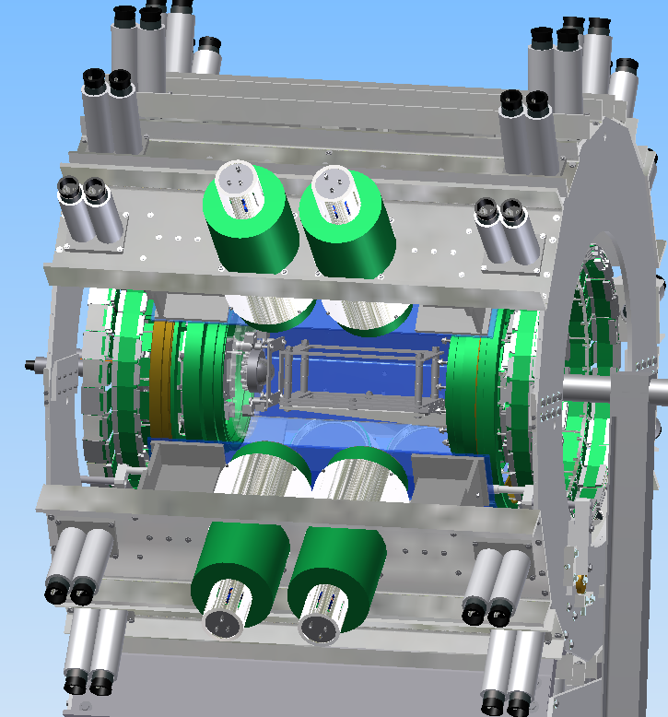
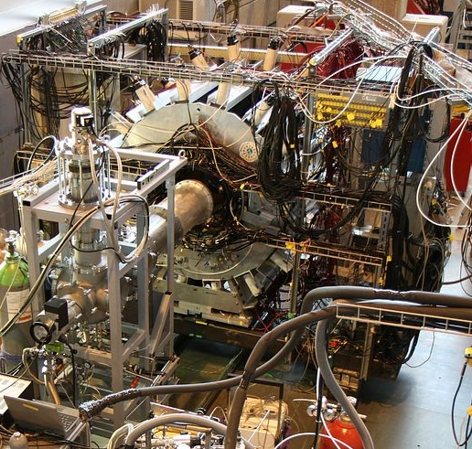
Experiment Overview
Experimental Setup:
Muons (Z - axis) enter Al vessel (~ 3 mm)– TPC (10 x 10 x 8.2 cm). X - horizontal and Y - vertical. Target deuterium.
Electron Scintillator
e⁻
Electron and
Neutron Detectors
μ Scintillator
μ Wire Chamber
Electron Wire Chamber
cryo-TPC
μ beam
cryo-TPC
Neutron Detectors
Nandita Raha

Slide 4
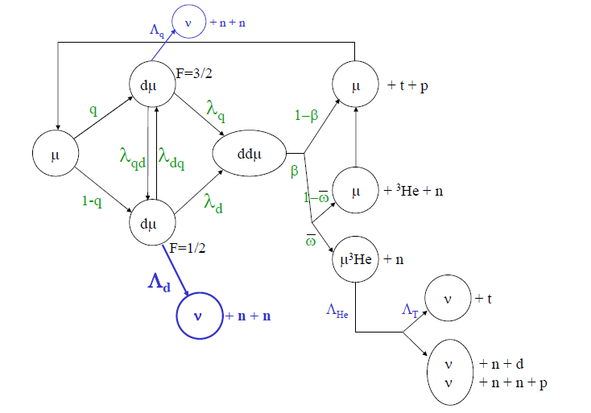
Muon Chemistry
0.002%
Initial pop.
Measure λ_{qd} and λ_{q} : λ_{d}
2/3
λ_{q}
3.05%
λ_{qd}
λ_{dq}
β
1/3
λ_{d}
Initial pop.
Fusion neutrons (2.45 MeV)
accompanied by e⁻
μ stopped in TPC
0.073%
Muon decay – 99.92%
Nandita Raha

Slide 5
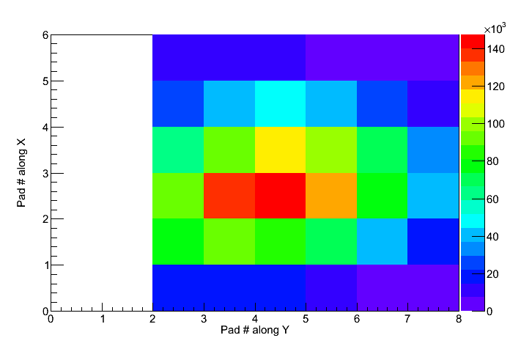
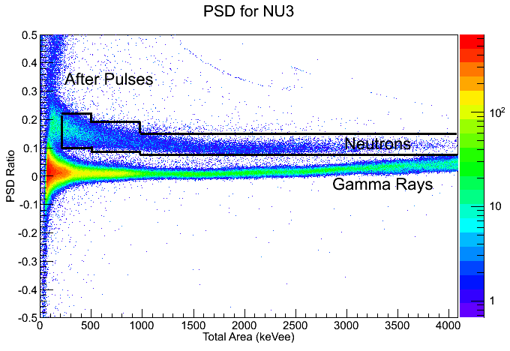
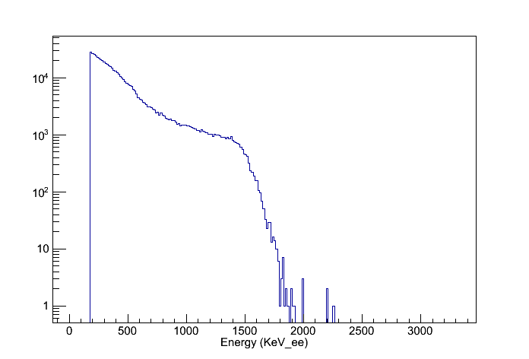
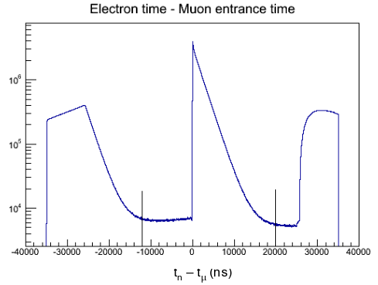
Fusion Neutron definition
Muon stop
Neutron cut (PSD)
Accompanied by electrons
Energy < 2.5 MeV
Nandita Raha
t_{e}- t_{μ} (ns)

Slide 6
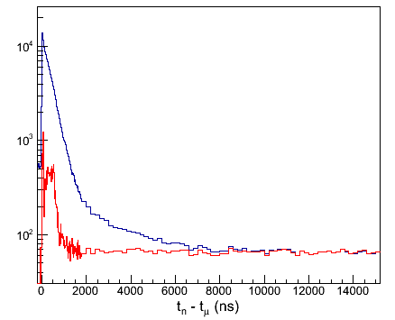
Fusion Neutron Time Distribution
Time distribution: Time of neutron relative to the muon entrance time.
All fusion neutron cuts applied gives time distribution in blue
Contains accidental background from accelerator and beamline neutrons.
Subtracted background histogram and fitted it.
Fusion Neutrons
Background
Nandita Raha

Slide 7
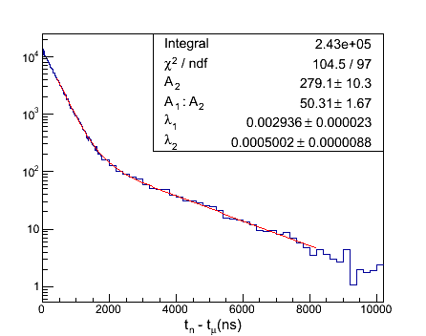
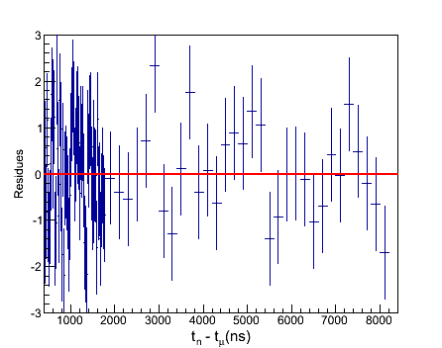
Lifetime Fit of Fusion time distribution
Lifetime fit: A two lifetime (λ₁ and λ₂) fit function from the general solution of muon
chemistry gives the fusion time distribution as,
n(t) = A₁ e^{−λ}1^{t} + A₂ e^{−λ}2^{t}
Fitted the background subtracted histogram with above fit function on a flat background = 0. Fit parameters A₁:A₂, prompt lifetime rate λ₁ and and slow rate λ₂ , A₂ – Initial population.
y(t) - y_{i}
Residue =
σ
Reduced χ² of 1.08
Nandita Raha

Slide 8
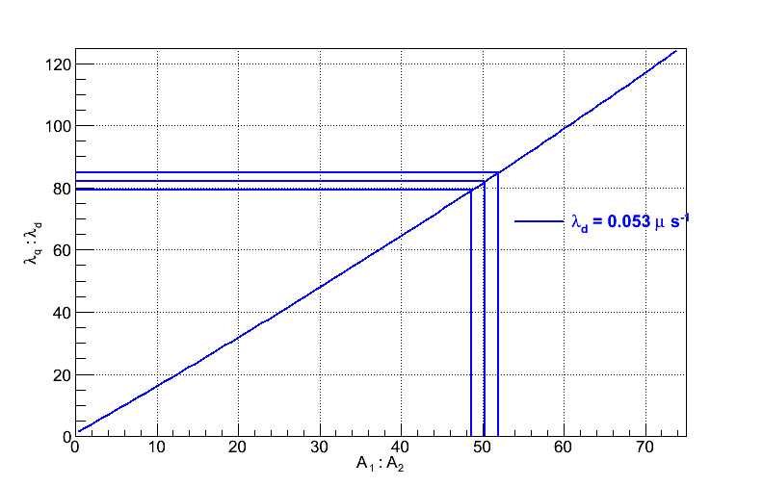
Results from Analytical Solutions
Differential equations of the population of states derived from the muon chemistry were solved
to find kinematic parameters λ_{qd} and λ_{q} : λ_{d} from the fit results.
λ₁ ~ φ (λ_{qd} - λ_{μ})
λ₂ ~ φ λ_{μ}
λ_{qd} ~ (λ₂ − λ₁) / φ
Thus the difference in λ₂ − λ₁ gave
λ_{qd} = 39.67 (0.4)
Amplitude ratio
A₁: A₂ = f ( λ_{q}: λ_{d} )
A plot of amplitude ratio versus λ_{q}: λ_{d}
gave λ_{q}: λ_{d} = 82.05 (2.89)
Nandita Raha

Slide 9
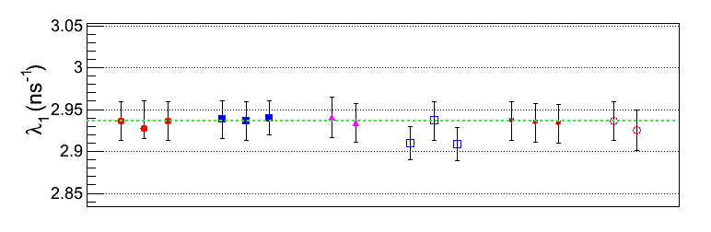
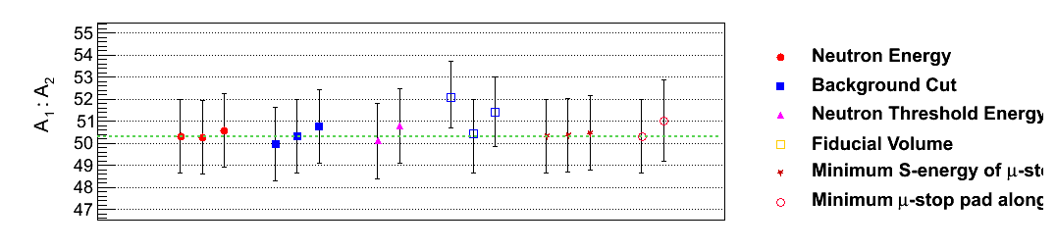
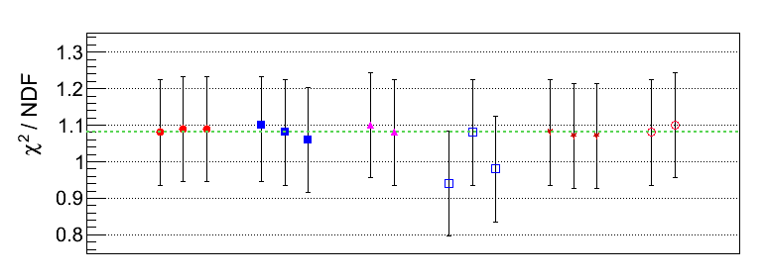
Systematic Errors
Shows stable fit results. The horizontal green line shows original values (before changing the cuts)
Neutron Energy
(E<2.45 MeV)
Background Cut
Neutron Threshold
Energy
Fiducial Volume
Minimum Energy of
μ -stop
Minimum μ -stop
pad along Z
Nandita Raha

Slide 10
Preliminary Results
The transition rate of muonic deuterium from quartet to double state at a temperature 34 K and density 6.12% LH₂
Preliminary
λ_{qd} = 39.67 + 0.402_{stat} + 0.032_{sys} μs⁻¹
The dμd formation rate from quartet
state to double state
λ_{q} / λ_{d} = 82.05 + 2.89_{stat} + 2.78_{sys}
Experiment | Year | λ_{qd} (μs⁻¹) | λ_{q} : λ_{d} | Density | Temp (K)
SIN [1] | 1983 | 37.0^{+1.3} | 79.5(8.0) | 4.8 % | 34.7
PSI [2] | 1987 | 36.89 (0.8) | 80.17(7.8) | 4.83 % | 40
Dubna [3] | 1991 | 37.84 (21) | 65.51(0.59) | 4.9 % | 53
PSI (PNPI) [4] | 2011 | 37.1 (3) | 80.98(1.59) | 5.14 % | 32.2
This work | 2014 | 39.67 (0.4) | 82.05(4.01) | 6.12 % | 34
−1.7
1. First observation of muonic hyperfine effects in pure deuterium - P. Kammel et al. Phys.Rev. A28 2611-2622 (1983)
2. Muon Catalysed dd fusion b/w 25 to 150 K: Experiment - J. Zmeskal et. al. Phy. Rev. Vol. 42, # 3. 1987
3. D. V. Balin et al., Muon Catalyzed Fusion 5/6, 163(1990/1991).
4. High precision study of Muon Catalyzed Fusion in D2 and HD gas - D. V. Balin et al.
Nandita Raha

Slide 11
Conclusion
We obtain quite stable results which would help us find the relative populations of μd in quartet and doublet states under our experimental conditions. The relative population of the doublet state from this analysis will be further used by MuSun to ultimately find Λ_{d}
Thank You!
Nandita Raha

Slide 12
Back up Slides

Slide 13
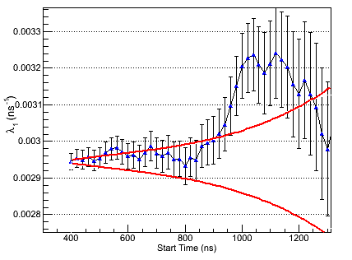
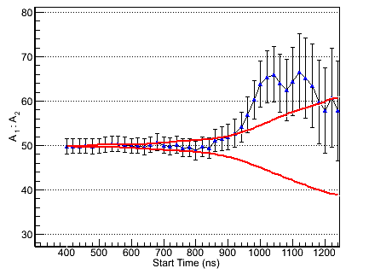
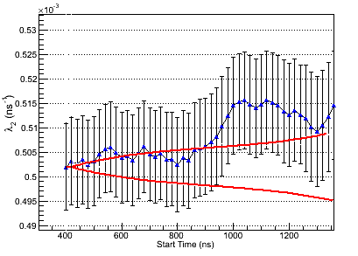
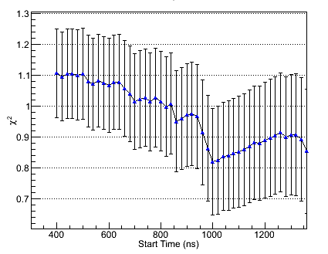
Start Time Scan for Fit Range

Slide 14
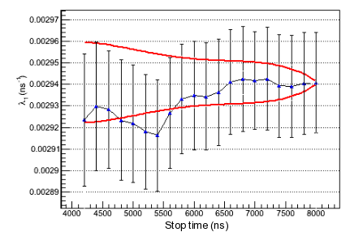
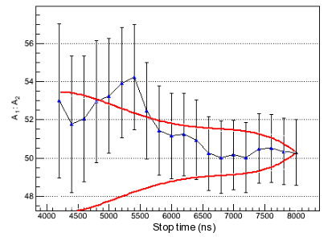
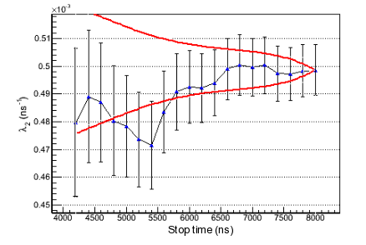
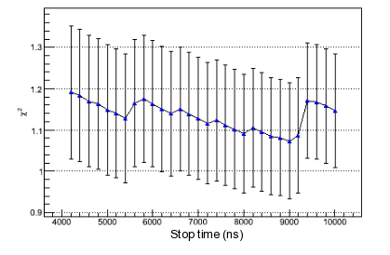
Stop Time Scan for Fit Range

Slide 15
Systematic Errors - Sources
In a previous analysis I completed a set of systematic error analysis – to near completion for this method. The fit results were extremely stable, and sources of these errors were found to be due to:
An imperfect pile up protection – accidental external muons in coincidence with
the muon in consideration
Fiducial volume and other backgrounds in the muon stop definition
Misidentified muon stops like a fusion causing confusion
Misidentified electrons due to imperfect pile up protection and accidental
electrons
Electrons not emanating from the fiducial volume of the TPC to eSC, but rather in
opposite direction
Background spectrum being sensitive to electron Bremsstrahlung, afterpulses in
neutron detectors, misidentified gamma rays etc.
Meticulous cuts were made to minimize these effects and all cuts corresponding to these effects were varied to investigate the effects

